Slide 1
Suggestions for Case Analysis
Chapter 12

Slide 2
Learning Objectives
Research the case situation as needed
Analyze financial statements by using ratios and common-size statements
Use the strategic audit as a method of organizing and analyzing case information
Notes:
After reading this chapter, you should be able to:
Research the case situation as needed
Analyze financial statements by using ratios and common-size statements
Use the strategic audit as a method of organizing and analyzing case information

Slide 3
The Case Method
Case method
offers the opportunity to move from a narrow, specialized view that emphasizes functional techniques to a broader, less precise analysis of the overall corporation
Cases present actual business situations and enable you to examine both successful and unsuccessful corporations.
Notes:
The case method offers the opportunity to move from a narrow, specialized view that emphasizes functional techniques to a broader, less precise analysis of the overall corporation. Cases present actual business situations and enable you to examine both successful and unsuccessful corporations.

Slide 4
Researching the Case Situation
You should not restrict yourself only to the information written in the case unless your instructor states otherwise.
You should undertake outside research about the environmental setting.
Check decision dates.
Notes:
You should not restrict yourself only to the information written in the case unless your instructor states otherwise. You should, if possible, undertake outside research about the environmental setting. Check the decision date of each case (typically the latest date mentioned in the case) to find out when the situation occurred and then screen the business periodicals for that time period.

Slide 5
Researching the Case Situation
Important Note: Don’t go beyond the decision date of the case in your research unless directed to do so by your instructor.
Notes:
Important Note: Don’t go beyond the decision date of the case in your research unless directed to do so by your instructor.

Slide 6
Researching the Case Situation
Available Information Sources
Compustat
Compact Disclosure
Hoover’s
EDGAR database
Company’s annual report
SEC 10-K form
Notes:
Some available information sources are:
Compustat
Compact Disclosure
Hoover’s
EDGAR database
Company’s annual report
SEC 10-K form

Slide 7
Financial Analysis: A Place to Begin
A review of key financial ratios can help you assess a company’s overall situation and pinpoint some problem areas.
Ratios are useful regardless of firm size and enable you to compare a company’s ratios with industry averages.
Notes:
A review of key financial ratios can help you assess a company’s overall situation and pinpoint some problem areas.
Ratios are useful regardless of firm size and enable you to compare a company’s ratios with industry averages.

Slide 8
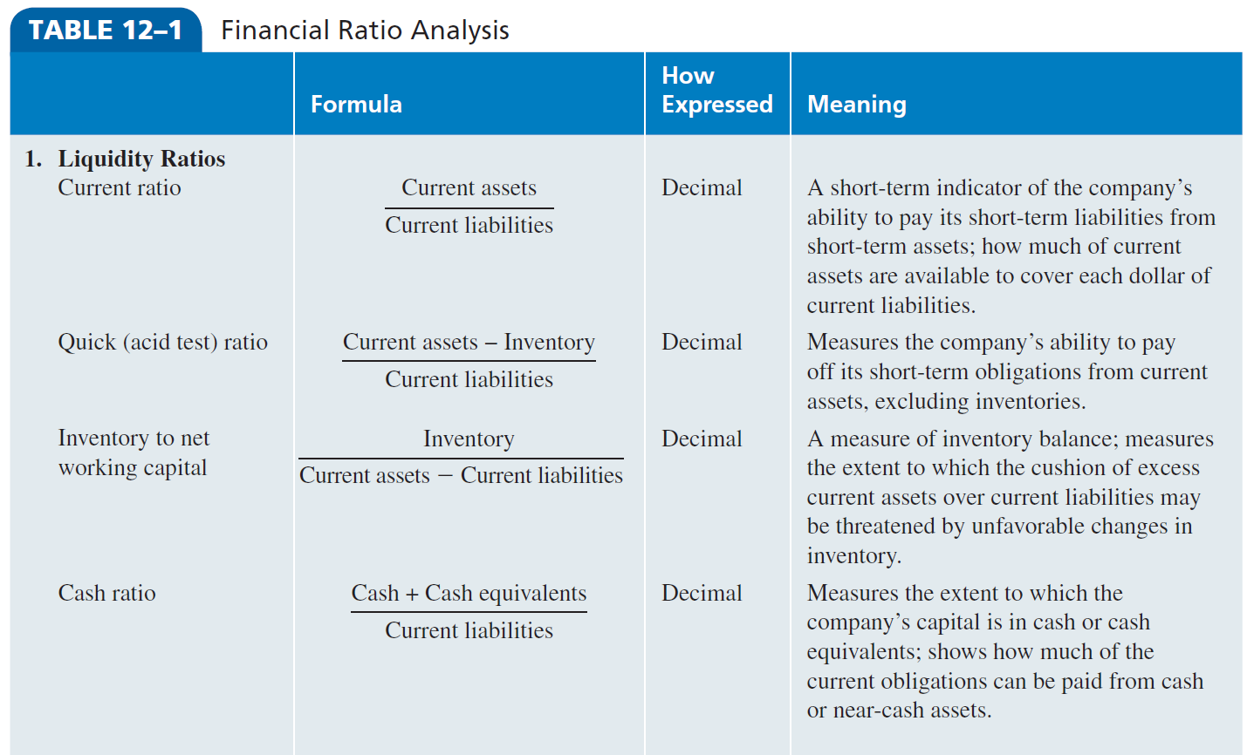
Financial Ratio Analysis
Notes:
Table 12–1 lists some of the most important financial ratios, which are (1) liquidity ratios, (2) profitability ratios, (3) activity ratios and (4) leverage ratios.

Slide 9
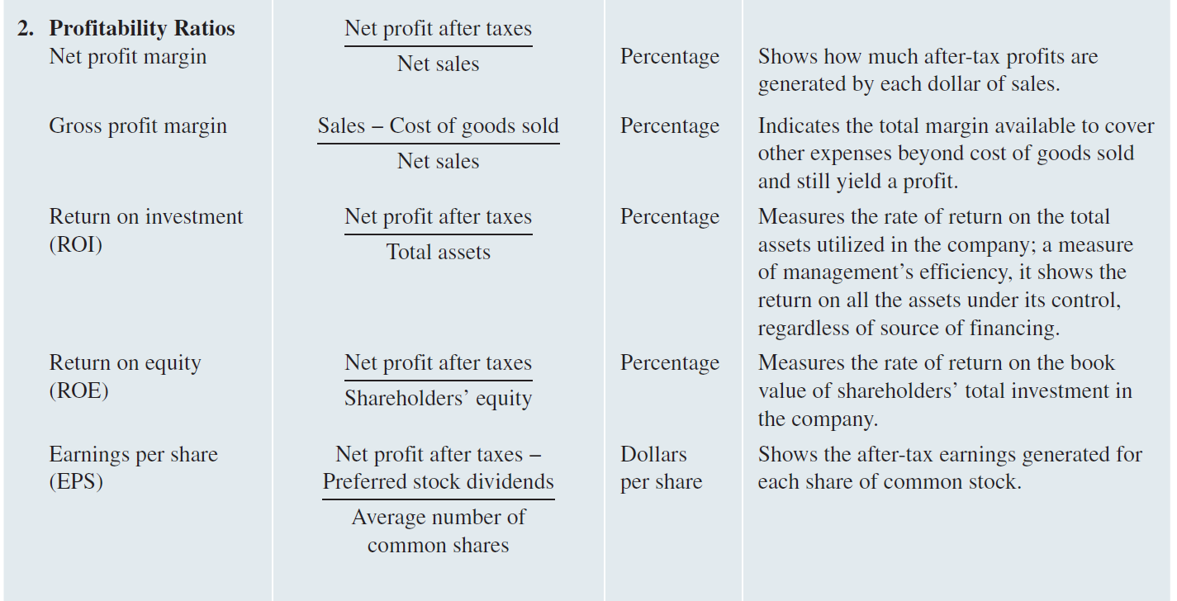
Financial Ratio Analysis
Notes:
Table 12–1 lists some of the most important financial ratios, which are (1) liquidity ratios, (2) profitability ratios, (3) activity ratios and (4) leverage ratios.

Slide 10
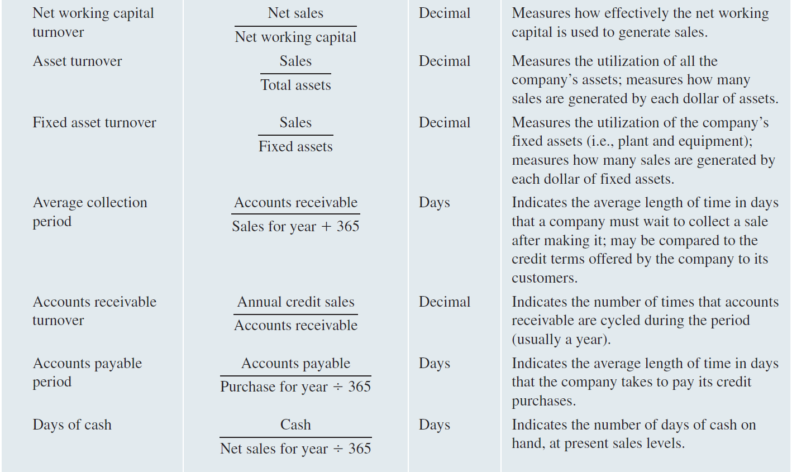
Financial Ratio Analysis
Notes:
Table 12–1 lists some of the most important financial ratios, which are (1) liquidity ratios, (2) profitability ratios, (3) activity ratios and (4) leverage ratios.

Slide 11
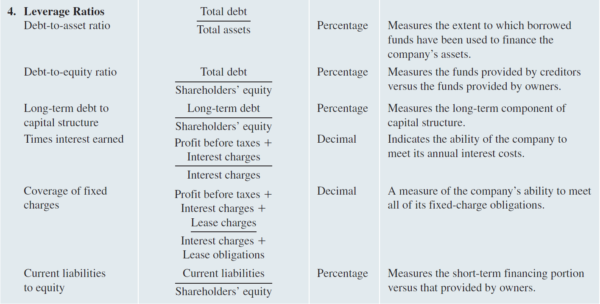
Financial Ratio Analysis
Notes:
Table 12–1 lists some of the most important financial ratios, which are (1) liquidity ratios, (2) profitability ratios, (3) activity ratios and (4) leverage ratios.

Slide 12
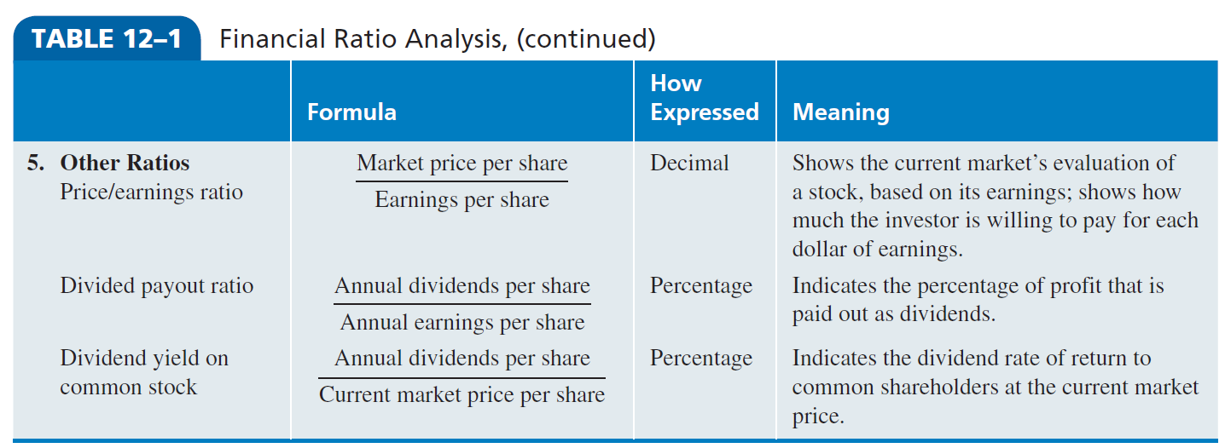
Financial Ratio Analysis
Notes:
Other ratios include the price/earnings ratio, divided payout ratio and the dividend yield on common stock

Slide 13
Analyzing Financial Statements
Scrutinize historical income statements and balance sheets
Compare historical statements over time
Calculate changes that occur in individual categories from year to year
Determine the change as a percentage
Adjust for inflation
Notes:
As a minimum, undertake the following five steps in basic financial analysis.
1. Scrutinize historical income statements and balance sheets: These two basic statements provide most of the data needed for analysis. Statements of cash flow may also be useful.
2. Compare historical statements over time if a series of statements is available.
3. Calculate changes that occur in individual categories from year to year, as well as the cumulative total change.
4. Determine the change as a percentage as well as an absolute amount.
5. Adjust for inflation if that was a significant factor.

Slide 14
Common-Size Statements
Common-size statements
income statements and balance sheets in which the dollar figures have been converted into percentages
used to identify trends in each of the categories
Notes:
Common-size statements are income statements and balance sheets in which the dollar figures have been converted into percentages. These statements are used to identify trends in each of the categories.

Slide 15
Common-Size Statements
Common-size statements are especially helpful in developing scenarios and pro forma statements because they provide a series of historical relationships from which you can estimate the future with your scenario assumptions for each year.
Notes:
Common-size statements are especially helpful in developing scenarios and pro forma statements because they provide a series of historical relationships (for example, cost of goods sold to sales, interest to sales, and inventories as a percentage of assets) from which you can estimate the future with your scenario assumptions for each year.

Slide 16
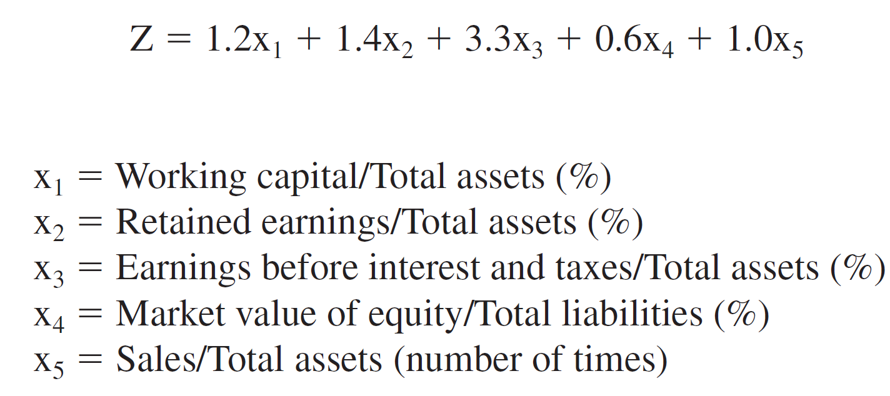
Altman’s Z-Value Bankruptcy Formula
Altman’s Z-Value Bankruptcy Formula is used to calculate a firm’s likelihood of going bankrupt.
Notes:
If the corporation being studied appears to be in poor financial condition, use Altman’s Z-Value Bankruptcy Formula to calculate its likelihood of going bankrupt. The Z-value formula combines five ratios by weighting them according to their importance to a corporation’s financial strength.

Slide 17
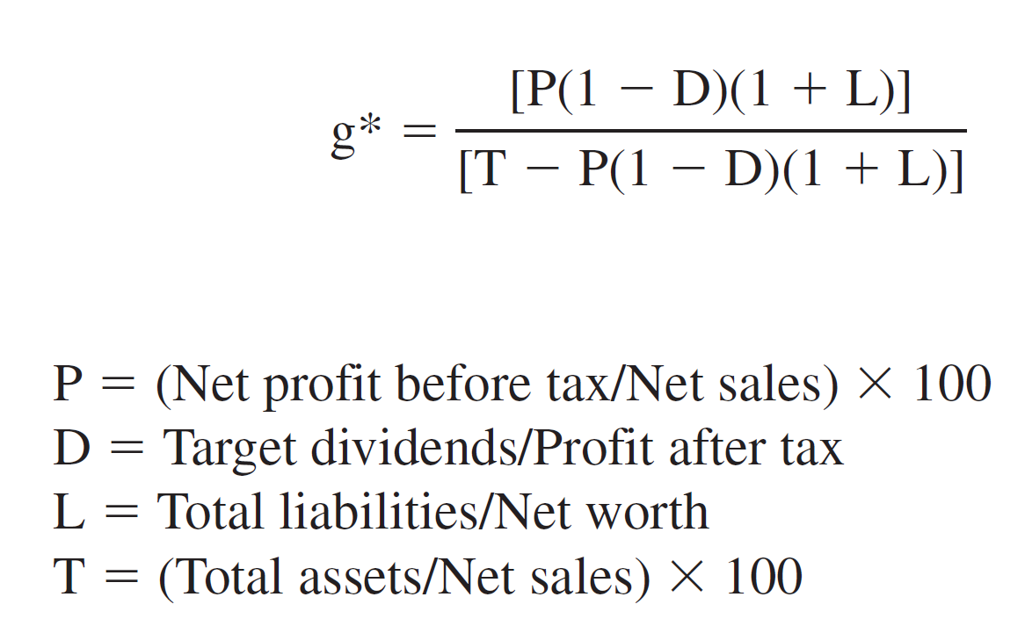
Index of Sustainable Growth
Index of sustainable growth
indicates how much of the growth rate of sales can be sustained by internally generated funds
Notes:
The index of sustainable growth is useful to learn whether a company embarking on a growth strategy will need to take on debt to fund this growth. The index indicates how much of the growth rate of sales can be sustained by internally generated funds.

Slide 18
Useful Economic Measures
Constant dollars
are dollars adjusted for inflation to make them comparable over various years
Prime interest rate
the rate of interest banks charge on their lowest risk loans
Gross domestic product
measures total output of goods and services within a country’s borders
Notes:
Constant dollars are dollars adjusted for inflation to make them comparable over various years. The prime interest rate is the rate of interest banks charge on their lowest-risk loans. GDP is used worldwide and measures the total output of goods and services within a country’s borders.

Slide 19
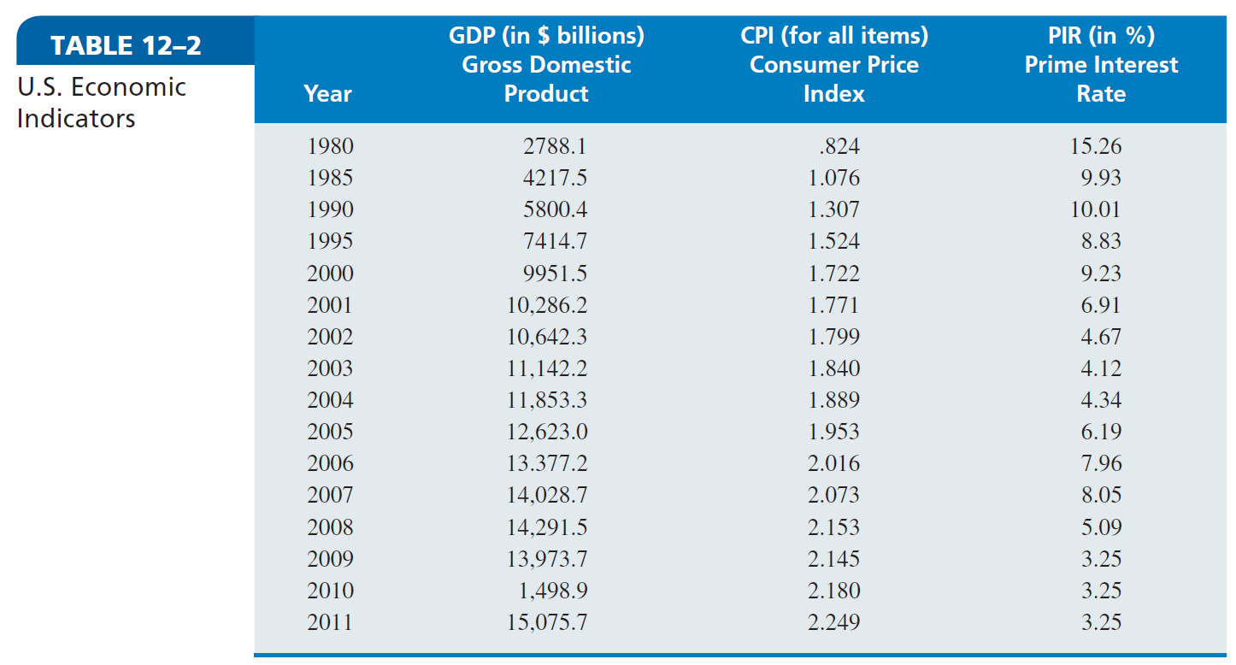
U.S. Economic Indicators
Notes:
One way to adjust for inflation in the United States is to use the consumer price index (CPI), as given in Table 12–2. Another helpful analytical aid provided in Table 12–2 is the prime interest rate. In preparing a scenario for your pro forma financial statements, you may want to use the gross domestic product (GDP) from Table 12–2.

Slide 20
Format for Case Analysis: The Strategic Audit
Strategic audit
an approach for both written and oral reports that provides a systematic method for successfully attacking a case
Figure 12-1
Notes:
The strategic audit is an approach for both written and oral reports that provides a systematic method for successfully attacking a case. If you choose to use the strategic audit as a guide to the analysis of complex strategy cases, you may want to use the strategic audit worksheet in Figure 12–1.

