Slide 1
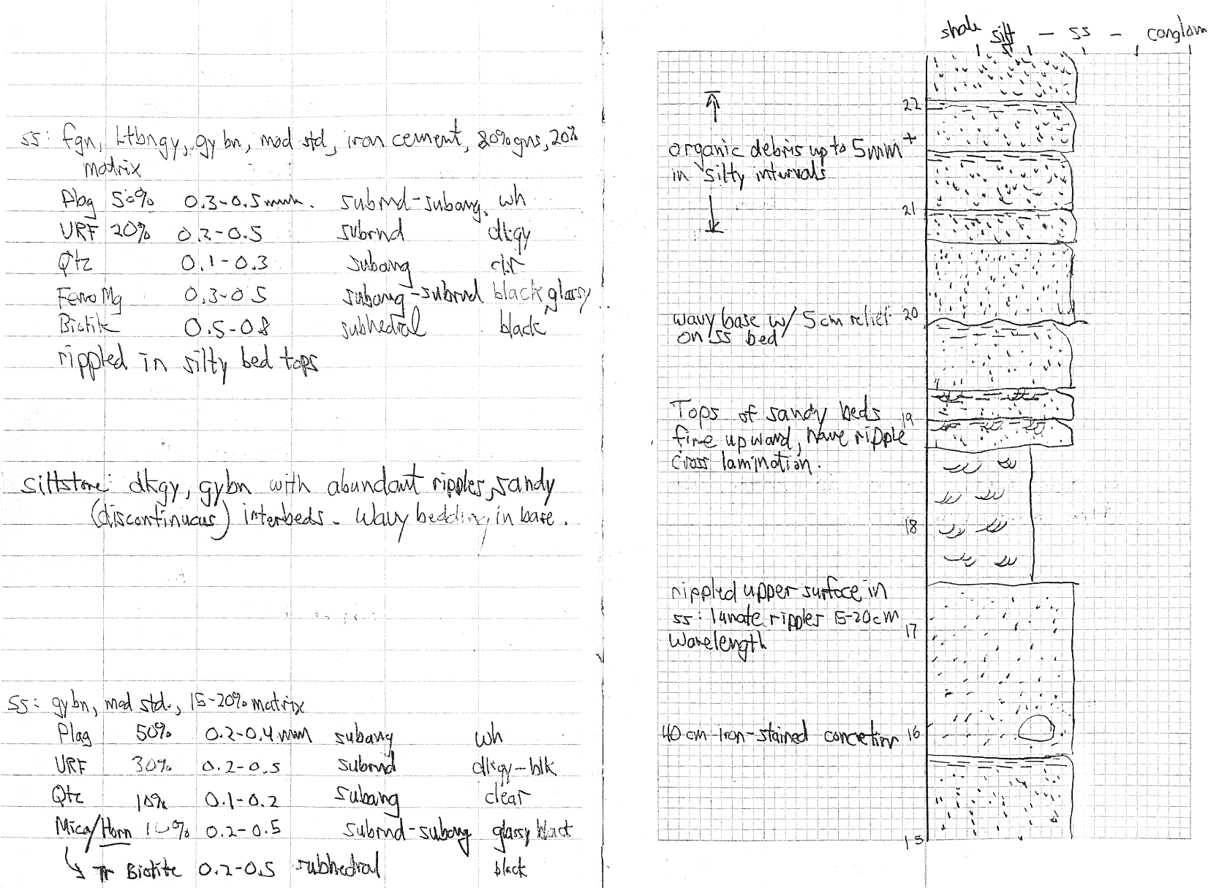
Example from a field notebook

Slide 2
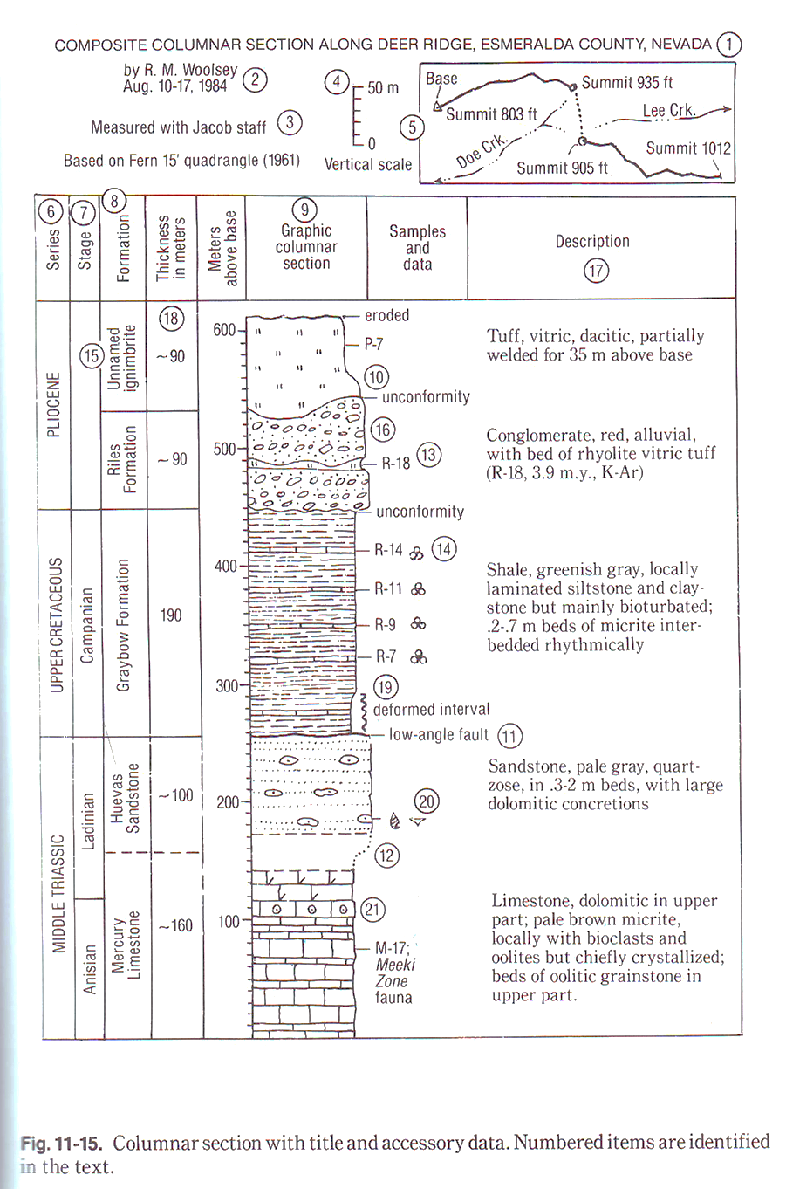
Example from Compton
Use this as your template, see notes!

Slide 3
Example of a grain size column (Journal of sedimentary petrology)

Slide 4
Example of a hand-drawn column (weathering profile)

