Slide 1
Foreclosure effects on home prices
Michael J. Cox
Dept. of Economics
CSU Sacramento
Notes:
Intro: How many of you are looking to purchase home in the next few years or who have possibly purchased a home recently. This information is for you. I am going to discuss the effects certain scenarios have on home prices and also other important attributes to seek when looking for a new home .

Slide 2
Definitions
A foreclosure (REO) or bank owned property is when the bank has taken the home back from the original purchaser because of non-payment.
A short sale occurs when the current owner is no longer interested or becomes incapable of purchasing the property and is willing to work with the lender and sell it for a mutually agreed upon price from any and all parties involved.
Notes:
A few important definitions before we move on for foreclosures and short sales, the first foreclosure or REO (Real Estate Owned) and the second is Short Sales.

Slide 3
Research Question
What are the impacts foreclosures and short sales have on neighborhood home values?
Why is it important
To help decide on certain characteristics when looking for a new home.
Notes:
As we witness more and more foreclosures and short Sales on the market one can’t help to think what are those impacts and what are they doing to home values. This is important because if one is looking for a new home there are specific things to look for and specific things to stay away from.

Slide 4
Literature Review
Banked Owned Phenomenon
>Borrower justification
(Foote, L. C., Geradi, K., Willen, P., 2008)
>Decreasing owner occupied availability
(Ong, S., Neo, H., P., Tu, Y., 2007)
>Raising credit standards
(Calomiris, C., Longhofer, S., & Miles, W. 2008)

Slide 5
Economic Theory
Impacts of Increasing Foreclosures
Before Foreclosures
Supply 1
Price
Demand
After Foreclosures
Supply 2
Price
1
2
Q1
Q2
Quantity
Notes:
As an increasing number of homes flood the market the supply curve shifts and outward inevitably decreasing price.

Slide 6
Hypothesis & Equation
Effect of Neighborhood Foreclosures = 0
Effect of Neighborhood Foreclosures > 0
Selling Price
Time Dummies
Housing Characteristics
Neighborhood Characteristics
Notes:
Proportion of last month’s home sales in each neighborhood that were foreclosures

Slide 7
Data
Variable | Observations | Mean | Min | Max
Selling Price | 11,081 | $312,267.70 | $45,000.00 | $2,000,000.00
Bedrooms | 11,015 | 3.20 | 1 | 8
Bathrooms | 11,031 | 1.96 | 1 | 6
Approximate Square Feet | 11,087 | 1,695.80 | 805 | 7,500
Foreclosures | 11,138 | .41 | 0 | 1
Short Sales | 11,138 | .05 | 0 | 1
Years Old | 11,043 | 31.91 | 0 | 145
Pool | 11,138 | .10 | 0 | 1
Unemployment Rate | 11,138 | 6.47 | 4.30 | 10.80
DOM | 11,138 | 54.07 | 0 | 484

Slide 8
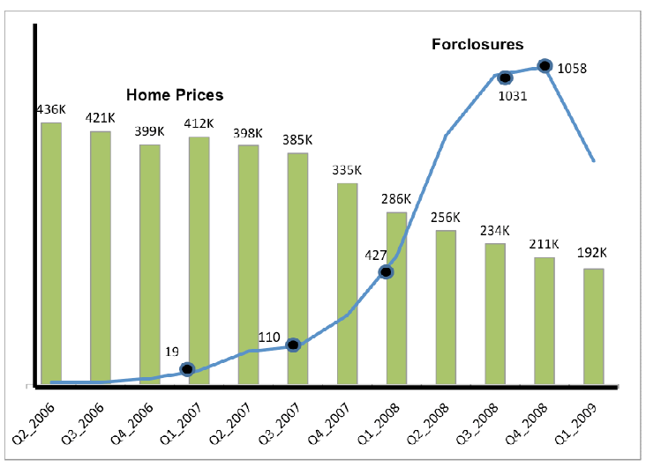
The Increasing Number of Foreclosures
Home Prices and the Number of Foreclosures

Slide 9
Results
Housing Characteristics
Selling Price | Coefficients | T-Score
Bedrooms | -22,773.92 | -14.45
Bathrooms | 22,011.90 | 9.89
Days On Market | -83.05 | -5.36
Approximate Square Feet | 168.88 | 78.66
Lot Size | 2.30 | 32.16
Pool | 41,332.18 | 13.47
Years Old | 601.81 | 54.18

Slide 10
Results
Neighborhood Characteristics
Selling Price | Coefficients | T-Score
Foreclosures | -93,989.57 | -37.12
Short Sales | -54,755.70 | -12.19
Unemployment Rate | -11,015.04 | -2.57
Natomas | -81232.60 | -20.85
Elk Grove | -85807.13 | -19.82
Land Park | -38,377.64 | -11.17
Downtown & Mid Town | 48,164.01 | 8.83
Summer | 7,333.13 | 1.93
Winter | -1,378.08 | -.33
Notes:
This is a combination of variables from metrolist services incorporated and as you see the coefficients and t-scores are quite significant.

Slide 11
Results
Time Dummies
Selling Price | Coefficients | T-Score
Quarter 3_2006 | -12,104.15 | -2.28
Quarter 4_2006 | -23,580.12 | -5.13
Quarter 1_2007 | -9,003.11 | -1.44
Quarter 2_2007 | -20,437.72 | -4.21
Quarter 3_2007 | -27,84.81 | -4.35
Quarter 4_2007 | -43,611.64 | -6.69
Quarter 1_2008 | -61,760.70 | -6.98
Quarter 2_2008 | -74,915.89 | -8.40
Quarter 3_2008 | -88,700.71 | -7.35
Quarter 4_2008 | -86,940.49 | -5.49
Quarter 1_2009 | -75,242.08 | -2.98

Slide 12
Implementation of LagREO
REO dummy variable measures the effect of an individual house being a foreclosure on a home’s selling price
Lagged REO variable (LagREO) measures the effect of neighborhood foreclosures last month on all houses’ selling prices
Notes:
Proportion of last month’s home sales in each neighborhood that were foreclosures

Slide 13
Neighborhood Foreclosure Effect
Neighborhood | Neighborhood Foreclosure Effect | T-Stat | P-Value
Natomas | -48,766.10 | -2.33 | 0.02
Elk Grove | -53,948.87 | -1.74 | 0.08
Land Park | 7,021.15 | 0.18 | 0.85
Downtown & Midtown | -75,061.03 | -0.85 | 0.39
East Sac | 5,033.74 | 0.10 | 0.91

Slide 14
Conclusion
Real estate boils down to three basic principles
As foreclosures increase, property values decline rejecting the null hypothesis:
Effect of Neighborhood Foreclosures =0
location, location and location

