Slide 1
The Impact of the Acid Rain Program on Sulfur Dioxide Intensive Industries
Josh Verseman

Slide 2
Background
Sulfur Dioxide: chemical compound (SO2).
Acid Rain: forms when sulfur dioxide particles combine in the atmosphere, creates sulfuric acid.
Environmental concern: Affects health (upper respiratory diseases), damages ecosystems due to increased acidity levels, deteriorates historical landmarks, buildings.
Major source of SO2 pollution comes from the burning of coal.
- Power generation plants are the top polluters
Notes:
Sulfur dioxide is a chemical compound usually generated by the combustion of coal.
Acid rain forms when sulfur dioxide particles combine in the atmosphere and create sulfuric acid, result is acid rain
This raises environmental concerns. Affects such things as health, damages to ecosystems due to increased acidity levels.
Major source of so2 pollution comes from coal fired power plants

Slide 3
Background
1990 Clean Air Act
Congressional effort to improve national ambient air quality standards.
Title IV : Acid Rain Program
- Specifically aimed at reducing sulfur dioxide (SO₂) levels.
- Implements cap-and-trade policy to achieve this
Notes:
Cap-and-trade or Emissions trading programs attempt to reduce pollution by creating a market to trade emission permits, which in essence, a permits to pollute. The amount of permits a firm acquires designates the amount of pollution they are able to emit.
Firms whose emission levels exceed the permitted amount are subject to fines.
The program is broken into 2 phases.
Phase 1 targets at the most polluting power generation plants and started in 1995 which serves as the dividing year for the before and after analysis of this research.

Slide 4
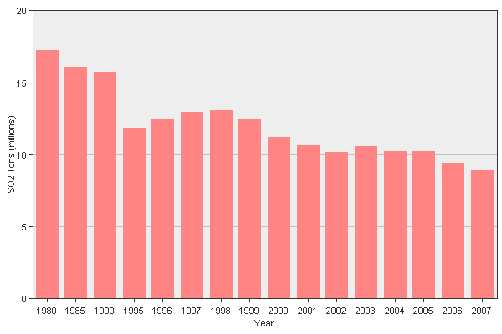
SO2 Pollution Rates Nationwide
Start of Phase I of the Acid Rain Program
http://camddataandmaps.epa.gov/gdm/index.cfm?fuseaction=emissions.prepackaged_select
Notes:
As you can see the Acid Rain Program has been successful at reducing SO2 levels on a national scale.
Notice the sharp decline in so2 pollution at the inception of the program in 1995

Slide 5
This research examines the potential loss in output that might result from reactionary strategies adopted by firms under the Acid Rain Program.
Notes:
1. So….
With the growing popularity for adopting Cap and trade policies to deal with environmental problems it is crucial to examine not just the benefits that might arise but also the consequences attached to such policies
2. [ read slide]

Slide 6
Economic Model
Theory predicts that when marginal costs increase output should decrease
Increase in Abatement Costs
-Under the Acid Rain Program a firm has a few options to choose from in order adhere to the pollution restrictions. The abatement costs lead to an increase in marginal costs
Notes:
This brings us to the economic model.
2. Implementation of the ARP leads to increase in costs. These abatement costs can lead to an increase in marginal costs.
3. Firms basically have 4 options under the program
Reduce output- therefore reduce emissions
Buy necessary amount of permits
Upgrade technology, install scrubbers on smoke stack. Essentially cleans the air before it leaves the plant.
Or for efficient firms, sell permits, this would actually reduce the costs for a firm

Slide 7
P
INDUSTRY
MC₁
MC₀
P₁
P₀
Q₁ Q₀
Q
MR
D
Notes:
Describe chart:

Slide 8
Empirical Strategy
Compare gross domestic product in terms of value added and employment levels of six broadly defined industries before and after the implementation of the Acid Rain Program to capture any loss of output that might occur.
Treatment Industries Control Industries
Utilities Retail
Manufacturing Professional Business Services,
Mining Financial Activities
Data come from BEA and BLS
-Annual observations between1983-2007
Notes:
1. Basically, I am comparing before and after levels of employment and gross domestic product in terms of value added to see if there is any loss in output
2.The representative industries are broken down into 2 groups.
Ones that are presumed to be affected directly by the ARP (treatment group) and three industries presumed to be unaffected (control group).
The divisions of industries are highlighted:[ point to slide. And describe]
3. Data observations are from 1983 - 2007

Slide 9
 | Variables Defined
Variable | Description
GDPVA | Gross domestic product in terms of value added by industry in billions of dollars
EMP | Average yearly number of employees by industry in thousands
POST | Dummy variable, 1 if observation is after 1995, 0 otherwise
TREAT | Dummy Variable, 1 if an industry is presumed to be affected (treatment), 0 otherwise (control).
POST* TREAT | Interaction of Post and Treat variables
AHOUR | Average weekly hours per production worker per industry
AWAGE | Average wage per production worker per industry
Notes:
Definition of variables are shown
1. GDPVA stands gross domestic output value added and is in billions of dollars per industry.
EMP stands for employment and is thousands
2. I used several dummy variables in order to isolate industries into ones presumed to be affected and unaffected, which is the ‘Treat’ variable. Also, distinguished between before1995 and after 1995 observations which represents the Post variable.
3. The [Post Treat]variables equates to a 1 if an observation is after 1995 and an affected industry, 0 otherwise.

Slide 10
Summary Statistics
Industry Means (n=26)
Variables | Utilities | Mining | MFG. | Retail | Business Services | Financial Activities
GDPVA | 174.2 | 112.7 | 1,140.9 | 542.1 | 844.6 | 1,532.9
EMP | 651.3 | 713.6 | 16,517.5 | 13,786.8 | 13,250.4 | 7,073.9
AWAGE | 19.0 | 14.8 | 12.3 | 9.1 | 13.1 | 12.3
AHOURS | 41.3 | 44.0 | 40.6 | 31.3 | 34.3 | 36.1
Notes:
The manufacturing industry employs the most people on average annual basis.
…[next slide]

Slide 11
Empirical Model
Equation 1.
GDPVA _{i}= β₀ + β₁POST_{i} + β₂TREAT_{i} + β₃POST*TREAT+β₄EMP + β₅AHOURS + β₆AWAGE + ε_{it}
Equation 2.
EMP_{i}= β₀ + β₁POST_{i} + β₂TREAT_{i} + β₃POST*TREAT+β₄ GDPVA + β₅AHOURS + β₆AWAGE + ε_{it}
β₃ is the coefficient of importance
-captures change in output measurements for treatment industries relative to the changes that occurred in the control industries.
Null Hypothesis H_{o}: β₃ = 0
Alternative Hypothesis H_{A}: β₃ ≠ 0
Notes:
1. I have two equations of use, one with employment levels as the dependent and one using gross domestic product as the other.
[talk about ‘B3’, according to the slide]
3. Each equation tests the null hypothesis that the change in either employment or gross domestic output for the treatment industries did not change after 1995 relative to the changes experienced by the control industries over the same time span.

Slide 12
Simplified Difference-in-Difference Example
 | Pre 1995 Levels | Post 1995 Levels | Difference
Treatment Industries | Y_{t1} - | Y_{t2 =} | ΔY_{t}
Control Industries | Y_{c1} - | Y_{c2 =} | ΔY_{c}
Difference |  |  | ΔΔY = (β₃)
Notes:
This is a simplified difference in difference regression example.
Basically, ….. [ describe how the chart works]
2. ‘Y’ is the dependent variable that captures the theoretical output levels.
‘Y’ will either be GDPVA or Employment figures for regression calculations.
3. Use of others variables such as average wage and average hours worked per week were included in the final equations

Slide 13
Results
Dependent Variable: GDPVA Adjusted R² = .61 Observations = 150
Variable | Coefficients | Std. Error | t-Stat | P-value
Intercept | -5,306.76 | .001 | 10.13 | .000
Employment | 0.07 | 729.26 | -7.27 | .040
Post | 231.31 | 116.72 | 1.98 | .000
Treatment | -1,390.17 | 188.36 | -7.38 | .030
Post*Treatment | -282.91 | 127.81 | -2.21 | .000
Average Earnings | 47.48 | 12.06 | 3.93 | .000
Average Hours Week | 141.48 | 19.99 | 7.08 | .000
Notes:
1. These are the results using gross domestic product value added as the dependent variable.
The post treatment variable, beta 3, in this regression is statistically significant. [point out t-stat, 2.21]
Implies that gross domestic product in terms of value added did decline by 282 billion dollars within the treatment industries relative to the control industries.

Slide 14
Results
Dependent Variable: Employment Adjusted R² = .74 Observations = 150
Variable | Coefficients | Std. Error | t-Stat | P-value
Intercept | 66,792.67 | 4,860.63 | 13.74 | .000
GDPVA | 5.61 | 0.55 | 10.13 | .000
Post | 2,729.82 | 1,000.46 | 2.73 | .007
Treatment | 14,538.35 | 1,485.84 | 9.78 | .000
Post*Treatment | -124.65 | 1,127.35 | -0.11 | .91
Average Earnings | -695.36 | 93.03 | -7.43 | .000
Average Hours Week | -1,612.56 | 149.78 | -10.77 | .000
Notes:
Here are the Results using employment as dependent variable.
In this regression all variables are statistically significant except Beta 3.
This implies that there was no change in employment levels within treatment industries relative to the control industries after the implementation of the acid rain program.

Slide 15
Conclusions
Analysis indicates mixed results.
- Able to reject null hypothesis and conclude that there is a correlation between implementation of the Acid Rain Program and a decease in gross domestic product.
-In terms of employment, fail to reject null hypothesis. Conclude that the Acid Rain Program did not affect employment levels.
Further research could examine the discrepancy between the two outcomes
Notes:
1.[just read the freak’n slide dude]… able to reject…
2.In terms of economic significance, it should be noted that the coefficient of beta 3, 282 billions , involves 3 entire industries over a span of 13 years. (7.83)
The magnitude is not as great. This equates to approximately a half percent to 5 percent reduction in gdp value added depending upon the industry in question.
3. [read employment conclusion ]
….. And this concludes my presentation, any questions?

Slide 17
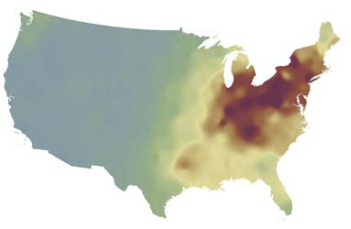
Wet Sulfate Deposition
1989-1991
Source: National Atmospheric Deposition Program, 2007
http://www.epa.gov/eroeweb1/pdf/roe_hd_layout_508.pdf

Slide 18
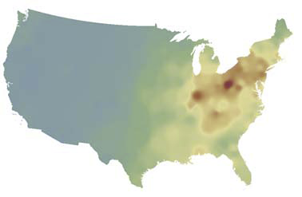
Wet Sulfate Deposition
2004-2006
Source: National Atmospheric Deposition Program, 2007
http://www.epa.gov/eroeweb1/pdf/roe_hd_layout_508.pdf

Slide 19
Wet Sulfate Deposition
1989-1991 2004-2006
Source: National Atmospheric Deposition Program, 2007
http://www.epa.gov/eroeweb1/pdf/roe_hd_layout_508.pdf

