Slide 1
The Value Line Investment Survey:
The Value Line Investment Survey was created in 1931 to guide the investor to realize superior returns on invested capital.
The Value Line Investment Survey has a number of unique features that distinguish it from other advisory service.

Slide 2
The Value Line Investment Survey:
Unique Features of the Value Line:
1. Unique Easy to Use Format
2. Broad Coverage on 1700+ stocks in 95
different Industries
3. Timeliness and Safety Ranks. The VL
Timeliness rank measures probable price
performance during the next 6 to 12 months
relative to all other 1700 stocks (representing
94% of the trading volume on all U.S. stock
exchanges.

Slide 3
The Value Line Investment Survey:
The Value Line Investment Survey was created in 1931 to guide the investor to realize superior returns on invested capital.
The Value Line Investment Survey has a number of unique features that distinguish it from other advisory service.

Slide 4
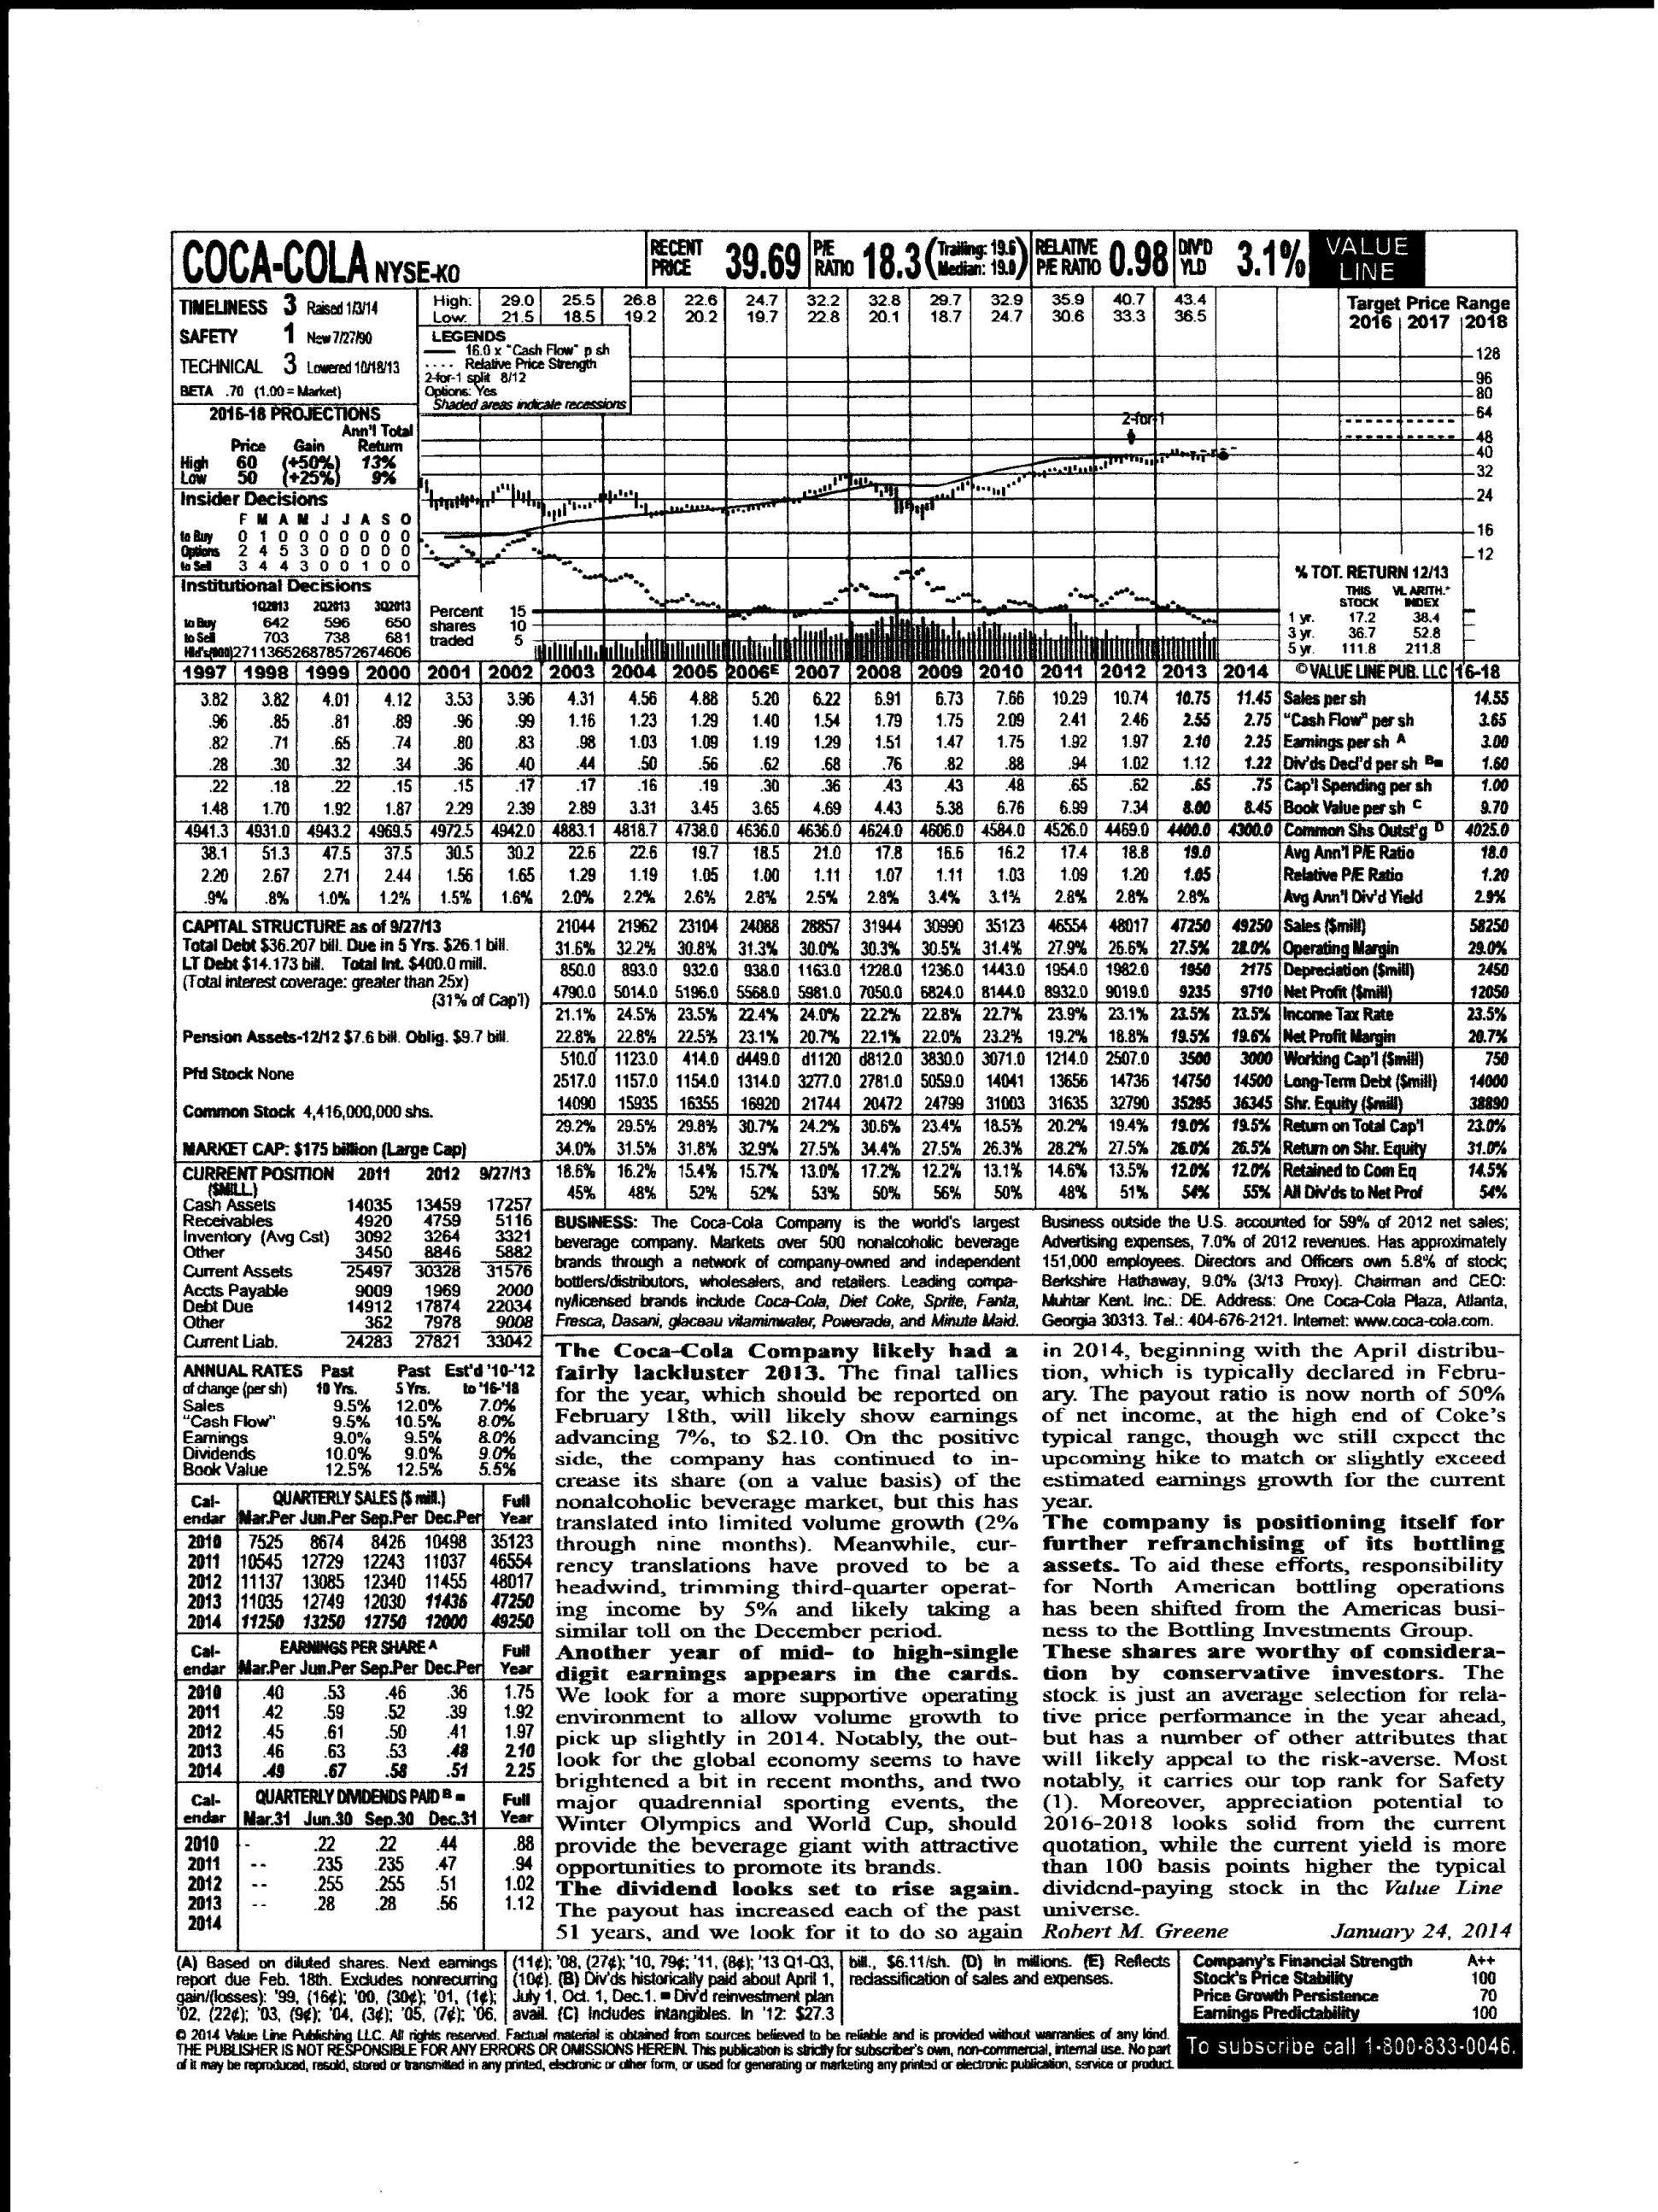

Slide 5
The Value Line Investment Survey:
4. The Value Line Safety Rank. This measures the total risk of a stock or it’s price stability index and the company’s financial strength rating.
5. Record of Performance. Value Line shows how its rankings have worked over the years. In every year since 1965, stocks ranked 1 or 2 for Timeliness as a group have averaged approximately 16% return per year.

Slide 6
The Value Line Investment Survey:
6. Quarterly Earnings Estimates. VL’s estimates of earnings for the current year and the following 12 month period for each of the 1700 are continually monitored, quarter by quarter in Ratings and Reports.
7. Dividend Estimates. Since the dividend income you may receive from a company over the next 12 months can change VL gives an estimate of dividends it expects the company will declare during the coming 12 months.

Slide 7
The Value Line Investment Survey:
8. A Summary of Important Investment
Screens. The Summary & Index shows weekly alphabetical listings of all 1700 stocks with important statistical information about each at a glance. It also provides 19 weekly screens of stocks grouped according to various criteria such as highest yields, greatest 3 to 5 year appreciation potential, and widest discounts from book value.

Slide 8
The Value Line Investment Survey:
9. Continual, Current Follow-up. An analysis of how each company’s business is progressing, and of how the stock compares to others, is provided for every stock once each quarter in Ratings & Reports.
10. Supplementary Reports are also provided as needed at the back of each week’s issue. Rank changes are listed in each week’s issue of Summary & Index.

Slide 9
The Value Line Investment Survey: Timeliness and Safety
The Timeliness Rank measures probable price performance during the next 6 to 12 months on a scale from 1 (highest) to 5 (lowest). The components of the Ranking System are the long-term trend of earnings, prices, recent earnings, and price momentum, along with earnings surprise. Earnings surprise is simply greater earnings than what was expected.

Slide 10
The Value Line Investment Survey: Timeliness Ranking System
A computer program is used to forecast relative price behavior for each stock, relative to all other 1700 stocks.
Rank 1: Highest rank (100), expect this stock to be one of the best relative price performers during the next 6 to 12 months.
Rank 2: Above average rank (300), expect better-than-average price performance.

Slide 11
The Value Line Investment Survey: Timeliness Ranking System
Rank 3: Average performance. Expect price performance in line with the market (900).
Rank 4: Below average performance. Expect below-average price performance (300).
Rank 5: Lowest performance. Expect the poorest relative price performance (100).
All changes in the Timeliness ranks are caused by: new earnings reports, changes in the price movement of the stock relative to the market, a combination of the earnings and price factors, and shifts in the relative positions of other stocks.

Slide 12
The Value Line Investment Survey: Safety Ranking System
The Safety Rank measures the total risk of a stock. It is derived from the stock’s Index of Price Stability relative to the 1700 other stocks and from the financial strength rating of the company.

Slide 13
The Value Line Investment Survey: Safety Rankings
Rank 1 (Highest): This stock is one of the safest, most stable, and least risky of all in relation to the market.
Rank 2 (Above Average): This stock is safer and less risky than most.
Rank 3 (Average): This stock is of average risk and safety.
Rank 4 (Below Average): This stock is riskier and less safe than most.
Rank 5 (Lowest): One of the riskiest and least safe.

Slide 14
The Value Line Investment Survey: Riskiness
The Penalty and Reward of Risk
A risky stock is one whose price fluctuates widely around its own long-term trend and whose financial strength is low. Traditionally characterized by high betas.
The Financial Strength Rating is a relative measure of financial strength of the companies reviewed by Value Line. The relative ratings range from A++(strongest, least fluctuating) to C (weakest, most fluctuating).

Slide 15
The Value Line Data Sheet Analysis of Coca -Cola:
We selected this company for several reasons. First, its Timeliness Rank is now a 3 from a 4. It is beginning to do better. Yet, its industry, Beverage is ranked among the middle (67 of 95) of all industry groups for Timeliness. The Safety rank is now a 1 up from a 2, a good trend. Let’s look at the information on the page, item by item.

Slide 16
Analysis of Coca-Cola:
1. Putting Data in Perspective
Looking at the top of the page, we see that Coca-Cola’s stock price in January, 2014 was $39.69 a share. Just below the price, is the annual high and low prices for the historical 12 month time period. The price continues to move up steadily. Note that sales per share, dividends declared per share, and , book value per share are all at historically high levels.

Slide 17
Analyzing Coca-Cola:
Data in Perspective, P/E ratios:
To gauge the significance of the recent price, the reader must look at it in relation to other data. The P/E ratio relates the recent price to earnings per share; it is computed by dividing the most recent stock price by the latest six months’ share earnings plus earnings estimated for the next six months. The trailing P/E is a ratio of the recent price to the latest 12 months’ reported earnings.

Slide 18
Analyzing Coca-Cola
P/E Ratios - Continued:
The danger of focusing on trailing P/Es is that a company whose earnings are about to fall apart might appear to be selling at a modest P/E based on what has already been reported. The 10-year median P/E puts the recent P/E in historical perspective. The eighth line from the top in the statistical array gives the average annual P/E going back 16 years, as a further basis for comparison.

Slide 19
Analyzing Coca-Cola
P/E Ratios - Continued:
A current P/E ratio that is above a stock’s 10-year median could mean that the stock is overvalued, unless there are factors indicating that there will be a significant improvement in the company’s fundamentals. Is this the case with Coca-Cola? The company has been very vigilant in its efforts to maximize returns from its domestic and international businesses. A high P/E ratio makes it easy for the company to raise larger amounts of capital for a small number of new shares.

Slide 20
Analyzing Coca-Cola
P/E ratios - continued:
One way of gauging the significance of the P/E is to consider the relative P/E, which is the stock’s current P/E divided by the median P/E of all stocks in the Value Line survey. Coca-Cola’s most recent (2013) relative P/E is 1.05, representing a small premium over the market’s median.

Slide 21
Analyzing Coca-Cola
Analyzing the Dividend Yield:
The dividend yield shows you the expected return from income on the stock over the next 12 months, as a percentage of the recent price. Back to the top of the page, we find Coke’s dividend yield is 3.1%.

Slide 22
Analyzing Coca-Cola
Analyzing the price chart:
The price trend had been an upward trend over the past decade. The target price range indicates that Value Line believes even higher prices lie ahead in the range of 48 to 52.
Analyzing the “Value Line”
This line is derived by summing annual earnings per share and its depreciation per share and then assigning a multiple that is consistent with its projected target price.

Slide 23
Analyzing Coca-Cola: The Value Line Statistical Array
Per-Share Basis:
Sales Per share. When EPS is depressed because of poor margins, a still high level of sales per share can suggest the potential for an earnings recovery. But, if sales per share declined with EPS a significant problem may exist.
Cash Flow Per Share:
Earnings plus depreciation, less preferred dividends. It is an indicator of a company’s internal cash-generating ability, the amount of cash it earns to expand or replace plant and equipment, working capital, and to cover dividends.

Slide 24
Analyzing Coca-Cola: The Value Line Statistical Array
Earnings Per Share:
These are total fully diluted earnings divided by the number of common shares outstanding.
Dividends Declared Per Share:
These are usually highest, in proportion to earnings, with mature companies. Management's of growth-oriented companies prefer to pay token dividends.
Capital Spending Per Share:
Measures how much a company is investing in new plant and equipment in anticipation of future growth. Coke’s growth in this area is due to overseas expansion.

Slide 25
Analyzing Coca-Cola: The Value Line Statistical Array
Book Value Per Share:
This is the theoretical value of what the investor owns (equity) in the company. It is the total value of the assets minus the debt of the company divided by the number of shares outstanding.
Common Shares Outstanding:
This is self-explanatory. Sometimes net income rises, but per-share profits do not because the number of shares outstanding has increased. As a result, sales and profits may soar, while per share sales and earnings lag.

Slide 26
Analyzing Coca-Cola: The Value Line Statistical Array
The Average Annual P/E Ratio:
This ratio shows what multiple of earnings investors have been willing to pay for a stock in the past. Coke’s average annual P/E has been growing historically.
The Average Annual Dividend Yield:
This is of special interest to the conservative investor. The higher the dividend yield the more likely the company’s best growth days are behind it. Coke’s dividend yield has never been an overriding investment characteristic.

Slide 27
Analyzing Coca-Cola: The Value Line Statistical Array
The Operating Margin:
The operating margin indicates what percentage of sales is being converted into operating income before depreciation is subtracted. By definition it is Net sales minus COGS and Operating Expenses divided by the Sales amount.
Depreciation:
Depreciation is the amount by which the company’s depreciable assets are written down in a single year. Depreciation for Coke has expanded at a rate equal to that of sales, indicating that the company has steadily built up capacity to match its needs.

Slide 28
Analyzing Coca-Cola: The Value Line Statistical Array
Net Profit:
Net profit is the amount the company earned in the previous year for all its stockholders, preferred and common excluding nonrecurring gains or losses and the results of discontinued operations. Usually, the higher the net profit, the higher per-share earnings. Coke’s profit has grown without interruption historically. Coke’s net profits are over $9 billion.
Income Tax Rate:
Coke’s income tax rate has fluctuated between 22.4% and 23.9% indicating varying levels of investment tax credit, the changing percentage of foreign profits to total earnings and a lower corporate tax rate due to tax reform.

Slide 29
Analyzing Coca-Cola: The Value Line Statistical Array
Net Profit Margin:
Net Profit margin is defined as net profits divided by total sales. Coke’s net profit margin is 19.5% for 2013.
Working Capital:
Defined as current assets minus current liabilities, indicates the liquid assets available for running the business on a day-to-day basis. The higher the company’s sales, the more working capital it typically needs. Though Coke’s working capital is negative, their strong capital position would tend to offset this negative value.

Slide 30
Analyzing Coca-Cola: The Value Line Statistical Array
Net Worth:
Net worth is the total stockholders’ equity (preferred and common) after all liabilities have been deducted from the company’s total assets. All intangible assets such as goodwill, patents, and sometimes, deferred charges are included in net worth.
Percent earned on Total Capital:
This measures a company’s return on its stockholders’ equity and long-term debt. When a company’s return on total capital goes up, there should also be an increase in the return on net worth. If not, it simply means that the company is borrowing more and not investing it wisely.

Slide 31
Analyzing Coca-Cola: The Value Line Statistical Array
Percent Earned on Net Worth:
This reveals how much is being earned every year for the stockholders. The higher the figure, the better. Coke’s percent earned on net worth has risen steadily since 2009 (27.5%) but decreased in 2013 to 26.0%.
Percent Retained to Common Equity:
This is net income less all dividends, divided by common stockholders equity, and is expressed as a percentage. It measures the extent to which a company is reinvesting in itself in itself in anticipation of future growth. A high plowback ratio and rapidly growing book value can be considered positive investment characteristics.

Slide 32
Analyzing Coca-Cola: The Value Line Statistical Array
Percent of All Dividends to Net Profit:
This is the “payout” ratio. It measures the proportion of a company’s profits that is distributed as dividends to all stockholders- both common and preferred. Look for a small payout ratio for fast growing companies.

Slide 33
Assignment #1: Begin looking for a company to analyze using the Value Line criteria given in class and the information in these overheads.
Assignment #2: Read in the Tutorial Section (for Beginners) of Investopedia the topics Investing 101 and Economics.
Assignment #3: Read the Masters document on the website.

