Slide 1
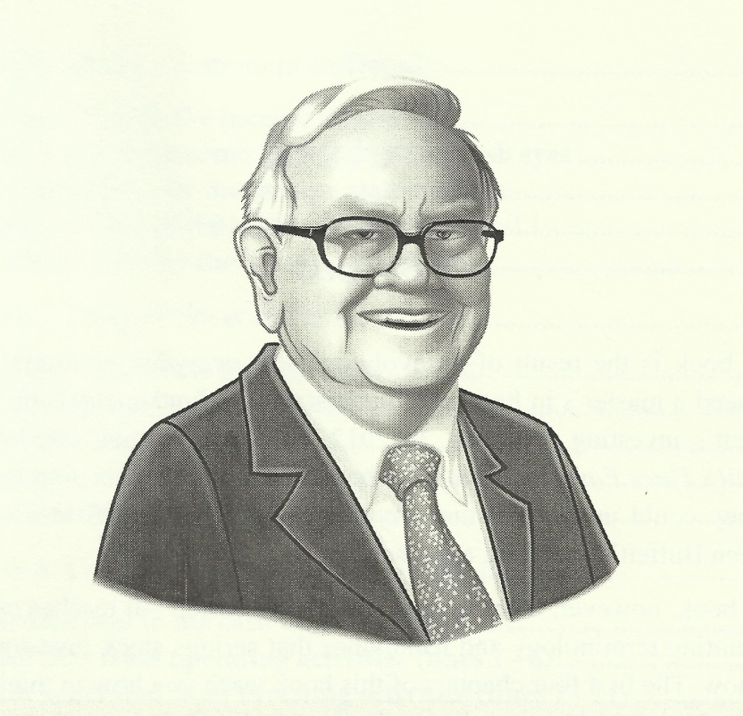
Buffettology

Slide 2
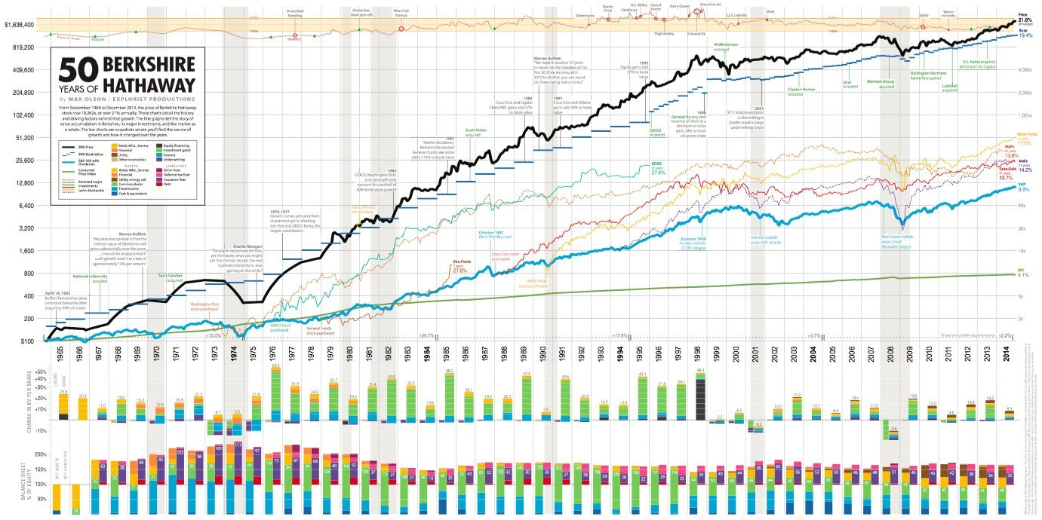

Slide 3
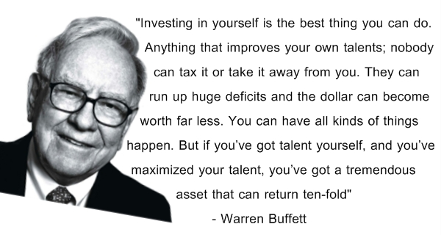

Slide 4
Chapter 1: How to Look at the Stock Market the Warren Buffett Way

Slide 5
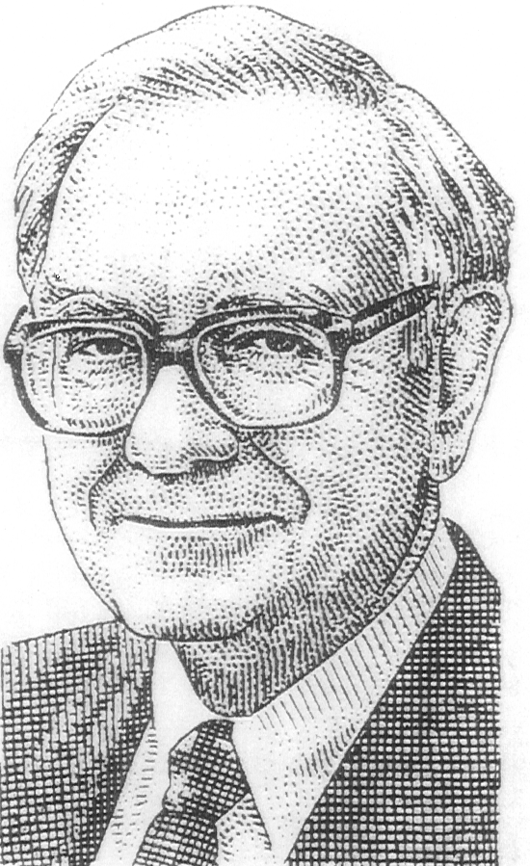
Buffettology 101
The Wisdom of Warren Buffett
As far as I am concerned,
the stock market doesn’t
exist. It is there only as a
reference to see if anybody
is offering to do anything
foolish.

Slide 6
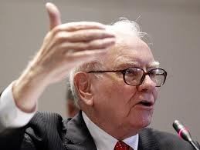
Buffettology 101
The Wisdom of Warren Buffett
“Investing is often described as the process of laying out money now in the expectation of receiving more money in the future. At Berkshire we take a more demanding approach, defining investing as the transfer to others of purchasing power now with the reasoned expectation of receiving more purchasing power – after taxes have been paid on nominal gains – in the future.”
-Warren Buffett (2011 Annual Report)

Slide 7
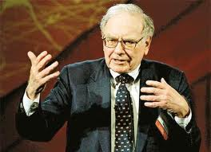
Buffettology 101
The Wisdom of Warren Buffett
All we want is to be in businesses that we understand, run by people whom we like, and priced attractively relative to their future prospects.
I buy businesses, not stocks, businesses I would be willing to own forever.
Invest within your circle of competence. It’s not how big the circle is that counts, it’s how well you define the parameters.
When management with an excellent reputation meets a business with a poor reputation, it is usually the business’s reputation that remains intact.

Slide 8
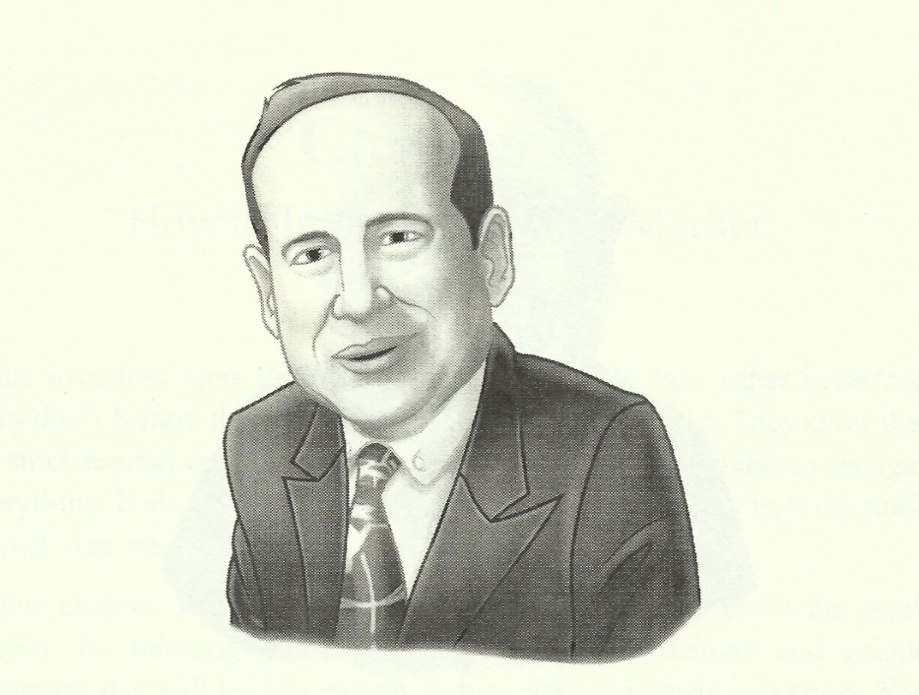
Understanding the Influence of Ben Graham on Warren Buffett Through the Story of Mr. Market
Long ago Ben Graham described the mental attitude toward market fluctuations that I believe to be most conducive to investment success. He said that you should imagine market quotations coming from a remarkably accommodating fellow named Mr. Market who is your partner in a private business. Without fail, Mr. Market appears daily and names a price at which he will either buy your interest or sell you his. Even though the business that the two of you own may have economic characteristics that are stable, Mr. Market’s quotations will be anything but stable. For, it is sad to say, Mr. Market is a fellow who has incurable emotional problems. At times he falls euphoric and can see only the favorable factors effecting the business. When in that mood, he names a very high buy-sell price because he fears that you will snap up his interest and rob him of imminent gains. At other times he is depressed and can see nothing but trouble ahead for both the business and the world. On these occasions he will name a very low price, since he is terrified that you will unload your interest on him.

Slide 9
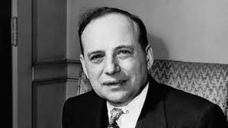
Ben Graham and Mr. Market Continued:
Mr. Market has another endearing characteristic: He doesn’t mind being ignored. If his quotation is uninteresting to you today, he will be back with a new one tomorrow. Transactions are strictly at your option. Under these conditions, the more manic-depressive his behavior, the better for you.
But, like Cinderella at the ball, you must heed one warning or everything will turn into pumpkins and mice: Mr. Market is there to serve you, not to guide you. It is his pocketbook, not his wisdom, that you will find useful. If he shows up someday in a particularly foolish mood, you are free to either ignore him or to take advantage of him, but it will be disastrous if you fall under his influence. Indeed, if you aren’t certain that you understand and can value your business far better than Mr. Market, you don’t belong in the game. As they say in poker, “If you’ve been in the game 30 minutes and you don’t know who the patsy is, you’re the patsy.”

Slide 10
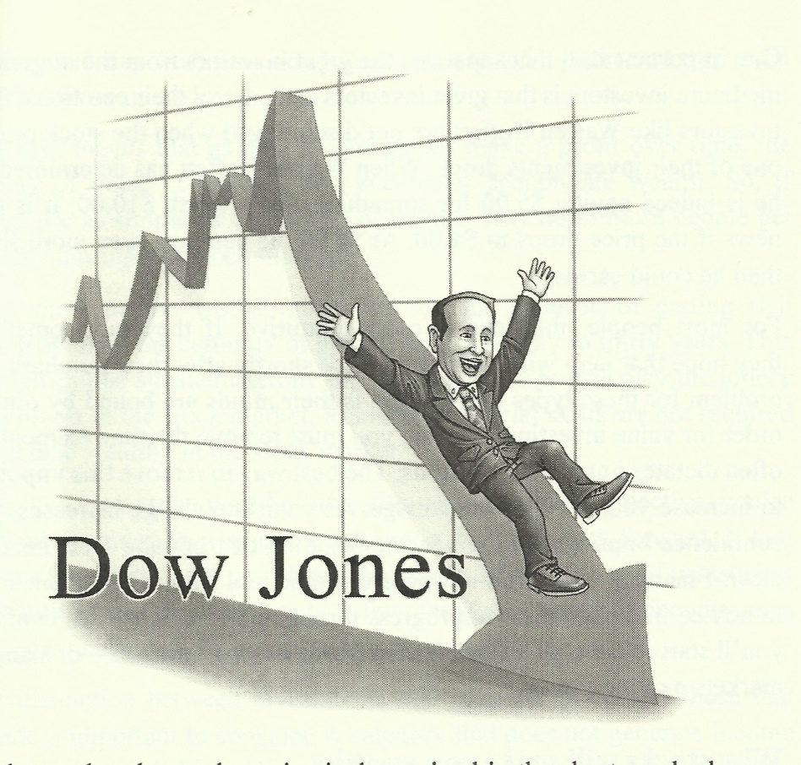
Good News! The Market is Dropping
Practice a selective contrarian investment strategy. This is one in which the investor is motivated to invest by a falling stock price. Contrarians invest in what the market finds unattractive.
Recognize that the majority of investors play the short-term investment game.
People sell on bad news.
Companies that have a franchise product and thus a competitive advantage, have the economic power to weather most bad-news storms.
Always invest in companies with a long-term durable competitive advantage, which we call a franchise product. A product characterized by few or no substitutes, a product in demand by many, little or no government regulation.

Slide 11
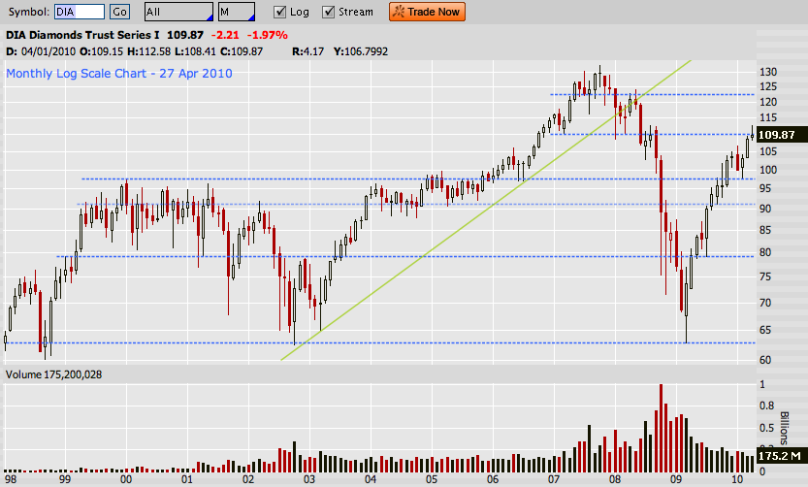
Market Volatility – Your Best Friend!

Slide 12
The Essence of what Warren Buffett Does
The driving force of Warren Buffett’s investment strategy is the rational allocation of capital. Determining how to allocate a company’s earnings is the most important decision a manager will make. Rationality is the quality Buffett most admires. Buffett’s success has depended as much on eliminating those things you can get wrong, which are many (i.e. predicting markets, economies, and stock prices), as on getting things right, which are few and simple (valuing a business). There are two simple variables Buffett focuses on: the price of the business and the value of that business.

Slide 13
Buffett’s Four Steps to Investing
and how stocks will make you wealthy
1. Turn off the stock market. Remember that the stock market is manic-depressive. Wildly excited sometimes or unreasonably depressed. This behavior creates opportunities, but you do not allow the market to dictate your actions.
2. Don’t worry about the economy. Buy a business that has the opportunity to profit in any economy.
3. Buy a business, not a stock. Change your perspective to that of a business owner and learn as much as possible about the business and industry.
4. Manage a portfolio of businesses. Don’t diversify for diversification’s sake.

Slide 14
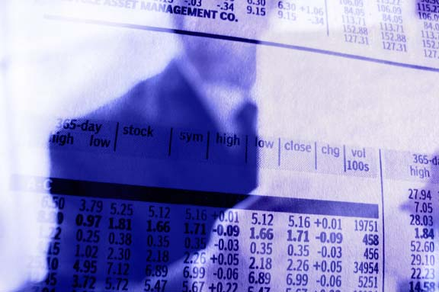
Chapter 2: Concepts Every Investor Should Know

Slide 15
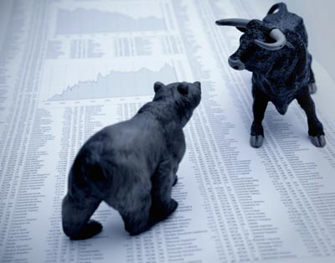
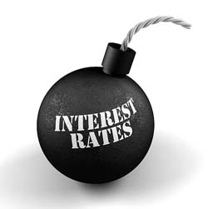
Interest Rates
When interest rates rise, business becomes more difficult and vulnerable. This is due to the high cost of borrowing money to invest in the business.
When interest rates decrease, it is easier to borrow capital and therefore expand capacity and activity.
Hence, interest rates are the price of borrowing capital to the business. In Finance 101 you should have already covered the before and after-tax cost of borrowing capital.
The Federal reserve determines interest rates in three different ways, all of which you should be familiar with.

Slide 16
Recognize the Enemy: Inflation
The arithmetic makes it plain that inflation is a far more devastating tax than anything that has been enacted by our legislature. The inflation tax has a fantastic ability to simply consume capital. It makes no difference to a widow with her savings in a 5% passbook account whether she pays 100% income tax on her interest income during a period of zero inflation, or pays no income taxes during years of 5% inflation. Either way, she is “taxed” in a manner that leaves her no real income whatsoever. Any money she spends comes right out of capital. She would find outrageous a 120% income tax, but doesn’t seem to notice that 5% inflation is the economic equivalent.

Slide 17
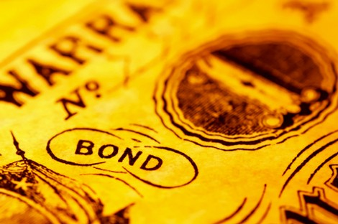
Common Stock as an Inflation Hedge:
S&P LT Bonds LT Gov’t Bonds T. Bills CPI
Last 10: 13.8% 11.3% 11.9% 5.6% 3.5%
Last 20: 14.6% 10.6% 10.4% 7.3% 5.2%
Last 30: 10.7% 8.2% 7.9% 6.7% 5.4%
Last 40: 10.8% 6.8% 6.4% 5.7% 4.5%
Last 50: 11.9% 5.8% 5.3% 5.7% 4.4%
Source: Ibbotson and Sinquefield, “Stocks, Bonds, Bills and Inflation 2014 yearbook,” Chicago.

Slide 18
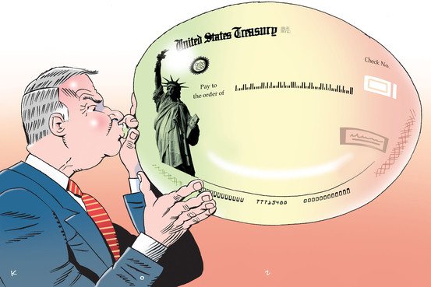
Bonds
A Bond Example:
Par Value $1,000
Term 30 Years
Coupon Rate 5%
What happens when interest rates change?
Rates go to 3%; What is the value of
the bond?
Rates go to 7%; What is the value of
the bond?

Slide 19
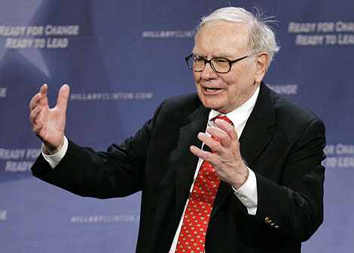
Chapter Summary
 |  | Low Interest Rates | High Interest Rates
 | Low Inflation | Stocks | Bonds
 | High Inflation | Stocks | Stocks

Slide 20
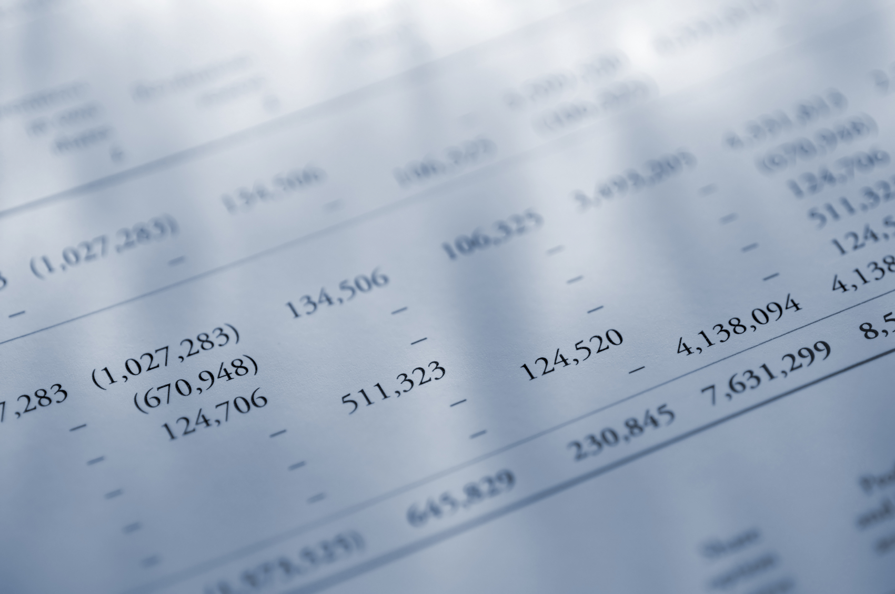
Chapter 3: a Brief Introduction to Financial Statements

Slide 21
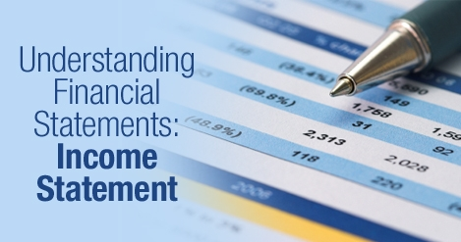

Slide 23
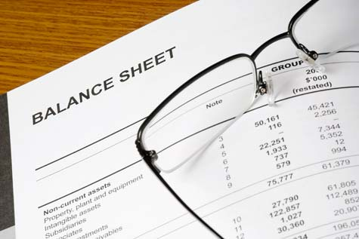
UNDERSTANDING THE

Slide 26
Basic Report Terminology
10K ( Annual Report): These are the annual accounts that are filed for all major businesses conducted in the last year. Every corporation must file their annual report within sixty to 90 days after the fiscal year ends, depending on their size.
10 Q (Quarterly Report): These reports are similar to the 10K but they only cover financial activities for the last quarter (three months).
8Q (Current Report Filing): This report is filed whenever any major event occurs that could have an effect on the company’s financial position.

Slide 27
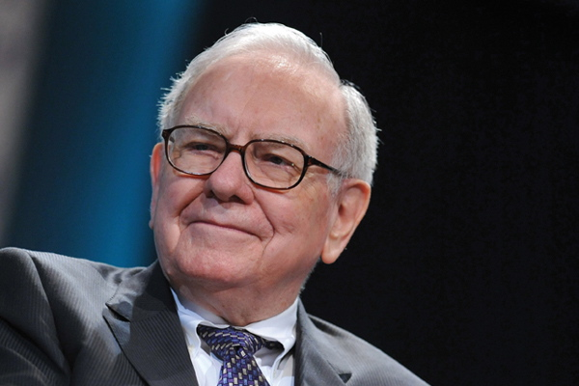
Keep it simple
Chapter 4:
Principles and Rules of Value Investing

Slide 28
Investment Philosophy of Warren Buffett
The basic ideas of investing are to
look at stocks as businesses,
use market fluctuations to your advantage, and
3) seek a margin of safety.
That’s what Ben Graham taught us. A hundred years from now they will still be the cornerstones of investing.

Slide 29
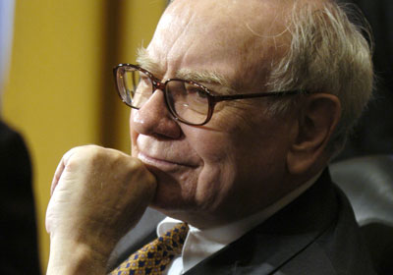
The Warren Buffett Way - his Tenets
Business Tenets
1. Is the business simple and easy to understand?
2. Does the business have a consistent operating history?
3. Does the business have favorable long-term prospects?
Management Tenets
1. Is management rational?
2. Is management candid with its shareholders?
3. Does management resist the institutional imperative?
Financial Tenets
1. Focus on return on equity, not earnings per share.
2. Calculate shareholders “intrinsic value.”
3. Look for companies with high profit margins.
4. Make sure the “value added” is greater than 1.
Market Tenets
1. What is the “intrinsic value” of the business?
2. Can the business be purchased at a discount to it’s market value?

Slide 30
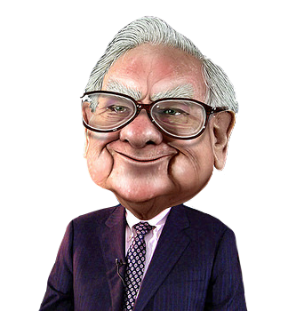
The Warren Buffett Way:
Business Tenets
Is the business simple and understandable?
Does the business have a consistent operating history?
Does the business have favorable long-term prospects?
Is the business simple and understandable. Does the company have an identifiable durable competitive advantage?
Does the business have an identifiable consumer monopoly or franchise product? What is the chance the product will become obsolete in the next 20 years?

Slide 31
The Warren Buffett Way:
Business Tenets
Is the business simple and understandable? What does this mean? Does the business make a product(s) that is simple or complex for the average investor to understand? An example would be See’s Candy. Everyone can relate to See’s Candy, especially on special occasions. It doesn’t take a lot of new technology to continue to make the product and it is relatively insulated from increasing prices. Compare this to an Intel, whose products may lead the market but it does take a lot of re-investment of capital to maintain a competitive edge.

Slide 32
The Warren Buffett Way:
Business Tenets
Does the business have a consistent operating history?

Slide 33
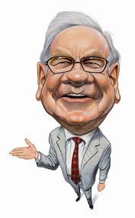
The Warren Buffett Way:
An investor needs to do very few things right as long as he or she avoids big mistakes.
We like stocks that generate high returns on invested capital where there is a strong likelihood that it will continue to do so. I look at long-term competitive advantage and whether that’s something that’s enduring.

Slide 34
The Warren Buffett Way:
Management Tenets
Is management rational?
Is management candid with its shareholders?
Does management resist the institutional imperative?

Slide 35
The Warren Buffett Way:
When you have able managers of high character running businesses about which they are passionate, you can have a dozen or more reporting to you and still have time for an afternoon nap.
In evaluating people, you look for three qualities: integrity, intelligence, and energy. If they don’t have the first, the other two will kill you.
In the long run, of course, trouble awaits managements that paper over operating problems with accounting maneuvers.

Slide 36
The Warren Buffett Way:
The Institutional Imperative
This is defined as the “lemming like” tendency of corporate management to imitate the behavior of other managers, no matter how silly or irrational that behavior may be. The institutional Imperative is responsible for several serious conditions:
1. the organization resists any change in its current direction
2. just as work expands to fill available time, corporate projects or
acquisitions will materialize to soak up available funds.
3. any business craving of the leader, however foolish, will quickly be
supported by detailed rate-of-return and strategic studies prepared
by his troops.
4. the behavior of peer companies, whether they are expanding,
acquiring, setting executive compensation or whatever, will be
mindlessly imitated.

Slide 37
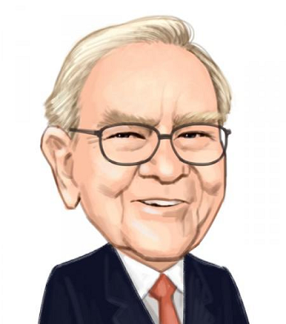
The Warren Buffett Way:
Financial Tenets
What is the return on equity?
What are the company’s “owner cash flows”
What are the profit margins?
Has the company created at least one dollar of market value for every dollar retained (value added)?
Does the Company have less than 30% debt?

Slide 39
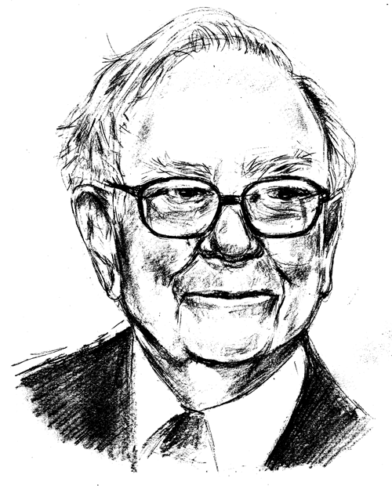
The Warren Buffett Way:
Value Tenets
What is the business value of the company – that is the “intrinsic” value?
Can the shares be purchased at a significant discount (roughly 50%) to its current trading price?

Slide 40
Value Tenets
INTRINSIC VALUATION MODEL - TWO-STAGE EARNINGS GROWTH PROJECTIONS
 |  |  |  | 2014 |  | 2015 |  | 2016 |  | 2017 |  | 2018 |  | 2019 |  | 2020 |  | 2021 |  | 2022 |  | 2023
Prior year cash flows (mil) |  |  |  | 37,894 |  | 47,368 |  | 59,210 |  | 74,013 |  | 92,516 |  | 115,645 |  | 144,556 |  | 180,695 |  | 225,868 |  | 282,335
10-year growth rate (.00) |  |  |  | 25.00% |  | 25.00% |  | 25.00% |  | 25.00% |  | 25.00% |  | 25.00% |  | 25.00% |  | 25.00% |  | 25.00% |  | 25.00%
Cash flow |  |  |  | 47,368 |  | 59,210 |  | 74,013 |  | 92,516 |  | 115,645 |  | 144,556 |  | 180,695 |  | 225,868 |  | 282,335 |  | 352,919
Discount Rate (.00) |  |  |  | 0.15 |  | 0.15 |  | 0.15 |  | 0.15 |  | 0.15 |  | 0.15 |  | 0.15 |  | 0.15 |  | 0.15 |  | 0.15
Discount Factor (mult.) |  |  |  | 0.869565 |  | 0.756144 |  | 0.657516 |  | 0.571753 |  | 0.497177 |  | 0.432328 |  | 0.375937 |  | 0.326902 |  | 0.284262 |  | 0.247185
Discounted value per annum |  |  |  | 41,190 |  | 44,771 |  | 48,664 |  | 52,896 |  | 57,496 |  | 62,495 |  | 67,930 |  | 73,837 |  | 80,257 |  | 87,236
Sum of present value of cash flows |  |  |  | $616,773
Residual value
Cash flow in year 10 |  |  |  | $352,919
Growth rate (.00) (g) |  |  |  | 0.04
Cash flow in year 11 |  |  |  | $367,036
Capitalization rate (k-g) |  |  |  | 0.11
Value at end of year 10 |  |  |  | $3,336,691
Discount factor year 10 |  |  |  | 0.24718
Present value of residual |  |  |  | $824,779
Total Intrinsic Value (mil) |  |  |  | $1,441,552
Number of shares (mil) |  |  |  | 5,866
Intrinsic value per share |  | 245.75
Intrinsic / Market |  | 1.95
Input discount & growth rates
First 10 year growth rate |  | 25.00%
Growth Rate Year 11 in perpetuity |  | 0.04
Discount rate |  | 0.15
Owners cash flow (mil) |  | $37,894.42
This page is all pre-determined by the information from the Value Line page. The only thing you may have to change is the growth rate for the three different scenarios.

Slide 41
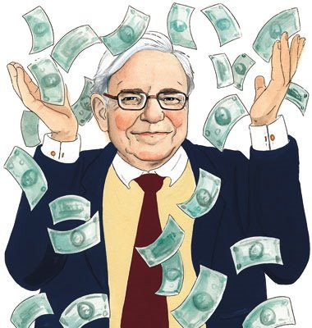
Buffett’s Four Principles of Investing
The company must have capable and vigilant leaders.
The company must have long-term prospects .
Is the stock stable and understandable?
A company must be undervalued so you can make a “good buy.”

Slide 42
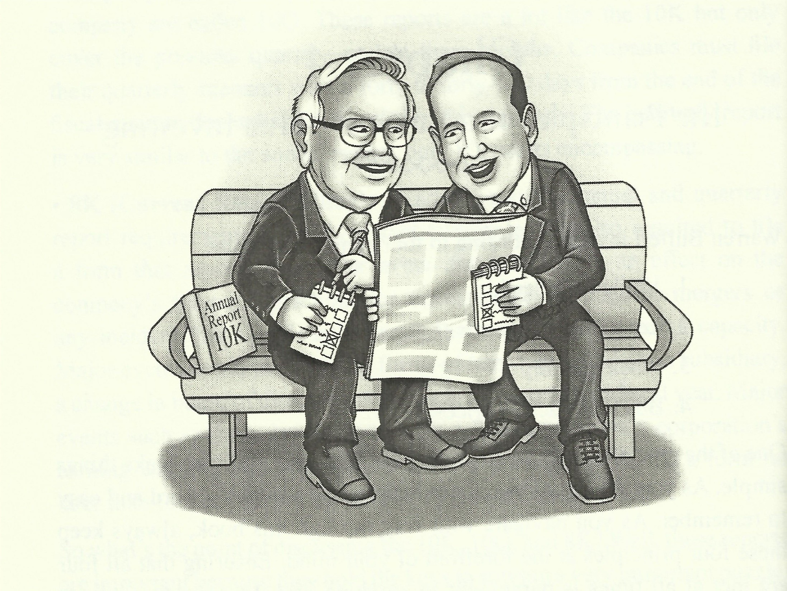
Principle 1 – Vigilant Leaders
Rule 1 – Low debt. A D/E < .5 and a D/TA < .3
Rule 2 – High Current Ratio. CR > 1.5
Rule 3 – Strong and consistent ROE. Buffett requires 8% average over a 10 year period. Kuhle likes to see an average of 15%.
Appropriate management incentives.

Slide 44
Vigilant Leaders
When you have able managers of high character running businesses about which they are passionate, you can have a dozen or more reporting to you and still have time for an afternoon nap.
In evaluating people, you look for three qualities: integrity, intelligence, and energy. If you don’t have the first, the other two will kill you.
In the long run, of course, trouble awaits managements that paper over operating problems with accounting maneuvers.

Slide 45
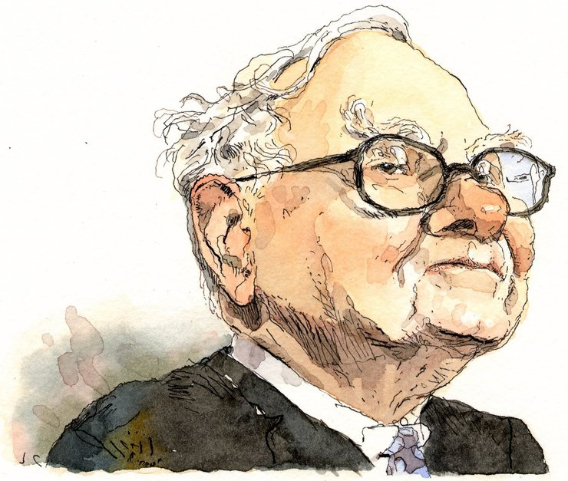
Principle 2 – Long term Prospects
Rule #1 – Persistent or Durable Product(s)
The kind of business to invest in is one which is Durable (franchise product) meaning that the business must be able to keep its competitive advantage well into the future without having to expend great sums of capital to maintain it. A low-cost competitive advantage is important for two reasons: First, is the predictability of the future earning power. Second, it improves the chances the business can expand shareholders’ fortunes rather than having to expend capital.

Slide 46
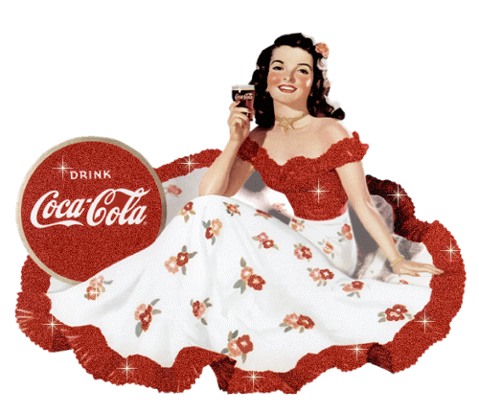
The Business should have a
franchise product(s)
The Franchise Product has (is):
A Durable Product with a Competitive Advantage that is sustainable over the long-run (5-10 years).
In high demand by a large segment of the market.
Little or no close substitutes.
Little or no Government regulation.

Slide 47
Franchise Product
The example used in the book is a good one. While Apple is a consistently high performer, they must stay ahead of the curve by investing in R&D and coming out with new products that may replace major products already in the market. This doesn’t mean that Apple won’t be profitable in the future, it means that there will always be more uncertainty attached to their products.
Graham always told us that speculation on the future was no way to invest. A steady-eddy like Coke already has a record for a solid long-term success with it’s current franchise products.

Slide 48
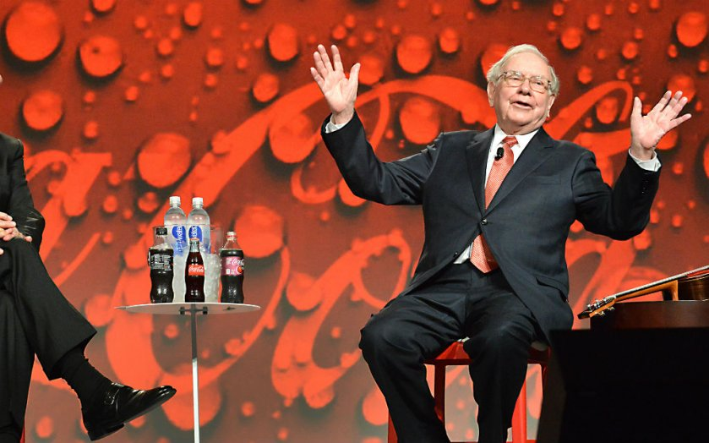
Franchise Product
When considering a new investment you should aim to determine whether changing technology will have a significant effect on the demand for that product in the future, this is what establishes a long-term competitive advantage. You must be able to ascertain the feasibility of a franchise product at least 10 years into the future.
When Buffett says he “doesn’t understand” a business he means he knows how it works but doesn’t know what their future looks like.
Again, it comes down to the simplicity of the business and the investing story. Mr. Buffett says that “the chance of being way wrong about Coke (where he does own shares) are probably less than being way wrong in Apple or Google.” Ultimately, he says, “I just don’t know how to value them.”

Slide 49
RULE 2 – MINIMIZE TAXES

Slide 50
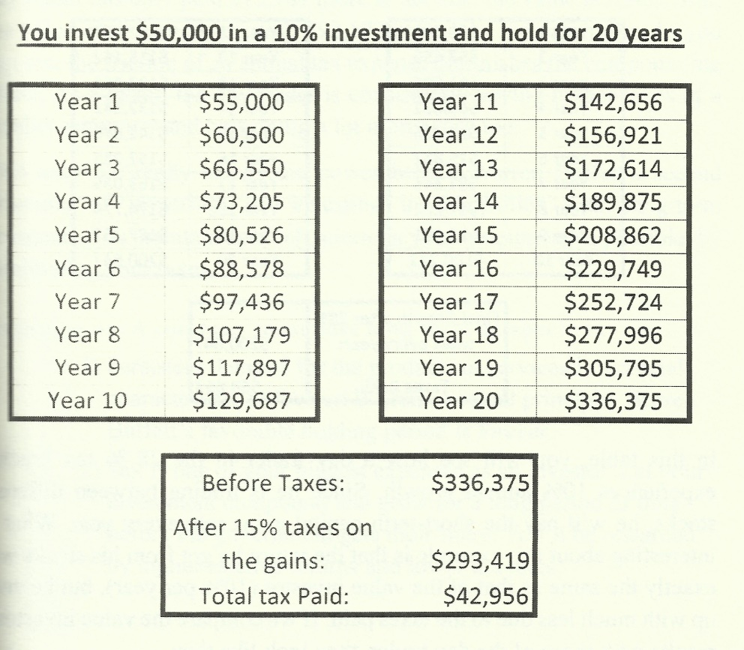

Slide 51
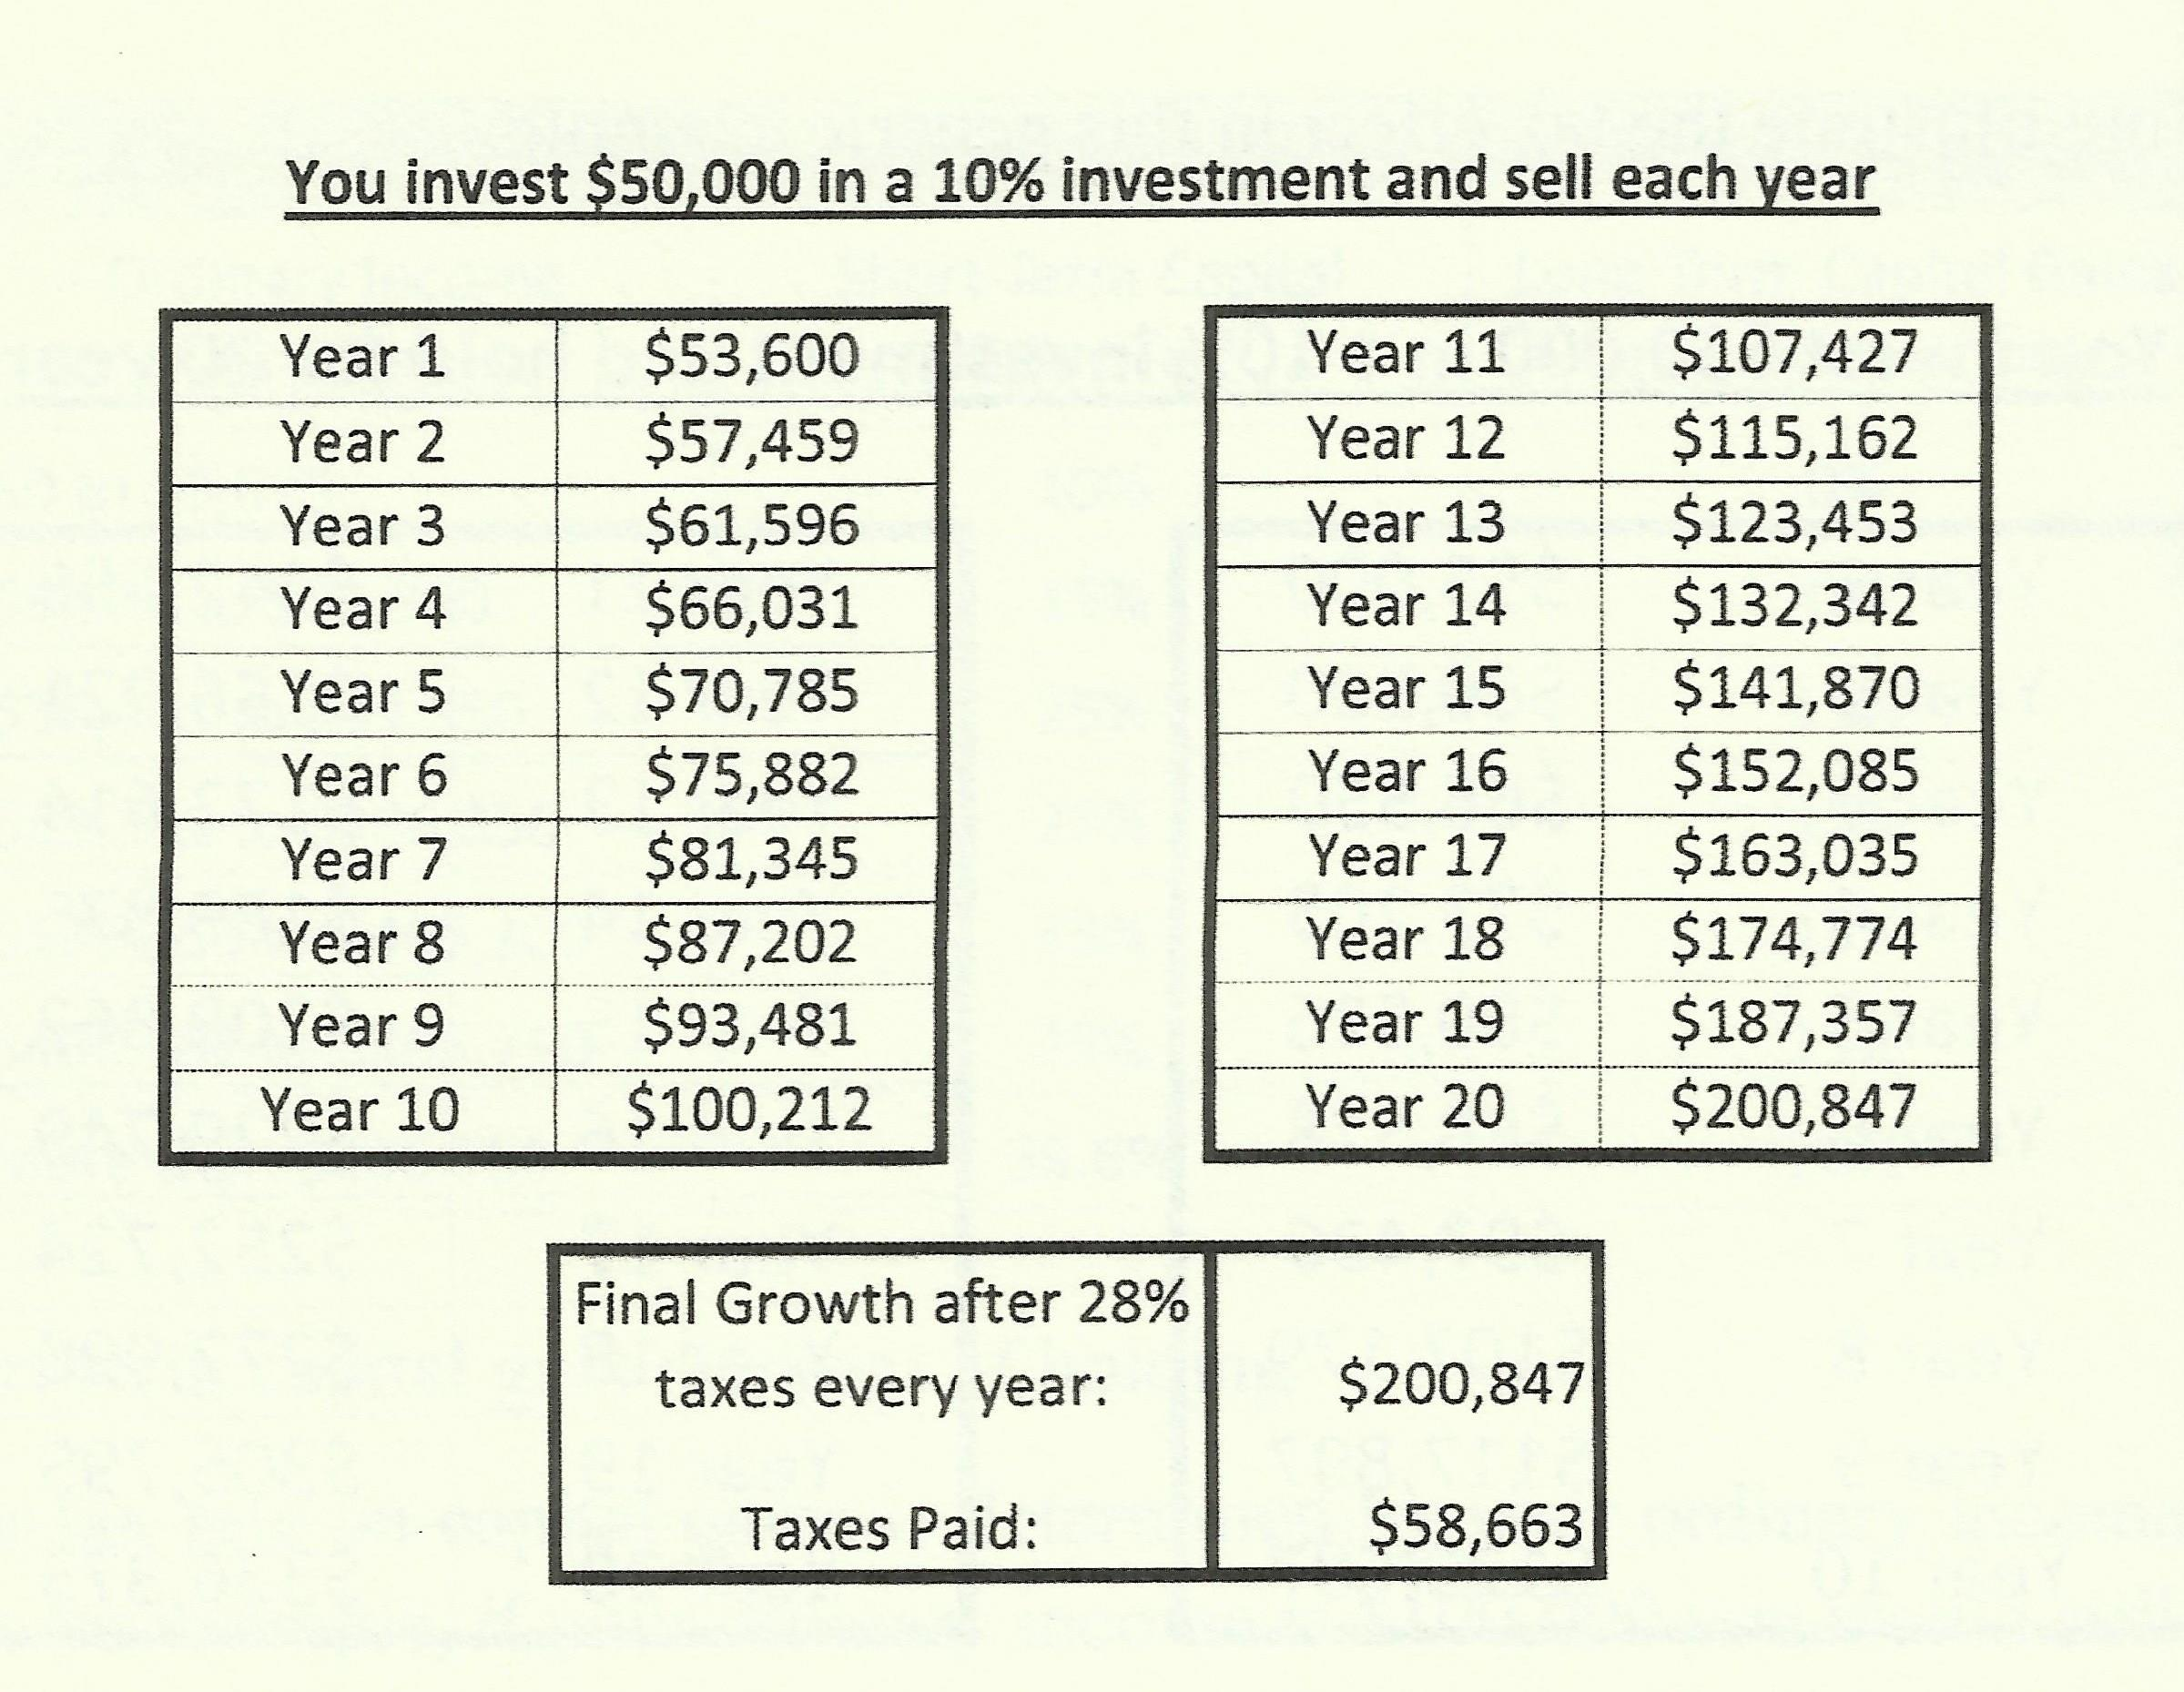
vs. $336,375
vs. $42,956

Slide 53
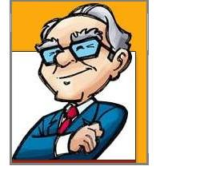
According to Buffett, what causes Risk?
Excessive Debt: Buffett never considers a company that has a Debt/Total Asset ratio greater than 30%.
Overpaying for an investment. The price you pay for a stock should have a potential of at least a 50% premium. That is for every dollar you spend for an asset, you should get at least $1.50 in intrinsic value.
Not knowing what you are doing. That is, not knowing the company and what they do.

Slide 54
Sayings of Warren Buffett
I’ve never swung at a ball while it’s still in the pitcher’s glove.
Never ask the barber if you need a haircut.
Wall Street is the only place that people ride to in a Rolls Royce to get advice from those who take the subway.
When you combine ignorance and borrowed money, the consequences can get interesting.
Most of our shareholders have to pay their bills in U.S. dollars.
When I was 20, I invested well over half of my net worth in GEICO.
Do a lot of reading.
If you have to go through too much investigation, something is wrong.

Slide 55
Sayings of Warren Buffett
I can’t be involved in 50 or 75 things. That’s a Noah’s Ark way of investing-you end up with a portfolio that resembles a zoo.
We’re looking for 747’s, not model airplanes.
Read Ben Graham and Phil Fisher, real annual reports, but don’t do equations with Greek letters in them.
In reference to quantitative analysis: Every priesthood does it. How could you be on top if no one is on the bottom?
The funny thing is, better shows don’t cost that much more than lousy shows.
Anything that can’t go on forever will end.
It’s an old principle. You don’t have to make it back the way you lost it.

Slide 56
Sayings of Warren Buffett
You need a moat in business to protect you from the guy who is going to come along and offer it (your product) for a penny cheaper.
Owning Snow White (the movie) is like owning an oil field. You pump it out and sell it and then it seeps back in again.
It’s far better to own a portion of the Hope diamond than 100 percent of a rhinestone.
Diversification is a protection against ignorance. It makes very little sense for those who know what they’re doing.
Buffett says he’s a Rip Van Winkle investor. What does he mean and why?
I don’t try to jump over 7-foot bars: I look around for 1-foot bars that I can step over.

Slide 57
Sayings of Warren Buffett
Like Wayne Gretzky says, go where the puck is going, not where it is.
To swim a fast 100 meters, it’s better to swim with the tide than to work on your stroke.
I’d be a bum on the street with a tin cup if the markets were always efficient.
You can’t get rich with a weather vane.
I like to buy stocks when the bears are giving them away.
Berkshire buys when the lemmings are heading the other way.
Happily, there’s more than one way to get to financial heaven.
I call it the cigar-butt theory of investing. You find these well-smoked, down-to-the-nub cigars, but they’re free. You pick them up and get one free puff out of them.

Slide 58
Sayings of Warren Buffett
Good jockeys will do well on good horses, but not on broken-down nags.
We don’t tell 400 hitters how to hit.
Of Wall Street maxims the most foolish may be “you can’t go broke taking a profit.”
If you expect to be a net investor for the next five years, should you hope for a higher or lower stock market during the period? Explain.
Grahamites should probably endow chairs to ensure the perpetual teaching of EMT.
In their hunger for a single statistic to measure risk, academics forget a fundamental principle: it is better to be approximately right than precisely wrong.

Slide 59
Sayings of Warren Buffett
We think that the very term “value investing” is redundant.
Business growth, per se, tells us little about value.
An intelligent investor in common stocks will do better in the secondary market than he will do buying new issues.
Why does Berkshire prefer to use cash vs. Berkshire stock to buy companies?
Bull markets can obscure mathematical laws, but they can’t repeal them.
Charlie and I have found that making silk purses out of silk is the best that we can do; with sow’s ears, we fail.
There seems to be some perverse human characteristic that likes to make easy things difficult.

Slide 60
Sayings of Warren Buffett
With enough inside information and a million dollars, you can go broke in a year.
If the true value of a company doesn’t just scream at you, it’s too close.
In investments, there’s no such thing as a called strike.
I never attempt to make money on the stock market. I buy on the assumption that they could close the market the next day and not reopen it for five years.
There seems to be some perverse human characteristic that likes to make easy things difficult.
“In the business world, the rearview mirror is always clearer than the windshield.”

Slide 61
Sayings of Warren Buffett
“Only when the tide goes out do you discover who's been swimming naked”
“If past history was all there was to the game, the richest people would be librarians”
“When a management team with a reputation for brilliance tackles a business with a reputation for bad economics, it is the reputation of the business that remains intact.”
“Only buy something that you'd be perfectly happy to hold if the market shut down for 10 years.”
“Time is the friend of the wonderful company, the enemy of the mediocre.”
“We simply attempt to be fearful when others are greedy and to be greedy only when others are fearful.”

Slide 62
Sayings of Warren Buffett
55. The Golden Rule works in business too.
56. Healthy cultures create wealth; toxic cultures destroy it.
57. To create long-lasting wealth, don’t lose money.
58. Aiding investors’ analysis builds investor trust.
59. Failed discipline will lead to a poorhouse, not an economic
powerhouse.
60. A conclusion about the economy does not tell us if the stock
market will rise or fall.
61. Great CEO’s need to be disciplined capital allocators.
62. Price is what you pay; value is what you get.
63. A chain of folly will always end badly.
64. What looks safe may be unsafe; challenge assumptions and be
open to new facts.
65. Remember that large, unfathomable derivatives are still
financial weapons of mass destruction.
66. Indecipherable disclosures tell us which emperors are naked.

Slide 63
Sayings of Warren Buffett
67. Live beneath your means.
68. Betting on tortoises can create long-lasting wealth.
69. Invest with CEO’S who explain important risks.
70. Recovery depends on choosing to restore our social compact and
to reset our moral compasses.

Slide 64
It’s been a
Wonderful life
End of
Buffettology

