Slide 1

Investing in
Mutual Funds
Topic 11

Slide 2


A. Pooled Diversification
1. Professional Money Managers
2. Combines the Funds of many people with similar investment goals
3. Receive shares of stock in the mutual fund; a pooled common investment.
4. An indirect investment

Slide 3
B. Attractions and Drawbacks of Mutual Fund Ownership
1. Diversification
2. Full-time Professional Management
3. Modest Capital Investment
4. Services offered
  a. Automatic reinvestment of dividends
  b. Withdrawal plans
  c. Exchange privileges
  d. Check writing privileges

Slide 4

B. Attractions and Drawbacks of Mutual Fund Ownership
5. Convenience
  a. Easy to acquire
  b. Paperwork and record keeping
  c. Prices (NAV) are widely quoted
6. Lack of liquidity
  a. Normally must be sold back to the fund
  b. No brokerage commissions
7. Consistently average to below average performance

Slide 5

C. Essential Characteristics
1. Open-end Funds ($6.5 trillion)
  a. Investors buy and sell shares back to the fund itself
  b. There is no limit on the number of shares the fund can issue
  c. NET ASSET VALUE (NAV)
    Defined as the total market value of all securities held by the fund less liabilities, divided by the number of fund shares outstanding.

Slide 6
Open-end Funds
In an open-end mutual fund, shares are issued and redeemed daily by the fund's sponsor (the issuer of the fund). By design, these funds are always traded at their actual cash value, also known as net asset value (NAV), which is calculated on a per-share basis before sales charges are applied. Moreover, while this is the most popular type of fund, it is not necessarily the best for those seeking income.

Slide 7
C. Essential Characteristics (continued)
2. Closed-end Funds
  a. A fixed number of shares outstanding
  b. 600 Closed-end funds
  c. $279 (2013) billion market value
3. Investment Trusts
  a. Interest is an unmanaged pool of investments
  b. Usually consist of corporate, government, or municipal bonds

Slide 8
Closed-end Funds
Closed-end mutual funds, which generally provide more income to investors, issue all of their shares on the first day they go public, instead of issuing and redeeming new shares everyday at their NAV. After that, the fund's market value can move just like an individual stock, free to rise and fall above and below the actual cash value of the shares. The fund's sponsor does not issue or redeem any new shares on a daily basis. Instead, shares trade between other investors independent of the NAV.

Slide 9
Net Asset Value Example
Example: NAV
  XYZ Mutual Fund owns assets totaling $10M and liabilities equal to $500,000 with 500,000 shares outstanding
  Therefore, NAV is:
  $10,000,000 - $500,000 / 500,000
  $19/share

Slide 10
Differences in Return
Suppose that an open-end income fund goes public and issues 10 million shares at $10 each, raising $100 million for the fund, which it subsequently invests in securities yielding 7% annually, or 70 cents per share in income, which in turn is paid out to investors. Now imagine that a closed-end fund issued the same number of shares at the same price, but after it went public, the share price of the closed-end fund fell to $8 while the NAV (cash value) stayed at $10. This represents a 20% discount, and the dividend, which started at 7 cents, and what was originally a 7% yield is now providing a yield of 8.75% ($0.70 / $8.00 = 8.75%).

Slide 11
C. Essential Characteristics (continued)
4. Load or No Load
  a. Load Fund
    Charges a commission when shares are bought (7 - 8 1/2% or more)
  b. No Load Fund
    No sales charges are levied
5. Other fees and Costs
  a. Professional Management Fee
    .25 to 1.75 percent of the average dollar amount of assets under management

Slide 12
D. Types of Funds (Equity)
1. Growth
  Goal is capital appreciation
2. Maximum Growth
  Highly speculative, seeking large profits from capital gains
    a. Often buy stocks of small, unseasoned companies
    b. Highly speculative

Slide 13
D. Types of Funds (Equity)
3. Income
  CURRENT income is main objective
    a. Interest income
    b. Dividend income
4. Balanced Funds
  Objective is to earn both capital gains and current income
    a. High-grade common stocks (60 - 75%)
    b. Fixed income securities (25 - 40%)

Slide 14
D. Types of Funds (continued)
5. Small Company
  Invest in small companies that usually have sales of $100 million or less.
  6. International
  Can invest in one region or area of the world
  Can invest in specific country

Slide 15
D. Types of Funds (continued)
Bond Funds
  Objective is to invest in bonds
    a. Income is primary objective
    b. Two advantages
      Liquidity
      Diversification

Slide 16
D. Types of Funds (continued)
6. Money Market Funds
  Offers the individual investor access to high-yielding money market instruments without having to pay $100,000 denominations
    a. Bank CD’s
    b. Treasury Bills
    c. Commercial Paper

Slide 17
D. Types of Funds (continued)
7. Dual Funds
  Closed-end Funds with two types of shares
    a. INCOME shares (Senior) which receive two times income as Junior
    b. CAPITAL shares (Junior) which receive two times the capital gains as Senior

Slide 18
D. Types of Funds (continued)
8. Specialty Funds - Single Industry
  a. Option trading
  b. Commodity funds
  c. Oil drilling
  d. Cattle funds
  e. Electronics
  f. Gold
  g. Chemicals
  h. Health
  i. Legal Funds

Slide 19
E. Special Services
1. Saving Plans
  Investor adds funds on a regular basis
2. Automatic Reinvestment Plans
  Dividends and capital gains are reinvested in additional shares
3. Regular Income
  Through withdrawal plans, the investor can receive periodic repayment or income
    Shares or Dollars

Slide 20
E. Special Services (continued)
4. Conversion Privileges
  Allows the investor the right to switch from one fund to another
    a. Must confine switches within the same family of funds
    b. Usually no transfer charges

Slide 21
E. Special Services (continued)
5. Check Writing Privileges
  a. Shareholders have the right to write checks drawn on the Mutual Fund account
  b. Normally checks must be written for at least $500
  c. Almost all Money Funds have this privilege

Slide 22

F. Risk
Because Mutual Funds are so well diversified (typically), the inherent risk is similar to that in the Market
However, Specialty Fund risk can vary significantly from overall Market risk
σp
Systematic ≡ Market
5
30
Assets

Slide 23
Analyzing Mutual Funds
Assessment of your risk tolerance
Importance of diversification
Should hold six mutual funds
Should be able to earn 16% plus with a beta equivalent to 1.0 or slightly less

Slide 24
Analyzing Mutual Funds
Mutual Funds Seek Relative Returns
Most mutual funds invest in a predefined style, such as "small cap value", or into a particular sector, such as the technology sector. To measure performance, the mutual fund's returns are compared to a style-specific index or benchmark. For example, if you buy into a "small cap value" fund, the managers of that fund may try to outperform the S&P Small Cap 600 Index. Less active managers might construct the portfolio by following the index and then applying stock-picking skills to increase (overweigh) favored stocks and decrease (underweigh) less appealing stocks.

Slide 25
Analyzing Mutual Funds
A mutual fund's goal is to beat the index or "beat the bogey", even if only modestly. If the index is down 10% while the mutual fund is down only 7%, the fund's performance would be called a success. On the passive-active spectrum, on which pure index investing is the passive extreme, mutual funds lie somewhere in the middle as they semi-actively aim to generate returns that are favorable compared to a benchmark.

Slide 26
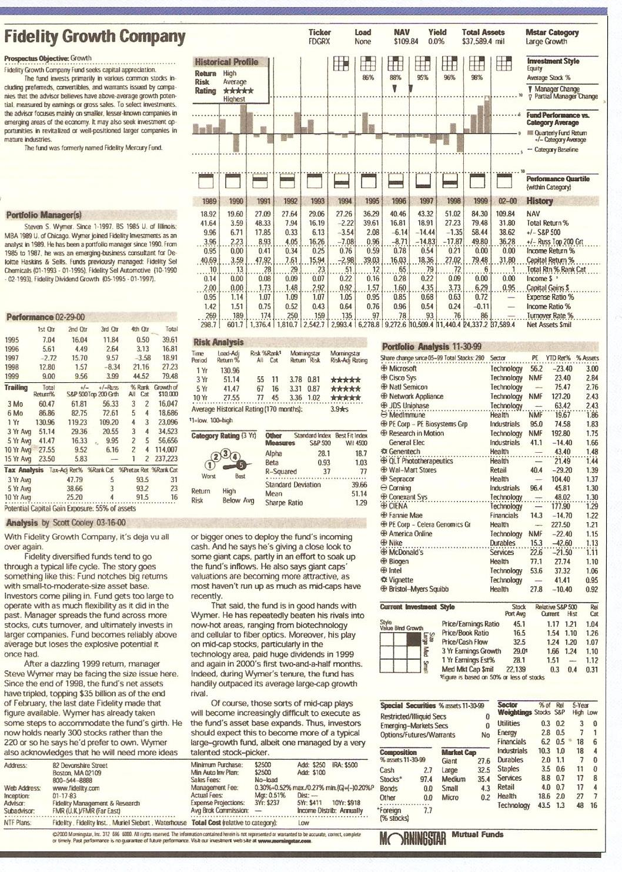

Slide 27
Exchange Traded Funds
1. A security that tracks an index, a commodity or a basket of assets like an index fund, but trades like a stock on an exchange. ETFs experience price changes throughout the day as they are bought and sold.
Because it trades like a stock, an ETF does not have its net asset value (NAV) calculated every day like a mutual fund does.
2. By owning an ETF, you get the diversification of an index fund as well as the ability to sell short, buy on margin and purchase as little as one share. Another advantage is that the expense ratios for most ETFs are lower than those of the average mutual fund. When buying and selling ETFs, you have to pay the same commission to your broker that you'd pay on any regular order.

Slide 28
Exchange Traded Funds
3. One of the most widely known ETFs is called the Spider (SPDR), which tracks the S&P 500 index and trades under the symbol SPY.
4. The easiest way to highlight the advantage of the ETF trading like a stock is to compare it to the trading of a mutual fund. Mutual funds are priced once per day, at the close of business. Everyone purchasing the fund that day gets the same price, regardless of the time of day their purchase was made.
Because, like traditional stocks and bonds, ETFs can be traded intraday, they provide an opportunity for speculative investors to bet on the direction of shorter-term market movements through the trading of a single security.

Slide 29
Hedge Funds
Hedge funds are like mutual funds in two respects: (1) they are pooled investment vehicles (i.e. several investors entrust their money to a manager) and (2) they invest in publicly traded securities. But there are important differences between a hedge fund and a mutual fund. These stem from and are best understood in light of the hedge fund's charter: investors give hedge funds the freedom to pursue absolute return strategies.

Slide 30
Hedge Funds
Definition: An aggressively managed portfolio of investments that uses advanced investment strategies such as leveraged, long, short and derivative positions in both domestic and international markets with the goal of generating high returns (either in an absolute sense or over a specified market benchmark).
Legally, hedge funds are most often set up as private investment partnerships that are open to a limited number of investors and require a very large initial minimum investment. Investments in hedge funds are illiquid as they often require investors keep their money in the fund for at least one year.

Slide 31
Hedge Funds
Seek Positive Absolute Returns
Engages in aggressive strategies
  Short selling
  Trading derivatives
  Using OPM
Popular in Bear Markets (they Hedge
against losses)
Notes:
Hedge funds lie at the active end of the investing spectrum as they seek positive absolute returns, regardless of the performance of an index or sector benchmark. Unlike mutual funds, which are "long-only" (make only buy-sell decisions), a hedge fund engages in more aggressive strategies and positions, such as short selling, trading in derivative instruments like options and using leverage (borrowing) to enhance the risk/reward profile of their bets.
This activeness of hedge funds explains their popularity in bear markets. In a bull market, hedge funds may not perform as well as mutual funds, but in a bear market - taken as a group or asset class - they should do better than mutual funds because they hold short positions and hedges. The absolute return goals of hedge funds vary, but a goal might be stated as something like "6-9% annualized return regardless of the market conditions".

Slide 32
Hedge Funds
Hedge Funds Actively Seek Absolute Returns
Investors, however, need to understand that the hedge fund promise of pursuing absolute returns means hedge funds are "liberated" with respect to registration, investment positions, liquidity and fee structure. First, hedge funds in general are not registered with the SEC. They have been able to avoid registration by limiting the number of investors and requiring that their investors be accredited, which means they meet an income or net worth standard. Furthermore, hedge funds are prohibited from soliciting or advertising to a general audience, a prohibition that lends to their mystique.

Slide 33
Hedge Fund Costs
Tend to be more expensive than
mutual funds
Typical charge of an annual management fee of 1%-2%
Plus the manager usually receives a share (20%) of the investment gains.
Notes:
Lastly, hedge funds are more expensive even though a portion of the fees are performance-based. Typically, they charge an annual fee equal to 1% of assets managed (sometimes up to 2%), plus they receive a share - usually 20% - of the investment gains. The managers of many funds, however, invest their own money along with the other investors of the fund and, as such, may be said to "eat their own cooking".

Slide 34
Types of Hedge Fund
Strategies
Most hedge funds are entrepreneurial organizations that employ proprietary or well-guarded strategies.
Arbitrage Strategies (A.K.A., Relative Value)
Arbitrage is the exploitation of an observable price inefficiency and, as such, pure arbitrage is considered riskless. Consider a very simple example. Say Acme stock currently trades at $10 and a single stock future contract due in six months is priced at $14. The futures contract is a promise to buy or sell the stock at a predetermined price. So, by purchasing the stock and simultaneously selling the futures contract, you can, without taking on any risk, lock in a $4 gain before transaction and borrowing costs.
Cost of stock is $1000 (100 shares x $10)
Sell futures contract @ $14 x 100 = $1400
Net is $1400 - $1000 = $400
Notes:
Three Broad Categories and Many Strategies
Most hedge funds are entrepreneurial organizations that employ proprietary or well-guarded strategies. The three broad hedge fund categories are based on the types of strategies they use:
1. Arbitrage Strategies (A.K.A., Relative Value)
Arbitrage is the exploitation of an observable price inefficiency and, as such, pure arbitrage is considered riskless. Consider a very simple example. Say Acme stock currently trades at $10 and a single stock futures contract due in six months is priced at $14. The futures contract is a promise to buy or sell the stock at a predetermined price. So, by purchasing the stock and simultaneously selling the futures contract, you can, without taking on any risk, lock in a $4 gain before transaction and borrowing costs.
In practice, arbitrage is more complicated, but three trends in investing practices have opened up the possibility of all sorts of arbitrage strategies: the use of (1) derivative instruments, (2) trading software, and (3) various trading exchanges (for example, electronic communication networks and foreign exchanges make it possible to take advantage of "exchange arbitrage", the arbitraging of prices among different exchanges).
Only a few hedge funds are pure arbitrageurs, but when they are, historical studies often prove they are a good source of low-risk reliably-moderate returns. But, because observable price inefficiencies tend to be quite small, pure arbitrage requires large, usually leveraged investments and high turnover. Further, arbitrage is perishable and self-defeating: if a strategy is too successful, it gets duplicated and gradually disappears.
Most so-called arbitrage strategies are better labeled "relative value". These strategies do try to capitalize on price differences, but they are not risk free. For example, convertible arbitrage entails buying a corporate convertible bond, which can be converted into common shares, while simultaneously selling short the common stock of the same company that issued the bond. This strategy tries to exploit the relative prices of the convertible bond and the stock: the arbitrageur of this strategy would think the bond is a little cheap and the stock is a little expensive. The idea is to make money from the bond's yield if the stock goes up but also to make money from the short sale if the stock goes down. However, as the convertible bond and the stock can move independently, the arbitrageur can lose on both the bond and the stock, which means the position carries risk.

Slide 35
Types of Hedge Fund
Strategies
2. Event-Driven Strategies
Example - Merger Arbitrage : A hedge fund strategy in which the stocks of two merging companies are simultaneously bought and sold to create a riskless profit. A merger arbitrageur looks at the risk that the merger deal will not close on time, or at all. Because of this slight uncertainty, the target company's stock will typically sell at a discount to the price that the combined company will have when the merger is closed. This discrepancy is the arbitrageur's profit.
Notes:
Event-driven strategies take advantage of transaction announcements and other one-time events. One example is merger arbitrage, which is used in the event of an acquisition announcement and involves buying the stock of the target company and hedging the purchase by selling short the stock of the acquiring company. Usually at announcement, the purchase price that the acquiring company will pay to buy its target exceeds the current trading price of the target company. The merger arbitrageur bets the acquisition will happen and cause the target company's price to converge (rise) to the purchase price that the acquiring company pays. This also is not pure arbitrage. If the market happens to frown on the deal, the acquisition may unravel and send the stock of the acquirer up (in relief) and the target company's stock down (wiping out the temporary bump) which would cause a loss for the position.
There are various types of event-driven strategies. One other example is "distressed securities", which involves investing in companies that are reorganizing or have been unfairly beaten down. Another interesting type of event-driven fund is the activist fund, which is predatory in nature. This type takes sizable positions in small, flawed companies and then uses its ownership to force management changes or a restructuring of the balance sheet.

Slide 36
Types of Hedge Fund
Strategies
2. Event-Driven Strategies
Example - distressed securities", which involves investing in companies that are reorganizing or have been unfairly beaten down. Another interesting type of event-driven fund is the activist fund, which is predatory in nature. This type takes sizable positions in small, flawed companies and then uses its ownership to force management changes or a restructuring of the balance sheet.
Example - Another interesting type of event-driven fund is the activist fund, which is predatory in nature. This type takes sizable positions in small, flawed companies and then uses its ownership to force management changes or a restructuring of the balance sheet.

Slide 37
Hedge Fund Strategies
3. Directional or Tactical Strategies
LONG/SHORT Equity Hedge:
In this strategy, hedge fund managers can either purchase stocks that they feel are undervalued or sell short stocks they deem to be overvalued. In most cases, the fund will have positive exposure to the equity markets – for example, having 70% of the funds invested long in stocks and 30% invested in the shorting of stocks. In this example, the net exposure to the equity markets is 40% (70%-30%) and the fund would not be using any leverage. If the manager, however, increases the long positions in the fund to, say, 80% while still maintaining a 30% short position, the fund would have gross exposure of 110% (80%+30% = 110%), which indicates leverage of 10%.

Slide 38
Hedge Fund Strategies
3. Directional or Tactical Strategies
Market Neutral Strategy:
In this strategy, a hedge fund manager applies the same basic concepts, but seeks to minimize the exposure to the broad market. This can be done in two ways. If there are equal amounts of investment in both long and short positions, the net exposure of the fund would be zero. For example, if 50% of funds were invested long and 50% were invested short, the net exposure (refers to the long/short exposure) would be 0% and the gross exposure (refers to the % invested in the market) would be 100%.

Slide 39
Hedge Fund Strategies
Market Neutral Strategy:
There is a second way to achieve market neutrality, and that is to have zero beta exposure. In this case, the fund manager would seek to make investments in both long and short positions so that the beta measure of the overall fund is as low as possible. In either of the market-neutral strategies, the fund manager's intention is to remove any impact of market movements and rely solely on his or her ability to pick stocks.

Slide 40
Hedge Fund Strategies
Global Macro
Generally speaking, these are the strategies that have the highest risk/return profiles of any hedge fund strategy. Global macro funds invest in stocks, bonds, currencies, commodities, options, futures, forwards and other forms of derivative securities. They tend to place directional bets on the prices of underlying assets and they are usually highly leveraged. Most of these funds have a global perspective and, because of the diversity of investments and the size of the markets in which they invest, they can grow to be quite large before being challenged by capacity issues. Many of the largest hedge fund "blow-ups" were global macros, including Long-Term Capital Management and Amaranth Advisors. Both were fairly large funds and both were highly leveraged.

