Slide 1
Reefs

Slide 2
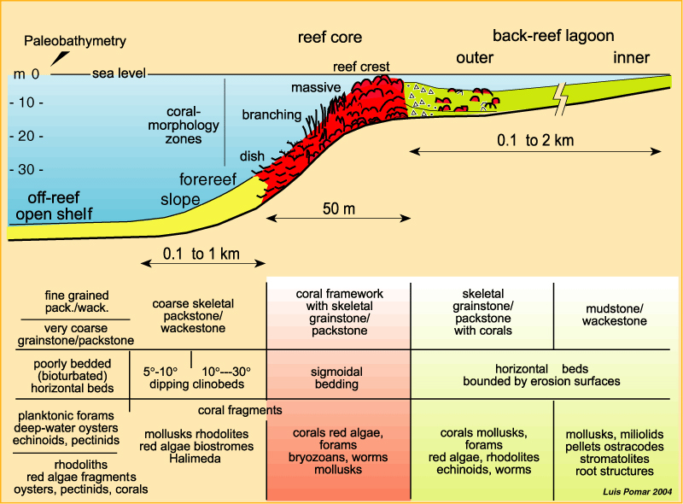
Modern Reef Structure

Slide 3
Factor | Fore Reef | Reef Core | Back Reef
Energy of Water | Low especially in deeper parts, except for storms, turbidity currents | High energy where waves break | Low to medium
Temperature | Cool water, relatively constant | Warm water, variable | High, variable
Oxygen Level | Moderate, constant | Lots of photosynthesis, lots of breaking waves – higher O, stable | Depends – could be high if photosynthesis, could be low if decomp
Salinity | Moderate, constant | Variable within bounds | Variable: high if evaporation, lower if storms
Substrate (what is the bottom like) | Some mud, some sandy, sometimes unstable | Hardground, sandy channels | Sandy if higher energy, muddy if low energy

Slide 4
Zone | Advantages | Challenges | Adaptations
Forereef | Constant environment | Less sun, colder, debris flows | Righting orgs, weedy orgs., filter feeders
Reef core | Lots of oxygen, light, incoming food particles. Stable bottom, | High energy, somewhat variable | Clamping down orgs., robust skeletons, dome-shaped orgs
Back reef | Lots of sunlight, possibly lots of oxygen, warm, lower energy | Could be low oxygen, interacts with terrestrial env., variable temp & salinity | Smaller, more delicate orgs., photosynthesizing, adapted to changing conditions

Slide 5
Now let’s look at a Permian reef
Guadalupe Reef, Permian Basin, Texas
All images from Scholle, Goldstein & Ulmer-Scholle, 2007, Open File Report 504,
New Mexico Bureau of Geology and Mineral Resources

Slide 6
A
B
C
D
E
F
G
A
C
E
G
B
D
F

Slide 7
A: Redbeds and Evaporites
What do redbeds and evaporites tell us about environment?
Redbeds: terrestrial deposition; Evaporites: restricted circulation
(reef is blocking incoming ocean water)

Slide 8
A
B
C
D
E
F
G
A
C
E
G
B
D
F

Slide 9
B: Lagoonal Mudstones
What does the presence of stromatolites tell us about the environment?
Stromatolites mean nobody is eating the algae, not even snails. So unusual water chemistry (probably too saline, and that is confirmed by the dolomite and evaporites)

Slide 10
A
B
C
D
E
F
G
A
C
E
G
B
D
F

Slide 11
C&D: Pisolites & Grainstones

Slide 12
C&D: Pisolites & Grainstones (cont)
What do pisolites and cross-beds tell us about the environment?
Pisolites = shoaling (waves sloshing back and forth) or tidal motion causing sediment to roll. Cross-beds = current

Slide 13
A
B
C
D
E
F
G
A
C
E
G
B
D
F

Slide 14
E: Reef Core
There are no Permian corals that build big frameworks, so the reef is built from other organisms: here it’s algae.

Slide 15
E: Reef
Core
These are cross-sections through the sponge framework of the reef.

Slide 16
Reconstruction of reef core
Sponges, algae, corals and coral-like creatures, bryozoans, echinoderms (cystoids, crinoids)

Slide 17
A
B
C
D
E
F
G
A
C
E
G
B
D
F

Slide 18
F: Upper Reef Slope

Slide 19
F: Lower Reef Slope

Slide 20
A
B
C
D
E
F
G
A
C
E
G
B
D
F

Slide 21
G: Basinal Deposits
Turbidites cascaded down the reef slope into the basin. Coarse grained layers are channels; finer grained are the farther edges of a flow or the finer materials that spilled over the channel lip (overbank deposits).

Slide 22
G: Basinal Deposits
Turbidites at the bottom edge of the fans
Very fine-grained limestone in the basin

