Slide 1
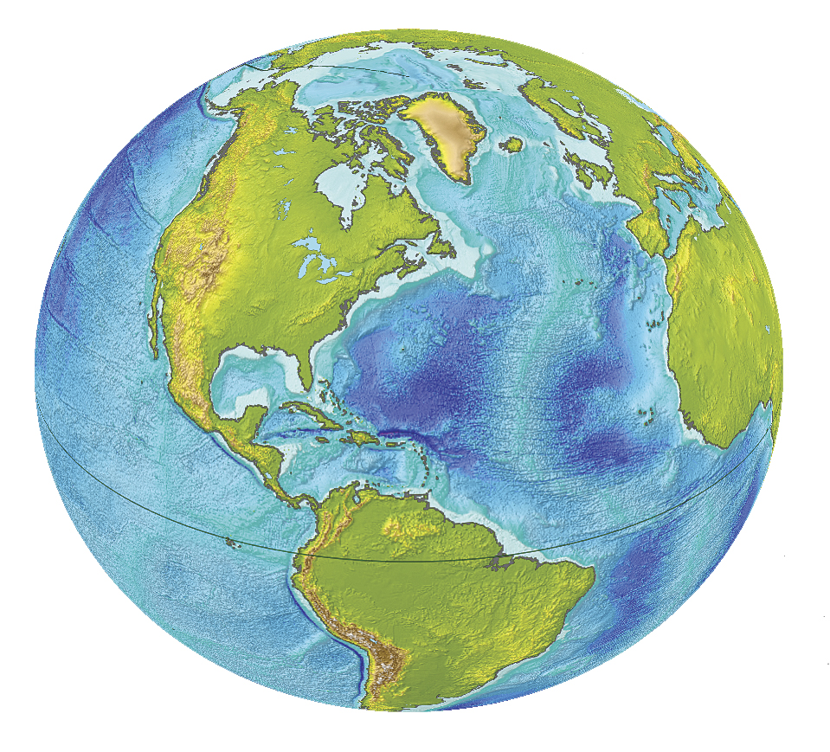
Let’s look at the Earth
What makes the Earth special?
If you were an alien visiting from another planet, what would you notice about the Earth that makes it distinctive?
http://www.esri.com/news/arcuser/0610/graphics/nospin_2-lg.jpg
Notes:
Students talk in pairs and come up with 2-3 things that they think make the Earth special. This is only things that a visitor could SEE, either from space or on the ground, not things that they might have read about or know from other prior knowledge. 2 minutes to think and write down 3 things in their notebook.
Then whip around the room – everyone says only a few words or a phrase with no explanation. If someone else has said your things, you say “pass”.
This whole intro should take about 5 minutes.

Slide 2
Now we’re going to look at the Earth in more detail.
Science is all about recognizing patterns and trying to make sense of the patterns.
We want to start our examination of the processes on Earth by looking for patterns.
It will be easier to see patterns if we compare the Earth with other planetary bodies – the Moon and Mars.

Slide 3
First set of patterns – topography
Topography = the shape of the ground – ups and downs.
Let’s look at the maps together
Notes:
Students should be working in groups of 2-3. Each group gets these handouts:
Thinking about Patterns in the Planets – one per student
Moon Maps – one set per group
Mars maps – one set per group

Slide 4
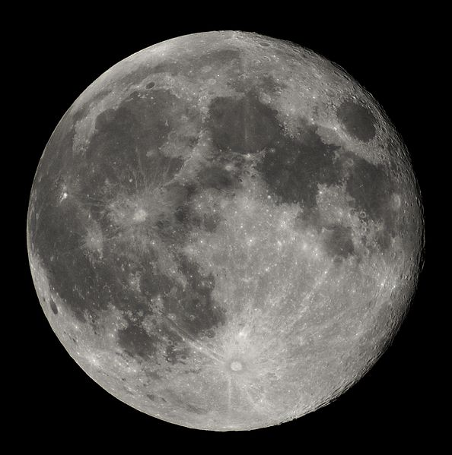
The Moon
This is what we are used to seeing when we look at images of the Moon. We are looking at just one side of the Moon, and we aren’t seeing a lot of detail.
http://en.wikipedia.org/wiki/File:Full_Moon_Luc_Viatour.jpg
Notes:
About 8 minutes in
Ask students to find their Moon Maps and follow along with you.
The next section (slides 4-7) should take about 5 minutes

Slide 5
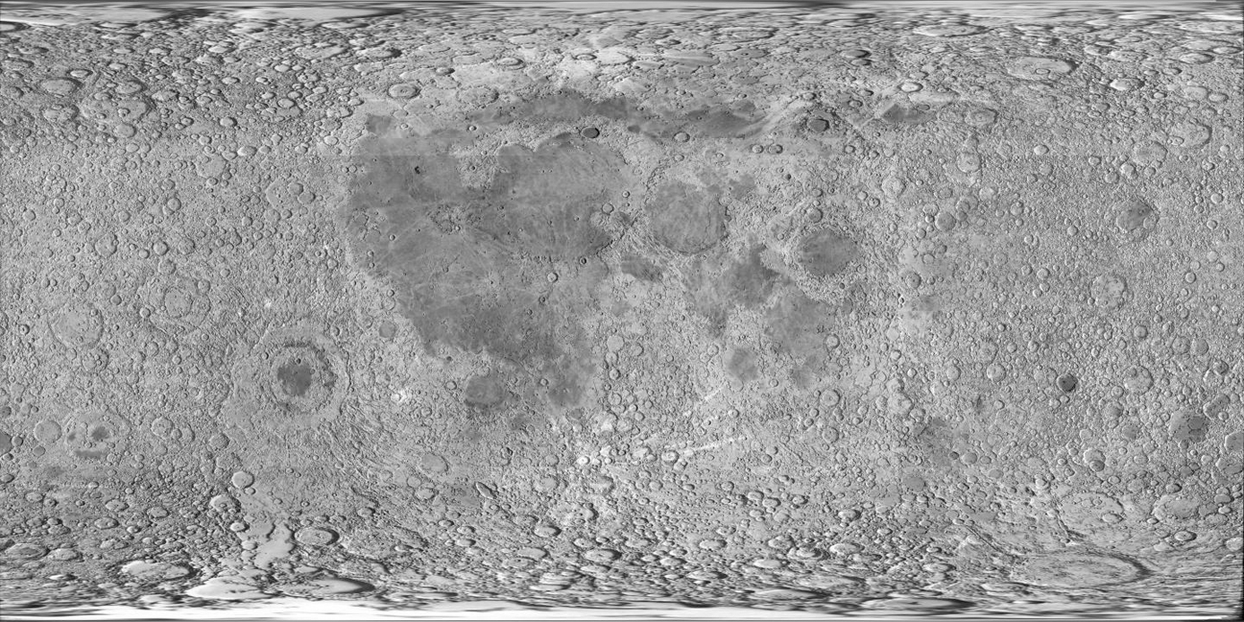
http://maps.jpl.nasa.gov/textures/ear1ccc2.jpg
This map was made with data from a space probe that orbited the Moon. On this cylindrical map of the Moon, the North and South poles are stretched out across the top and bottom of the map.

Slide 6
One more kind of map
False color maps – show values for some kind of data using color.
Red is high values, blue is low.
We are looking at topography, so red is high mountains, blue is low valleys.
Notes:
About 21-23 minutes in.

Slide 7
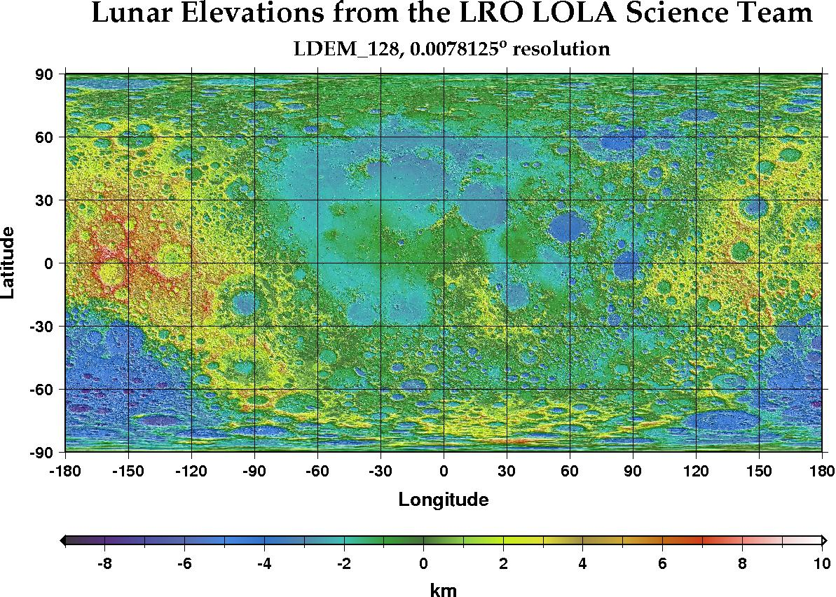
What color are the highest places?
How high are those high places?
What color are the lowest places?
How low are the lowest places?
Notes:
27 minutes in.
Students talk to a partner about these four questions – 2 minutes.
Whole group discussion to make sure they understand how to read the map – 2 minutes.

Slide 8
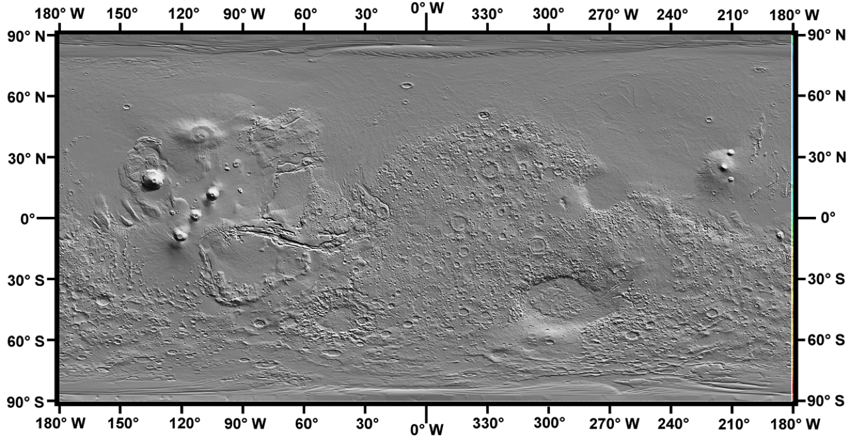
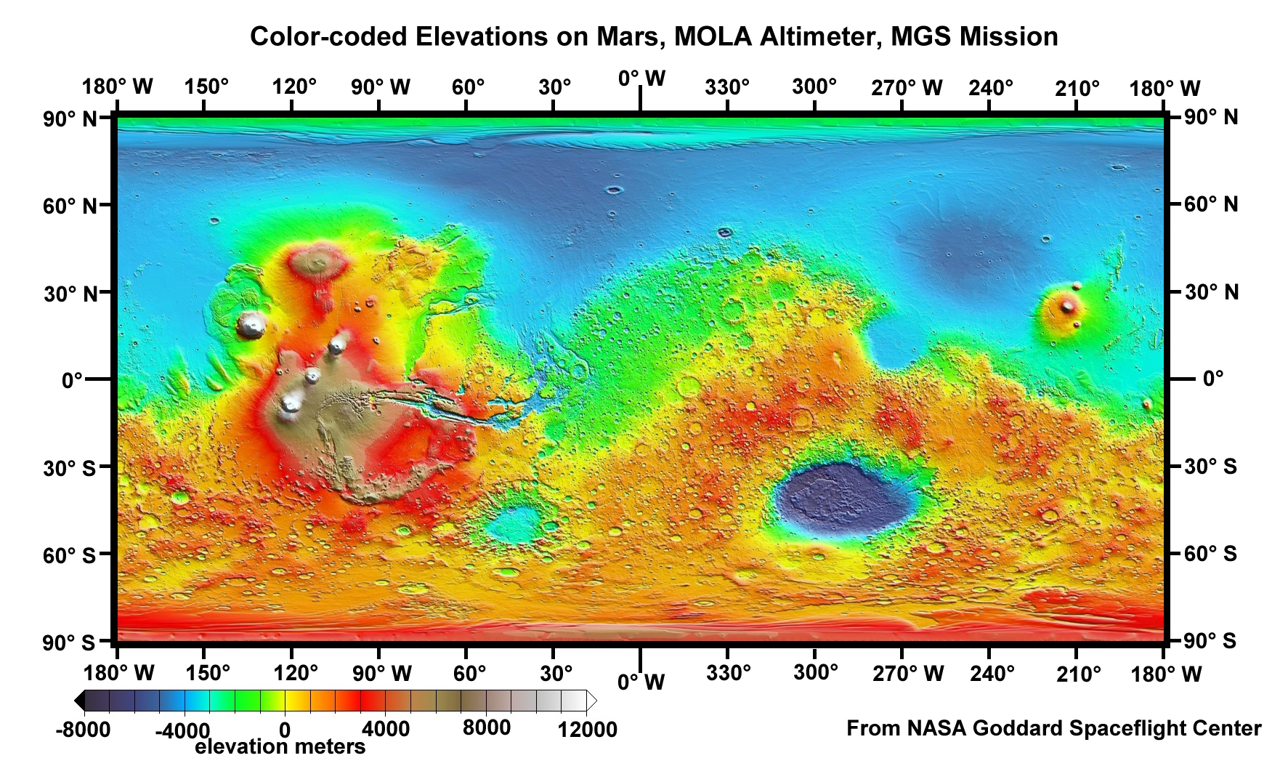
Now find your Mars maps
Find the high places and the low places.
Notes:
31 minutes in
Ask the students the same questions as before (2 minute partner discussion, 2 minute review as class)
What color are the high places?
How high are the high places?
What color are the low places?
How low are the low places?
Note that the legend on the Moon map is in kilometers, and on the Mars map is in meters. The color scale is not quite the same. Red on the Moon map is about 6000 m, and about 4000 m on the Mars map. The Mars map uses brown and white for the very high places. But we are just interested in the general patterns.

Slide 9
Now let’s compare Mars and the Moon
Find your handout called Thinking About Patterns in the Planets.
With your partner, talk about how Mars and the Moon are similar, and how they are different from each other.
Write down your thinking in the chart.
Notes:
Should be about 35 minutes into lesson.
Allow about 5 minutes for thinking and writing.

Slide 10
Now let’s collect our thinking
How are Mars and the Moon similar?
How are they different?
Notes:
About 40 minutes into lesson
Group discussion – you can type the answers into the Powerpoint.

Slide 11
Remember when we look at our maps of Earth
Earth has water, but the Moon and Mars don’t have oceans of surface water.
So we will be considering the Earth without the water – what the surface is like under the water.
The blue on the map does NOT show water – it shows depth.

Slide 12
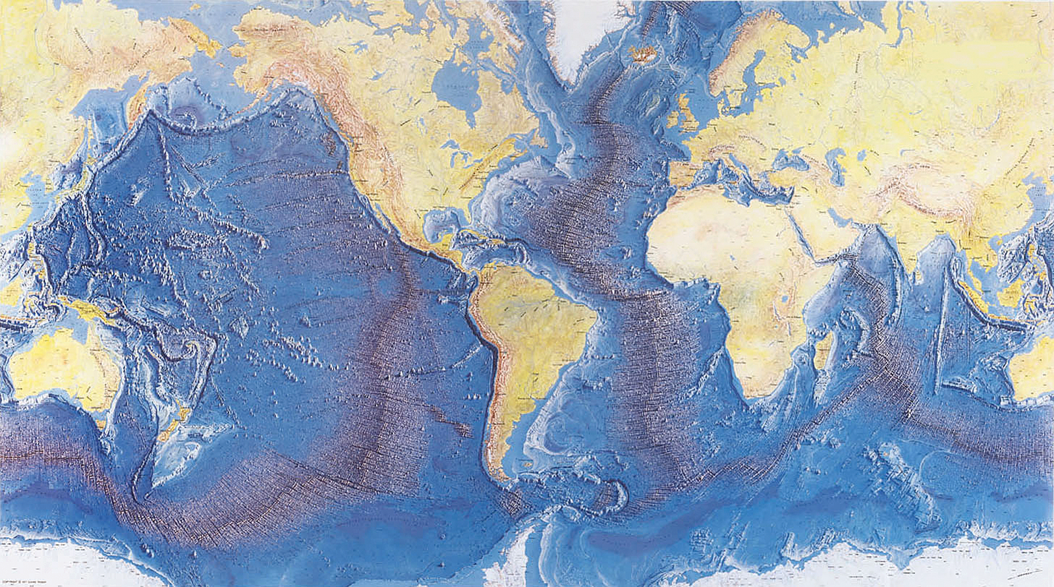
Now let’s look at the topography of the Earth
Find your Earth maps.
The first shaded relief map shows the topography of the ocean floor very well.
Notes:
About 50 minutes into the lesson.

Slide 13
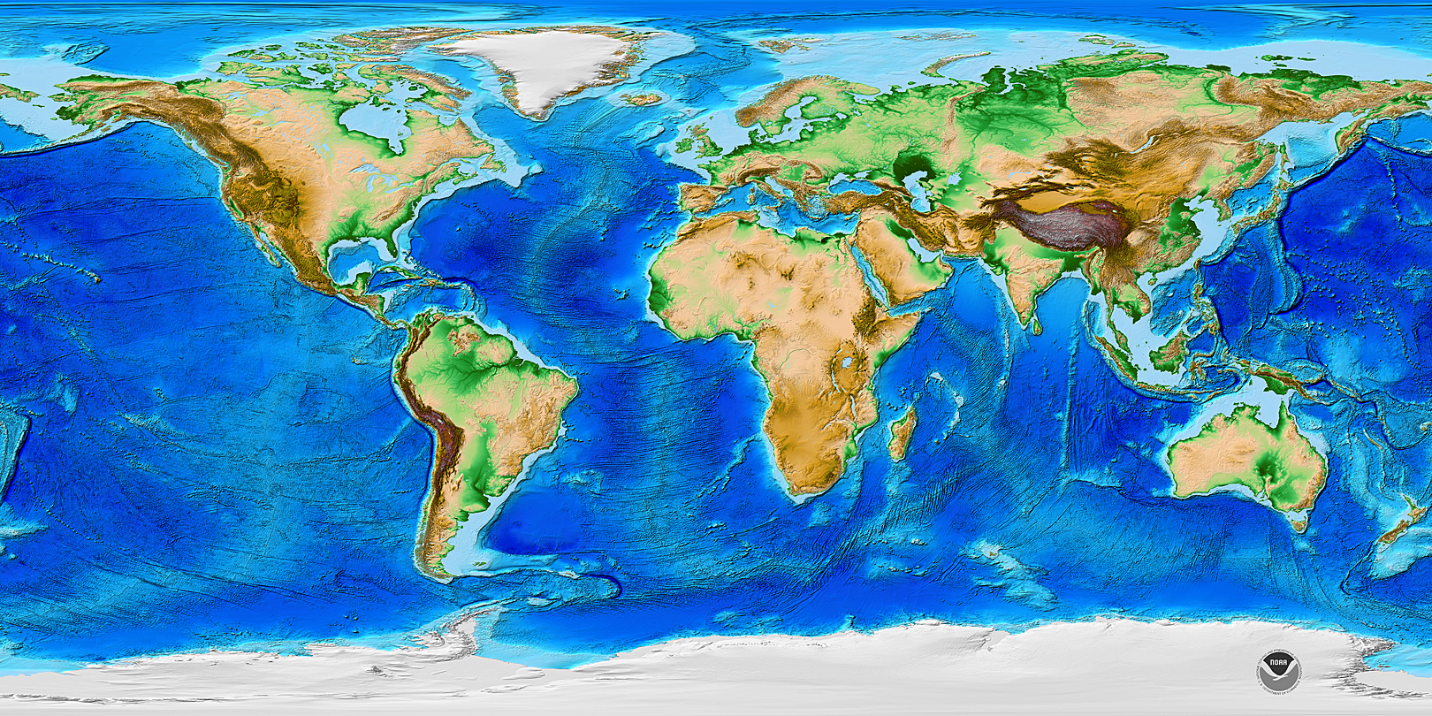
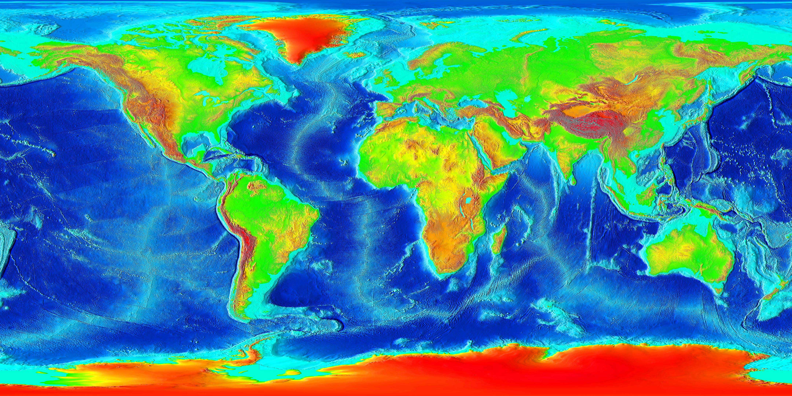
This map shows the continents really well and uses colors you’re used to seeing on maps.
This map uses the same false colors you saw on the Moon and Mars maps.

Slide 14
Now compare the Earth to Mars and the Moon
How is the Earth like these other planetary bodies?
How is the Earth different from the Moon and Mars?
Talk with your partner, then write down your thoughts in your chart
Notes:
Talking with partners – about 3 minutes.
Writing down thoughts – about 3 minutes.
Group discussion – about 4 minutes.
Most important ideas:
On the Earth, the higher areas are organized into continents, which are very different from the low places - the ocean floor.
On Mars and the Moon, the higher areas are less organized. On Mars, the low places are most of the northern part of the planet; on the Moon the low places are mostly two areas.
The low places on the Earth are well-organized with long mountain chains in them.

Slide 15
Let’s look at the Earth more closely
At your table, one set of partners will work on the continents, and the other set of partners will work on the ocean floor. Decide who will do what.
Read the questions on the chart. Talk with your partner, and answer the questions for either the continents (top of the chart) or the oceans (bottom of the chart).
Share your answers with the other partnership. Make sure they understand the patterns you described.
Notes:
60 minutes in

Slide 16
Now let’s combine our observations
We’ll make one big sharesheet for the whole class that describes the topographic patterns of the Earth.

Slide 17
Now let’s look new maps
Find your maps of volcanoes on Earth and volcanoes on Mars (both have little red triangles).
Do you see any patterns (or a lack of pattern) in the location of volcanoes on each planet? Are they similar or different?
Talk with your partner, and record your thinking on the chart.
Notes:
Remind the students that the ABSENCE of an obvious pattern is itself a pattern.
You can do a whole class debrief now, or wait until after you do the earthquake comparison.

Slide 18
Now let’s think about earthquakes
Find your maps of earthquakes on the Earth and on the Moon
Do you see any patterns (or a lack of pattern) in the location of volcanoes on each planet? Are they similar or different?
Talk with your partner, and record your thinking on the chart.

Slide 19
Time to reflect
Paper at the back of your binder
Make a little chart:
I notice…
I wonder…
Notes:
5 minutes of writing.
Point out to the students that they can also write that they didn’t know anything about a subject.

Slide 20
Let’s combine our thinking
Now let’s make a class share sheet of what we observed about volcanoes and earthquakes.

Slide 21
Let’s look for patterns
Find the handout called Age Patterns on the Earth
Find your maps:
  Age of Rocks on the Continents
  Age of the Ocean Floor
Notes:
Reviewing the maps may take about 3-5 minutes.

Slide 22
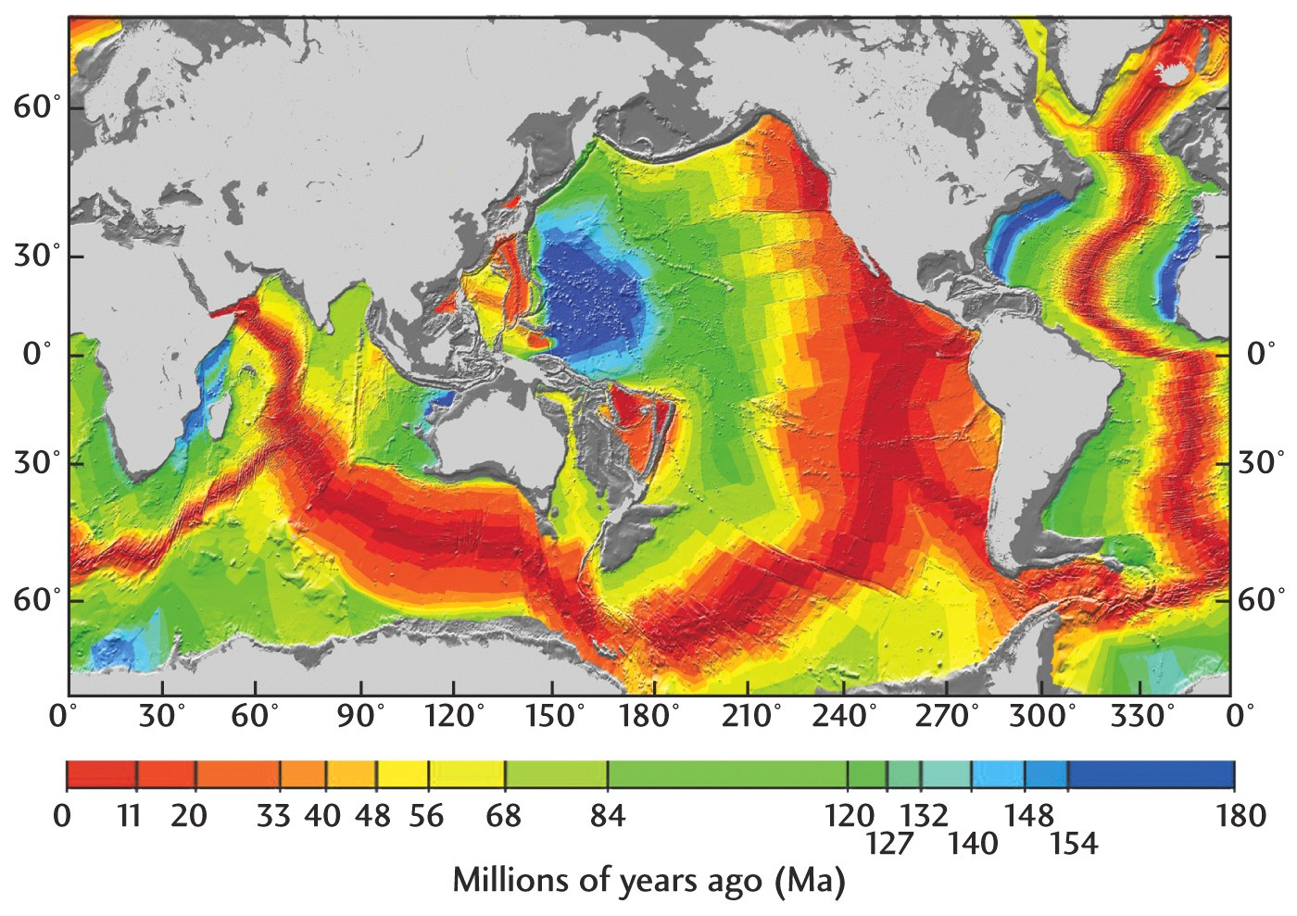
http://bc.outcrop.org/images/tectonics/press4e/figure-02-14.jpg
What do the different colors on this map mean?
Notes:
If I’m looking for the youngest rocks, what color should I look for?
If I’m looking for the oldest rocks, what color should I look for? How old are they?
If I’m looking at green rocks, how old are they?

Slide 23
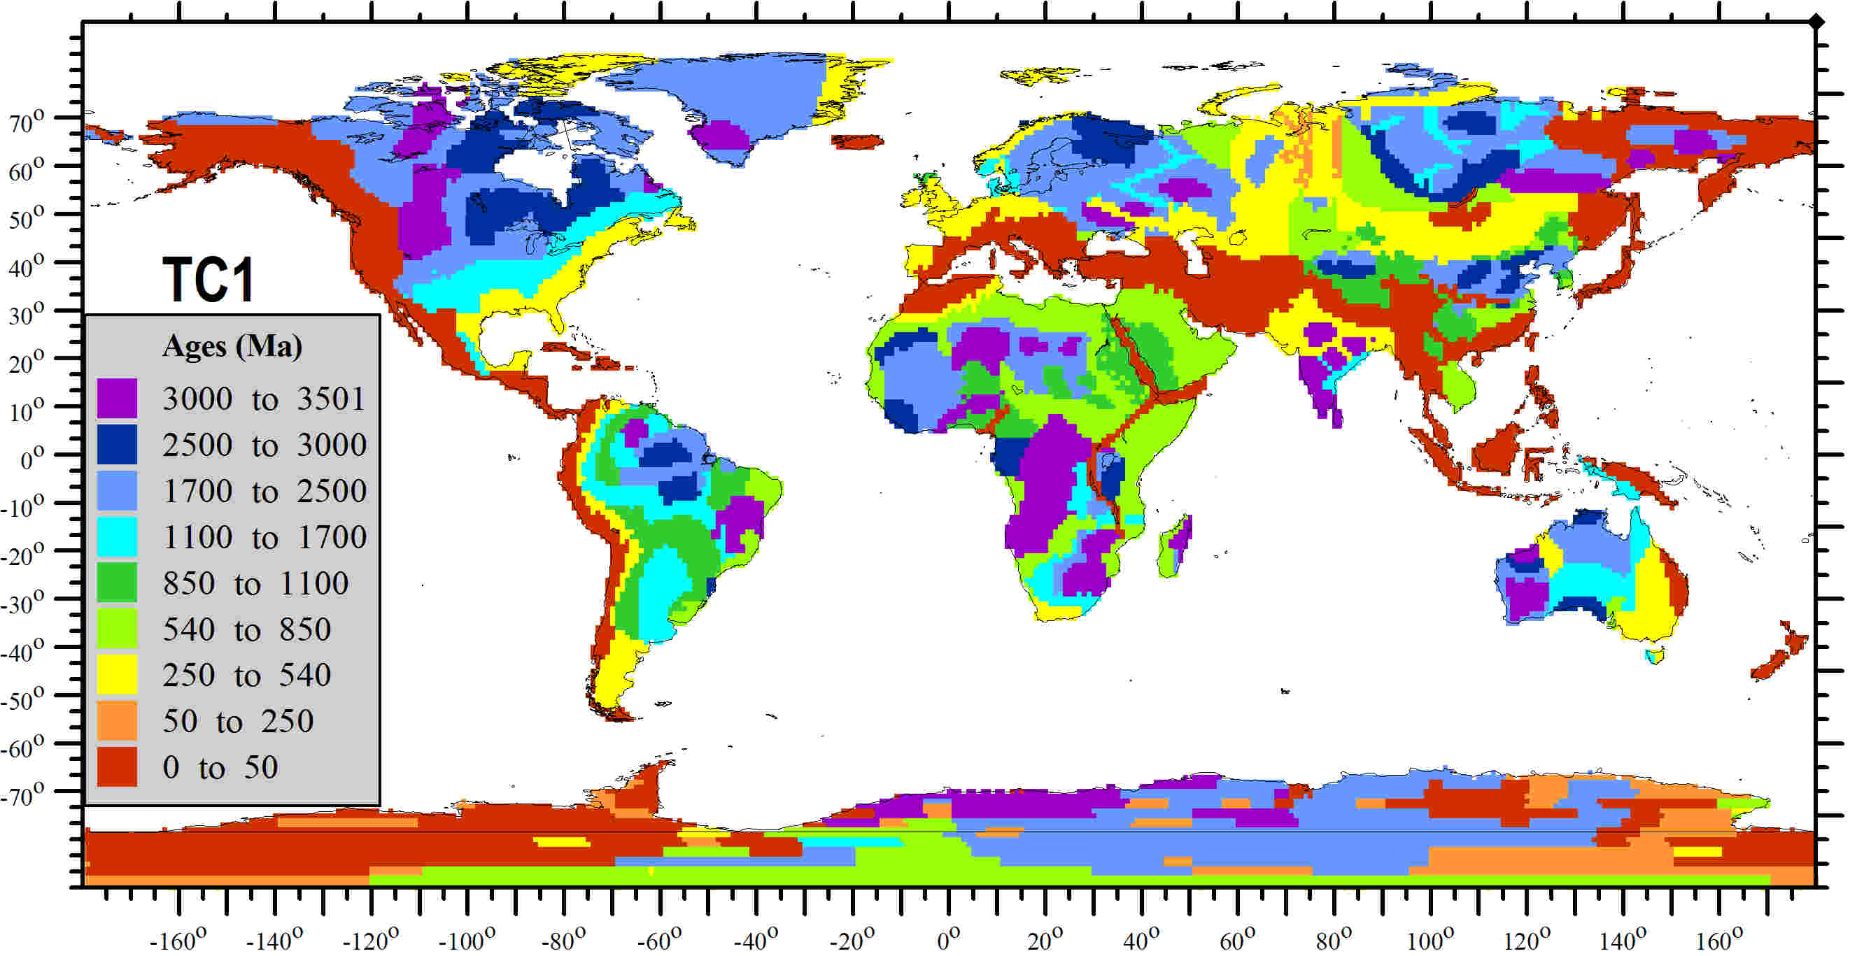
http://www.lithosphere.info/TC1-2006/TC1_Fig2-ages-062006.jpg
What do the different colors on this map mean?
Notes:
Go through the legend to make sure students understand it.
These ages are in millions of years. 1000 million = 1 American billion
If I want to find the old rocks, what color should I look for?
If I want to find young rocks, what color should I look for?
What age are the green rocks on this map?
Do the two maps use the same color for the same age of rocks? (no)

Slide 24
Time to think about the patterns
Talk to your partner about the questions in the graphic organizer. Fill in the chart.
Notes:
10-15 minutes to work on chart

Slide 25
Share what you figured out with another partner
In a minute you will find an eye contact partner.
You will do a Structured Think Pair Share with that partner.
Make this chart in your binder:
Think
Pair
Share
Notes:
20-25 minutes in. 10 minutes to do STPS.

Slide 26
Structured Think Pair Share
First you will write what you think about the question in the Think box.
Then you and your partner will each describe your ideas. Write your partner’s ideas in the Pair box.
Finally you and your partner will decide on a common answer to the question. Write that in the Share box.

Slide 27
Question:
How are the age patterns on the continents different from the age patterns on the ocean floors?
Notes:
Have the students do the Structured Think Pair Share protocol – 2-5 minutes to Think and write, 2-3 minutes to exchange ideas and write them down, and 2-3 minutes to compose their Share common answer to the question.

Slide 28
Time to share
Let’s make a class share sheet about age patterns on the Earth.

