Slide 1
Climate and Interaction of Earth Systems
Judi Kusnick
kusnickje@csus.edu

Slide 2
Elements in this lesson sequence
The science is embedded in a scenario that answers provides the big “So What”
The science involves building and using models
Literacy strategies are interwoven into the lesson
It’s a sequence, so we may not do all of it today, but you have all of it.

Slide 3
Pragmatics
You are receiving a limited number of handouts.
A lot of the sequence is recorded in the PowerPoint rather than in handouts. The PowerPoint is on my Website
We are using color handouts. I did not print them for each of you, but they are available at my Website.
Everything is also in the SuperSIRC Dropbox.

Slide 4
The scenario
A group of investors want to build the next great American theme park. They are considering some sites near the coast, and some inland sites. They are concerned about:
What being near the ocean will do to the weather at the theme park
If changing climate will cause problems for the theme park.

Slide 5
Your task
As earth science consultants, you have been hired to:
Find out how being near or far from the ocean could affect the climate of the four proposed theme park sites.
Find out how climate change might affect each of the sites.
Make a recommendation of where the investors should put their theme park, based on your investigation.

Slide 6
First we need a model
To predict the influence of the ocean on our possible theme park sites, we need a model that explains how the ocean influences climate. We’ll do that in pieces.

Slide 7
First piece of data
Examine the map of surface temperatures for North America on May 6, 2016.
What patterns do we see in general? Where is it hotter? Where is it cooler?
Now let’s look for patterns that could be related to proximity to the ocean.
Let’s note these patterns on a chart.

Slide 8
Second set of data
We only looked at one day on one continent. Let’s see if our patterns hold over time, and on different continents.
Look at the temperature data from the cities in the U.S.
Do we see a pattern of difference between coastal and inland cities that holds over the entire year?

Slide 9
Let’s write a Model Statement
A scientific model is a set of ideas that we can use to predict and explain phenomena in the natural and constructed world. A model is valuable when:
It is well-supported by evidence.
It is useful.
Scientists constantly test and revise models in the face of new evidence.
We will express our model as a set of Model Statements. Models can be represented in words, in pictures or mathematically.

Slide 10
Looking deeper
Now let’s compare cities on different continents.
Take all your temperature data. Do you see any similar patterns in temperature among any of the cities?

Slide 11
Where are these cities?
Let’s look at a map and see if that helps us spot any additional patterns.
You have a world map in your data.

Slide 12
Building a more complex model
So far we figured out that coastal cities have a different climate than inland cities, but there seem to be two different patterns in the coastal cities in our data set.
First let’s add a model statement about this new pattern. Does which coast you are on make a difference?
Now let’s see if we can explain why this pattern occurs.

Slide 13
Third data set
Find these images:
North America sea surface temperatures
World sea surface temperatures
Do you see any patterns in the two images?
Let’s record these patterns in a chart.

Slide 14
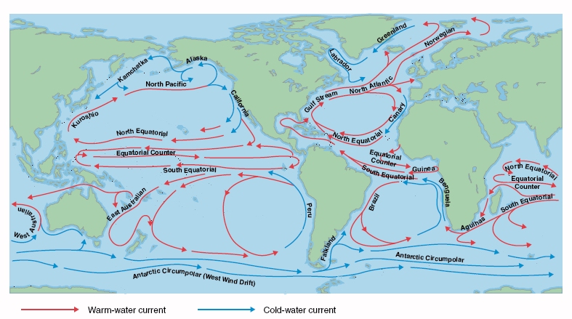
Ocean Currents

Slide 15
Now let’s link this pattern to our temperature pattern
Compare the temperature data from the different cities with the sea surface temperature data.
Do you see any connections between the ocean current temperature patterns and the city temperature data?

Slide 16
Time to extend our model
Let’s write some more Model Statements.

Slide 17
Let’s stop and apply the model so far.
Looking back at the proposed sites for the theme park, can we explain how the ocean might impact the climate at each one?
Let’s construct a set of arguments:
Claim – what do you claim about the ocean/climate link for each city?
Evidence – what evidence do you have to back up your claim?
Reasoning – make the link between claim and evidence

Slide 18
On to climate change
Will climate change affect inland areas and coastal areas equally?
Constructing the model for this is beyond our expertise. Fortunately other more experienced earth scientists with a LOT of data have constructed mathematical models, which are represented in two sets of maps for you.

Slide 19
Temperature and precipitation
Find your temperature model map. What does it predict about temperature increase for each of the four cities?
Find your precipitation map. What does it predict for each of the four cities?
Construct an argument (claim, evidence, reasoning) about how climate change will impact each of the cities.

Slide 20
Understanding a little more about the climate models
Included in your packet is a brief article about how changing ocean temperatures could affect the Gulf Stream.

Slide 21
Formal writing piece
Time for your team to write your report. Remember, it needs to address these three things:
How being near or far from the ocean could affect the climate of the four proposed theme park sites.
How climate change might affect each of the sites.
A recommendation of where the investors should put their theme park, based on your investigation.

Slide 22
Questions & Comments

