Slide 1


Chapter
4
Discrete Probability Distributions

Slide 2
Chapter Outline
4.1 Probability Distributions
4.2 Binomial Distributions
4.3 More Discrete Probability Distributions
.

Slide 3
Section 4.2
Binomial Distributions
.

Slide 4
Section 4.2 Objectives
How to determine whether a probability experiment is a binomial experiment
How to find binomial probabilities using the binomial probability formula
How to find binomial probabilities using technology, formulas, and a binomial probability table
How to construct and graph a binomial distribution
How to find the mean, variance, and standard deviation of a binomial probability distribution
.

Slide 5
Binomial Experiments
The experiment is repeated for a fixed number of trials, where each trial is independent of other trials.
There are only two possible outcomes of interest for each trial. The outcomes can be classified as a success (S) or as a failure (F).
The probability of a success, P(S), is the same for each trial.
The random variable x counts the number of successful trials.
.

Slide 6
Notation for Binomial Experiments
Symbol | Description
n | The number of times a trial is repeated
p | The probability of success in a single trial
q | The probability of failure in a single trial (q = 1 – p)
x | The random variable represents a count of the number of successes in n trials: x = 0, 1, 2, 3, … , n.
.

Slide 7
Example: Identifying and Understanding Binomial Experiments
Decide whether each experiment is a binomial experiment. If it is, specify the values of n, p, and q, and list the possible values of the random variable x. If it is not, explain why.
A certain surgical procedure has an 85% chance of success. A doctor performs the procedure on eight patients. The random variable represents the number of successful surgeries.
.

Slide 8
Solution: Identifying and Understanding Binomial Experiments
Binomial Experiment
Each surgery represents a trial. There are eight surgeries, and each one is independent of the others.
There are only two possible outcomes of interest for each surgery: a success (S) or a failure (F).
The probability of a success, P(S), is 0.85 for each surgery.
The random variable x counts the number of successful surgeries.
.

Slide 9
Solution: Identifying and Understanding Binomial Experiments
Binomial Experiment
n = 8 (number of trials)
p = 0.85 (probability of success)
q = 1 – p = 1 – 0.85 = 0.15 (probability of failure)
x = 0, 1, 2, 3, 4, 5, 6, 7, 8 (number of successful surgeries)
.

Slide 10
Example: Identifying and Understanding Binomial Experiments
Decide whether each experiment is a binomial experiment. If it is, specify the values of n, p, and q, and list the possible values of the random variable x. If it is not, explain why.
A jar contains five red marbles, nine blue marbles, and six green marbles. You randomly select three marbles from the jar, without replacement. The random variable represents the number of red marbles.
.

Slide 11
Solution: Identifying and Understanding Binomial Experiments
Not a Binomial Experiment
The probability of selecting a red marble on the first trial is 5/20.
Because the marble is not replaced, the probability of success (red) for subsequent trials is no longer 5/20.
The trials are not independent and the probability of a success is not the same for each trial.
.

Slide 12
Binomial Probability Formula
Binomial Probability Formula
The probability of exactly x successes in n trials is
n = number of trials
p = probability of success
q = 1 – p probability of failure
x = number of successes in n trials
Note: number of failures is n − x
.

Slide 13
Example: Finding a Binomial Probability
Rotator cuff surgery has a 90% chance of success. The surgery is performed on three patients. Find the probability of the surgery being successful on exactly two patients. (Source: The Orthopedic Center of St. Louis)
.

Slide 14
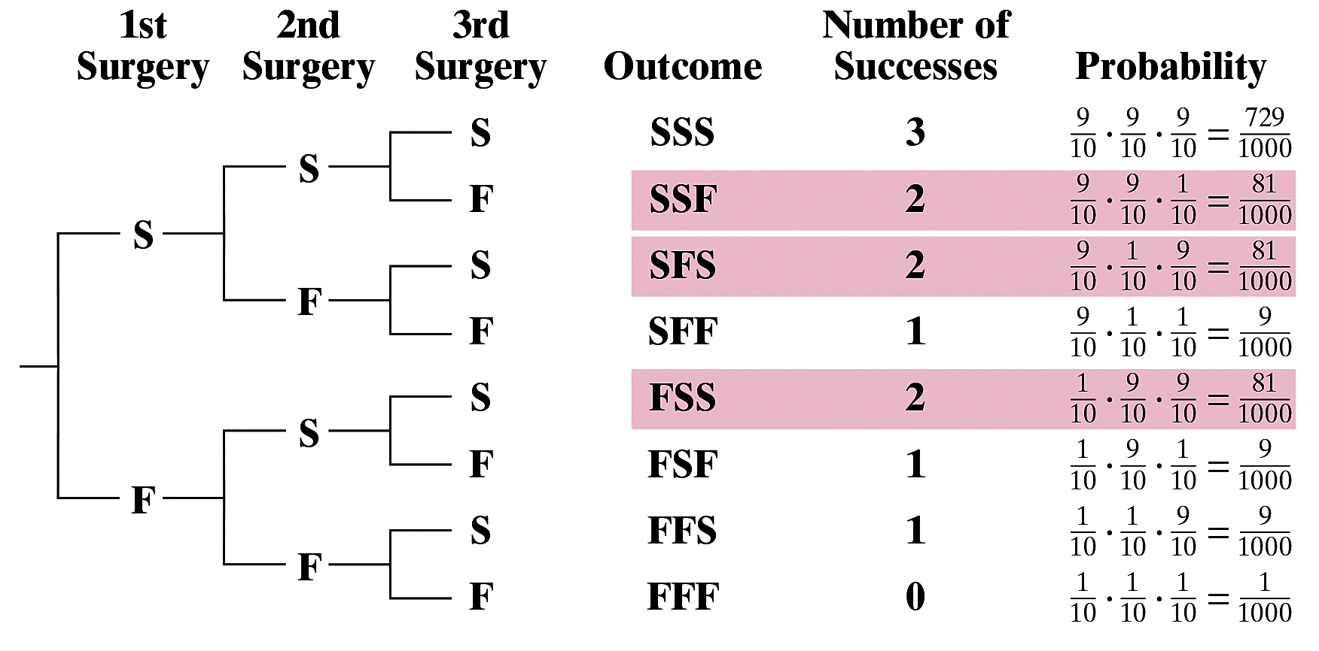
Solution: Finding a Binomial Probability
Method 1: Draw a tree diagram and use the Multiplication Rule.
.

Slide 15
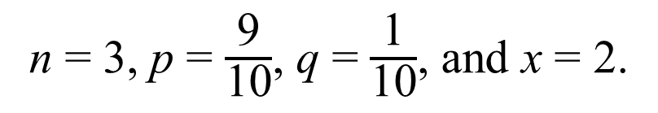
Solution: Finding a Binomial Probability
Method 2: Use the binomial probability formula.
n = 3, p = $\frac{\text{9}}{\text{10}}$, q = $\frac{\text{1}}{\text{10}}$, and x = 2.
.

Slide 16
Binomial Probability Distribution
Binomial Probability Distribution
List the possible values of x with the corresponding probability of each.
Example: Binomial probability distribution for Microfacture knee surgery: n = 3, p =
  Use binomial probability formula to find probabilities.
x | 0 | 1 | 2 | 3
P(x) | 0.016 | 0.141 | 0.422 | 0.422
.

Slide 17
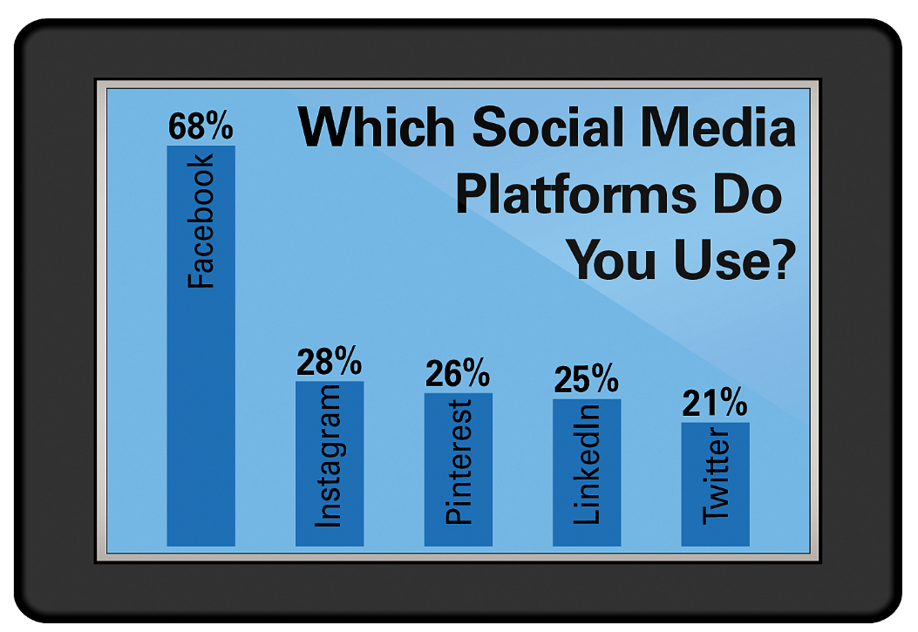
Example: Constructing a Binomial Distribution
In a survey, U.S. adults were asked to identify which social media platforms they use. The results are shown in the figure. Six adults
who participated in the
survey are randomly
selected and asked
whether they use the
social media platform
Facebook. Construct a
binomial probability distribution for the number of adults who respond yes. (Source: Pew Research)
.

Slide 18
Solution: Constructing a Binomial Distribution
p = 0.68 and q = 0.32
n = 6, possible values for x are 0, 1, 2, 3, 4, 5 and 6
.

Slide 19
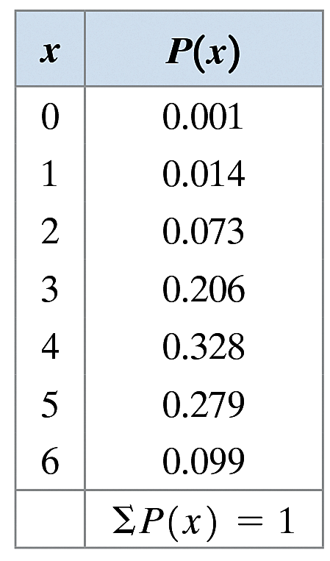
Solution: Constructing a Binomial Distribution
Notice in the table that all the probabilities are between 0 and 1 and that the sum of the probabilities is 1.
.

Slide 20
Example: Finding a Binomial Probabilities Using Technology
A survey found that 26% of U.S. adults believe there is no difference between secured and unsecured wireless networks. (A secured network uses barriers, such as firewalls and passwords, to protect information; an unsecured network does not.) You randomly select 100 adults. What is the probability that exactly 35 adults believe there is no difference between secured and unsecured networks? Use technology to find the probability. (Source: University of Phoenix)
.

Slide 21
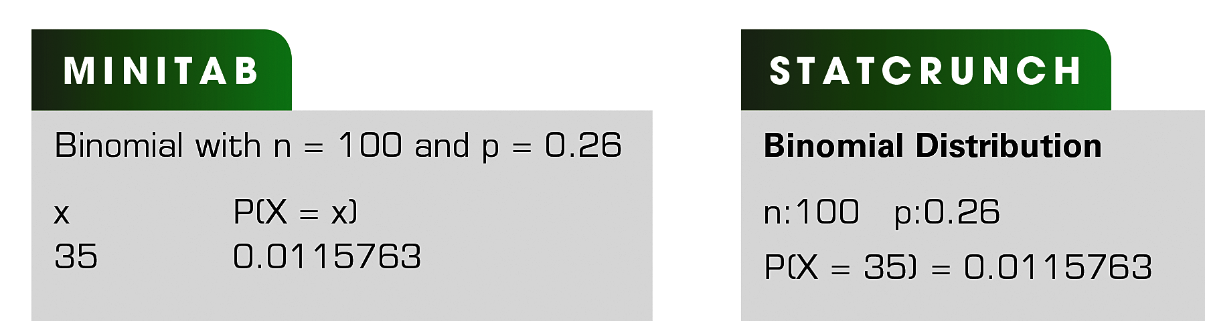
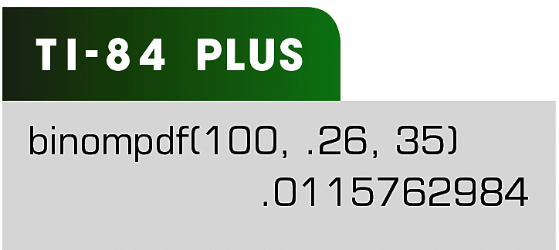
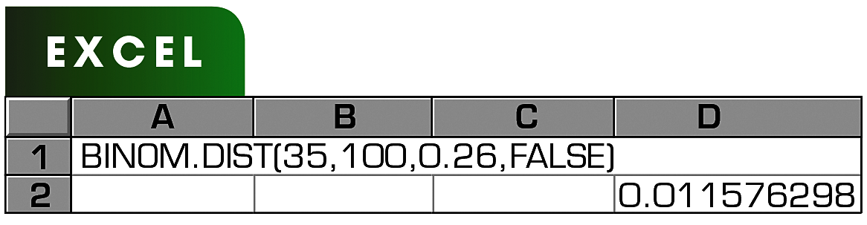
Solution: Finding a Binomial Probabilities Using Technology
Solution
Minitab, Excel, StatCrunch, and the TI-84 Plus each have features that allow you to find binomial probabilities. Try using these technologies. You should obtain results similar to these displays.
.

Slide 22
Solution: Finding a Binomial Probabilities Using Technology
Solution
From these displays, you can see that the probability that exactly 35 adults believe there is no difference between secured and unsecured networks is about 0.012. Because 0.012 is less than 0.05, this can be considered an unusual event.
.

Slide 23
Example: Finding Binomial Probabilities Using Formulas
A survey found that 17% of U.S. adults say that Google News is a major source of news for them. You randomly select four adults and ask them whether Google News is a major source of news for them. Find the probability that (1) exactly two of them respond yes, (2) at least two of them respond yes, and (3) fewer than two of them respond yes. (Source: Ipsos Public Affairs)
.

Slide 24
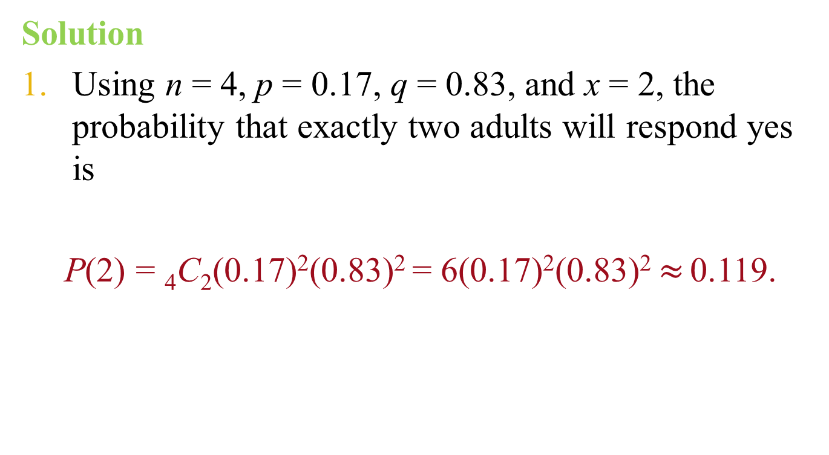
Solution: Finding Binomial Probabilities Using Formulas
Solution
Using n = 4, p = 0.17, q = 0.83, and x = 2, the probability that exactly two adults will respond yes is
P(2) = ₄C₂(0.17)²(0.83)² = 6(0.17)²(0.83)² $≈$0.119.
.

Slide 25
Solution: Finding Binomial Probabilities Using Formulas
Solution
To find the probability that at least two adults will respond yes, find the sum of P(2), P(3), and P(4). Begin by using the binomial probability formula to write an expression for each probability.
    P(2) = ₄C₂(0.17)²(0.83)² = 6(0.17)²(0.83)²
    P(3) = ₄C₃(0.17)³(0.83)¹ = 4(0.17)³(0.83)¹
    P(4) = ₄C₄(0.17)⁴(0.83)⁰ = 1(0.17)⁴(0.83)⁰
.

Slide 26
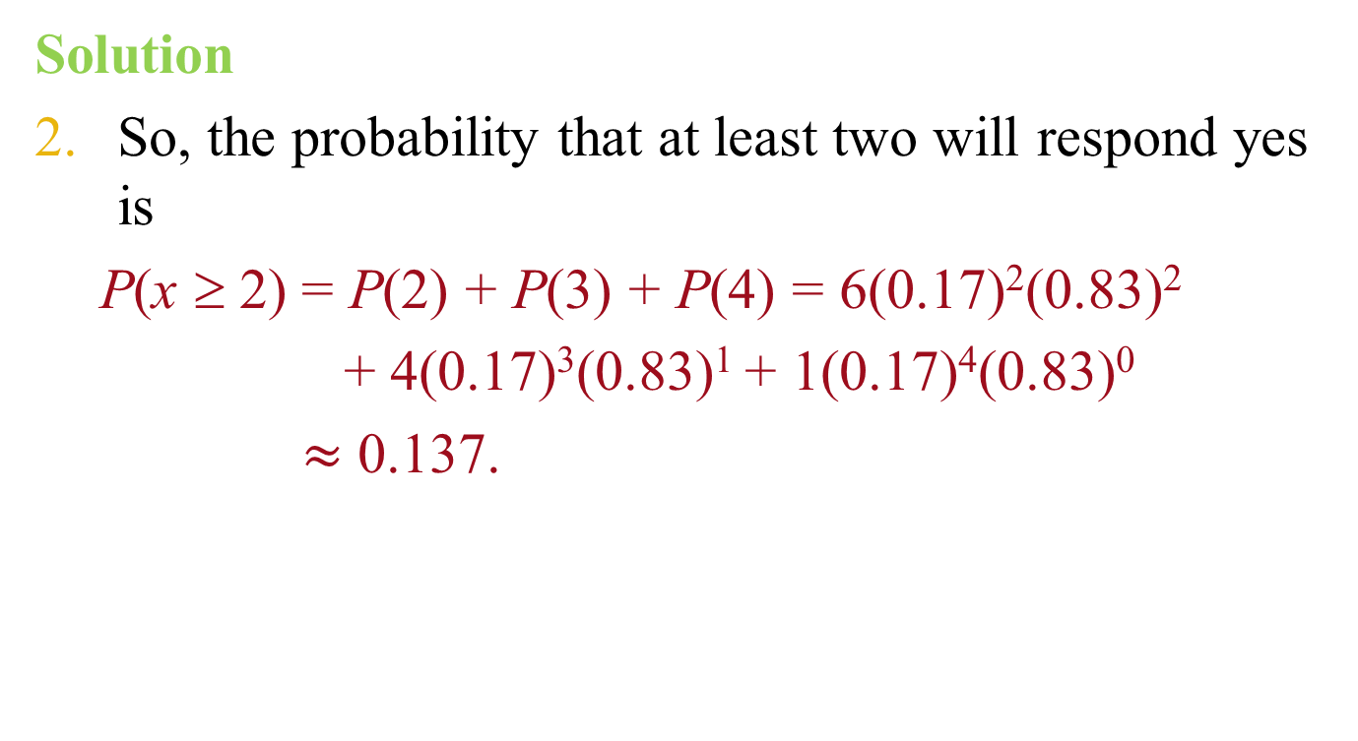
Solution: Finding Binomial Probabilities Using Formulas
Solution
So, the probability that at least two will respond yes is
  P(x ≥ 2) = P(2) + P(3) + P(4) = 6(0.17)²(0.83)²
  + 4(0.17)³(0.83)¹ + 1(0.17)⁴(0.83)⁰
  $≈$ 0.137.
.

Slide 27
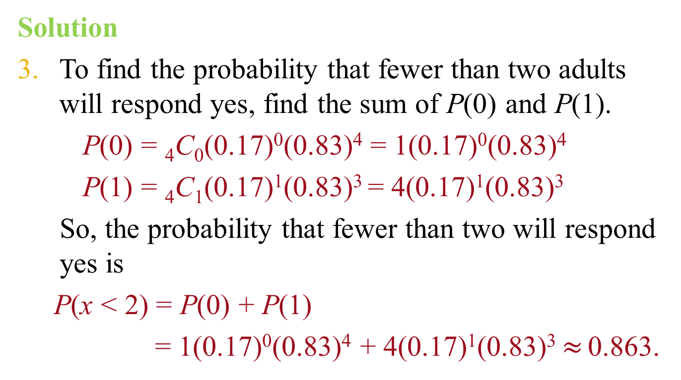
Solution: Finding Binomial Probabilities Using Formulas
Solution
To find the probability that fewer than two adults will respond yes, find the sum of P(0) and P(1).
    P(0) = ₄C₀(0.17)⁰(0.83)⁴ = 1(0.17)⁰(0.83)⁴
    P(1) = ₄C₁(0.17)¹(0.83)³ = 4(0.17)¹(0.83)³
So, the probability that fewer than two will respond yes is
P(x < 2) = P(0) + P(1)
= 1(0.17)⁰(0.83)⁴ + 4(0.17)¹(0.83)³ $≈$0.863.
.

Slide 28
Example: Finding a Binomial Probability Using a Table
About 10% of workers (ages 16 years and older) in the United States commute to their jobs by carpooling. You randomly select eight workers. What is the probability that exactly four of them carpool to work? Use a table to find the probability. (Source: American Community Survey)
Solution:
Binomial with n = 8, p = 0.1, x = 4
.

Slide 29
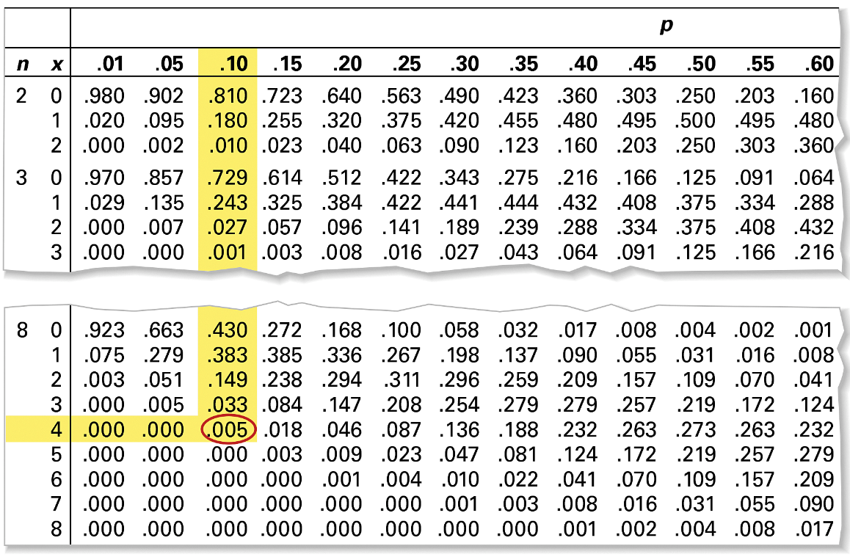
Solution: Finding Binomial Probabilities Using a Table
A portion of Table 2 is shown
According to the table, the probability is 0.005.
.

Slide 30
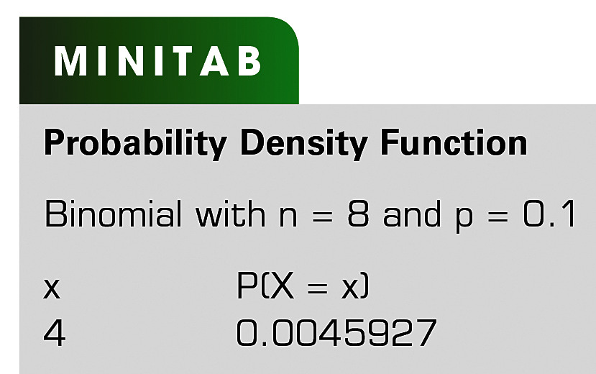
Solution: Finding Binomial Probabilities Using a Table
You can check the result using technology.
So, the probability that exactly four of the eight workers carpool to work is 0.005. Because 0.005 is less than 0.05, this can be considered an unusual event.
.

Slide 31
Example: Graphing a Binomial Distribution
Sixty-two percent of cancer survivors are ages 65 years or older. You randomly select six cancer survivors and ask them whether they are 65 years of age or older. Construct a probability distribution for the random variable x. Then graph the distribution. (Source: National Cancer Institute)
Solution:
n = 6, p = 0.62, q = 0.38
Find the probability for each value of x
.

Slide 32
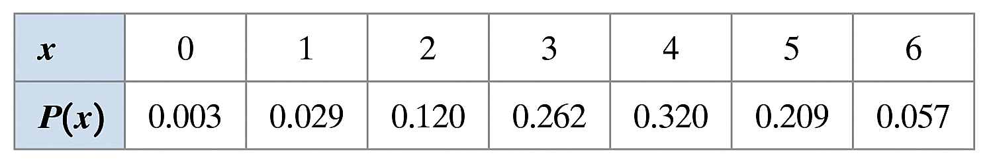
Solution: Graphing a Binomial Distribution
Notice in the table that all the probabilities are between 0 and 1 and that the sum of the probabilities is 1.
.

Slide 33
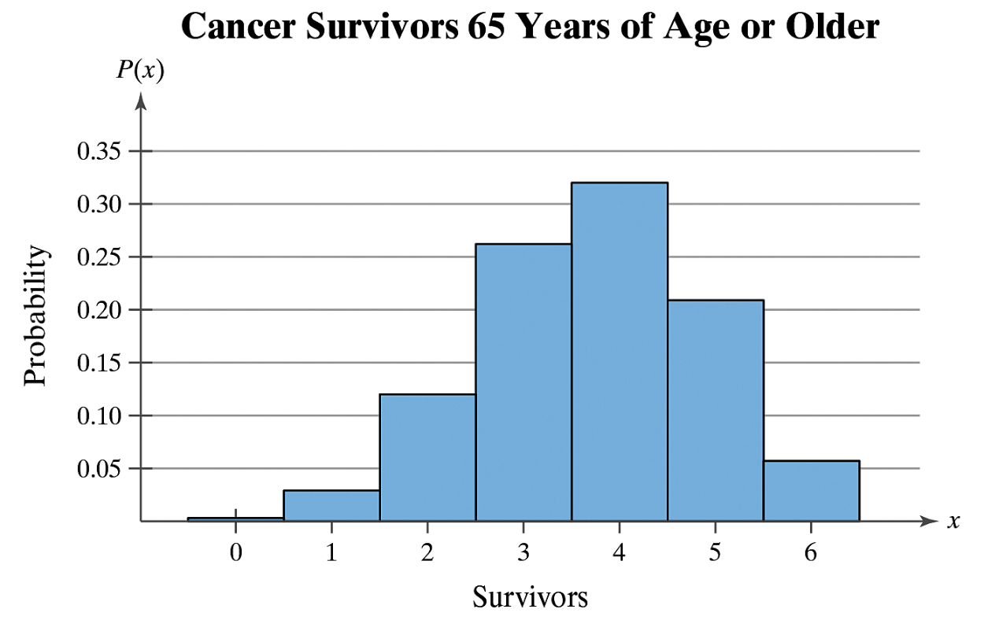
Solution: Graphing a Binomial Distribution
Histogram:
From the histogram, you can see that it would be unusual for none or only one of the survivors to be age 65 years or older because both probabilities are less than 0.05.
.

Slide 34
Mean, Variance, and Standard Deviation
Mean: μ = np
Variance: σ² = npq
Standard Deviation:
.

Slide 35
Example: Mean, Variance, and Standard Deviation
In Pittsburgh, Pennsylvania, about 56% of the days in a year are cloudy. Find the mean, variance, and standard deviation for the number of cloudy days during the month of June. Interpret the results and determine any unusual values. (Source: National Climatic Data Center)
Solution: n = 30, p = 0.56, q = 0.44
Mean: μ = np = 30∙0.56 = 16.8
Variance: σ² = npq = 30∙0.56∙0.44 ≈ 7.4
Standard Deviation:
.

Slide 36
Solution: Mean, Variance, and Standard Deviation
μ = 16.8 σ² ≈ 7.4 σ ≈ 2.7
On average, there are 16.8 cloudy days during the month of June.
The standard deviation is about 2.7 days.
Values that are more than two standard deviations from the mean are considered unusual.
  16.8 – 2(2.7) =11.4; A June with 11 cloudy days or less would be unusual.
  16.8 + 2(2.7) = 22.2; A June with 23 cloudy days or more would also be unusual.
.

