Slide 1
Dada rejects rational thought Dada arrived in almost all major Western cities between 1916 and 1922/3 Five main sites: Zurich, Paris, New York, Berlin, Cologne
“Revolted by the butchery of the 1914 World War, we in Zurich devoted ourselves to the arts.”
“While the guns rumbled in the distance, we sang, painted, made collages and wrote poems with all our might. We were seeking an art based on fundamentals, to cure the madness of the age, and a new order of things that would restore the balance between heaven and hell.”
- Jean (Hans) Arp

Slide 2
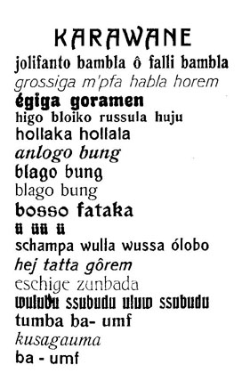
Hugo Ball (German, 1886 -1927) performing his Dada phonetic poem "karawane" on stage June 23, 1916 at the Cabaret Voltaire wearing “the bishop’s dress” that Marcel Janco created. "Art for us is an occasion for social criticism, and for a real understanding of the age we lived in."

Slide 3
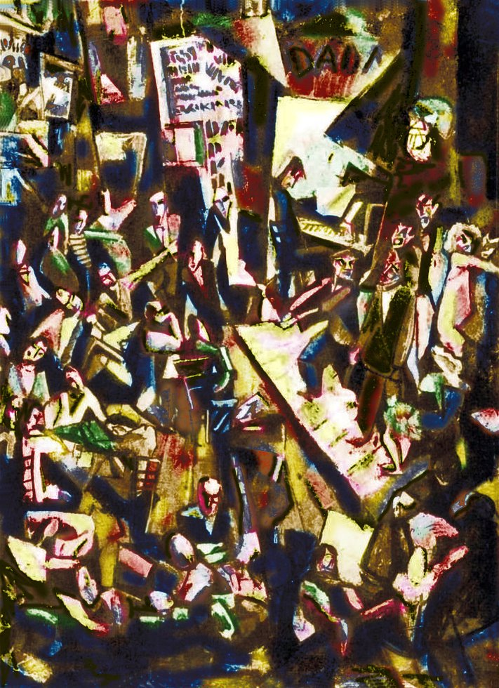
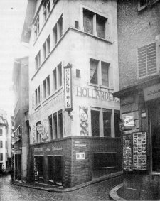
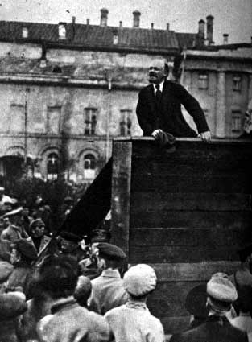
Marcel Janco (Romanian, 1895-1984), Cabaret Voltaire, oil on canvas (lost), 1916 (right) Photo of Cabaret Voltaire, Zurich, Switzerland "We had lost our confidence in our culture... we would begin again after the tabula rasa" - Marcel Janco
Lenin in 1917 (after Zurich)
in St. Petersburg

Slide 4
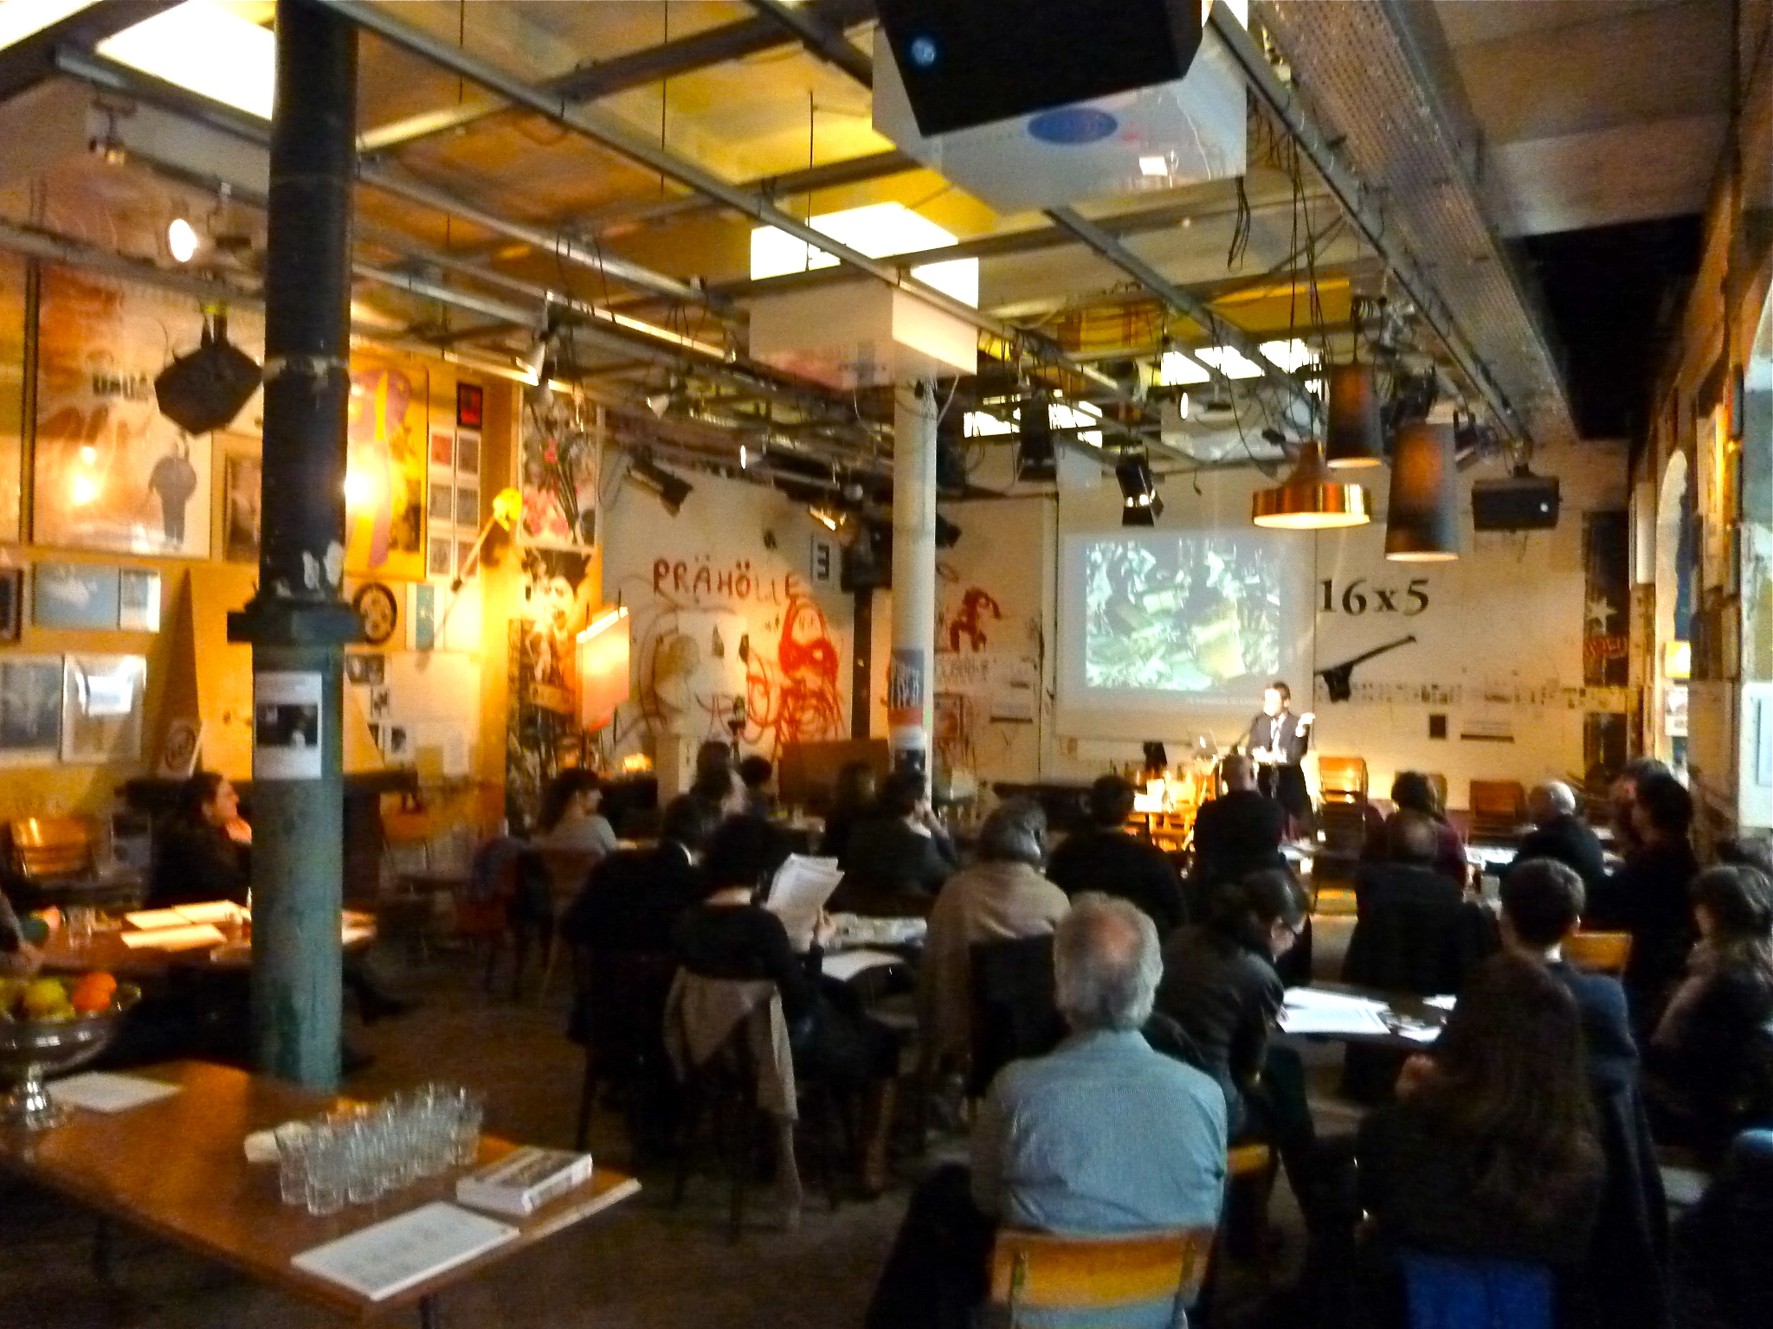
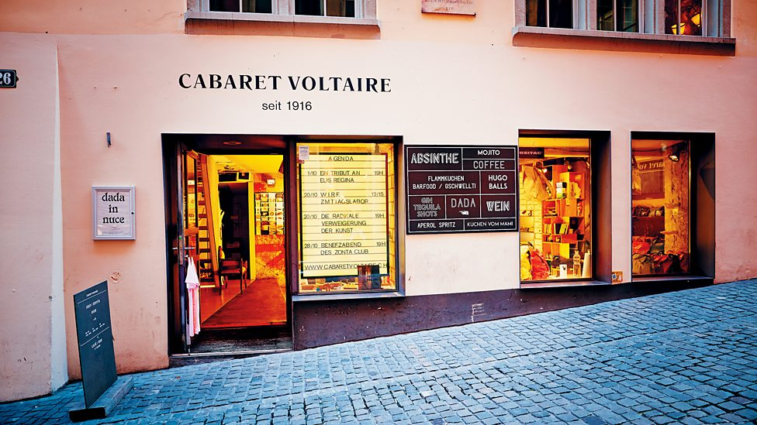
Cabaret Voltaire today

Slide 5
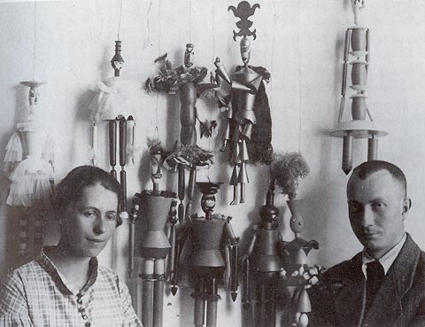
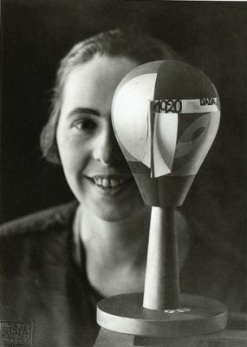
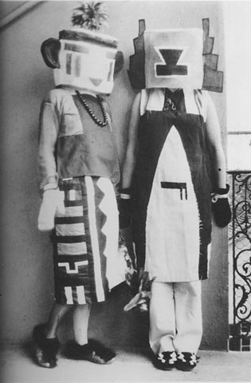
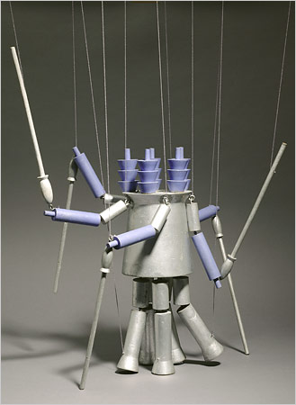
(Center above) Jean (Hans) Arp (Alsatian,1886-1966) and Sophie Täuber (Swiss, 1889-1943), photo of the artists with puppets by Täuber, 1918 (right) Sophie Täuber and her sister in Kachina (Hopi) Dada costumes for an interpretative dance based on a Hugo Ball poem, 1916
Täuber with Dada Head,1919
Täuber, puppet for
King’s Guards, 1918

Slide 6
Jean (Hans) Arp, Collage Arranged According to the Laws of Chance, 1916-17, torn and pasted paper, 19 x 13” “Concrete art” (reading in Chipp) "Art is a fruit that grows in man, like a fruit on a plant, or a child in its mother's womb." - Jean Arp

Slide 7
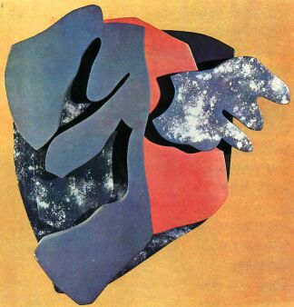
Jean Arp, Portrait of Tristan Tzara, 1916, oil on wood assemblage “Destroy the hoaxes of reason and discover an unreasoned order.” - Jean Arp

Slide 8
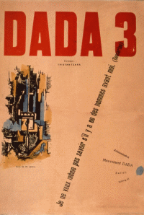
Marcel Janco, Cover of Dada No. 3, December 1918,

Slide 9
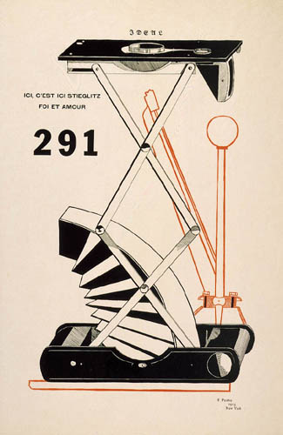
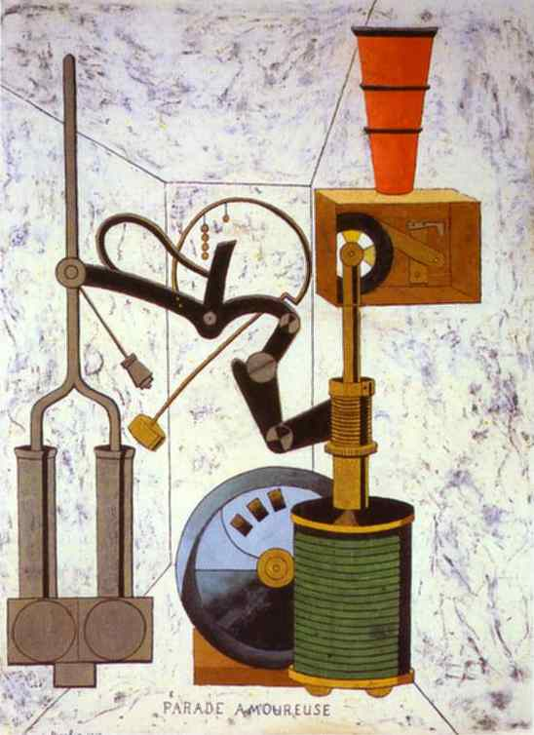
Francis Picabia (French, Cuban, 1879-1953) International Dada, “Mechanomorphic” images: (left) Ici, c'est ici Stieglitz / Foi et Amour [Here, This is Stieglitz / Faith and Love], Cover of 291, Alfred Stieglitz’s New York based magazine, 1915 (right) Love Parade/Parade Amoureuse, 1917, oil/cdbd, 37 x 28 inches.

Slide 10
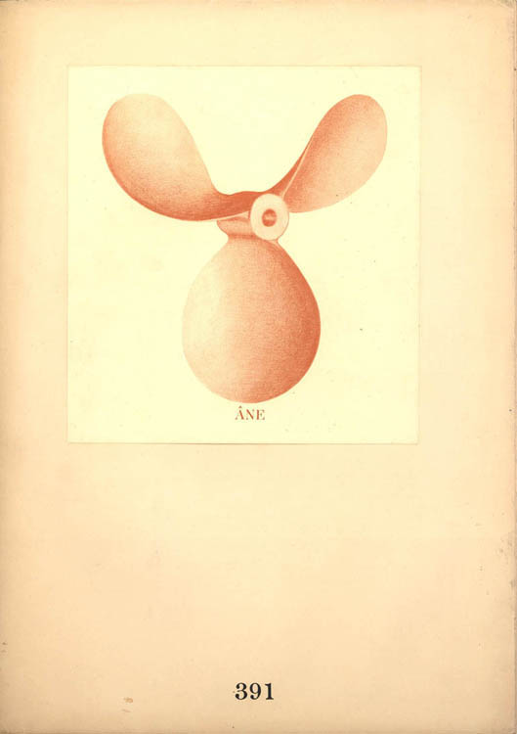
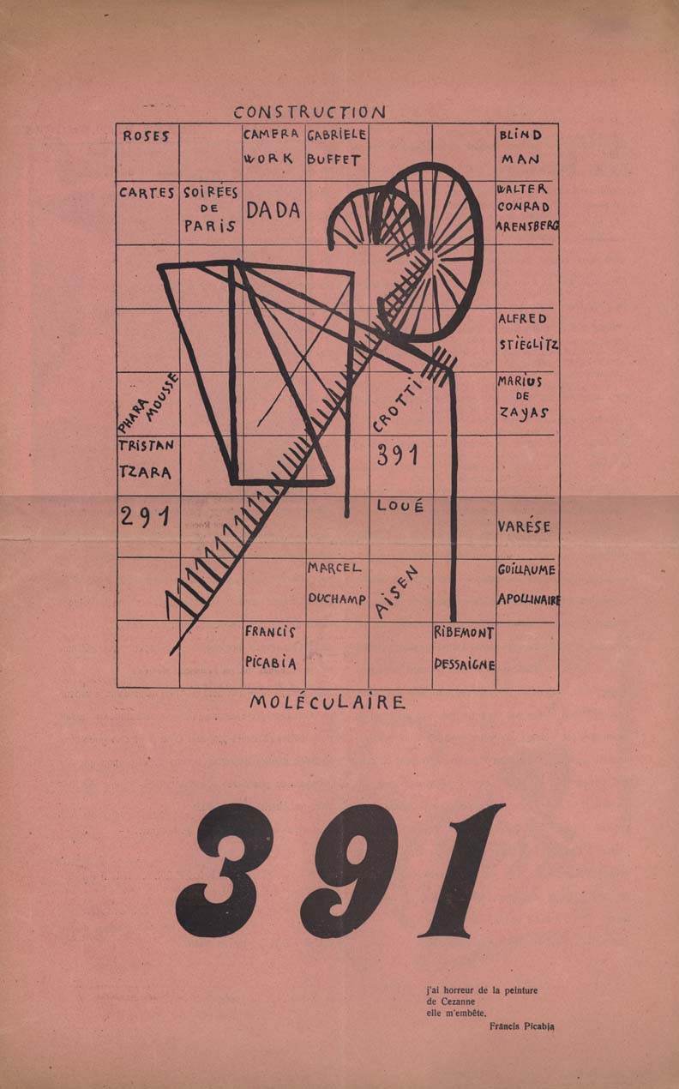
Francis Picabia (left) Cover of 391, No. 5 (New York, July 1917) (right) Cover of 391, No. 8 (Zurich issue,1919 )

Slide 11
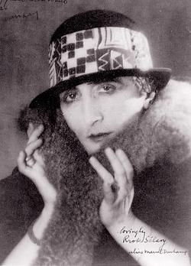
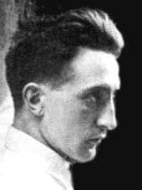
Man Ray photo portraits of Marcel Duchamp (French 1887-1966) (right) Duchamp as Rrose Sélavy c. 1920 New York Dada // Duchamp came to New York in 1915 at the invitation of Walter Arensberg and became part of the Alfred Stieglitz circle

Slide 12
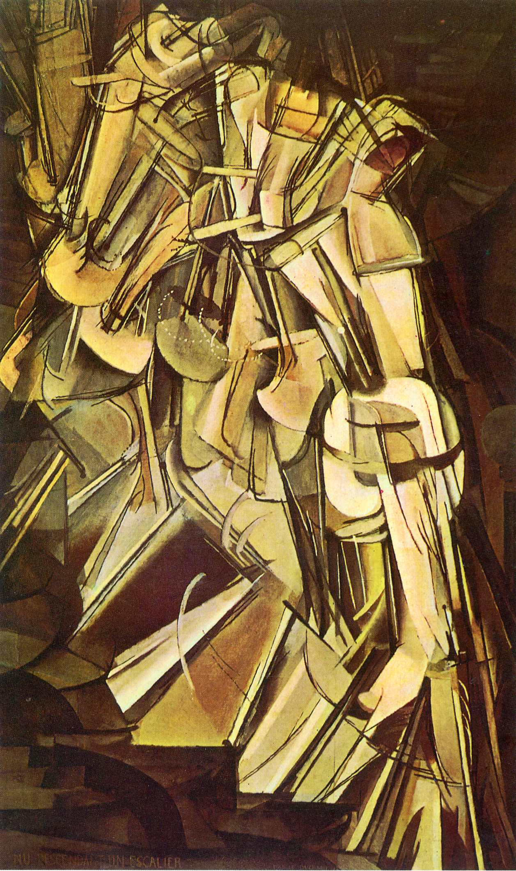
Marcel Duchamp, Nude Descending a Staircase, No.2, 1912, oil on canvas, 58 x 35 in., Philadelphia Museum of Art. Rejected by the Cubists for exhibition in Paris ("one doesn't paint a nude descending a staircase, that's ridiculous... a nude should be respected") and a scandal success at the 1913 Armory Show in New York and Chicago. “An explosion in a shingle factory“ (New York Times art critic)

Slide 13
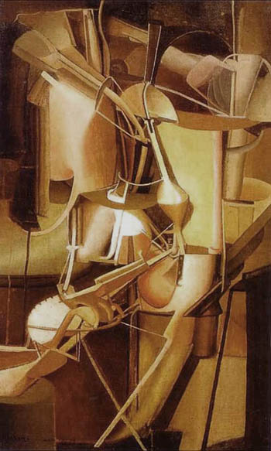
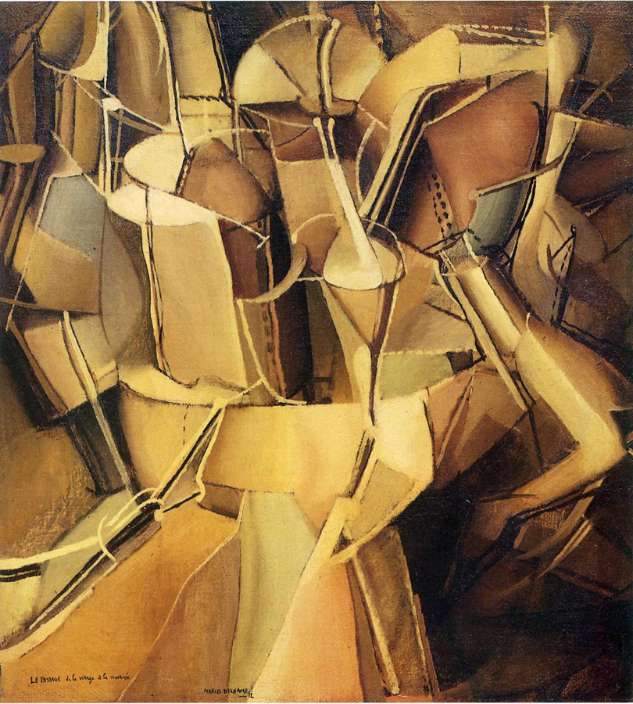
Marcel Duchamp, (left) Bride, oil on canvas (right) The Passage from Virgin to Bride, Munich, Summer, 1912, oil, 23 x 21”
Juxtaposition of mechanical elements and female visceral forms

Slide 14
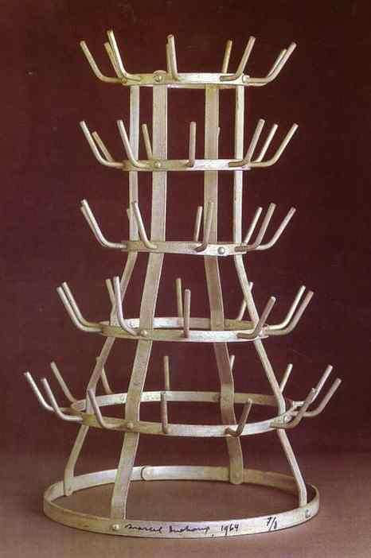
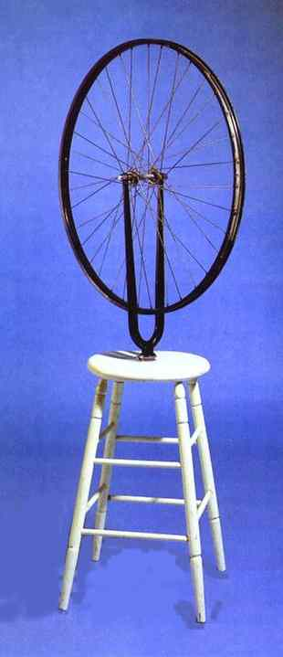
Marcel Duchamp. Bottle Rack, 1914/64, galvanized iron bottle rack Bicycle Wheel, 1913, “Readymade”: Bicycle Wheel, mounted on a stool. Originals lost

Slide 15
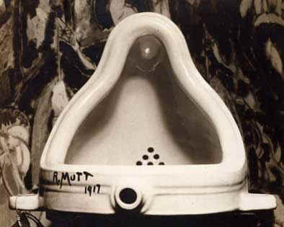
Duchamp, Fountain 1917 (photographed in 1917 by Alfred Stieglitz) New York DADA Duchamp said he chose his objects on the basis of "visual indifference…as well as a total absence of taste, good or bad."

Slide 16
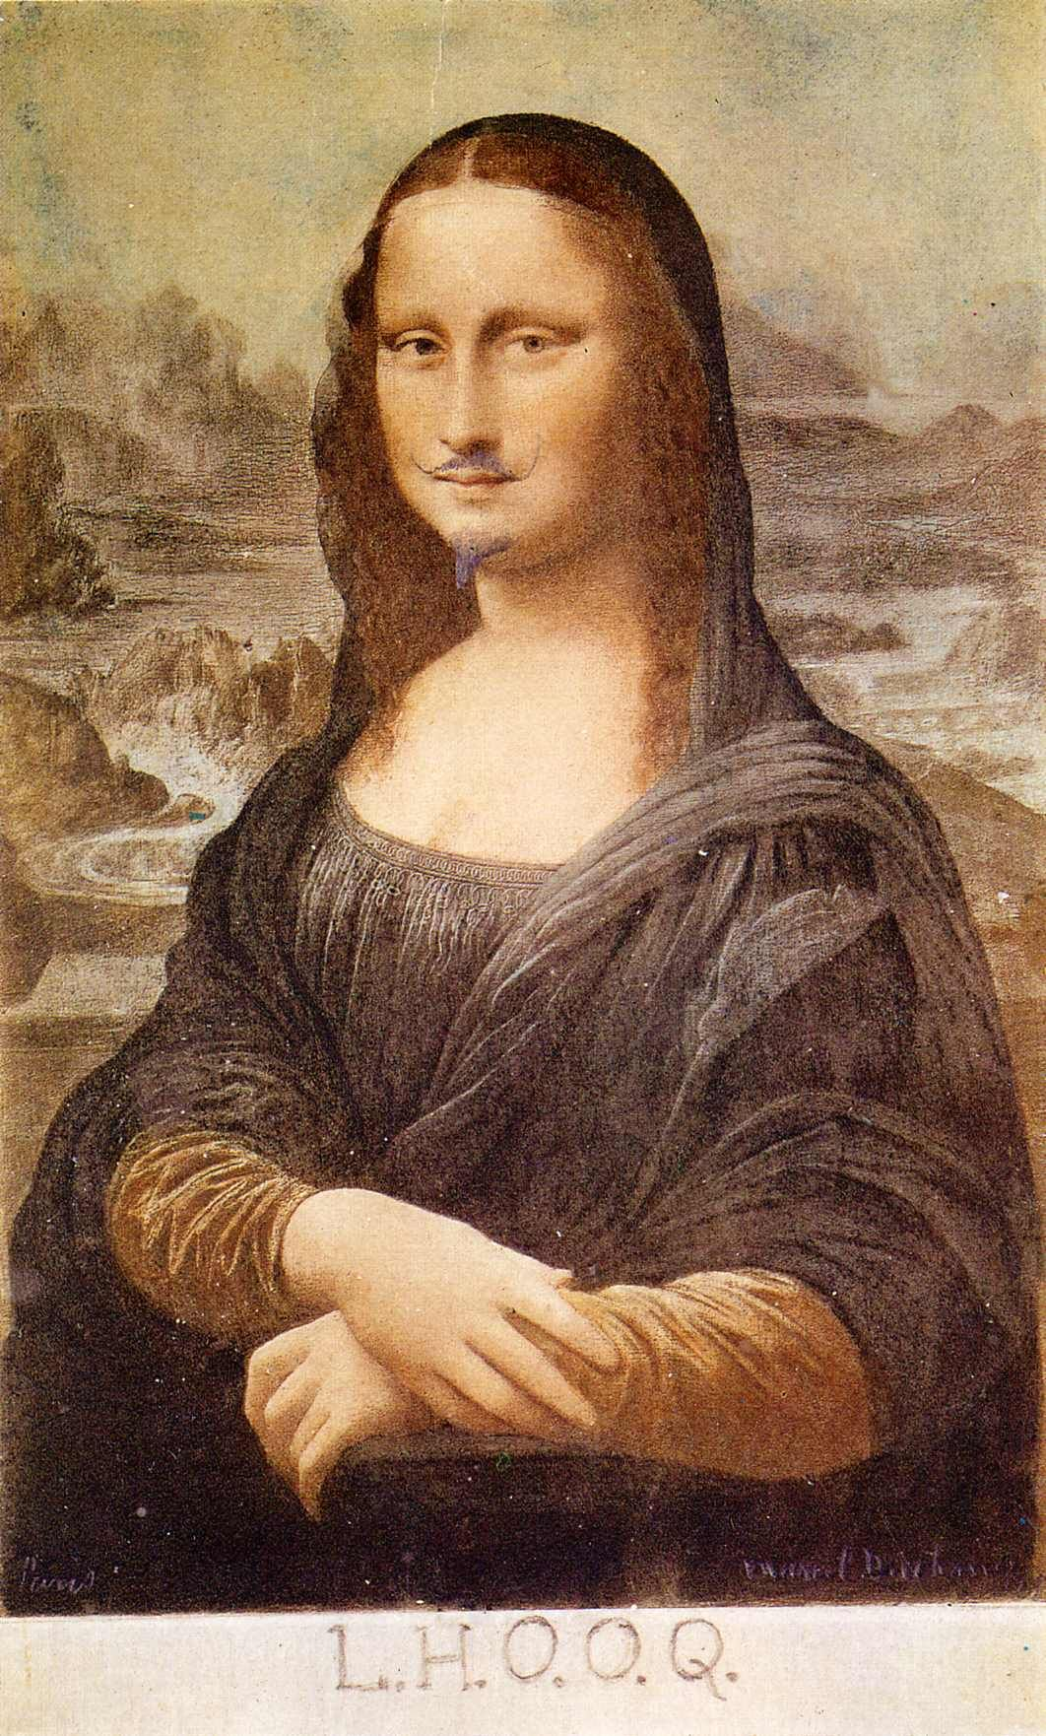
Duchamp, L.H.O.O.Q, 1919, reproduction of the Mona Lisa with hand drawn mustache and goatee, and added iconoclastic inscription. Readymade Assisted

Slide 17
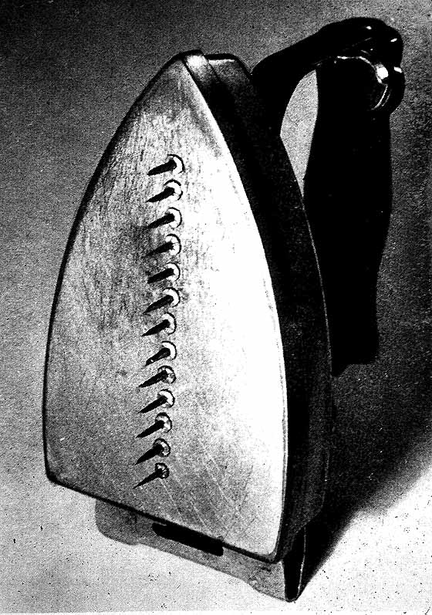
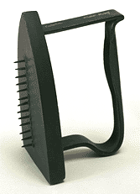
Man Ray (born Emmanuel Radnitsky, American, 1890-1976) Gift, 1921 Duchampian "ready-made altered" & Surrealist "uncanny" object

Slide 18
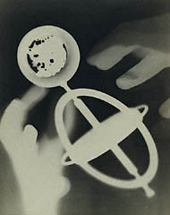
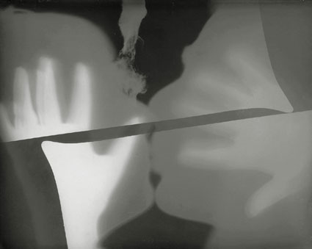
Man Ray, Rayographs (photograms), 1922 – direct exposure without a camera, single originals; objects take on a surprising, ambiguous form reliant on chance, not the (rational) machine (a camera)

Slide 19
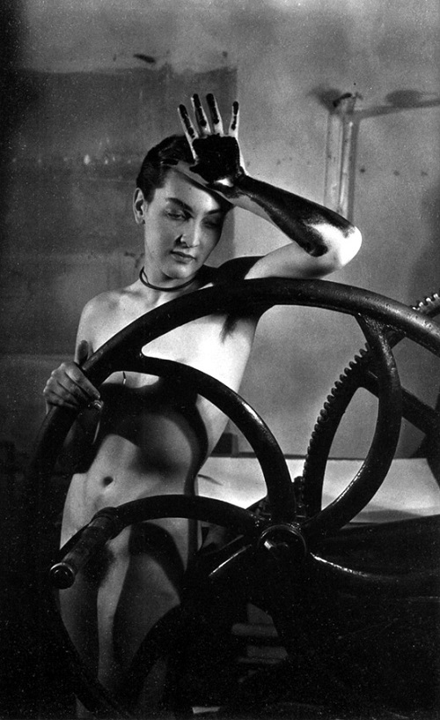
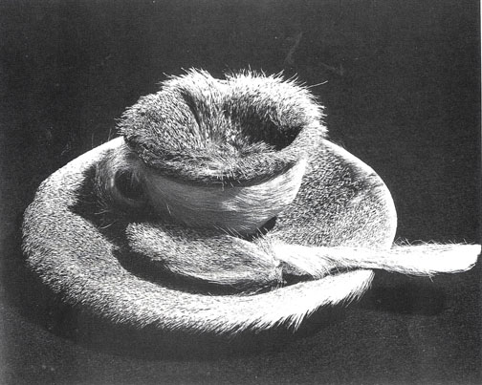
(left) Man Ray, Érotique voilée (Veiled Erotic, 1934-35) Meret Oppenheim behind printing press (below) Meret Oppenheim (German, 1913-1985), Object (Luncheon in Fur) 1936, fur covered cup, saucer, spoon, two views, Surrealism
1936 photo of Object by Dora Maar

Slide 20
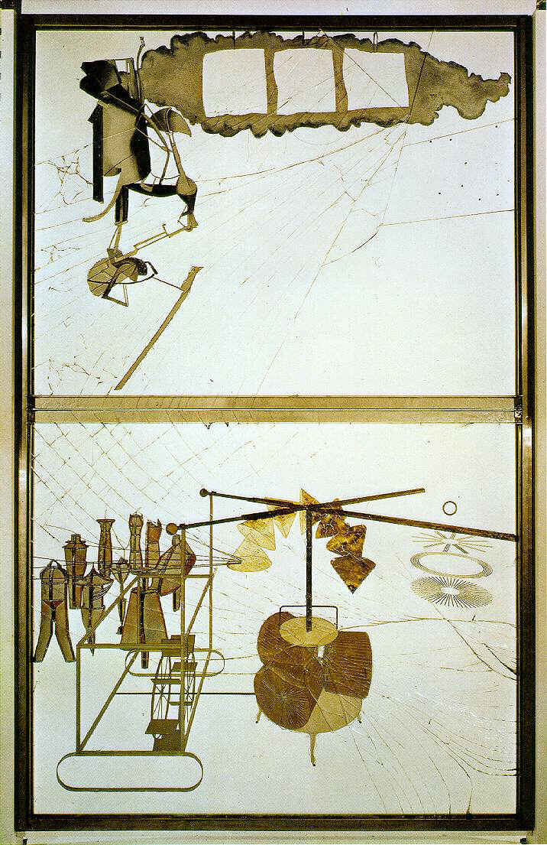
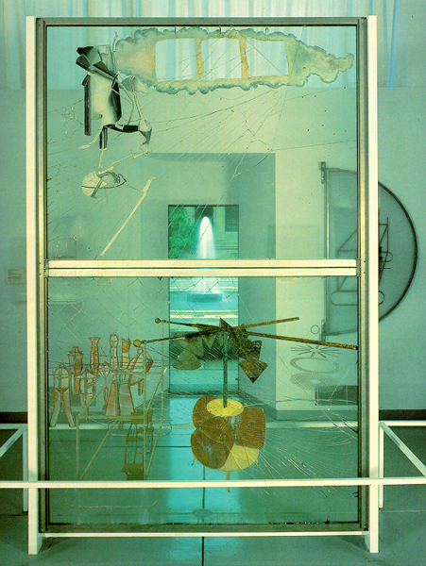
Marcel Duchamp, The Bride Stripped Bare by Her Bachelors, Even (The Large Glass) 1915-23, oil, lead wire, foil, dust, and varnish on glass, 8’11” x 5’7” http://youtu.be/lmag4vL7hnQ

Slide 21
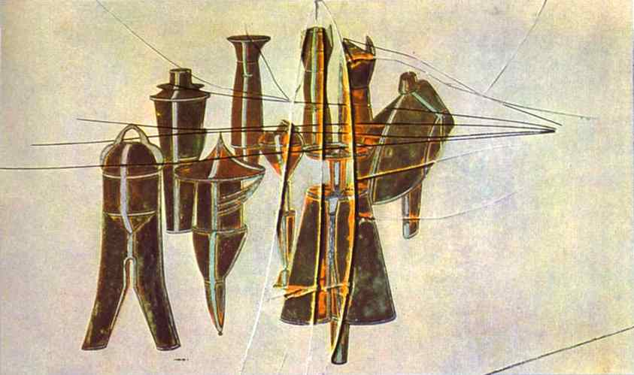
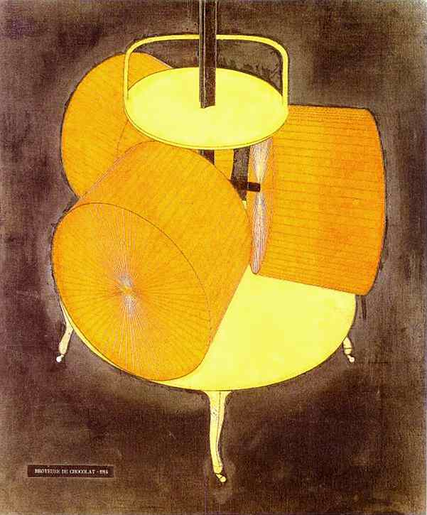
Marcel Duchamp, Nine Malic Molds, 1914-15, 64 x 102 cm. Oil, lead wire, lead foil on glass between two glass plates (right) Chocolate Grinder No.2, 1914, Oil and thread on canvas. 65 x 54 cm.
It was fundamentally Roussel [Raymond Roussel, 1877-1933] who was responsible for my glass, La Mariée mis à nu par ses célibataires, même. From his Impressions d’Afrique I got the general approach….My ideal library would have contained all Roussel’s writings – Brisset, perhaps Lautréamont and Mallarmé….This is the direction in which art should turn: to an intellectual expression . . . . I am sick of the expression “bête comme un peintre” – stupid as a painter.” - Marcel Duchamp

Slide 22
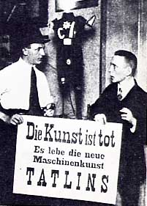
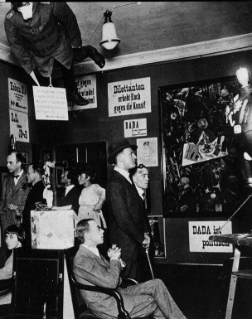
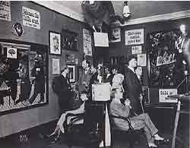
Berlin Dada First Dada Fair, Berlin, 1920; John Heartfield top left

Slide 23
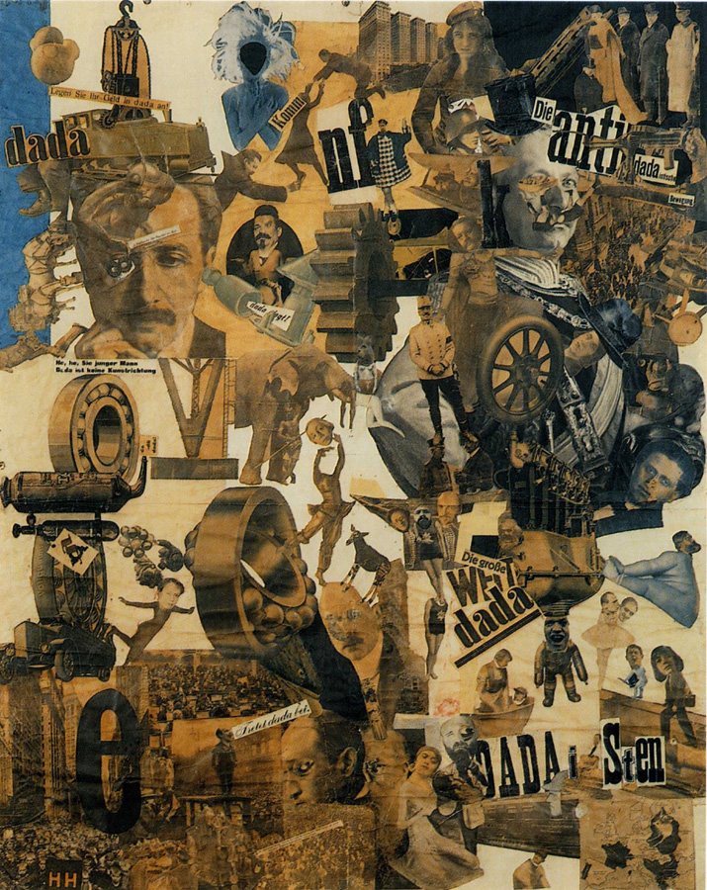
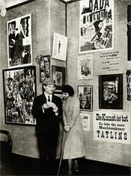
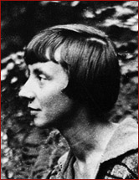
Hannah Höch (German, 1889 -1978), Cut With the Kitchen Knife Dada through the Last Weimar Beer Belly Cultural Epoch of Germany, 1919 (below left) Raoul Hausmann & Hannah Höch at 1920 Berlin Dada Fair
Anti-Dada of the Weimar Republic
Höch in 1917
Map of Europe with countries that allow women voting rights

Slide 24
Hannah Höch, Pretty Woman, 1920, anti-bourgeois, anti-capitalist, feminist critique The New Woman

Slide 25
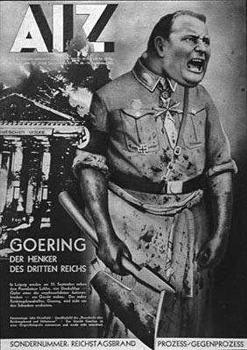
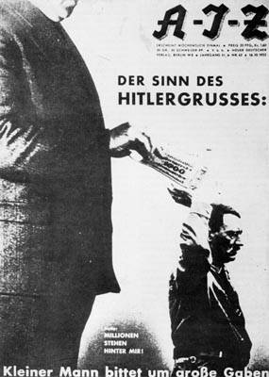
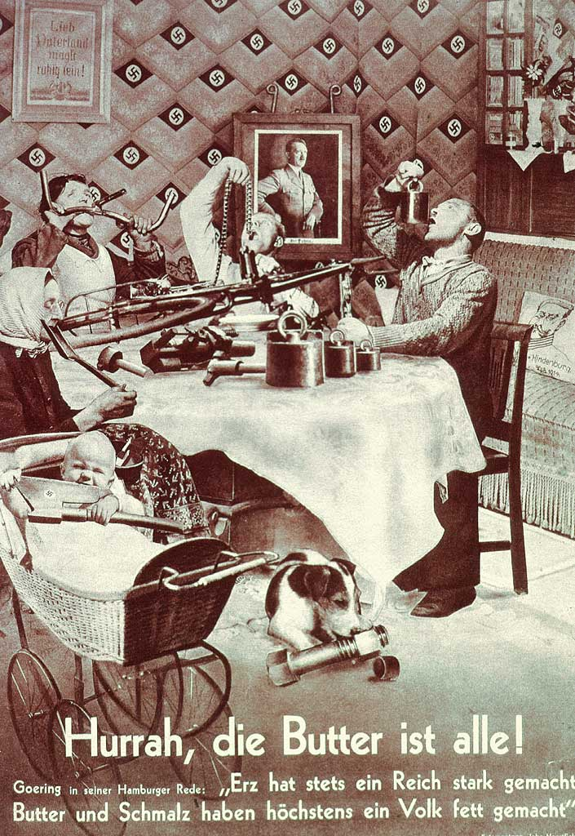
John Heartfield (Born Herzfelde, German, 1891-1968) front covers of the newspaper AIZ (Arbeiter-Illustrierte Zeitung / Workers’ Illustrated Newspaper), all from 1932-33 (left) The Butcher Goering, (center) Millions Stand Behind Me; (right) Hurrah, The Butter is Gone!

Slide 26
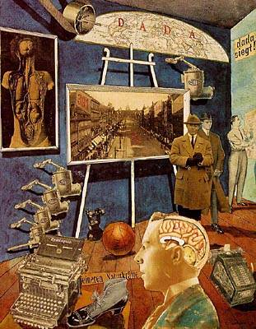
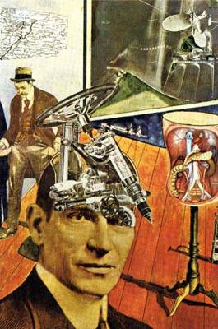
“They were the first to use photography to create, from often totally disparate spatial and material elements, a new unity in which was revealed a visually and conceptually new image of the chaos of an age of war and revolution. And they were aware that their method possessed a power for propaganda purposes which their contemporaries had not the courage to exploit ...” - Raoul Hausmann (Austrian, 1886-1971) on Dada photomontage
Hausmann, Dada Siegt!, 1919
Hausmann, Tatlin at Home, 1920

Slide 27
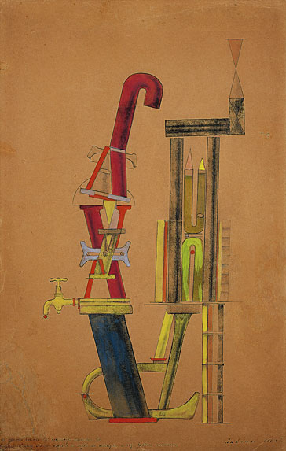
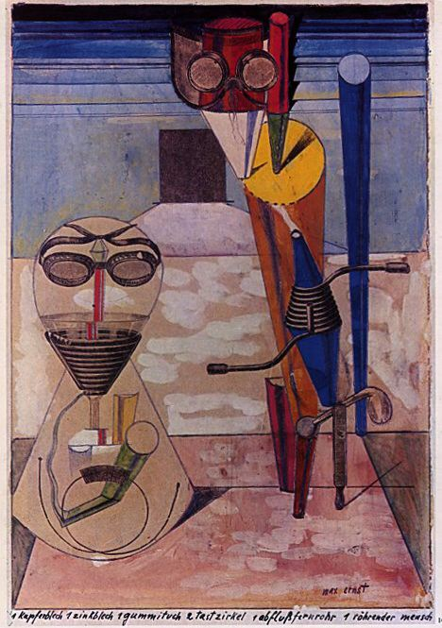
Max Ernst (German, 1891-1976), (left) 1 Copper Plate 1 Zinc Plate 1 Rubber Cloth 2 Calipers 1 Drainpipe Telescope 1 Pipe Man, 1920, gouache, ink, and pencil on reproduction, 9 x 6” (right) Little Machine Constructed by Minimax Dadamax in Person, 1919–20. Hand printing, pencil and ink frottage, watercolor, and gouache on paper, 49.4 x 31.5 cm. Cologne Dada
Mechanomorphism - Dada

Slide 28
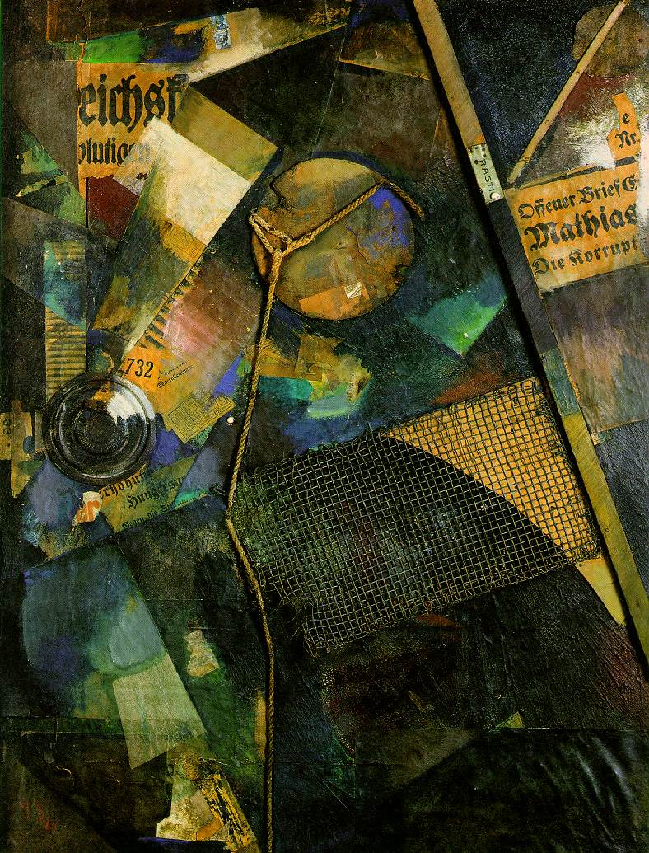
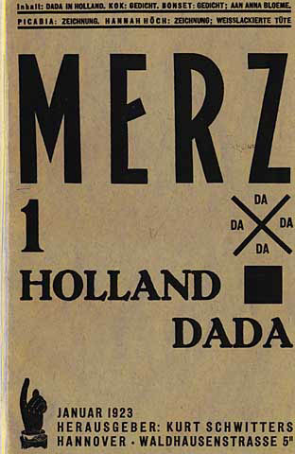
Merz: Hannover Dada: Kurt Schwitters (German 1887-1948) (below) Cover design for Schwitters’ magazine, Merz, 1923 (right) Merzbild 25A (Stars Picture), 1920, Assemblage, 41 x 31”
“The word “Merz” had no meaning when I formed it. Now it has the meaning which I gave it.”
- Kurt Schwitters

Slide 29
Kurt Schwitters, Hannover Merzbau, 1924-37(destroyed in 1943) photos c.1931 Schwitters rebuilt the Merzbau in Norway in 1937 and again in England (University of Newcastle) in 1947

Slide 31
Marcel Duchamp, Étant Donnés: 1º La Chute D'eau 2º Le Gaz D'éclairage (Given: The Waterfall, The Illuminating Gas) 1946-66, an old wooden door, bricks, velvet, twigs gathered by Duchamp on his walks in the park, leather stretched over a metal armature of a female form, glass, linoleum, an electric motor, etc.

Slide 32
Raoul Hausmann (Austrian, 1886-1971), Mechanical Head [or The Spirit of Our Time], 1919, assemblage: wooden mannequin head, with objects attached to it (including a leather pocketbook, a collapsing aluminum cup, camera, telescope, and watch parts, a pipe, white cardboard with the figure 22, a part of a dressmaker's measure, a printing roller), 12 5/8” H
“The average German has no more capabilities than those which chance
has glued on the outside of his skull; his brain remains empty.” - Hausmann

