Slide 1
UMBERTO BOCCIONI: A Futurist Artist
By John Abrajano

Slide 2
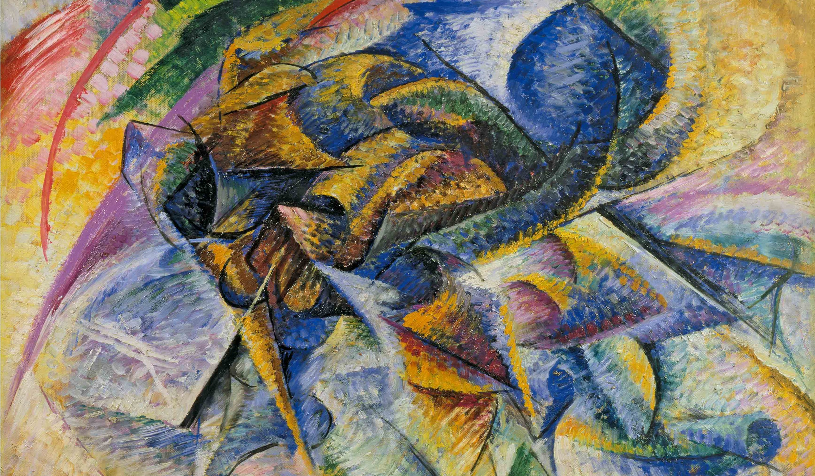
Artist
Umberto Boccioni
Year
1913
Medium
Oil on canvas
Dimensions
70 cm × 95 cm (28 in × 37 in)
Location
Peggy Guggenheim Collection (long term loan from the Gianni Mattioli Collection), Venice.

Slide 3
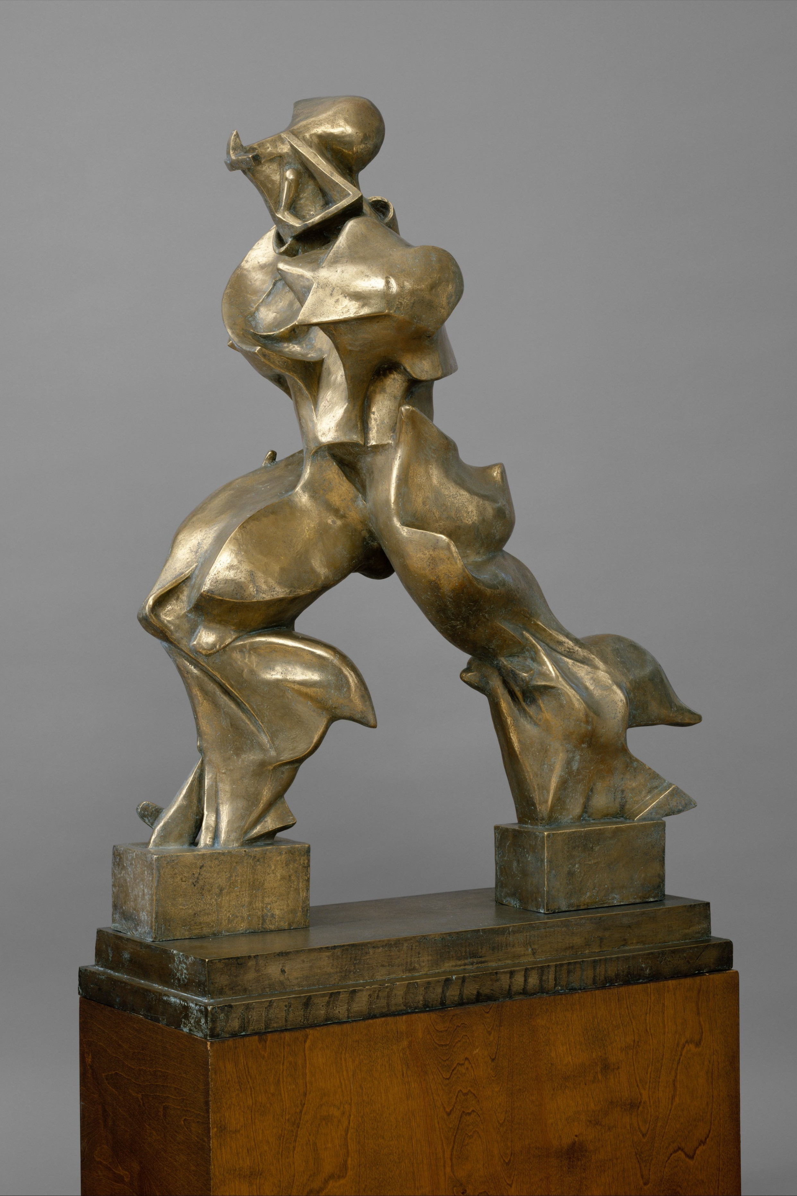
Artist: Umberto Boccioni Dimensions: 3′ 8″ x 2′ 11″ Period: Futurism
Location: Museum of Contemporary Art, University of São Paulo
Medium: Plaster
Created: 1913

