Slide 1
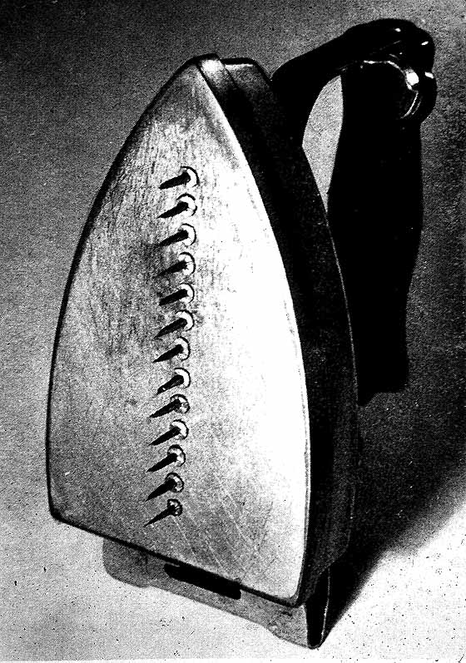
Man Ray (born Emmanuel Radnitsky, American, 1890-1976) Gift, 1921 Duchampian "ready-made altered" & Surrealist "uncanny" object

Slide 2
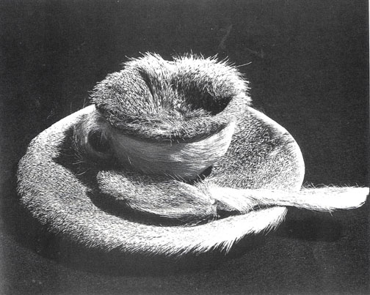
(left) Man Ray, Érotique voilée (1934-35) subject is Meret Oppenheim and printing press (right) Meret Oppenheim (German, 1913-1985), Object (Luncheon in Fur) 1936, fur covered cup, saucer, spoon, two views, Surrealism

Slide 3
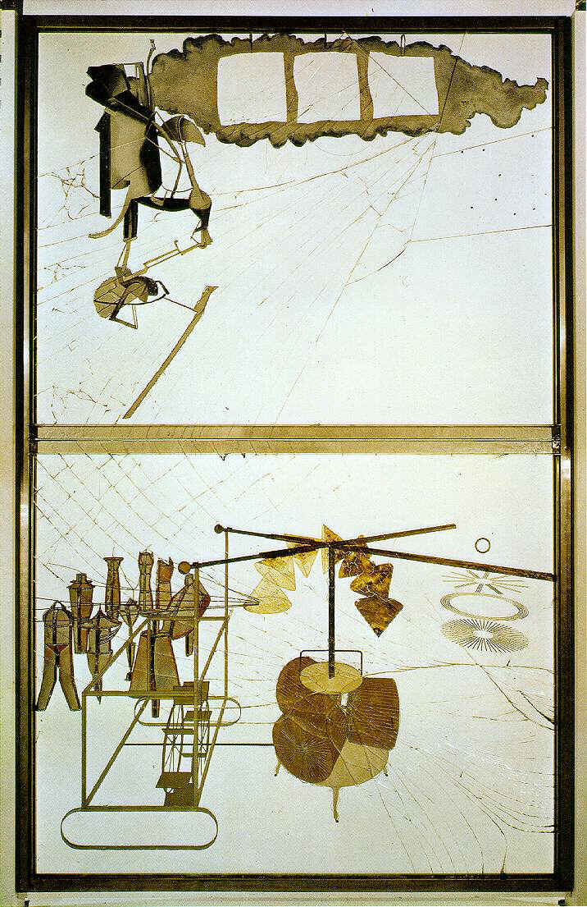
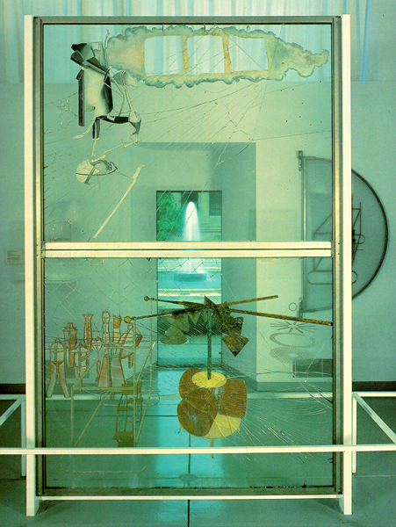
Marcel Duchamp, The Bride Stripped Bare by Her Bachelors, Even (The Large Glass) 1915-23, oil, lead wire, foil, dust, and varnish on glass, 8’11” x 5’7” http://youtu.be/lmag4vL7hnQ

Slide 4
Marcel Duchamp interview

Slide 5
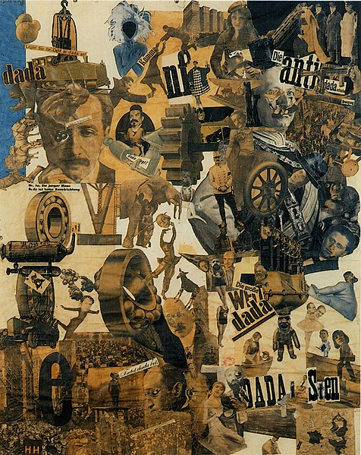
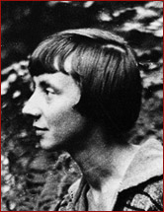
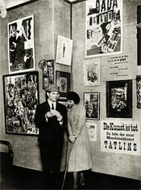
Hannah Höch (German, 1889 -1978), Cut With the Kitchen Knife Dada through the Last Weimar Beer Belly Cultural Epoch of Germany, 1919
Höch in 1917
Raoul Hausmann & Hannah Höch at 1920 Berlin Dada Fair

Slide 6
Hannah Höch, Pretty Woman, 1920, anti-bourgeois, anti-capitalist (commodification), feminist critique The New Woman

Slide 7
Surrealism Circa 1921 – 1940 The last Modern Art Movement
"Beautiful as the chance encounter of a sewing machine and an umbrella
on a dissection table.“
- Lautréamont
Les chants de Maldoror

Slide 8
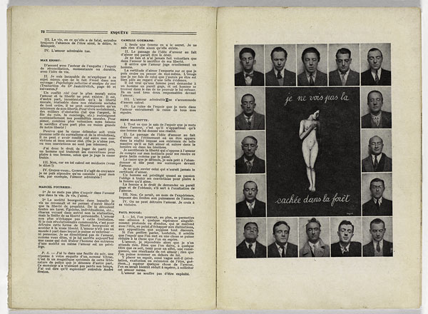
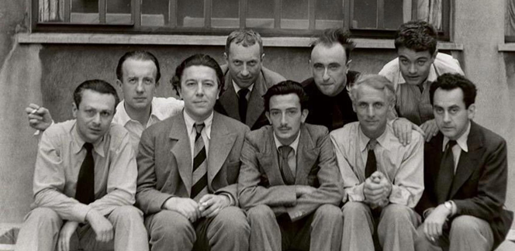
The Surrealist Revolution (right) Painting photomontage for La Révolution Surréaliste magazine nº 12, 1929 / painting by René Magritte, Enquête sur l'amour’ (Inquiry on Love), photos of Surrealists (bottom) Surrealist group, Paris, 1930, L-R: Tristan Tzara, Paul Eluard, André Breton, Hans Arp, Salvador Dali, Yves Tanguy, Max Ernst, René Crevel, Man Ray

Slide 9
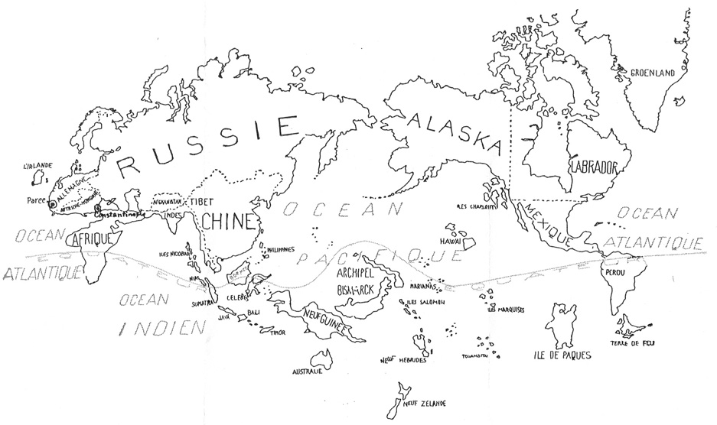
"We are determined to make a Revolution." "We have joined the word surrealism to the word revolution solely to show the disinterested, detached and even entirely desperate character of this revolution." - André Breton
(above)The World in the Time of the Surrealists, 1929
(right) Easter Island, ceremonial dance paddle (rapa) from André Breton’s collection of Oceanic art. It represents a highly stylized male figure with Janus-face head and phallic finial showing retracted foreskin.

Slide 10
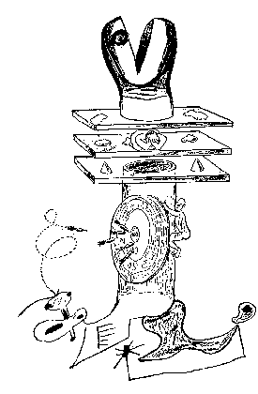
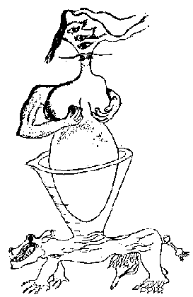
Surrealist AUTOMATISM: Surrealist method for revealing subconscious by relinquishing individual control Exquisite corpse collaborative drawings: (left) by Yves Tanguy, Man Ray, Max Morise, Joan Miró, c. 1926. (right) An exquisite corpse by Victor Brauner, André Breton, Jacques Hérold and Yves Tanguy, 1935

Slide 11
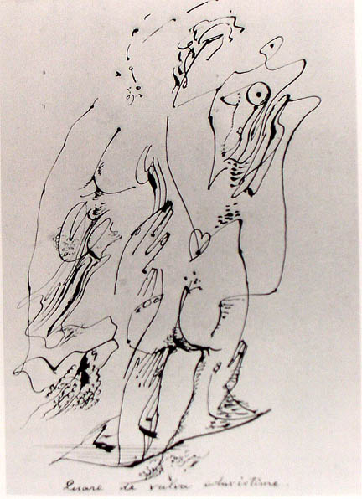
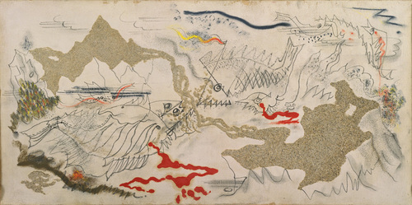
AUTOMATISM and abstract biomorphic Surrealism André Masson (French, 1896-1987) Quare de vulva eduxiste me (Why dids’t thou bring me forth from the womb?), 1923, pen & ink on paper (right) Battle of Fishes, 1926, sand, gesso, oil, pencil, and charcoal on canvas, 14 x 28 inches. Masson had been wounded in the war and traumatized. He believed that, if left to chance, pictorial compositions would reveal the sadism of all living creatures.

Slide 12
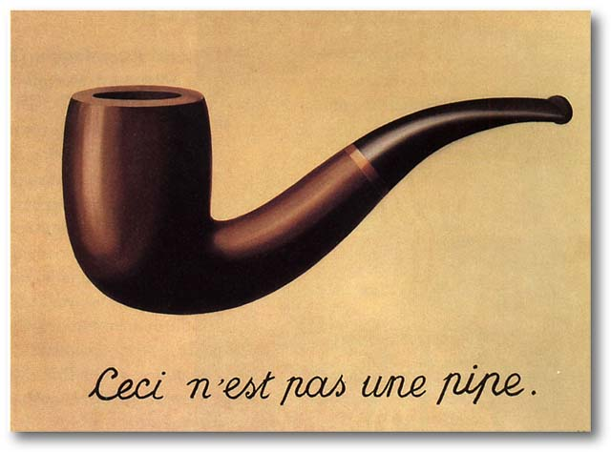
“Naturalist” or “Hand Painted Dream” Surrealism René Magritte (Belgian, 1898-1967) The Treachery of Images, 1928-29, oil on canvas, 23 x 31”, LACMA, Deconstruction

Slide 13
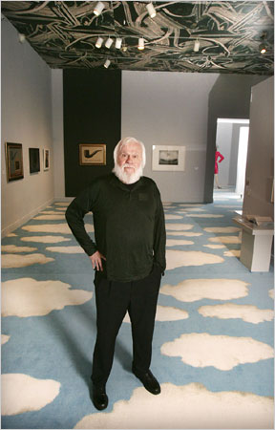
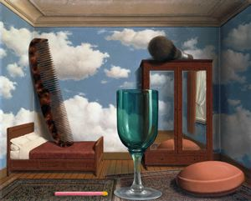
René Magritte, Les Valeurs personnelles (Personal Values), 1952, 31 1/2 in. x 39 3/8 in., oil on canvas, SFMOMA
LA Conceptual artist, John Baldessari at 2007 exhibition he curated at LACMA: Treachery of Images: René Magritte and Contemporary Art

Slide 14
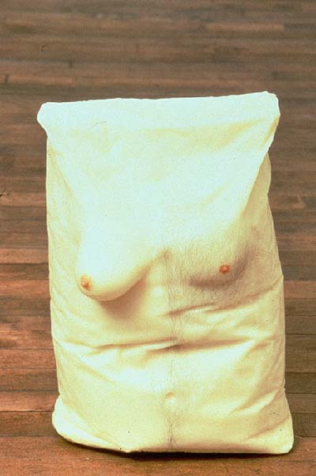
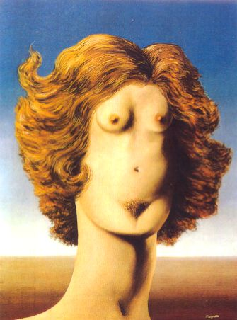
(left) Robert Gober, Untitled, 1990, beeswax, human hair, pigment. Lifesize (right) René Magritte, The Rape, 1935, oil on canvas

Slide 15
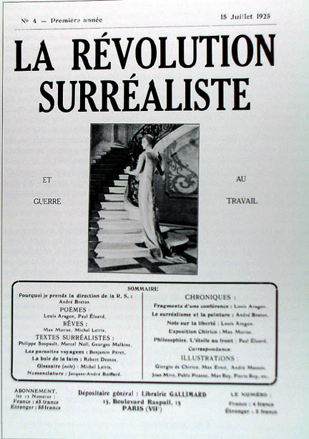
Surrealist magazine, La Révolution Surréaliste [The Surrealist Revolution, 12 issues, 1924-1929] graphic design was modeled on the look of the conservative scientific magazine, La Nature. In a mock scientific manner, specimens of automatic writing and records of dreams were illustrated with photographs, mostly by the “machine-poet” Man Ray (American,1890-1976). The review succeeded in shocking everyone.

Slide 16
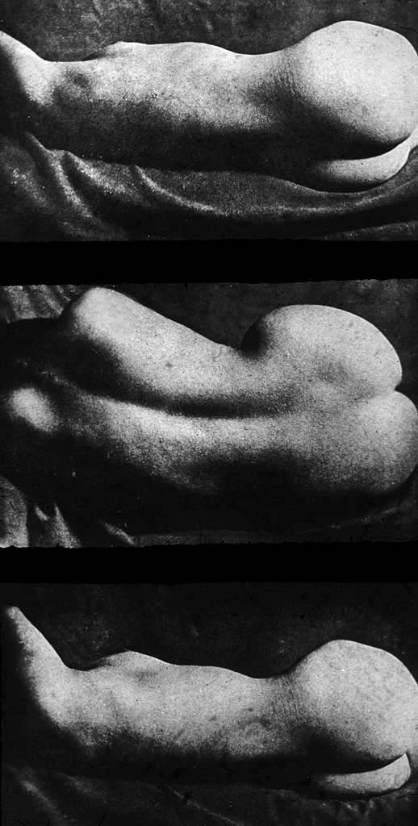
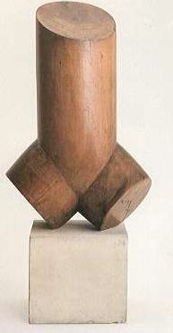
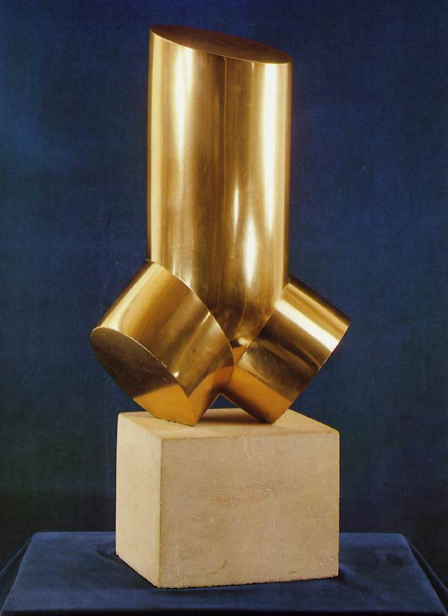
Man Ray, Minotaur, 1933
Surrealist “formlessness”:
challenging the duality of sex
Brassai, Nudes, 1933
Phallus-female torso
Constantin Brancusi, Torso, 1924 & 1926

Slide 17
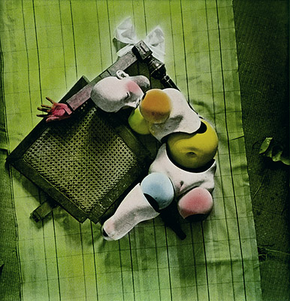
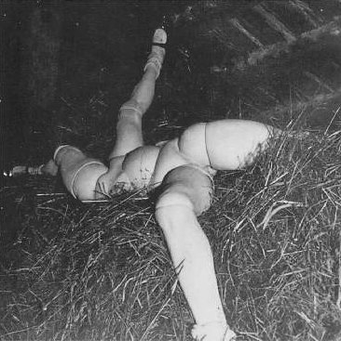
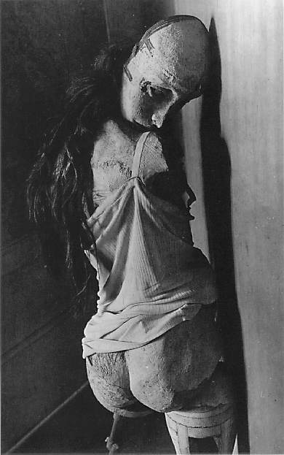
Surrealist AUTOMATONS and mannequins: (left) Hans Bellmer (Polish, 1902-75), La Poupée (Doll), 1935-49, hand colored gelatin silver print (right) Hans Bellmer, La Poupée, 1935-36: (center) La Poupée, 1934; gelatin silver prints “Dolls” are made of wood, metal, papier-mâché and often dressed with wigs, clothing, etc.
Bellmer’s art object is not the sculpture; it is the photograph.

Slide 18
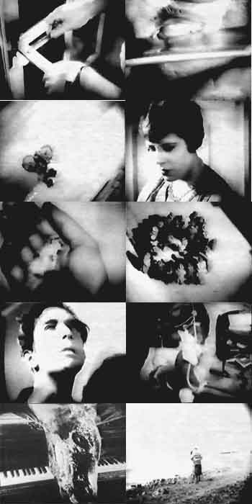
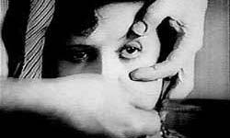
Luis Buñuel & Salvador Dali, frames from Un Chien Andalou (France) An Andalusian Dog, Surrealist film, 1928. http://youtu.be/BIKYF07Y4kA Eyes, insects, metamorphosis, erotics, madness of the dream & subconscious

Slide 19
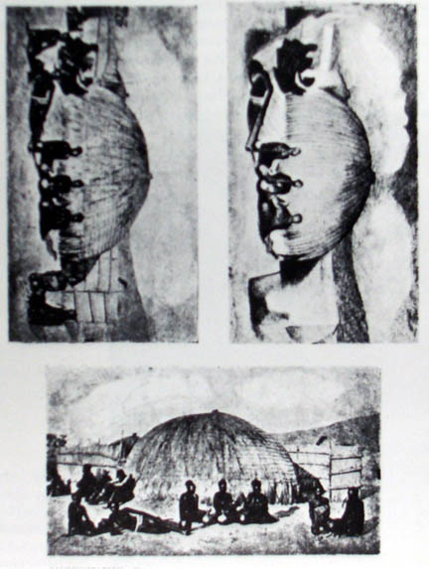
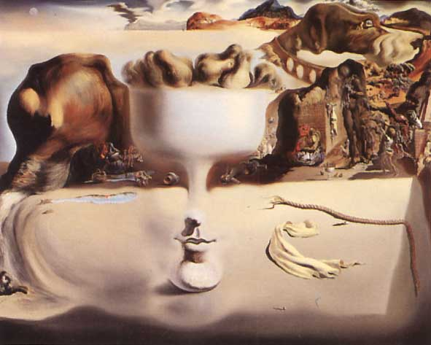
METAMOPHOSIS OF FORM Salvador Dali (Spanish, 1904-89) interpreted photograph, Paranoic Face, 1931 from Le Surrealisme au Service de la Revolution, no.3. “voluntary hallucination" = the "critical paranoic method" (right) Dali, Apparition of a Face and a Fruit Dish, 1930
I think the time is rapidly coming when it will be possible…to systematize confusion thanks to a paranoiac and active process of thought, and so assist in discrediting completely the world of reality.”
Salvador Dali

Slide 20
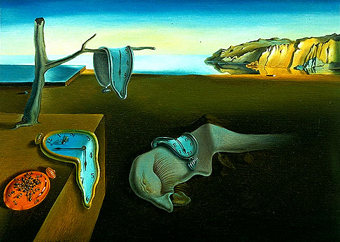
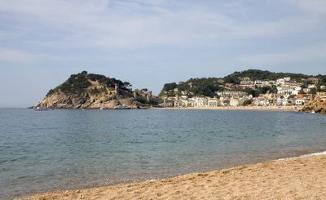
Salvador Dali, The Persistence of Memory, 1931 oil on canvas, 9 x 13,” MoMA NYC
“The transcription of reveries.” Hand-painted dream photographs. Dali’s morphological aesthetics of the soft and hard and the search for form: “un-form” (Informe)
Cape Creus, Catalonia

Slide 21
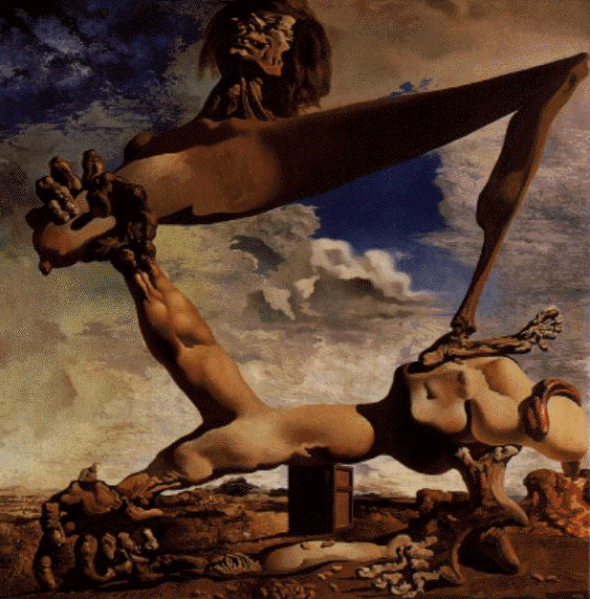
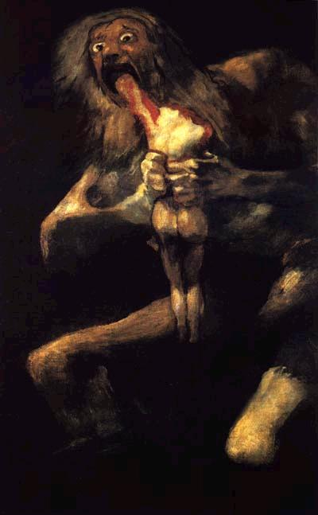
ANXIOUS VISIONS for anxious times – the social contexts of Surrealist imagery (left) Salvador Dali, Soft Construction with Boiled Beans: Premonitions of Civil War, 1936, oil on canvas, 39 x 39” (Spanish Civil War), Surrealism (right) compare Francisco Goya, 1821 (context of Napoleonic wars in Spain), Romanticism

Slide 22
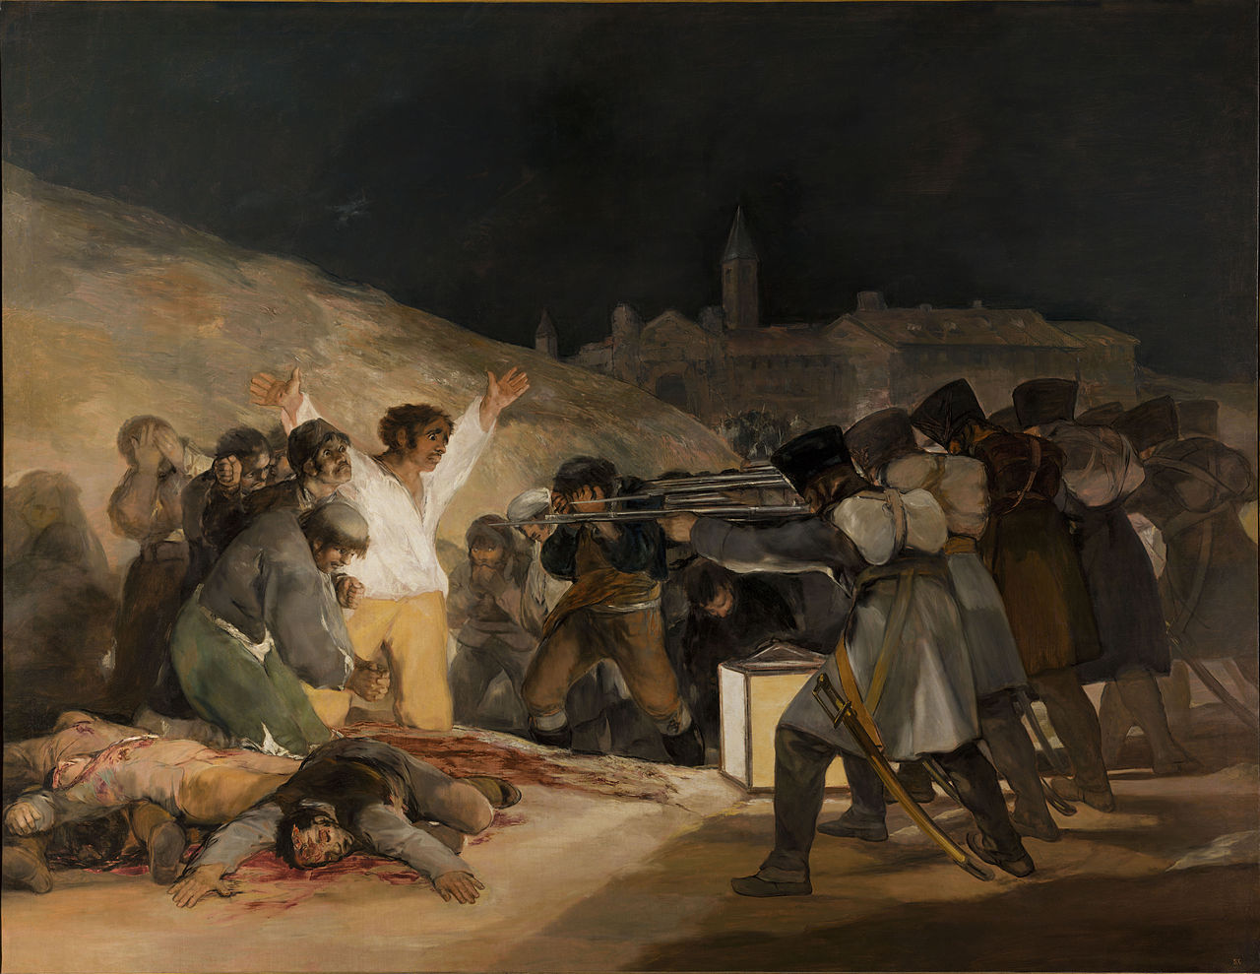
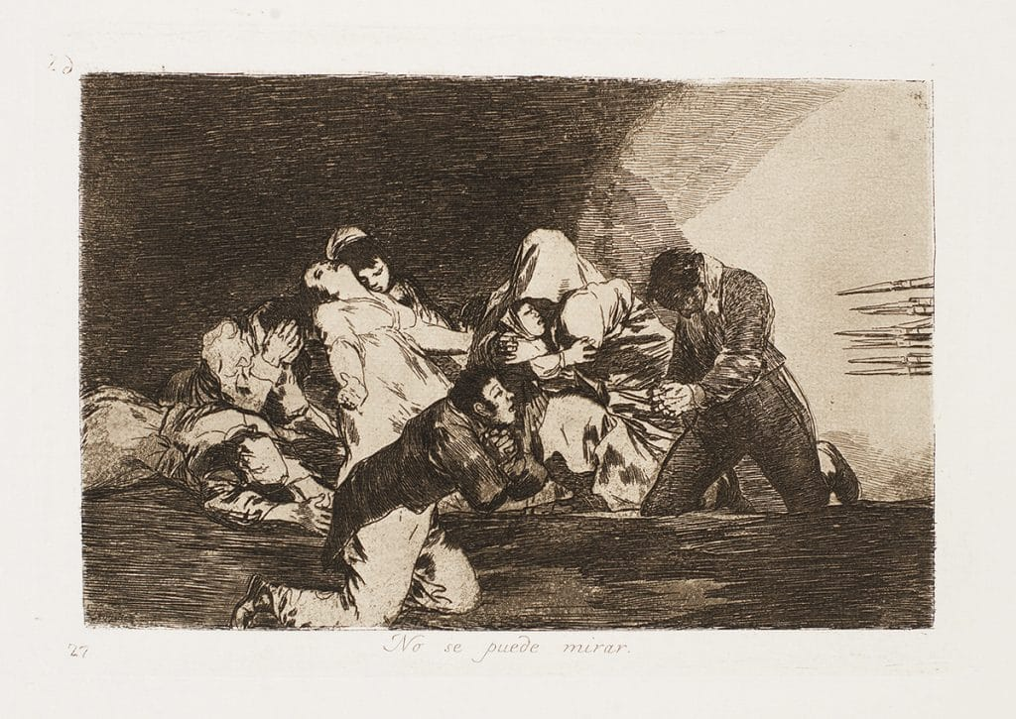
Francisco Goya (Spanish Romantic, 1747-1828), Disasters of War etching series (1810-1820) and The Third of May 1808 (1814) in the Prado museum, Madrid

Slide 23
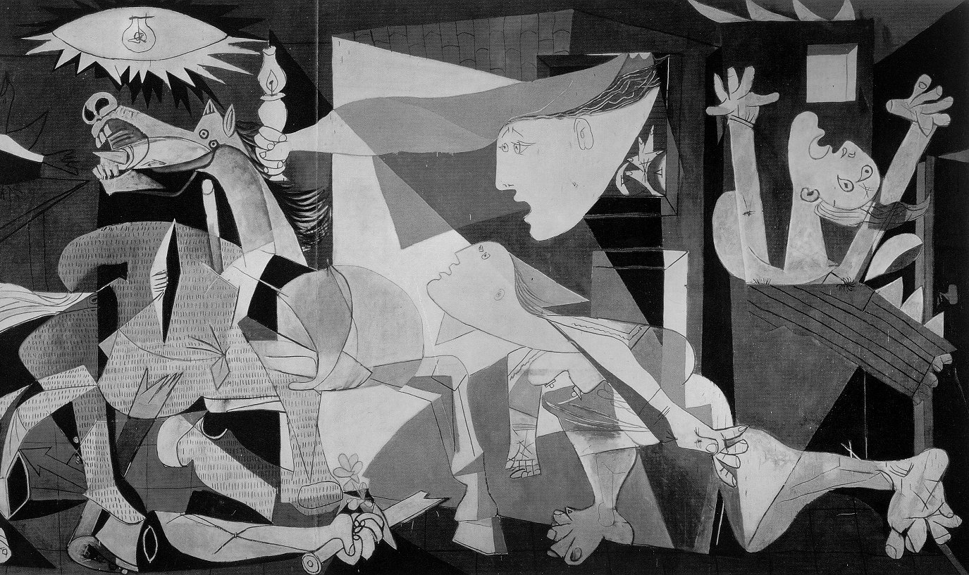
Pablo Picasso, Guernica, 1937, oil on canvas, 11’6” x 25’8” Museo Nacional Centro de Arte Reina Sofía, Madrid. Picasso stipulated that it be returned to Spain after the death of Francisco Franco (dictator from 1939 to his death in 1975) and the return of democracy to Spain. MoMA NYC returned it in 1981.
https://www.museoreinasofia.es/en/multimedia/pity-and-terror-picassos-path-guernica

Slide 24
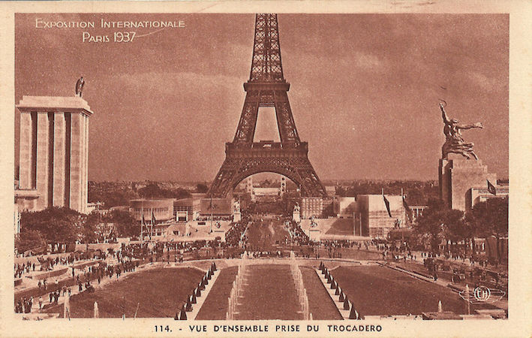
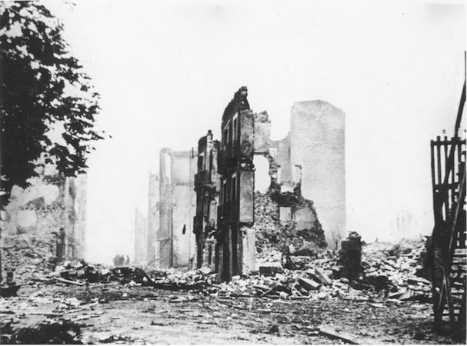
Picasso was commissioned by the newly
elected government of Spain to do a
mural-size painting for the Spanish Pavilion
at the 1937 world fair in Paris.
https://www.museoreinasofia.es/en/multimedia/pity-and-terror-picassos-path-guernica
Basque town of Guernica in 1937 after bombing by the Nazi air force in support of Franco’s fascist forces in the Spanish Civil War

Slide 25
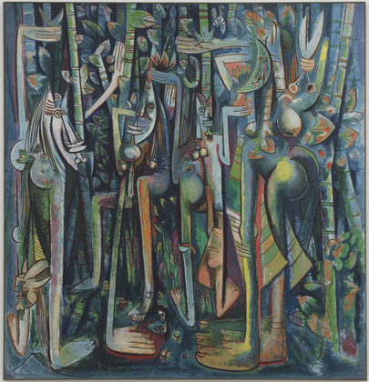
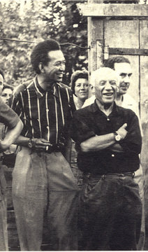
SURREALISM and DIASPORIC INDIGENISM (Primitivism) / “MAGIC REALISM” (right) Wifredo Lam (Cuban, 1902-82) The Jungle, 1943, gouache on paper mounted on canvas, 7’10” x 7’6”, MoMA NYC. Draws on Santerìa: Cuban blend of African and Catholic religious beliefs and practices (below) Lam in Paris with Picasso in 1963

Slide 26
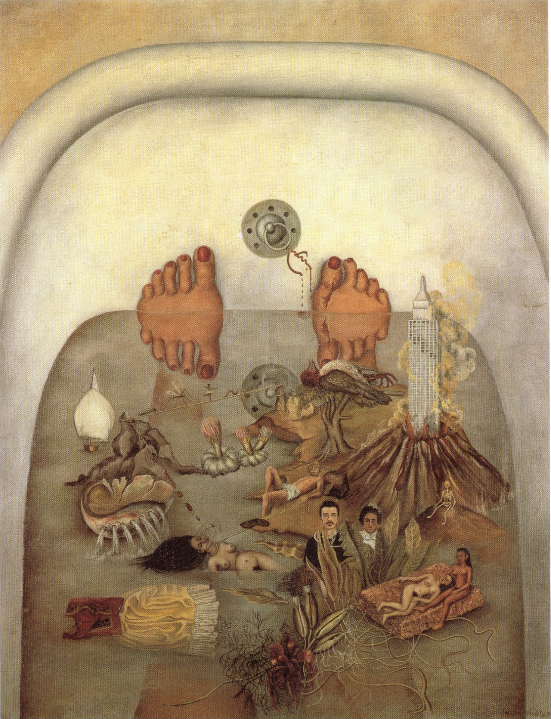
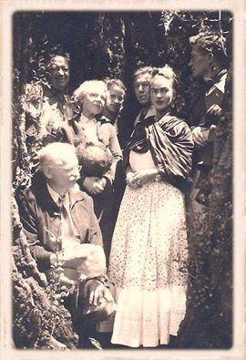
Frida Kahlo (Mexican, 1907-1954) (right) What the Water Yields Me, 36 x 28”, oil on canvas,1938, the year she met Breton. Exhibited in Paris in 1939 by André Breton.

Slide 27
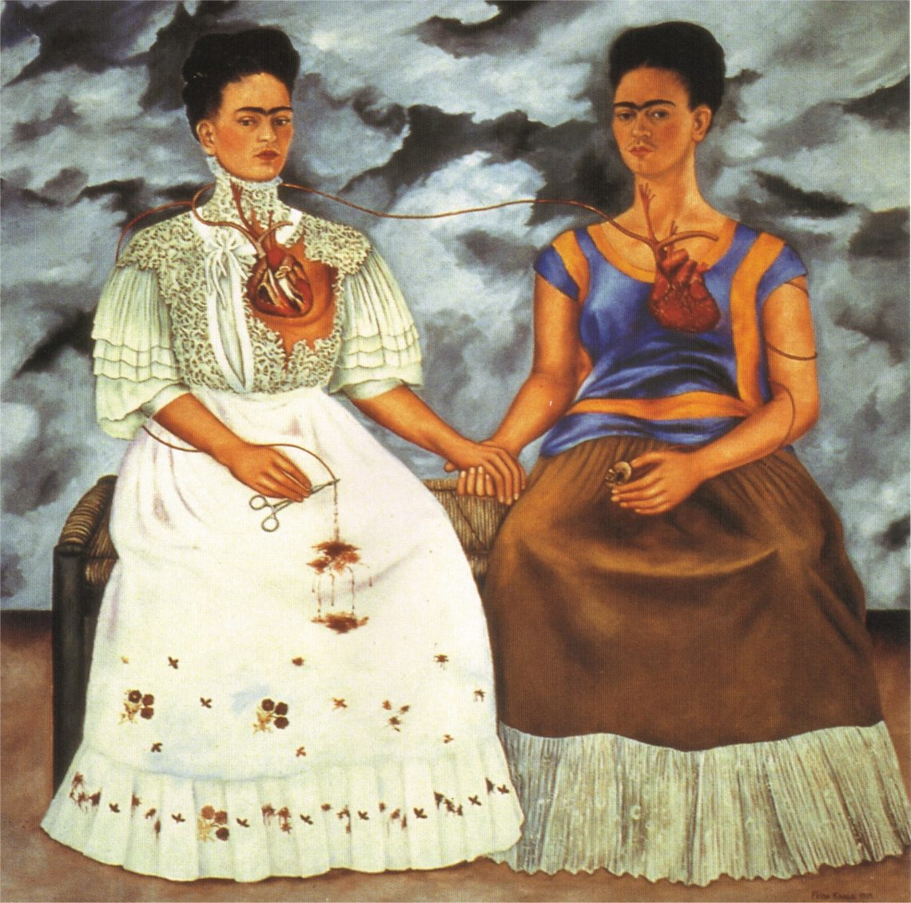
Frida Kahlo, The Two Fridas (1939) 68 × 68 in), oil on canvas, Museo de Arte Moderno, Mexico City. The painting was made for the International Exhibition of Surrealism held in Mexico City in 1940.

Slide 28
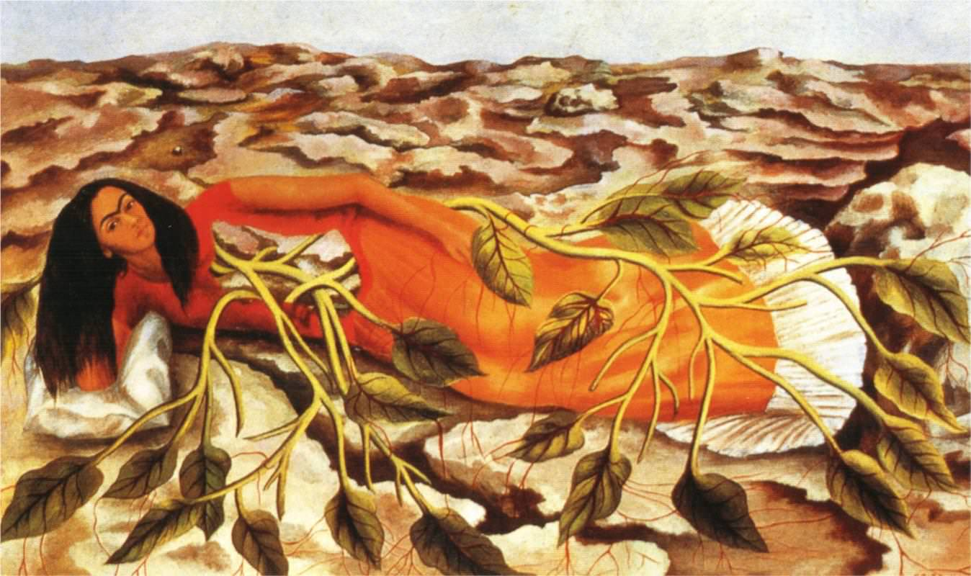
Frida Kahlo, Roots, 1943

Slide 29
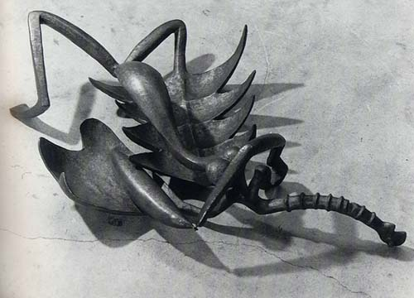
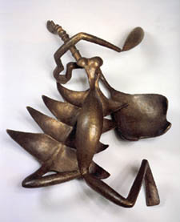
Alberto Giacometti (Swiss, 1901-1966) Woman with Her Throat Cut (Femme égorgée) bronze, 1932, 8 x 34 x 25”, MoMA, NYC

Slide 30
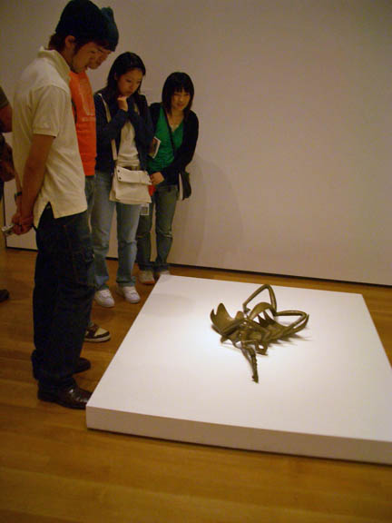
Alberto Giacometti, Woman with Her Throat Cut 1932, bronze, 8x34 x 25”, MoMA, NYC

Slide 31
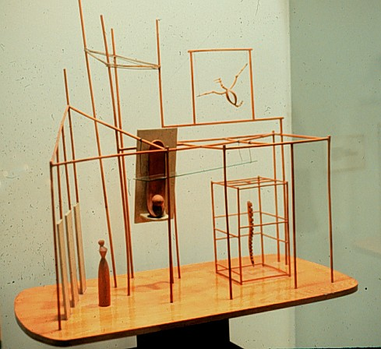
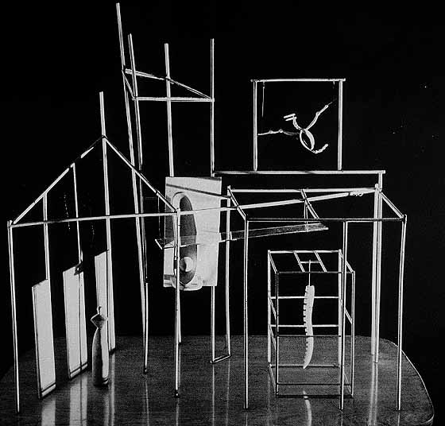
Alberto Giacometti, The Palace at 4 a.m., 1932-3, construction in wood, glass, wire, and string, 25 x 28 x 16”, MoMA NYC
1932 sketch indicates
pre-conception

Slide 32
THE END OF THE AGE OF EUROPE AND EMERGENCE OF THE NEW YORK SCHOOL (left) Hitler occupies Paris in June,1940 Artists in the Artists in Exile show at the Pierre Matisse Gallery, New York, March, 1942. Left to right, first row: Matta, Ossip Zadkine, Yves Tanguy, Max Ernst, Marc Chagall, Fernand Léger; second row: André Breton, Piet Mondrian, André Masson, Amédée Ozenfant, Jacques Lipchitz, Pavel Tchelitchew, Kurt Seligmann, Eugene Berman

Slide 33
DISJUNCTION / READYMADE /UNCANNY OBJECT (left) Joan Miró, Object, assemblage: stuffed parrot on wood perch, stuffed silk stocking with velvet garter and doll’s paper shoe suspended in hollow wood frame, derby hat, hanging cork ball, celluloid fish, and engraved map, 32 x 12 x 10,” 1936 (right) Joseph Cornell (American, 1903-1972] ) Medici Boy, 1942-52. mixed media assemblage

Slide 34
Details of Giacometti’s The Palace at 4 A.M.

Slide 35
END OF THE AGE OF EUROPE AND EMERGENCE OF NEW YORK SCHOOL Max Ernst, Europe After the Rain, 1940-42, oil on canvas, 21 x 58,” automatist technique of decalcomania, which involves pressing paint between two surfaces

Slide 36
Precursors to Surrealism: 19th Century Romanticism and Symbolism (left) Arnold Böcklin (Swiss Symbolist, 1827-1901), The Isle of the Dead, 1880, oil on canvas (right) Francisco Goya (Spanish Romantic, 1746-1828), Saturn Devouring One of His Children, c. 1821-1823, oil on plaster remounted on canvas

Slide 37
Precursor to Surrealism: Giorgio de Chirico, (Greek-Italian,1888-1978) (left) The Melancholy and Mystery of a Street, 1914, oil on canvas, 34 x 28” Metaphysical School (right) The Great Metaphysician, 1917, oil on canvas, 41 x 27” influence on De Chirico of Arnold Bocklin (center)

