Slide 1
Crocker Art Museum
Make-up assignment worth two 2 classes (2 attendances) and 10 points averaged into your quiz score

Slide 2
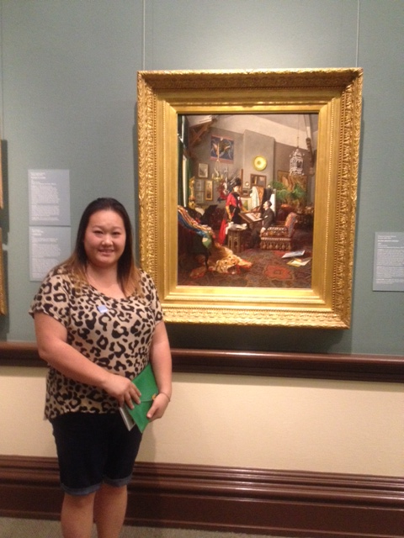
Kao Yang with In the Artist’s Studio by Edouard-Antoine Marsal,1889, oil on canvas

Slide 3
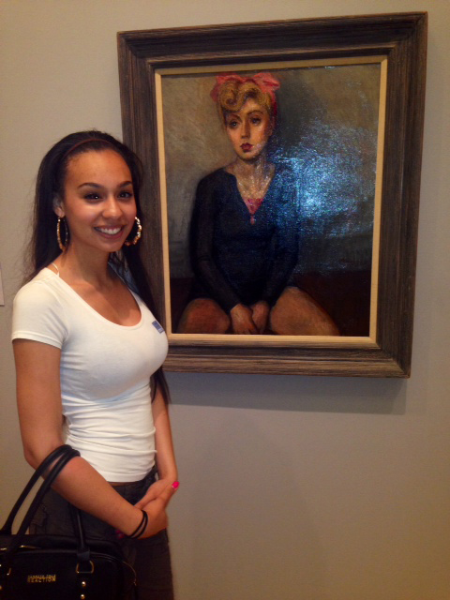
Daijah Thomas with Ballerina by Moses Soyer, n/d

Slide 4
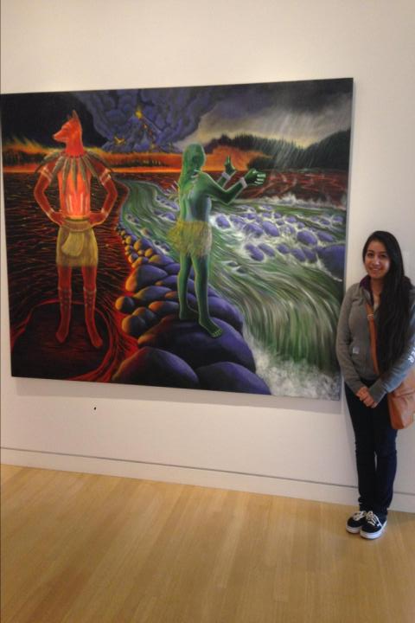
Elizabeth Morales with Welgatim’s Song, 2001, by Judith Lowery

Slide 5
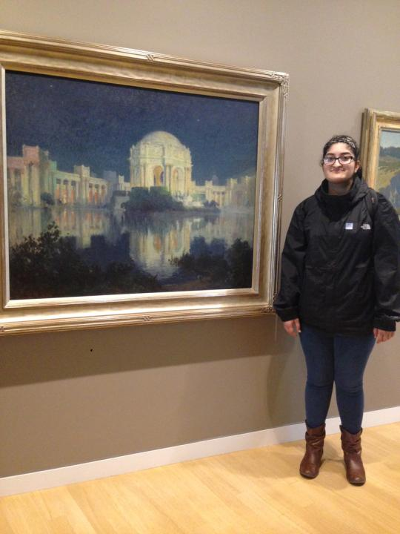
Fatima Choudhary with Palace of Fine Arts and the Lagoon by Edwin Deakin, 1915

Slide 6
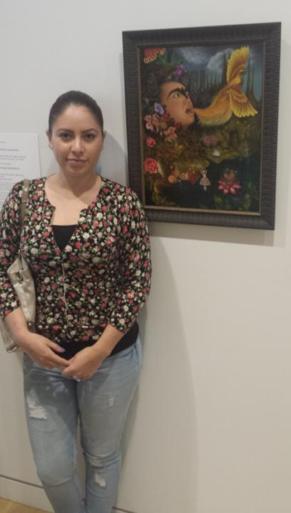
Geisha Lopez Leon with
Xochipilli’s Ecstatic Universe
by Tino Rodriguez, 2004.

Slide 7
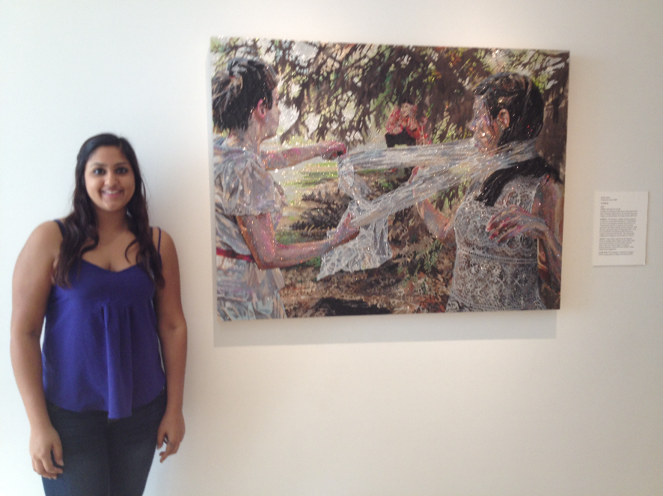
Harpreet Kaur with Voyeur by Jamie Vasta, 2007

Slide 8
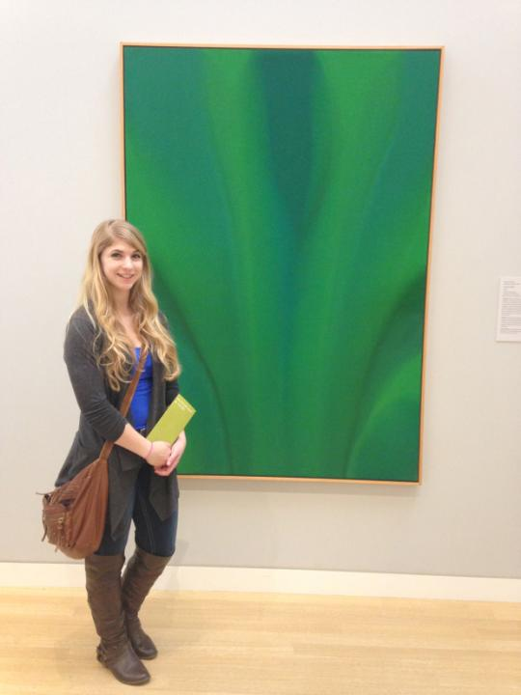
Faith Allen

Slide 9
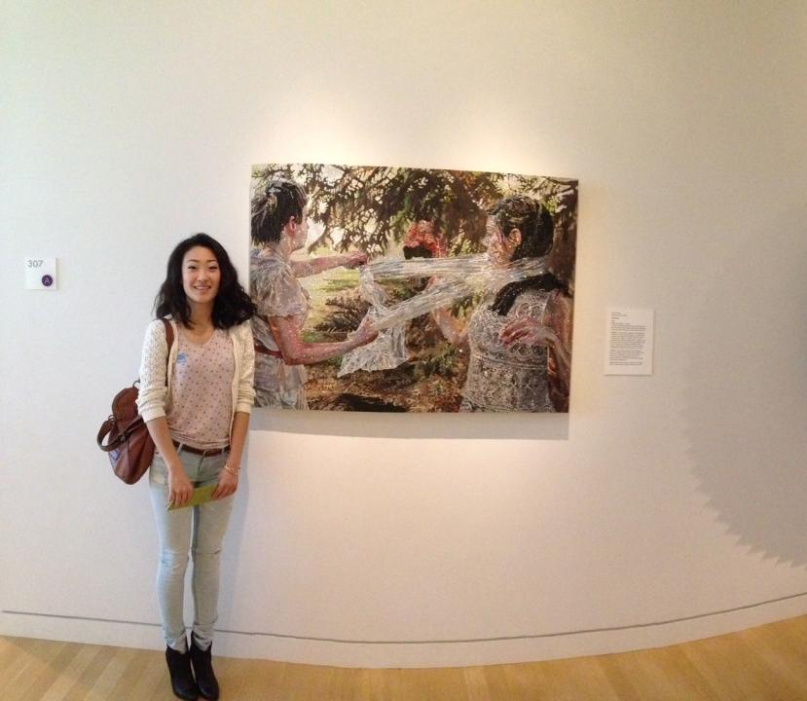
Ji Ah Ryu with Voyeur by Jamie Vasta, 2007

Slide 10
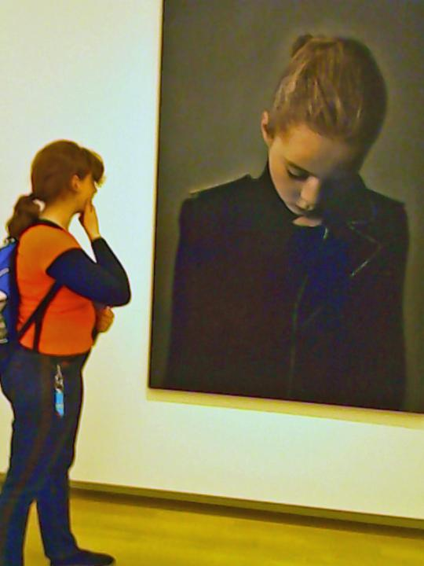
Amarylis Graybill

Slide 11
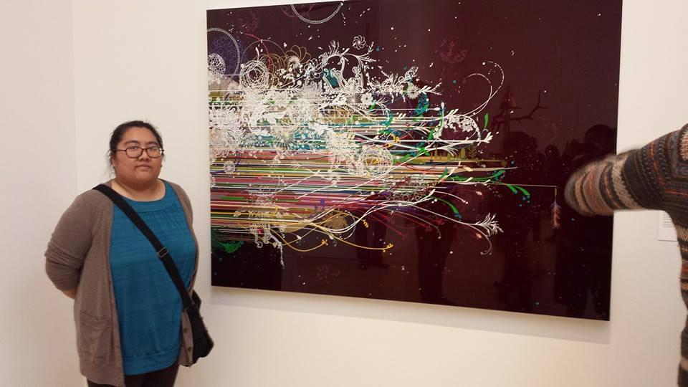
Linda Vang

Slide 12
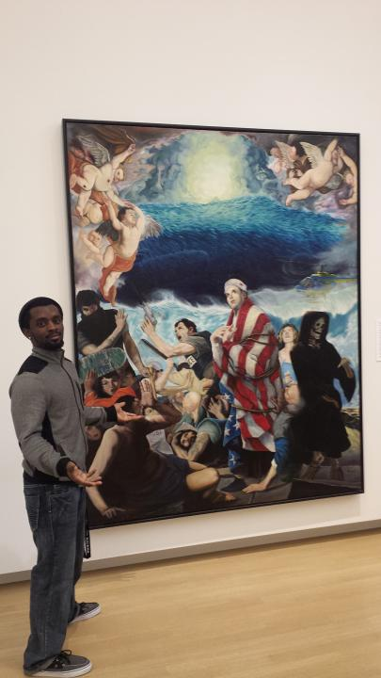
Joseph Hancock

Slide 13
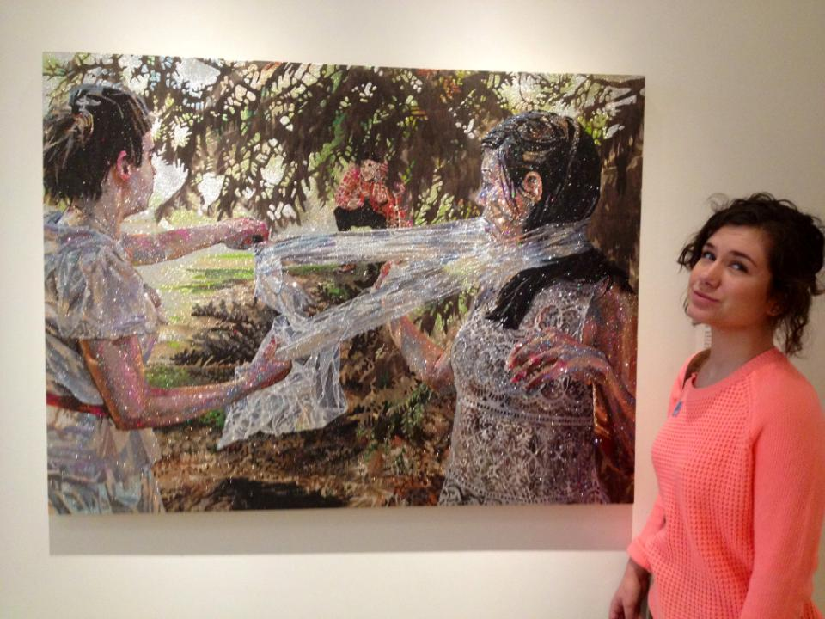
Eva Hoch

Slide 14
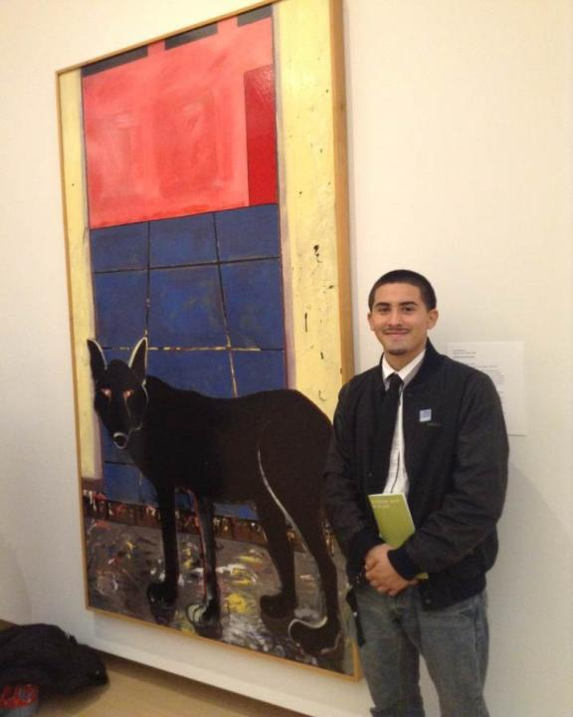
Abraham Muniz with The Wolf in the Studio by Joan Brown, 1972, Enamel on Masonite

Slide 15
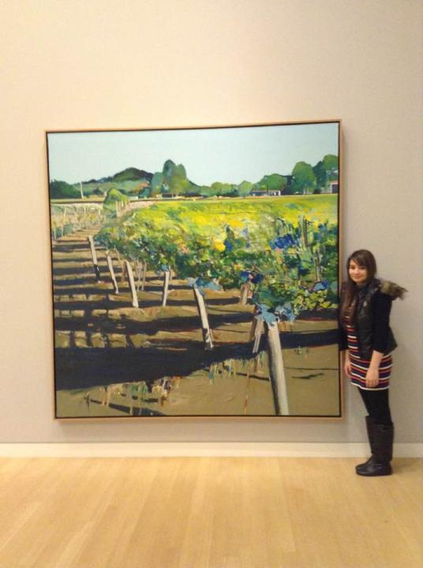
Joanna Galvan with Rutherford Vineyard by Gregory Kondos 1989, oil on canvas

Slide 16
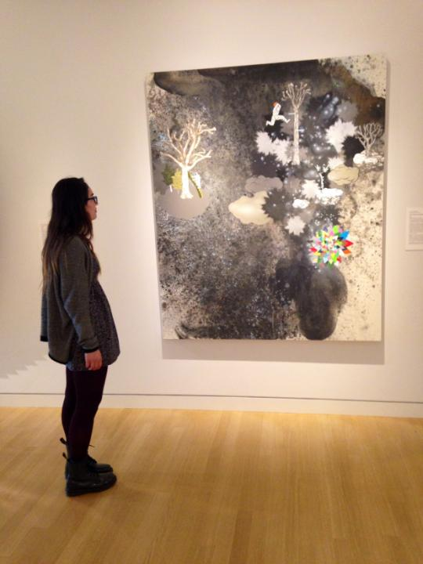
Bianca Aguirre

Slide 17
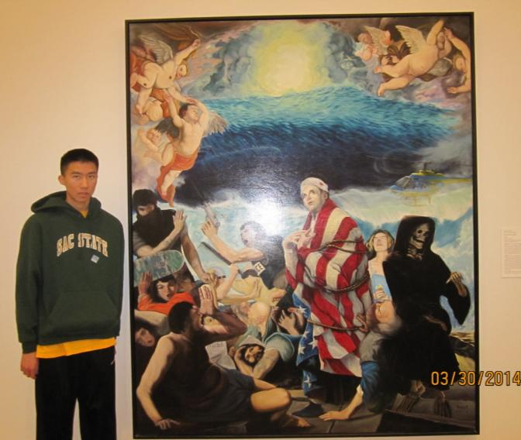
Andrew Leung with In God We Trust by Kevin Ancell, 1996

Slide 18
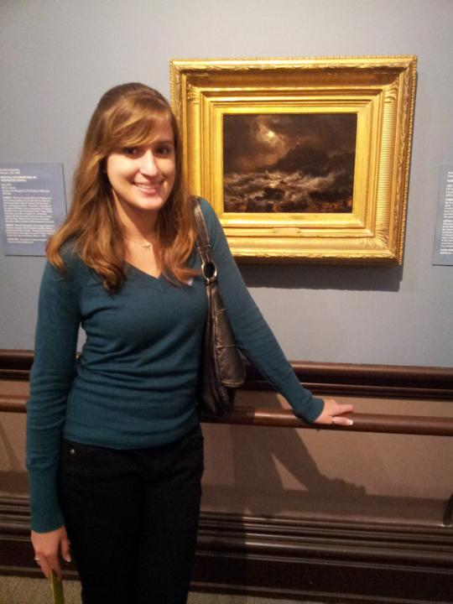
Mallory Peters with Norwegian Coast By Moonlight by Andreas Achenbach, a 19th Century German painter

Slide 19
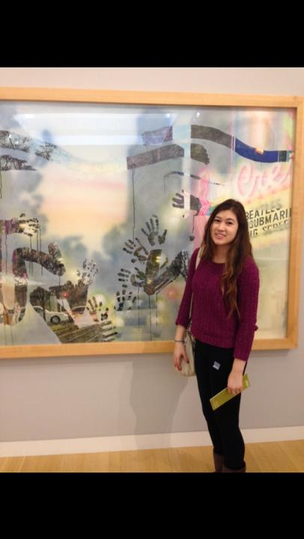
Taylor Holland with The K Street Mall and Crest Theatre by Jerald Silva

Slide 20
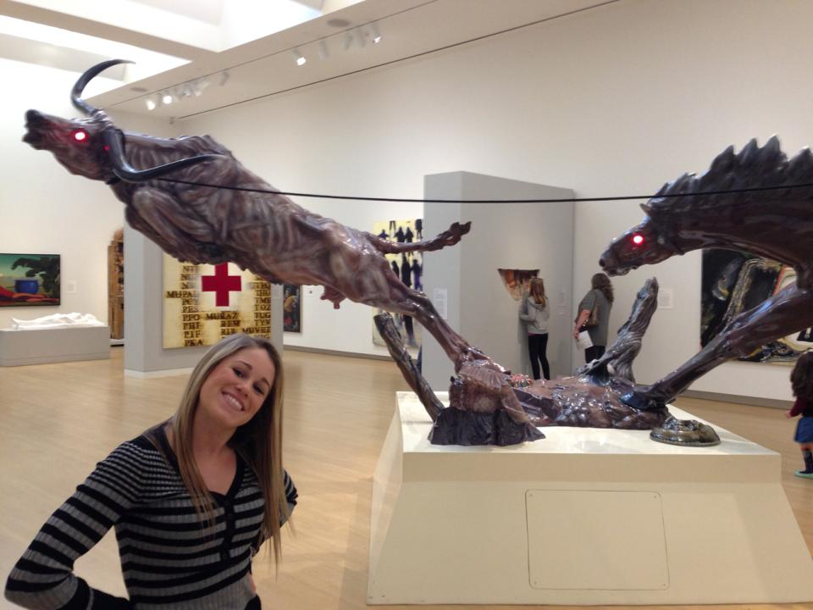
Kylie Harvey with Progress II, 1974, by Luis Jimenez

Slide 21
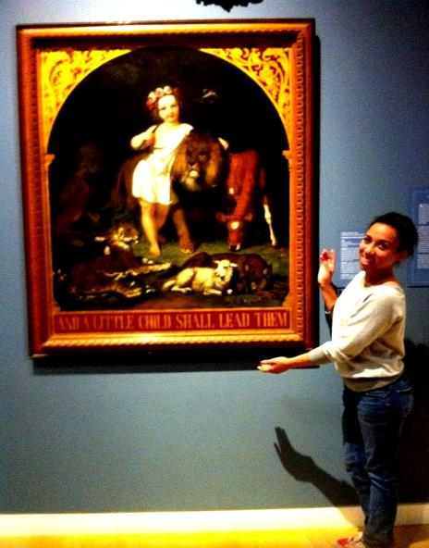
Vannessa Lewis with Charles Christian Nahl, And A Little Child Shall Lead Them, early 19th century

Slide 22
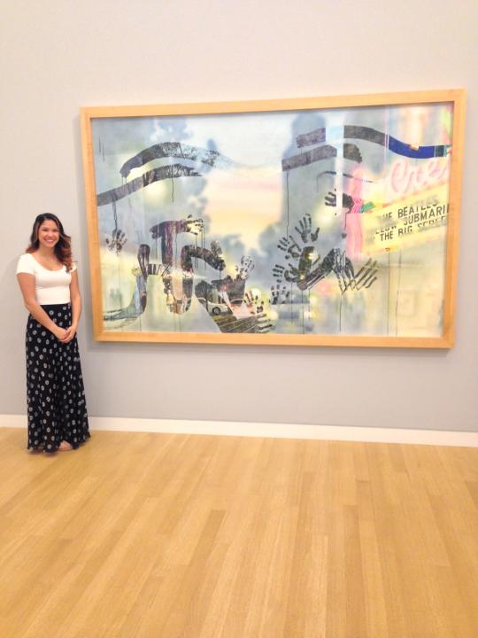
Alexandria Shipe with The K Street Mall and Crest Theatre by Jerald Silva

Slide 23
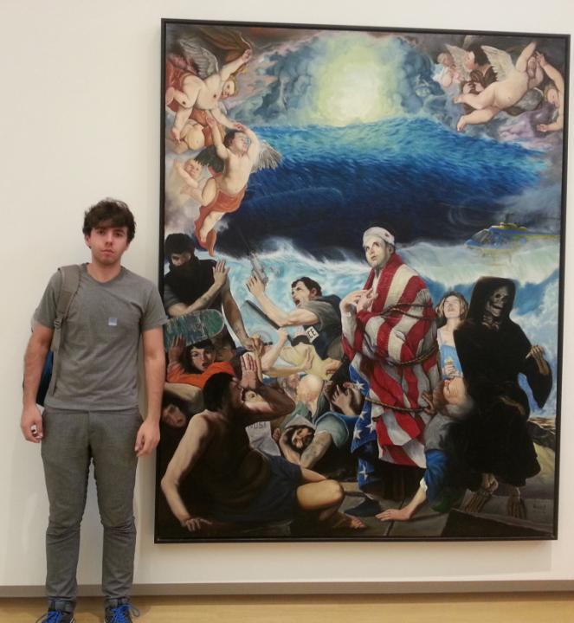
“It is very radical to me because it displays total impurity but at the same time it is called In God We Trust.”
Vladislav Kolesnikov with In God We Trust by Kevin Ancell, 1996

Slide 24
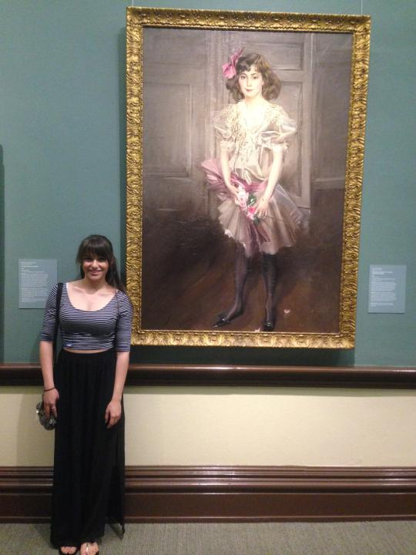
Carina Vizcarra

Slide 25
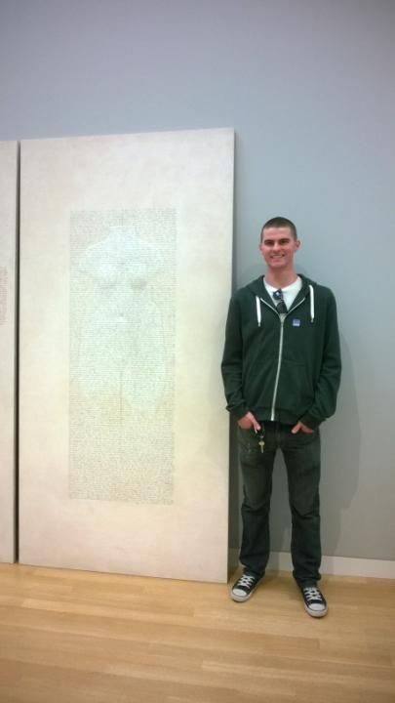
Peter Thornton with Section 1998-2002: Three Diptychs From the Winter Notebooks: PP 6, 1998-2000

Slide 26
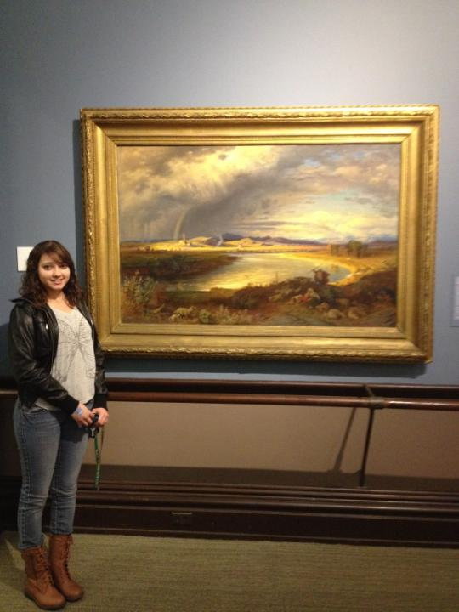
Victoria Fernandez withThunderstorm in the Roman Campagna by Albert Venus , oil on canvas,1868

Slide 27
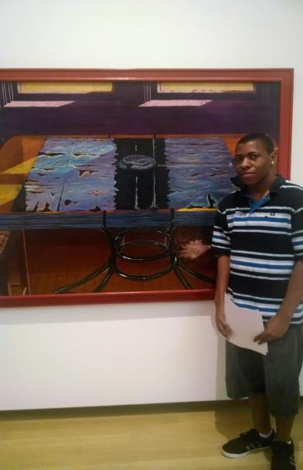
Malik Hill with Eduardo Carrillo’s Testament of the Holy Spirit, 1971

Slide 28
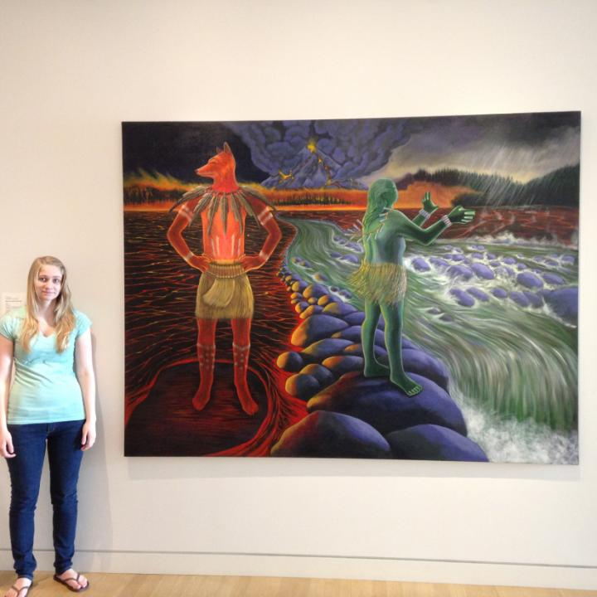
Eileen Frame with Welgatim’s Song by Judith Lowry, 2001

Slide 29
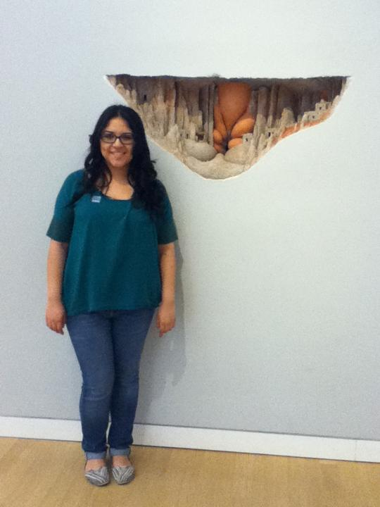
Ashley Martinez with Dwelling by Charles Simonds, 1982

Slide 30
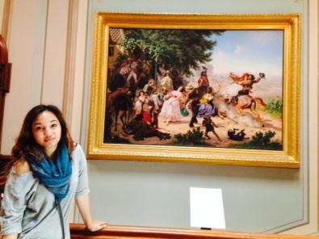
Yvanne Bolano with Charles Christian Nahl ‘s 1873 painting, The Fandango

Slide 31
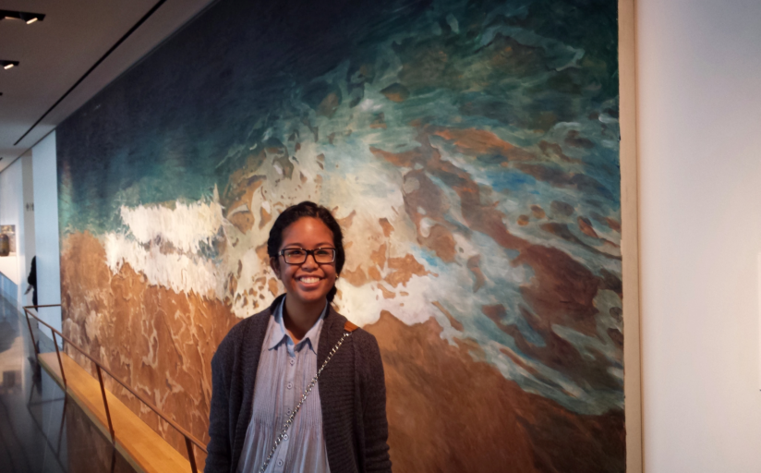
Grece Fernandez with Jennifer Bartlett’s oil painting, Pacific Ocean, 1984

Slide 32
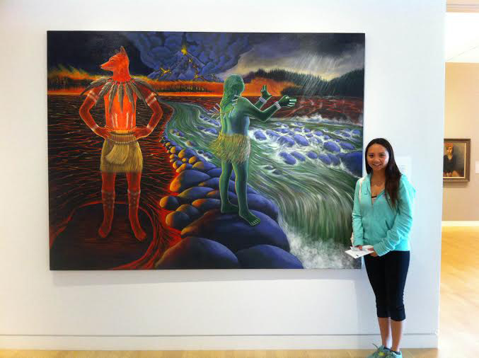
Vivian Tran with Welgatim’s Song , 2001, by Judith Lowry

Slide 33
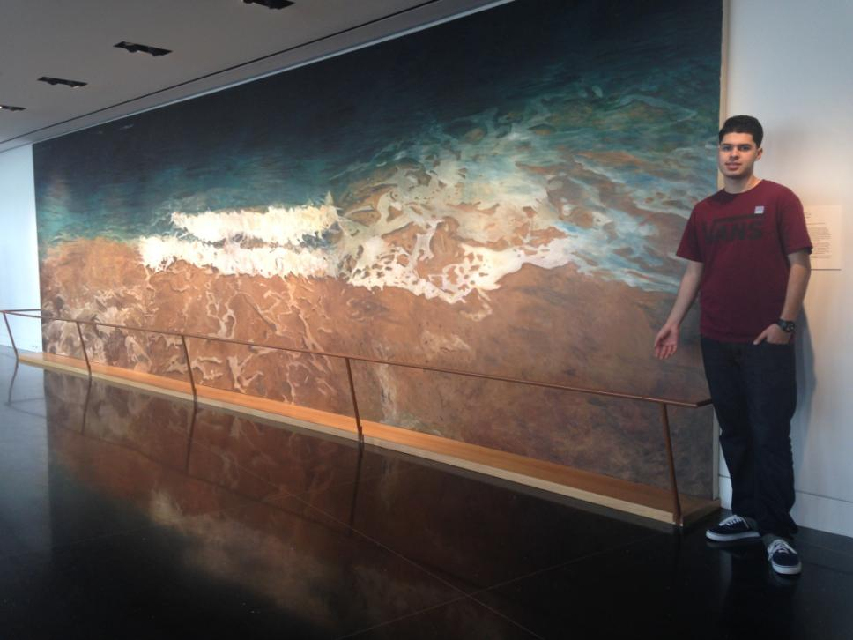
David Gonzalez with Pacific Ocean by Jennifer Bartlett, 1984

Slide 34
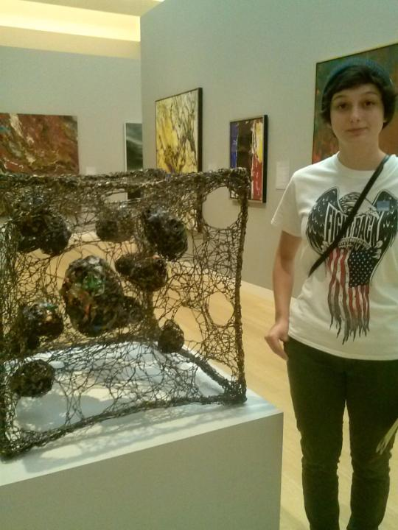
Sarah Montano with Claire Falkenstein’s Body Centered Cubic , c.1960

Slide 35
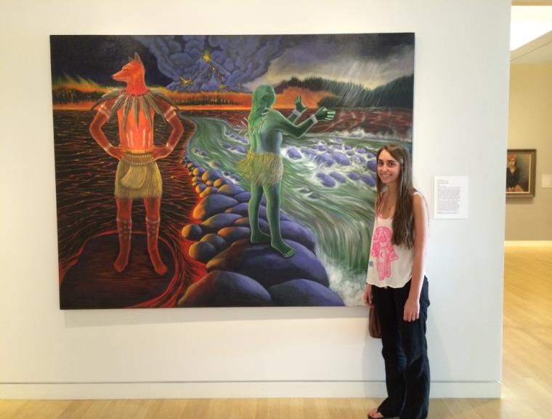
Jenny Novak with Judith Lowery’s painting, Welgatim’s Song, 2001

Slide 36
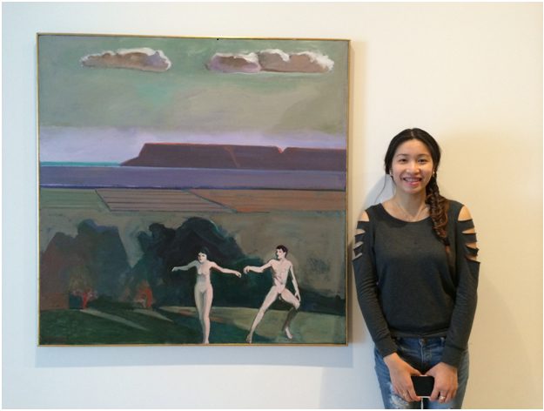
Tina Huang with William Theophilus Brown’s painting, Figures in a Field, 1966

Slide 37
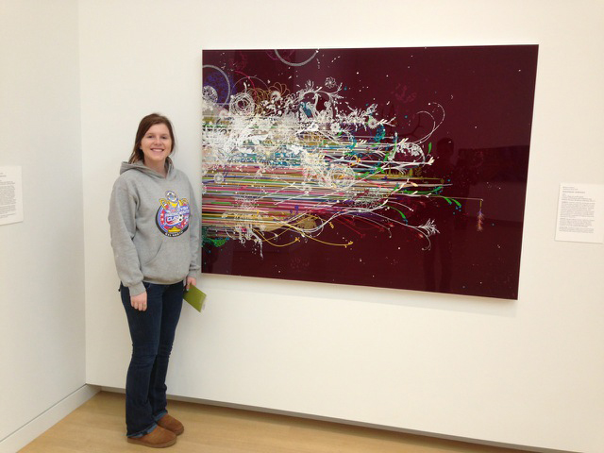
Danielle Deveau with Benicia Gantner’s
Sidestream+ Rubyspace, 2010
“It would be something I would buy
and put in my house. “

Slide 38
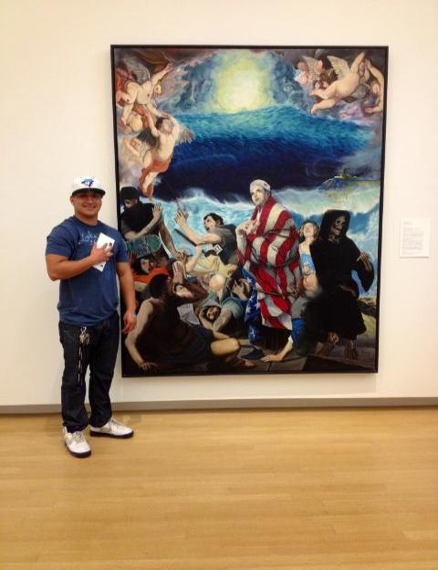
Joshua Gonzalez with In God We Trust
a painting by Kevin Ancell, 1996, oil on canvas

Slide 39
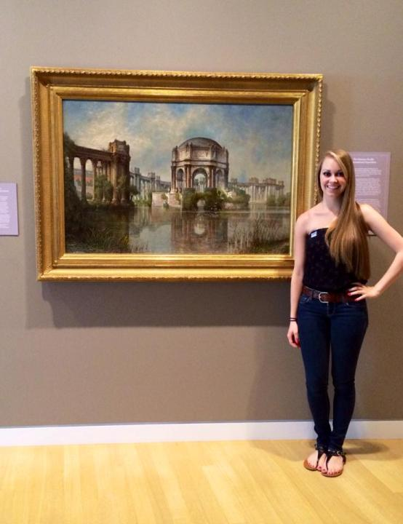
Cristina Etcheverry with Palace of Fine Arts and the Lagoon by Edwin Deakin, 1915

Slide 40
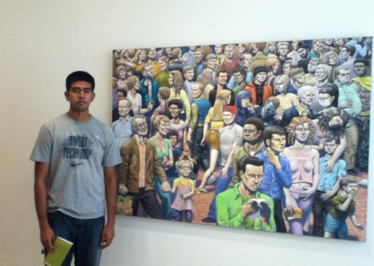
Pritesh Chand with Epidemic, a painting by Guy Colwell, 2009, acrylic on canvas

Slide 41
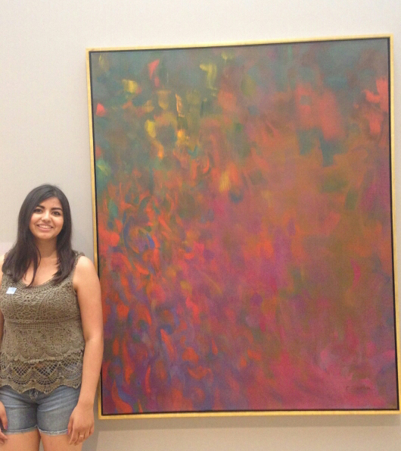
Irania Lopez with Rec, Green, and Violet , a painting by by Clay Spohn ,1961, oil on canvas.

Slide 42
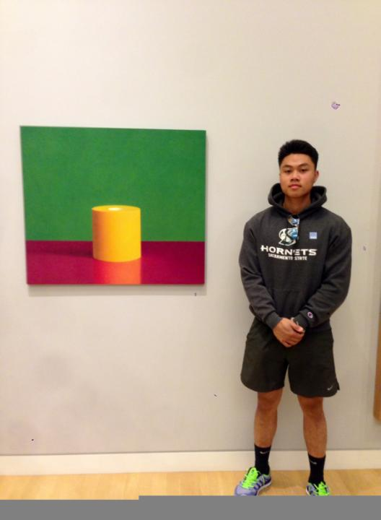
Nathan Ngo with Violet, Yellow, and Green , 1973, by Margaret Alf

Slide 43
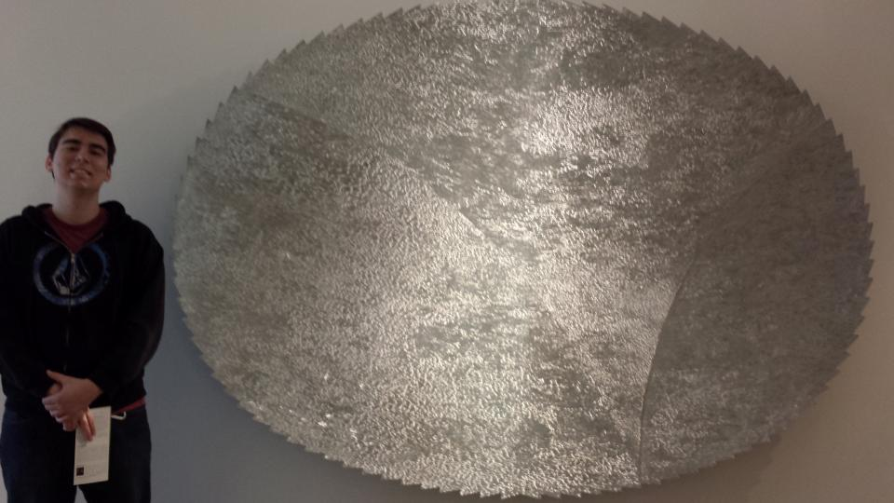
Bryan Herman with KNI725 by Andreas Nottebohm

Slide 44
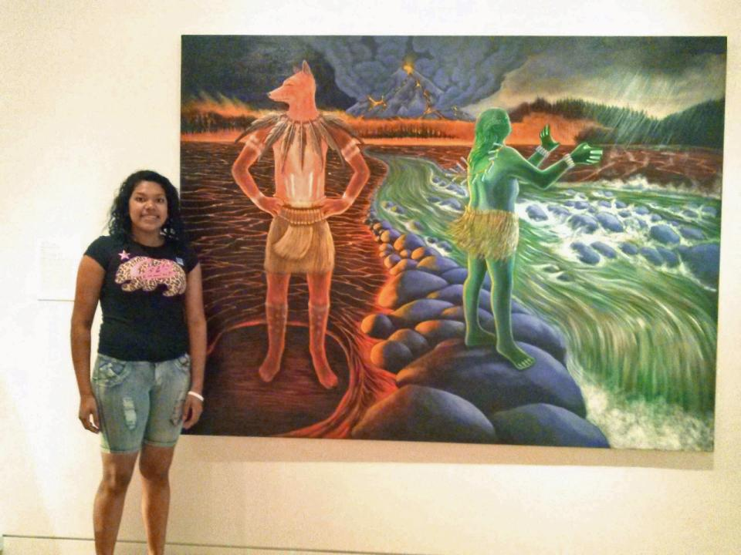
Jennifer Marin

Slide 45
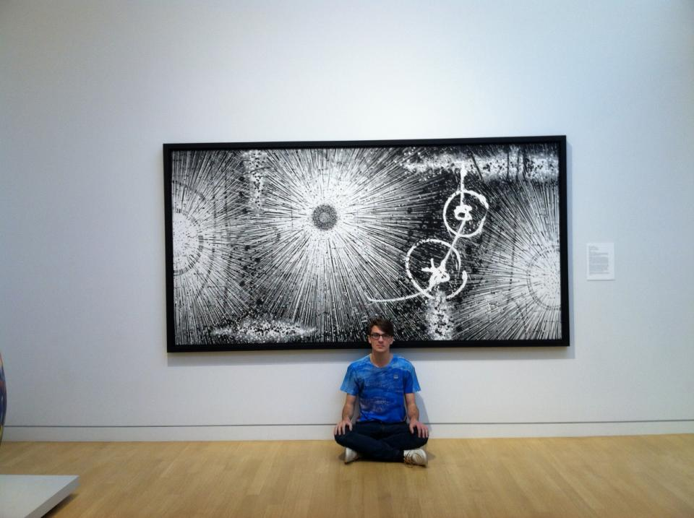
James Gates

Slide 46
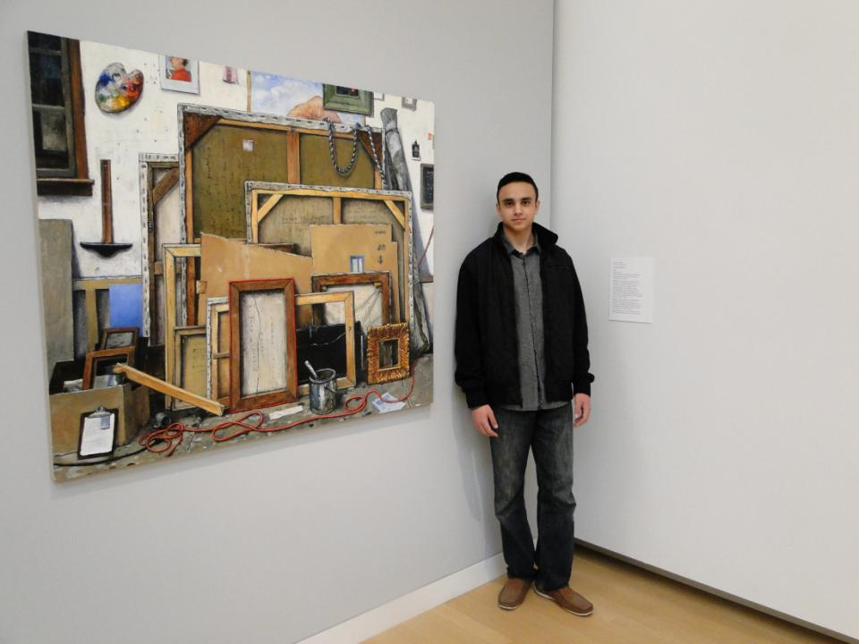
Dmitry Arakelyan with After the Fact by Chester Arnold

Slide 47
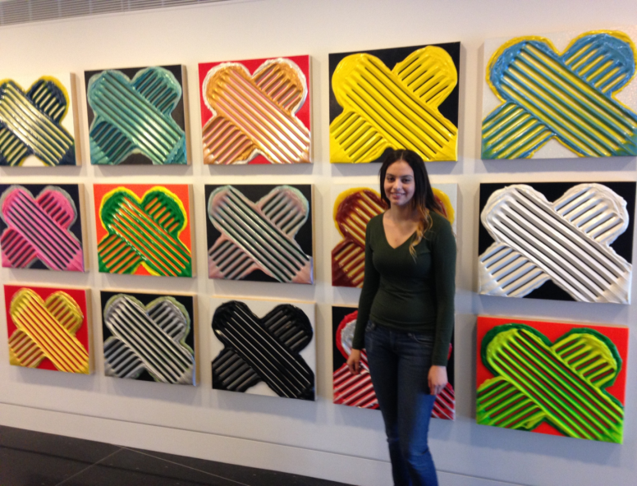
Brenda Ordaz with Untitled, acrylic on panel, 2010, by Albert Contreras

Slide 48
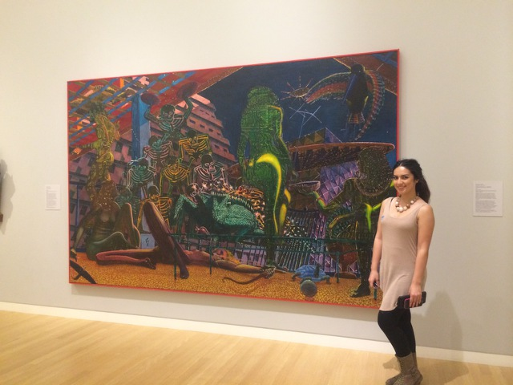
Carla Villa with Eduardo Carrillo’s Las Tropicanas, 1974

Slide 49
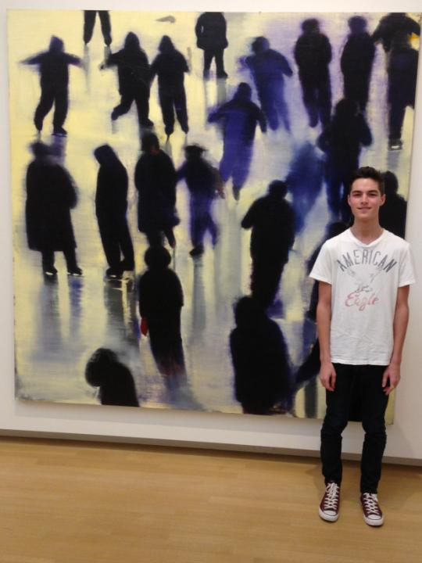
Hunter Wood with Winter's Blue Cold by Christopher Brown, oil on canvas, 1990-1991

Slide 50
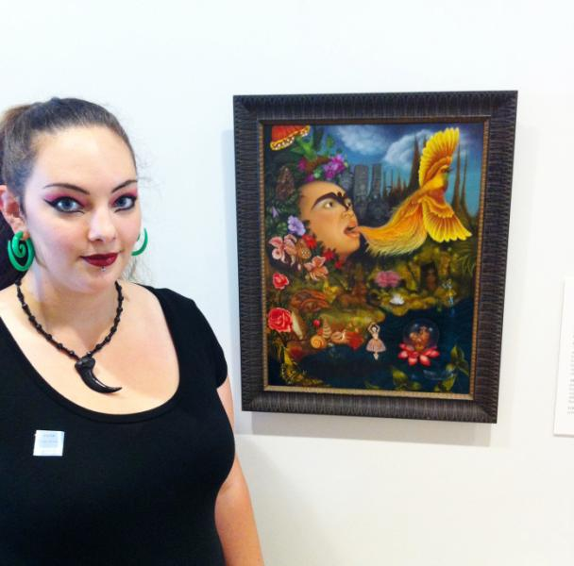
Laurel Glazzard, Xochipilli’s Ecstatic Universe, 2004 by Tino Rodriguez

Slide 51
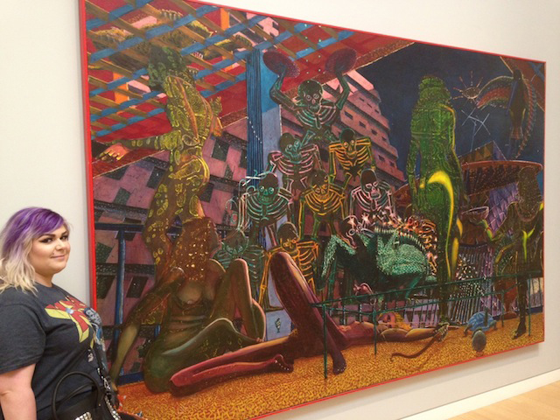
Ashley Zito with Eduardo Carrillo’s Las Tropicanas painted in 1974, oil on panel

Slide 52
Dimitriy Verstivskiy

Slide 53
Christy Brown with a Sam Francis painting

Slide 54
Sarah Graver with Wayne Thiebaud’s oil on linen painting, Street and Shadow, 1982-1983

Slide 55
Marlin Garcia with Judith Lowery’s painting, Welgatim’s Song, 2001

Slide 56
Evan Munoz, with Untitled, a 1974 cast bronze sculpture by Manuel Neri

Slide 57
Alissa Aguirre and friend with Judith Lowery’s painting, Welgatim’s Song, 2001

Slide 58
Kristen Allen with Wayne Thiebaud’s Boston Cremes, 1962
”It reminded me of late nights in diners with friends, or standing in line for a piece of birthday cake at a kid’s party.”

Slide 59
Brandon Hayworth with In God We Trust by Kevin Ancell

Slide 60
Jordan Krupa with Paul Lauritz’s The High Sierras, 1925-1929

Slide 61
Caitlin Pearsall with Barbara Cerno and Joseph Cerno Sr.'s Pictorial Train Olla, 2011
“…the combination of a tradtional medium featuring a contemporary subject creates something truly special.”

Slide 62
Adriana Espinoza with Paul Jenkins’
Phenomena Intervening Mantle, 2006, acrylic on canvas

Slide 63
Derek Embree with StoneWall by Shadow Birk, 1999

Slide 64
Kayla Nalley with Off Mission Point (Point Lobos), by Guy Rose around 1914

Slide 65
Gabriela Quiroz-Gonzalez with Carl Wilhelm Hubner’s The Village on Fire,1854

Slide 66
“I picked this one because the work was not too abstract and not too idealized. “
Brandon Arellano-Mora with
Otis Oldfield’s Self Portrait –Shorn

Slide 67
Chelsea Winston with Robert Bechtle ‘s French Doors II, 1966

Slide 68
Ari Stubblefield with Epidemic by Guy Colwell, 2009

Slide 69
Thomas Haas with Benicia Gantner’s
Sidestream+ Rubyspace, 2010

