Slide 1

Process Costing
Chapter 4
Managerial Accounting
Seventeenth edition
© 2021 McGraw Hill. All rights reserved. Authorized only for instructor use in the classroom. No reproduction or further distribution permitted without the prior written consent of McGraw Hill.

Slide 2
Similarities Between Job-Order and Process Costing
Both systems assign material, labor, and overhead costs to products, and they provide a mechanism for computing unit product costs.
Both systems use the same manufacturing accounts, including Manufacturing Overhead, Raw Materials, Work in Process, and Finished Goods.
The flow of costs through the manufacturing accounts is basically the same in both systems.

Slide 3
Differences Between Job-Order and Process Costing
Job-Order Costing | Process Costing
Many different jobs are worked on during each period, with each job having unique production requirements. Costs are accumulated by individual job. Unit costs are computed by job on the job cost sheet. | A single product is produced either on a continuous basis or for long periods of time. All units of product are identical. Costs are accumulated by department. Unit costs are computed by department.

Slide 4
Quick Check 1
Process costing is used for products that are:
a. Different and produced continuously.
b. Similar and produced continuously.
c. Individual units produced to customer specifications.
d. Purchased from vendors.

Slide 5
Quick Check 1a
Process costing is used for products that are:
a. Different and produced continuously.
b. Answer: Similar and produced continuously.
c. Individual units produced to customer specifications.
d. Purchased from vendors.

Slide 6
Processing Departments
Any unit in an organization where materials, labor, or overhead are added to the product.
The activities performed in a processing department are performed uniformly on all units of production. Furthermore, the output of a processing department must be homogeneous.
Products in a process costing environment typically flow in a sequence from one department to another.

Slide 7
Learning Objective 1
Record the flow of materials, labor, and overhead through a process costing system.

Slide 8
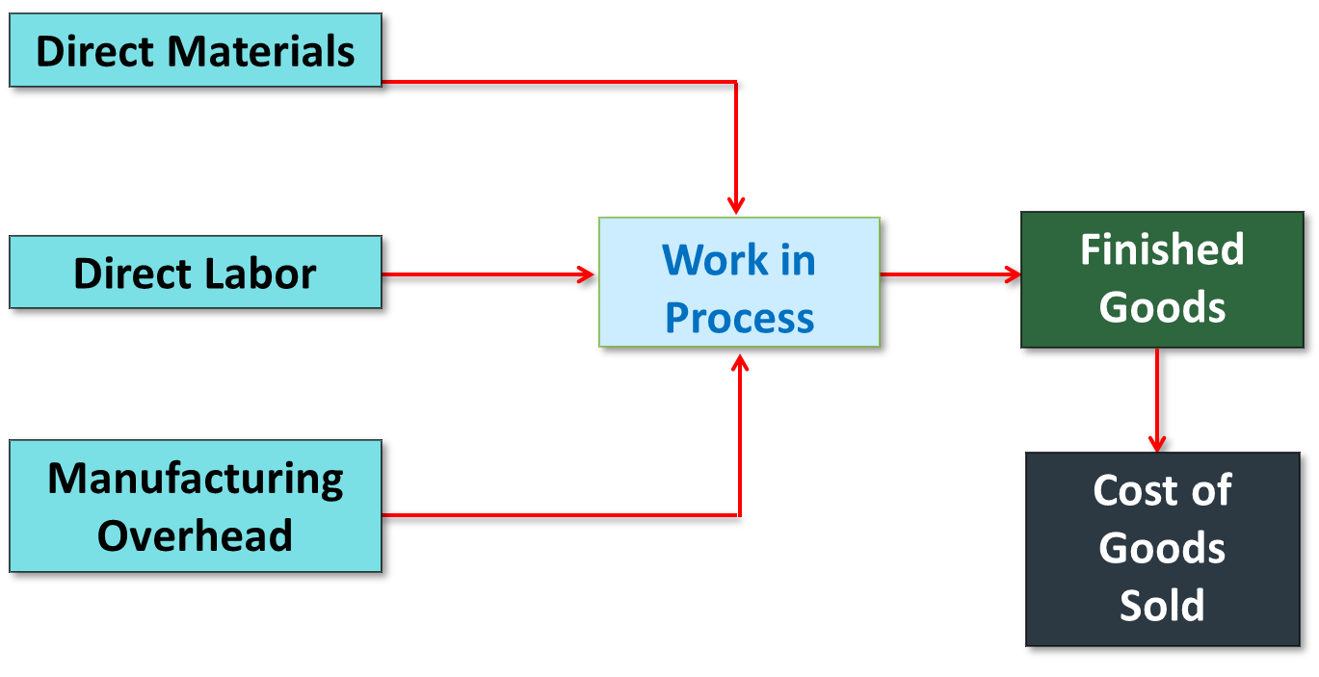
The Flow of Materials, Labor, and Overhead Costs 1
Access the text alternative for slide images.

Slide 9
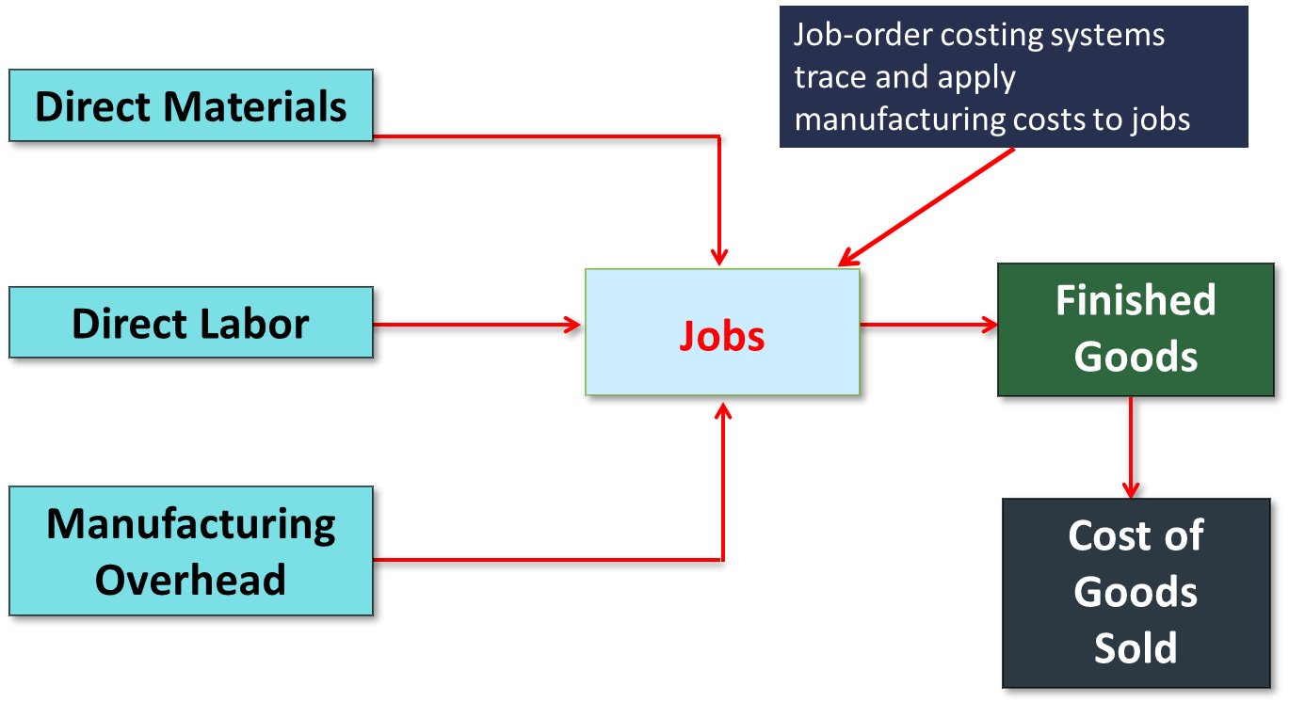
The Flow of Materials, Labor, and Overhead Costs 2

Slide 10
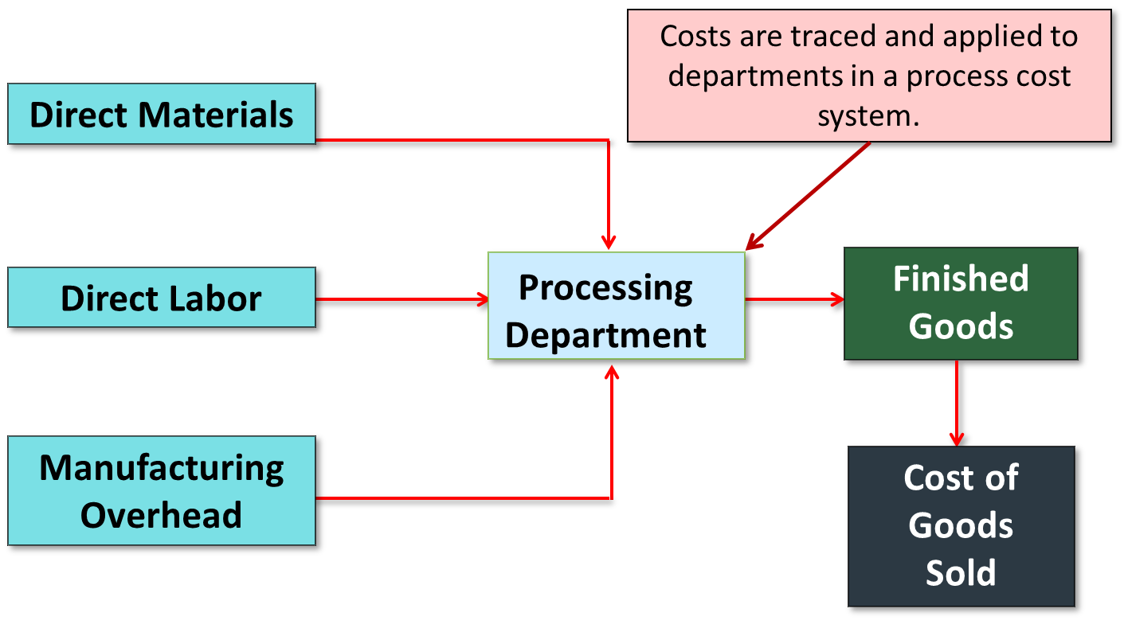
The Flow of Costs in a Process Costing System

Slide 11
Flow of Raw Material Costs
For purposes of this example, assume there are two processing departments: Departments A and B.
We will use T-accounts and journal entries.

Slide 12
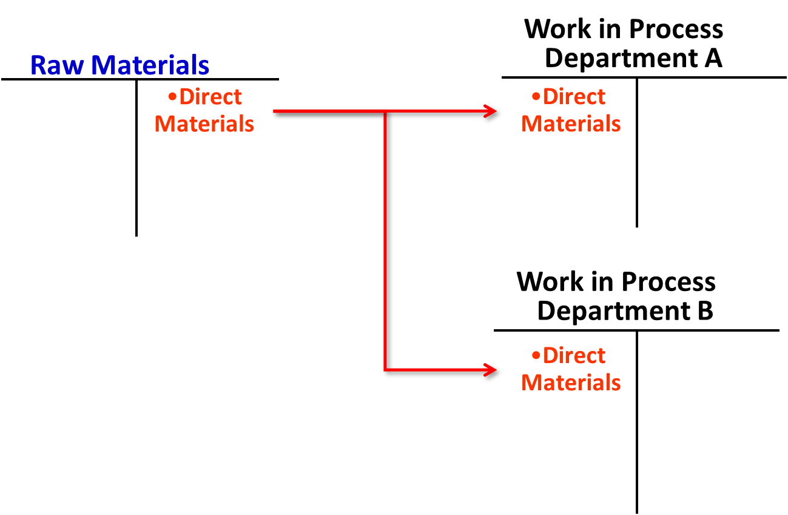
Flow of Raw Material Costs: T-Account Form
Access the text alternative for slide images.

Slide 13
Flow of Raw Material Costs: Journal Entry Form
As in job-order costing, materials are drawn from the storeroom using a materials requisition form. Materials can be added in any processing department. Here is the journal entry to issue raw materials to processing Department A and Department B.
Work in Process—Department A | XXXXX
Work in Process—Department B | XXXXX
Raw Materials |  | XXXXX

Slide 14
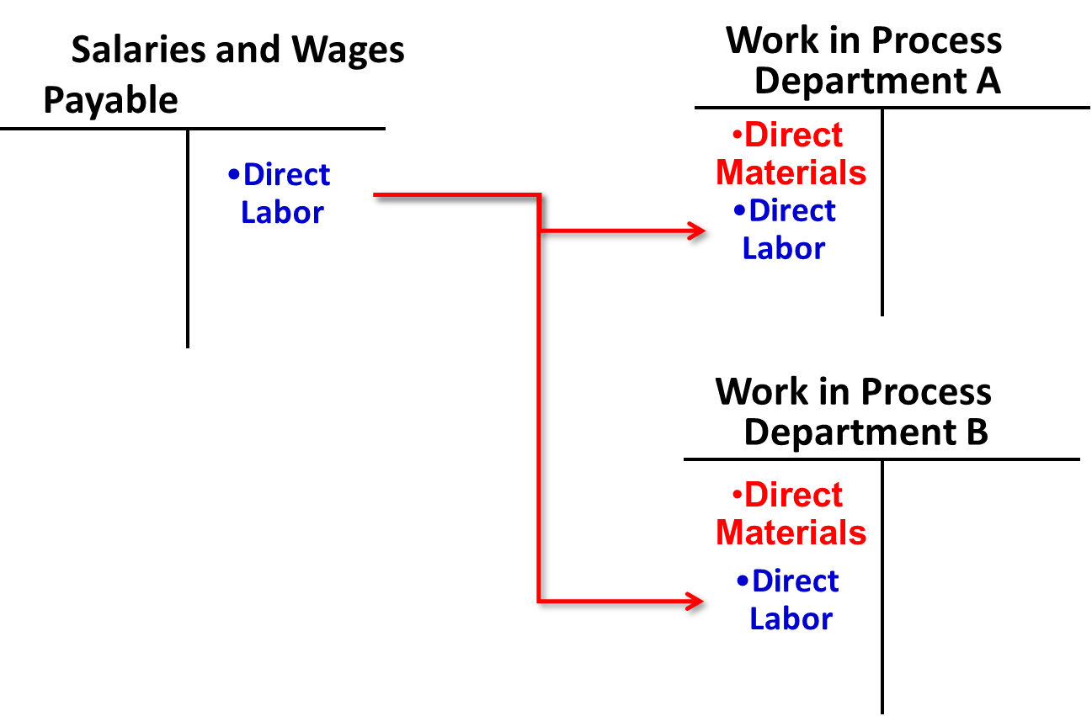
The Flow of Labor Costs: T-Account Form
Access the text alternative for slide images.

Slide 15
The Flow of Labor Costs: Journal Entry Form
In process costing, labor costs are traced to departments—not to individual jobs. The following journal entry records the labor costs recorded to Department A and Department B.
Work in Process—Department A | XXXXX
Work in Process—Department B | XXXXX
Salaries and Wages Payable |  | XXXXX

Slide 16
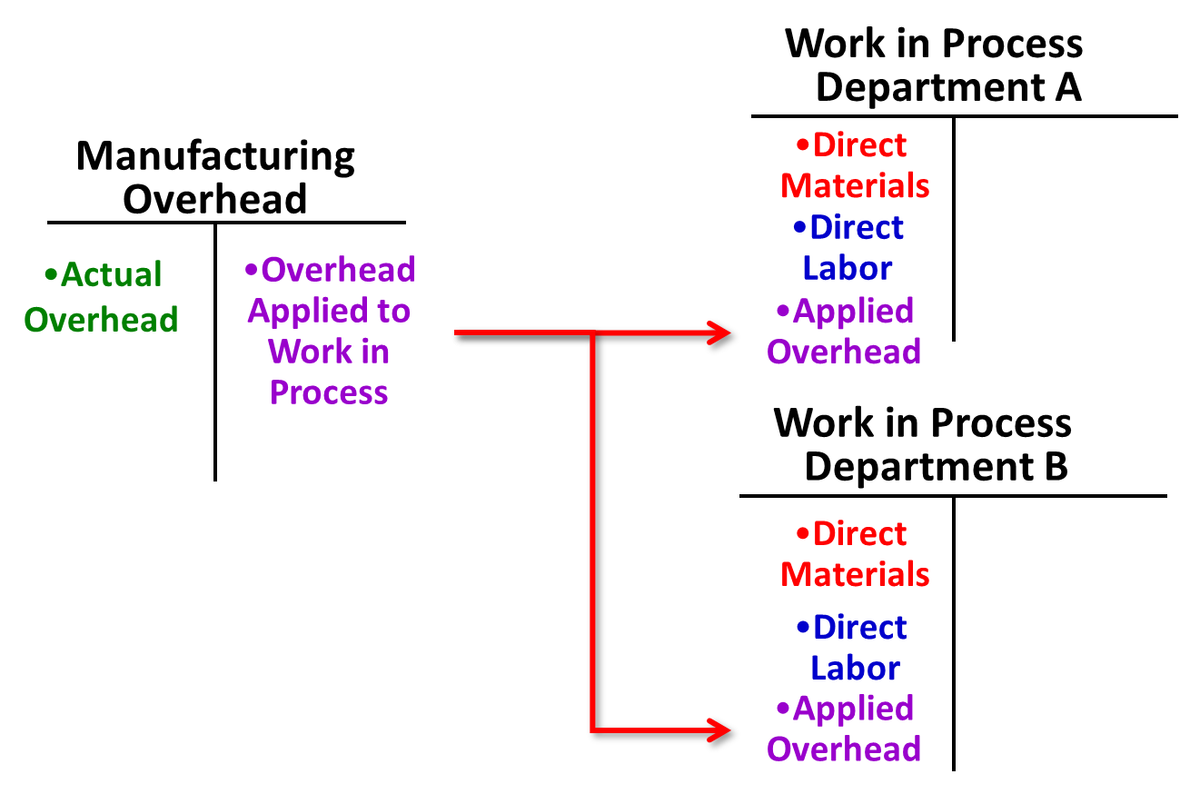
The Flow of Manufacturing Overhead Costs: T-Account Form
Access the text alternative for slide images.

Slide 17
The Flow of Manufacturing Overhead Costs: Journal Entry Form
In process costing, as in job-order costing, predetermined overhead rates are usually used. Manufacturing overhead cost is applied according to the amount of the allocation base that is incurred in the department. The following journal entry records the overhead cost applied to Department A and Department B.
Work in Process—Department A | XXXXX
Work in Process—Department B | XXXXX
Manufacturing Overhead |  | XXXXX

Slide 18
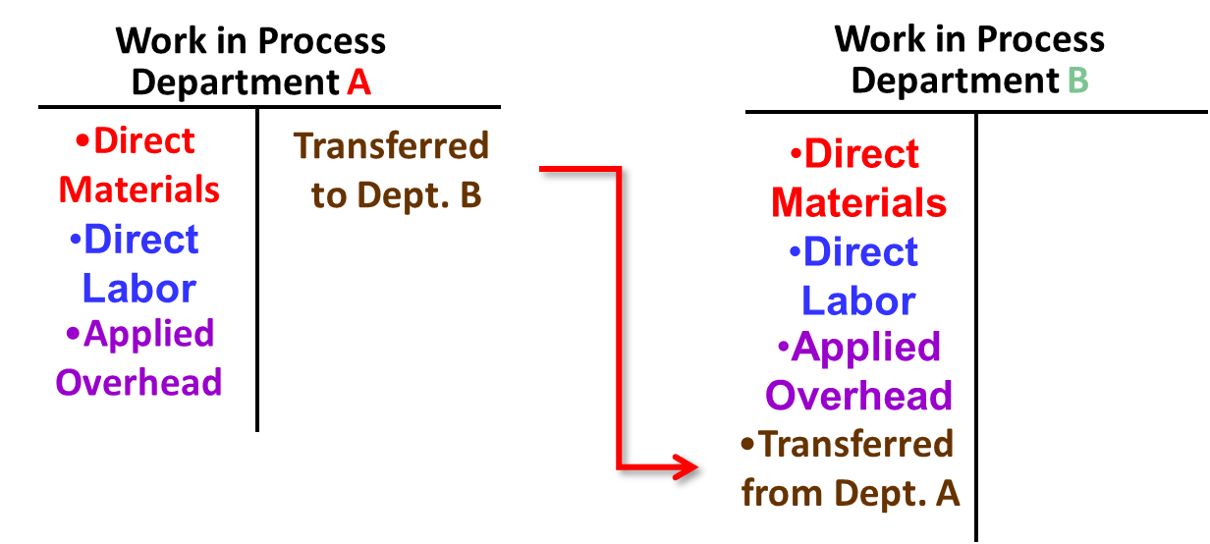
Transfers from Work in Process—Dept. A to Work in Process—Dept. B: T-Account Form
The transferred-in costs from Department A are added to the manufacturing costs incurred in Department B.
Access the text alternative for slide images.

Slide 19
Transfers from Work in Process—Dept. A to Work in Process—Dept. B: Journal Entry Form
Once processing has been completed in a department, the units are transferred to the next department for further processing.
Work in Process—Department B | XXXXX
Work in Process—Department A |  | XXXXX

Slide 20
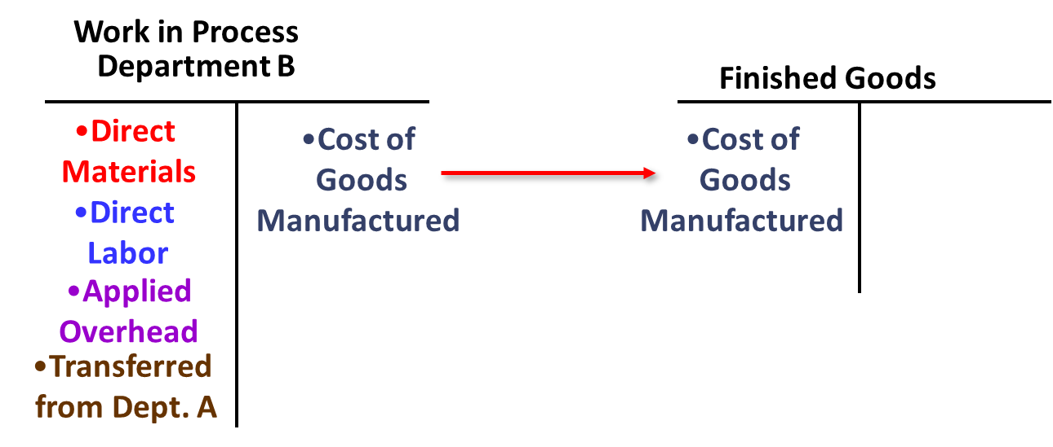
Transfers from Work in Process—Dept. B to Finished Goods: T-Account Form

Slide 21
Transfers from Work in Process—Dept. B to Finished Goods: Journal Entry Form
After processing has been finished in Department B, the costs of the completed units are transferred to the Finished Goods inventory account.
Finished Goods | XXXXX
Work in Process—Department B |  | XXXXX

Slide 22
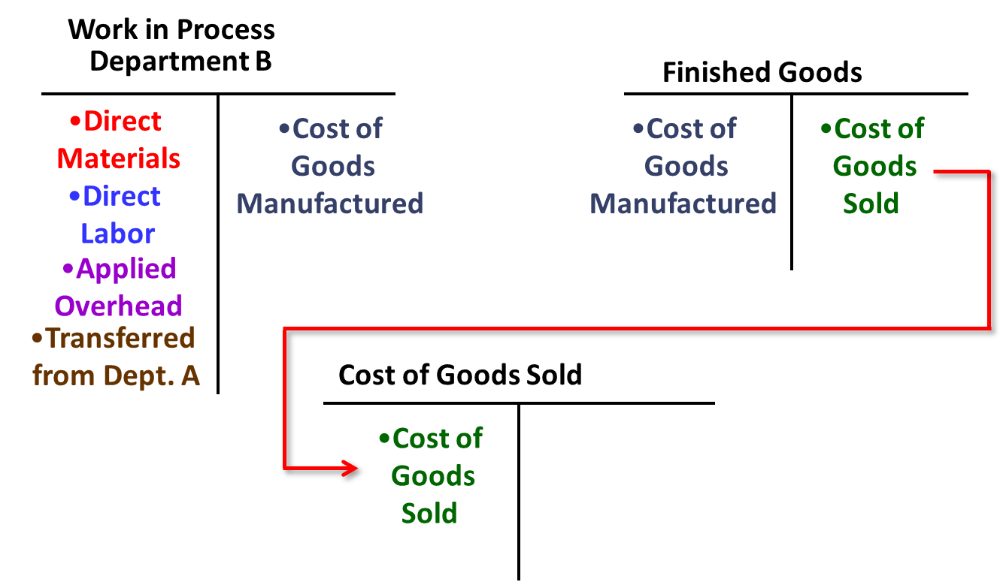
Transfers from Finished Goods Inventory to Cost of Goods Sold: T-Account Form

Slide 23
Transfers from Finished Goods to Cost of Goods Sold: Journal Entry Form
Finally, when a customer’s order is filled and units are sold, the cost of the units is transferred to Cost of Goods Sold.
Cost of Goods Sold | XXXXX
Finished Goods |  | XXXXX

Slide 24
Process Costing Computations: Three Key Concepts 1
In process costing, each department needs to calculate two numbers for financial reporting purposes—the cost of its ending work in process inventory and the cost of its completed units that were transferred to the next stage of the production process. The key to deriving these two numbers is calculating unit costs within each department.
Key Concept #1: The two methods for performing the computations are the weighted-average method and the FIFO method. The weighted-average method of process costing calculates unit costs by combining costs and outputs from the current and prior periods. The FIFO method of process costing, which will be covered in Appendix 4A, calculates unit costs based solely on the costs and outputs from the current period.

Slide 25
Process Costing Computations: Three Key Concepts 2
Characteristics of the weighted-average method:
1. This method makes no distinction between work done in the prior and current periods. It blends units and costs from the prior and current periods.
2. The equivalent units of production for a department are the number of units transferred to the next department (or finished goods) plus the equivalent units in the department’s ending work in process inventory.

Slide 26
Process Costing Computations: Three Key Concepts 3
Key Concept #2: Conversion Costs
Direct labor costs are often small in comparison to the other product costs in process cost systems.

Slide 27
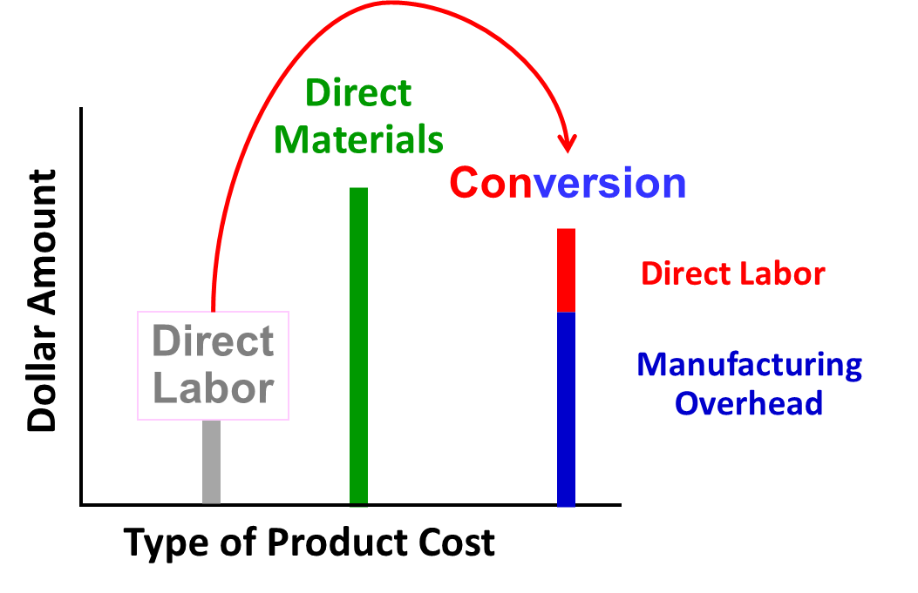
Process Costing Computations: Three Key Concepts 4
Therefore, direct labor and manufacturing overhead are often combined into one classification of product cost called conversion costs.
The example combines these costs:
Access the text alternative for slide images.

Slide 28
Process Costing Computations: Three Key Concepts 5
Key Concept #3: Equivalent Units
1. Equivalent units: Defined as the product of the number of partially completed units and the percentage completion of those units.
2. Equivalent units need to be calculated because a department usually has some partially completed units in its beginning and ending inventories. These partially completed units complicate the determination of a department’s output for a given period and the unit cost that should be assigned to that output.

Slide 29
Calculating Equivalent Units
Equivalent units = Number of partially completed units × Percentage completion
Equivalent units is the product of the number of partially completed units and the percentage completion of those units with respect to the processing in the department. The equivalent units is the number of complete units that could have been obtained from the materials and effort that went into the partially complete units.
Assume Department A has 500 units in its ending work in process inventory that are 60% complete with respect to processing in the department. These 500 partially complete units are equivalent to 300 fully complete units (500 × 60% = 300). Department A’s ending work in process inventory would contain 300 equivalent units for the period.

Slide 30
Quick Check 2
For the current period, Jones started 15,000 units and completed 10,000 units, leaving 5,000 units in process 30% complete. How many equivalent units of production did Jones have for the period?
a. 10,000.
b. 11,500.
c. 13,500.
d. 15,000.

Slide 31
Quick Check 2a
For the current period, Jones started 15,000 units and completed 10,000 units, leaving 5,000 units in process 30% complete. How many equivalent units of production did Jones have for the period?
a. 10,000.
b. Answer: 11,500.
10,000 units + (5,000 units × 0.30)
= 11,500 equivalent units
c. 13,500.
d. 15,000.

Slide 32
Learning Objective 2
Compute the equivalent units of production using the weighted-average method.

Slide 33
Step 1: Compute the Equivalent Units of Production 1
Smith Company reported the following activity in the Assembly Department for the month of June:
 | Units | Percent Completed Materials | Percent Completed Conversion
Work in process, June 1 | 300 | 40% | 20%
Units started into production in June | 6,000
Units completed and transferred out of Department A during June | 5,400
Work in process, June 30 | 900 | 60% | 30%

Slide 34
Step 1: Compute the Equivalent Units of Production 2
Begin by calculating the equivalent units completed and transferred out of the Assembly Department in June (5,400 units).
 | Materials |  | Conversion
Units completed and transferred out of the department in June | 5,400 |  | 5,400
 | . |  | .

Slide 35
Step 1: Compute the Equivalent Units of Production 3
Next, identify the equivalent units of production in ending work in process with respect to materials for the month (540 units) and add this to the 5,400 units from Step 1.
 | Materials |  | Conversion
Units completed and transferred out of the department in June | 5,400 |  | 5,400
Work in process, June 30:
900 units × 60% | 540 |  | .
Equivalent units of production in the department during June | 5,940 |  | .

Slide 36
Step 1: Compute the Equivalent Units of Production 4
Finally, identify the equivalent units of production in ending work in process with respect to conversion for the month (270 units) and add this to the 5,400 units.
 | Materials |  | Conversion
Units completed and transferred out of the department in June | 5,400 |  | 5,400
Work in process, June 30:
900 units × 60% | 540
900 units × 30% | . |  | 270
Equivalent units of production in the department during June | 5,940 |  | 5,670

Slide 37
Step 1: Compute the Equivalent Units of Production 5
Equivalent units of production always equals:
Units completed and transferred
+ Equivalent units remaining in work in process
 | Materials |  | Conversion
Units completed and transferred out of the department in June | 5,400 |  | 5,400
Work in process, June 30:
900 units × 60% | 540
900 units × 30% | . |  | 270
Equivalent units of production in the department during June | 5,940 |  | 5,670

Slide 38
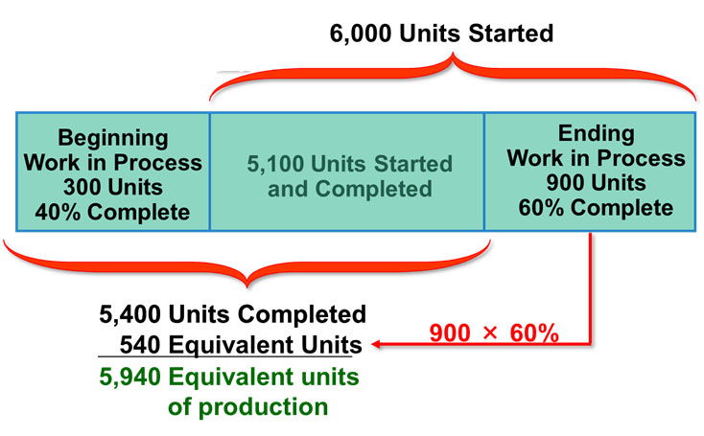
Step 1: Compute the Equivalent Units of Production 6
Materials
Access the text alternative for slide images.

Slide 39
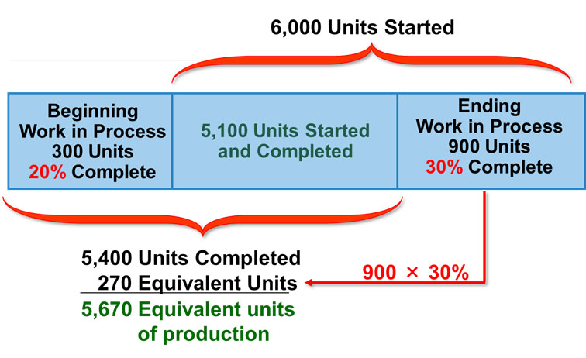
Step 1: Compute the Equivalent Units of Production 7
Conversion
Access the text alternative for slide images.

Slide 40
Learning Objective 3
Compute the cost per equivalent unit using the weighted-average method.

Slide 41
Step 2: Compute the Cost per Equivalent Unit 1
Beginning Work in Process Inventory: 300 units
Materials: 40% complete $6,119
Conversion: 20% complete $3,920
Production started during June 6,000 units
Production completed during June 5,400 units
Costs added to production in June
Materials cost $118,621
Conversion cost $81,130
Ending Work in Process Inventory: 900 units
Materials: 60% complete
Conversion: 30% complete

Slide 42
Step 2: Compute the Cost per Equivalent Unit 2
The formula for computing the cost per equivalent unit is:
Weighted-Average Method
(a separate calculation is made for each cost category in each processing department)

Slide 43
Step 2: Compute the Cost per Equivalent Unit 3
Here is a schedule with the cost and equivalent unit information.
 | Total Cost | Materials | Conversion
Cost to be accounted for:
Work in process, June 1 | $ 10,039 | $ 6,119 | $ 3,920
Cost added in Assembly | 199,751 | 118,621 | 81,130
Total cost | $209,790 | $124,740 | $85,050
Equivalent units |  | 5,940 | 5,670

Slide 44
Step 2: Compute the Cost per Equivalent Unit 4
Here is a schedule with the cost and equivalent unit information.
 | Total Cost | Materials | Conversion
Cost to be accounted for:
Work in process, June 1 | $ 10,039 | $ 6,119 | $ 3,920
Cost added in Assembly | 199,751 | 118,621 | 81,130
Total cost | $209,790 | $124,740 | $85,050
Equivalent units |  | 5,940 | 5,670
Cost per equivalent unit |  | $21.00* | $15.00**
*$124,740 ÷ 5,940 units = $21.00
**$85,050 ÷ 5,670 units = $15.00
Cost per equivalent unit = $21.00 + $15.00 = $36.00

Slide 45
Learning Objective 4
Assign costs to units using the weighted-average method.

Slide 46
Step 3: Assign Costs to Units 1
Assembly Department
Cost of Ending W I P Inventory and Units Transferred Out
 | Materials | Conversion | Total
Ending W I P inventory:
Equivalent units | 540 | 270

Slide 47
Step 3: Assign Costs to Units 2
Assembly Department
Cost of Ending W I P Inventory and Units Transferred Out
 | Materials | Conversion | Total
Ending W I P inventory:
Equivalent units | 540 | 270
Cost per equivalent unit | $21.00 | $15.00

Slide 48
Step 3: Assign Costs to Units 3
Assembly Department
Cost of Ending W I P Inventory and Units Transferred Out
 | Materials | Conversion | Total
Ending W I P inventory:
Equivalent units | 540 | 270
Cost per equivalent unit | $21.00 | $15.00
Cost of Ending W I P inventory | $11,340 | $4,050 | $15,390

Slide 49
Step 3: Compute Cost of Units Transferred Out
Assembly Department
Cost of Ending W I P Inventory and Units Transferred Out
 | Materials | Conversion | Total
Ending W I P inventory:
Equivalent units | 540 | 270
Cost per equivalent unit | $21.00 | $15.00
Cost of Ending W I P inventory | $11,340 | $4,050 | $15,390
Units completed and transferred out:
Units transferred | 5,400 | 5,400

Slide 50
Step 3: Assign Costs to Units 4
Assembly Department
Cost of Ending W I P Inventory and Units Transferred Out
 | Materials | Conversion | Total
Ending W I P inventory:
Equivalent units | 540 | 270
Cost per equivalent unit | $21.00 | $15.00
Cost of Ending W I P inventory | $11,340 | $4,050 | $15,390
Units completed and transferred out:
Units transferred | 5,400 | 5,400
Cost per equivalent unit | $21.00 | $15.00

Slide 51
Step 3: Assign Costs to Units 5
Assembly Department
Cost of Ending W I P Inventory and Units Transferred Out
 | Materials | Conversion | Total
Ending W I P inventory:
Equivalent units | 540 | 270
Cost per equivalent unit | $21.00 | $15.00
Cost of Ending W I P inventory | $11,340 | $4,050 | $ 15,390
Units completed and transferred out:
Units transferred | 5,400 | 5,400
Cost per equivalent unit | $21.00 | $15.00
Cost of units transferred out | $113,400 | $81,000 | $194,400

Slide 52
Learning Objective 5
Prepare a cost reconciliation report using the weighted-average method.

Slide 53
Step 4: Prepare a Cost Reconciliation Report 1
Assembly Department
Cost Reconciliation
Costs to be accounted for:
Cost of beginning work in process inventory | $ 10,039
Costs added to production during the period | 199,751
Total cost to be accounted for | $209,790

Slide 54
Step 4: Prepare a Cost Reconciliation Report 2
Assembly Department
Cost Reconciliation
Costs to be accounted for:
Cost of beginning work in process inventory | $ 10,039
Costs added to production during the period | 199,751
Total cost to be accounted for | $209,790
Cost accounted for as follows:
Cost of ending work in process inventory | $ 15,390
Cost of units transferred out | 194,400
Total cost accounted for | $209,790

Slide 55
Operation Costing
Operation costing is a hybrid of job-order and process costing because it possesses attributes of both approaches.
Operation costing is commonly used when batches of many different products pass through the same processing department.

Slide 56

End of Chapter 4
© 2021 McGraw Hill. All rights reserved. Authorized only for instructor use in the classroom. No reproduction or further distribution permitted without the prior written consent of McGraw Hill.

Slide 57
Accessibility Content: Text Alternatives for Images

Slide 58
The Flow of Materials, Labor, and Overhead Costs 1 – Text Alternative
Return to parent-slide containing images.
From there, they are assigned to Finished Goods and then to Cost of Goods Sold. A Work in Process account is maintained for each department.
Return to parent-slide containing images.

Slide 59
Flow of Raw Material Costs: T-Account Form – Text Alternative
Return to parent-slide containing images.
The Raw Materials T-account shows Direct Materials in the right column, which flows to Direct Materials in the left column for both the Work in Process Department A and Work in Process Department B T-accounts.
Return to parent-slide containing images.

Slide 60
The Flow of Labor Costs: T-Account Form – Text Alternative
Return to parent-slide containing images.
The Salaries and Wages Payable T-account shows Direct Labor in the right column, which flows to Direct Labor in the left column for both the Work in Process Department A and Work in Process Department B T-accounts. The Work in Process Department A and Work in Process Department B accounts also show Direct Materials in the left column.
Return to parent-slide containing images.

Slide 61
The Flow of Manufacturing Overhead Costs: T-Account Form – Text Alternative
Return to parent-slide containing images.
The Manufacturing Overhead T-account shows Actual Overhead in the left column and Overhead Applied to Work in Process in the right column. Overhead Applied to Work in Process is also shown in the left column of the T-accounts for Work in Process Department A and Work in Process Department B. The Work in Process Department A and Work in Process Department B accounts also show Direct Materials and Direct Labor in the left column.
Return to parent-slide containing images.

Slide 62
Transfers from Work in Process—Dept. A to Work in Process—Dept. B: T-Account Form – Text Alternative
Return to parent-slide containing images.
Two T-accounts, one for Work in Process for Department A and one for Department B are shown. Both accounts show Direct Materials, Direct Labor, and Applied Overhead in the left column. In the right column of the Department A T-account is listed a transfer to Department B. The same transfer is listed in the left column of the T-account for Department B.
Return to parent-slide containing images.

Slide 63
Process Costing Computations: Three Key Concepts 4 – Text Alternative
Return to parent-slide containing images.
Direct Labor is the lowest bar and then Conversion (which is the sum of manufacturing overhead and direct labor). The tallest bar is Direct materials. Direct Labor is shown as being combined with Manufacturing Overhead.
Return to parent-slide containing images.

Slide 64
Step 1: Compute the Equivalent Units of Production 6 – Text Alternative
Return to parent-slide containing images.
Beginning work in process is 300 units, which are 40% complete. 5,100 units are started and completed. Together, this makes 5,400 (300 + 5,100) units completed. Ending work in process contains 900 units, which are 60% complete. So there are 540 equivalent units for a total of 5,940 (5,400 + 540) equivalent units of production.
Return to parent-slide containing images.

Slide 65
Step 1: Compute the Equivalent Units of Production 7 – Text Alternative
Return to parent-slide containing images.
Beginning work in process is 300 units, which are 20% complete. 5,100 units are started and completed. This is a total of 5,400 (300 + 5,100) units completed. Ending work in process is 900 units, which are 30% complete. So there are 270 equivalent units for a grand total of 5,670 (5,400 + 270) equivalent units of production.
Return to parent-slide containing images.

