Slide 1
Cost-Volume-Profit Relationships
Chapter 5
Managerial Accounting
Seventeenth edition
© 2021 McGraw Hill. All rights reserved. Authorized only for instructor use in the classroom. No reproduction or further distribution permitted without the prior written consent of McGraw Hill.

Slide 2
Cost-Volume-Profit Analysis: Key Assumptions
To simplify C V P calculations, managers typically adopt the following assumptions with respect to these factors:
Selling price is constant. The price of a product or service will not change as volume changes.
Costs are linear and can be accurately divided into variable and fixed components. The variable costs are constant per unit and the fixed costs are constant in total over the entire relevant range.
In multiproduct companies, the mix of products sold remains constant.

Slide 3
Learning Objective 1
Explain how changes in sales volume affect contribution margin and net operating income.

Slide 4
Basics of Cost-Volume-Profit Analysis 1
The contribution income statement is helpful to managers in judging the impact on profits of changes in selling price, cost, or volume. The emphasis is on cost behavior.
Racing Bicycle Company
Contribution Income Statement
For the Month of June
Sales (500 bicycles) | $ 250,000
Less: Variable expenses | 150,000
Contribution margin | 100,000
Less: Fixed expenses | 80,000
Net operating income | $ 20,000
Contribution margin (C M) is the amount remaining from sales revenue after variable expenses have been deducted.

Slide 5
Basics of Cost-Volume-Profit Analysis 2
C M is used first to cover fixed expenses.
Any remaining C M contributes to net operating income.
Racing Bicycle Company
Contribution Income Statement
For the Month of June
Sales (500 bicycles) | $ 250,000
Less: Variable expenses | 150,000
Contribution margin | 100,000
Less: Fixed expenses | 80,000
Net operating income | $ 20,000

Slide 6
Contribution Approach 1
Sales, variable expenses, and contribution margin can also be expressed on a per-unit basis. If Racing sells an additional bicycle, $200 additional C M will be generated to cover fixed expenses and profit.
Racing Bicycle Company
Contribution Income Statement
For the Month of June
 | Total | Per Unit
Sales (500 bicycles) | $ 250,000 | $ 500
Less: Variable expenses | 150,000 | 300
Contribution margin | 100,000 | $ 200
Less: Fixed expenses | 80,000
Net operating income | $ 20,000

Slide 7
Contribution Approach 2
Each month, R B C must generate at least $80,000 in total contribution margin to break even (which is the level of sales at which profit is zero).
Racing Bicycle Company
Contribution Income Statement
For the Month of June
 | Total | Per Unit
Sales (500 bicycles) | $ 250,000 | $ 500
Less: Variable expenses | 150,000 | 300
Contribution margin | 100,000 | $ 200
Less: Fixed expenses | 80,000
Net operating income | $ 20,000

Slide 8
Contribution Approach 3
If R B C sells 400 units in a month, it will be operating at the break-even point.
Racing Bicycle Company
Contribution Income Statement
For the Month of June
 | Total | Per Unit
Sales (400 bicycles) | $ 200,000 | $ 500
Less: Variable expenses | 120,000 | 300
Contribution margin | 80,000 | $ 200
Less: Fixed expenses | 80,000
Net operating income | $ -

Slide 9
Contribution Approach 4
If R B C sells one more bike (401 bikes), net operating income will increase by $200.
Racing Bicycle Company
Contribution Income Statement
For the Month of June
 | Total | Per Unit
Sales (401 bicycles) | $ 200,500 | $ 500
Less: Variable expenses | 120,300 | 300
Contribution margin | 80,200 | $ 200
Less: Fixed expenses | 80,000
Net operating income | $ 200

Slide 10
Contribution Approach 5
We do not need to prepare an income statement to estimate profits at a particular sales volume. Simply multiply the number of units sold above break-even by the contribution margin per unit.
If R B C sells 430 bikes, its net operating income will be $6,000
(30 units × $200 per unit).

Slide 11
C V P Relationships in Equation Form
The contribution format income statement can be expressed in the following equation:
Profit = (Sales − Variable expenses) − Fixed expenses
Racing Bicycle Company
Contribution Income Statement
For the Month of June
 | Total | Per Unit
Sales (401 bicycles) | $ 200,500 | $ 500
Less: Variable expenses | 120,300 | 300
Contribution margin | 80,200 | $ 200
Less: Fixed expenses | 80,000
Net operating income | $ 200

Slide 12
C V P Relationships in Equation Form – Example
This equation can be used to show the profit R B C earns if it sells 401. Notice that the answer of $200 mirrors our earlier solution.
Profit = ($200,500 − $120,300) − $80,000
$200 = ($200,500 − $120,300) − $80,000
Access the text alternative for slide images.

Slide 13
C V P Relationships in Equation Form – Detail Breakdown
When a company has only one product, we can further refine this equation as shown on this slide.
Profit = (P×Q − V×Q) − Fixed expenses
Access the text alternative for slide images.

Slide 14
C V P Relationships in Equation Form – Example Showing Detail
This equation can also be used to show the $200 profit R B C earns if it sells 401 bikes.
Profit = (Sales − Variable expenses) − Fixed expenses
Profit = (P×Q − V×Q) − Fixed expenses
$200 = ($500 × 401 − $300 × 401) − $80,000

Slide 15
C V P Relationships in Equation Form –Using Unit Contribution Margin
It is often useful to express the simple profit equation in terms of the unit contribution margin (Unit C M) as follows:
Unit C M = Selling price per unit – Variable expenses per unit
Unit C M = P − V
Profit = (P × Q − V × Q) − Fixed expenses
Profit = (P − V) × Q − Fixed expenses
Profit = Unit C M × Q − Fixed expenses

Slide 16
C V P Relationships in Equation Form – Example Using Unit C M
Profit = (P × Q − V × Q) – Fixed expenses
Profit = (P − V) × Q − Fixed expenses
Profit = Unit C M × Q − Fixed expenses
Profit = ($500 − $300) × 401 − $80,000
Profit = $200 × 401 − $80,000
Profit = $80,200 − $80,000
Profit = $200
This equation can also be used to compute R B C’s $200 profit if it sells 401 bikes.

Slide 17
Learning Objective 2
Prepare and interpret a cost-volume-profit (C V P) graph and a profit graph.

Slide 18
C V P Relationships in Graphic Form
The relationships among revenue, cost, profit, and volume can be expressed graphically by preparing a C V P graph. Racing Bicycle developed contribution margin income statements at 0, 200, 400, and 600 units sold. We will use this information to prepare the C V P graph.
 | Units Sold: 0 | Units Sold: 200 | Units Sold: 400 | Units Sold: 600
Sales | $ - | $ 100,000 | $ 200,000 | $ 300,000
Total variable expenses | - | 60,000 | 120,000 | 180,000
Contribution margin | - | 40,000 | 80,000 | 120,000
Fixed expenses | 80,000 | 80,000 | 80,000 | 80,000
Net operating income (loss) | $ (80,000) | $ (40,000) | $ - | $ 40,000

Slide 19
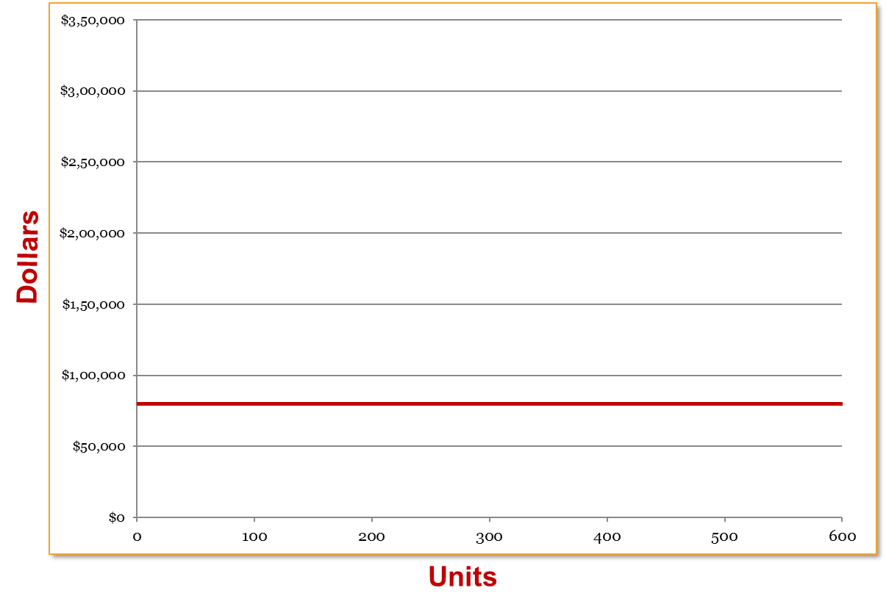
Preparing the C V P Graph – Step 1
In a C V P graph, unit volume is usually represented on the horizontal (x) axis and dollars on the vertical (y) axis.

Slide 20
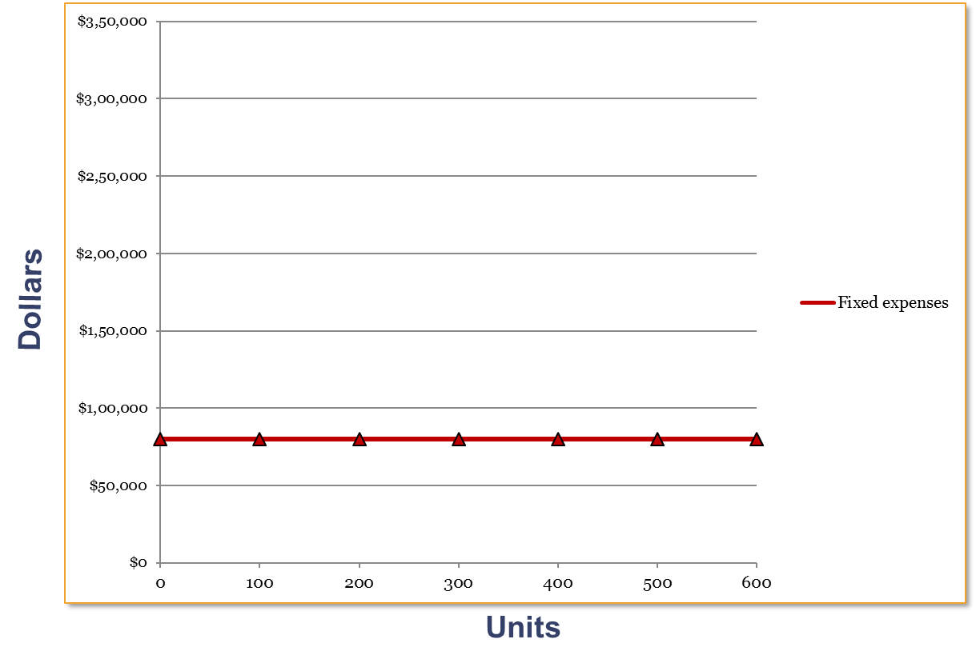
Preparing the C V P Graph – Step 2
Draw a line parallel to the volume axis to represent total fixed expenses.

Slide 21
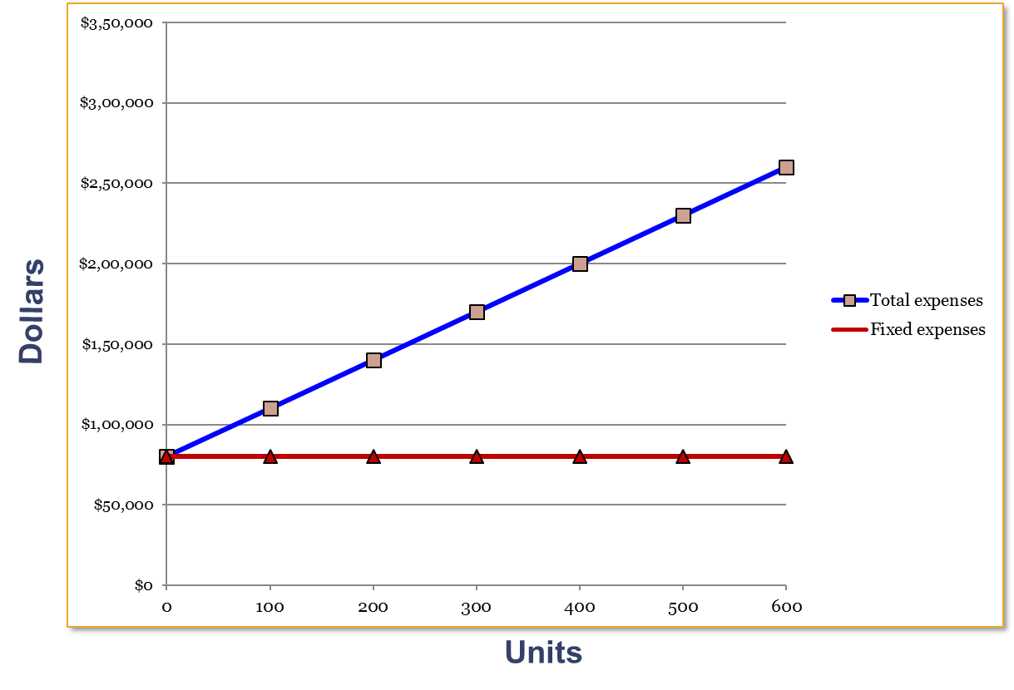
Preparing the C V P Graph – Step 3
Choose some sales volume, say 400 units, and plot the point representing total expenses (fixed and variable). Draw a line through the data point back to where the fixed expenses line intersects the dollar axis.

Slide 22
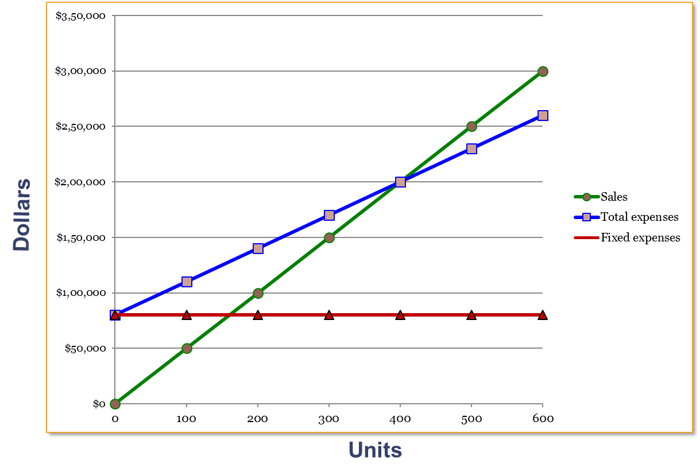
Preparing the C V P Graph – Step 4
Choose some sales volume, say 400 units, and plot the point representing total sales. Draw a line through the data point back to the point of origin.

Slide 23
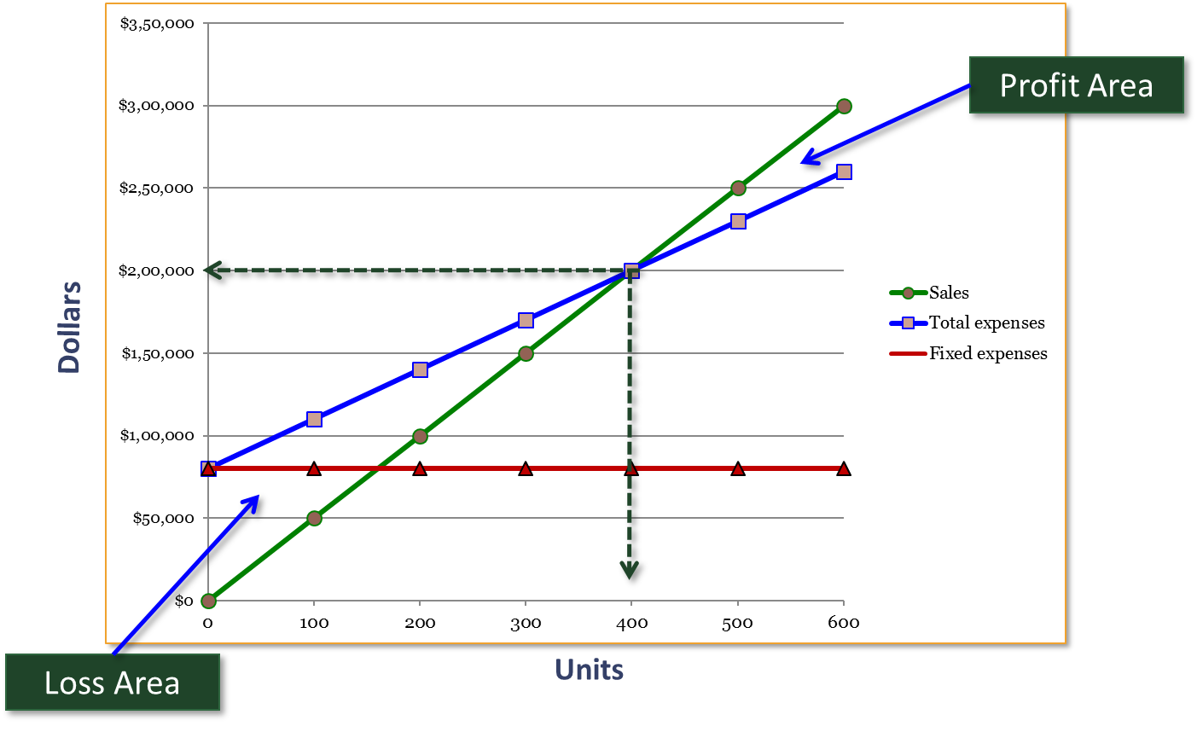
Preparing the C V P Graph – Break-Even Point
Break-even point (400 units or $200,000 in sales)

Slide 24
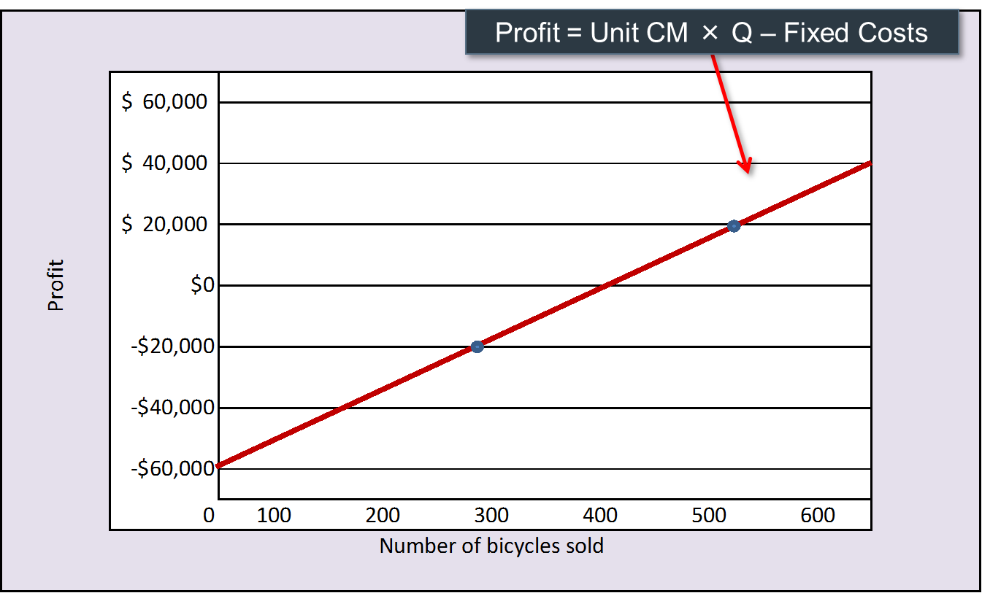
Preparing the Profit Graph – Simple Form
An even simpler form of the C V P graph is called the profit graph.

Slide 25
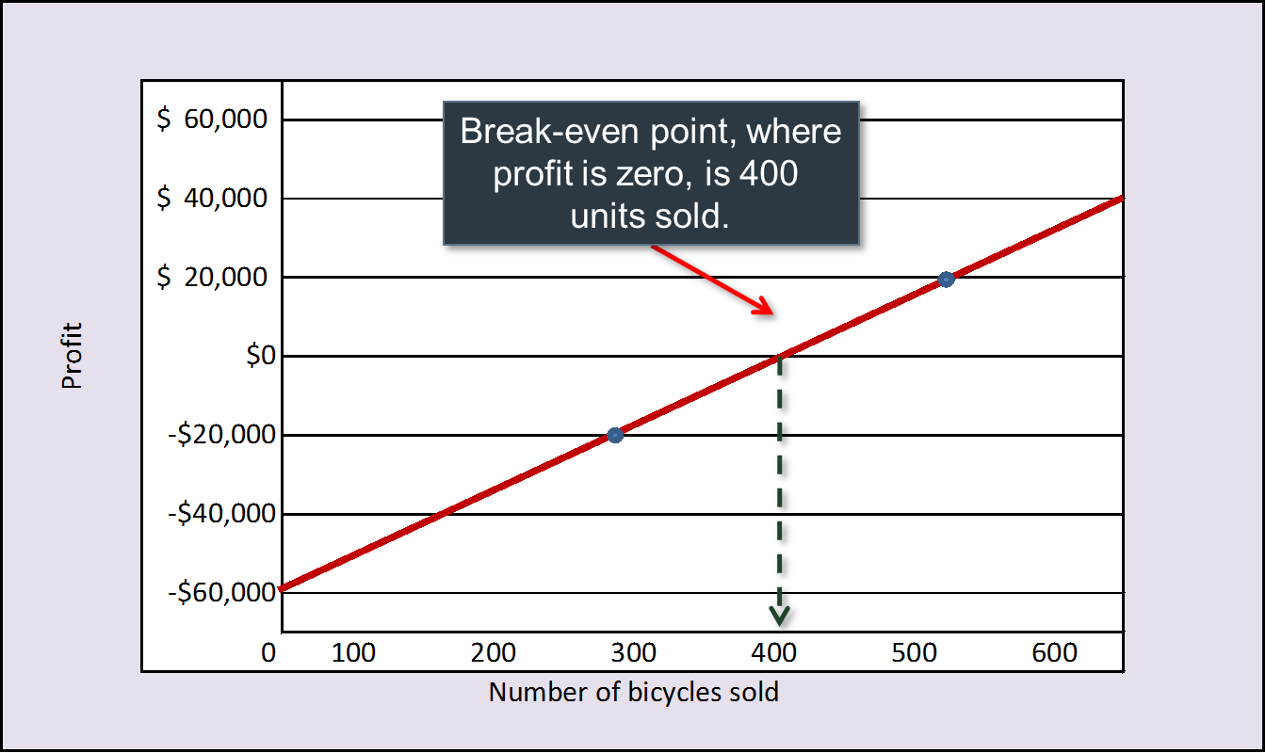
Preparing the Profit Graph – Showing Break-Even Point

Slide 26
Learning Objective 3
Use the contribution margin ratio (C M ratio) to compute changes in contribution margin and net operating income resulting from changes in sales volume.

Slide 27
Contribution Margin Ratio (C M Ratio) and the Variable Expense Ratio – Step 1
The contribution margin as a percentage of sales is referred to as the contribution margin ratio (C M ratio). This ratio is computed as follows:
For R B C, the contribution margin ratio is calculated as follows:
Each $1.00 increase in sales results in a total contribution margin increase of 40¢.

Slide 28
Contribution Margin Ratio (C M Ratio) and the Variable Expense Ratio – Step 2
The C M ratio can also be calculated by dividing the contribution margin per unit by the selling price per unit.

Slide 29
Contribution Margin Ratio (C M Ratio) and the Variable Expense Ratio – Step 3
The variable expenses as a percentage of sales is referred to as the variable expense ratio. This ratio is computed as follows:
For R B C, the variable expense ratio is calculated as follows:

Slide 30
Contribution Margin Ratio (C M Ratio) and the Variable Expense Ratio – Step 4
Having defined the two terms, it bears emphasizing that the contribution margin ratio and the variable expense ratio can be mathematically related to one another:

Slide 31
Applications of Contribution Ratio
If R B C increases sales from 400 to 500 bikes ($50,000), contribution margin will increase by $20,000 ($50,000 × 40%). Here is the proof:
 | 400 Units | 500 Units
Sales | $ 200,000 | $ 250,000
Less: Variable expenses | 120,000 | 150,000
Contribution margin | 80,000 | 100,000
Less: Fixed expenses | 80,000 | 80,000
Net operating income | $ - | $ 20,000
A $50,000 increase in sales revenue results in a $20,000 increase in C M ($50,000 × 40% = $20,000).

Slide 32
Quick Check 1
Coffee Klatch is an espresso stand in a downtown office building. The average selling price of a cup of coffee is $1.49, and the average variable expense per cup is $0.36. The average fixed expense per month is $1,300. An average of 2,100 cups are sold each month. What is the C M ratio for Coffee Klatch?
a. 1.319.
b. 0.758.
c. 0.242.
d. 4.139.

Slide 33
Quick Check 1a
Coffee Klatch is an espresso stand in a downtown office building. The average selling price of a cup of coffee is $1.49, and the average variable expense per cup is $0.36. The average fixed expense per month is $1,300. An average of 2,100 cups are sold each month. What is the C M ratio for Coffee Klatch?
a. 1.319.
b. Answer: 0.758.
c. 0.242.
d. 4.139.

Slide 34
Applications of Contribution Ratio – Increase in Sales Volume
The relationship between profit and the C M ratio can be expressed using the following equation:
Profit = (C M ratio × Sales) − Fixed expenses
If R B C increased its sales volume to 500 bikes, what would management expect profit or net operating income to be?
Profit = (40% × $250,000) − $80,000
Profit = $100,000 − $80,000
Profit = $20,000

Slide 35
Learning Objective 4
Show the effects on net operating income of changes in variable costs, fixed costs, selling price, and sales volume.

Slide 36
Additional Applications of C V P Concepts – Example 1
Example 1: Change in Fixed Cost and Sales Volume
What is the profit impact if R B C can increase unit sales from 500 to 540 by increasing the monthly advertising budget by $10,000?

Slide 37
Additional Applications of C V P Concepts – Solution to Example 1
Example 1: Change in Fixed Cost and Sales Volume
$80,000 + $10,000 advertising = $90,000
 | 500 Units | 540 Units
Sales | $ 250,000 | $ 270,000
Less: Variable expenses | 150,000 | 162,000
Contribution margin | 100,000 | 108,000
Less: Fixed expenses | 80,000 | 90,000
Net operating income | $ 20,000 | $ 18,000
Sales increased by $20,000, but net operating income decreased by $2,000.

Slide 38
Additional Applications of C V P Concepts – A Shortcut
Example 1: Change in Fixed Cost and Sales Volume
A shortcut solution using incremental analysis:
Increase in C M (40 units × $200) | $ 8,000
Increase in advertising expenses | 10,000
Decrease in net operating income | $ (2,000)

Slide 39
Additional Applications of C V P Concepts – Example 2
Example 2: Change in Variable Costs and Sales Volume
What is the profit impact if R B C can use higher-quality raw materials, thus increasing variable costs per unit by $10, to generate an increase in unit sales from 500 to 580?

Slide 40
Additional Applications of C V P Concepts – Solution to Example 2
Example 2: Change in Variable Costs and Sales Volume
580 units × $310 variable cost/unit = $179,800
 | 500 Units | 580 Units
Sales | $ 250,000 | $ 290,000
Less: Variable expenses | 150,000 | 179,800
Contribution margin | 100,000 | 110,200
Less: Fixed expenses | 80,000 | 80,000
Net operating income | $ 20,000 | $ 30,200
Sales increase by $40,000 and net operating income increases by $10,200.

Slide 41
Additional Applications of C V P Concepts – Example 3
Example 3: Change in Fixed Cost, Selling Price, and Sales Volume
What is the profit impact if R B C:
Cuts its selling price $20 per unit,
Increases its advertising budget by $15,000 per month, and
Increases sales from 500 to 650 units per month?

Slide 42
Additional Applications of C V P Concepts – Solution to Example 3
Example 3: Change in Fixed Cost, Selling Price, and Sales Volume
650 units × $480 = $312,000
 | 500 Units | 650 Units
Sales | $ 250,000 | $ 312,000
Less: Variable expenses | 150,000 | 195,000
Contribution margin | 100,000 | 117,000
Less: Fixed expenses | 80,000 | 95,000
Net operating income | $ 20,000 | $ 22,000
Sales increase by $62,000, fixed costs increase by $15,000, and net operating income increases by $2,000.

Slide 43
Additional Applications of C V P Concepts – Example 4
Example 4: Change in Variable Cost, Fixed Cost, and Sales Volume
What is the profit impact if R B C:
Pays a $15 sales commission per bike sold instead of paying salespersons flat salaries that currently total $6,000 per month, and
Increases unit sales from 500 to 575 bikes?

Slide 44
Additional Applications of CVP Concepts – Solution to Example 4
Example 4: Change in Variable Cost, Fixed Cost, and Sales Volume
575 units × $315 = $181,125
 | 500 Units | 575 Units
Sales | $ 250,000 | $ 287,500
Less: Variable expenses | 150,000 | 181,125
Contribution margin | 100,000 | 106,375
Less: Fixed expenses | 80,000 | 74,000
Net operating income | $ 20,000 | $ 32,375
Sales increase by $37,500, fixed expenses decrease by $6,000, and net operating income increases by $12,375.

Slide 45
Additional Applications of C V P Concepts – Example 5
Example 5: Change in Selling Price
If R B C has an opportunity to sell 150 bikes to a wholesaler without disturbing sales to other customers or fixed expenses, what price would it quote to the wholesaler if it wants to increase monthly profits by $3,000?

Slide 46
Additional Applications of C V P Concepts – Solution to Example 5
Example 5: Change in Selling Price
$ 300 ÷ 150 bikes | = | $ 20 | per bike
Variable cost per bike | = | 300 | per bike
Selling price required | = | $ 320 | per bike
150 bikes × $320 per bike | = | $ 48,000
Total variable costs | = | 45,000
Increase in net operating income | = | $ 3,000

Slide 47
Learning Objective 5
Determine the break-even point.

Slide 48
Break-Even Analysis
The equation and formula methods can be used to determine the unit sales and dollar sales needed to achieve a target profit of zero. Let’s use the R B C information to complete the break-even analysis.
Racing Bicycle Company
Contribution Income Statement
For the Month of June
a | Total | Per Unit | C M Ratio
Sales (500 bicycles) | $ 250,000 | $ 500 | 100%
Less: Variable expenses | 150,000 | 300 | 60%
Contribution margin | 100,000 | $ 200 | 40%
Less: Fixed expenses | 80,000
Net operating income | $ 20,000

Slide 49
Break-Even Analysis: Equation Method 1
The equation method relies on the basic profit equation introduced earlier in the chapter. Because Racing Bicycle has only one product, we’ll use the contribution margin form of this equation to perform the break-even calculations. We calculate break-even by solving the equation below.
Profit = Unit C M × Q − Fixed expenses
$0 = $200 × Q − Fixed expenses

Slide 50
Break-Even Analysis: Equation Method 2
In a single product situation, the equation method for computing the unit sales at break-even is:
Profit = Unit C M × Q − Fixed expenses
$0 = $200 × Q − Fixed expenses
$200 × Q = $0 + $80,000
Q = $80,000 ÷ $200
Q = 400 units

Slide 51
Break-Even Analysis: Formula Method
The formula method is a shortcut version of the equation method. It centers on the idea discussed earlier in the chapter that each unit sold provides a certain amount of contribution margin that goes toward covering fixed expenses.

Slide 52
Break-Even Analysis: Dollar Sales
Suppose R B C wants to compute the sales dollars required to break even (earn a target profit of $0). Let’s use the equation method and the formula method to solve this problem.

Slide 53
Break-Even Analysis: Dollar Sales Using Equation Method
The equation method is shown on this slide:
Profit = C M ratio × Sales − Fixed expenses
$0 = 40% × Sales − $80,000
40% × Sales = $80,000
Sales = $80,000 ÷ 40%
Sales = $200,000

Slide 54
Break-Even Analysis: Dollar Sales Using C M Ratio
Now let’s use the formula method to calculate the dollar sales at the break-even point:
Dollar sales = $200,000

Slide 55
Quick Check 2
Coffee Klatch is an espresso stand in a downtown office building. The average selling price of a cup of coffee is $1.49, and the average variable expense per cup is $0.36. The average fixed expense per month is $1,300. An average of 2,100 cups are sold each month. What is the break-even sales dollars?
a. $1,300.
b. $1,715.
c. $1,788.
d. $3,129.

Slide 56
Quick Check 2a
Coffee Klatch is an espresso stand in a downtown office building. The average selling price of a cup of coffee is $1.49, and the average variable expense per cup is $0.36. The average fixed expense per month is $1,300. An average of 2,100 cups are sold each month. What is the break-even sales dollars?
a. $1,300.
b. Answer: $1,715.
c. $1,788.
d. $3,129.

Slide 57
Quick Check 3
Coffee Klatch is an espresso stand in a downtown office building. The average selling price of a cup of coffee is $1.49, and the average variable expense per cup is $0.36. The average fixed expense per month is $1,300. An average of 2,100 cups are sold each month. What is the break-even sales in units?
a. 872 cups.
b. 3,611 cups.
c. 1,200 cups.
d. 1,150 cups.

Slide 58
Quick Check 3a
Coffee Klatch is an espresso stand in a downtown office building. The average selling price of a cup of coffee is $1.49, and the average variable expense per cup is $0.36. The average fixed expense per month is $1,300. An average of 2,100 cups are sold each month. What is the break-even sales in units?
a. 872 cups.
b. 3,611 cups.
c. 1,200 cups.
d. Answer: 1,150 cups.

Slide 59
Learning Objective 6
Determine the level of sales needed to achieve a desired target profit.

Slide 60
Target Profit Analysis
In target profit analysis, we estimate what sales volume is needed to achieve a specific target profit.
We can compute the number of units that must be sold to attain a target profit using either the:
Equation method, or
Formula method.

Slide 61
Target Profit Analysis – Equation Method
Profit = Unit C M × Q − Fixed expenses
Our goal is to solve for the unknown “Q” which represents the quantity of units that must be sold to attain the target profit.

Slide 62
Target Profit Analysis – Equation Method Solution
Suppose R B C’s management wants to know how many bikes must be sold to earn a target profit of $100,000.
Profit = Unit C M × Q − Fixed expenses
$100,000 = $200 × Q − $80,000
$200 × Q = $100,000 + $80,000
Q = ($100,000 + $80,000) ÷ $200
Q = 900 units

Slide 63
Target Profit Analysis – Formula Method
The formula method uses the following equation:

Slide 64
Target Profit Analysis – Formula Method Solution
Suppose R B C wants to know how many bikes must be sold to earn a profit of $100,000.
Unit sales = 900 units

Slide 65
Target Profit Analysis – Formula Method Sales Dollars
We can also compute the target profit in terms of sales dollars using either the equation method or the formula method.

Slide 66
Target Profit Analysis – Equation Method Sales Dollars Solution
Suppose R B C management wants to know the sales volume that must be generated to earn a target profit of $100,000.
Profit = C M ratio × Sales – Fixed expenses
$100,000 = 40% × Sales – $80,000
40% × Sales = $100,000 + $80,000
Sales = ($100,000 + $80,000) ÷ 40%
Sales = $450,000

Slide 67
Target Profit Analysis – Formula Method Sales Dollars Solution
Dollar sales = $450,000

Slide 68
Quick Check 4
Coffee Klatch is an espresso stand in a downtown office building. The average selling price of a cup of coffee is $1.49, and the average variable expense per cup is $0.36. The average fixed expense per month is $1,300. Use the formula method to determine how many cups of coffee would have to be sold to attain a target profit of $2,500 per month.
a. 3,363 cups.
b. 2,212 cups.
c. 1,150 cups.
d. 4,200 cups.

Slide 69
Quick Check 4a
Coffee Klatch is an espresso stand in a downtown office building. The average selling price of a cup of coffee is $1.49, and the average variable expense per cup is $0.36. The average fixed expense per month is $1,300. Use the formula method to determine how many cups of coffee would have to be sold to attain a target profit of $2,500 per month.
a. Answer: 3,363 cups.
b. 2,212 cups.
c. 1,150 cups.
d. 4,200 cups.

Slide 70
Quick Check 5
Coffee Klatch is an espresso stand in a downtown office building. The average selling price of a cup of coffee is $1.49, and the average variable expense per cup is $0.36. The average fixed expense per month is $1,300. Use the formula method to determine the sales dollars that must be generated to attain a target profit of $2,500 per month.
a. $2,550.
b. $5,013.
c. $8,458.
d. $10,555.

Slide 71
Quick Check 5a
Coffee Klatch is an espresso stand in a downtown office building. The average selling price of a cup of coffee is $1.49, and the average variable expense per cup is $0.36. The average fixed expense per month is $1,300. Use the formula method to determine the sales dollars that must be generated to attain a target profit of $2,500 per month.
a. $2,550.
b. Answer: $5,013.
c. $8,458.
d. $10,555.

Slide 72
Learning Objective 7
Compute the margin of safety and explain its significance.

Slide 73
Margin of Safety in Dollars
The margin of safety is the excess of budgeted or actual sales dollars over the break-even volume of sales dollars. It is the amount by which sales can drop before losses are incurred. The higher the margin of safety, the lower the risk of not breaking even and incurring a loss.
Margin of safety in dollars = Total sales − Break-even sales
Let’s look at R B C and determine the margin of safety.

Slide 74
Margin of Safety in Dollars – Example
If we assume that R B C has actual sales of $250,000, given that we have already determined the break-even sales to be $200,000, the margin of safety is $50,000 as shown.
 | Break-Even Sales 400 units | Actual Sales 500 units
Sales | $ 200,000 | $ 250,000
Less: Variable expenses | 120,000 | 150,000
Contribution margin | 80,000 | 100,000
Less: Fixed expenses | 80,000 | 80,000
Net operating income | $ - | $ 20,000

Slide 75
Margin of Safety Percentage
R B C’s margin of safety can be expressed as 20% of sales ($50,000 ÷ $250,000).
 | Break-Even Sales 400 units | Actual Sales 500 units
Sales | $ 200,000 | $ 250,000
Less: Variable expenses | 120,000 | 150,000
Contribution margin | 80,000 | 100,000
Less: Fixed expenses | 80,000 | 80,000
Net operating income | $ - | $ 20,000

Slide 76
Margin of Safety in Units
The margin of safety can be expressed in terms of the number of units sold. The margin of safety at R B C is $50,000, and each bike sells for $500; hence, R B C’s margin of safety is 100 bikes.

Slide 77
Quick Check 6
Coffee Klatch is an espresso stand in a downtown office building. The average selling price of a cup of coffee is $1.49, and the average variable expense per cup is $0.36. The average fixed expense per month is $1,300. An average of 2,100 cups are sold each month. What is the margin of safety expressed in cups?
a. 3,250 cups.
b. 950 cups.
c. 1,150 cups.
d. 2,100 cups.

Slide 78
Quick Check 6a
Coffee Klatch is an espresso stand in a downtown office building. The average selling price of a cup of coffee is $1.49, and the average variable expense per cup is $0.36. The average fixed expense per month is $1,300. An average of 2,100 cups are sold each month. What is the margin of safety expressed in cups?
a. 3,250 cups.
b. Answer: 950 cups.
c. 1,150 cups.
d. 2,100 cups.
Margin of safety = Total sales – Break-even sales
= 2,100 cups − 1,150 cups
= 950 cups

Slide 79
Cost Structure and Profit Stability
Cost structure refers to the relative proportion of fixed and variable costs in an organization. Managers often have some latitude in determining their organization’s cost structure.

Slide 80
Cost Structure and Profit Stability – High and Low Fixed Cost Structures
There are advantages and disadvantages to high fixed cost (or low variable cost) and low fixed cost (or high variable cost) structures.
An advantage of a high fixed cost structure is that income will be higher in good years compared to companies with a lower proportion of fixed costs.
Companies with low fixed cost structures enjoy greater stability in income across good and bad years.
A disadvantage of a high fixed cost structure is that income will be lower in bad years compared to companies with a lower proportion of fixed costs.

Slide 81
Learning Objective 8
Compute the degree of operating leverage at a particular level of sales and explain how it can be used to predict changes in net operating income.

Slide 82
Operating Leverage
Operating leverage is a measure of how sensitive net operating income is to percentage changes in sales. It is a measure, at any given level of sales, of how a percentage change in sales volume will affect profits.

Slide 83
Operating Leverage – Example
To illustrate, let’s revisit the contribution income statement for R B C.
 | Actual Sales 500 Bikes
Sales | $ 250,000
Less: Variable expenses | 150,000
Contribution margin | 100,000
Less: Fixed expenses | 80,000
Net income | $ 20,000

Slide 84
Operating Leverage – Changes in Profit
With an operating leverage of 5, if R B C increases its sales by 10%, net operating income would increase by 50%.
Percent increase in sales |  | 10%
Degree of operating leverage | × | 5
Percent increase in profits |  | 50%
Here’s the verification!

Slide 85
Operating Leverage – Proof of Changes
 | Actual Sales (500) | Increased Sales (550)
Sales | $ 250,000 | $ 275,000
Less: Variable expenses | 150,000 | 165,000
Contribution margin | 100,000 | 110,000
Less: Fixed expenses | 80,000 | 80,000
Net operating income | $ 20,0000 | $ 30,000
10% increase in sales from
$250,000 to $275,000 . . .
. . . results in a 50% increase in
income from $20,000 to $30,000.

Slide 86
Quick Check 7
Coffee Klatch is an espresso stand in a downtown office building. The average selling price of a cup of coffee is $1.49, and the average variable expense per cup is $0.36. The average fixed expense per month is $1,300. An average of 2,100 cups are sold each month. What is the operating leverage?
a. 2.21.
b. 0.45.
c. 0.34.
d. 2.92.

Slide 87
Quick Check 7a
Coffee Klatch is an espresso stand in a downtown office building. The average selling price of a cup of coffee is $1.49, and the average variable expense per cup is $0.36. The average fixed expense per month is $1,300. An average of 2,100 cups are sold each month. What is the operating leverage?
a. Answer: 2.21.
b. 0.45.
c. 0.34.
d. 2.92.
 | Actual Sales 2,100 cups
Sales | $ 3,129
Less: Variable expenses | 756
Contribution margin | 2,373
Less: Fixed expenses | 1,300
Net operating income | $ 1,073

Slide 88
Quick Check 8
At Coffee Klatch, the average selling price of a cup of coffee is $1.49, the average variable expense per cup is $0.36, the average fixed expense per month is $1,300, and an average of 2,100 cups are sold each month.
If sales increase by 20%, by how much should net operating income increase?
a. 30.0%.
b. 20.0%.
c. 22.1%.
d. 44.2%.

Slide 89
Quick Check 8a
At Coffee Klatch, the average selling price of a cup of coffee is $1.49, the average variable expense per cup is $0.36, the average fixed expense per month is $1,300, and an average of 2,100 cups are sold each month.
If sales increase by 20%, by how much should net operating income increase?
a. 30.0%.
b. 20.0%.
c. 22.1%.
d. Answer: 44.2%.
 | Percent increase in sales | 20.0%
× | Degree of operating leverage | 2.21
 | Percent increase in profits | 44.2%

Slide 90
Verify Increase in Profit
 | Actual Sales | Increased Sales
 | 2,100 cups | 2,520 cups
Sales | $ 3,129 | $ 3,755
Less: Variable expenses | 756 | 907
Contribution margin | 2,373 | 2,848
Less: Fixed expenses | 1,300 | 1,300
Net operating income | $ 1,073 | $ 1,548
% change in sales |  | 20.0%
% change in net operating income |  | 44.2%

Slide 91
Structuring Sales Commissions
Companies generally compensate salespeople by paying them either a commission based on sales or a salary plus a sales commission. Commissions based on sales dollars can lead to lower profits in a company.
Let’s look at an example.

Slide 92
Structuring Sales Commissions – Example
Pipeline Unlimited produces two types of surfboards, the XR7 and the Turbo. The XR7 sells for $100 and generates a contribution margin per unit of $25. The Turbo sells for $150 and earns a contribution margin per unit of $18.
The sales force at Pipeline Unlimited is compensated based on sales commissions.

Slide 93
Structuring Sales Commissions – Solution
If you were on the sales force at Pipeline, you would push hard to sell the Turbo even though the XR7 earns a higher contribution margin per unit.
To eliminate this type of conflict, commissions can be based on contribution margin rather than on selling price alone.

Slide 94
Learning Objective 9
Compute the break-even point for a multiproduct company and explain the effects of shifts in the sales mix on contribution margin and the break-even point.

Slide 95
Definition of Sales Mix
Sales mix is the relative proportion in which a company’s products are sold.
Different products have different selling prices, cost structures, and contribution margins.
When a company sells more than one product, break-even analysis becomes more complex as the following example illustrates.
Let’s assume R B C sells bikes and carts and that the sales mix between the two products remains the same.

Slide 96
Sales Mix and Break-Even Analysis 1
Bikes comprise 45% of R B C’s total sales revenue, and the carts comprise the remaining 55%. R B C provides the following information:
 | Bicycles |  | Carts |  | Total
Sales | $ 250,000 | 100.0% | $ 300,000 | 100% | $ 550,000 | 100.0%
Less: Variable expenses | 150,000 | 60.0% | 135,000 | 45% | 285,000 | 51.8%
Contribution margin | 100,000 | 40.0% | 165,000 | 55% | 265,000 | 48.2%
Less: Fixed expenses |  |  |  |  | 170,000
Net operating income |  |  |  |  | $ 95,000
Sales mix | $250,000 | 45% | $ 300,000 | 55% | $ 550,000 | 100%

Slide 97
Sales Mix and Break-Even Analysis 2
 | Bicycles |  | Carts |  | Total
Sales | $ 158,714 | 100% | $ 193,983 | 100% | $ 352,697 | 100.0%
Less: Variable expenses | 95,228 | 60% | 87,293 | 45% | 182,521 | 51.8%
Contribution margin | 63,486 | 40% | 106,690 | 55% | 170,176 | 48.2%
Less: Fixed expenses |  |  |  |  | 170,000
Net operating income |  |  |  |  | $ 176*
Sales mix | $ 158,714 | 45% | $ 193,983 | 55% | $ 352,697 | 100.0%
*Rounding error

Slide 98
End of Chapter 5
© 2021 McGraw Hill. All rights reserved. Authorized only for instructor use in the classroom. No reproduction or further distribution permitted without the prior written consent of McGraw Hill.

Slide 99
Accessibility Content: Text Alternatives for Images

Slide 100
C V P Relationships in Equation Form – Example – Text Alternative
Return to parent-slide containing images.
The equation for profit is Profit equals the quantity Sales minus Variable expenses minus Fixed expenses. The data to input for Sales are 401 units times $500. The data to input for Variable expenses are 401 units times $300. The number to input for Fixed expenses is $80,000.
Return to parent-slide containing images.

Slide 101
C V P Relationships in Equation Form – Detail Breakdown – Text Alternative
Return to parent-slide containing images.
The equation for profit is Profit equals the quantity Sales minus Variable expenses minus Fixed expenses. Additional equations are shown below this. The equation on the left is for Sales: Quantity sold (Q) times Selling price per unit (P) equals Sales (Q times P). The equation on the right is for Variable expenses: Quantity sold (Q) times Variable expenses per unit (V) equals Variable expenses (Q times V).
Return to parent-slide containing images.

