Slide 1

Activity-Based Costing: A Tool to Aid Decision Making
Chapter 7
Managerial Accounting
Seventeenth edition
© 2021 McGraw Hill. All rights reserved. Authorized only for instructor use in the classroom. No reproduction or further distribution permitted without the prior written consent of McGraw Hill.

Slide 2
Activity-Based Costing (ABC): Key Definition
ABC is a costing method designed to provide managers with cost information for strategic and other decisions that potentially affect capacity, and therefore, “fixed” as well as variable costs. It is ordinarily used as a supplement to, rather than as a replacement for, the company’s usual costing system.

Slide 3
Learning Objective 1
Understand activity-based costing and how it differs from a traditional costing system.

Slide 4
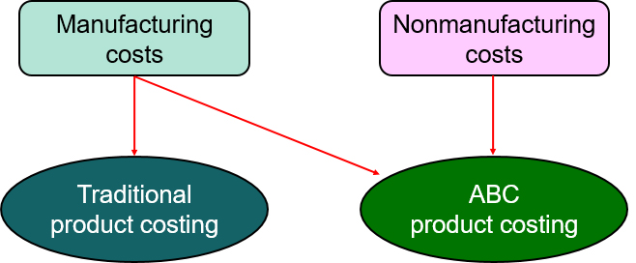
How Costs Are Treated Under
Activity-Based Costing 1
In ABC, nonmanufacturing as well as manufacturing costs may be
assigned to products but only on a cause-and-effect basis.
ABC systems can assign sales commissions, shipping costs, and
warranty repair costs to specific products.

Slide 5
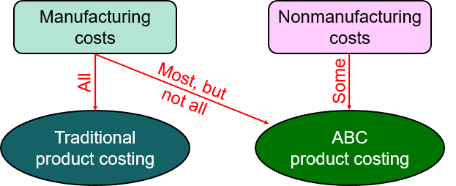
How Costs Are Treated Under
Activity-Based Costing 2
Some manufacturing costs may be excluded from product costs.
ABC excludes organization-sustaining costs and idle
capacity costs from product cost.

Slide 6
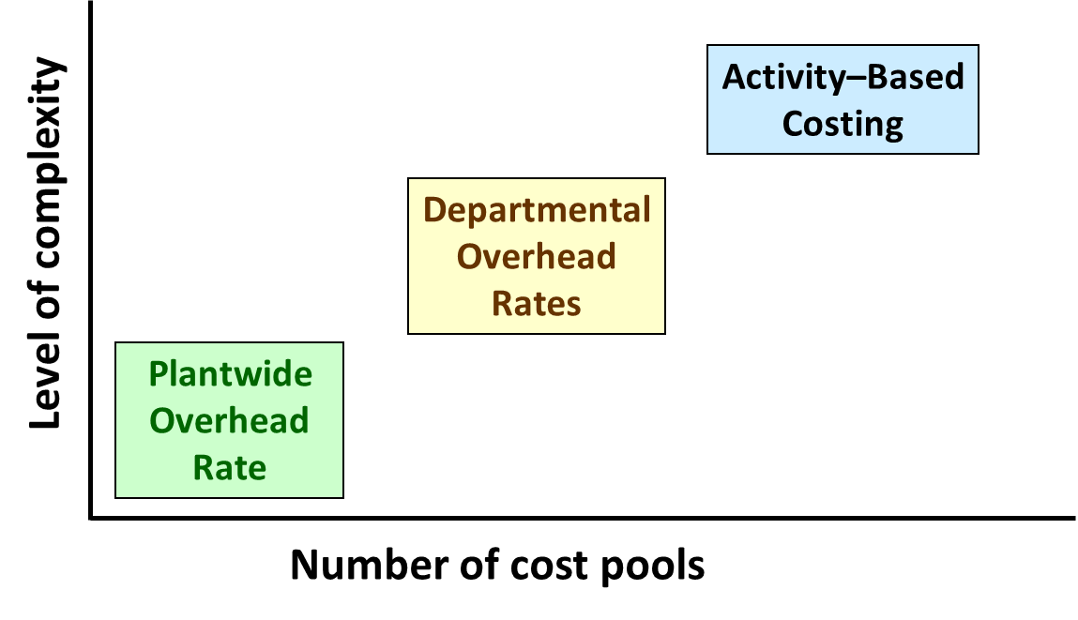
How Costs Are Treated Under
Activity-Based Costing 3
ABC differs from traditional cost accounting because
numerous overhead cost pools are used.
Access the text alternative for slide images.

Slide 7
How Costs Are Treated Under
Activity-Based Costing 4
Each ABC cost pool has its own unique measure of activity, while
traditional cost systems usually rely on direct labor-hours and/or
machine-hours to allocate all overhead costs to products.
Direct-labor and machine-hours work correctly when changes in the quantity of the base are correlated with changes in the overhead costs being assigned using the base.
Relying exclusively on direct labor-hours and/or machine-hours to assign overhead costs to products has come under increased scrutiny since, on an economy-wide basis, direct labor and overhead costs have been moving in opposite directions and the variety of products produced by companies has increased.

Slide 8
Key Definitions and Concepts 1
Activity
  An event that causes the consumption of overhead resources.
Activity Cost Pool
  A “cost bucket” in which costs related to a single activity measure are accumulated.

Slide 9
Key Definitions and Concepts 2
Activity Measure
The term cost driver is also used to refer to an activity measure.
An allocation base in an activity-based costing system.

Slide 10
Key Definitions and Concepts 3
Two common types of activity measures:
  Transaction driver
    Simple count of the number of times an activity occurs.
  Duration driver
    A measure of the amount of time needed for an activity.

Slide 11
Key Definitions and Concepts 4
Traditional cost systems rely exclusively on allocation bases that are driven by the volume of production.
ABC defines
five levels of activity
that largely do not relate
to the volume of units
produced.

Slide 12
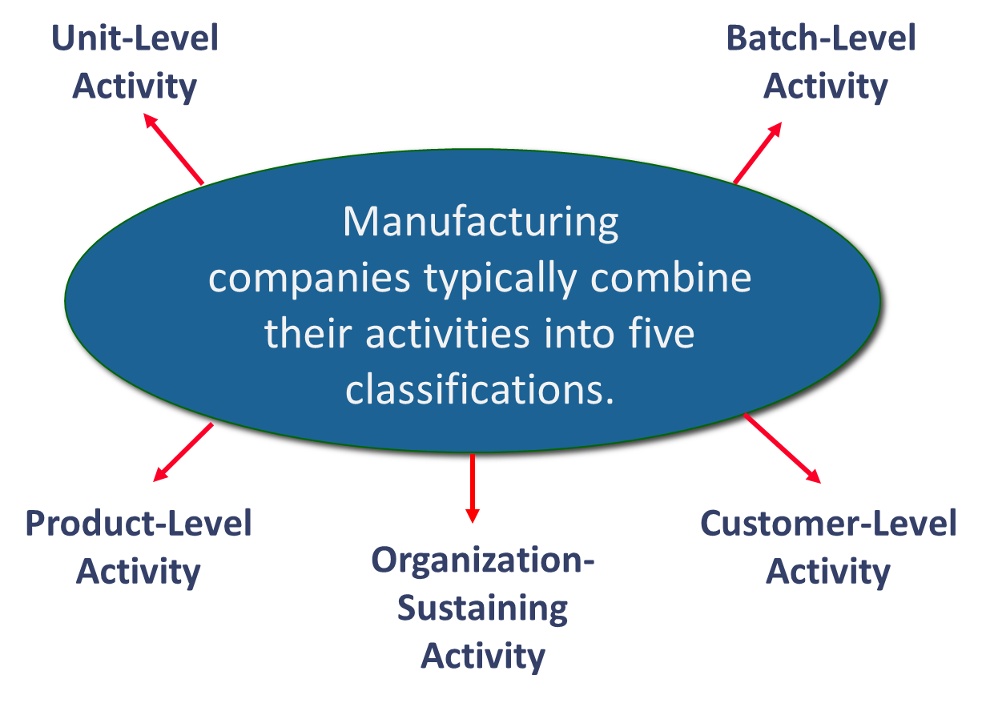
Key Definitions and Concepts 5

Slide 13
Characteristics of a Successful ABC Implementation
Strong top
management support.
Without leadership from top management, some managers may not be motivated to embrace the need to change.
Linked to how people are evaluated
and rewarded.
If employees continue to be evaluated and rewarded using traditional (non-ABC) cost data, they will quickly get the message that ABC is not important and they will abandon it.
Cross-functional teams should be created.
Cross-functional employees possess intimate knowledge of operations that is necessary for designing an effective ABC system.

Slide 14
Five Steps for Implementing ABC
Baxter Battery company Income Statement Year Ended December 31,20X0
Sales |  | $ 50,000,000
Cost of goods sold
Direct materials | $ 15,000,000
Direct labor | 12,000,000
Manufacturing overhead | 14,000,000 | 41,000,000
Gross margin |  | 9,000,000
Selling and administrative expense
Shipping expense | 3,000,000
Marketing expense | 2,000,000
General administrative expense | 6,000,000 | 11,000,000
Net operating loss |  | $ (2,000,000)
The company makes two types of automobile batteries—SureStart (a standard battery) and LongLife (a deluxe battery). Baxter reported its first loss ever.

Slide 15
Define Activities, Activity Cost Pools, and Activity Measures 1
At Baxter Battery, the ABC team selected the following activity cost pools
and activity measures:
Activity Cost Pools at Baxter Battery
Activity Cost Pool | Activity Measure
Customer orders | Number of customer orders
Design changes | Number of design changes
Order size | Machine-hours
Customer relations | Number of active customers
Other | Not applicable

Slide 16
Define Activities, Activity Cost Pools, and Activity Measures 2
Customer Orders: Assigned all costs of resources that are consumed by taking and processing customer orders.
Design Changes: Assigned all costs of resources consumed by customer-requested design changes.
Order Size: Assigned all costs of resources consumed as a consequence of the number of units produced.
Customer Relations: Assigned all costs associated with maintaining relations with customers.
Other: Assigned all organization-sustaining costs and unused capacity costs.

Slide 17
Learning Objective 2
Assign costs to cost pools using a first-stage allocation.

Slide 18
Assign Overhead Costs to Activity Cost Pools 1
Overhead Costs Baxter Battery (Manufacturing and Nonmanufacturing)
Production Department
Indirect factory wages | $ 6,000,000
Factory equipment depreciation | 3,500,000
Factory utilities | 2,500,000
Factory building lease | 2,000,000 | $14,000,000
General Administrative Department
Administrative wages and salaries | 4,000,000
Office equipment depreciation | 900,000
Administrative building lease | 1,100,000 | 6,000,000
Marketing Department
Marketing wages and salaries | 1,500,000
Selling expense | 500,000 | 2,000,000
Total overhead costs |  | $22,000,000

Slide 19
Assign Overhead Costs to Activity Cost Pools 2
Direct materials, direct labor, and shipping are excluded
because Baxter Battery’s existing cost system can directly
trace these costs to products or customer orders.
Overhead Costs Baxter Battery (Manufacturing and Nonmanufacturing)
Production Department
Indirect factory wages | $ 6,000,000
Factory equipment depreciation | 3,500,000
Factory utilities | 2,500,000
Factory building lease | 2,000,000 | $ 14,000,000
General Administrative Department
Administrative wages and salaries | 4,000,000
Office equipment depreciation | 900,000
Administrative building lease | 1,100,000 | 6,000,000
Marketing Department
Marketing wages and salaries | 1,500,000
Selling expense | 500,000 | 2,000,000
Total overhead costs |  | $ 22,000,000

Slide 20
Assign Overhead Costs to Activity Cost Pools 3
At Baxter Battery, the following distribution of resource consumption across activity cost pools is determined.
Activity Cost Pools
 | Customer Orders | Design Changes | Order Size | Customer Relations | Other | Total
Production Department
Indirect factory wages | 30% | 30% | 20% | 10% | 10% | 100%
Factory equipment depreciation | 20% | 10% | 60% | 0% | 10% | 100%
Factory utilities | 0% | 10% | 60% | 0% | 30% | 100%
Factory building lease | 0% | 0% | 0% | 0% | 100% | 100%
General Administrative Department
Administrative wages and salaries | 30% | 10% | 10% | 30% | 20% | 100%
Office equipment depreciation | 30% | 10% | 0% | 20% | 40% | 100%
Administrative building lease | 0% | 0% | 0% | 0% | 100% | 100%
Marketing Department
Marketing wages and salaries | 30% | 10% | 0% | 50% | 10% | 100%
Selling expenses | 20% | 0% | 0% | 70% | 10% | 100%

Slide 21
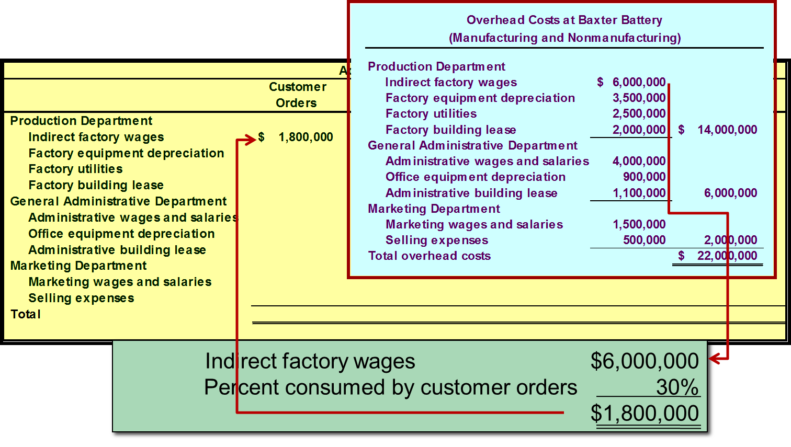
Assign Overhead Costs to Activity Cost Pools 4
Access the text alternative for slide images.

Slide 22
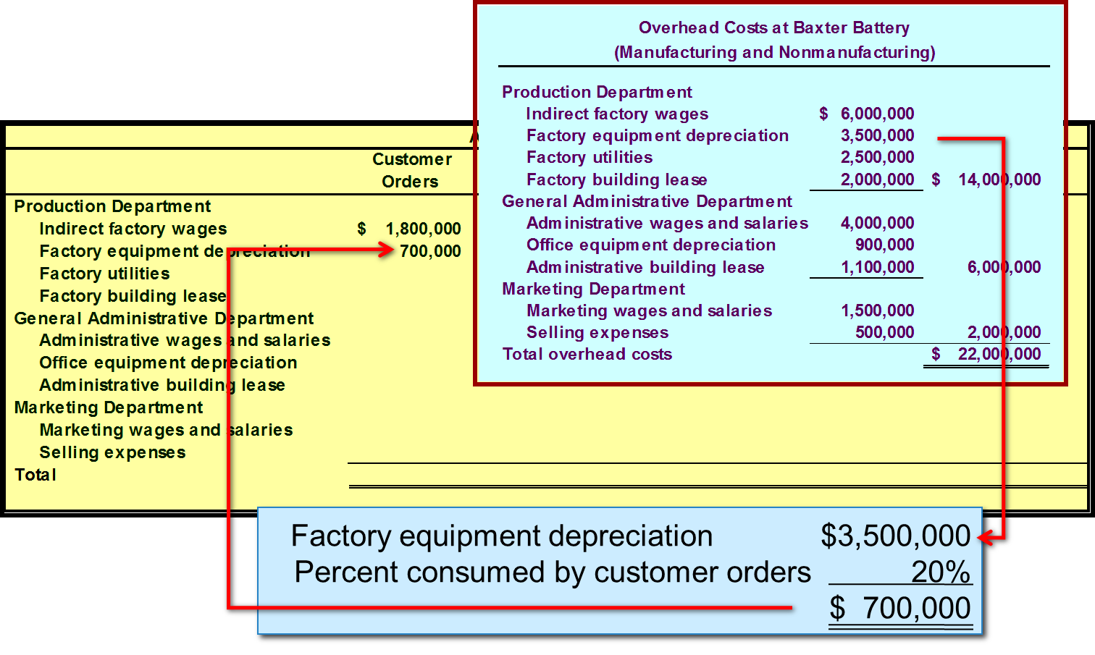
Assign Overhead Costs to Activity Cost Pools 5
Access the text alternative for slide images.

Slide 23
Assign Overhead Costs to Activity Cost Pools 6
Activity Cost Pools
 | Customers Orders | Design Changes | Order Size | Customer Relations | Other | Total
Production Department
Indirect factory wages | $ 1,800,000 | $ 1,800,000 | $ 1,200,000 | $ 600,000 | $ 600,000 | $ 6,000,000
Factory equipment depreciation | 700,000 | 350,000 | 2,100,000 | - | 350,000 | 3,500,000
Factory utilities | - | 250,000 | 1,500,000 | - | 750,000 | 2,500,000
Factory building ease | - | - | - | - | 2,000,000 | 2,000,000
General Administrative Department
Administrative wages and salaries | 1,200,000 | 400,000 | 400,000 | 1,200,000 | 800,000 | 4,000,000

Slide 24
Assign Overhead Costs to Activity Cost Pools 7
 | Customers Orders | Design changes | Order Size | Customer Relations | Other | Total
Office equipment depreciation | 270,000 | 90,000 | - | 180,000 | 360,000 | 900,000
Administrative building Lease | - | - | - | - | 1,100,000 | 1,100,000
Marketing Department
Marketing wages and salaries | 450,000 | 150,000 | - | 750,000 | 150,000 | 1,500,000
Selling expenses | 100,000 | - | - | 350,000 | 50,000 | 500,000
Total | $ 4,520,000 | $ 3,040,000 | $ 5,200,000 | $ 3,080,000 | $ 6,160,000 | $ 22,000,000

Slide 25
Learning Objective 3
Compute activity
rates for cost pools.

Slide 26
Calculate Activity Rates 1
The ABC team determines that Baxter Battery will have these total activities for each activity cost pool:
10,000 customer orders,
4,000 design changes,
800,000 machine-hours, and
2,000 customers served.
Now the team can compute the individual activity rates by dividing the total cost for each activity by the total activity levels.

Slide 27
Calculate Activity Rates 2
Computation of Activity Rates
 | (a) | (b) | (a) ÷ (b)
Activity Cost Pools | Total Cost | Total Activity | Activity Rate
Customer orders | $ 4,520,000 | 10,000 orders | $452 per order
Design changes | 3,040,000 | 4,000 changes | $760 per change
Order size | 5,200,000 | 800,000 MHs | $6.50 per MH
Customer relations | 3,080,000 | 2,000 customers | $1,540 per customer
Other | 6,160,000 | Not applicable | Not applicable
Total | $ 22,000,000
These are organization-sustaining costs and will not be assigned to products or customers.

Slide 28
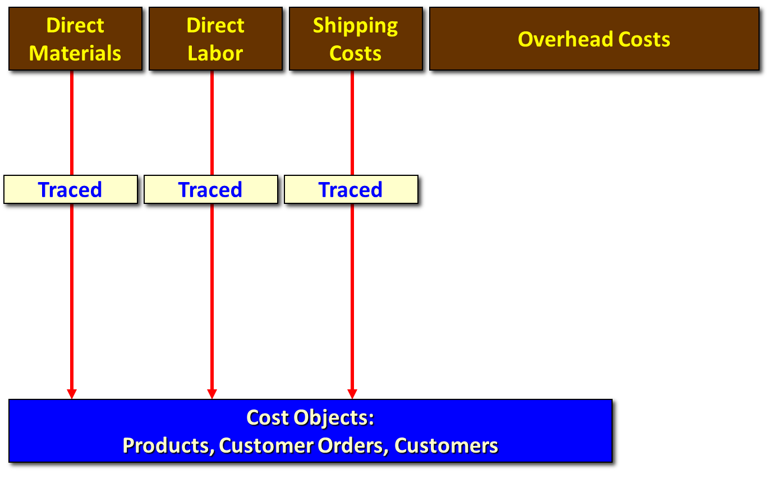
Calculate Activity Rates 3
Access the text alternative for slide images.

Slide 29
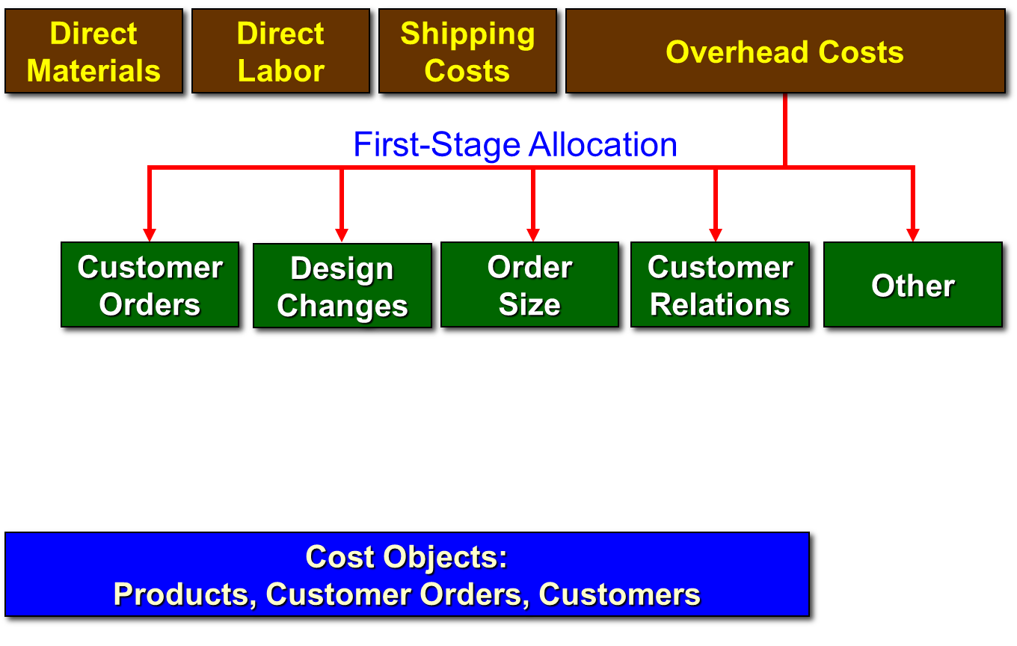
Calculate Activity Rates 4
Access the text alternative for slide images.

Slide 30
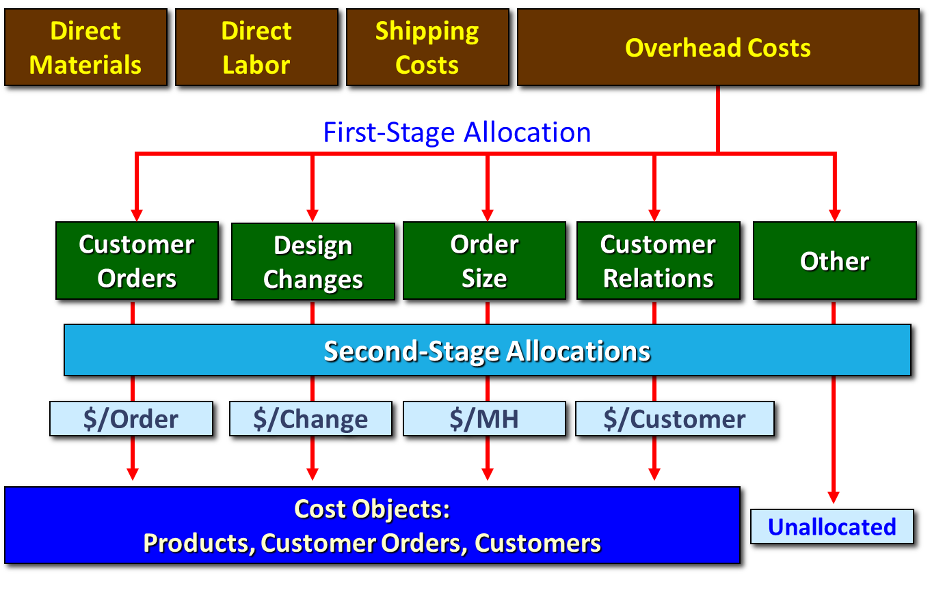
Calculate Activity Rates 5
Access the text alternative for slide images.

Slide 31
Learning Objective 4
Assign costs to a cost object using a second-stage allocation.

Slide 32
Assigning Overhead to Products 1
Baxter Battery Information
SureStart
Requires no new design resources.
800,000 batteries ordered with 4,000 separate orders.
Each SureStart requires 36 minutes of machine time for a total of 480,000 machine-hours.
LongLife
Requires new design resources.
400,000 batteries ordered with 6,000 separate orders.
4,000 custom designs prepared.
Each LongLife requires 48 minutes of machine time for a total of 320,000 machine-hours.

Slide 33
Assigning Overhead to Products 2
Overhead Cost for the SureStart
Activity Cost Pools | (a) Activity Rate | (b) Activity | (a)×(b) ABC Cost
Customer orders | $452.00 | 4,000 | $1,808,000
Design changes | 760.00 | - | -
Order size | 6.50 | 480,000 | 3,120,000
Total |  |  | $4,928,000
Overhead Cost for the LongLife
Activity Cost Pools | (a) Activity Rate | (b) Activity | (a)×(b) ABC Cost
Customer orders | $452.00 | 6,000 | $2,712,000
Design changes | 760.00 | 4,000 | 3,040,000
Order size | 6.50 | 320,000 | 2,080,000
Total |  |  | $7,832,000
$4,928,000 + $7,832,000 + $9,240,000 (not assigned) = $22,000,000

Slide 34
Assigning Overhead to Customers 1
Let’s take a look at how Baxter Battery’s system works for just one of the 2,000 customers—Acme Auto Parts that placed a total of 12 orders. Note that the four orders of LongLife required a design change.
Orders
Eight orders for 60 SureStarts per order.
Four orders for 50 LongLifes per order.
Machine-hours
The 480 SureStarts required 288 machine-hours.
The 200 LongLifes required 160 machine-hours.

Slide 35
Assigning Overhead to Customers 2
Overhead Cost for Acme Auto Parts
Activity Cost Pools | (a) Activity Rate | (b) Activity | × (b) ABC Cost
Customer orders | $ 452.00 | 12 | $ 5,424
Design changes | 760.00 | 4 | 3,040
Order size | 6.50 | 448 | 2,912
Customer relations | 1,540.00 | 1 | 1,540
Total |  |  | $12,916

Slide 36
Learning Objective 5
Use activity-based costing to compute product and customer margins.

Slide 37
Prepare Management Reports 1
Product Margin Calculations
The first step in computing product margins is to
gather each product’s sales and direct cost data.
 | SureStart | LongLife | Total
Sales | $31,300,000 | $18,700,000 | $50,000,000
Direct costs
Direct material | 9,000,000 | 6,000,000 | 15,000,000
Direct labor | 7,000,000 | 5,000,000 | 12,000,000
Shipping | 2,000,000 | 1,000,000 | 3,000,000

Slide 38
Prepare Management Reports 2
Product Margin Calculations
The second step in computing product margins is to incorporate the previously computed activity-based cost assignments pertaining to each product.
 | SureStart | LongLife | Total
Sales | $31,300,000 | $18,700,000 | $50,000,000
Direct costs
Direct material | 9,000,000 | 6,000,000 | 15,000,000
Direct labor | 7,000,000 | 5,000,000 | 12,000,000
Shipping | 2,000,000 | 1,000,000 | 3,000,000
ABC cost assignments
Customer orders | 1,808,000 | 2,712,000 | 4,520,000
Design changes |  | 3,040,000 | 3,040,000
Order size | 3,120,000 | 2,080,000 | 5,200,000

Slide 39
Prepare Management Reports 3
Product Margin Calculations
The third step in computing product margins is to deduct each product’s direct and indirect costs from sales.
 | Sure Starts |  | LongLifes
Sales |  | $ 31,300,000 |  | $ 18,700,000
Costs
Direct material | $ 9,000,000 |  | $ 6,000,000
Direct labor | 7,000,000 |  | 5,000,000
Shipping | 2,000,000 |  | 1,000,000
Customer orders | 1,808,000 |  | 2,712,000
Design changes |  |  | 3,040,000
Order size | 3,120,000 |  | 2,080,000
Total cost |  | 22,928,000 |  | 19,832,000
Product margin |  | $ 8,372,000 |  | $ (1,132,000)

Slide 40
Prepare Management Reports 4
Product Margin Calculations
The product margins can be reconciled with the company’s net operating income as follows:
 | SureStart | LongLife | Total
Sales | $31,300,000 | $18,700,000 | $50,000,000
Total costs | 22,928,000 | 19,832,000 | 42,760,000
Product margins | $ 8,372,000 | $ (1,132,000) | $ 7,240,000
Less costs not assigned to products:
Customer relations |  |  | 3,080,000
Other |  |  | 6,160,000
Total |  |  | 9,240,000
Net operating loss |  |  | $(2,000,000)

Slide 41
Prepare Management Reports 5
Customer Margin Calculation
The first step in computing Acme Auto Parts’ customer margin is to gather its sales and direct cost data.
 | Acme Auto Parts
Sales | $29,200
Direct costs
Direct material | 7,500
Direct labor | 6,700
Shipping | 1,700

Slide 42
Prepare Management Reports 6
Customer Margin Calculation
The second step is to incorporate Acme Auto Parts’ previously computed activity-based cost assignments.
 | Acme Auto Parts
Sales | $29,200
Direct costs
Direct material | 7,500
Direct labor | 6,700
Shipping | 1,700
ABC cost assignments
Customer orders | 5,424
Product design | 3,040
Order size | 2,912
Customer relations | 1,540

Slide 43
Prepare Management Reports 7
Customer Margin Calculation
The third step is to compute Acme Auto Parts’ customer margin of $384 by deducting all its direct and indirect costs from its sales.
 | Acme Auto Parts | Acme Auto Parts
Sales |  | $ 29,200
Direct costs
Direct material | $ 7,500
Direct labor | 6,700
Shipping | 1,700
Customer orders | 5,424
Product design | 3,040
Order size | 2,912
Customer relations | 1,540 | 28,816
Customer margin |  | $ 384

Slide 44
Product Margins Computed Using the Traditional Cost System 1
The first step in computing product margins is to
gather each product’s sales and direct cost data.
 | SureStart | LongLife | Total
Sales | $31,300,000 | $18,700,000 | $50,000,000
Direct costs
Direct material | 9,000,000 | 6,000,000 | 15,000,000
Direct labor | 7,000,000 | 5,000,000 | 12,000,000

Slide 45
Product Margins Computed Using the Traditional Cost System 2
The second step in computing product margins is to compute the plantwide overhead rate.
Manufacturing Overhead Costs at Baxter Battery
Production Department
Indirect factory wages | $ 6,000,000
Factory equipment depreciation | 3,500,000
Factory utilities | 2,500,000
Factory building lease | 2,000,000
Total manufacturing overhead | $ 14,000,000

Slide 46
Product Margins Computed Using the Traditional Cost System 3
 | Machine-Hours
SureStart (800,000 @ 0.60 hour) | 480,000
LongLife (400,000 @ 0.80 hour) | 320,000
Total machine-hours | 800,000

Slide 47
Product Margins Computed Using the Traditional Cost System 4
The third step in computing product margins is to
allocate manufacturing overhead to each product.
 | Machine- Hours | Overhead Rate | Overhead Allocated
SureStart | 480,000 | $17.50 | $ 8,400,000
LongLife | 320,000 | 17.50 | 5,600,000
Total overhead allocated to products |  |  | $14,000,000
480,000 hours × $17.50 per hour = $8,400,000

Slide 48
Product Margins Computed Using the Traditional Cost System 5
The fourth step is to actually compute the product margins.
 | SureStarts | SureStarts | LongLifes | LongLifes | Total | Total
Sales |  | $31,300,000 |  | $18,700,000 |  | $50,000,000
Cost of goods sold
Direct materials | $9,000,000 |  | $6,000,000 |  | $15,000,000
Direct labor | 7,000,000 |  | 5,000,000 |  | 12,000,000
Manufacturing overhead | 8,400,000 | 24,400,000 | 5,600,000 | 16,600,000 | 14,000,000 | 41,000,000
Product margin |  | $ 6,900,000 |  | 2,100,000 |  | 9,000,000
Selling and administrative |  |  |  |  |  | 11,000,000
Net operating loss |  |  |  |  |  | $ (2,000,000)
Shipping expense | $ 3,000,000
Marketing expense | 2,000,000
General administrative expense | 6,000,000
 | $11,000,000

Slide 49
Differences Between ABC and Traditional Product Costs 1
 | SureStart | LongLife
Product margin—traditional | $6,900,000 | $ 2,100,000
Product margin—ABC | 8,372,000 | (1,132,000)
Change in reported margins | $1,472,000 | $(3,232,000)
The traditional cost system overcosts the SureStart and reports
a lower product margin for this product.
The traditional cost system undercosts the LongLife
and reports a higher product margin for this product.

Slide 50
Differences Between ABC and Traditional Product Costs 2
There are three reasons why the
reported product margins for the two
costing systems differ from one another.
Traditional costing allocates all manufacturing overhead to products. ABC costing only assigns manufacturing overhead costs consumed by products to those products.

Slide 51
Differences Between ABC and Traditional Product Costs 3
There are three reasons why the
reported product margins for the two
costing systems differ from one another.
Traditional costing allocates all manufacturing
overhead costs using a volume-related allocation
base. ABC costing also uses non-volume-related
allocation bases.

Slide 52
Differences Between ABC and Traditional Product Costs 4
There are three reasons why the
reported product margins for the two
costing systems differ from one another.
Traditional costing disregards selling and
administrative expenses because they are
assumed to be period expenses. ABC costing
directly traces shipping costs to products and
includes nonmanufacturing overhead costs caused
by products in the activity cost pools that are
assigned to products.

Slide 53
Targeting Process Improvement
Activity-based management is used in conjunction with ABC to identify areas that would benefit from process improvements by focusing on activities to eliminate waste, decrease processing time, and reduce defects.
ABC activity rates can also provide valuable clues concerning where there is waste and the opportunity for improvement.
Benchmarking can be used to compare activity cost information with standards of performance achieved by other organizations.

Slide 54
Activity-Based Costing and External Reporting
Most companies do not use ABC for external
reporting because . . .
External reports are less detailed than internal reports.
It may be difficult to make changes to the company’s accounting system.
ABC does not conform to GAAP.
Auditors may be suspect of the subjective allocation process based on interviews with employees.

Slide 55
Five Limitations of ABC
Substantial resources
required to implement
and maintain.
Resistance to
unfamiliar numbers
and reports.
Desire to fully
allocate all costs
to products.
Potential
misinterpretation of
unfamiliar numbers.
Does not conform to
GAAP. Two costing
systems may be needed.

Slide 56
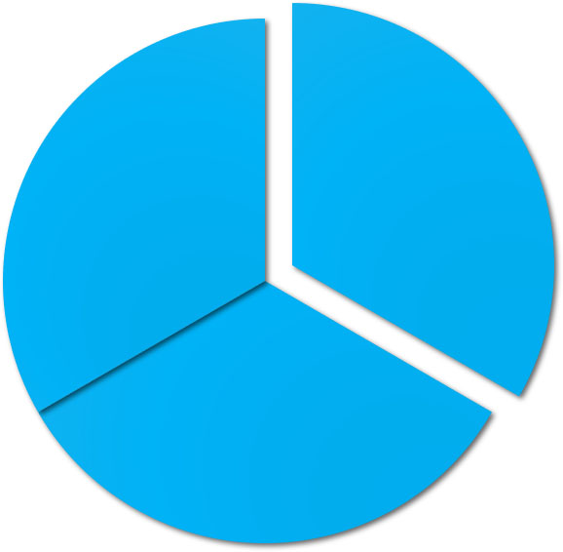
End of Chapter 7
© 2021 McGraw Hill. All rights reserved. Authorized only for instructor use in the classroom. No reproduction or further distribution permitted without the prior written consent of McGraw Hill.

Slide 57
Accessibility Content: Text Alternatives for Images

Slide 58
How Costs Are Treated Under Activity-Based Costing 3 – Text Alternative
Return to parent-slide containing images.
Plantwide overhead rate has a low number of cost pools and low level of complexity. Departmental overhead rates is moderate for both variables. Activity-based costing has a large number of cost pools and a high level of complexity.
Return to parent-slide containing images.

Slide 59
Assign Overhead Costs to Activity Cost Pools 4 – Text Alternative
Return to parent-slide containing images.
The overhead costs report for Baxter Battery from a previous slide is set in front of a similar statement with the same department cost items listed. The statement in the background is mostly hidden, but the first column that is visible is titled Customer Orders and shows $1,800,000 for Indirect factory wages for the Production Department. A calculation for this amount is shown below the two statements: Indirect factory wages of $6,000,000 (taken from the overhead costs report) is multiplied by 30% (Percent consumed by customer orders) which equals $1,800,000.
Return to parent-slide containing images.

Slide 60
Assign Overhead Costs to Activity Cost Pools 5 – Text Alternative
Return to parent-slide containing images.
The overhead costs report for Baxter Battery from a previous slide is set in front of a similar statement with the same department cost items listed. The statement in the background is mostly hidden, but the first column that is visible is titled Customer Orders and shows 700,000 for Factory equipment depreciation for the Production Department. A calculation for this amount is shown below the two statements: Factory equipment depreciation of $3,500,000 (taken from the overhead costs report) is multiplied by 20% (Percent consumed by customer orders) which equals $700,000.
Return to parent-slide containing images.

Slide 61
Calculate Activity Rates 3 – Text Alternative
Return to parent-slide containing images.
This partial illustration shows that Direct Materials, Direct Labor, and Shipping Costs can be traced or assigned to cost objects of products, customer orders, and customers. On this slide, the Overhead Costs category is shown, but no indication of how it is assigned is yet shown.
Return to parent-slide containing images.

Slide 62
Calculate Activity Rates 4 – Text Alternative
Return to parent-slide containing images.
This partial illustration focuses on Overhead Costs which can be broken down into multiple allocations. The first-stage allocation can be made to categories of Customer Orders, Design Changes, Order Size, Customer Relations, and Other.
Return to parent-slide containing images.

Slide 63
Calculate Activity Rates 5 – Text Alternative
Return to parent-slide containing images.
This partial illustration focuses on Overhead Costs which can be broken down into multiple allocations. The first-stage allocation can be made to categories of Customer Orders, Design Changes, Order Size, Customer Relations, and Other. In the second-stage allocation, Customer Orders are shown as $ per order, Design Changes is shown as $ per Change, Order Size is shown as S per machine-hour, and Customer Relations is shown as $ per Customer. These four items can be traced or assigned to cost objects of products, customer orders, and customers. The Other category, which con­tains organization-sustaining costs and unused capacity costs, is not allocated (unallocated) to products or customers.
Return to parent-slide containing images.

