Slide 1

Master Budgeting
Chapter 8
Managerial Accounting
Seventeenth edition
© 2021 McGraw Hill. All rights reserved. Authorized only for instructor use in the classroom. No reproduction or further distribution permitted without the prior written consent of McGraw Hill.

Slide 2
Learning Objective 1
Understand why organizations budget and the processes they use to create budgets.

Slide 3
Basic Framework of Budgeting
A budget is a detailed quantitative plan for acquiring and using financial and other resources over a specified forthcoming time period.
A company’s budget ordinarily covers a one-year period corresponding to its fiscal year.
Some companies also use a perpetual budget, which is a 12-month budget that continuously rolls forward.

Slide 4
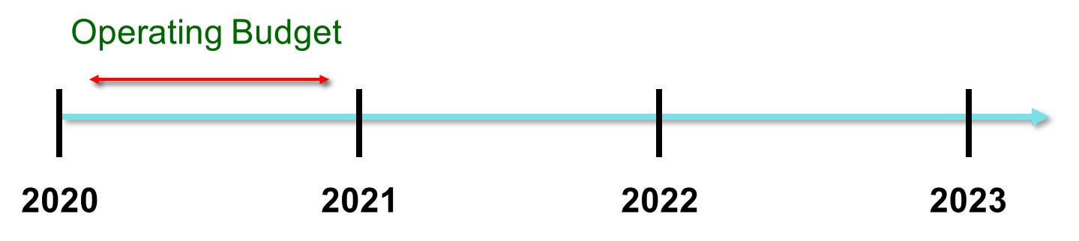
Choosing the Budget Period
Operating budgets ordinarily cover a one-year period corresponding to a company’s fiscal year. Many companies divide their annual budget into four quarters.
A continuous budget is a 12-month budget that rolls forward one month (or quarter) as the current month (or quarter) is completed.

Slide 5
Budgets Are Used for Two Key Purposes
Planning involves developing objectives and preparing various budgets to achieve those objectives.
Control involves the steps taken by management to increase the likelihood that the objectives set down while planning are attained and that all parts of the organization are working together toward that goal.

Slide 6
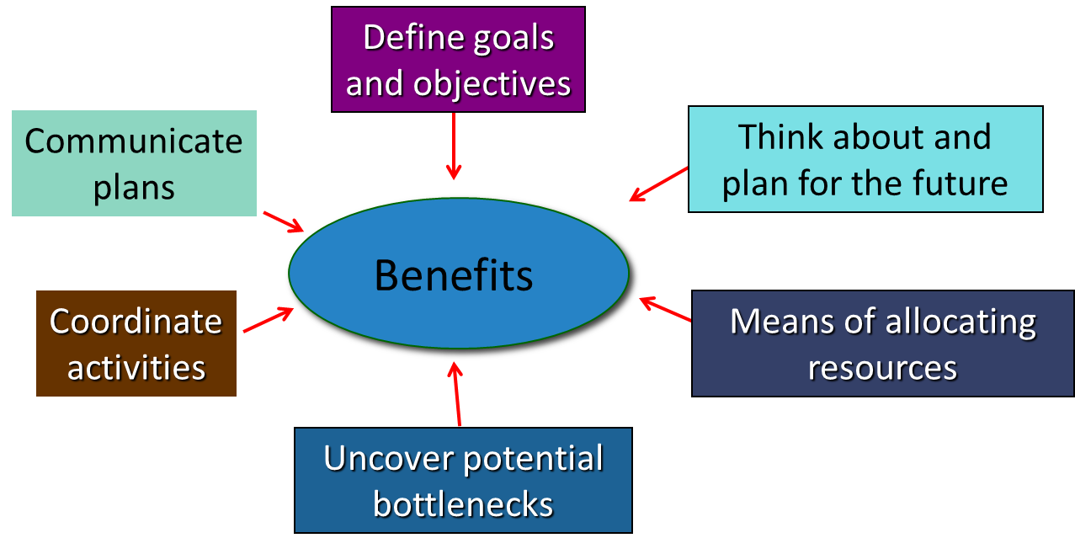
Why Do Organizations Create Budgets? (Planning Perspective)

Slide 7
Why Do Organizations Create Budgets? (Control Perspective)
From a control standpoint, organizations compare their budgets to actual results to:
Improve the efficiency and effectiveness of operations.
Evaluate and reward employees.

Slide 8
How Do Organizations Create Budgets?
Companies usually create budgets by relying on some combination of top-down budgeting and self-imposed budgeting. A self-imposed budget or participative budget is a budget that is prepared with the full cooperation and participation of managers at all levels.

Slide 9
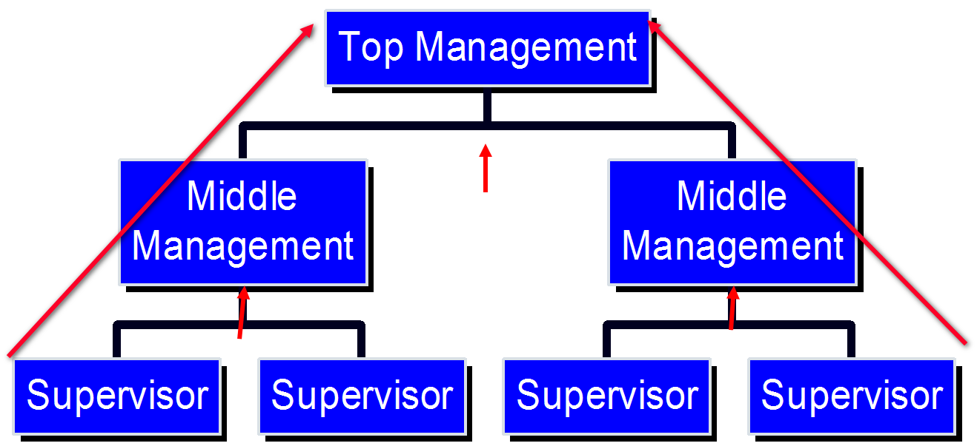
Self-Imposed Budgets
When managers throughout the organization work collaboratively to prepare a budget, they often strive to establish challenging targets that are also highly achievable. These goals are likely to build a lower-level manager’s confidence and commitment to the budget.

Slide 10
Advantages of Self-Imposed Budget
1. It shows respect for the opinions of lower-level managers when they are involved in the budgeting process.
2. Budget estimates prepared by front-line managers are often more accurate than estimates prepared by top managers.
3. Motivation is generally higher when individuals participate in setting their own goals than when the goals are imposed from above.
4. It empowers them to take ownership of the budget and to be accountable for deviations from it.

Slide 11
Self-Imposed Budgets – Management Review
Self-imposed budgets should be reviewed by higher levels of management to prevent “budgetary slack.”
Most companies issue broad guidelines in terms of overall profits or sales. Lower-level managers are directed to prepare budgets that meet those targets.

Slide 12
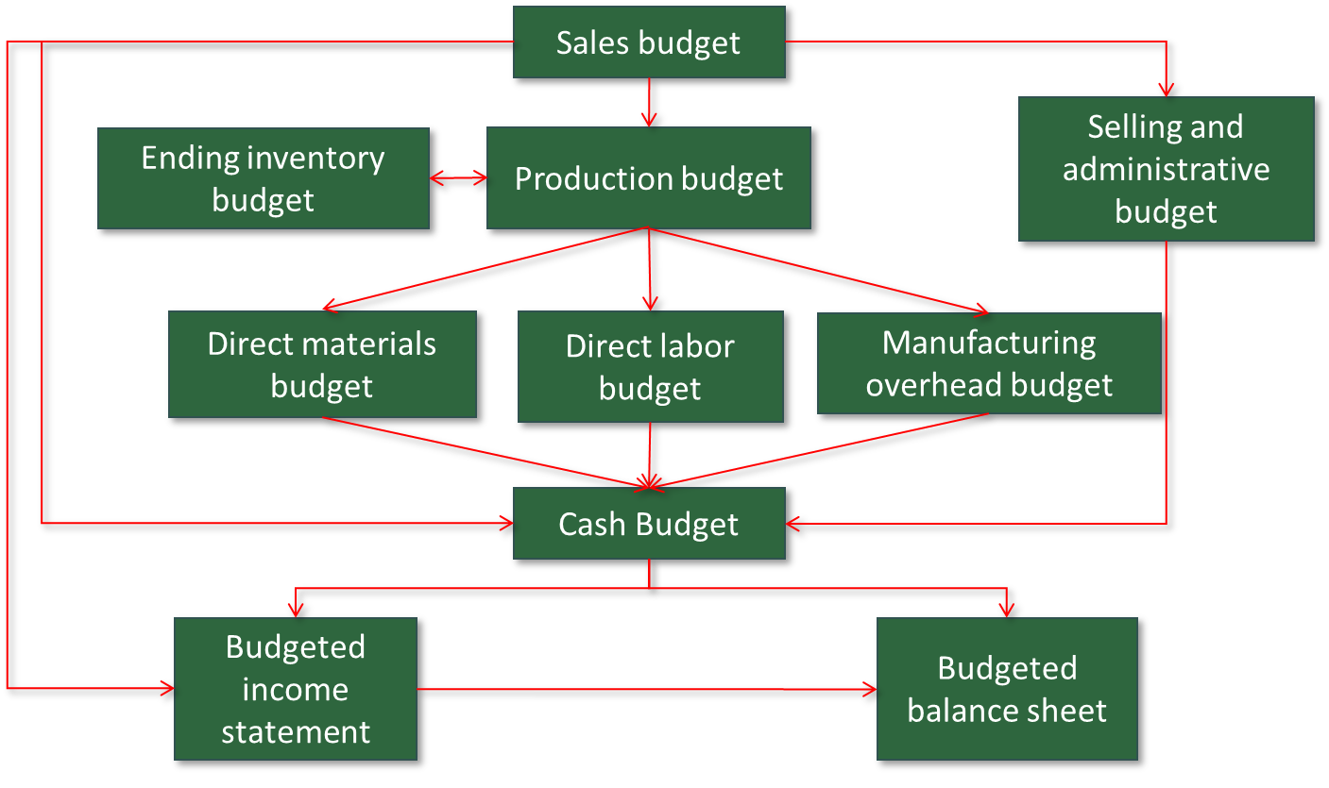
Master Budget – An Overview 1
Access the text alternative for slide images.

Slide 13
Seeing the Big Picture 1
To help you see the “big picture,” keep in mind that the 10 schedules in the master budget are designed to answer the 10 questions shown on the next screen.

Slide 14
Seeing the Big Picture 2
How much sales revenue will we earn?
How much cash will we collect from customers?
How much raw material will we need to purchase?
How much manufacturing costs will we incur?
How much cash will we pay to our suppliers and our direct laborers, and how much cash will we pay for manufacturing overhead resources?
What is the total cost that will be transferred from finished goods inventory to cost of goods sold?
How much selling and administrative expense will we incur, and how much cash will we pay related to those expenses?
How much money will we borrow from or repay to lenders—including interest?
How much operating income will we earn?
What will our balance sheet look like at the end of the budget period?

Slide 15
Master Budget – An Overview 2
A master budget is based on various estimates and assumptions. For example, the sales budget requires three estimates/assumptions as follows:
What are the budgeted unit sales?
What is the budgeted selling price per unit?
What percentage of accounts receivable will be collected in the current and subsequent periods?

Slide 16
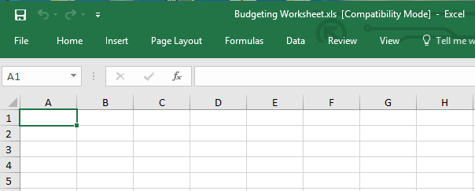
Master Budget – An Overview 3
When Microsoft Excel© is used to create a master budget, these types of assumptions can be depicted in a Budget Assumptions tab, thereby enabling Excel-based budgets to answer “what-if” questions.

Slide 17
Learning Objective 2
Prepare a sales budget, including a schedule of expected cash collections.

Slide 18
Budgeting Example
Royal Company is preparing budgets for the quarter ending June 30.
Budgeted sales for the next five months are:
April | 20,000 units
May | 50,000 units
June | 30,000 units
July | 25,000 units
August | 15,000 units
The selling price is $10 per unit.

Slide 19
Sales Budget
The individual months of April, May, and June are summed to obtain the total budgeted sales in units and dollars for the quarter ended June 30.
 | April | May | June | Quarter
Budgeted sales in units | 20,000 | 50,000 | 30,000 | 100,000
Selling price per unit | $ 10 | $ 10 | $ 10 | $ 10
Total budgeted sales | $ 200,000 | $ 500,000 | $ 300,000 | $ 1,000,000

Slide 20
Expected Cash Collections 1
All sales are on account.
Royal’s collection pattern is:
  70% collected in the month of sale.
  30% collected in the month following sale.
In April, the March 31 accounts receivable balance of $30,000 will be collected in full in April.

Slide 21
Expected Cash Collections 2
 | April | May | June | Quarter
Accounts receivable 3/31 | $ 30,000 |  |  | $ 30,000

Slide 22
Expected Cash Collections 3
 | April | May | June | Quarter
Accounts receivable 3/31 | $ 30,000 |  |  | $ 30,000
April sales:
70% × $200,000 | 140,000 |  |  | 140,000
30% × $200,000 |  | 60,000 |  | 60,000
From the sales budget for April

Slide 23
Expected Cash Collections 4
 | April | May | June | Quarter
Accounts receivable 3/31 | $ 30,000 |  |  | $ 30,000
April sales:
70% × $200,000 | 140,000 |  |  | 140,000
30% × $200,000 |  | 60,000 |  | 60,000
May sales:
70% × $500,000 |  | 350,000 |  | 350,000
30% × $500,000 |  |  | 150,000 | 150,000
From the sales budget for May

Slide 24
Quick Check 1
What will be the total cash collections for the quarter?
  a. $700,000.
  b. $220,000.
  c. $190,000.
  d. $940,000.

Slide 25
Quick Check 1a
What will be the total cash collections for the quarter?
  a. $700,000.
  b. $220,000.
  c. $190,000.
  d. Answer: $940,000.

Slide 26
Expected Cash Collections 5
 | April | May | June | Quarter
Accounts receivable 3/31 | $ 30,000 |  |  | $ 30,000
April sales:
70% × $200,000 | 140,000 |  |  | 140,000
30% × $200,000 |  | 60,000 |  | 60,000
May sales:
70% × $500,000 |  | 350,000 |  | 350,000
30% × $500,000 |  |  | 150,000 | 150,000
June sales:
70% × $300,000 |  |  | 210,000 | 210,000
 | $ 170,000 | $ 410,000 | $ 360,000 | $ 940,000
Accounts Receivable 6/30 = 30%×$300,000 = $90,000

Slide 27
Learning Objective 3
Prepare a production budget.

Slide 28
Production Budget 1
Sales Budget and Expected Cash Collections (Completed).
Production Budget.
The production budget must be adequate to meet budgeted sales and to provide for the desired ending inventory.

Slide 29
Production Budget 2
The management at Royal Company wants ending inventory to be equal to 20% of the following month’s budgeted sales in units.
On March 31, 4,000 units were on hand
Let’s prepare the production budget.
If Royal was a merchandising company, it would prepare a merchandise purchase budget instead of a production budget.

Slide 30
Production Budget 3
 | April | May | June | Quarter
Budgeted sales | 20,000 | 50,000 | 30,000 | 100,000
Add: Desired ending inventory
Total needs
Less: Beginning inventory
Required production

Slide 31
Production Budget 4
 | April | May | June | Quarter
Budgeted sales | 20,000 | 50,000 | 30,000 | 100,000
Add: Desired ending inventory | 10,000
Total needs | 30,000
Less: Beginning inventory | 4,000
Required production | 26,000
Budgeted May sales | 50,000
Desired ending inventory % | 20%
Desired ending inventory | 10,000
March 31 ending inventory

Slide 32
Quick Check 2
What is the required production for May?
  a. 56,000 units.
  b. 46,000 units.
  c. 62,000 units.
  d. 52,000 units.

Slide 33
Quick Check 2a
What is the required production for May?
  a. 56,000 units.
  b. Answer: 46,000 units.
  c. 62,000 units.
  d. 52,000 units.

Slide 34
Production Budget 5
 | April | May | June | Quarter
Budgeted sales | 20,000 | 50,000 | 30,000 | 100,000
Add: Desired ending inventory | 10,000 | 6,000
Total needs | 30,000 | 56,000
Less: Beginning inventory | 4,000 | 10,000
Required production | 26,000 | 46,000

Slide 35
Production Budget 6
 | April | May | June | Quarter
Budgeted sales | 20,000 | 50,000 | 30,000 | 100,000
Add: Desired ending inventory | 10,000 | 6,000 | 5,000 | 5,000
Total needs | 30,000 | 56,000 | 35,000 | 105,000
Less: Beginning inventory | 4,000 | 10,000 | 6,000 | 4,000
Required production | 26,000 | 46,000 | 29,000 | 101,000
July sales of 25,000 units×20% = 5,000

Slide 36
Learning Objective 4
Prepare a direct materials budget, including a schedule of expected cash disbursements for purchases of materials.

Slide 37
Direct Materials Budget 1
At Royal Company, five pounds of material are required per unit of product.
Management wants materials on hand at the end of each month equal to 10% of the following month’s production.
On March 31, there are 13,000 pounds of material on hand. Material cost is $0.40 per pound.
Let’s prepare the direct materials budget.

Slide 38
Direct Materials Budget 2
 | April | May | June | Quarter
Production | 26,000 | 46,000 | 29,000 | 101,000
Materials per unit (pounds)
Production needs
Add: Desired ending inventory
Total needed
Less: Beginning inventory
Materials to be purchased
From production budget

Slide 39
Direct Materials Budget 3
 | April | May | June | Quarter
Production | 26,000 | 46,000 | 29,000 | 101,000
Materials per unit (pounds) | 5 | 5 | 5 | 5
Production needs | 130,000 | 230,000 | 145,000 | 505,000
Add: Desired ending inventory
Total needed
Less: Beginning inventory
Materials to be purchased

Slide 40
Direct Materials Budget 4
 | April | May | June | Quarter
Production | 26,000 | 46,000 | 29,000 | 101,000
Materials per unit (pounds) | 5 | 5 | 5 | 5
Production needs | 130,000 | 230,000 | 145,000 | 505,000
Add: Desired ending inventory | 23,000
Total needed | 153,000
Less: Beginning inventory | 13,000
Materials to be purchased | 140,000
March 31 inventory.
10% of following month’s production needs.
Now, why don’t you calculate the materials to be purchased in May.

Slide 41
Quick Check 3
How much materials should be purchased in May?
  a. 221,500 pounds.
  b. 240,000 pounds.
  c. 230,000 pounds.
  d. 211,500 pounds.

Slide 42
Quick Check 3a
How much materials should be purchased in May?
  a. Answer: 221,500 pounds.
  b. 240,000 pounds.
  c. 230,000 pounds.
  d. 211,500 pounds.

Slide 43
Direct Materials Budget 5
 | April | May | June | Quarter
Production | 26,000 | 46,000 | 29,000 | 101,000
Materials per unit (pounds) | 5 | 5 | 5 | 5
Production needs | 130,000 | 230,000 | 145,000 | 505,000
Add: Desired ending inventory | 23,000 | 14,500
Total needed | 153,000 | 244,500
Less: Beginning inventory | 13,000 | 23,000
Materials to be purchased | 140,000 | 221,500

Slide 44
Direct Materials Budget 6
 | April | May | June | Quarter
Production | 26,000 | 46,000 | 29,000 | 101,000
Materials per unit (pounds) | 5 | 5 | 5 | 5
Production needs | 130,000 | 230,000 | 145,000 | 505,000
Add: Desired ending inventory | 23,000 | 14,500 | 11,500 | 11,500
Total needed | 153,000 | 244,500 | 156,500 | 516,000
Less: Beginning inventory | 13,000 | 23,000 | 14,500 | 13,000
Materials to be purchased | 140,000 | 221,500 | 142,000 | 503,500
Beginning inventory from April

Slide 45
Expected Cash Disbursement for Materials 1
Royal pays $0.40 per pound for its materials.
One-half of a month’s purchases is paid for in the month of purchase; the other half is paid in the following month.
The March 31 accounts payable balance is $12,000.
Let’s calculate expected cash disbursements.

Slide 46
Expected Cash Disbursement for Materials 2
 | April | May | June | Quarter
Accounts payable 3/31 | $ 12,000 |  |  | $ 12,000

Slide 47
Expected Cash Disbursement for Materials 3
 | April | June | July | Quarter
Accounts payable 3/31 | $ 12,000 |  |  | $ 12,000
April purchases:
50% × $56,000 | 28,000 |  |  | 28,000
50% × $56,000 |  | 28,000 |  | 28,000
Compute the expected cash
disbursements for materials
for the quarter.
140,000 lbs. × $0.40/lb. = $56,000

Slide 48
Quick Check 4
What are the total cash disbursements for the quarter?
a. $185,000.
b. $68,000.
c. $56,000.
d. $201,400.

Slide 49
Quick Check 4a
What are the total cash disbursements for the quarter?
a. Answer: $185,000.
b. $68,000.
c. $56,000.
d. $201,400.

Slide 50
Expected Cash Disbursement for Materials 4
 | April | May | June | Quarter
Accounts payable 3/31 | $ 12,000 |  |  | $ 12,000
April purchases:
50% × $56,000 | 28,000 |  |  | 28,000
50% × $56,000 |  | 28,000 |  | 28,000
May purchases:
50% × $88,600 |  | 44,300 |  | 44,300
50% × $88,600 |  |  | 44,300 | 44,300
June purchases:
50% × $56,800 |  |  | 28,400 | 28,400
Total cash disbursements | $ 40,000 | $ 72,300 | $ 72,700 | $ 185,000
Accounts payable at June 30 = $56,800×50% = $28,400

Slide 51
Learning Objective 5
Prepare a direct labor budget.

Slide 52
Direct Labor Budget 1
At Royal, each unit of product requires 0.05 hour (3 minutes) of direct labor. The labor can be unskilled because the production process is relatively simple and formal training is not required.
Royal pays its workers at the rate of $10 per hour.
Let’s prepare the direct labor budget.

Slide 53
Direct Labor Budget 2
 | April | May | June | Quarter
Units of production | 26,000 | 46,000 | 29,000 | 101,000
Direct labor time per unit
Labor-hours required
Hourly wage rate
Total direct labor costs
From production budget

Slide 54
Direct Labor Budget 3
 | April | May | June | Quarter
Units of production | 26,000 | 46,000 | 29,000 | 101,000
Direct labor time per unit | 0.05 | 0.05 | 0.05 | 0.05
Labor-hours required | 1,300 | 2,300 | 1,450 | 5,050
Hourly wage rate
Total direct labor costs

Slide 55
Direct Labor Budget 4
 | April | May | June | Quarter
Units of production | 26,000 | 46,000 | 29,000 | 101,000
Direct labor time per unit | 0.05 | 0.05 | 0.05 | 0.05
Labor-hours required | 1,300 | 2,300 | 1,450 | 5,050
Hourly wage rate | $ 10 | $ 10 | $ 10 | $ 10
Total direct labor costs | $ 13,000 | $ 23,000 | $ 14,500 | $ 50,500

Slide 56
Learning Objective 6
Prepare a manufacturing overhead budget.

Slide 57
Manufacturing Overhead Budget 1
At Royal, manufacturing overhead is applied to units of product on the basis of direct labor-hours.
The variable manufacturing overhead rate is $20 per direct labor-hour.
Fixed manufacturing overhead is $50,000 per month, which includes $20,000 of noncash costs (primarily depreciation of plant assets).
Let’s prepare the manufacturing overhead budget.

Slide 58
Manufacturing Overhead Budget 2
 | April | May | June | Quarter
Budgeted direct labor-hours | 1,300 | 2,300 | 1,450 | 5,050
Variable mfg. OH rate
Variable mfg. OH costs
Fixed mfg. OH costs
Total mfg. OH costs
Less: Noncash costs
Cash disbursement for mfg. OH
Direct labor budget

Slide 59
Manufacturing Overhead Budget 3
 | April | May | June | Quarter
Budgeted direct labor-hours | 1,300 | 2,300 | 1,450 | 5,050
Variable mfg. OH rate | $ 20 | $ 20 | $ 20 | $ 20
Variable mfg. OH costs | $ 26,000 | $ 46,000 | $ 29,000 | $ 101,000
Fixed mfg. OH costs | 50,000 | 50,000 | 50,000 | 150,000
Total mfg. OH costs | 76,000 | 96,000 | 79,000 | 251,000
Less: Noncash costs | 20,000 | 20,000 | 20,000 | 60,000
Cash disbursement for mfg. OH | $ 56,000 | $ 76,000 | $ 59,000 | $ 191,000
* rounded

Slide 60
Manufacturing Overhead Budget 4
 | April | May | June | Quarter
Budgeted direct labor-hours | 1,300 | 2,300 | 1,450 | 5,050
Variable mfg. OH rate | $ 20 | $ 20 | $ 20 | $ 20
Variable mfg. OH costs | $ 26,000 | $ 46,000 | $ 29,000 | $ 101,000
Fixed mfg. OH costs | 50,000 | 50,000 | 50,000 | 150,000
Total mfg. OH costs | 76,000 | 96,000 | 79,000 | 251,000
Less: Noncash costs | 20,000 | 20,000 | 20,000 | 60,000
Cash disbursement for mfg. OH | $ 56,000 | $ 76,000 | $ 59,000 | $ 191,000
Depreciation is a noncash charge.

Slide 61
Ending Finished Goods Inventory Budget 1
Production costs per unit | Quantity | Cost | Total
Direct materials | 5.00 Ibs. | $ 0.40 | $ 2.00
Direct materials budget and information

Slide 62
Ending Finished Goods Inventory Budget 2
Production costs per unit | Quantity | Cost | Total
Direct materials | 5.00 Ibs. | $ 0.40 | $ 2.00
Direct labor | 0.05 hr. | $ 10.00 | 0.50
Direct labor budget

Slide 63
Ending Finished Goods Inventory Budget 3
Production costs per unit | Quantity | Cost | Total
Direct materials | 5.00 Ibs. | $ 0.40 | $ 2.00
Direct labor | 0.05 hr. | $ 10.00 | 0.50
Manufacturing overhead | 0.05 hr. | $ 49.70 | 2.49
 |  |  | $ 4.99
Budgeted finished goods inventory
Ending inventory in units
Unit product cost |  |  | $ 4.99
Ending finished goods inventory |  |  | ?

Slide 64
Ending Finished Goods Inventory Budget 4
Production costs per unit | Quantity | Cost | Total
Direct materials | 5.00 Ibs. | $ 0.40 | $ 2.00
Direct labor | 0.05 hr. | $ 10.00 | 0.50
Manufacturing overhead | 0.05 hr. | $ 49.70 | 2.49
 |  |  | $ 4.99
Budgeted finished goods inventory
Ending inventory in units |  |  | 5,000
Unit product cost |  |  | $ 4,99
Ending finished goods inventory |  |  | $ 24,950

Slide 65
Ending Finished Goods Inventory Budget 5
Production costs per unit | Quantity | Cost | Total
Direct materials | 5.00 Ibs. | $ 0.40 | $ 2.00
Direct labor | 0.05 hr. | $ 10.00 | 0.50
Manufacturing overhead | 0.05 hr. | $ 49.70 | 2.49
 |  |  | $ 4.99
Budgeted finished goods inventory
Ending inventory in units |  |  | 5,000
Unit product cost |  |  | $ 4.99
Ending finished goods inventory |  |  | $ 24,950
Production budget

Slide 66
Learning Objective 7
Prepare a selling and administrative expense budget.

Slide 67
Selling and Administrative Expense Budget 1
At Royal, the selling and administrative expense budget is divided into variable and fixed components.
The variable selling and administrative expenses are $0.50 per unit sold.
Fixed selling and administrative expenses are $70,000 per month.
The fixed selling and administrative expenses include $10,000 in costs—primarily depreciation—that are not cash outflows of the current month.
Let’s prepare the company’s selling and administrative expense budget.

Slide 68
Selling and Administrative Expense Budget 2
 | April | May | June | Quarter
Budgeted sales | 20,000
Variable S&A rate | 0.50
Variable expenses | $ 10,000
Fixed S&A expenses | 70,000
Total S&A expenses | 80,000
Less: Noncash expenses | 10,000
Cash S&A expenses | $ 70,000
Calculate the selling and administrative
cash expenses for the quarter.

Slide 69
Quick Check 6
What are the total cash disbursements for selling and administrative expenses for the quarter?
  a. $180,000.
  b. $230,000.
  c. $110,000.
  d. $70,000.

Slide 70
Quick Check 6a
What are the total cash disbursements for selling and administrative expenses for the quarter?
  a. $180,000
  b. Answer: $230,000.
  c. $110,000
  d. $70,000

Slide 71
Selling and Administrative Expense Budget 3
 | April | May | June | Quarter
Budgeted sales | 20,000 | 50,000 | 30,000 | 100,000
Variable S&A rate | 0.50 | 0.50 | 0.50 | 0.50
Variable expenses | $ 10,000 | $ 25,000 | $ 15,000 | $ 50,000
Fixed S&A expenses | 70,000 | 70,000 | 70,000 | 210,000
Total S&A expenses | 80,000 | 95,000 | 85,000 | 260,000
Less: Noncash expenses | 10,000 | 10,000 | 10,000 | 30,000
Cash S&A expenses | $ 70,000 | $ 85,000 | $ 75,000 | $ 230,000

Slide 72
Learning Objective 8
Prepare a cash budget.

Slide 73
Format of the Cash Budget
The cash budget is divided into four sections:
1. Cash receipts section lists all cash inflows excluding cash received from financing;
2. Cash disbursements section consists of all cash payments excluding repayments of principal and interest;
3. Cash excess or deficiency section determines if the company will need to borrow money or if it will be able to repay funds previously borrowed; and
4. Financing section details the borrowings and repayments projected to take place during the budget period.

Slide 74
Additional Cash Budget Information
Assume the following information for Royal:
  Maintains a 16% open line of credit for $75,000.
  Maintains a minimum cash balance of $30,000.
  Borrows on the first day of the month and repays loans on the last day of the month.
  Pays a cash dividend of $49,000 in April.
  Purchases $143,700 of equipment in May and $48,300 in June (both purchases paid in cash).
  Has an April 1 cash balance of $40,000.

Slide 75
Cash Budget 1
 | April | May | June | Quarter
Beginning cash balance | $ 40,000
Add: Cash collections | 170,000
Total cash available | $ 210,000
Less: Cash disbursements
Materials
Direct labor
Manufacturing overhead
Selling and administrative
Equipment purchase
Dividend
Total disbursements
Excess (deficiency)
Financing:
Borrowing
Repayment
Interest
Total financing
Ending cash balance
Schedule of expected cash collections

Slide 76
Cash Budget 2
 | April | May | June | Quarter
Beginning cash balance | $ 40,000
Add: Cash collections | 170,000
Total cash available | $ 210,000
Less: Cash disbursements
Materials | 40,000
Direct labor | 13,000
Manufacturing overhead | 56,000
Selling and administrative | 70,000
Equipment purchase | -
Dividend | 49,000
Total disbursements | 228,000
Excess (deficiency)
Financing:
Borrowing
Repayment
Interest | -
Total financing | -
Ending cash balance | -
Schedule of expected cash disbursements
Manufacturing overhead budget
Selling and administrative expense budget

Slide 77
Cash Budget 3
 | April | May | June | Quarter
Beginning cash balance | $ 40,000
Add: Cash collections | 170,000
Total cash available | $ 210,000
Less: Cash disbursements
Materials | 40,000
Direct labor | 13,000
Manufacturing overhead | 56,000
Selling and administrative | 70,000
Equipment purchase | -
Dividend | 49,000
Total disbursements | 228,000
Excess (deficiency) | (18,000)
Financing:
Borrowing
Repayment
Interest | -
Total financing | -
Ending cash balance | -
Because Royal maintains a cash balance of $30,000, the company must borrow $48,000 on its line of credit.

Slide 78
Cash Budget 4
 | April | May | June | Quarter
Beginning cash balance | $ 40,000
Add: Cash collections | 170,000
Total cash available | $ 210,000
Less: Cash disbursements
Materials | 40,000
Direct labor | 13,000
Manufacturing overhead | 56,000
Selling and administrative | 70,000
Equipment purchase | -
Dividend | 49,000
Total disbursements | 228,000
Excess (deficiency) | (18,000)
Financing:
Borrowing | 48,000
Repayment | -
Interest | -
Total financing | 48,000
Ending cash balance | $ 30,000
Because Royal maintains a cash balance of $30,000, the company must borrow $48,000 on its line of credit.
Ending cash balance for April is the beginning May balance.

Slide 79
Cash Budget 5
 | April | May | June | Quarter
Beginning cash balance | $ 40,000 | $ 30,000
Add: Cash collections | 170,000 | 410,000
Total cash available | $ 210,000 | $ 440,000
Less: Cash disbursements
Materials | 40,000 | 72,300
Direct labor | 13,000 | 23,000
Manufacturing overhead | 56,000 | 76,000
Selling and administrative | 70,000 | 85,000
Equipment purchase | - | 143,700
Dividend | 49,000 | -
Total disbursements | 228,000 | 400,000
Excess (deficiency) | (18,000) | 40,000
Financing:
Borrowing | 48,000 | -
Repayment | - | -
Interest | - | -
Total financing | 48,000 | -
Ending cash balance | $ 30,000 | $ 40,000

Slide 80
Quick Check 7
What is the excess (deficiency) of cash available over disbursements for June?
  a. $95,000.
  b. $(21,000).
  c. $175,000.
  d. $130,500.

Slide 81
Quick Check 7a
What is the excess (deficiency) of cash available over disbursements for June?
  a. $95,000.
  b. $(21,000).
  c. $175,000.
  d. Answer: $130,500.

Slide 82
Cash Budget 6
 | April | May | June | Quarter
Beginning cash balance | $ 40,000 | $ 30,000 | $ 40,000 | $ 40,000
Add: Cash collections | 170,000 | 410,000 | 360,000 | 940,000
Total cash available | $ 210,000 | $ 440,000 | $ 400,000 | $ 980,000
Less: Cash disbursements
Materials | 40,000 | 72,300 | 72,700 | 185,000
Direct labor | 13,000 | 23,000 | 14,500 | 50,500
Manufacturing overhead | 56,000 | 76,000 | 59,000 | 191,000
Selling and administrative | 70,000 | 85,000 | 75,000 | 230,000
Equipment purchase | - | 143,700 | 48,300 | 192,000
Dividend | 49,000 | - | - | 49,000
Total disbursements | 228,000 | 400,000 | 269,500 | 897,500
Excess (deficiency) | (18,000) | 40,000 | 130,500 | 82,500
Financing:
Borrowing | 48,000 | - |  | 48,000
Repayment | - | - | (48,000) | (48,000)
Interest | - | - | (1,920) | (1,920)
Total financing | 48,000 | - | (49,920) | (1,920)
Ending cash balance | $ 30,000 | $ 40,000 | $ 80,580 | $ 80,580
$48,000 × 16% × 3/12 = $1,920
Borrowings on April 1 and
repayment on June 30.

Slide 83
Budgeted Income Statement 1
Cash Budget (Completed).
Budgeted income statement.
With interest expense from the cash budget, Royal can prepare the budgeted income statement.

Slide 84
Learning Objective 9
Prepare a budgeted income statement.

Slide 85
Budgeted Income Statement 2
Royal Company
Budgeted Income Statement
For the Three Months Ended June 30
Sales (100,000 units @ $10) | $ 1,000,000
Cost of goods sold (100,000 @ $4.99) | 499,000
Gross margin | 501,000
Selling and administrative expenses | 260,000
Operating income | 241,000
Interest expense | 1,920
Net income | $ 239,080
Sales budget
Ending finished goods inventory
Selling and administrative expense budget
Cash budget

Slide 86
Learning Objective 10
Prepare a budgeted balance sheet.

Slide 87
Additional Budgeted Balance Sheet Information
Royal reported the following account balances prior to preparing its budgeted financial statements:
  Land $50,000
  Common Stock $150,000
  Retained Earnings $248,650 (April 1)
  Equipment $175,000

Slide 88
Budgeted Balance Sheet 1
Royal Company
Budgeted Balance Sheet
June 30
Assets:
Cash | $ 80,580
Accounts receivable | 90,000
Raw materials inventory | 4,600
Finished goods inventory | 24,950
Land | 50,000
Equipment | 367,000
Total assets | $ 617,130
30% of June sales of $300,000
11,500 lbs. at $0.40/lb.
5,000 units at $4.99 each
Liabilities and Stockholders’ Equity
Accounts payable | $ 28,400
Common stock | 150,000
Retained earnings | 438,730
Total liabilities and stockholders’ equity | $ 617,130
50% of June purchases of $56,800

Slide 89
Budgeted Balance Sheet 2
Royal Company
Budgeted Balance Sheet
June 30
Assets:
Cash | $ 80,580
Accounts receivable | 90,000
Raw materials inventory | 4,600
Finished goods inventory | 24,950
Land | 50,000
Equipment | 367,000
Total assets | $ 617,130
 | Retained Earnings
Beginning balance | $ 248,650
Net income | 239,080
Dividends | (49,000)
Ending balance | $ 438,730
Liabilities and Stockholders’ Equity
Accounts payable | $ 28,400
Common stock | 150,000
Retained earnings | 438,730
Total liabilities and stockholders’ equity | $ 617,130

Slide 90
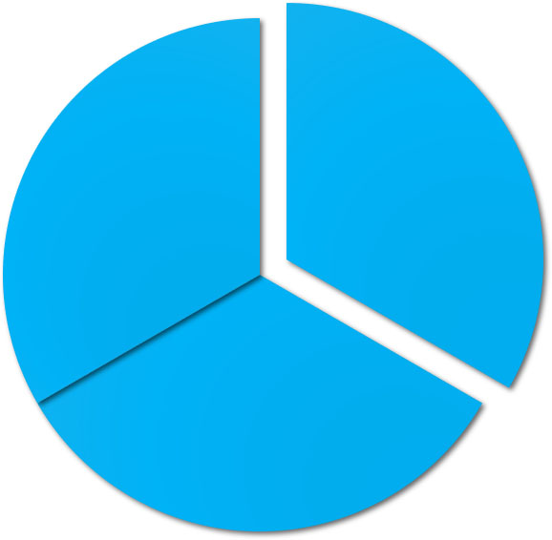
End of Chapter 8
© 2021 McGraw Hill. All rights reserved. Authorized only for instructor use in the classroom. No reproduction or further distribution permitted without the prior written consent of McGraw Hill.

Slide 91
Accessibility Content: Text Alternatives for Images

Slide 92
Master Budget – An Overview 1 – Text Alternative 1
Return to parent-slide containing images.
At the top of the diagram is the Sales Budget. From it, four arrows extend to the
Production budget.
Selling and administrative expense budget.
Cash budget.
Budgeted income statement.
From the Production budget, arrows extend to the:
Ending inventory budget, which also has an arrow returning to the Production budget.
Direct materials budget.
Direct labor budget.
Manufacturing overhead budget.
Advance to rest of text alternative.

Slide 93
Master Budget – An Overview 1 – Text Alternative 2
Return to parent-slide containing images.
The Cash budget has arrows coming into it from the following:
Selling and administrative expense budget.
Direct materials budget.
Direct labor budget.
Manufacturing overhead budget.
The Cash budget has arrows going out to:
Budgeted income statement.
Budgeted balance sheet.
The Budgeted income statement has arrows coming into it from the following:
Sales budget.
Cash budget.
The Budgeted income statement has an arrow coming from it that goes into the Budgeted balance sheet.
And finally, the Budgeted balance sheet has arrows coming into it from the following:
Cash budget.
Budgeted income statement.
Return to parent-slide containing images.

