Slide 1
Differential Analysis: The Key to Decision Making
Chapter 13
Managerial Accounting
Seventeenth edition
© 2021 McGraw Hill. All rights reserved. Authorized only for instructor use in the classroom. No reproduction or further distribution permitted without the prior written consent of McGraw Hill.

Slide 2
Learning Objective 1
Identify relevant and irrelevant costs and benefits in a decision.

Slide 3
Decision Making – Six Key Concepts – Concepts 1 and 2
Key Concept #1
Every decision involves choosing from among at least two alternatives. Therefore, the first step in decision making is to define the alternatives being considered.
Key Concept #2
Once you have defined the alternatives, you need to identify the criteria for choosing among them.
Relevant costs and relevant benefits should be considered when making decisions.
Irrelevant costs and irrelevant benefits should be ignored when making decisions.

Slide 4
Decision Making – Six Key Concepts – Concept 3
Key Concept #3
The key to effective decision making is differential analysis—focusing on the future costs and benefits that differ between the alternatives. Everything else is irrelevant and should be ignored.
A future cost that differs between any two alternatives is known as a differential cost.
Future revenue that differs between any two alternatives is known as differential revenue.
An incremental cost is an increase in cost between two alternatives.
An avoidable cost is a cost that can be eliminated by choosing one alternative over another.

Slide 5
Decision Making – Six Key Concepts – Concepts 4 and 5
Key Concept #4
Sunk costs are always irrelevant when choosing among alternatives.
A sunk cost is a cost that has already been incurred and cannot be changed regardless of what a manager decides to do.
Key Concept #5
Future costs and benefits that do not differ between alternatives are irrelevant to the decision-making process.

Slide 6
Decision Making – Six Key Concepts – Concept 6
Key Concept #6
Opportunity costs also need to be considered when making decisions.
An opportunity cost is the potential benefit that is given up when one alternative is selected over another.

Slide 7
Identifying Relevant Costs – An Example
Cynthia, a Boston student, is considering visiting her friend in New York. She can drive or take the train. By car, it is 230 miles to her friend’s apartment. She is trying to decide which alternative is less expensive and has gathered the following information.
Automobile Costs (based on 10,000 miles driven per year)
 |  | Annual Cost of Fixed Items | Cost per Mile
1 | Annual straight-line depreciation on car | $2,800 | $0.280
2 | Cost of gasoline |  | 0.100
3 | Annual cost of auto insurance and license | 1,380 | 0.138
4 | Maintenance and repairs |  | 0.065
5 | Parking fees at school | 360 | 0.036
6 | Total average cost |  | $0.619
$45 per month × 8 months
$2.70 per gallon ÷ 27 M P G
$24,000 cost − $10,000 salvage value ÷ 5 years

Slide 8
Identifying Relevant Costs – Additional Information
Automobile Costs (based on 10,000 miles driven per year)
. | . | Annual Cost of Fixed Items | . | Cost per Mile
1 | Annual straight-line depreciation on car | $2,800 |  | $0.280
2 | Cost of gasoline |  |  | 0.100
3 | Annual cost of auto insurance and license | 1,380 |  | 0.138
4 | Maintenance and repairs |  |  | 0.065
5 | Parking fees at school | 360 |  | 0.036
6 | Total average cost |  |  | $0.619
 | Additional Information
7 | Reduction in resale value of car per mile of wear | $0.026
8 | Round-tip train fare | $104
9 | Benefits of relaxing on train trip | ????
10 | Cost of putting dog in kennel while gone | $40
11 | Benefit of having car in New York | ????
12 | Hassle of parking car in New York | ????
13 | Per-day cost of parking car in New York | $25

Slide 9
Identifying Relevant Costs 1
Which costs and benefits are relevant in Cynthia’s decision?
The cost of the car is a sunk cost and is not relevant to the current decision.
The annual cost of insurance is not relevant. It will remain the same if she drives or takes the train.
However, the cost of gasoline is clearly relevant if she decides to drive. If she takes the train, she will avoid the cost of the gasoline, so the cost differs between the alternatives.

Slide 10
Identifying Relevant Costs 2
Which costs and benefits are relevant in Cynthia’s decision?
The cost of maintenance and repairs is relevant. In the long run, these costs depend upon miles driven.
The monthly school parking fee is not relevant because it must be paid if Cynthia drives or takes the train.
At this point, we can see that some of the average costs of $0.619 per mile are relevant and others are not.

Slide 11
Identifying Relevant Costs 3
Which costs and benefits are relevant in Cynthia’s decision?
The decline in resale value due to additional miles is a relevant cost.
The round-trip train fare is clearly relevant. If she drives, the cost can be avoided.
Relaxing on the train is relevant even though it is difficult to assign a dollar value to the benefit.
The kennel cost is not relevant because Cynthia will incur the cost if she drives or takes the train.

Slide 12
Identifying Relevant Costs 4
Which costs and benefits are relevant in Cynthia’s decision?
The cost of parking in New York is relevant because it can be avoided if she takes the train.
The benefits of having a car in New York and the problems of finding a parking space are both relevant but are difficult to assign a dollar amount.

Slide 13
Identifying Relevant Costs 5
From a financial standpoint, Cynthia would be better off taking the train to visit her friend. Some of the nonfinancial factors may influence her final decision.
Relevant Financial Cost of Driving
Gasoline (460 @ $0.100 per mile) | $ 46.00
Maintenance (460 @ $0.065 per mile) | 29.90
Reduction in resale (460 @ $0.026 per mile) | 11.96
Parking in New York (2 days @ $25 per day) | 50.00
Total | $137.89
Relevant Financial Cost of Taking the Train
Round-trip ticket | $104.00

Slide 14
Total and Differential Cost Approaches – Total Cost Approach
The management of a company is considering a new labor-saving machine that rents for $3,000 per year. Data about the company’s annual sales and costs with and without the new machine are:
 | Current Situation | Situation with New Machine | Differential Costs and Benefits
Sales (5,000 units @ $40 per unit) | $ 200,000 | $ 200,000 | -
Less variable expenses:
Direct materials (5,000 units @ $14 per unit) | 70,000 | 70,000 | -
Direct labor (5,000 units @ $8 and $5 per unit) | 40,000 | 25,000 | 15,000
Variable overhead (5,000 units @ $2 per unit) | 10,000 | 10,000 | -
Total variable expenses | 120,000 | 105,000 | -
Contribution margin | 80,000 | 95,000 | 15,000
Less fixed expense:
Other | 62,000 | 62,000 | -
Rent on new machine | - | 3,000 | (3,000)
Total fixed expenses | 62,000 | 65,000 | (3,000)
Net operating income | $ 18,000 | $ 30,000 | 12,000

Slide 15
Total and Differential Cost Approaches – Differential Cost Approach
As you can see, the only costs that differ between the alternatives are the direct labor costs savings and the increase in fixed rental costs.
 | Current Situation | Situation with New Machine | Differential Costs and Benefits
Sales (5,000 units @ $40 per unit) | $ 200,000 | $ 200,000 | -
Less variable expenses:
Direct materials (5,000 units @ $14 per unit) | 70,000 | 70,000 | -
Direct labor (5,000 units @ $8 and $5 per unit) | 40,000 | 25,000 | 15,000
Variable overhead (5,000 units @ $2 per unit) | 10,000 | 10,000 | -
Total variable expenses | 120,000 | 105,000 | -
Contribution margin | 80,000 | 95,000 | 15,000
Less fixed expense:
Other | 62,000 | 62,000 | -
Rent on new machine | - | 3,000 | (3,000)
Total fixed expenses | 62,000 | 65,000 | (3,000)
Net operating income | $ 18,000 | $ 30,000 | 12,000
We can efficiently analyze the decision by looking at the different costs and revenues and arrive at the same solution.
Financial Advantage of Renting the New Machine
Decrease in direct labor costs (5,000 units @ $3 per unit) | $ 15,000
Increase in fixed rental expenses | (3,000)
Financial advantage of renting the new machine | $ 12,000

Slide 16
Total and Differential Cost Approaches
Using the differential approach is desirable for two reasons:
Only rarely will enough information be available to prepare detailed income statements for both alternatives.
Mingling irrelevant costs with relevant costs may cause confusion and distract attention away from the information that is really critical.

Slide 17
Learning Objective 2
Prepare an analysis showing whether a product line or other business segment should be added or dropped.

Slide 18
Adding/Dropping Segments 1
One of the most important decisions managers make is whether to add or drop a business segment. Ultimately, a decision to drop an old segment or add a new one is going to hinge primarily on its financial impact.
To assess this impact, it is necessary to carefully analyze the costs.

Slide 19
Adding/Dropping Segments 2
Due to the declining popularity of digital watches, Lovell Company’s digital watch line has not reported a profit for several years. Lovell is considering whether to keep this product line or drop it.

Slide 20
A Contribution Margin Approach
DECISION RULE
Lovell should drop the digital watch segment only if its profit would increase.
Lovell will compare the contribution margin that would be lost if the digital watch line was discontinued to the fixed expenses that would be avoided if the line was discontinued.

Slide 21
Adding/Dropping Segments – Example 1
Segment Income Statement
Digital Watches
Sales |  | $ 500,000
Less: Variable expenses
Variable manufacturing costs | $ 120,000
Variable shipping costs | 5,000
Commissions | 75,000 | 200,000
Contribution margin |  | $ 300,000
Less: Fixed expenses
General factory overhead | $ 60,000
Salary of line manager | 90,000
Depreciation of equipment | 50,000
Advertising—direct | 100,000
Rent—factory space | 70,000
General administrative expenses | 30,000 | 400,000
Net operating loss |  | $ (100,000)

Slide 22
Adding/Dropping Segments – Example 2
Segment Income Statement
Digital Watches
Sales |  | $ 500,000
Less: Variable expenses
Variable manufacturing costs | $ 120,000
Variable shipping costs | 5,000
Commissions | 75,000 | 200,000
Contribution margin |  | $ 300,000
Less: Fixed expenses
General factory overhead | $ 60,000
Salary of line manager | 90,000
Depreciation of equipment | 50,000
Advertising—direct | 100,000
Rent—factory space | 70,000
General administrative expenses | 30,000 | 400,000
Net operating loss |  | $ (100,000)
An investigation has revealed that the fixed general factory overhead and fixed general administrative expenses will not be affected by dropping the digital watch line. The fixed general factory overhead and general administrative expenses assigned to this product would be reallocated to other product lines.

Slide 23
Adding/Dropping Segments – Example 3
Segment Income Statement
Digital Watches
Sales |  | $ 500,000
Less: Variable expenses
Variable manufacturing costs | $ 120,000
Variable shipping costs | 5,000
Commissions | 75,000 | 200,000
Contribution margin |  | $ 300,000
Less: Fixed expenses
General factory overhead | $ 60,000
Salary of line manager | 90,000
Depreciation of equipment | 50,000
Advertising—direct | 100,000
Rent—factory space | 70,000
General administrative expenses | 30,000 | 400,000
Net operating loss |  | $ (100,000)
The equipment used to manufacture digital watches has no resale value or alternative use.
Should Lovell retain or drop the digital watch segment?

Slide 24
Contribution Margin Approach Solution
Contribution Margin Solution
Contribution margin lost if digital watches are dropped |  | $ (300,000)
Less fixed costs that can be avoided
Salary of the line manager | $ 90,000
Advertising—direct | 100,000
Rent—factory space | 70,000 | 260,000
Financial disadvantage of dropping the digital watches product line |  | $ (40,000)

Slide 25
Comparative Income Approach 1
The Lovell solution can also be obtained by preparing comparative income statements showing results with and without the digital watch segment.
Let’s look at this second approach.

Slide 26
Comparative Income Approach 2
 | Keep Digital Watches | . | Drop Digital Watches | . | Difference
Sales | $ 500,000 |  | $ - |  | $ (500,000)
Less variable expenses: |  |  | -
Manufacturing expenses | 120,000 |  | - |  | 120,000
Shipping | 5,000 |  | - |  | 5,000
Commissions | 75,000 |  | - |  | 75,000
Total variable expenses | 200,000 |  | - |  | 200,000
Contribution margin | 300,000 |  | - |  | (300,000)
Less fixed expenses:
General factory overhead | 60,000
Salary of line manager | 90,000
Depreciation | 50,000
Advertising—direct | 100,000
Rent—factory space | 70,000
General admin. Expenses | 30,000 |  | . |  | .
Total fixed expenses | 400,000 |  | . |  | .
Net operating loss | $ (100,000) |  | . |  | .
If the Digital Watch line is dropped, the company loses $300,000 in contribution margin.

Slide 27
Comparative Income Approach 3
 | Keep Digital Watches | . | Drop Digital Watches | . | Difference
Sales | $ 500,000 |  | $ - |  | $ (500,000)
Less variable expenses: |  |  | -
Manufacturing expenses | 120,000 |  | - |  | 120,000
Shipping | 5,000 |  | - |  | 5,000
Commissions | 75,000 |  | - |  | 75,000
Total variable expenses | 200,000 |  | - |  | 200,000
Contribution margin | 300,000 |  | - |  | (300,000)
Less fixed expenses:
General factory overhead | 60,000 |  | 60,000 |  | -
Salary of line manager | 90,000
Depreciation | 50,000
Advertising—direct | 100,000
Rent—factory space | 70,000
General admin. expenses | 30,000 |  | . |  | .
Total fixed expenses | 4,00,000 |  | . |  | .
Net operating loss | $ (100,000) |  | . |  | .
On the other hand, the general factory overhead would be the same under both alternatives, so it is irrelevant.

Slide 28
Comparative Income Approach 4
 | Keep Digital Watches | . | Drop Digital Watches | . | Difference
Sales | $ 500,000 |  | $ - |  | $ (500,000)
Less variable expenses: |  |  | -
Manufacturing expenses | 120,000 |  | - |  | 120,000
Shipping | 5,000 |  | - |  | 5,000
Commissions | 75,000 |  | - |  | 75,000
Total variable expenses | 200,000 |  | - |  | 200,000
Contribution margin | 300,000 |  | - |  | (300,000)
Less fixed expenses:
General factory overhead | 60,000 |  | 60,000 |  | -
Salary of line manager | 90,000 |  | - |  | 90,000
Depreciation | 50,000
Advertising—direct | 100,000
Rent—factory space | 70,000
General admin. expenses | 30,000 |  | . |  | .
Total fixed expenses | 4,00,000 |  | . |  | .
Net operating loss | $ (100,000) |  | . |  | .
The salary of the product line manager would disappear, so it is relevant to the decision.

Slide 29
Comparative Income Approach 5
 | Keep Digital Watches | . | Drop Digital Watches | . | Difference
Sales | $ 500,000 |  | $ - |  | $ (500,000)
Less variable expenses: |  |  | -
Manufacturing expenses | 120,000 |  | - |  | 120,000
Shipping | 5,000 |  | - |  | 5,000
Commissions | 75,000 |  | - |  | 75,000
Total variable expenses | 200,000 |  | - |  | 200,000
Contribution margin | 300,000 |  | - |  | (300,000)
Less fixed expenses:
General factory overhead | 60,000 |  | 60,000 |  | -
Salary of line manager | 90,000 |  | - |  | 90,000
Depreciation | 50,000 |  | 50,000 |  | -
Advertising—direct | 100,000
Rent—factory space | 70,000
General admin. expenses | 30,000 |  | . |  | .
Total fixed expenses | 400,000 |  | . |  | .
Net operating loss | $ (100,000) |  | . |  | .
The depreciation is a sunk cost. Also, remember that the equipment has no resale value or alternative use, so the equipment and the depreciation expense associated with it are irrelevant to the decision.

Slide 30
Comparative Income Approach 6
 | Keep Digital Watches | . | Drop Digital Watches | . | Difference
Sales | $ 500,000 |  | $ - |  | $ (500,000)
Less variable expenses: |  |  | -
Manufacturing expenses | 120,000 |  | - |  | 120,000
Shipping | 5,000 |  | - |  | 5,000
Commissions | 75,000 |  | - |  | 75,000
Total variable expenses | 200,000 |  | - |  | 200,000
Contribution margin | 300,000 |  | - |  | (300,000)
Less fixed expenses:
General factory overhead | 60,000 |  | 60,000 |  | -
Salary of line manager | 90,000 |  | - |  | 90,000
Depreciation | 50,000 |  | 50,000 |  | -
Advertising—direct | 100,000 |  | - |  | 100,000
Rent—factory space | 70,000 |  | - |  | 70,000
General admin. expenses | 30,000 |  | 30,000 |  | -
Total fixed expenses | 400,000 |  | 140,000 |  | 260,000
Net operating loss | $ (100,000) |  | $ (140,000) |  | $ (40,000)
The complete comparative income statements reveal that Lovell would earn $40,000 of additional profit by retaining the Digital Watch line.

Slide 31
Beware of Allocated Fixed Costs 1
Be aware that allocated fixed costs can distort the keep/drop decision.
Lovell’s managers may ask: “Why should we keep the digital watch segment when it’s showing a $100,000 loss?”

Slide 32
Beware of Allocated Fixed Costs 2
The answer lies in the way we allocate common fixed costs to our products.

Slide 33
Beware of Allocated Fixed Costs 3
Including unavoidable common fixed costs makes the product line appear to be unprofitable, when in fact dropping the product line would decrease the company’s overall net operating income.

Slide 34
Learning Objective 3
Prepare a make or buy analysis.

Slide 35
The Make or Buy Decision 1
When a company is involved in more than one activity in the entire value chain, it is vertically integrated. A decision to carry out one of the activities in the value chain internally, rather than to buy externally from a supplier, is called a “make or buy” decision.

Slide 36
Vertical Integration – Advantages
Smoother flow of parts and materials
Better quality control
Realize profits

Slide 37
Vertical Integration – Disadvantages
Companies may fail to take advantage of suppliers who can create economies of scale advantage by pooling demand from numerous companies.
While the economics of scale factor can be appealing, a company must be careful to retain control over activities that are essential to maintaining its competitive position.

Slide 38
The Make or Buy Decision – An Example
Essex Company manufactures part 4A that is used in one of its products. The unit product cost of this part is:
Direct materials | $ 9
Direct labor | 5
Variable overhead | 1
Depreciation of special equipment | 3
Supervisor’s salary | 2
General factory overhead | 10
Unit product cost | $ 30

Slide 39
The Make or Buy Decision 2
The special equipment used to manufacture part 4A has no resale value.
The total amount of general factory overhead, which is allocated on the basis of direct labor-hours, would be unaffected by this decision.
The $30 unit product cost is based on 20,000 parts produced each year.
An outside supplier has offered to provide the 20,000 parts at a cost of $25 per part.
Should the company stop making part 4A and buy it from an outside supplier?

Slide 40
The Make or Buy Decision 3
 | Cost per Unit | Cost of 20,000 Units Make | Cost of 20,000 Units Buy
Outside purchase price | $25 |  | $500,000
Direct materials (20,000 units) | $ 9 | $180,000
Direct labor | 5 | 100,000
Variable overhead | 1 | 20,000
Depreciation of equipment | 3 | -
Supervisor’s salary | 2 | 40,000
Allocated gen. fact. overhead | 10 | - | .
Total cost | $30 | $340,000 | $500,000
The avoidable costs associated with making part 4A include direct materials, direct labor, variable overhead, and the supervisor’s salary.

Slide 41
The Make or Buy Decision 4
 | Cost per Unit | Cost of 20,000 Units Make | Cost of 20,000 Units Buy
Outside purchase price | $ 25 |  | $500,000
Direct materials (20,000 units) | $ 9 | $180,000
Direct labor | 5 | 100,000
Variable overhead | 1 | 20,000
Depreciation of equipment | 3 | -
Supervisor’s salary | 2 | 40,000
Allocated gen. fact. overhead | 10 | - | .
Total cost | $30 | $340,000 | $500,000
The cost incurred to buy the equipment is a sunk cost; the depreciation simply spreads this sunk cost over the equipment’s useful life.

Slide 42
The Make or Buy Decision 5
 | Cost Per Unit | Cost of 20,000 Units Make | Cost of 20,000 Units Buy
Outside purchase price | $ 25 |  | $ 500,000
Direct materials (20,000 units) | $ 9 | 180,000
Direct labor | 5 | 100,000
Variable overhead | 1 | 20,000
Depreciation of equip. | 3 | -
Supervisor’s salary | 2 | 40,000
Allocated gen. fact. overhead | 10 | - | .
Total cost | $ 30 | $ 340,000 | $ 500,000
The allocated general factory overhead represents allocated costs common to all items produced in the factory and would continue unchanged. Thus, it is irrelevant to the decision.

Slide 43
The Make or Buy Decision 6
 | Cost per Unit | Cost of 20,000 Units Make | Cost of 20,000 Units Buy
Outside purchase price | $25 |  | $500,000
Direct materials (20,000 units) | $ 9 | $180,000
Direct labor | 5 | 100,000
Variable overhead | 1 | 20,000
Depreciation of equipment | 3 | -
Supervisor’s salary | 2 | 40,000
Allocated gen. fact. overhead | 10 | - | .
Total cost | $30 | $340,000 | $500,000
Financial advantage of making part 4A $160,000
Should we make or buy part 4A? Given that the total avoidable costs are less than the cost of buying the part, Essex should continue to make the part.

Slide 44
The Make or Buy Decision 7
 | Cost Per Unit | Cost of 20,000 Units Make | Cost of 20,000 Units Buy
Outside purchase price | $ 25 |  | $ 500,000
Direct materials (20,000 units) | $ 9 | 180,000
Direct labor | 5 | 100,000
Variable overhead | 1 | 20,000
Depreciation of equip. | 3 | -
Supervisor’s salary | 2 | 40,000
Allocated gen. fact. overhead | 10 | - | .
Total cost | $ 30 | $ 340,000 | $ 500,000
The allocated general factory overhead represents allocated costs common to all items produced in the factory and would continue unchanged. Thus, it is irrelevant to the decision.

Slide 45
The Make or Buy Decision 8
 | Cost Per Unit | Cost of 20,000 Units Make | Cost of 20,000 Units Buy
Outside purchase price | $ 25 |  | $ 500,000
Direct materials (20,000 units) | $ 9 | 180,000
Direct labor | 5 | 100,000
Variable overhead | 1 | 20,000
Depreciation of equip. | 3 | -
Supervisor’s salary | 2 | 40,000
Allocated gen. fact. overhead | 10 | - | .
Total cost | $ 30 | $ 340,000 | $ 500,000
The allocated general factory overhead represents allocated costs common to all items produced in the factory and would continue unchanged. Thus, it is irrelevant to the decision.

Slide 46
Opportunity Cost
Opportunity costs are not actual cash outlays and are not recorded in the formal accounts of an organization.
An opportunity cost is the benefit that is foregone as a result of pursuing some course of action.
If the space to make part 4A had an alternative use, the opportunity cost would have been equal to the segment margin that could have been derived from the best alternative use of the space.

Slide 47
Learning Objective 4
Prepare an analysis showing whether a special order should be accepted.

Slide 48
Special Orders
A special order is a one-time order that is not considered part of the company’s normal ongoing business.
When analyzing a special order, only the incremental costs and benefits are relevant.
Since the existing fixed manufacturing overhead costs would not be affected by the order, they are not relevant.

Slide 49
Special Orders – Example
Jet Inc. makes a single product that has a normal selling price of $20 per unit.
A foreign distributor offers to purchase 3,000 units for $10 per unit.
This is a one-time order that would not affect the company’s regular business.
Annual capacity is 10,000 units, but Jet Inc. is currently producing and selling only 5,000 units.
Should Jet accept the offer?

Slide 50
Special Orders 1
Jet Inc.
Contribution Inc. Statement, before considering special order
Revenue (5,000 × $20) | . |  | . | $100,000
Variable costs:
Direct materials |  | $ 20,000
Direct labor |  | 5,000
Manufacturing overhead |  | 10,000
Marketing costs |  | 5,000
Total variable costs |  |  |  | 40,000
Contribution margin |  |  |  | 60,000
Fixed costs:
Manufacturing overhead |  | $ 28,000
Marketing costs |  | 20,000
Total fixed costs |  |  |  | 48,000
Net operating income |  |  |  | $ 12,000
$8 variable cost

Slide 51
Special Orders 2
If Jet accepts the special order, the incremental revenue will exceed the incremental costs. In other words, net operating income will increase by $6,000. This suggests that Jet should accept the order.
Incremental revenue (3,000 × $10) | $ 30,000
Incremental cost (3,000 × $8 variable cost) | 24,000
Financial advantage of accepting the order | $ 6,000
Note: This answer assumes that the fixed costs are unavoidable and that variable marketing costs must be incurred on the special order.

Slide 52
Quick Check 1
Northern Optical ordinarily sells the X-lens for $50. The variable production cost is $10, the fixed production cost is $18 per unit, and the variable selling cost is $1. A customer has requested a special order for 10,000 units of the X-lens to be imprinted with the customer’s logo. This special order would not involve any selling costs, but Northern Optical would have to purchase an imprinting machine for $50,000.

Slide 53
Quick Check 1a
What is the rock bottom minimum price below which Northern Optical should not go in its negotiations with the customer? In other words, below what price would Northern Optical actually be losing money on the sale? There is ample idle capacity to fulfill the order and the imprinting machine has no further use after this order.
a. $50.
b. $10.
c. $15.
d. $29.

Slide 54
Quick Check 1b
What is the rock bottom minimum price below which Northern Optical should not go in its negotiations with the customer? In other words, below what price would Northern Optical actually be losing money on the sale? There is ample idle capacity to fulfill the order and the imprinting machine has no further use after this order.
a. $50.
b. $10.
c. Answer: $15.
d. $29.
Variable production cost | $100,000
Additional fixed cost | + 50,000
Total relevant cost | $150,000
Number of units | 10,000
Average cost per unit | $15

Slide 55
Learning Objective 5
Determine the most profitable use of a constrained resource.

Slide 56
Volume Trade-Off Decisions
Companies are forced to make volume trade-off decisions when they do not have enough capacity to produce all of the products and sales volumes demanded by their customers.
In these situations, companies must trade off, or sacrifice, production of some products in favor of others to maximize profits.

Slide 57
Key Terms and Concepts
When a limited resource of some type restricts the company’s ability to satisfy demand, the company is said to have a constraint.
The machine or process that is limiting overall output is called the bottleneck—it is the constraint.

Slide 58
Utilization of a Constrained Resource
Fixed costs are usually unaffected in these situations, so the product mix that maximizes the company’s total contribution margin should ordinarily be selected.
A company should not necessarily promote those products that have the highest unit contribution margins.
Rather, total contribution margin will be maximized by promoting those products or accepting those orders that provide the highest contribution margin in relation to the constraining resource.

Slide 59
Utilization of a Constrained Resource – An Example 1
Ensign Company produces two products and selected data are shown below.
 | . | Product 1 | . | Product 2
Selling price per unit |  | $60 |  | $50
Less variable expenses per unit |  | 36 |  | 35
Contribution margin per unit |  | $24 |  | $15
Current demand per week (units) |  | 2,000 |  | 2,200
Contribution margin ratio |  | 40% |  | 30%
Processing time required on machine A1 per unit |  | 1.00 min. |  | 0.50 min.

Slide 60
Utilization of a Constrained Resource – An Example 2
Machine A1 is the constrained resource and is being used at 100% of its capacity.
There is excess capacity on all other machines.
Machine A1 has a capacity of 2,400 minutes per week.
Should Ensign focus its efforts on Product 1 or Product 2?

Slide 61
Quick Check 2
How many units of each product can be processed through Machine A1 in one minute?
Product 1 Product 2
a. 1 unit 0.5 unit
b. 1 unit 2.0 units
c. 2 units 1.0 unit
d. 2 units 0.5 unit

Slide 62
Quick Check 2a
How many units of each product can be processed through Machine A1 in one minute?
Product 1 Product 2
a. 1 unit 0.5 unit
b. Answer: 1 unit 2.0 units
c. 2 units 1.0 unit
d. 2 units 0.5 unit

Slide 63
Quick Check 2b
What generates more profit for the company, using one minute of Machine A1 to process Product 1 or using one minute of Machine A1 to process Product 2?
a. Product 1.
b. Product 2.
c. They both would generate the same profit.
d. Cannot be determined.

Slide 64
Quick Check 2c
What generates more profit for the company, using one minute of Machine A1 to process Product 1 or using one minute of Machine A1 to process Product 2?
a. Product 1.
b. Answer: Product 2.
c. They both would generate the same profit.
d. Cannot be determined.
With one minute of Machine A1, Ensign could make one unit of Product 1, with a contribution margin of $24, or two units of Product 2, each with a contribution margin of $15 per unit.
2 × $15 = $30 > $24

Slide 65
Utilization of a Constrained Resource 1
The key is the contribution margin per unit of the constrained resource.
 | . | Product 1 | . | Product 2
Contribution margin per unit |  | $ 24 |  | $ 15
Time required to produce one unit | ÷ | 1.00 | min. ÷ | 0.50 | min.
Contribution margin per minute |  | $ 24 |  | $ 30
Ensign should emphasize Product 2 because it generates a contribution margin of $30 per minute of the constrained resource relative to $24 per minute for Product 1.

Slide 66
Utilization of a Constrained Resource 2
The key is the contribution margin per unit of the constrained resource.
 | . | Product 1 | . | Product 2
Contribution margin per unit |  | $ 24 |  | $ 15
Time required to produce one unit | ÷ | 1.00 | min. ÷ | 0.50 | min.
Contribution margin per minute |  | $ 24 |  | $ 30
Ensign can maximize its contribution margin by first producing Product 2 to meet customer demand and then using any remaining capacity to produce Product 1. The calculations would be performed as follows:

Slide 67
Utilization of a Constrained Resource 3
Let’s see how this plan would work.
Allotting Our Constrained Resource (Machine A1)
Weekly demand for Product 2 |  | 2,200 units
Time required per unit |  | × 0.50 min.
Total time required to make Product 2 |  | 1,100 min.
 | .
 |  | .
 |  | .
 |  | .

Slide 68
Utilization of a Constrained Resource 4
Let’s see how this plan would work.
Allotting Our Constrained Resource (Machine A1)
Weekly demand for Product 2 |  | 2,200 units
Time required per unit |  | × 0.50 min.
Total time required to make Product 2 |  | 1,100 min.
 | .
Total time available |  | 2,400 min.
Time used to make Product 2 |  | 1,100 min.
Time available for Product 1 |  | 1,300 min.
 |  | . units

Slide 69
Utilization of a Constrained Resource 5
Let’s see how this plan would work.
Allotting Our Constrained Resource (Machine A1)
Weekly demand for Product 2 |  | 2,200 units
Time required per unit |  | × 0.50 min.
Total time required to make Product 2 |  | 1,100 min.
 | .
Total time available |  | 2,400 min.
Time used to make Product 2 |  | 1,100 min.
Time available for Product 1 |  | 1,300 min.
Time required per unit |  | ÷ 1.00 min.
Production of Product 1 |  | 1,300 units

Slide 70
Utilization of a Constrained Resource 6
According to the plan, we will produce 2,200 units of Product 2 and 1,300 of Product 1. Our contribution margin looks like this.
 | Product 1 | Product 2
Production and sales (units) | 1,300 | 2,200
Contribution margin per unit | $24 | $15
Total contribution margin | $31,200 | $33,000
The total contribution margin for Ensign is $64,200.

Slide 71
Learning Objective 6
Determine the value of obtaining more of the constrained resource.

Slide 72
Value of a Constrained Resource – Example
Increasing the capacity of a constrained resource should lead to increased production and sales.
How much should Ensign be willing to pay for an additional minute of Machine A1 time?

Slide 73
Value of a Constrained Resource – Solution
The additional machine time would be used to make more units of Product 1, which had a contribution margin per minute of $24.
Ensign should be willing to pay up to $24 per minute. This amount equals the contribution margin per minute of machine time that would be earned producing more units of Product 1.

Slide 74
Quick Check 3
Colonial Heritage makes reproduction colonial furniture from select hardwoods.
 | Chairs | Tables
Selling price per unit | $80 | $400
Variable cost per unit | $30 | $200
Board feet per unit | 2 | 10
Monthly demand | 600 | 100
The company’s supplier of hardwood will only be able to supply 2,000 board feet this month. Is this enough hardwood to satisfy demand?
a. Yes.
b. No.

Slide 75
Quick Check 3a
Colonial Heritage makes reproduction colonial furniture from select hardwoods.
 | Chairs | Tables
Selling price per unit | $80 | $400
Variable cost per unit | $30 | $200
Board feet per unit | 2 | 10
Monthly demand | 600 | 100
The company’s supplier of hardwood will only be able to supply 2,000 board feet this month. Is this enough hardwood to satisfy demand?
a. Yes.
b. Answer: No.
(2 × 600) + (10 × 100) = 2,200 > 2,000

Slide 76
Quick Check 3b
 | Chairs | Tables
Selling price per unit | $80 | $400
Variable cost per unit | $30 | $200
Board feet per unit | 2 | 10
Monthly demand | 600 | 100
The company’s supplier of hardwood will only be able to supply 2,000 board feet this month. What plan would maximize profits?
a. 500 chairs and 100 tables.
b. Answer: 600 chairs and 80 tables.
c. 500 chairs and 80 tables.
d. 600 chairs and 100 tables.

Slide 77
Quick Check 3c
 | Chairs | Tables
Selling price per unit | $80 | $400
Variable cost per unit | $30 | $200
Board feet per unit | 2 | 10
Monthly demand | 600 | 100
The company’s supplier of hardwood will only be able to supply 2,000 board feet this month. What plan would maximize profits?
a. 500 chairs and 100 tables.
b. Answer: 600 chairs and 80 tables.
c. 500 chairs and 80 tables.
d. 600 chairs and 100 tables.
 | Chairs | Tables
Selling price | $80 | $400
Variable cost | 30 | 200
Contribution margin | $50 | $200
Board feet | 2 | 10
CM per board foot | $25 | $20
.
Production of chairs | 600
Board feet required | 1,200
Board feet remaining | 800
Board feet per table | 10
Production of tables | 80

Slide 78
Quick Check 4
As before, Colonial Heritage’s supplier of hardwood will only be able to supply 2,000 board feet this month. Assume the company follows the plan we have proposed. Up to how much should Colonial Heritage be willing to pay above the usual price to obtain more hardwood?
a. $40 per board foot.
b. $25 per board foot.
c. $20 per board foot.
d. Zero.

Slide 79
Quick Check 4a
As before, Colonial Heritage’s supplier of hardwood will only be able to supply 2,000 board feet this month. Assume the company follows the plan we have proposed. Up to how much should Colonial Heritage be willing to pay above the usual price to obtain more hardwood?
a. $40 per board foot.
b. $25 per board foot.
c. Answer: $20 per board foot.
d. Zero.
The additional wood would be used to make tables. In this case, each board foot of additional wood will allow the company to earn an additional $20 of contribution margin and profit.

Slide 80
Managing Constraints
It is often possible for a manager to increase the capacity of a bottleneck, which is called relaxing (or elevating) the constraint, in numerous ways such as:
Working overtime on the bottleneck.
Subcontracting some of the processing that would be done at the bottleneck.
Investing in additional machines at the bottleneck.
Shifting workers from non-bottleneck processes to the bottleneck.
Focusing business process improvement efforts on the bottleneck.
Reducing defective units processed through the bottleneck.

Slide 81
Learning Objective 7
Prepare an analysis showing whether joint products should be sold at the split-off point or processed further.

Slide 82
Joint Product Costs
In some industries, two or more products, known as joint products, are produced from a single raw material input.
The point in the manufacturing process where joint products can be recognized as a separate product is called the split-off point.
A decision as to whether a joint product should be sold at the split-off point or processed further is known as a sell or process further decision.

Slide 83
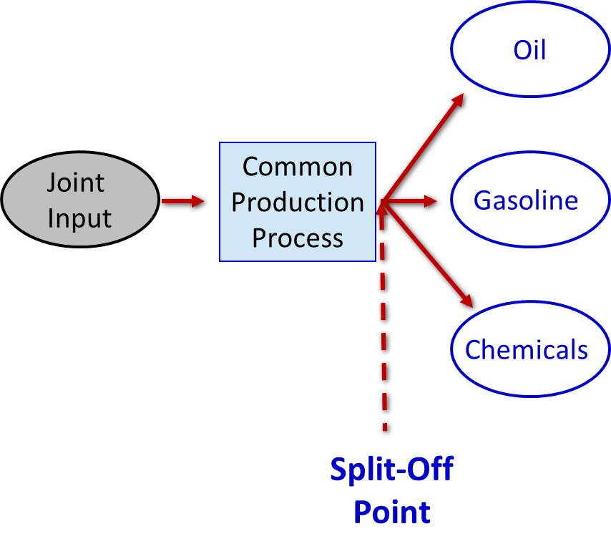
Joint Products
For example, in the petroleum refining industry, a large number of products are extracted from crude oil, including gasoline, jet fuel, home heating oil, lubricants, asphalt, and various organic chemicals.

Slide 84
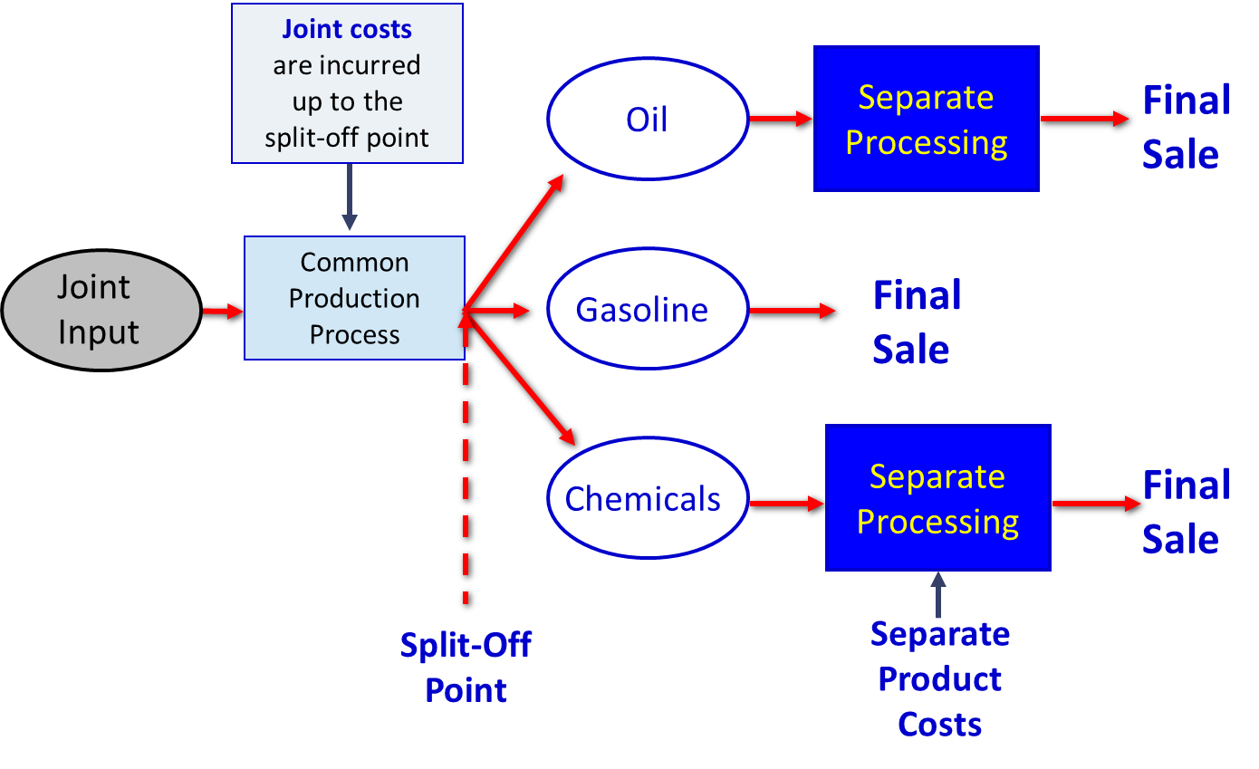
Joint Products – Additional Processing
Access the text alternative for slide images.

Slide 85
Pitfalls of Allocation
Joint costs are traditionally allocated among different products at the split-off point. A typical approach is to allocate joint costs according to the relative sales value of the end products.
Although allocation is needed for some purposes such as balance sheet inventory valuation, allocations of this kind are very dangerous for decision making.

Slide 86
Sell or Process Further
Joint costs are irrelevant in decisions regarding what to do with a product from the split-off point forward. Therefore, these costs should not be allocated to end products for decision-making purposes.
With respect to sell or process further decisions, it is profitable to continue processing a joint product after the split-off point so long as the incremental revenue from such processing exceeds the incremental processing costs incurred after the split-off point.

Slide 87
Sell or Process Further – An Example
Sawmill, Inc. cuts logs from which unfinished lumber and sawdust are the immediate joint products.
Unfinished lumber is sold “as is” or processed further into finished lumber.
Sawdust can also be sold “as is” to gardening wholesalers or processed further into “presto-logs.”

Slide 88
Sell or Process Further – Additional Data
Data about Sawmill’s joint products include:
 | Per Log Lumber | Per Log Sawdust
Sales value at the split-off point | $140 | $40
Sales value after further processing | 270 | 50
Allocated joint product costs | 176 | 24
Cost of further processing | 50 | 20

Slide 89
Sell or Process Further 1
Analysis of Sell or Process Further
 | Per Log Lumber | Per Log Sawdust
Final sales value after further processing | $270 | $50
Sales value at the split-off point | 140 | 40
Incremental revenue from further processing | 130 | 10
Cost of further processing | . | .
Financial advantage (disadvantage) of further processing | . | .

Slide 90
Sell or Process Further 2
Analysis of Sell or Process Further
 | Per Log Lumber | Per Log Sawdust
Final sales value after further processing | $270 | $ 50
Sales value at the split-off point | 140 | 40
Incremental revenue from further processing | 130 | 10
Cost of further processing | 50 | 20
Financial advantage (disadvantage) of further processing | $ 80 | $(10)

Slide 91
Sell or Process Further 3
Analysis of Sell or Process Further
 | Per Log Lumber | Per Log Sawdust
Final sales value after further processing | $270 | $ 50
Sales value at the split-off point | 140 | 40
Incremental revenue from further processing | 130 | 10
Cost of further processing | 50 | 20
Financial advantage (disadvantage) of further processing | $ 80 | $(10)
The lumber should be processed further, and the sawdust should be sold at the split-off point.

Slide 92
Activity-Based Costing and Relevant Costs
ABC can be used to help identify potentially relevant costs for decision-making purposes.
However, managers should exercise caution against reading more into this “traceability” than really exists.
People have a tendency to assume that if a cost is traceable to a segment, then the cost is automatically avoidable, which is untrue. Before making a decision, managers must decide which of the potentially relevant costs are actually avoidable.

Slide 93
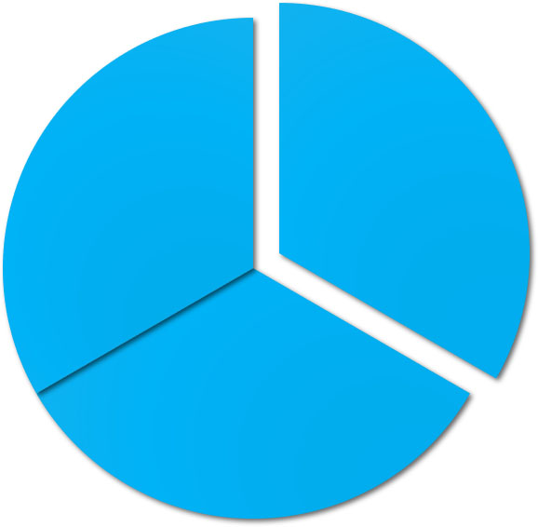
End of Chapter 13
© 2021 McGraw Hill. All rights reserved. Authorized only for instructor use in the classroom. No reproduction or further distribution permitted without the prior written consent of McGraw Hill.

Slide 94
Accessibility Content: Text Alternatives for Images

Slide 95
Joint Products – Additional Processing – Text Alternative
Return to parent-slide containing images.
Illustration shows that joint inputs are entered into a common production process. Joint costs are incurred up to the split-off point. At the split-off point, a number of distinct products such as oil, gasoline, and chemicals can be extracted. In this diagram, oil goes through separate processing, during which separate product costs can be incurred, and then a final sale occurs. The gasoline is not processed further before final sale occurs. The chemicals go through separate processing, during which separate product costs can be incurred, and then a final sale occurs.
Return to parent-slide containing images.

