Slide 1
Capital Budgeting Decisions
Chapter 14
Managerial Accounting
Seventeenth edition
© 2021 McGraw Hill. All rights reserved. Authorized only for instructor use in the classroom. No reproduction or further distribution permitted without the prior written consent of McGraw Hill.

Slide 2
Typical Capital Budgeting Decisions 1
Plant expansion
Equipment selection
Equipment replacement
Lease or buy
Cost reduction

Slide 3
Typical Capital Budgeting Decisions 2
Capital budgeting tends to fall into two broad categories.
Screening decisions. Does a proposed project meet some preset standard of acceptance?
Preference decisions. Selecting from among several competing courses of action.

Slide 4
Cash Flows versus Operating Income
Payback Method
These methods focus on analyzing the cash flows associated with capital investment projects.
Net Present Value
Internal Rate of Return
The simple rate of return method focuses on incremental net operating income.

Slide 5
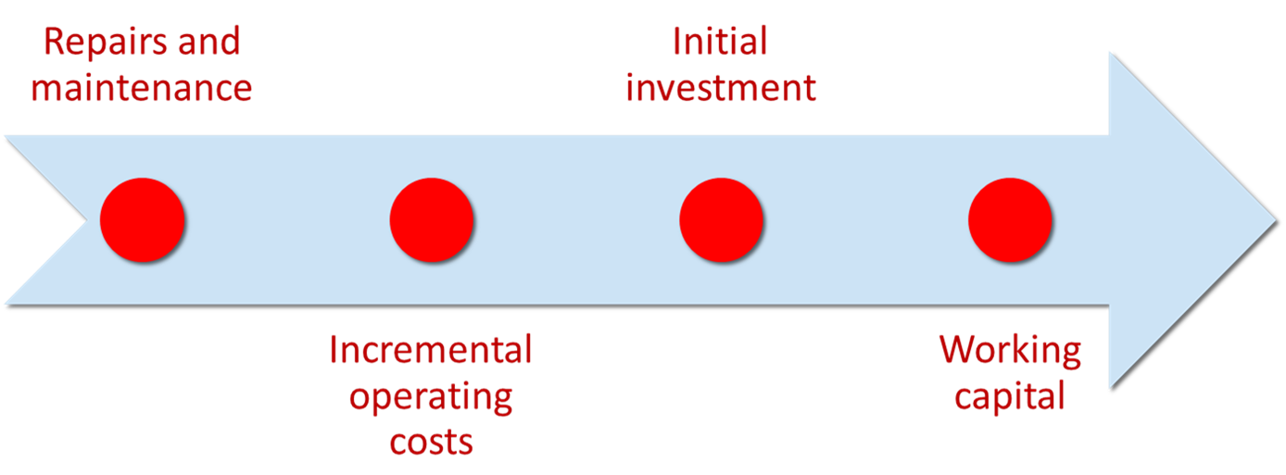
Typical Cash Outflows

Slide 6
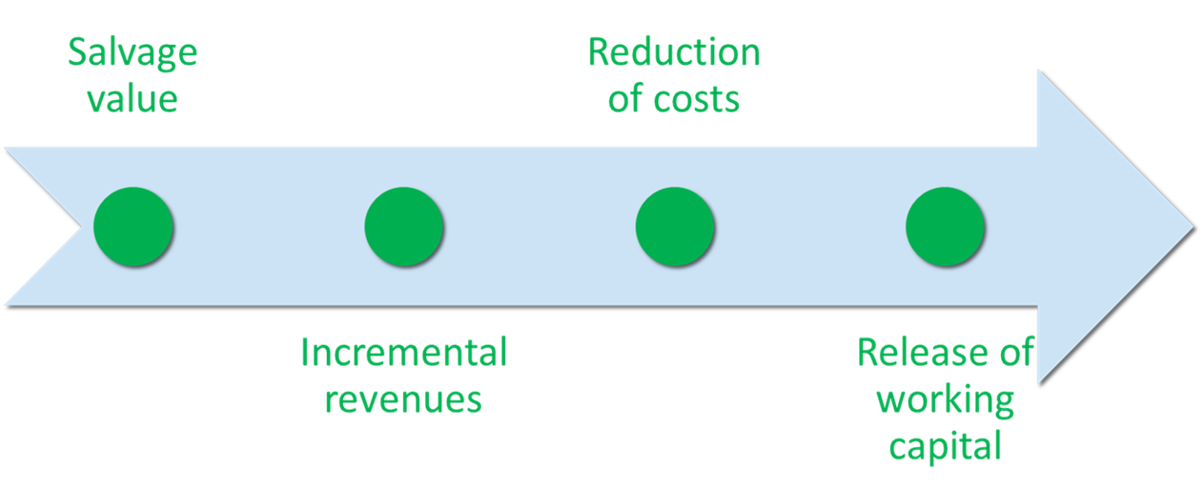
Typical Cash Inflows

Slide 7
Time Value of Money 1
A dollar today is worth more than a dollar a year from now.
Therefore, projects that promise earlier returns are preferable to those that promise later returns.

Slide 8
Time Value of Money 2
The capital budgeting techniques that best recognize the time value of money are those that involve discounted cash flows.

Slide 9
Learning Objective 1
Determine the payback period for an investment.

Slide 10
Payback Method 1
The payback method focuses on the payback period, which is the length of time that it takes for a project to recoup its initial cost out of the cash receipts that it generates.

Slide 11
Payback Method 2
The payback method analyzes cash flows; however, it does not consider the time value of money.
When the annual net cash inflow is the same each year, this formula can be used to compute the payback period:

Slide 12
Payback Method 3
Management at the Daily Grind wants to install an espresso bar in its restaurant that:
Costs $140,000 and has a 10-year life.
Will generate annual net cash inflows of $35,000.
Management requires a payback period of five years or less on all investments.
What is the payback period for the espresso bar?

Slide 13
Payback Method 4
According to the company’s criterion, management would invest in the espresso bar because its payback period is less than five years.

Slide 14
Quick Check 1
Consider the following two investments:
 | Project X | Project Y
Initial investment | $100,000 | $100,000
Year 1 cash inflow | $60,000 | $60,000
Year 2 cash inflow | $40,000 | $35,000
Year 3 cash inflow | $0 | $25,000
Which project has the shortest payback period?
a. Project X.
b. Project Y.
c. Cannot be determined.

Slide 15
Quick Check 1a
Consider the following two investments:
 | Project X | Project Y
Initial investment | $100,000 | $100,000
Year 1 cash inflow | $60,000 | $60,000
Year 2 cash inflow | $40,000 | $35,000
Year 3 cash inflow | $0 | $25,000
Which project has the shortest payback period?
a. Answer: Project X.
b. Project Y.
c. Cannot be determined.
Project X has a payback period of two years.
Project Y has a payback period of slightly more than two years.
Which project do you think is better?

Slide 16
Evaluation of the Payback Method 1
Shortcomings
Ignores the time value of money.
Ignores cash flows after the payback period.
Shorter payback period does not always mean a more desirable investment.

Slide 17
Evaluation of the Payback Method 2
Strengths
Serves as screening tool.
Identifies investments that recoup cash investments quickly.
Identifies products that recoup initial investment quickly.

Slide 18
Payback and Uneven Cash Flows 1
When the cash flows associated with an investment project change from year to year, the payback formula introduced earlier cannot be used.
Instead, the unrecovered investment must be tracked year by year.
Year 1 | Year 2 | Year 3 | Year 4 | Year 5
$1,000 | $0 | $2,000 | $1,000 | $500

Slide 19
Payback and Uneven Cash Flows 2
For example, if a project requires an initial investment of $4,000 and provides uneven net cash inflows in years 1‒5 as shown, the investment would be fully recovered in Year 4.
Year 1 | Year 2 | Year 3 | Year 4 | Year 5
$1,000 | $0 | $2,000 | $1,000 | $500

Slide 20
Learning Objective 2
Evaluate the acceptability of an investment project using the net present value method.

Slide 21
Net Present Value Method 1
The net present value method compares the present value of a project’s cash inflows with the present value of its cash outflows. The difference between these two streams of cash flows is called the net present value.

Slide 22
Net Present Value Method 2
Two Simplifying Assumptions
All cash flows other than the initial investment occur at the end of periods.
All cash flows generated by an investment project are immediately reinvested at a rate of return equal to the discount rate.

Slide 23
Net Present Value Method 3
Lester Company has been offered a five-year contract to provide component parts for a large manufacturer.
Cost and Revenue Information
Cost of special equipment | $160,000
Working capital required | 100,000
Relining equipment in 3 years | 30,000
Salvage value of equipment in 5 years | 5,000
Annual cash revenue and costs:
Sales revenue from parts | 750,000
Cost of parts sold | 400,000
Salaries, shipping, etc. | 270,000

Slide 24
Net Present Value Method 4
At the end of five years, the working capital will be released and may be used elsewhere by Lester.
Lester Company uses a discount rate of 11%.
Should the contract be accepted?

Slide 25
Net Present Value Method 5
Annual net cash inflow from operations
Sales revenue | $ 750,000
Cost of parts sold | (400,000)
Salaries, shipping, etc. | (270,000)
Annual net cash inflows | $ 80,000

Slide 26
Net Present Value Method 6
 | Years | Cash Flows | 11% Factor | Present Value
Investment in equipment | Now | $ (160,000) | 1.000 | $ (160,000)
Working capital needed | Now | (100,000) | 1.000 | (100,000)
 |  |  |  | .
Net present value |  |  |  | .

Slide 27
Net Present Value Method 7
 | Years | Cash Flows | 11% Factor | Present Value
Investment in equipment | Now | $(160,000) | 1.000 | $(160,000)
Working capital needed | Now | (100,000) | 1.000 | (100,000)
Annual net cash inflows | 1 to 5 | 80,000 | 3.696 | 295,680
 |  |  |  | .
 |  |  |  | .
Present value of an annuity of $1 factor* for 5 years at 11%.
Alternatively, the individual annual net cash inflows could be discounted using the related five separate “present value of a single payment of $1” factors. That method would produce the same present value of $295,680.
*The present value factors in Appendix 3B are rounded to three decimal places. Another approach is to use Microsoft Excel’s NPV function to perform these calculations using unrounded discount factors.

Slide 28
Net Present Value Method 8
 | Years | Cash Flows | 11% Factor | Present Value
Investment in equipment | Now | $(160,000) | 1.000 | $(160,000)
Working capital needed | Now | (100,000) | 1.000 | (100,000)
Annual net cash inflows | 1 to 5 | 80,000 | 3.696 | 295,680
Relining of equipment | 3 | (30,000) | 0.731 | (21,930)
 |  |  |  | .
 |  |  |  | .
Present value of $1
factor for 3 years at 11%.

Slide 29
Net Present Value Method 9
 | Years | Cash Flows | 11% Factor | Present Value
Investment in equipment | Now | $(160,000) | 1.000 | $(160,000)
Working capital needed | Now | (100,000) | 1.000 | (100,000)
Annual net cash inflows | 1 to 5 | 80,000 | 3.696 | 295,680
Relining of equipment | 3 | (30,000) | 0.731 | (21,930)
Salvage value of equip. | 5 | 5,000 | 0.593 | 2,965
Working capital released | 5 | 100,000 | 0.593 | 59,300
 |  |  |  | .
Present value of $1
factor for 5 years at 11%.
Total present value of the release of the working capital and the salvage value of the equipment is $62,265.

Slide 30
Net Present Value Method 10
 | Years | Cash Flows | 11% Factor | Present Value
Investment in equipment | Now | $(160,000) | 1.000 | $(160,000)
Working capital needed | Now | (100,000) | 1.000 | (100,000)
Annual net cash inflows | 1 to 5 | 80,000 | 3.696 | 295,680
Relining of equipment | 3 | (30,000) | 0.731 | (21,930)
Salvage value of equip. | 5 | 5,000 | 0.593 | 2,965
Working capital released | 5 | 100,000 | 0.593 | 59,300
Net present value |  |  |  | $ 76,015
Accept the contract because the project has a positive net present value.

Slide 31
Quick Check 2
Denny Associates has been offered a four-year contract to supply the computing requirements for a local bank.
Cash flow information
Cost of computer equipment | $250,000
Working capital required | 20,000
Upgrading of equipment in 2 years | 90,000
Salvage value of equipment in 4 years | 10,000
Annual net cash inflow | 120,000
The working capital would be released at the end of the contract.
Denny Associates requires a 14% return.

Slide 32
Quick Check 2a
What is the net present value of the contract with the local bank?
a. $150,000.
b. $28,230.
c. $92,340.
d. $132,916.

Slide 33
Quick Check 2b
What is the net present value of the contract with the local bank?
a. $150,000.
b. Answer: $28,230.
c. $92,340.
d. $132,916.
 | Years | Cash Flows | 14% Factor | Present Value
Investment in equipment | Now | $(250,000) | 1.000 | $(250,000)
Working capital needed | Now | (20,000) | 1.000 | (20,000)
Annual net cash inflows | 1 to 4 | 120,000 | 2.914 | 349,680
Upgrading of equipment | 2 | (90,000) | 0.769 | (69,210)
Salvage value of equip. | 4 | 10,000 | 0.592 | 5,920
Working capital released | 4 | 20,000 | 0.592 | 11,840
Net present value |  |  |  | $ 28,230

Slide 34
Net Present Value Method 11
Let’s look at another way to calculate the NPV.
Lester Company has been offered a five-year contract to provide component parts for a large manufacturer.
Cost and Revenue Information
Cost of special equipment | $160,000
Working capital required | 100,000
Relining equipment in 3 years | 30,000
Salvage value of equipment in 5 years | 5,000
Annual cash revenue and costs:
Sales revenue from parts | 750,000
Cost of parts sold | 400,000
Salaries, shipping, etc. | 270,000

Slide 35
Net Present Value Method 12
At the end of five years, the working capital will be released and may be used elsewhere by Lester.
Lester Company uses a discount rate of 11%.
Should the contract be accepted?

Slide 36
Net Present Value Method 13
 | Years | Cash Flows | 11% Factor | Present Value
Investment in equipment | Now | $(160,000) | 1.000 | $(160,000)
Working capital needed | Now | (100,000) | 1.000 | (100,000)
 |  |  |  | .
 |  |  |  | .
Since the investments in equipment ($160,000) and working capital ($100,000) occur immediately, the discounting factor used is 1.000.

Slide 37
Net Present Value Method 14
 | Years | Cash Flows | 11% Factor | Present Value
Investment in equipment | Now | $(160,000) | 1.000 | $(160,000)
Working capital needed | Now | (100,000) | 1.000 | (100,000)
Annual net cash inflows | 1 | 80,000 | 0.901 | 72,080
Annual net cash inflows | 2 | 80,000 | 0.812 | 64,960
Annual net cash inflows | 3 | 50,000 | 0.731 | 36,550
Annual net cash inflows | 4 | 80,000 | 0.659 | 52,720
Annual net cash inflows | 5 | 80,000 | 0.593 | 47,440
Salvage value of equip. | 5 | 5,000 | 0.593 | 2,965
Working capital released | 5 | 100,000 | 0.593 | 59,300
 |  |  |  | .
The total cash flows for Years 1‒5 are discounted to their present values using the discount factors from Exhibit 13B-1.

Slide 38
Net Present Value Method 15
 | Years | Cash Flows | 11% Factor | Present Value
Investment in equipment | Now | $(160,000) | 1.000 | $(160,000)
Working capital needed | Now | (100,000) | 1.000 | (100,000)
Annual net cash inflows | 1 | 80,000 | 0.901 | 72,080
Annual net cash inflows | 2 | 80,000 | 0.812 | 64,960
Annual net cash inflows | 3 | 50,000 | 0.731 | 36,550
Annual net cash inflows | 4 | 80,000 | 0.659 | 52,720
Annual net cash inflows | 5 | 80,000 | 0.593 | 47,440
Salvage value of equip. | 5 | 5,000 | 0.593 | 2,965
Working capital released | 5 | 100,000 | 0.593 | 59,300
 |  |  |  | .
For example, the total cash flows in Year 1 of $80,000 are multiplied by the discount factor of 0.901 to derive this future cash flow’s present value of $72,080.

Slide 39
Net Present Value Method 16
 | Years | Cash Flows | 11% Factor | Present Value
Investment in equipment | Now | $(160,000) | 1.000 | $(160,000)
Working capital needed | Now | (100,000) | 1.000 | (100,000)
Annual net cash inflows | 1 | 80,000 | 0.901 | 72,080
Annual net cash inflows | 2 | 80,000 | 0.812 | 64,960
Annual net cash inflows | 3 | 50,000 | 0.731 | 36,550
Annual net cash inflows | 4 | 80,000 | 0.659 | 52,720
Annual net cash inflows | 5 | 80,000 | 0.593 | 47,440
Salvage value of equip. | 5 | 5,000 | 0.593 | 2,965
Working capital released | 5 | 100,000 | 0.593 | 59,300
 |  |  |  | .
As another example, the total cash flows in Year 3 of $50,000 are multiplied by the discount factor of 0.731 to derive this future cash flow’s present value of $36,550.

Slide 40
Net Present Value Method 17
 | Years | Cash Flows | 11% Factor | Present Value
Investment in equipment | Now | $(160,000) | 1.000 | $(160,000)
Working capital needed | Now | (100,000) | 1.000 | (100,000)
Annual net cash inflows | 1 | 80,000 | 0.901 | 72,080
Annual net cash inflows | 2 | 80,000 | 0.812 | 64,960
Annual net cash inflows | 3 | 50,000 | 0.731 | 36,550
Annual net cash inflows | 4 | 80,000 | 0.659 | 52,720
Annual net cash inflows | 5 | 80,000 | 0.593 | 47,440
Salvage value of equip. | 5 | 5,000 | 0.593 | 2,965
Working capital released | 5 | 100,000 | 0.593 | 59,300
Net present value |  |  |  | $ 76,015
The net present value of the investment opportunity is $76,015. Notice this amount equals the net present value from the earlier approach.

Slide 41
Net Present Value Method 18
Once you have computed a net present value, you should interpret the results as follows:
A positive net present value indicates that the project’s return exceeds the discount rate.
A negative net present value indicates that the project’s return is less than the discount rate.

Slide 42
Net Present Value Method 19
If the Net Present Value is . . . | Then the Project is . . .
Positive . . . | Acceptable because it promises a return greater than the required rate of return.
Zero . . . | Acceptable because it promises a return equal to the required rate of return.
Negative . . . | Not acceptable because it promises a return less than the required rate of return.

Slide 43
Choosing a Discount Rate
The company’s cost of capital is usually regarded as the minimum required rate of return.
The cost of capital is the average return the company must pay to its long-term creditors and stockholders.

Slide 44
Recovery of the Original Investment 1
The net present value method automatically provides for return of the original investment.

Slide 45
Recovery of the Original Investment 2
Carver Hospital is considering buying an attachment for its X-ray machine.
Cost | $3,169
Life | 4 years
Salvage value | $-
Increase in annual cash inflows | $1,000
No investments are to be made unless they have an annual return of at least 10%. Will we be allowed to invest in the attachment?

Slide 46
Recovery of the Original Investment 3
Item | Year(s) | Amount of Cash Flow | 10% Factor | Value of Cash Flows
Initial investment (outflow) | Now | $(3, 169) | 1.000 | $(3,169)
Annual cash inflows | 1 | $1,000 | 0.909 | $909
Annual cash inflows | 2 | $1,000 | 0.826 | $826
Annual cash inflows | 3 | $1,000 | 0.751 | $751
Annual cash inflows | 4 | $1,000 | 0.683 | $683
Net present value |  |  |  | -
Notice that the net present value of the investment is zero.

Slide 47
Recovery of the Original Investment 4
Item | Year(s) | Amount of Cash Flow | 10% Factor | Value of Cash Flows
Initial investment (outflow) | Now | $(3, 169) | 1.000 | $(3,169)
Annual cash inflows | 1 | $1,000 | 0.909 | $909
Annual cash inflows | 2 | $1,000 | 0.826 | $826
Annual cash inflows | 3 | $1,000 | 0.751 | $751
Annual cash inflows | 4 | $1,000 | 0.683 | $683
Net present value |  |  |  | -
This implies that the cash inflows are sufficient to recover the $3,169 initial investment and to provide exactly a 10% return on the investment.

Slide 48
Learning Objective 3
Evaluate the acceptability of an investment project using the internal rate of return method.

Slide 49
Internal Rate of Return Method 1
The internal rate of return is the rate of return promised by an investment project over its useful life. It is computed by finding the discount rate that will cause the net present value of a project to be zero.
It works very well if a project’s cash flows are identical every year. If the annual cash flows are not identical, a trial-and-error process must be used to find the internal rate of return.

Slide 50
Internal Rate of Return Method 2
General decision rule . . .
If the Internal Rate of Return is . . . | Then the Project is . . .
Equal to or greater than the minimum required rate of return . . . | Acceptable.
Less than the minimum required rate of return . . . | Rejected.
When using the internal rate of return, the cost of capital acts as a hurdle rate that a project must clear for acceptance.

Slide 51
Internal Rate of Return Method 3
Decker Company can purchase a new machine at a cost of $104,320 that will save $20,000 per year in cash operating costs.
The machine has a 10-year life.

Slide 52
Internal Rate of Return Method 4
Future cash flows are the same every year in this example, so we can calculate the internal rate of return as follows:

Slide 53
Internal Rate of Return Method 5
Using the present value of an annuity of $1 table . . .
Find the 10-period row and move across until you find the factor 5.216. Look at the top of the column and find the rate of 14%.
Periods | 10% | 12% | 14%
1 | 0.909 | 0.893 | 0.877
2 | 1.736 | 1.690 | 1.647
… | … | … | …
9 | 5.759 | 5.328 | 4.946
10 | 6.145 | 5.650 | 5.216

Slide 54
Internal Rate of Return Method 6
If Decker’s minimum required rate of return is equal to or greater than 14%, then the machine should be purchased.
Periods | 10% | 12% | 14%
1 | 0.909 | 0.893 | 0.877
2 | 1.736 | 1.690 | 1.647
… | … | … | …
9 | 5.759 | 5.328 | 4.946
10 | 6.145 | 5.650 | 5.216

Slide 55
Quick Check 3
The expected annual net cash inflow from a project is $22,000 over the next five years. The required investment now in the project is $79,310. What is the internal rate of return on the project?
a. 10%.
b. 12%.
c. 14%.
d. Cannot be determined.

Slide 56
Quick Check 3a
The expected annual net cash inflow from a project is $22,000 over the next five years. The required investment now in the project is $79,310. What is the internal rate of return on the project?
a. 10%.
b. Answer: 12%.
c. 14%.
d. Cannot be determined.
$79,310/$22,000 = 3.605, which is the present value factor for an annuity over five years when the interest rate is 12%.

Slide 57
Comparing the Net Present Value and Internal Rate of Return Methods 1
NPV is often simpler to use.
Questionable assumption:
The internal rate of return method assumes that cash inflows are reinvested at the internal rate of return.

Slide 58
Comparing the Net Present Value and Internal Rate of Return Methods 2
If the internal rate of return is high, this assumption may be unrealistic.
It is more realistic to assume that the cash flows can be reinvested at the discount rate, which is the underlying assumption of the net present value method.

Slide 59
Expanding the Net Present Value Method
We will now expand the net present value method to include two alternatives.
First, we will analyze the alternatives using the total cost approach.
All cash inflows and all cash outflows will be included in the solution under each alternative. No effort will be made to isolate those cash flows that are relevant to the decision and those that are irrelevant. And, the net present value will be computed for each alternative.

Slide 60
Total-Cost Approach 1
White Company has two alternatives:
Remodel an old car wash or,
Remove the old car wash and install a new one.
The company uses a discount rate of 10%.
 | New Car Wash | Old Car Wash
Annual revenues | $90,000 | $70,000
Annual cash operating costs | 30,000 | 25,000
Annual net cash inflows | $60,000 | $45,000

Slide 61
Total-Cost Approach 2
If White installs a new washer . . .
Cost | $300,000
Productive life | 10 years
Salvage value | $7,000
Replace brushes at the end of 6 years | $50,000
Salvage of old equipment | $40,000
Let’s look at the present value of this alternative.

Slide 62
Total-Cost Approach 3
Install the New Washer
 | Year | Cash Flows | 10% Factor | Present Value
Initial investment | Now | $(300,000) | 1.000 | $(300,000)
Replace brushes | 6 | (50,000) | 0.564 | (28,200)
Annual net cash inflows | 1 to 10 | 60,000 | 6.145 | 368,700
Salvage of old equipment | Now | 40,000 | 1.000 | 40,000
Salvage of new equipment | 10 | 7,000 | 0.386 | 2,702
Net present value |  |  |  | $ 83,202
If we install the new washer, the investment will yield a positive net present value of $83,202.

Slide 63
Total-Cost Approach 4
If White remodels the existing washer . . .
Remodel costs | $175,000
Replace brushes at the end of 6 years | 80,000
Let’s look at the present value of this second alternative.

Slide 64
Total-Cost Approach 5
Remodel the Old Washer
 | Year | Cash Flows | 10% Factor | Present Value
Initial investment | Now | $(175,000) | 1.000 | $(175,000)
Replace brushes | 6 | (80,000) | 0.564 | (45,120)
Annual net cash inflows | 1 to 10 | 45,000 | 6.145 | 276,525
Net present value |  |  |  | $ 56,405
If we remodel the existing washer, we will produce a positive net present value of $56,405.

Slide 65
Total-Cost Approach 6
Both projects yield a positive net present value.
 | Present Value
Invest in new washer | $83,202
Remodel existing washer | 56,405
In favor of new washer | $26,797
However, investing in the new washer will produce a higher net present value than remodeling the old washer.

Slide 66
Least-Cost Decisions 1
In decisions where revenues are not directly involved, managers should choose the alternative that has the least total cost from a present value perspective.

Slide 67
Least-Cost Decisions 2
Home Furniture Company is trying to decide whether to overhaul an old delivery truck now or purchase a new one.
The company uses a discount rate of 10%.

Slide 68
Least-Cost Decisions 3
Here is information about the trucks . . .
Old Truck
Overhaul cost now | $ 4,500
Annual operating costs | 10,000
Salvage value in 5 years | 250
Salvage value now | 9,000
New Truck
Purchase price | $21,000
Annual operating costs | 6,000
Salvage value in 5 years | 3,000

Slide 69
Least-Cost Decisions 4
Buy the New Truck
 | Year | Cash Flows | 10% Factor | Present Value
Purchase price | Now | $(21,000) | 1.000 | $(21,000)
Annual operating costs | 1 to 5 | (6,000) | 3.791 | (22,746)
Salvage value of old truck | Now | 9,000 | 1.000 | 9,000
Salvage value of new truck | 5 | 3,000 | 0.621 | 1,863
Net present value |  |  |  | (32,883)
Keep the Old Truck
 | Year | Cash Flows | 10% Factor | Present Value
Overhaul cost | Now | $ (4,500) | 1.000 | $ (4,500)
Annual operating costs | 1 to 5 | (10,000) | 3.791 | (37,910)
Salvage value of old truck | 5 | 250 | 0.621 | 155
Net present value |  |  |  | (42,255)

Slide 70
Least-Cost Decisions 5
Home Furniture should purchase the new truck.
Net present value of costs associated with purchase of new truck | $(32,883)
Net present value of costs associated with overhauling existing truck | (42,255)
Net present value in favor of purchasing the new truck | $ 9,372

Slide 71
Learning Objective 4
Evaluate an investment project that has uncertain cash flows.

Slide 72
Uncertain Cash Flows – Example 1
Assume that all the cash flows related to an investment in a supertanker have been estimated, except for its salvage value in 20 years.
Using a discount rate of 12%, management has determined that the net present value of all the cash flows, except the salvage value, is a negative $1.04 million.
How large would the salvage value need to be to make this investment attractive?

Slide 73
Uncertain Cash Flows – Example 2
This equation can be used to determine that if the salvage value of the supertanker is at least $10,000,000, the net present value of the investment would be positive and therefore acceptable.

Slide 74
Quick Check 4
Bay Architects is considering a drafting machine that would cost $100,000, last four years, and provide annual cash savings of $10,000 and considerable intangible benefits each year. How large (in cash terms) would the intangible benefits have to be per year to justify investing in the machine if the discount rate is 14%?
a. $15,000.
b. $90,000.
c. $24,317.
d. $60,000.

Slide 75
Quick Check 4a
Bay Architects is considering a drafting machine that would cost $100,000, last four years, and provide annual cash savings of $10,000 and considerable intangible benefits each year. How large (in cash terms) would the intangible benefits have to be per year to justify investing in the machine if the discount rate is 14%?
a. $15,000.
b. $90,000.
c. Answer: $24,317.
d. $60,000.
 | Years | Cash Flows | 14% Factor | Present Value
Investment in machine | Now | $(100,000) | 1.000 | $(100,000)
Annual net cash inflows | 1 to 4 | 10,000 | 2.914 | 29,140
Annual intangible benefits | 1 to 4 | ? | 2.914 | ?
Net present value |  |  |  | $ (70,860)

Slide 76
Learning Objective 5
Rank investment projects in order of preference.

Slide 77
Preference Decision – Ranking of Investment Projects
Screening Decisions
Pertain to whether or not some proposed investment is acceptable; these decisions come first.
Preference Decisions
Attempt to rank acceptable alternatives from the most to least appealing.

Slide 78
Internal Rate of Return Method
When using the internal rate of return method to rank competing investment projects, the preference rule is:
The higher the internal rate of return, the more desirable the project.

Slide 79
Net Present Value Method 20
The net present value of one project cannot be directly compared to the net present value of another project unless the investments are equal.

Slide 80
Ranking Investment Projects
 | Project A | Project B
Net present value (a) | $ 1,000 | $ 1,000
Investment required (b) | $ 10,000 | $ 5,000
Profitability index (a) ÷ (b) | 0.10 | 0.20
The higher the profitability index, the more desirable the project.

Slide 81
Learning Objective 6
Compute the simple rate of return for an investment.

Slide 82
Simple Rate of Return Method 1
Does not focus on cash flows—rather it focuses on accounting net operating income.
The following formula is used to calculate the simple rate of return:
*Should be reduced by any salvage from the sale of the old equipment

Slide 83
Simple Rate of Return Method 2
Management of the Daily Grind wants to install an espresso bar in its restaurant that:
Costs $140,000 and has a 10-year life.
Will generate incremental revenues of $100,000 and incremental expenses of $65,000 including depreciation.
What is the simple rate of return on the investment project?

Slide 84
Simple Rate of Return Method 3

Slide 85
Criticism of the Simple Rate of Return
Shortcomings
Ignores the time value of money.
The same project may appear desirable in some years and undesirable in other years.

Slide 86
Behavioral Implications of the Simple Rate of Return
When investment center managers are evaluated using return on investment (ROI), a project’s simple rate of return may motivate them to bypass investment opportunities that earn positive net present values.

Slide 87
Postaudit of Investment Projects
A postaudit is a follow-up after the project has been completed to see whether or not expected results were actually realized.

Slide 88
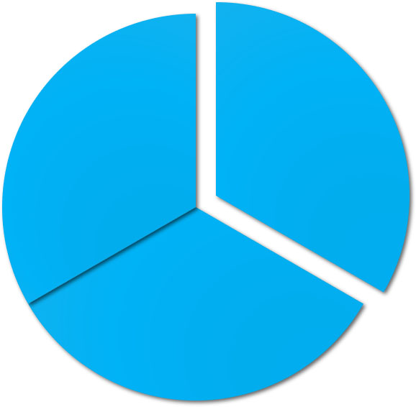
End of Chapter 14
© 2021 McGraw Hill. All rights reserved. Authorized only for instructor use in the classroom. No reproduction or further distribution permitted without the prior written consent of McGraw Hill.

