Slide 1
Fundamentals of Cost Accounting
Sixth Edition
William Lanen
Shannon Anderson
Michael Maher
©2020 McGraw-Hill Education. All rights reserved. Authorized only for instructor use in the classroom. No reproduction or further distribution permitted without the prior written consent of McGraw-Hill Education.

Slide 2
Chapter 2
Cost Concepts and Behavior

Slide 3
Learning Objectives
LO 2-1 Explain the basic concept of “cost.”
LO 2-2 Explain how costs are presented in financial statements.
LO 2-3 Explain the process of cost allocation.
LO 2-4 Understand how material, labor, and overhead costs are added to a product at each stage of the production process.
LO 2-5 Define basic cost behaviors, including fixed, variable, semivariable, and step costs.
LO 2-6 Identify the components of a product’s costs.
LO 2-7 Understand the distinction between financial and contribution margin income statements.

Slide 4
What is a Cost?
LO 2-1
LO 2-1 Explain the basic concept of “cost.”
Cost is a sacrifice of resources.

Slide 5
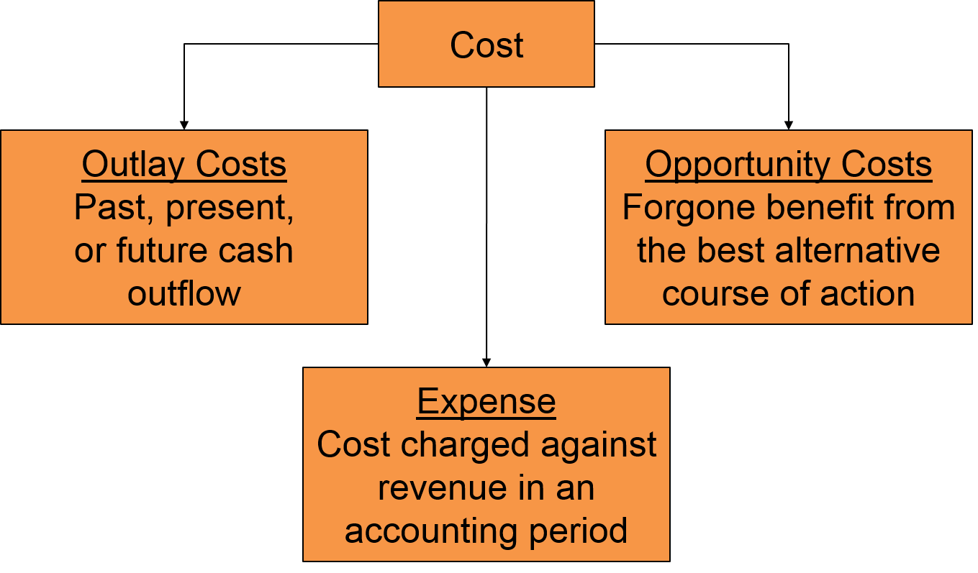
Cost versus Expenses
LO 2-1
Access the text alternative for these images

Slide 6
Presentation of Costs in Financial Statements 1
LO 2-2
LO 2-2 Explain how costs are presented in financial statements.
RPE ASSOCIATES
Income Statement
For the Year Ended December 31, Year 2
($000)
Sales revenue | $32,000
Cost of services sold | 23,500
Gross margin | $ 8,500
Marketing and administrative costs | 4,300
Operating profit | $ 4,200
Cost of billable hours
The excess of operating revenue over costs necessary to generate those revenues

Slide 7
Presentation of Costs in Financial Statements 2
LO 2-2
SOUTHWEST OFFICE PRODUCTS
Income Statement
For the Year Ended December 31, Year 2
($000)
Expense assigned to products sold during a period
Sales revenue | $3,225
Cost of goods sold (see following statement) | 1,775
Gross margin | $1,450
Marketing and administrative costs | 825
Operating profit | $ 625
The excess of operating revenue over costs necessary to generate those revenues
Cost of Goods Sold Statement
For the Year Ended December 31, Year 2
($000)
Beginning inventory |  | $ 300
Cost of goods purchased
Merchandise cost | $ 1,830
Transportation-in costs | 90
Total cost of goods purchased |  | 1,920
Cost of goods available for sale |  | $2,220
Less cost of goods in ending inventory |  | 445
Cost of goods sold |  | $1,775

Slide 8
Presentation of Costs in Financial Statements 3
LO 2-2
Cost incurred to manufacture the product sold
Product costs recorded as “inventory” when cost is incurred
Expense when sold
THREE RIVERS FABRICATION
Income Statement
For the Year Ending December 31, Year 2
($000)
Sales revenue | $40,900
Cost of goods sold (see Exhibit 2.8) | 26,200
Gross margin | $14,700
Less marketing and administrative costs | 7,700
Operating profit before taxes | $ 7,000
Period costs recorded as an expense in the period the cost is incurred

Slide 9
Product versus Period Costs 1
LO 2-2
Two types of manufacturing costs:
Product Costs
Costs related to inventory
Period Costs
Nonmanufacturing costs related to the firm

Slide 10
Product versus Period Costs 2
LO 2-2
Product Costs
Costs that are recorded as an asset in inventory when incurred and expensed as Cost of Goods Sold when sold
Period Costs
Costs recognized for financial reporting when incurred

Slide 11
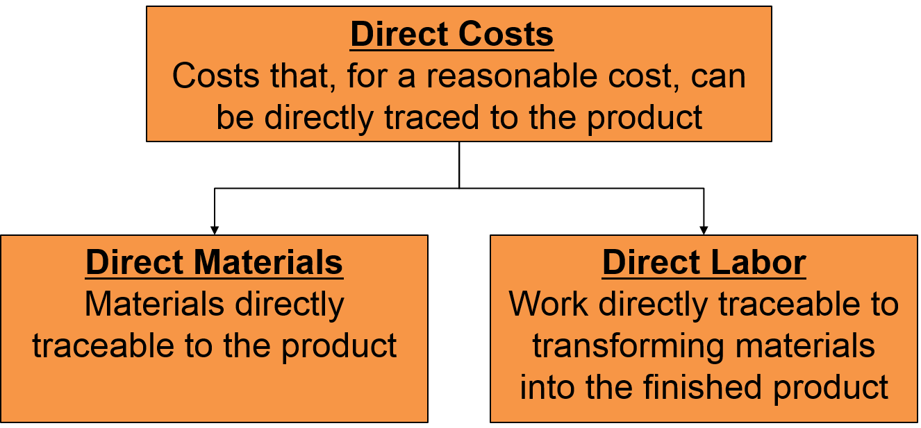
Direct and Indirect Manufacturing Costs 1
LO 2-2
Access the text alternative for these images

Slide 12
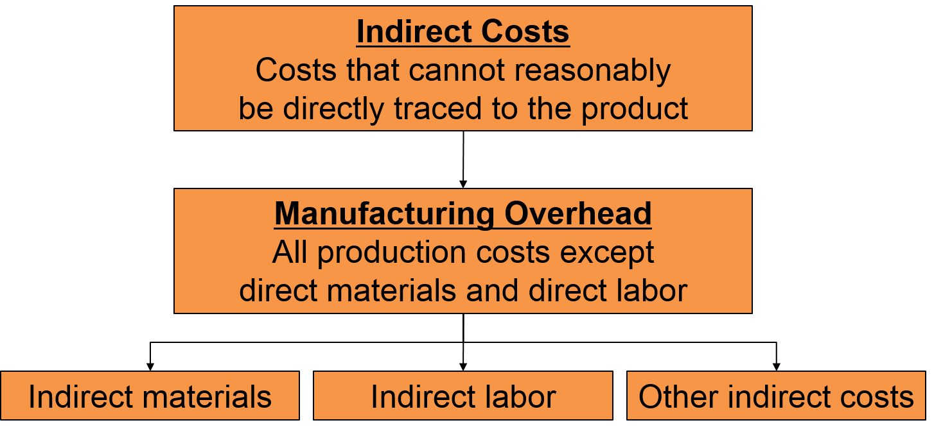
Direct and Indirect Manufacturing Costs 2
LO 2-2
Access the text alternative for these images

Slide 13
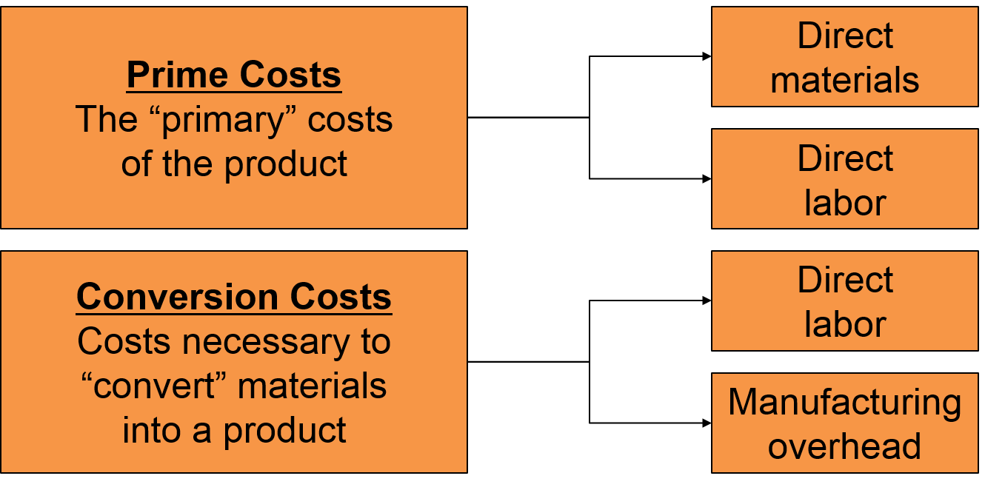
Prime Costs and Conversion Costs
LO 2-2
Access the text alternative for these images

Slide 14
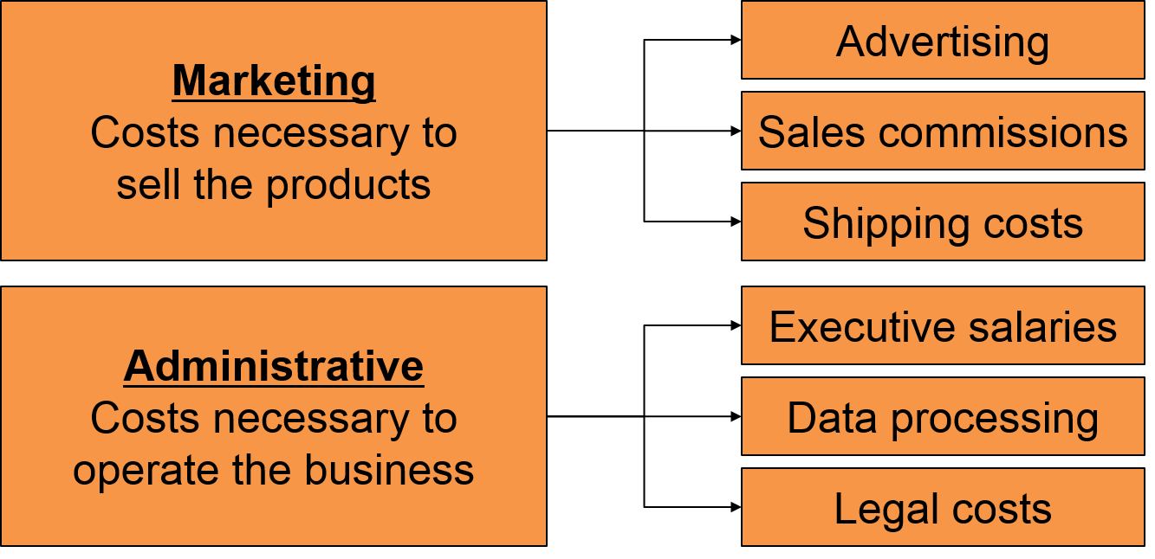
Nonmanufacturing (Period) Costs
LO 2-2
Recognized as expenses when the costs are incurred
Access the text alternative for these images

Slide 15
Cost Allocation 1
LO 2-3
LO 2-3 Explain the process of cost allocation.
It is the process of assigning indirect costs to products, services, people, business units, etc.

Slide 16
Cost Allocation 2
LO 2-3
Define the cost pool:
The collection of costs to be assigned to cost objects
Determine the cost allocation rule:
The method used to assign costs in the cost pool to cost objects
Assign the costs in the cost pool to the cost object:
Any end to which a cost is assigned—product, product line, department, customer, etc.

Slide 17
Cost Allocation: Example
LO 2-3
Rockford Corporation has two divisions: East Coast and West Coast. Both divisions are supported by the IS Group.
 | East Coast | West Coast | Total
Revenues | $80 million | $20 million | $100 million
Define the cost pool: IS department’s costs of $1,000,000
Determine the cost allocation rule: IS costs are allocated based on divisional revenue. (% of revenue)
Assign to the cost object: East Coast: 80% of cost
West Coast: 20% of cost

Slide 18
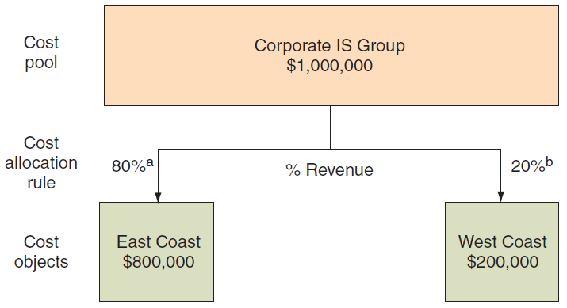
Cost Flow Diagram
LO 2-3
ª 80% = $80 million revenue ÷ ($80 million + $20 million)
^{b} 20% = $20 million revenue ÷ ($80 million + $20 million)
Access the text alternative for these images

Slide 19
Details of Manufacturing Cost Flows
LO 2-4
LO 2-4 Understand how material, labor, and overhead costs are added to a product at each stage of the production process.
Product costs are recorded in inventory when costs are incurred.
A manufacturing company has three inventory accounts:
Raw Materials Inventory:
Materials purchased to make a product
Work-in-Process Inventory:
Products currently in the production process, but not yet completed
Finished Goods Inventory:
Completed products that have not yet been sold

Slide 20
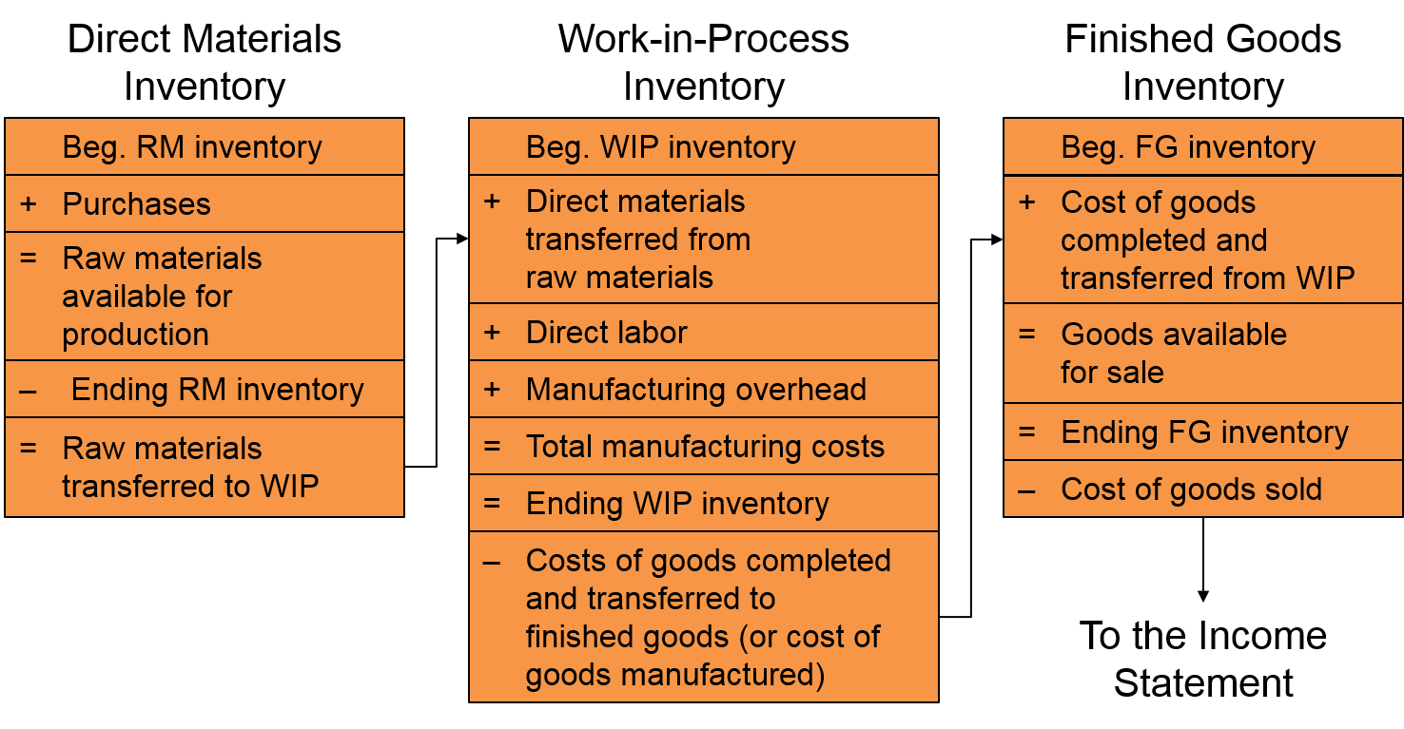
Inventory Accounts – The Balance Sheet
LO 2-4
Access the text alternative for these images

Slide 21
How Costs Flow through the Statements 1
LO 2-4
THREE RIVERS FABRICATION
Cost of Goods Manufactured and Sold Statement
For the Year Ending December 31, Year 2
($000)
Beginning work-in-process inventory, January 1 |  |  | $540
Manufacturing costs during the year:
Direct materials:
Beginning inventory, January 1 | $ 190
Add purchases | 11,254
Direct materials available | $11,444
Less ending inventory, Dec. 31 | 144
Direct material put into production |  | $11,300
Direct labor |  | 2,440
Manufacturing overhead |  | 13,560
Total manufacturing costs incurred |  |  | 27,300
Total work-in-process during the year |  |  | $27,840
Less ending work-in-process inventory, December 31 |  |  | 620
Cost of goods manufactured |  |  | $27,220
Next, determine the cost of goods sold.

Slide 22
How Costs Flow through the Statements 2
LO 2-4
THREE RIVERS FABRICATION
Cost of Goods Manufactured and Sold Statement
For the Year Ending December 31, Year 2
($000)
Beginning work-in-process inventory, January 1 |  |  | $540
Manufacturing costs during the year:
Direct materials:
Beginning inventory, January 1 | $ 190
Add purchases | 11,254
Direct materials available | $11,444
Less ending inventory, December 31 | 144
Direct material put into production |  | $11,300
Direct labor |  | 2,440
Manufacturing overhead |  | 13,560
Total manufacturing costs incurred |  |  | 27,300
Total work-in-process during the year |  |  | $27,840
Less ending work-in-process inventory, December 31 |  |  | 620
Cost of goods manufactured |  |  | $27,220
Beginning finished goods inventory, January 1 |  |  | 840
Finished goods available for sale |  |  | $28,060
Less ending finished goods inventory, December 31 |  |  | 1,860
Cost of goods sold |  |  | $26,200

Slide 23
How Costs Flow through the Statements 3
LO 2-4
THREE RIVERS FABRICATION
Income Statement
For the Year Ending December 31, Year 2
($000)
Sales revenue | $40,900
Cost of goods sold (see Exhibit 2.8) | 26,200
Gross margin | $14,700
Less marketing and administrative costs | 7,700
Operating profit before taxes | $ 7,000

Slide 24
Cost Behavior
LO 2-5
LO 2-5 Define basic cost behaviors, including fixed, variable, semivariable, and step costs.
Cost Behavior
How costs respond to a change in activity level within the relevant range
Relevant Range
Activity levels within which a given total fixed cost or unit variable cost will be unchanged

Slide 25
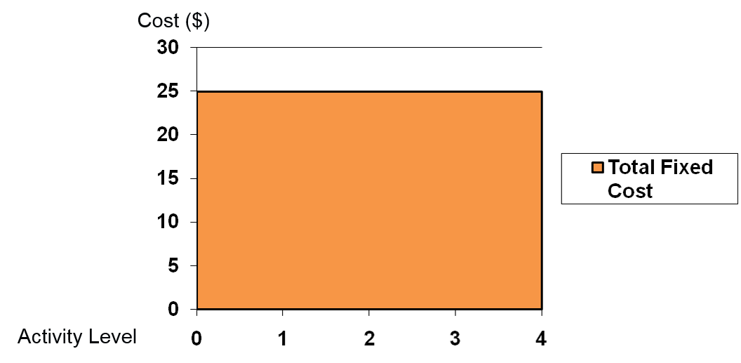
Fixed Costs
LO 2-5
Fixed costs in total remain unchanged as volume changes within the relevant range.
Fixed costs per unit varies inversely to a change in activity.
Fixed costs are “fixed” in “total” as activity changes.

Slide 26
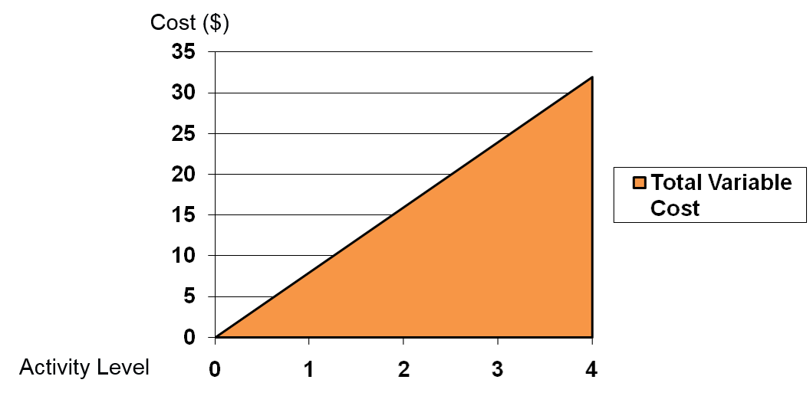
Variable Costs
LO 2-5
Costs that change in direct proportion with a change in the volume within the relevant range
Variable costs “vary” in “total” as activity changes.
Variable cost per unit stays constant when activity changes within the relevant range.

Slide 27
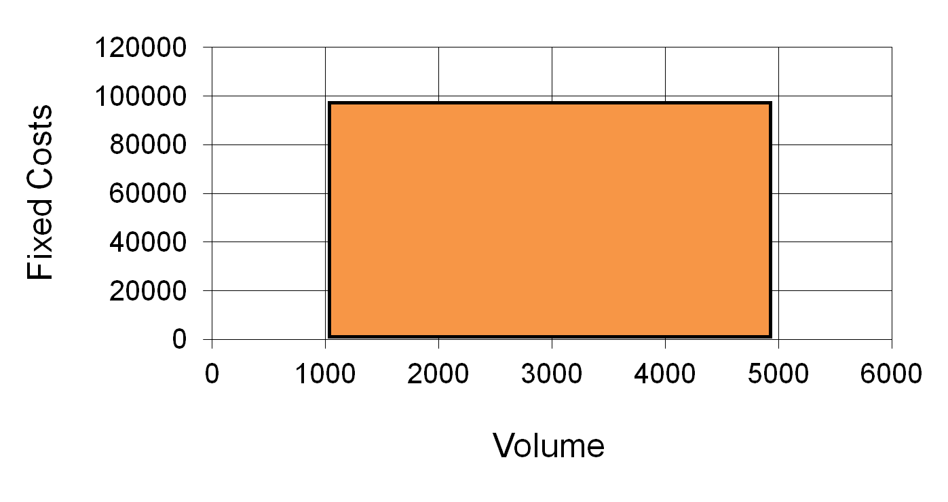
Relevant Range
LO 2-5

Slide 28
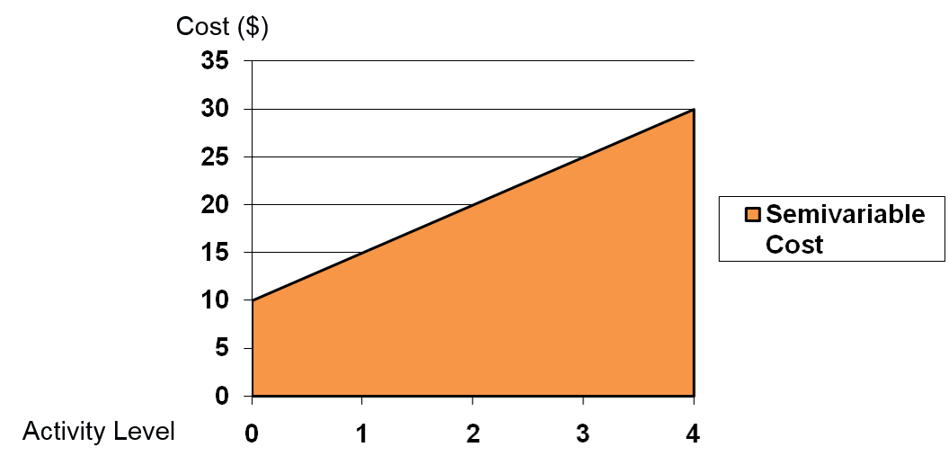
Semivariable Costs
LO 2-5
Costs that have both fixed and variable components
Also known as mixed costs

Slide 29
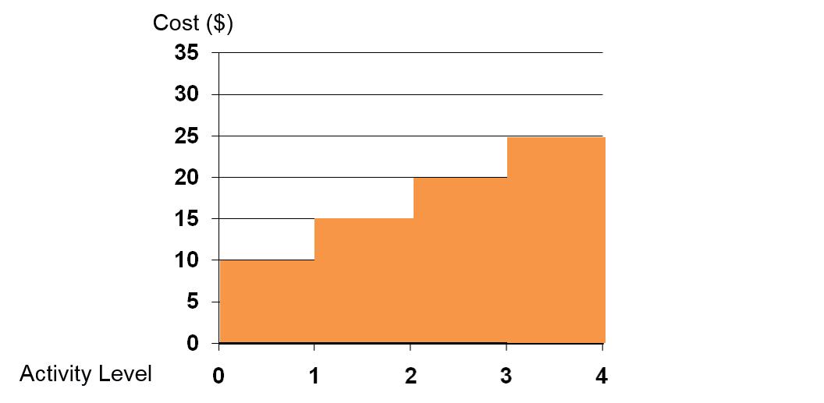
Step Costs
LO 2-5
Costs that increase in total with steps when the volume changes to a particular level.
Also known as semifixed costs.

Slide 30
Components of Product Costs 1
LO 2-6
LO 2-6 Identify the components of a product’s costs.
Full Cost
The sum of all costs of manufacturing and selling a unit of the product
Full Absorption Cost
The sum of all variable and fixed costs of manufacturing a unit of the product
Variable Cost
The sum of all variable costs of manufacturing and selling a unit of the product

Slide 31
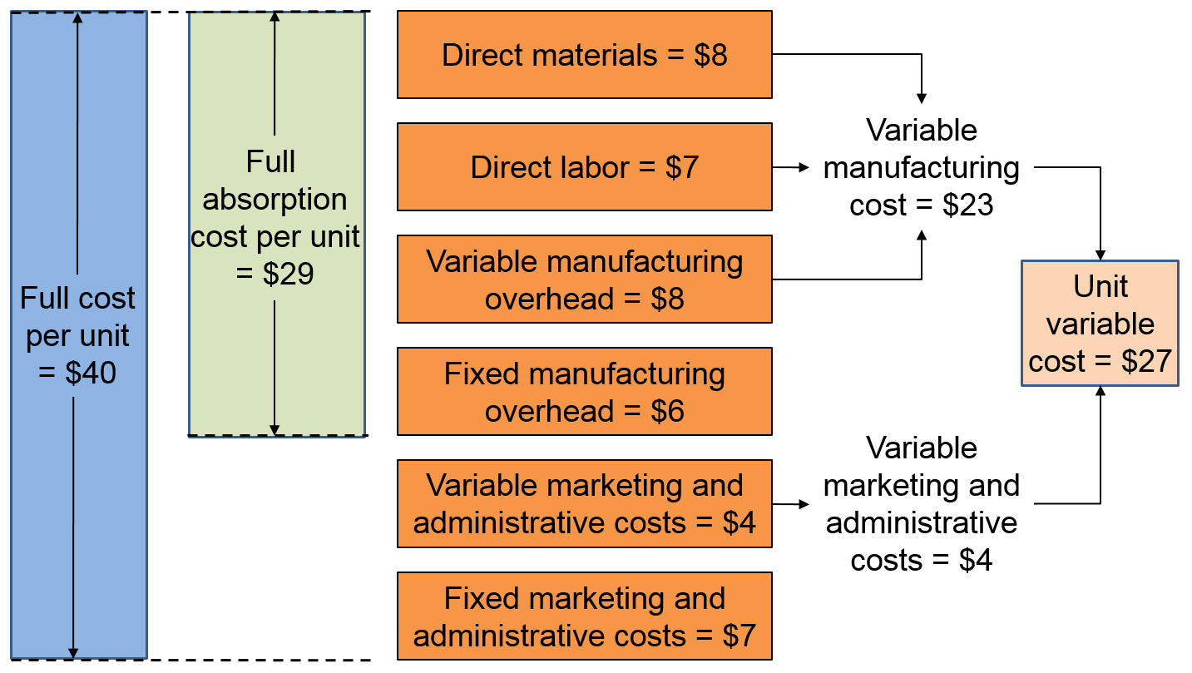
Components of Product Costs 2
LO 2-6
Access the text alternative for these images

Slide 32
Making Cost Information Useful 1
LO 2-7
LO 2-7 Understand the distinction between financial and contribution margin income statements.
Full absorption costing:
Required by GAAP
Used for:
Financial purposes
External reporting
Variable costing:
Used for:
Managerial purposes
Internal decision making
Sales revenue
− Cost of goods sold
= Gross margin
Sales revenue
− Variable costs
= Contribution margin

Slide 33
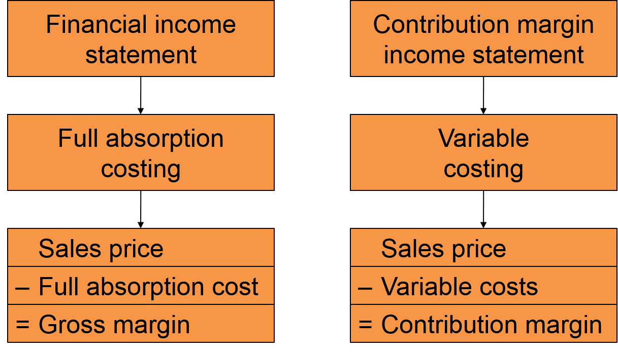
Making Cost Information Useful 2
LO 2-7
Access the text alternative for these images

Slide 34
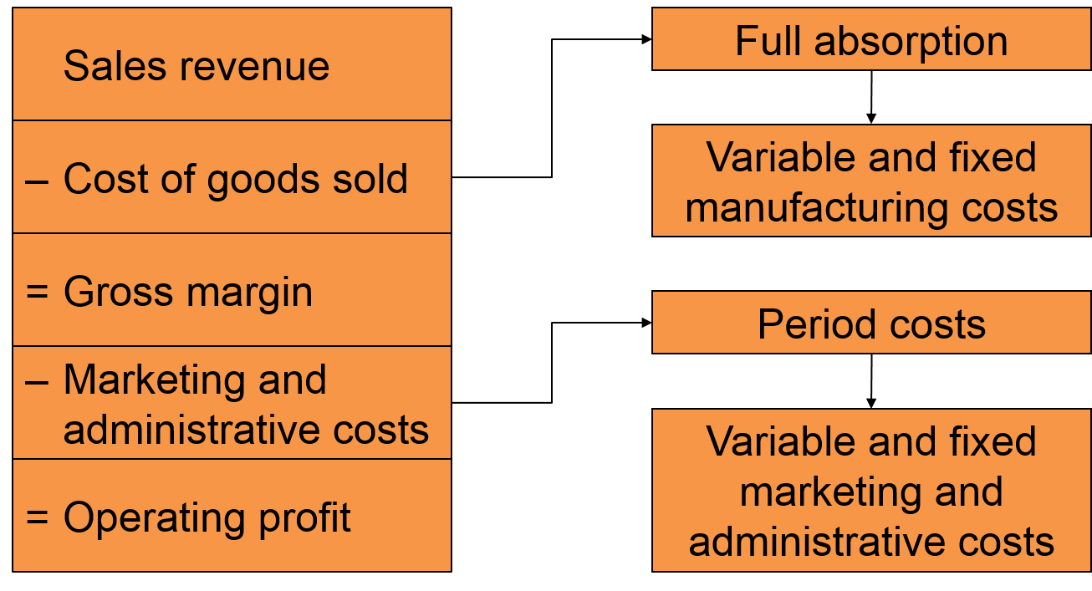
Income Statement:
Full Absorption Costing
LO 2-7
Access the text alternative for these images

Slide 35
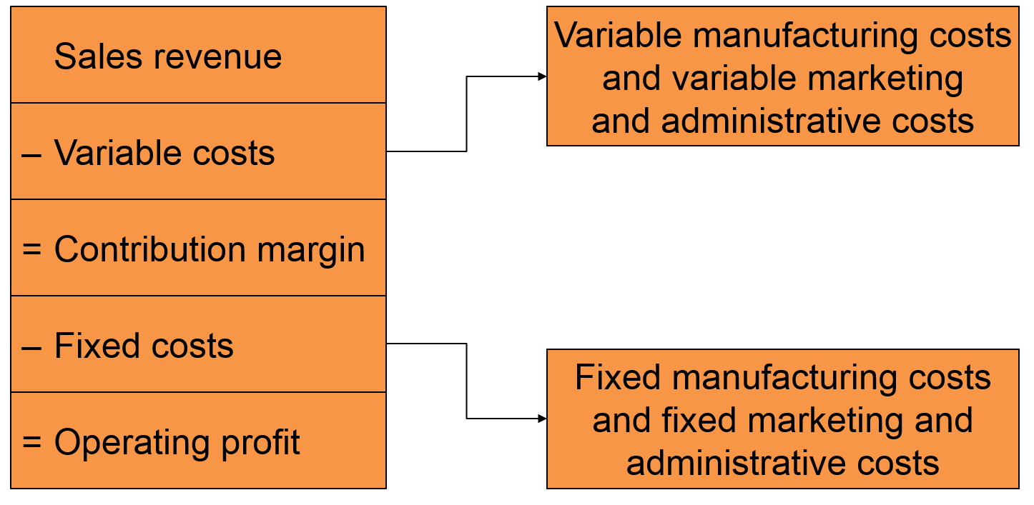
Income Statement:
Variable Costing
LO 2-7
Access the text alternative for these images

Slide 36
End of Chapter 2

Slide 37
Accessibility Content: Text Alternatives for Images

Slide 38
Cost versus Expenses Text Alternative
Cost is at the top and it points to three other boxes. One reads: Outlay Cost: Past, present, or future cash outflow. The next one reads: Opportunity Costs: Forgone benefit from the best alternative course of action. And the last reads: Expense: Cost charged against revenue in an accounting period.
Return to slide containing original image

Slide 39
Direct and Indirect Manufacturing Costs 1 Text Alternative
Top box reads: Direct Costs: Costs that, for a reasonable cost, can be directly traced to the product.
This branches to two boxes below it, the first of which reads: Direct materials: Materials directly traceable to the product. The second reads: Direct labor: Work directly traceable to transforming materials into the finished product.
Return to slide containing original image

Slide 40
Direct and Indirect Manufacturing Costs 2 Text Alternative
Top box reads: Indirect Costs: Costs that cannot reasonably be directly traced to the product. This points to a box below it reading: Manufacturing Overhead: All production costs except direct materials and direct labor. This branches down into three boxes, which read as follows: Indirect materials, Indirect labor, Other indirect costs.
Return to slide containing original image

Slide 41
Prime Costs and Conversion Costs Text Alternative
At the left is a box that reads: Prime Costs: The “primary” costs of the product. This branches right to two boxes, labeled Direct materials
and Direct labor. Then below the Prime Costs box is a box reading: Conversion costs: Costs necessary to convert” materials into a product. This splits into two boxes at the right as well: Direct labor and Manufacturing overhead.
Return to slide containing original image

Slide 42
Nonmanufacturing (Period) Costs Text Alternative
At the left is a box that reads: Marketing: Costs necessary to sell the products. This branches right to 3 boxes, labeled Advertising, Sales commissions, and Shipping costs.
Then below the Marketing box is a box reading: Administrative: Costs necessary to operate the business. This splits off to 3 boxes at the right as well: Executive salaries, Data processing, and Legal costs.
Return to slide containing original image

Slide 43
Cost Flow Diagram Text Alternative
In the diagram, the cost pool is $1,000,000 for the Corporate IS Group. Calculations for cost allocation are as follow: For the East Coast: 80% based on $80 million revenue ÷ ($80 million + $20 million). For the West Coast: 20% based on $20 million revenue ÷ ($80 million + $20 million). Therefore, the cost allocation rule for percent of revenue is 80% East Coast and 20% West Coast. The cost objects are: East Coast: $800,000, West Coast: $200,000.
Return to slide containing original image

Slide 44
Inventory Accounts – The Balance Sheet Text Alternative
There are three columns: Direct Materials Inventory, Work-in-Process Inventory, and Finished Goods Inventory.
The Direct Materials Inventory calculates the cost of raw materials, which is transferred to the Work-in-Process (WIP) Inventory:
Beginning RM inventory
+ Purchases
= Raw materials available for production
– Ending RM inventory
= Raw materials transferred to WIP
The WIP Inventory calculates the cost of goods completed (or cost of goods manufactured), which is transferred to the Finished Goods Inventory:
Beginning WIP inventory
+ Direct materials transferred from raw materials (taken from the Direct Materials Inventory)
+ Direct labor
+ Manufacturing overhead
= Total manufacturing costs
– Ending WIP inventory
= Cost of goods completed (or cost of goods manufactured) and transferred to finished goods
The Finished Goods (FG) Inventory calculates the cost of goods sold, which feeds into the Income Statement:
Beginning FG inventory
+ Cost of goods completed and transferred from WIP
= Goods available for sale
– Ending FG inventory
= Cost of goods sold
Return to slide containing original image

Slide 45
Components of Product Costs 2 Text Alternative
A vertical box at the left shows that the full cost per unit is $40. Next box, shorter depth, shows that of this $40, $29 is the full absorption cost per unit. This leads to a vertical set of 6 boxes as follows:
$8 direct materials
+ $7 direct labor
+ $8 variable manufacturing overhead
+ $6 fixed manufacturing overhead
= $29
The remaining $11 of the $40 full cost per unit is comprised of variable ($4) and fixed ($7) marketing and administrative costs ($4 + $7 = $11).
The direct materials ($8), direct labor ($7), and variable manufacturing overhead ($8) costs comprise the variable manufacturing cost, which is $8 + $7 + $8 = $23. This is added to the variable marketing and administrative costs ($4) to produce the unit variable cost: $23 + $4 = $27.
Return to slide containing original image

Slide 46
Making Cost Information Useful 2 Text Alternative
In left column is a top box labeled Financial income statement. This leads down to a box reading Full absorption costing. This further leads down to the following calculation table:
Sales price minus Full absorption cost
equals Gross margin.
Second column reads: Contribution margin income statement, which leads to Variable costing, that further leads to: Sales price minus Variable costs equals Contribution margin.
Return to slide containing original image

Slide 47
Income Statement:
Full Absorption Costing Text Alternative
First column reads:
Sales revenue
Minus Cost of goods sold, which points right to a box labeled: Full absorption. That box points down to:
Variable and fixed manufacturing costs. First column picks back up with:
=Gross margin
Minus Marketing and administrative costs, which points right to a box labeled Period costs, and this points down to: Variable and fixed marketing and administrative costs. The first column again picks back up and now with a final label: Equals Operating profit.
Return to slide containing original image

Slide 48
Income Statement: Variable Costing Text Alternative
At the left is a column of calculations ending in Operating profit. These read as:
Sales revenue
minus Variable costs
equals Contribution margin
minus Fixed costs
equals Operating profit
The variable costs box points right to a box reading: Variable manufacturing costs and variable marketing and administrative costs. The fixed costs box points right as well and to a box reading: Fixed manufacturing costs and fixed marketing and administrative costs.
Return to slide containing original image

