Slide 1
Fundamentals of Cost Accounting Sixth Edition
William Lanen
Shannon Anderson
Michael Maher
©2020 McGraw-Hill Education. All rights reserved. Authorized only for instructor use in the classroom. No reproduction or further distribution permitted without the prior written consent of McGraw-Hill Education.

Slide 2
Chapter 3
Fundamentals of Cost-Volume-Profit Analysis

Slide 3
Learning Objectives
LO 3-1 Use cost-volume-profit (CVP) analysis to analyze decisions.
LO 3-2 Understand the effect of cost structure on decisions.
LO 3-3 Use Microsoft Excel to perform CVP analysis.
LO 3-4 Incorporate taxes, multiple products, and alternative cost structures into the CVP analysis.
LO 3-5 Understand the assumptions and limitations of CVP analysis.

Slide 4
Cost-Volume-Profit Analysis
LO 3-1
LO 3-1 Use cost-volume-profit (CVP) analysis to analyze decisions.
What is CVP?
CVP analysis explores the relationship between revenue, cost, and volume and their effect on profits.

Slide 5
Profit Equation 1
LO 3-1
The Income Statement
Total revenues
− Total costs
= Operating profit
The Income Statement written horizontally
Operating profit | = | Total revenues | − | Total costs
Profit | = | TR | − | TC

Slide 6
Profit Equation 2
LO 3-1
Total revenue (TR)
Selling price per unit (P)
× Units of output produced and sold (X)
TR = PX
Total cost (TC)
[Variable cost per unit (V) × Units of output (X)]
+ Fixed costs (F)
TC = VX + F

Slide 7
Profit Equation 3
LO 3-1
Profit = Total revenue − Total costs
= TR − TC
TC = VX + F
Therefore, Profit = PX − (VX + F)
Profit = (Price − Variable costs) × Units of output − Fixed costs
= X(P − V) − F

Slide 8
Contribution Margin
LO 3-1
This is the difference between price and variable cost.
It is what is leftover to cover fixed costs and then add to operating profit.
Contribution margin = Price per unit – Variable cost per unit
P – V

Slide 9
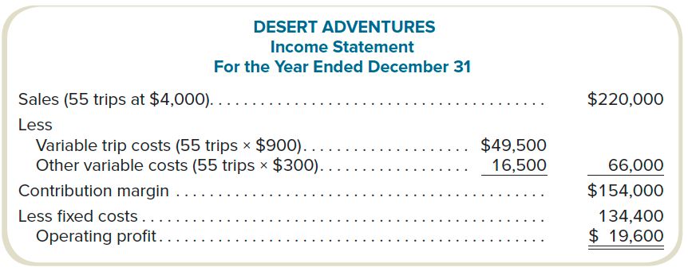
CVP Example
LO 3-1
Contribution margin = $154,000 ÷ 55 = $2,800
Access the text alternative for these images

Slide 10
Break-Even Volume in Units
LO 3-1
This is the volume level at which profits equal zero.
Profit 0 = X(P – V) – F
If profit = 0, then X = F ÷ (P – V)
Break-even volume (in units)

Slide 11
Break-Even Volume in Sales Dollars
LO 3-1
Contribution margin percentage (contribution margin ratio) is the contribution margin as a percentage of sales revenue.
Contribution Margin Ratio
$2,800 ÷ $4,000 = 0.70 (or 70%)
Break-even in Sales Dollars
$134,400 ÷ 0.70 = $192,000

Slide 12
Target Volume
LO 3-1
Assume that management wants to have a profit of $70,000.
How many trips must be sold?
What is the target dollar sales?
Target Volume in Units
($134,400 + $70,000) ÷ $2,800 = 73
Target Volume in Sales Dollars
($134,400 + $70,000) ÷ 0.70 = $292,000

Slide 13
CVP Summary: Break-Even
LO 3-1

Slide 14
CVP Summary: Target Volume
LO 3-1

Slide 15
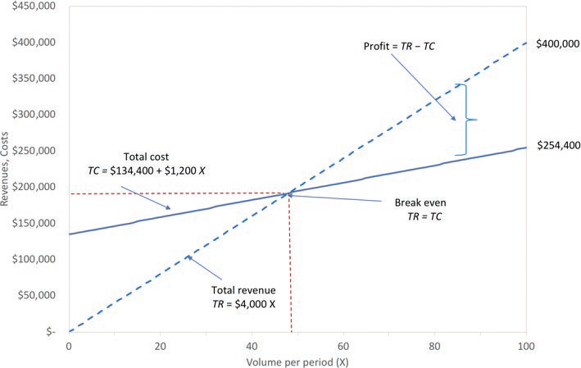
Graphic Presentation
LO 3-1
Access the text alternative for these images

Slide 16
Use of CVP to Analyze the Effect of Different Cost Structures 1
LO 3-2
LO 3-2 Understand the effect of cost structure on decisions.
Cost Structure
The proportion of fixed and variable costs to total costs.
Operating Leverage
The extent to which the cost structure is comprised of fixed costs.

Slide 17
Use of CVP to Analyze the Effect of Different Cost Structures 2
LO 3-2
The higher the organization’s operating leverage, the higher the break-even point.

Slide 18
Comparison of Cost Structures 1
LO 3-2
 | Lo-Lev Company (1,000,000 units) |  | Hi-Lev Company (1,000,000 units)
 | Amount | % | Amount | %
Sales | $1,000,000 | 100 | $1,000,000 | 100
Variable costs | 750,000 | 75 | 250,000 | 25
Contribution margin | $ 250,000 | 25 | $ 750,000 | 75
Fixed costs | 50,000 | 5 | 550,000 | 55
Operating profit | $ 200,000 | 20 | $ 200,000 | 20
Break-even point | 200,000 units |  | 733,334 units
Contribution margin per unit | $0.25 |  | $0.75

Slide 19
Comparison of Cost Structures 2
LO 3-2
Suppose Low-Lev and High-Lev both increase sales 10% or $100,000.
 | Lo-Lev | Hi-Lev
Sales increase | $100,000 | $100,000
Contribution margin | 0.25 | 0.75
Increase in profit | $ 25,000 | $ 75,000
Prior net income | $200,000 | $200,000
Net income with sales increase of 10% | $225,000 | $275,000

Slide 20
Margin of Safety
LO 3-2
The excess of projected or actual sales volume over break-even volume
or
The excess of projected or actual sales revenue over break-even revenue
Suppose Desert Adventures sells 55 trips.
At a break-even volume of 48 trips, its margin of safety is:
Sales − Break-even
55 − 48 = 7 trips

Slide 21
CVP Analysis with Spreadsheets
LO 3-3
LO 3-3 Use Microsoft Excel to perform CVP analysis.
A spreadsheet program is ideally suited to performing CVP routinely.
Desert Adv.
Price | $4,000
Variable cost | $1,200
Fixed cost | $134,400
Profit | ($22,400)
Volume | 40
Choose “Tools: Goal Seek…” from the menu bar.
In the “Set cell:” edit field, enter the cell address for the target profit calculation.
In the “To value:” edit field, enter the target profit.
In the “By changing cell:” edit field, enter the cell address of the volume variable.
Click “OK” and the program will find the break-even volume.
Desert Adv.
Price | $4,000
Variable cost | $1,200
Fixed cost | $134,400
Profit | $0.00
Volume | 48

Slide 22
Extensions of the CVP Model: Income Taxes 1
LO 3-4
LO 3-4 Incorporate taxes, multiple products, and alternative cost structures into the CVP analysis.
The owners of Desert Adventures want to generate after-tax operating profits of $25,200.
The tax rate is 25%.
What is the target operating profit?
Target operating profit = TOP ÷ (1 − Tax rate)
TOP = $25,200 ÷ (1 − 0.25)
TOP = $33,600

Slide 23
Extensions of the CVP Model: Income Taxes 2
LO 3-4
How many units must be sold?

Slide 24
Extensions of the CVP Model: Income Taxes 3
LO 3-4
Proof:
Sales: 60 × $4,000 | $240,000
Variable costs: 60 × $1,200 | 72,000
Contribution margin | $168,000
Fixed costs | 134,400
Net income before taxes | $33,600
Income taxes: $33,600 × 25% | 8,400
Net income | $25,200

Slide 25
Extensions of the CVP Model: Multiproduct Analysis 1
LO 3-4
Management expects to sell excursions and rafting trips in a ratio of 25:75.
 | Excursions | Rafting
Selling price | $4,000 | $500
Less: Variable cost | 1,200 | 100
Contribution margin | $2,800 | $400
Total fixed cost = $144,000

Slide 26
Extensions of the CVP Model: Multiproduct Analysis 2
LO 3-4
What is the contribution margin of the mix?
(25 × $2,800) + (75 × $400) = $70,000 + $30,000 = $100,000
What is the weighted-average contribution margin of the mix?
(.25 × $2,800) + (.75 × $400) = $1,000

Slide 27
Extensions of the CVP Model: Multiproduct Analysis 3
LO 3-4
What is the break-even of the mix?
144 × 25% | = | 36 excursions
144 × 75% | = | 108 rafting experiences
Total units | = | 144
$144,000 fixed costs ÷ $1,000 = 144 units
Break-even Sales in Dollars
36 excursions × $4,000 | = | $144,000
108 rafting experiences × $500 | = | $54,000
Total dollars | = | $198,000

Slide 28
Extensions of the CVP Model: Multiproduct Analysis 4
LO 3-4
Weighted-Average Revenue
(.25 × $4,000 for excursions) + (.75 × $500 for rafting) = $1,375
What is the weighted-average contribution margin percentage?
$1,000 ÷ $1,375 = 72.7273%

Slide 29
Extensions of the CVP Model: Multiproduct Analysis 5
LO 3-4
Weighted-Average Revenue
(.25 × $4,000 for excursions) + (.75 × $500 for rafting) = $1,375
Weighted-Average Contribution Margin
$1,000 ÷ $1,375 = 72.7273%
Break-even Sales in Dollars
$144,000 ÷ 0.727273 = $198,000

Slide 30
Extensions of the CVP Model: Alternative Cost Structures 1
LO 3-4
Given: Fixed costs of $134,400 are sufficient for monthly volumes less than or equal to 40 excursion trips. For every additional 40 trips, Desert Adventures must rent a machine for $19,600 per year. Original break-even was 48 units.
With the increased in fixed costs, Desert Adventures is no longer able to break-even by selling 48 units.
($4,000 − $1,200) × 48 − ($134,400 + $19,600) = ($19,600) net loss

Slide 31
Extensions of the CVP Model: Alternative Cost Structures 2
LO 3-4
What is the break-even using the new fixed cost containing the rental of the additional machine?
Break-even units = ($134,400 + $19,600) ÷ $2,800 = 55 trips

Slide 32
Assumptions and Limitations of CVP Analysis 1
LO 3-5
LO 3-5 Understand the assumptions and limitations of CVP analysis.
Although the CVP model is a very strong tool, the output is dependent upon the assumptions made by cost analysts.
These assumptions include which costs are fixed and which are variable.

Slide 33
Assumptions and Limitations of CVP Analysis 2
LO 3-5
With the aid of software programs, many of the limitations have been eliminated.
Complicated cost structures are easily incorporated in CVP analysis when software tools are used.

Slide 34
End of Chapter 3

Slide 35
Accessibility Content: Text Alternatives for Images

Slide 36
CVP Example Text Alternative
Sales (55 trips at $4,000), $220,000
Less variable trip costs (55 trips times $900), $49,500
Less other variable costs (55 trips times $300), $16,500
These two subtotal $66,000
Contribution margin, $154,000
Less fixed costs, $134,400
Operating profit, $19,600
Return to slide containing original image

Slide 37
Graphic Presentation Text Alternative
The line graph presents the cost-volume-profit relations for Desert Adventures. Trips per period (X) from 0 to 100 units, is given on the horizontal axis, and revenues and costs from $0 to $450,000 are indicated on the vertical axis. The total revenue (TR) line is upward-sloping from $0 at 0 units to $400,000 at 100 units. The total cost line (TC) line is also upward sloping with Total Cost equaling $134,400 plus $1,200 X. The break-even point, where total costs equal total revenues, occurs at 48 trips and $192,000. Profit is calculated by subtracting total costs from total revenues.
Return to slide containing original image

