Slide 1
Fundamentals of Cost Accounting
Sixth Edition
William Lanen
Shannon Anderson
Michael Maher
©2020 McGraw-Hill Education. All rights reserved. Authorized only for instructor use in the classroom. No reproduction or further distribution permitted without the prior written consent of McGraw-Hill Education.

Slide 2
Chapter 4
Fundamentals of Cost Analysis for Decision Making

Slide 3
Learning Objectives
LO 4-1 Use differential analysis to analyze decisions.
LO 4-2 Understand how to apply differential analysis to pricing decisions.
LO 4-3 Understand several approaches for establishing prices based on costs for long-run pricing decisions.
LO 4-4 Understand how to apply differential analysis to production decisions.
LO 4-5 Understand the theory of constraints.

Slide 4
Differential Analysis
LO 4-1
LO 4-1 Use differential analysis to analyze decisions.
Differential Analysis
The process of estimating revenues and costs of alternative actions available to decision makers and of comparing these estimates to the status quo.
Short Run
The period of time over which capacity will be unchanged, usually one year.

Slide 5
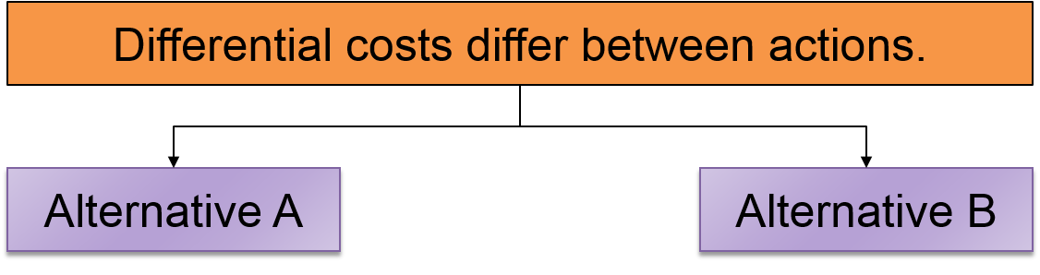
Differential Costs
LO 4-1
With two or more alternatives, costs that differ among or between alternatives
Costs that change in response to an alternative course of action

Slide 6
Sunk Costs
LO 4-1
Costs incurred in the past that cannot be changed by present or future decisions
A sunk cost is NOT relevant for making decisions.

Slide 7
Differential Costs versus Total Costs
LO 4-1
Information presented to management can show the detailed costs that are included for making a decision, or it can show just the differences between alternatives, as follows.
 | Status Quo | Alternative | Difference
Sales revenue | $750 | $900 | $150
Variable costs | (250) | (300) | (50)
Contribution margin | $500 | $600 | $100
Fixed costs | (350) | (350) | -0-
Operating profit | $150 | $250 | $100

Slide 8
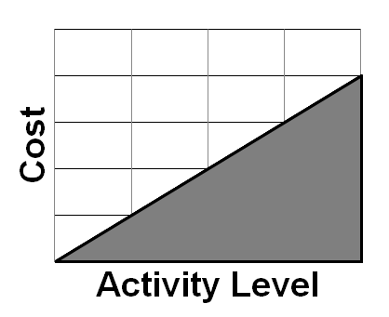
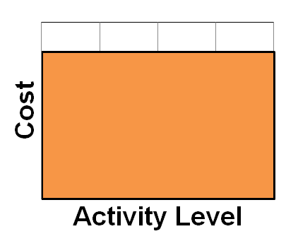
Differential Analysis and
Pricing Decisions
LO 4-2
LO 4-2 Understand how to apply differential analysis to pricing decisions.
Variable costs must always be covered.
Fixed costs must be covered in the long run.

Slide 9
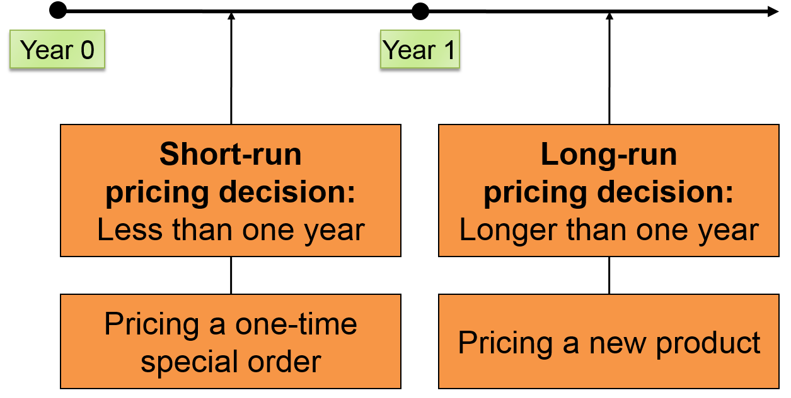
Short-Run versus Long-Run
Pricing Decisions
LO 4-2
Access the text alternative for these images

Slide 10
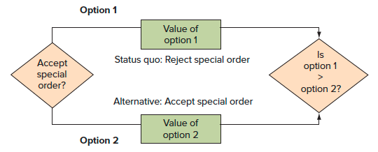
Short-Run Pricing Decisions:
Special Orders 1
LO 4-2
An order that will not affect other sales and is usually a short-run occurrence
Access the text alternative for these images

Slide 11
Short-Run Pricing Decisions:
Special Orders 2
LO 4-2
Desert Adventures has received a one-time offer for 5 additional tours at a discounted price of $700 per tour.
The regular price is $900 per tour and they have enough idle capacity in the month to take the offer.
Sales (20 tours at $900) | $ 18,000
Variable costs including food, labor, and so on (20 tours at $300) | 6,000
Total contribution margin | $ 12,000
Fixed costs (insurance, depreciation, and other costs assigned to self-guided tours) | 5,400
Operating profit | $ 6,600

Slide 12
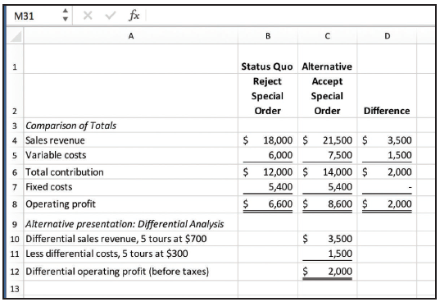
Short-Run Pricing Decisions:
Special Orders 3
LO 4-2
Analysis of Special Order: U-Develop
Access the text alternative for these images

Slide 13
Long-Run Pricing Decisions
LO 4-3
LO 4-3 Understand several approaches for establishing prices based on costs for long-run pricing decisions.
Full cost is the sum of all fixed and variable costs of manufacturing and selling a unit.
Full costs are relevant for the long-term pricing decisions.

Slide 14
Long-Run versus Short-Run Pricing
LO 4-3
In the short run, differential costs may be very low.
In the long run, differential costs are higher than in the short run.

Slide 15
Cost Analysis for Pricing
LO 4-3
In the long run, an organization must cover all variable and fixed costs—both manufacturing and selling.

Slide 16
Life-Cycle Product Costing and Pricing
LO 4-3
Product life-cycle is concerned with covering costs in all categories of the life cycle.
R & D
Design
Manufacturing
Marketing and distribution
Customer service
Take back (disposal)

Slide 17
Target Costing from Target Pricing
LO 4-3
Target Price
The price based on customers’ perceived value for the product and the price that competitors charge.
What would a customer pay?
How much profit do I need?
Can I make it at this cost?
Target price − Desired profit = Target cost

Slide 18
Legal Issues Relating to Costs and Sales Price 1
LO 4-3
Predatory Pricing
Practice of setting price below cost with the intent to drive competitors out of business
Dumping
Exporting a product to another country at a price below domestic price
Price Discrimination
Practice of selling identical goods to different customers at different prices

Slide 19
Legal Issues Relating to Costs and Sales Price 2
LO 4-3
Peak-load Pricing
Practice of setting prices highest when the quantity demanded for the product approaches capacity.
Price Fixing
Agreement among businesses to set prices at a particular level.

Slide 20
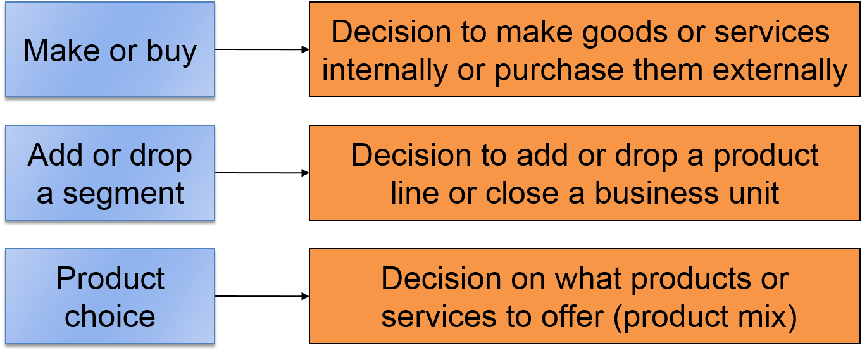
Use of Differential Analysis for Production Decision
LO 4-4
LO 4-4 Understand how to apply differential analysis to production decisions.
Access the text alternative for these images

Slide 21
Make-or-Buy Decisions 1
LO 4-4
Desert Adventure’s current costs of developing prints:
 | Per Tour | 150 Tours
Costs that can be directly assigned to the service:
Labor | $300 | $ 45,000
Food and food preparation | 400 | 60,000
Supplies and other variable costs | 300 | 45,000
Direct fixed costs |  | 48,000
Common costs allocated to this service |  | 24,000
Total costs |  | $222,000
This year’s expected volume is 150 tours, so the full cost of operating one of these tours is:
$222,000 ÷ 150 tours = $1,480

Slide 22
Make-or-Buy Decisions 2
LO 4-4
Desert Adventures has received an offer from a local tour operator to organize and lead these tours for a cost (to Desert Adventures) of $1,400.
Does Desert Adventures accept the offer?
The accounting department prepared cost analyses at volume levels of 150 and 100 tours per year.

Slide 23
Make-or-Buy Decisions 3
LO 4-4
 | Status Quo: Operate Tours | Alternative: Outsource Tours | Difference
150 Tours
Labor | $ 45,000 | $ –0–ª | $ 45,000 lower
Food and food prep | 60,000 | –0– | 60,000 lower
Supplies and other costs | 45,000 | $ 210,000^{b} | 165,000 higher
Direct fixed costs | 48,000 | –0– | 48,000 lower
Common costs | 24,000c | 24,000^{c} | –0–
Total costs | $222,000 | $234,000 | $ 12,000 higher
Differential costs increase by $12,000, so reject alternative to outsource.
 | Status Quo: Operate Tours | Alternative: Outsource Tours | Difference
100 Tours
Labor | $ 30,000^{d} | –0–^{e} | $ 30,000 lower
Food and food prep | 40,000^{d} | –0– | 40,000 lower
Supplies and other costs | 30,000^{d} | $ 140,000^{f} | 110,000 higher
Direct fixed costs | 48,000 | –0– | 48,000 lower
Common costs | 24,000^{c} | 24,000^{c} | –0–
Total costs | $172,000 | $164,000 | $ 8,000 higher
Differential costs decrease by $8,000, so accept alternative to outsource.
ª If tours are outsourced, no Desert Adventures labor is required for leading the tours.
^{b} Pay outside supplier $210,000 (= 150 tours × $1,400) to operate tours.
^{c} These common costs remain unchanged for these volumes. Because they do not change, they could be omitted from the analysis.
^{d} Total variable costs reduced by 1/3 because volume was reduced by 1/3 (= [150 tours − 100 tours]/150 tours).
^{e} If tours are outsourced, no Desert Adventures labor is required for leading the tours.
^{f} Pay outside supplier $140,000 (= 100 tours × $1,400) to operate tours.

Slide 24
Opportunity Costs of Making 1
LO 4-4
Desert Adventures expected volume is 150 trips.
Assume that the building used to store and maintain equipment could be used for aerial excursions of the local canyons. This new service would provide a $40,000 differential contribution.
Should Desert Adventures accept or reject the alternative?

Slide 25
Opportunity Costs of Making 2
LO 4-4
Panel A | Status Quo: Operate Desert Trips | Alternative: Outsource Desert Trips; Use Facilities for Aerial Service | Difference
Method 1
Total cost of 150 trips | $222,000 | $234,000 | $ 12,000 higher
Opportunity cost of using facilities for desert trips | 40,000 | –0– | 40,000 lower
Total costs, including opportunity costs | $262,000 | $234,000 | $28,000 lower
Differential costs decrease by $28,000, so accept the alternative.
“Higher” or “lower” indicates whether the alternative is higher or lower than the status quo.
Differential costs decrease by $28,000, so accept the alternative.

Slide 26
Add or Drop Decisions 1
LO 4-4
Desert Adventures
Fourth Quarter Product Line Income Statement
 | Total | Desert | Rafting | Aerial
Sales revenue | $ 910,000 | $ 140,000 | $ 350,000 | $420,000
Cost of sales (all variable) | 377,000 | 62,000 | 150,000 | 165,000
Contribution margin | $ 533,000 | $ 78,000 | $200,000 | $255,000
Less fixed costs:
Rent | 150,000 | 29,000 | 36,000 | 85,000
Salaries | 209,000 | 45,000 | 62,000 | 102,000
Marketing and administrative | 48,000 | 12,000 | 15,000 | 21,000
Operating profit (loss) | $ 126,000 | $ (8,000) | $ 87,000 | $ 47,000

Slide 27
Add or Drop Decisions 2
LO 4-4
Desert Adventures
Differential Analysis
 | Status Quo: Keep Desert Trips | Alternative: Drop Desert Trips | Difference
Sales revenue | $ 910,000 | $ 770,000 | $ 140,000 decrease
Cost of sales (all variable) | 377,000 | 315,000 | 62,000 decrease
Contribution margin | $ 533,000 | $ 455,000 | $ 78,000 decrease
Less fixed costs:
Rent | 150,000 | 150,000 | –0–
Salaries | 209,000 | 164,000 | 45,000 decrease
Marketing and administrative | 48,000 | 40,000 | 8,000 decrease
Operating profit (loss) | $ 126,000 | $ 101,000 | $ 25,000 decrease
Profits decrease $25,000. Therefore, keep desert trips.

Slide 28
Product Choice Decisions 1
LO 4-4
Constraints
Activities, resources, or policies that limit or bound the attainment of an objective
Contribution Margin per Unit of Scarce Resource
Contribution margin per unit of a particular input with limited availability

Slide 29
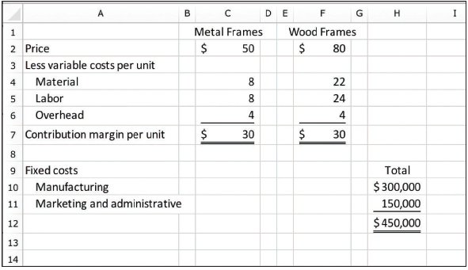
Product Choice Decisions 2
LO 4-4
Southwestern Frames
Revenue and Cost Information
Access the text alternative for these images

Slide 30
Product Choice Decisions 3
LO 4-4
Southwestern Frames
Revenue and Cost Information
 | Metal frames | Wood frames
Per unit:
Contribution margin | $ 30 | $ 30
Machine hours required | ÷ 0.5 | ÷ 1.0
Contribution margin per machine hour | $ 60 | $ 30
Metal Frames have a higher contribution margin per machine hour.

Slide 31
Product Choice Decisions 4
LO 4-4
Suppose Southwestern Frames has 20,000 machine hours per month available.
 | Metal frames | Wood frames
Capacity | 40,000 | 20,000
Contribution margin per unit | × $30 | × $30
Total contribution margin | 1,200,000 | 600,000
Less: Fixed manufacturing costs | 300,000 | 300,000
Less: Fixed marketing and admin. costs | 150,000 | 150,000
Operating profit | $ 750,000 | $150,000
Selling metal frames will result in higher profits than selling wooden frames.

Slide 32
The Theory of Constraints
LO 4-5
LO 4-5 Understand the theory of constraints.
Theory of Constraints
Focuses on revenue and cost management when faced with bottlenecks
Bottleneck
Operation where the work required limits production; a bottleneck is the constraining resource
Throughput Contribution
Sales dollars minus direct materials costs and variables such as energy and piecework labor

Slide 33
End of Chapter 4

Slide 34
Accessibility Content: Text Alternatives for Images

Slide 35
Short-Run versus Long-Run
Pricing Decisions Text Alternative
Short-run pricing decisions look less than one year forward, for example pricing a one-time special order.
Long-run pricing decisions look more than one year into the future, such as pricing a new product.
Return to slide containing original image

Slide 36
Short-Run Pricing Decisions:
Special Orders 1 Text Alternative
Decision to be made: Accept special order? Option 1: Status quo: Reject special order. Option 2: Alternative: Accept special order. Is the value of Option 1 greater than the value of Option 2?
Return to slide containing original image

Slide 37
Short-Run Pricing Decisions:
Special Orders 3 Text Alternative
 | A | B | C | D
1 |  | Status Quo: | Alternative:
2 |  | Reject special order | Accept special order | Difference
3 | Comparison of Totals
4 | Sales revenue | $18,000 | $21,500 | $3,500
5 | Variable costs | 6,000 | 7,500 | 1,500
6 | Total contribution | $12,000 | $14,000 | $2,000
7 | Fixed costs | 5,400 | 5,400 | -
8 | Operating profit | $6,600 | $8,600 | $2,000
9 | Alternative Presentation: Differential Analysis
10 | Differential sales, 5 tours at $700 |  | $3,500
11 | Less differential costs, 5 tours at $300 |  | 1,500
12 | Differential operating profit (before taxes) |  | $2,000
Return to slide containing original image

Slide 38
Use of Differential Analysis for Production Decision Text Alternative
First is Make or buy. This points right to Decision to make goods or services internally or purchase them externally. Next row shows at the left: Add or drop a segment. This points to: Decision to add or drop a product line or close a business unit. Last row has Product choice at the left. At the right is: Decision on what products or services to offer (product mix).
Return to slide containing original image

Slide 39
Product Choice Decisions 2 Text Alternative
 | A | B | C | D | E | F | G | H
1 |  |  | Metal frames |  |  | Wood frames
2 | Price |  | $50 |  |  | $80
3 | Less variable costs per unit
4 | Material |  | 8 |  |  | 22
5 | Labor |  | 8 |  |  | 24
6 | Overhead |  | 4 |  |  | 4
7 | Contribution margin per unit |  | $30 |  |  | $30
8
9 | Fixed costs |  |  |  |  |  |  | Total
10 | Manufacturing |  |  |  |  |  |  | $300,000
11 | Marketing and administrative |  |  |  |  |  |  | 150,000
12 |  |  |  |  |  |  |  | $450,000
13
Return to slide containing original image

