Slide 1
Fundamentals of Cost Accounting
Sixth Edition
William Lanen
Shannon Anderson
Michael Maher
©2020 McGraw-Hill Education. All rights reserved. Authorized only for instructor use in the classroom. No reproduction or further distribution permitted without the prior written consent of McGraw-Hill Education.

Slide 2
Chapter 7
Job Costing

Slide 3
Learning Objectives
LO 7-1 Explain what job and job shop mean.
LO 7-2 Assign costs in a job cost system.
LO 7-3 Account for overhead using predetermined rates.
LO 7-4 Apply job costing methods in service organizations.
LO 7-5 Understand the ethical issues in job costing.
LO 7-6 Describe the difference between jobs and projects.

Slide 4
Defining a Job
LO 7-1
LO 7-1 Explain what job and job shop mean.
Job
Unit of a product that is easily
distinguishable from other units
Job Shop
Firm that produces jobs

Slide 5
Using Accounting Records in a Job Shop
LO 7-1
Job Cost Sheet
Record of the cost of the job kept in the accounting system
Subsidiary Ledger Account
Account that records financial transactions for a specific
customer, vendor, or job (Job 1 WIP, Job 2 WIP, Job 3 WIP, etc.)
Control Account
Account in the general ledger that summarizes a set of
subsidiary ledger accounts

Slide 6
Production Process at Gupta
LO 7-2
LO 7-2 Assign costs in a job cost system.
Gupta Designs manufactures furniture for
offices and homes.

Slide 7
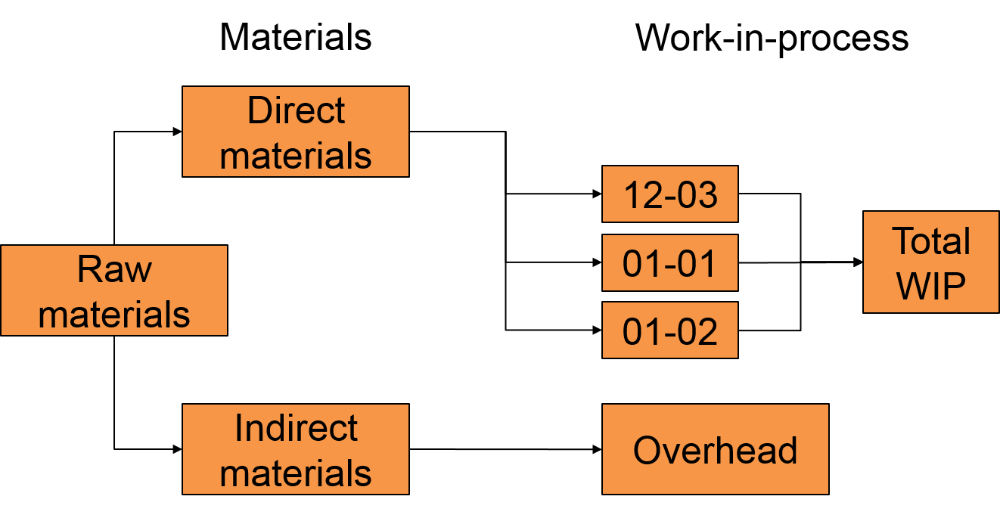
Records of Costs at Gupta 1
LO 7-2
Access the text alternative for these images

Slide 8
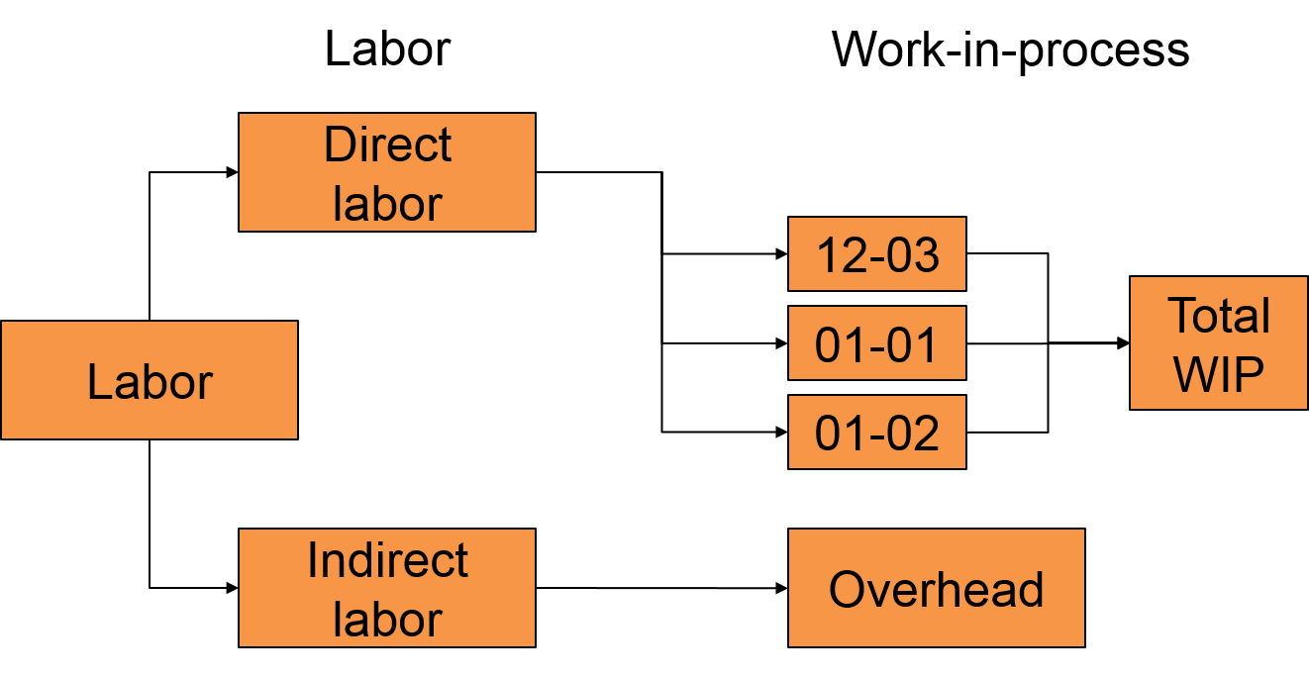
Records of Costs at Gupta 2
LO 7-2
Access the text alternative for these images

Slide 9
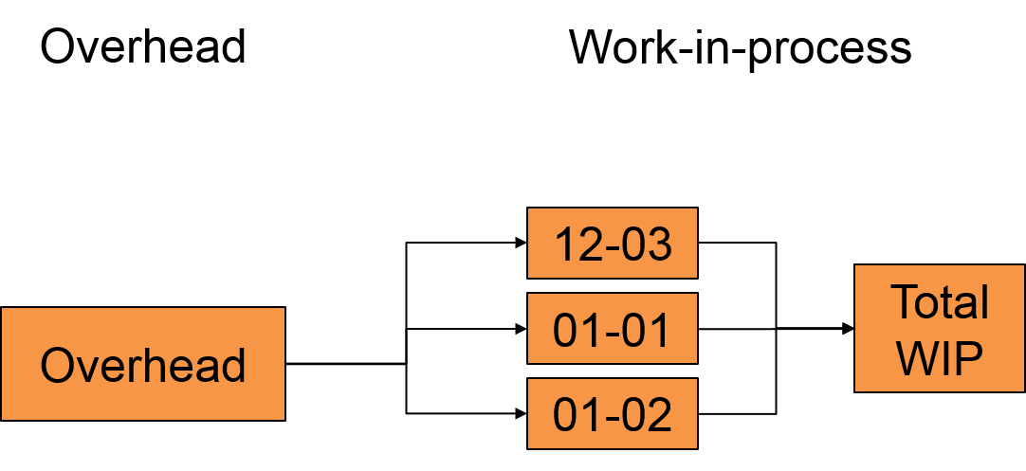
Records of Costs at Gupta 3
LO 7-2
OH costs are applied to each job using the POHR.
Access the text alternative for these images

Slide 10
Inventory Accounts
LO 7-2
On January 1, Gupta has the following balances in each of its three inventory accounts:
Direct materials inventory | $30,000
Work-in-process inventory (Job 12-03) | $41,000
Finished goods inventory (Job 12-02) | $27,000
Now, let’s record January’s activities for Gupta.

Slide 11
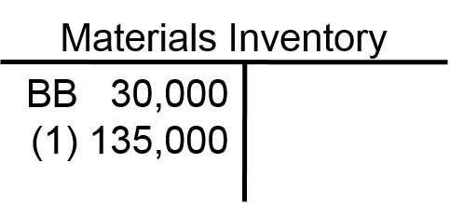
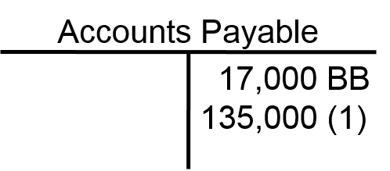
Direct Materials 1
LO 7-2
Gupta purchased $135,000
of raw materials on account.

Slide 12
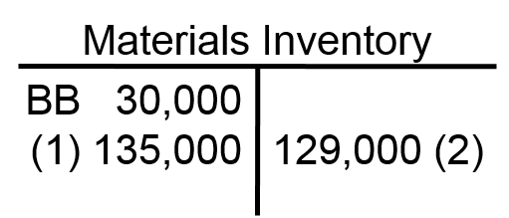
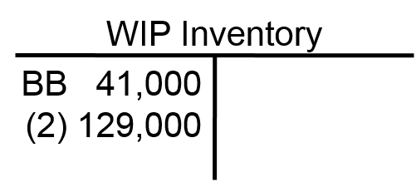
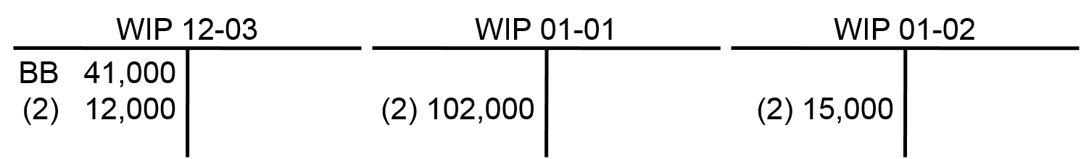
Direct Materials 2
LO 7-2
Gupta used $12,000 of direct materials for 12-03.
They also started 01-01 and 01-02 and used $102,000
and $15,000 of direct materials respectively.
Subsidiary WIP Accounts

Slide 13
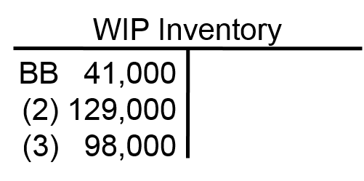
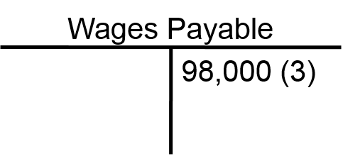
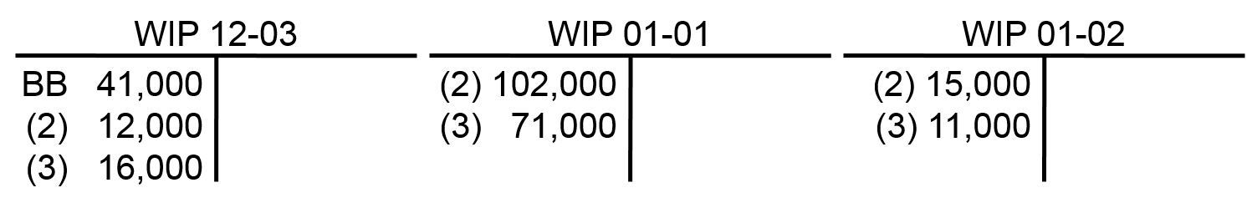
Direct Materials 3
LO 7-2
Direct labor of $98,000 was incurred ($16,000 for 12-03, $71,000 for 01-01, and $11,000 for 01-02).
Subsidiary WIP Accounts

Slide 14
Manufacturing Overhead 1
LO 7-2
Gupta incurred the following “actual” overhead
costs in January:
JE# | Item | Amount
(4) | Indirect material requisitioned | $12,000
(5) | Indirect labor incurred | 9,500
(6) | Utilities & other factory expenses (credit A/P) | 13,750
(6) | Prepaid factory expenses used | 5,000
(6) | Factory depreciation | 11,200
 | Total actual overhead expenses | $51,450
With this information, let’s continue recording
Gupta’s activities.

Slide 15
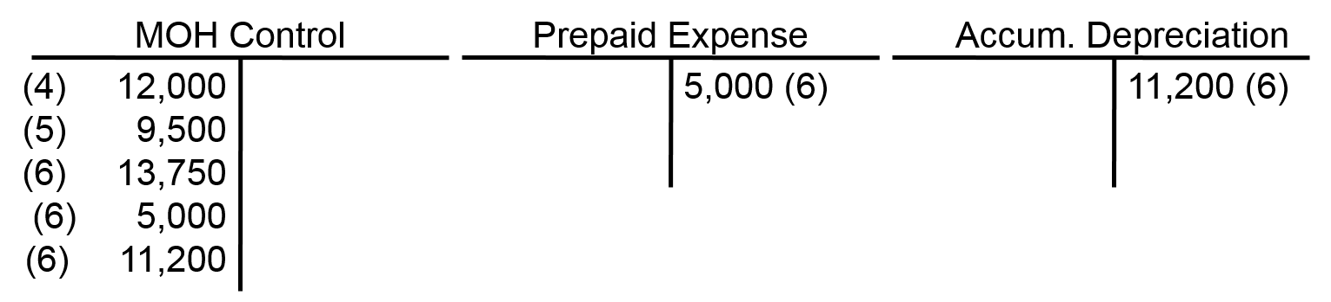
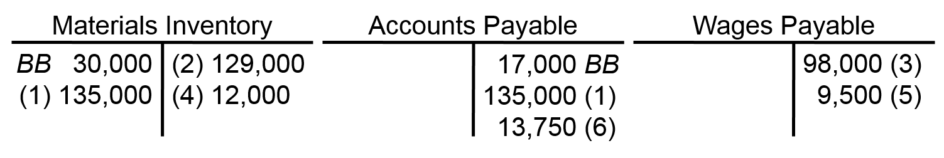
Manufacturing Overhead 2
LO 7-2
Access the text alternative for these images

Slide 16
How Manufacturing Overhead
Costs Are Recorded at Gupta
LO 7-3
LO 7-3 Account for overhead using predetermined rates.
Two common events that lead to manufacturing
overhead being recorded are:
Preparing financial statements
Completing a job

Slide 17
Predetermined Rate
LO 7-3
The estimated manufacturing overhead predetermined
rate is the estimated overhead divided by the estimated
activity for the allocation base.
Gupta uses estimates based on annual manufacturing
overhead and annual production volume.
Why?
Because it does not want erratic or monthly costs or
production volumes to affect the long-run production costs.

Slide 18
Application of Manufacturing
Costs to Jobs 1
LO 7-3
Overhead is allocated to jobs using
direct labor cost as its base.
Gupta estimated that the manufacturing
overhead for the coming year would be
$600,000 and that direct labor cost
would be $1,200,000.
What is the predetermined overhead rate?

Slide 19
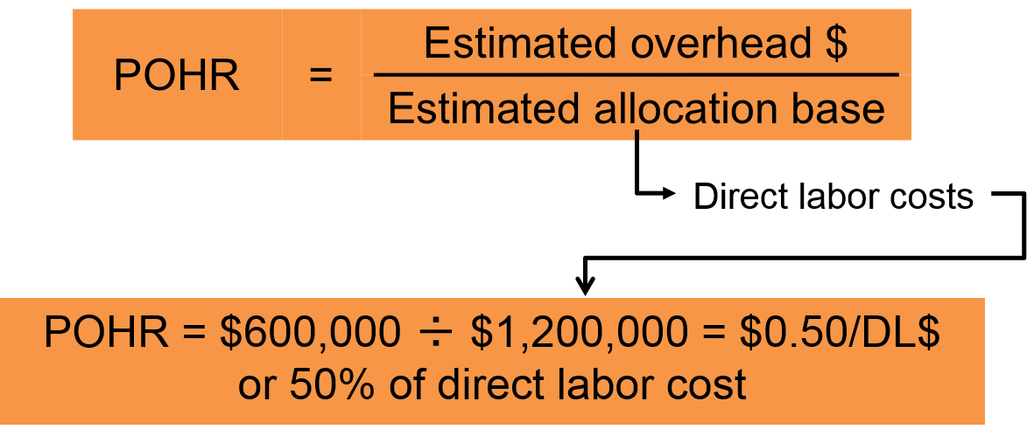
Application of Manufacturing
Costs to Jobs 2
LO 7-3

Slide 20
Application of Manufacturing
Costs to Jobs 3
LO 7-3
Job # | DL$ | Rate | OH Applied
12-03 | $16,000 | 50% | $ 8,000
01-01 | 71,000 | 50% | 35,500
01-02 | 11,000 | 50% | 5,500
Total | $98,000 | 50% | $49,000

Slide 21
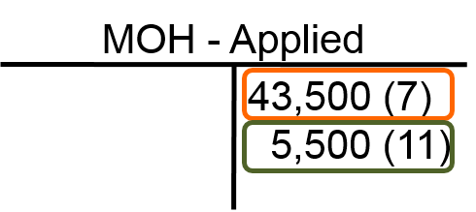
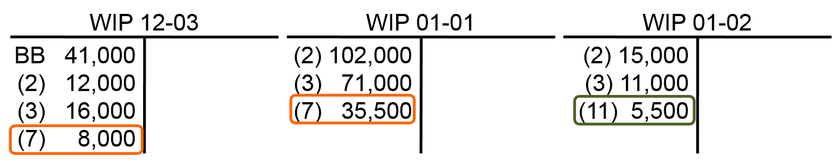
Application of Manufacturing
Costs to Jobs 4
LO 7-3
Access the text alternative for these images

Slide 22
Cost of Jobs Completed in January 1
LO 7-3
Gupta completed Jobs 12-03 and 01-01
and transferred them to Finished Goods.
Job Ticket Summary | Job 12-03 | Job 01-01
Beginning inventory January 1 | $41,000 | $ -0-
Direct materials – January | 12,000 | 102,000
Direct labor – January | 16,000 | 71,000
OH applied – January | 8,000 | 35,500
Total cost on job tickets | $77,000 | $208,500
What is the journal entry?

Slide 23
Cost of Jobs Completed in January 2
LO 7-3
Finished Goods Inventory (12-03) | 77,000
Finished Goods Inventory (01-01) | 208,500
Work-in-Process Inventory (12-03) |  | 77,000
Work-in-Process Inventory (01-01) |  | 208,500
Next, Jobs 12-02 and 12-03 were sold for
$35,000 and $95,000, respectively.
What are the journal entries?

Slide 24
Cost of Jobs Sold in January
LO 7-3
Cost of Goods Sold (12-02) | 27,000
Cost of Goods Sold (12-03) | 77,000
Finished Goods Inventory (12-02) |  | 27,000
Finished Goods Inventory (12-03) |  | 77,000
Accounts Receivable (12-02) | 35,000
Accounts Receivable (12-03) | 95,000
Revenue (12-02) |  | 35,000
Revenue (12-03) |  | 95,000

Slide 25
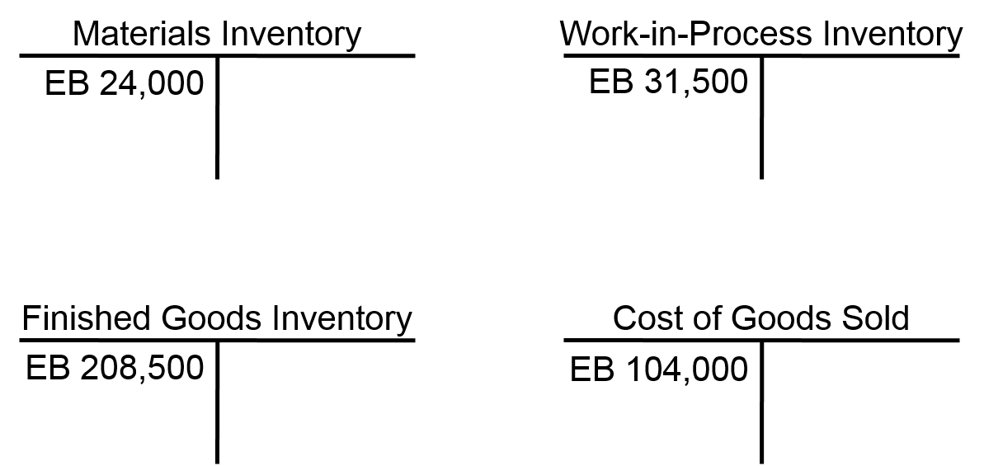
Cost Flows Through T-Accounts
LO 7-3
After the journal entries are completed, the accounts have the following ending balances.

Slide 26
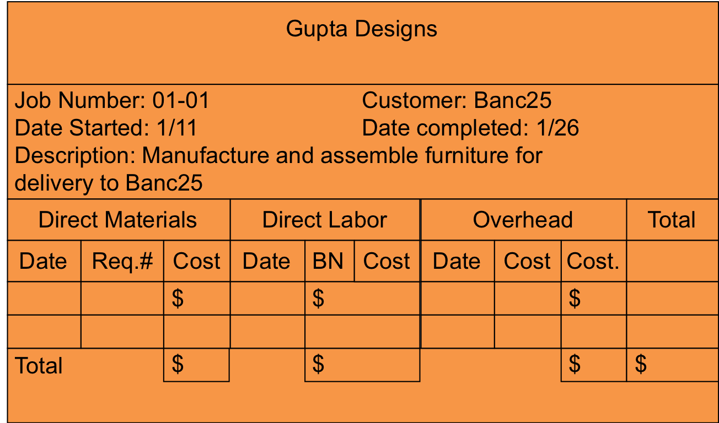
The Job Cost Sheet 1
LO 7-3
Access the text alternative for these images

Slide 27
The Job Cost Sheet 2
LO 7-3
Total Costs for Job 01-01
Direct materials | $102,000
Direct labor | 71,000
Manufacturing overhead | 35,500
Total | $208,500
Transferred to finished goods inventory
Direct materials | $102,000
Direct labor | 71,000
Manufacturing overhead | 35,500
Total | $208,500

Slide 28
An Alternative Method of Recording and Applying Manufacturing Overhead 1
LO 7-3
Assume Gupta maintains two manufacturing overhead accounts:
Manufacturing Overhead Control, which is used
to track all actual overhead expenses.
Applied Manufacturing Overhead, which is used
to allocate overhead to jobs based on the
predetermined OH rate.
Some companies combine these two accounts into one account.

Slide 29
An Alternative Method of Recording and Applying Manufacturing Overhead 2
LO 7-3
Underapplied Overhead
The excess of actual overhead costs incurred
over applied overhead costs
Overapplied Overhead
The excess of applied overhead costs over
actual overhead costs incurred

Slide 30
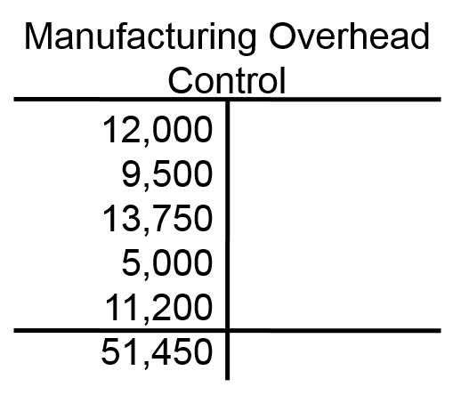
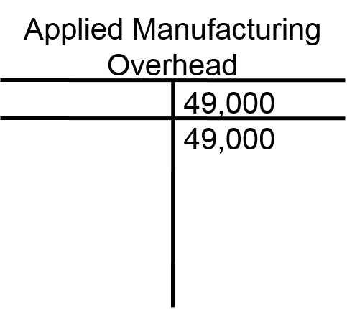
Writing Off Over- or Underapplied Overhead 1
LO 7-3
The two manufacturing overhead accounts
are not balance sheet accounts.
The combined ending balance must be zero.
The combined OH is $2,450 underapplied.

Slide 31
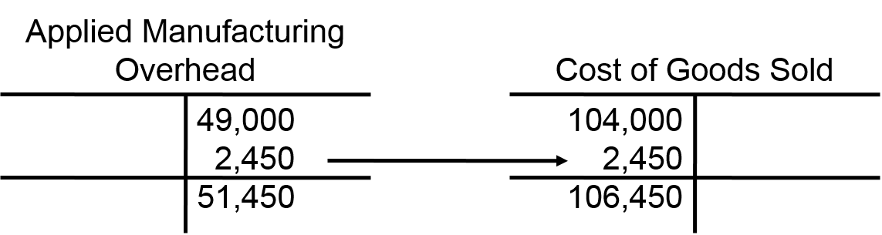
Writing Off Over- or Underapplied Overhead 2
LO 7-3
After entry, the applied and control
overhead accounts sum to zero.
Access the text alternative for these images

Slide 32
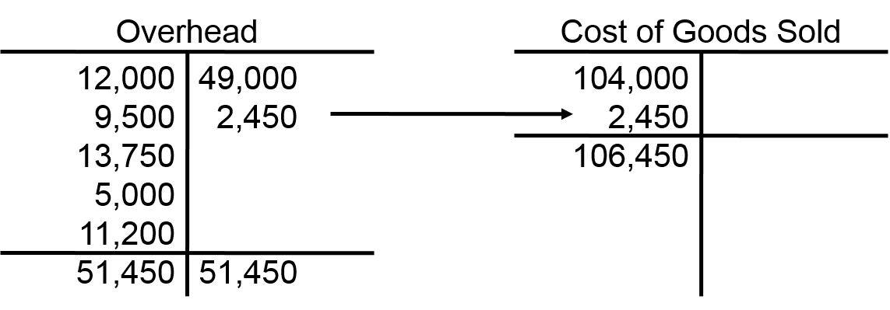
Writing Off Over- or Underapplied Overhead 3
LO 7-3
Some firms use only one OH account.
In this condition, the debit side of the OH account
contains actual data and the credit side contains applied data.
For either condition of under- or overapplied, actual must
equal applied in the Overhead control account at the end of the period.
Access the text alternative for these images

Slide 33
Writing Off Over- or Underapplied Overhead 4
LO 7-3
Some companies prorate the over/under applied MOH to WIP, FG, and COGS.
Accounts at January 31
 | Costs | % of Total
Work-in-Process Inventory | $ 31,500 | 9.2%
Finished Goods Inventory | 208,500 | 60.6%
Cost of Goods Sold | 104,000 | 30.2%
Total | $344,000 | 100.0%

Slide 34
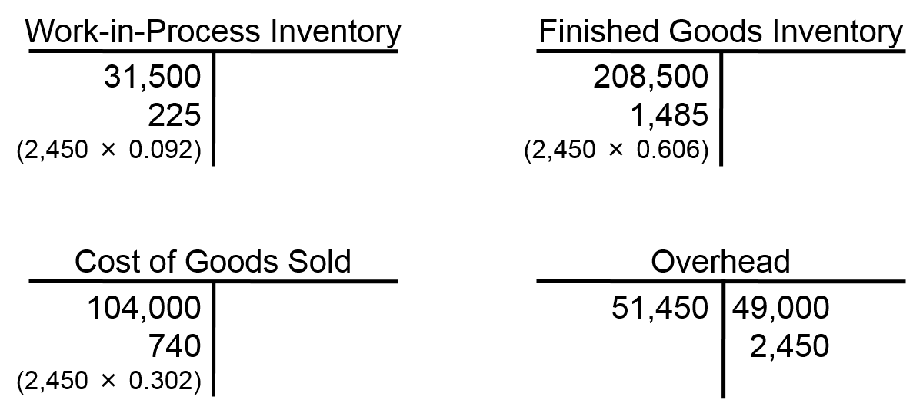
Writing Off Over- or Underapplied Overhead 5
LO 7-3
Allocate underapplied overhead to finished goods, cost of good sold and WIP.
Access the text alternative for these images

Slide 35
Using Normal, Actual, and Standard Costing
LO 7-3
Normal Cost of job determined by actual direct material, actual direct labor, and applied overhead using the POHR and the actual allocation base
Actual Cost of job determined by actual direct material, actual direct labor, and applied overhead using actual overhead rate and the actual allocation base
Standard Cost of job determined by standard (budgeted) direct material, standard direct labor, and applied overhead using the POHR and a standard (budgeted) allocation base

Slide 36
Using Job Costing in Service Organizations 1
LO 7-4
LO 7-4 Apply job costing methods in service organizations.
Service organizations use fewer direct materials than manufacturing companies.
Service companies’ overhead accounts have slightly different names.
Finished goods (or services) are charged to Cost of Services Billed.

Slide 37
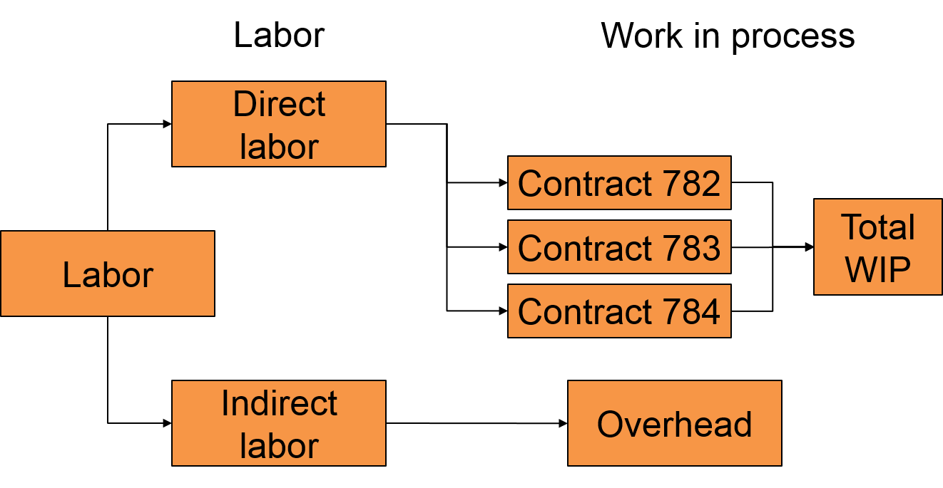
Using Job Costing in Service Organizations 2
LO 7-4
Access the text alternative for these images

Slide 38
Ethical Issues
LO 7-5
LO 7-5 Understand the ethical issues in job costing.
Improprieties include:
Misstating the stage of completion
Charging costs to the wrong jobs
Misrepresenting the cost of jobs

Slide 39
Managing Projects
LO 7-6
LO 7-6 Describe the difference between jobs and projects.
A project is a complex job that often takes months or years to complete and requires the work of many departments, divisions, or subcontractors.

Slide 40
End of Chapter 7

Slide 41
Accessibility Content: Text Alternatives for Images

Slide 42
Records of Costs at Gupta 1 Text Alternative
At the left is a column of Materials, which includes Direct Materials, Raw Materials, and Indirect Materials. At the right is a Work-in-process column.
Raw materials is center left and points up to the box labeled Direct materials. This box points to the right, under Work-in-process, to 3 labels: 12-03, 01-01, and 01-02. These 3 boxes point right to Total WIP. Then, back under Materials, Raw materials has an arrow leading down that points to Indirect materials, which points to the right to Overhead.
Return to slide containing original image

Slide 43
Records of Costs at Gupta 2 Text Alternative
At the left is a column of Labor, which includes Direct labor, Labor, and Indirect labor. At the right is a Work-in-process column.
Labor is center left and points up to the box labeled Direct labor. This box points to the right, under Work-in-process, to 3 labels: 12-03, 01-01, and 01-02. These 3 boxes point right to Total WIP. Then, back under Labor, the center Labor box has an arrow leading down that points to Indirect labor, which points to the right to Overhead.
Return to slide containing original image

Slide 44
Records of Costs at Gupta 3 Text Alternative
At the left is a column Overhead, which includes a box labeled Overhead pointing to the right. At the right is a Work-in-process column, which consists of 3 labels: 12-03, 01-01, and 01-02. These 3 boxes point right to Total WIP.
Return to slide containing original image

Slide 45
Manufacturing Overhead 2 Text Alternative
First is the MOH Control T Account, which has five entries in the debit column: (4) 12,000, (5) 9,500, (6) 13,750, (6) 5,000, and (6) 11,200. Next is the Prepaid Expense T Account, which has one entry in the credit column: 5,000 (6). Third account is Accumulated Depreciation T Account, which has one entry in the credit column: 11,200 (6).
The first is Materials Inventory T Account, which has two entries in the debit column and one entry in the credit column. Debit: Beginning balance 30,000 and (1) 135,000. Credit: (2) 129,000 and (4) 12,000. Second T account is Accounts Payable, which has three entries in the credit column: 17,000 Beginning Balance, 135,000 (1), and 13,750 (6). Third T account is Wages Payable, which has two entries in the credit column: 98,000 (3) and 9,500 (5).
Return to slide containing original image

Slide 46
Application of Manufacturing
Costs to Jobs 4 Text Alternative
MOH – Applied T Account has two entries in the credit column: 43,500 (7) [boxed in orange], 5,500 (11) [boxed in olive green].
Three WIP T-accounts as follows. 12-03 debit side has beginning balance of 41,000 followed by (2) 12,000, (3) 16,000, and (7) 8,000, which is boxed in orange. 01-01 account has debits of (2) 102,000, (3) 71,000, and (7) 35,500, boxed in orange. 01-02 has debits of (2) 15,000, (3) 11,000, and (11) 5,500, boxed in green.
Return to slide containing original image

Slide 47
The Job Cost Sheet 1 Text Alternative
The job number is 01-01 for the customer Banc25. The job began on 1/11 and ended on 1/26. The job was to manufacture and assemble furniture for delivery to Banc25.
The sheet has four columns: Direct Materials, Direct Labor, Overhead, and Total. Under Direct Materials, there are spaces to track date, requisition number, and cost. Under Direct Labor, there are spaces to track date, BN, and cost. Under Overhead, there are spaces to track date, cost, and a second cost. None of the data entry spaces are filled in.
Return to slide containing original image

Slide 48
Writing Off Over- or Underapplied Overhead 2 Text Alternative
The T account on the left is for the applied manufacturing overhead. It has two entries in the credit column: 49,000 and 2,450. Also shown is the total, which is 51,450.
The T account on the right is for the cost of goods sold. It has two entries in the debit column: 104,000; 2,450. Also shown is the total, which is 106,450.
An arrow points from the 2,450 figure in the left T account to the 2,450 figure in the right T account, indicating that they are the same.
Return to slide containing original image

Slide 49
Writing Off Over- or Underapplied Overhead 3 Text Alternative
The T account on the left is for the overhead. It has five entries in the debit column and two entries in the credit column. Debit: 12,000; 9,500; 13,750; 5,000; 11,200. Credit: 49,000; 2,450. Also shown are the column totals, which are both 51,450.
The T account on the right is for the cost of goods sold. It has two entries in the debit column: 104,000; 2,450. Also shown is the total, which is 106,450.
An arrow points from the 2,450 figure in the left T account to the 2,450 figure in the right T account, indicating that they are the same.
Return to slide containing original image

Slide 50
Writing Off Over- or Underapplied Overhead 5 Text Alternative
First is Work-in-Process Inventory T Account, which has two entries in the debit column: 31,500; 255 (2,450 × 0.092)
Next is the Finished Goods Inventory T Account, which has two entries in the debit column: 208,500; 1,485 (2,450 × 0.606).
Third is Cost of Goods Sold T Account, which has two entries in the debit column: 104,000; 740 (2,450 × 0.302). Lastly is the Overhead T Account, which has one entry in the debit column and two entries in the credit column. Debit: 51,450; Credit: 49,000 and 2,450.
Return to slide containing original image

Slide 51
Using Job Costing in Service Organizations 2 Text Alternative
At the left is a column of Labor, which includes Direct labor, Labor, and Indirect labor. At the right is a Work-in-process column.
Labor is center left and points up to the box labeled Direct labor. This box points to the right, under Work-in-process, to 3 labels: Contract 782, Contract 783, and Contract 784. These 3 boxes point right to Total WIP. Then, back under Labor, the center Labor box has an arrow leading down that points to Indirect labor, which points to the right to Overhead.
Return to slide containing original image

