Slide 1
Fundamentals of Cost Accounting Sixth Edition
William Lanen
Shannon Anderson
Michael Maher
©2020 McGraw-Hill Education. All rights reserved. Authorized only for instructor use in the classroom. No reproduction or further distribution permitted without the prior written consent of McGraw-Hill Education.

Slide 2
Chapter 8
Process Costing

Slide 3
Learning Objectives
LO 8-1 Explain the concept and purpose of equivalent units.
LO 8-2 Assign costs to products using a five-step process.
LO 8-3 Assign costs to products using weighted-average costing.
LO 8-4 Prepare and analyze a production cost report.
LO 8-5 Assign costs to products using first-in, first-out (FIFO) costing.
LO 8-6 Analyze the accounting choice between FIFO and weighted-average costing.
LO 8-7 Know when to use process or job costing.
LO 8-8 Compare and contrast operations costing with job costing and process costing.

Slide 4
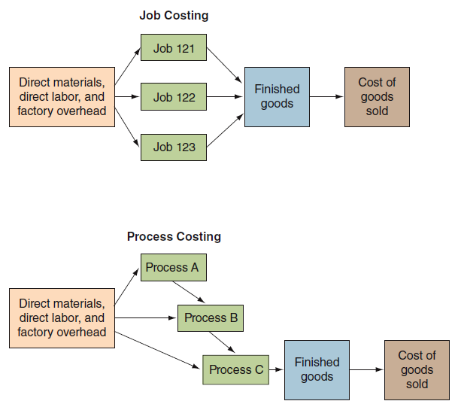
Comparison of Cost Flows
Access the text alternative for these images

Slide 5
Determining Equivalent Units 1
LO 8-1
LO 8-1 Explain the concept and purpose of equivalent units.
Equivalent Units
Number of complete physical units to which units in inventories are equal in terms of work done to date.

Slide 6
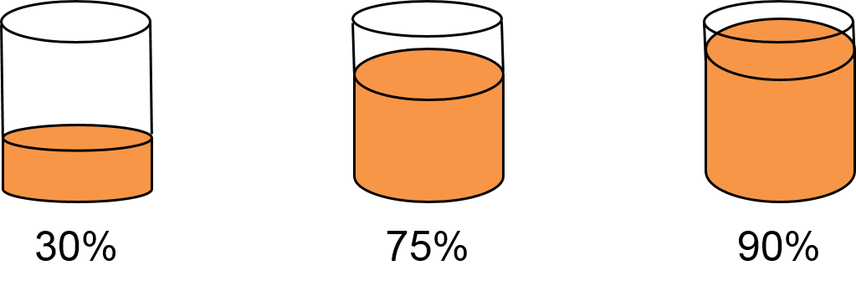
Determining Equivalent Units 2
LO 8-1
At month end, three cans of paint are filled as indicated.
(30% + 75% + 90%) ÷ 3 = 65%
Therefore, ending work-in-process inventory is 65 percent complete, on average.
Access the text alternative for these images

Slide 7
Using Product Costing in a Process Industry 1
LO 8-2
LO 8-2 Assign costs to products using a five-step process.
Step 1: Measure the physical flow of resources.
Step 2: Compute the equivalent units of production.
Step 3: Identify the costs to assign to products.
Step 4: Compute the costs per equivalent unit.
Step 5: Assign product cost to batches of work.

Slide 8
Using Product Costing in a Process Industry 2
LO 8-2
Apple State Juices (ASJ), produces and bottles various fruit juices.
Production at ASJ’s Exeter Plant takes place in three steps.
Access the text alternative for these images

Slide 9
Measure the Physical Flow of Resources (Step 1) 1
LO 8-2
Shredding Department, March, Year 2
 | A | B | C | D
1 |  | Gallons of Pulp |  | Gallons of Pulp
2
3 | Work in process, March 1 | 20,000ª
4 | + Gallons of pulp started | 92,000
5 | Total gallons to account for |  |  | 112,000
6
7 | = Transferred out to Pressing Department | 96,000
8 | + Work in process, March 31 | 16,000^{b}
9 | Total units accounted for |  |  | 112,000
10
ª 25% complete with respect to conversion costs.
^{b} 30% complete with respect to conversion costs.

Slide 10
Compute the Equivalent Units of Production (Step 2) 1
LO 8-2
Shredding Department, March, Year 2: Equivalent Units
 | A | B | C | D | E
1 |  |  |  | Equivalent Units | Equivalent Units
2 |  | Physical |  | Materials | Conversion
3 |  | Units
4 | Transferred out | 96,000 |  | 96,000 | 96,000
5 | Work in process, March 31 | 16,000ª |  | 16,000 | 4,800
6 | Total work |  |  | 112,000 | 100,800
7
ª 30% complete with respect to conversion.

Slide 11
Identify the Costs to Assign to Products (Step 3) 1
LO 8-2
Shredding Department, March, Year 2: Cost Information
 | A | B | C | D
1 |  | Total | Materials | Conversion
2 |  | Costs | Costs | Costs
3 | Work in process, March 1 | $ 24,286 | $ 16,160 | $ 8,126
4 | Current costs (March) | 298,274 | 84,640 | 213,634
5 | Total | $ 322,560 | $ 100,800 | $ 221,760
6

Slide 12
Identify the Costs to Assign to Products (Step 3) 2
LO 8-2
Costs: | Work-in-process costs | Current period costs
Work (EU) | Work-in-process EU* | Current period EU
 | Weighted-Average Unit Costs
Weighted average:
 | Work-in-Process Unit Costs | Current Period Unit Costs
FIFO:
*Note: EU is equivalent unit.

Slide 13
Identify the Costs to Assign to Products (Steps 4 and 5)
LO 8-3
LO 8-3 Assign costs to products using weighted-average costing.
Compute the costs per equivalent unit: Weighted-average (Step 4)
First, Steps 1, 2, and 3 must be revisited.

Slide 14
Measure the Physical Flow of Resources (Step 1) 2
LO 8-3
 | Gallons of Pulp
Work in process, March 1 | 20,000ª
+ Gallons of Pulp started | 92,000
Total gallons to account for | 112,000
= Transferred out to Pressing Department | 96,000
+ Work-in-process, March 31 | 16,000^{b}
Total units accounted for | 112,000
ª 25% complete with respect to conversion costs
^{b} 30% complete with respect to conversion costs

Slide 15
Compute the Equivalent Units of Production (Step 2) 2
LO 8-3
Shredding Department, March, Year 2: Equivalent Units
 | Physical units | Equivalent units | Equivalent units
 |  | Materials | Conversion
Transferred out | 96,000 | 96,000 | 96,000
Work-in-process, March 31 | 16,000 | 16,000ª | 4,800^{b}
Total work |  | 112,000 | 100,800
ª 16,000 units × 100% (all materials added in beginning)
^{b} 16,000 units × 30%

Slide 16
Identify the Costs to Assign to Products (Step 3) 3
LO 8-3
 | Total costs | Materials costs | Conversion costs
Work in process, March 1 | $ 24,286 | $ 16,160 | $ 8,126
Current costs, March | 298,274 | 84,640 | 213,634
Total | $322,560 | $100,800 | $221,760

Slide 17
Compute the Cost per Equivalent Unit (Step 4) 1
LO 8-3
 | A | B | C | D
1 |  | Total | Materials | Conversion
2 |  | Costs | Costs | Costs
3 | Work in process, March 1 | $ 24,286 | $ 16,160 | $ 8,126
4 | Current costs (March) | 298,274 | 84,640 | 213,634
5 | Total | $ 322,560 | $ 100,800 | $ 221,760
6
7 | Total equivalent units (from Exhibit 8.5) |  | 112,000 | 100,800
8 | Cost per equivalent unit |  | $ 0.90 | $ 2.20
9

Slide 18
Assign Product Costs to Batches of Work (Step 5) 1
LO 8-3
 | Total | Materials costs | Conversion costs
Transferred out:
Equivalent units |  | 96,000 | 96,000
Cost per equivalent unit |  | $ 0.90 | $ 2.20
Cost assigned | $297,600 | $ 86,400 | $211,200
Work-in-process, March 31
Equivalent units |  | 16,000 | 4,800
Cost per equivalent unit |  | $ 0.90 | $ 2.20
Cost assigned | 24,960 | 14,400 | 10,560
Total cost assigned | $322,560 | $100,800 | $221,760

Slide 19
The Production Cost Report
LO 8-4
LO 8-4 Prepare and analyze a production cost report.
The production cost report summarizes the production and cost results for a period.
It is used by managers to monitor production and cost flows.
Following is ASJ’s Shredding Department production cost report (weighted-average processing costing) for March.

Slide 20
Production Cost Report: Weighted-Average Process Costing 1
LO 8-4
Flow of units | Physical units | Equivalent units | Equivalent units
 |  | Materials | Conversion
Units to be accounted for:
In work-in-process beginning inventory | 20,000ª
Units started this period | 92,000
Total units to account for | 112,000
Units accounted for:
Completed and transferred out | 96,000 | 96,000 | 96,000
In work-in-process ending inventory | 16,000 | 16,000ª | 4,800^{b}
Total units accounted for | 112,000 | 112,000 | 100,800
ª 100 % complete with respect to materials
^{b} 30% complete with respect to conversion

Slide 21
Production Cost Report: Weighted-Average Process Costing 2
LO 8-4
Flow of costs | Total | Materials Costs | Conversion Costs
Costs to be accounted for:
Work-in-process beginning inventory | $ 24,286 | $ 16,160 | $ 8,126
Current period costs | 298,274 | 84,640 | 213,634
Total costs to be accounted for | $322,560 | $100,800 | $221,760
Cost per equivalent unit |  | $ 0.90^{c} | $ 2.20^{d}
Costs accounted for:
Costs assigned to transferred-out units | $297,600 | $ 86,400e | $211,200^{f}
Costs assigned to WIP ending inventory | 24,960 | 14,400^{g} | 10,560^{h}
Total costs accounted for | $322,560 | $100,800 | $221,760
^{c} $100,000 ÷ 112,000 EU
^{d} $221,760 ÷ 100,800 EU
^{e} 96,000 EU × $0.90 per EU
^{f} 96,000 EU × $2.20 per EU
^{g} 16,000 EU × $0.90 per EU
^{h} 4,800 EU × $2.20 per EU

Slide 22
Assigning Costs Using FIFO
LO 8-5
LO 8-5 Assign costs to products using first-in, first-out (FIFO) costing.
Use the same five-step process.
Step 1: Measure the physical flow of resources.
Step 2: Compute the equivalent units of production.
Step 3: Identify the costs to assign to products.
Step 4: Compute the costs per equivalent unit.
Step 5: Assign product cost to batches of work.

Slide 23
Measure the Physical Flow of Resources (Step 1) 3
LO 8-5
Exactly the same as weighted-average.
 | Gallons of Pulp
Work-in-process, March 1 | 20,000ª
+ Gallons of pulp started | 92,000
Total gallons to account for | 112,000
= Transferred out to Pressing Department | 96,000
+ Work-in-process, March 31 | 16,000^{b}
Total units accounted for | 112,000
ª 25% complete with respect to conversion costs
^{b} 30% complete with respect to conversion costs

Slide 24
Compute the Equivalent Units of Production (Step 2) 3
LO 8-5
 | Physical units | Equivalent units | Equivalent units
 |  | Materials | Conversion
From beginning work in process | 20,000 | 20,000 | 20,000
Started and completed | 76,000 | 76,000 | 76,000
Total completed and transferred out | 96,000 | 96,000 | 96,000
In work-in-process inventory | 16,000 | 16,000 | 4,800^{b}
Total units accounted for | 112,000 | 112,000 | 100,800
Less work from beginning WIP | 20,000 | 20,000 | 5,000^{c}
New work done in March | 92,000 | 92,000 | 95,800
ª 100% complete with respect to materials
^{b} 30% complete with respect to conversion
^{c} 20,000 units × 25% complete

Slide 25
Identify the Costs to Assign to Products (Step 3) 4
LO 8-5
Exactly the same as weighted-average.
 | Total costs | Materials costs | Conversion costs
Work-in-process, March 1 | $ 24,286 | $ 16,160 | $ 8,126
Current costs, March | 298,274 | 84,640 | 213,634
Total | $322,560 | $100,800 | $221,760

Slide 26
Compute the Cost per Equivalent Unit (Step 4) 2
LO 8-5
 | Total costs | Materials costs | Conversion costs
Current costs, March | $298,274 | $84,640 | $213,634
Total equivalent units (Step 2) |  | 92,000^{d} | 95,800e
Cost per equivalent unit |  | $ 0.92 | $ 2.23
^{d} $84,640 ÷ 92,000 equivalent units
^{e} $213,634 ÷ 92,000 equivalent units
Note: Include only current period costs and activities.

Slide 27
Assign Product Costs to Batches of Work (Step 5) 2
LO 8-5
 | Total | Materials costs | Conversion costs
Costs from beginning WIP | $ 24,286 | $ 16,160 | $ 8,126
Current costs to complete beginning WIP inventory | 33,450 | -0- | 33,450^{f}
Total costs from beginning WIP inventory | $ 57,736 | $ 16,160 | $ 41,576
Current costs of units started and completed | 239,400 | 69,920^{g} | 169,480^{h}
Total costs transferred out | $297,136 | $ 86,080 | $211,056
Costs assigned to WIP ending inventory | 25,424 | 14,720^{i} | 10,704^{j}
Total costs accounted for | $322,560 | $100,800 | $221,760
^{f} 15,000 EU × $2.23 per EU
^{g} 76,000 EU × $0.92
^{h} 76,000 EU × $2.23 per EU
^{I} 16,000 EU × $0.92 per EU
^{j} 4,800 EU × $2.23 per EU

Slide 28
Determining Which is Better: FIFO or Weighted-Average? 1
LO 8-6
LO 8-6 Analyze the accounting choice between FIFO and weighted-average costing.
Weighted-average
Does not separate prior period and current period activities and costs.
FIFO
Separates prior period and current period activities and traces the prior period and current period costs to the respective units.

Slide 29
Determining Which is Better: FIFO or Weighted-Average? 2
LO 8-6
Comparison of weighted-average and FIFO process costing (ASJ’s Shredding Department)
 | Weighted-average | FIFO
Equivalent unit costs:
Materials | $ 0.90 | $ 0.92
Conversion costs | 2.20 | 2.23
Batch costs:
Cost of goods transferred out | $297,600 | $297,136
Work-in-process, ending inventory | 24,960 | 25,424
Total costs assigned | $322,560 | $322,560

Slide 30
Using Costs Transferred in from Prior Departments
LO 8-6
Prior department costs are costs incurred in one department and transferred to a subsequent department.
It is important to distinguish between prior department costs and prior period costs.
Prior period costs are costs that were incurred in a previous accounting period.

Slide 31
Choosing between Job and Process Costing
LO 8-7
LO 8-7 Know when to use process or job costing.
Job Costing
Process Costing
An accounting system that traces costs to individual units or to specific jobs, contracts, or batches of goods.
An accounting system used when identical units are produced through a series of uniform production steps.
Custom homes
Movies
Services
Corn flakes
Beverages
Paint

Slide 32
Operations Costing 1
LO 8-8
LO 8-8 Compare and contrast operations costing with job costing and process costing.
Operations costing is a hybrid of job and process costing.
It is used in manufacturing goods that have some common characteristics plus some individual characteristics.

Slide 33
Operations Costing 2
LO 8-8
Job Costing | Operations Costing | Process Costing
Job shops make customized products. | Operations separate materials for each batch; common processes are used to produce products. | Mass production is used in continuous processes.

Slide 34
Product Costing in Operations 1
LO 8-8
St. Ignace Sports Company makes two models of snowmobiles, Ocelots and Tigers.
The Ocelot has a larger engine and requires more expensive materials.

Slide 35
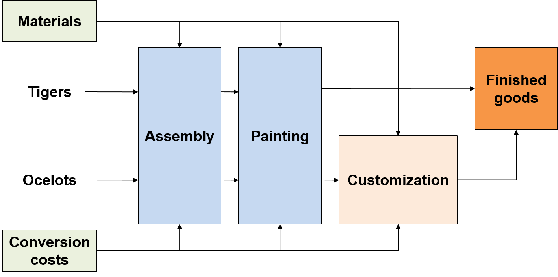
Product Costing in Operations 2
LO 8-8
Operations—St. Ignace Sports Company
Access the text alternative for these images

Slide 36
End of Chapter 8

Slide 37
Accessibility Content: Text Alternatives for Images

Slide 38
Comparison of Cost Flows Text Alternative
Job Costing: Direct materials, direct labor, and factory overhead flow into Job 121, Job 122, and Job 123. From these jobs the output is finished goods, which are accounted for by cost of goods sold.
Process Costing: In addition to direct materials, direct labor, and factory overhead flow into Process A, Process B, and Process C, Process A flows into Process B, which flows into Process C. The output from Process C is finished goods, which are accounted for by cost of goods sold.
Return to slide containing original image

Slide 39
Determining Equivalent Units 2 Text Alternative
Three cylinders are shaded to represent what proportion of it is filled. The first cylinder is filled 30 percent. The second cylinder is filled 75 percent. The third cylinder is filled 90 percent.
Return to slide containing original image

Slide 40
Using Product Costing in a Process Industry 2 Text Alternative
The diagram contains four boxes. The first three boxes are surrounded by a dashed line and represent the production process. 1. Shredding Department; 2. Pressing Department; 3. Pasteurization and Packaging Department; The process flows from one box to the next, ending with the fourth box: Warehouse.
Return to slide containing original image

Slide 41
Product Costing in Operations 2 Text Alternative
Two products are being produced: Tigers and Ocelots. The center part of the diagram contains three boxes that represent production activities: Assembly, Painting, and Customization. Lines and arrows flow from Assembly to Painting, and from Painting to either Customization or to Finished Goods. An arrow flows from Customization to Finished Goods as well. To the left, two smaller boxes indicate the inputs into the production process: Materials and Conversion costs. Lines and arrows indicate inputs flow from these two boxes into each of the three production boxes.
Return to slide containing original image

