Slide 1
Fundamentals of Cost Accounting
Sixth Edition
William Lanen
Shannon Anderson
Michael Maher
©2020 McGraw-Hill Education. All rights reserved. Authorized only for instructor use in the classroom. No reproduction or further distribution permitted without the prior written consent of McGraw-Hill Education.

Slide 2
Chapter 9
Activity-Based Costing

Slide 3
Learning Objectives
LO 9-1 Understand the potential effects of using reported
product costs for decision making.
LO 9-2 Explain how a two-stage product costing system works.
LO 9-3 Compare and contrast plantwide and department
allocation methods.
LO 9-4 Explain how activity-based costing and a two-stage product
costing system are related.
LO 9-5 Compute product costs using activity-based costing.
LO 9-6 Compare activity-based product costing to traditional
department product costing methods.
LO 9-7 Demonstrate the flow of costs through accounts using
activity-based costing.
LO 9-8 Apply activity-based costing to marketing and administrative
services.
LO 9-9 Explain how time-driven activity-based costing works.

Slide 4
Product Costs and Decision Making 1
LO 9-1
LO 9-1 Understand the potential effects of using reported product costs for decision making.
 | S-72s | S-66s | Total
Units produced | 80 | 240 | 320
Direct labor-hours | 2,400 | 3,900 | 6,300
Costs:
Direct materials | $ 40,000 | $ 36,000 | $ 76,000
Direct labor | 72,000 | 78,000 | 150,000
Manufacturing overhead (@ $40 per DLH) | 96,000 | 156,000 | 252,000
Total | $208,000 | $270,000 | $478,000
Cost per unit | $ 2,600 | $ 1,125
Sandia Custom Furniture is considering dropping S-72s.

Slide 5
Product Costs and Decision Making 2
LO 9-1
The accountant estimated that overhead will be $163,800.
 | Original | S-66s only
Manufacturing overhead:
Utilities | $ 3,360 | $ 2,100
Supplies | 3,500 | 2,240
Training | 42,000 | 26,520
Supervision | 76,860 | 76,860
Machine depreciation | 41,370 | 41,370
Plant depreciation | 56,070 | 56,070
Miscellaneous | 28,840 | 28,840
Total overhead | $252,000 | $234,000

Slide 6
Product Costs and Decision Making 3
LO 9-1
 | Original | S-66s only
Direct materials | $ 76,000 | $ 36,000
Direct labor | 150,000 | 78,000
Manufacturing overhead | 252,000 | 234,000
Total costs | $478,000 | $348,000
Burden rate |  | $60
Unit cost |  | $1,450
The cost per unit for the S-66’s will increase from $1,125 to $1,450.

Slide 7
The Death Spiral
LO 9-1
This is a process that begins by attempting to increase price to meet reported product cost.
The process may result in demand for even fewer units.

Slide 8
Two-Stage Cost Allocation 1
LO 9-2
LO 9-2 Explain how a two-stage product costing system works.
First stage:
Allocate overhead costs to departments.
Second stage:
Allocate department overhead costs to the products or services.

Slide 9
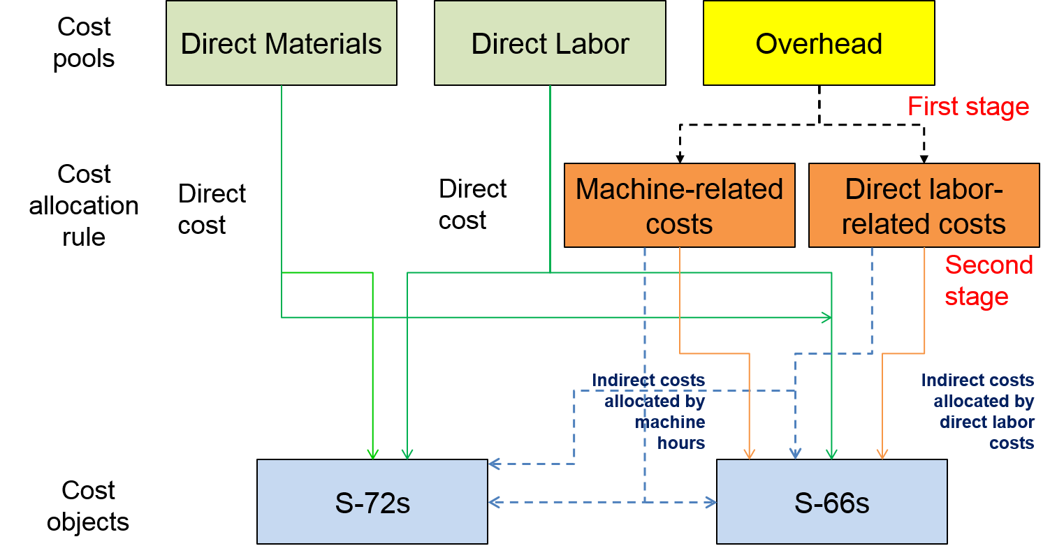
Two-Stage Cost Allocation 2
LO 9-2
Access the text alternative for these images

Slide 10
Two-Stage Cost Allocation 3
LO 9-2
Third Quarter – Production and Cost Data
 | Sport | Pro | Total
Number of units | 100,000 | 40,000 | 140,000
Machine hours—Assembly | 6,000 | 30,000 | 36,000
Direct materials | $1,500,000 | $2,400,000 | $3,900,000
Direct labor—Assembly | $ 750,000 | $ 600,000 | $1,350,000
Direct labor—Packaging | 990,000 | 360,000 | 1,350,000
Total direct labor | $1,740,000 | $ 960,000 | $2,700,000
Total direct cost | $3,240,000 | $3,360,000 | $6,600,000
Overhead costs:
Assembly |  |  | $1,620,000
Packaging |  |  | 810,000
Total overhead |  |  | $2,430,000
Total costs |  |  | $9,030,000
The cost system allocates manufacturing overhead to products based on direct labor costs.

Slide 11
Two-Stage Cost Allocation 4
LO 9-2
Third Quarter – Unit Cost Report – One allocation rate
 | Sport | Pro
Units produced | 100,000 | 40,000
Direct material | $ 15.00 | $ 60.00
Direct labor:
Assembly | $ 7.50 | $ 15.00
Packaging | 9.90 | 9.00
Total direct labor | $ 17.40 | $ 24.00
Direct cost | $ 32.40 | $ 84.00
Applied overhead (@ 90% of direct labor costs) | 15.66 | 21.60
 | $ 48.06 | $105.60
$2,430,000 ÷ $2,700,000 = 90% (Total overhead ÷ Total direct labor costs)

Slide 12
Two-Stage Cost Allocation 5
LO 9-2
Third Quarter – Unit Cost Report –Two Stage Allocation
 | Sport | Pro
Units produced | 100,000 | 40,000
Direct material | $ 15.00 | $ 60.00
Direct labor:
Assembly | $ 7.50 | $ 15.00
Packaging | 9.90 | 9.00
Total direct labor | $ 17.40 | $ 24.00
Direct cost | $ 32.40 | $ 84.00
Applied overhead:
Assembly @ $45/machine hour | $ 2.70 | $ 33.75
Packaging @ 60% of direct labor cost | 5.94 | 5.40
Total overhead | $ 8.64 | $ 39.15
Unit costs | $ 41.04 | $123.15

Slide 13
Plantwide versus Department-Specific Rates 1
LO 9-3
LO 9-3 Compare and contrast plantwide and department allocation methods.
Plantwide Allocation Method
All overhead costs are recorded in one cost pool and applied to products using one overhead allocation rate for the entire plant.
One set of rates to allocate overhead for products for all departments.

Slide 14
Plantwide versus Department-Specific Rates 2
LO 9-2
Department Allocation Method
Overhead costs are traced to separate
departments and applied to products
using a department allocation rate.
One cost pool for each department

Slide 15
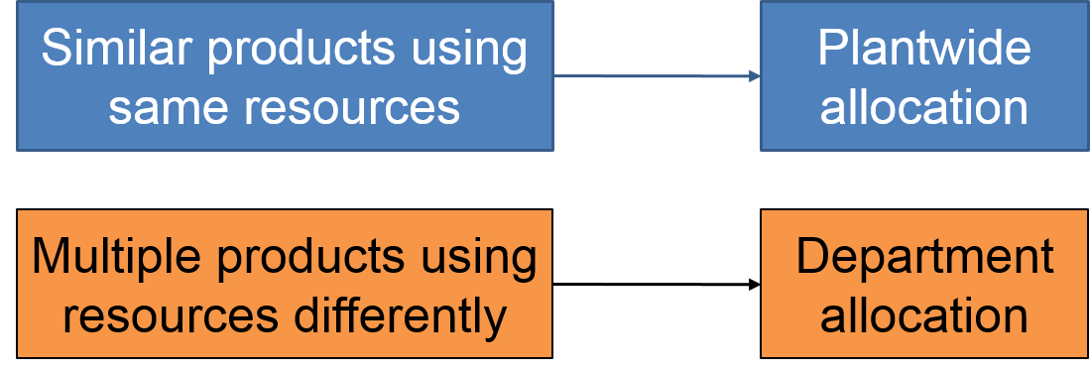
Choice of Allocation Methods
LO 9-3
Which cost application method is appropriate?

Slide 16
Activity-Based Costing (ABC) 1
LO 9-4
LO 9-4 Explain how activity-based costing and
a two-stage product system are related.
ABC is a costing method that first assigns costs to activities and then assigns them to products based on the products’ consumption of activities.
Stage 1:
Assign costs to activities.
Stage 2:
Assign costs to products based on the use of each activity

Slide 17
Activity-Based Costing (ABC) 2
LO 9-4
Why ABC?
Products
consume
activities
Activities
consume
resources

Slide 18
Developing Activity-Based Costs
LO 9-4
Step 1: Identify the activities that consume resources
and assign costs to them.
Step 2: Identify the cost driver(s) associated with
each activity.
Step 3: Compute a cost rate per cost driver unit
or transaction.
Step 4: Assign costs to products by multiplying the
cost driver rate by the volume of cost driver
units consumed by the product.

Slide 19
Identifying Activities that Use Resources
LO 9-4
Cost drivers are factors that cause, or “drive,”
an activity’s costs.
Identified Activity
Setting up machines Handling material Machining Packaging and shipping
Identified Cost Driver
?

Slide 20
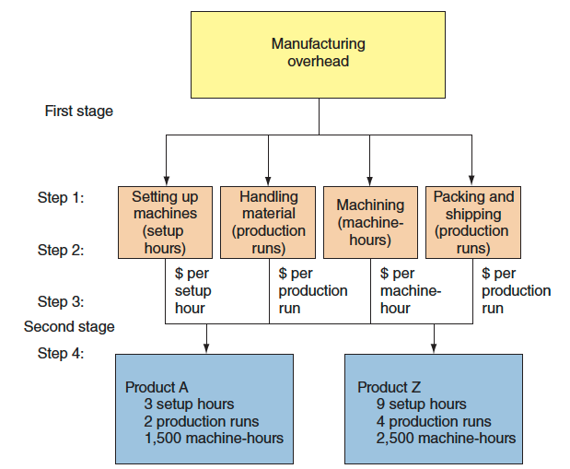
ABC Cost Flow Diagram
LO 9-4
Access the text alternative for these images

Slide 21
Cost Hierarchies 1
LO 9-4
This is the classification of cost drivers into general
levels of activity; volume, batch, product, and so on.
Hierarchy Level
Cost Example
Cost Driver Example

Slide 22
Cost Hierarchies 2
LO 9-4
This is the classification of cost drivers into general
levels of activity; volume, batch, product, and so on.
Hierarchy Level
Volume related
Cost Example
Supplies Lubricating oil Machine repair
Cost Driver Example
Direct labor cost Machine-hours Number of units

Slide 23
Cost Hierarchies 3
LO 9-4
This is the classification of cost drivers into general
levels of activity; volume, batch, product, and so on.
Hierarchy Level
Volume related
Batch related
Cost Example
Supplies Lubricating oil Machine repair
Setup costs Material handling Shipping costs
Cost Driver Example
Direct labor cost Machine-hours Number of units
Setup hours Production runs Number of shipments

Slide 24
Cost Hierarchies 4
LO 9-4
This is the classification of cost drivers into general
levels of activity; volume, batch, product, and so on.
Hierarchy Level
Volume related
Batch related
Product related
Cost Example
Supplies Lubricating oil Machine repair
Setup costs Material handling Shipping costs
Compliance costs Design and specification costs
Cost Driver Example
Direct labor cost Machine-hours Number of units
Setup hours Production runs Number of shipments
Number of products

Slide 25
Cost Hierarchies 5
LO 9-4
The cost hierarchy in any ABC system depends on the cost category and its cost driver.
Hierarchy Level
Volume related
Batch related
Product related
Facility related
Cost Example
Supplies Lubricating oil Machine repair
Setup costs Material handling Shipping costs
Compliance costs Design and specification costs
General plant costs Plant admin. costs
Cost Driver Example
Direct labor cost Machine-hours Number of units
Setup hours Production runs Number of shipments
Number of products
Direct costs Value added

Slide 26
ABC Illustrated
LO 9-5
LO 9-5 Compute product costs using activity-based costing.
Third Quarter – Production and Cost Data
 | Sport | Pro | Total
Number of units | 100,000 | 40,000 | 140,000
Machine hours – Assembly | 6,000 | 30,000 | 36,000
Direct materials | $1,500,000 | $2,400,000 | $3,900,000
Direct labor – Assembly | $ 750,000 | $ 600,000 | $1,350,000
Direct labor – Packaging | 990,000 | 360,000 | 1,350,000
Total direct labor | $1,740,000 | $ 960,000 | $2,700,000
Total direct cost | $3,240,000 | $3,360,000 | $6,600,000
Overhead costs:
Assembly |  |  | $1,620,000
Packaging |  |  | 810,000
Total overhead |  |  | $2,430,000
Total costs |  |  | $9,030,000

Slide 27
ABC Illustrated
Step 1: Identify the Activities
LO 9-5
Assembly Department
Setting up machines Handling material Product assembly
Packaging Department
Inspection Packing Shipping

Slide 28
ABC Illustrated
Step 2: Identify the Cost Drivers
LO 9-5
Cost Driver Volume
Activity | Cost Driver | Sport | Pro | Total
Assembly building:
Assembling | Machine-hours | 6,000 | 30,000 | 36,000
Setting up machines | Setup hours | 40 | 400 | 440
Handling material | Production runs | 8 | 40 | 48
Packaging building:
Inspecting and packing | Direct labor hours | 60,000 | 22,800 | 82,800
Shipping | No. of shipments | 100 | 200 | 300

Slide 29
ABC Illustrated Step 3: Compute the Cost Driver Rates
LO 9-5
Building and Activity | Overhead Cost | Cost Driver Volume | Cost Driver Rate
Assembly building:
Assembling | $1,080,000 | ÷ 36,000 machine hour = | $ 30/machine hour
Setting up machines | 396,000 | ÷ 440 hours = | $ 900/setup hour
Handling material | 144,000 | ÷ 48 runs = | $3,000/run
Total assembly overhead | $1,620,000
Packaging building:
Inspecting and packing | $ 414,000 | ÷82,800 direct labor hr = | $ 5/direct labor hour
Shipping | 396,000 | ÷ 300 shipments = | $ 1,320/shipment
Total packaging overhead | $ 810,000
Total overhead | $2,430,000

Slide 30
ABC Illustrated
Step 4: Assign Costs Using ABC
LO 9-5
Overhead | Sport | Pro
Assembly building:
Assembling @ $30/machine hour | $180,000 | $ 900,000
Machine setup @ $900/setup hour | 36,000 | 360,000
Handling material @ $3,000/run | 24,000 | 120,000
Packaging building:
Inspection and packaging @ $5/direct labor hour | 300,000 | 114,000
Shipping @ $1,320/ shipment | 132,000 | 264,000
Total ABC overhead | $672,000 | $1,758,000

Slide 31
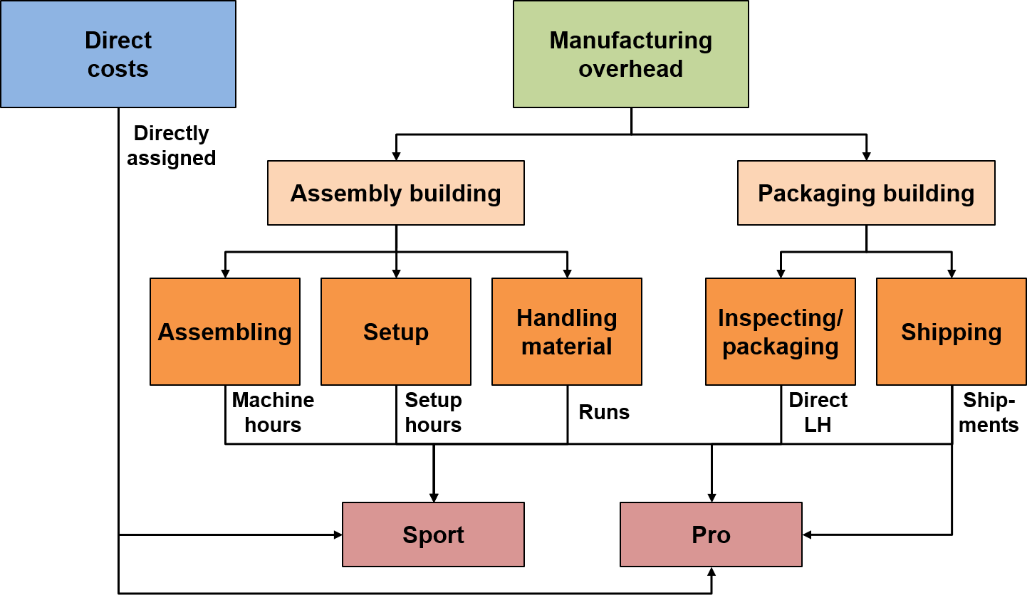
Cost Flow Diagram – ABC System
LO 9-5
Access the text alternative for these images

Slide 32
Activity Based Costing – Illustrated
LO 9-5
 | Sport | Pro
Direct material | $1,500,000 | $2,400,000
Direct labor:
Assembly | $ 750,000 | $ 600,000
Packaging | 990,000 | 360,000
Total direct labor | $ 1,740,000 | $ 960,000
Direct costs | $ 3,240,000 | $ 3,360,000
Overhead:
Assembly building:
Assembling @ $30 per machine hour | $ 180,000 | $ 900,000
Machine setup @ $900 per setup hour | 36,000 | 360,000
Handling material @ $3,000 per run | 24,000 | 120,000
Package building:
Inspecting and packing @ $5 per direct labor hour | 300,000 | 114,000
Shipping @ $1,320 per shipment | 132,000 | 264,000
Total ABC overhead | $ 672,000 | $ 1,758,000
Total ABC cost | $ 3,912,000 | $ 5,118,000
Number of units | 100,000 | 40,000
Unit cost | $ 39.12 | $ 127.95

Slide 33
Unit Costs Compared
LO 9-6
LO 9-6 Compare activity-based product costing to
traditional department product costing methods.
Comparison of Reported Unit Product Costs
 | Sport | Pro
Plantwide rate | $48.06 | $105.60
Department (building) rate | $41.04 | $123.15
Activity-based costing | $39.12 | $127.95

Slide 34
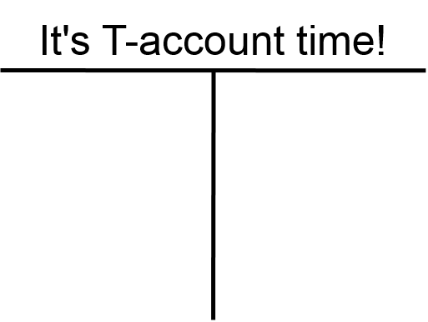
Cost Flows through Accounts
LO 9-7
LO 9-7 Demonstrate the flow of costs through
accounts using activity-based costing.
Let’s see ABC cost flow for the Assembly Department.

Slide 35
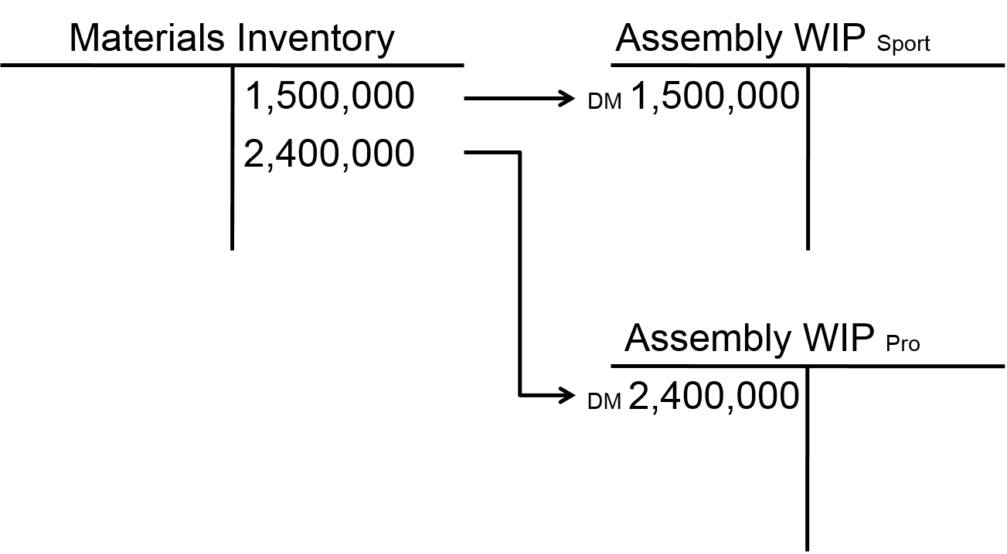
Direct Materials Costs
LO 9-7
Access the text alternative for these images

Slide 36
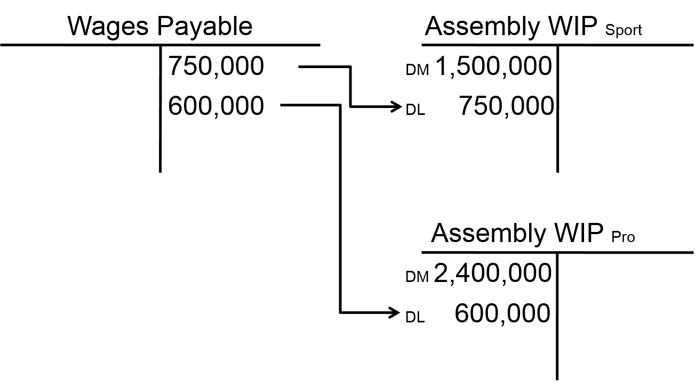
Direct Labor Costs
LO 9-7
Access the text alternative for these images

Slide 37
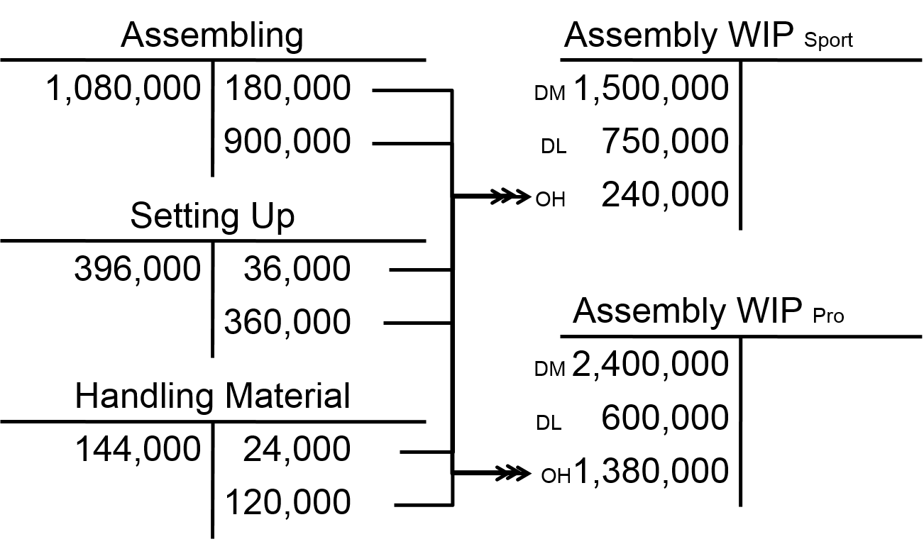
Overhead Costs
LO 9-7
Access the text alternative for these images

Slide 38
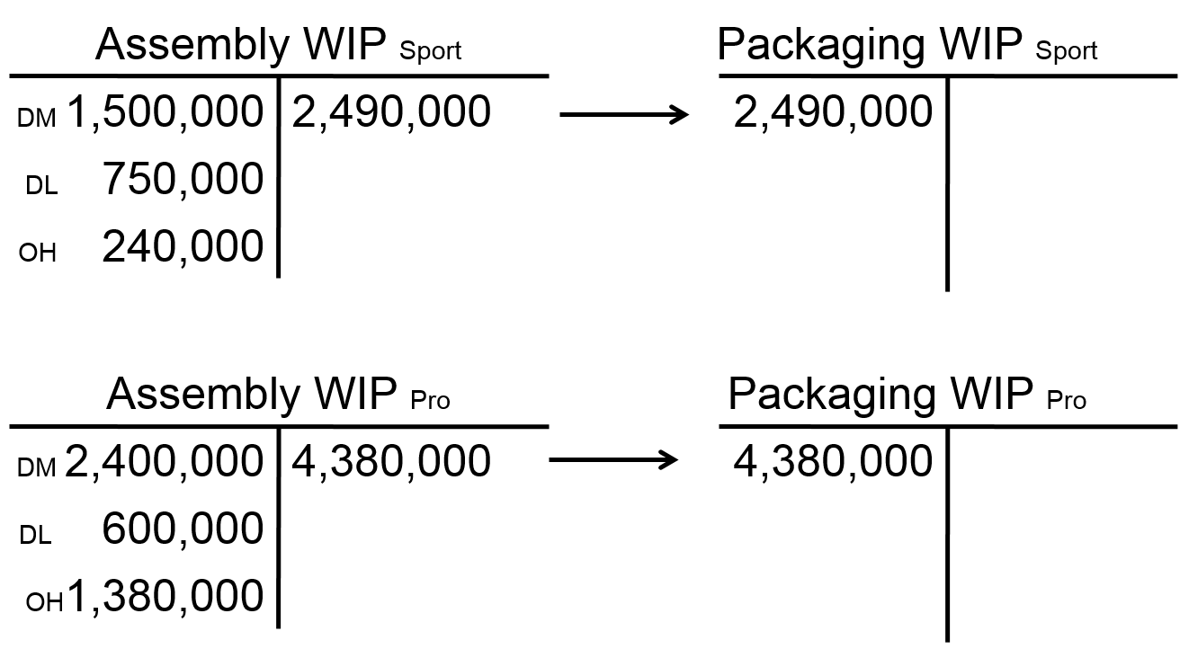
Transfer from Assembly to Packaging
LO 9-7
Access the text alternative for these images

Slide 39
ABC Costing in Administration
LO 9-8
LO 9-8 Apply activity-based costing to marketing
and administrative services.
The same four-step process:
Step 1: Identify the activities that consume resources.
Step 2: Identify the cost driver associated with each activity.
Step 3: Compute a cost rate per cost driver for each unit
or transaction.
Step 4: Assign costs to the marketing or administration
activity by multiplying the cost driver rate by the
volume of cost driver units consumed for that activity.

Slide 40
Time-Driven Activity-Based Costing 1
LO 9-9
LO 9-9 Explain how time-driven activity-based costing works.
Why might a company NOT
use ABC?
Costs may exceed benefits of ABC, especially if the ABC
system is maintained and updated to reflect current activities.
If not maintained, there is a danger that the products costs
ABC produces may be worse than those provided by a
simpler traditional system.

Slide 41
Time-Driven Activity-Based Costing 2
LO 9-9
A modified approach to ABC is called
time-driven activity-based costing, or TDABC.
With TDABC, a manager needs to determine:
The cost of the resources supplied
to a department
2) The time it takes to complete the
various activities of the department

Slide 42
End of Chapter 9

Slide 43
Accessibility Content: Text Alternatives for Images

Slide 44
Two-Stage Cost Allocation 2 Text Alternative
Across the top is a large box labeled manufacturing overhead. A line descends from this box and divides into two, each pointing to two boxes in the next row: Department 1: for example, fabrication, and Department 2: for example, assembly. A dashed line from each of these boxes descends to the large box in the third row labeled Products. At the second stage of cost allocation: Department 1 uses Cost driver 1, which is machine-hours and Department 2 uses Cost driver 2, which is labor-hours or labor costs.
Return to slide containing original image

Slide 45
ABC Cost Flow Diagram Text Alternative
Across the top is a large box labeled manufacturing overhead. From a line descends and divides into four to enter four boxes in the second row. The first stage of allocation includes three steps. In Step 1 and Step 2, the activities and cost drivers for the activity are identified in the four boxes: Setting up machines (setup hours), Handling materials (production runs), Machining (machine-hours), and Packing and shipping (production runs). Step 3 computes a dollar cost rate per cost driver unit. A line from each of the boxes in the second row descends and joins together to enter each of two boxes in the third row: Product A and Product Z. At this second stage, the actual volume for each of the cost drivers for each product is identified. Product A: 3 setup hours, 2 production runs, 1,500 machine-hours and Product Z: 9 setup hours, 4 production runs, 2,500 machine-hours.
Return to slide containing original image

Slide 46
Cost Flow Diagram – ABC System Text Alternative
Across the top are two boxes: A small box labeled direct costs and A large box labeled manufacturing overhead. A line descends from the direct costs box and splits to enter each of two product boxes in the fourth row: Sport and Pro. A line descends from the manufacturing overhead box and divides into two, each pointing to two boxes in the second row: Assembly building and Packaging building. The third row of boxes contains five boxes, three with lines from the Assembly building box in the second row, and two with lines from the Packaging building box in the second row. The boxes below Assembly building contain the activity and the cost drivers: Assembling cameras (machine-hours), Setting up machines (setup hours), and Handling materials (runs). The boxes below Packaging building contain the activity and the cost drivers: Inspecting and packing (direct labor-hours) and Shipping (shipments). A line from each of the boxes in the third row descends and joins together to enter each of the two boxes in the fourth row: Sports and Pro.
Return to slide containing original image

Slide 47
Direct Materials Costs Text Alternative
The T account on the left is titled Materials Inventory. It has two entries in the credit column: 1.5M and 2.4M.
The upper right T account is titled Assembly WIP Sport. It has one entry in the debit column: DM 1.5M. It has an arrow pointing to it from the 1.5M figure in the Materials Inventory T account.
The lower right T account is titled Assembly WIP Pro. It has one entry in the debit column: DM 2.4M. It has an arrow pointing to it from the 2.4M figure in the Materials Inventory T account.
Return to slide containing original image

Slide 48
Direct Labor Costs Text Alternative
The T account on the left is titled Wages Payable. It has two entries in the credit column: 750k and 600k.
The upper right T account is titled Assembly WIP Sport. It has two entries in the debit column: DM 1.5M and DL 750k, the latter of which has an arrow pointing to it from the 750k figure in the Wages Payable T account.
The lower right T account is titled Assembly WIP Pro. It has two entries in the debit column: DM 2.4M and DL 600k, the latter of which has an arrow pointing to it from the 600k figure in the Wages Payable T account.
Return to slide containing original image

Slide 49
Overhead Costs Text Alternative
The upper left T account is titled Assembling. It has one debit entry — 1,080k — and two credit entries: 180k and 900k.
The middle left T account is titled Setting Up. It has one debit entry — 396k — and two credit entries: 36k and 360k.
The bottom left T account is titled Handling Material. It has one debit entry — 144k — and two credit entries: 24k and 120k.
The upper right T account is titled Assembly WIP Sport and has three debit entries: DM 1.5M, DL 750k, and OH 240k.
The last of these is fed into from each of the credit entries in the left side T accounts.
The lower right T account is titled Assembly WIP Pro and has three debit entries: DM 2.4M, DL 600k, and OH 1,380k.
The last of these is fed into from each of the credit entries in the left side T accounts.
Return to slide containing original image

Slide 50
Transfer from Assembly to Packaging Text Alternative
The upper left T account is titled Assembly WIP Sport and has three debit entries: DM 1.5M, DL 750k, and OH 240k. It also has one credit entry: 2.490k.
The lower left T account is titled Assembly WIP Pro and has three debit entries: DM 2.4M, DL 600k, and OH 1,380k. It also has one credit entry: 4,380k.
The upper right T account is titled Packaging WIP Sport and has one debit entry: 2,490k. The identical figure from the Assembly WIP Sport T account points to this one.
The lower right T account is titled Packaging WIP Pro and has one debit entry: 4,380k. The identical figure from the Assembly WIP Pro T account points to this one.
Return to slide containing original image

