Slide 1
Fundamentals of Cost Accounting
Sixth Edition
William Lanen
Shannon Anderson
Michael Maher
©2020 McGraw-Hill Education. All rights reserved. Authorized only for instructor use in the classroom. No reproduction or further distribution permitted without the prior written consent of McGraw-Hill Education.

Slide 2
Chapter 11
Service Department and Joint Cost Allocation

Slide 3
Learning Objectives
LO 11-1 Explain why service costs are allocated.
LO 11-2 Allocate service department costs using the direct method.
LO 11-3 Allocate service department costs using the step method.
LO 11-4 Allocate service department costs using the reciprocal method.
LO 11-5 Use the reciprocal approach for outsourcing decisions.
LO 11-6 Explain why joint costs are allocated.
LO 11-7 Allocate joint costs using the net realizable value method.
LO 11-8 Allocate joint costs using the physical quantities method.
LO 11-9 Explain how cost data are used in the sell-or-process-further
decision.
LO 11-10 Account for by-products.
LO 11-11 (Appendix) Use spreadsheets to solve reciprocal cost
allocation problems.

Slide 4
Service Department Cost Allocation 1
LO 11-1
LO 11-1 Explain why service costs are allocated.
Service departments provide services to other departments. For example, an information systems department is a service department that provides information systems support to other departments, and a human resources department provides hiring and training services to other departments.
User departments use the functions of service departments. For example, the production department uses the services provided by the information systems and human resources departments. User departments could be other service departments or production or marketing departments that produce or market the organization’s products.

Slide 5
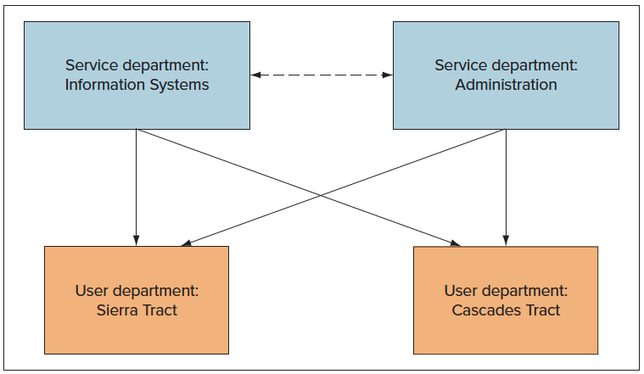
Service Department Cost Allocation 2
LO 11-1
Service and User Departments – Green Valley Mills
Access the text alternative for these images

Slide 6
Service Department Cost Allocation 3
LO 11-1
Basic Data for Service Department Cost Allocation –
Green Valley Mills
 | A | B | C | D | E
1 |  |  |  | Service Department
2 |  | Information Systems (S1) |  | Administration (S2)
3 |  | Usage | Percent | Usage | Percent
4 | Departments | (hours) | of Total | (employees) | of Total
5 | Administration | 100,000 | 50% | −0− | 0%
6 | Information Systems | −0− | 0 | 2,000 | 20
7 | Sierra Tract (P1) | 20,000 | 10 | 5,000 | 50
8 | Cascades Tract (P2) | 80,000 | 40 | 3,000 | 30
9 | Total | 200,000 | 100% | 10,000 | 100%
10
Departmental Costs $800,000
Departmental Costs $800,000

Slide 7
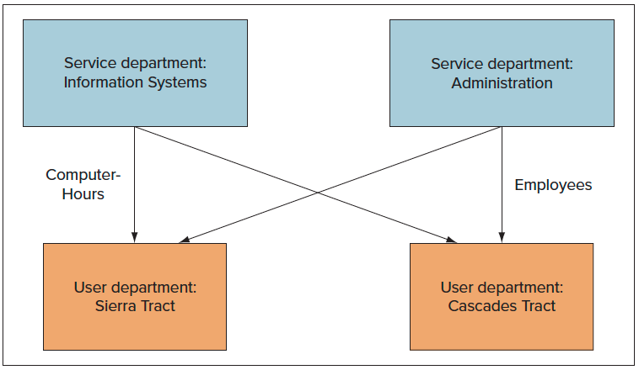
Cost Allocation: Direct Method 1
LO 11-2
LO 11-2 Allocate service department costs using the direct method.
Direct method:
Charges costs of service departments to user departments without making allocations among service departments
Access the text alternative for these images

Slide 8
Cost Allocation: Direct Method 2
LO 11-2
Basic Information of Direct Method Allocation: Green Valley Mills
 | A | B | C | D | E
1 |  |  |  | Service Department
2 |  | Information Systems (S1) |  | Administration (S2)
3 |  | Usage | Percent | Usage | Percent
4 | Departments | (hours) | of Total | (employees) | of Total
5 | Administration | 100,000 | 50% | −0− | 0%
6 | Information Systems | −0− | 0 | 2,000 | 20
7 | Sierra Tract (P1) | 20,000 | 10 | 5,000 | 50
8 | Cascades Tract (P2) | 80,000 | 40 | 3,000 | 30
9 | Total | 200,000 | 100% | 10,000 | 100%
10

Slide 9
Cost Allocation: Direct Method 3
LO 11-2
12 | Direct Method: |  |  | Percent Allocable to
14 |  | Department |  | Sierra Tract |  | Cascades Tract
15 |  | Direct Cost |  | (P1) |  | (P2)
16 | Service Department
17 | Information Systems (S1) | $ 800,000 | 20.0% | =(B7/(B7+B8)] | 80.0% | =(B8/(B7+B8)]
 | Administration (S2) | 5,000,000 | 20.0% | =(D7/(D7+D8)] | 37.5% | =[D8/(D7+D8)]
19
20 |  |  |  | Amount Allocable to
21 |  |  |  | Sierra Tract |  | Cascades Tract
22 |  |  |  | (P1) |  | (P2)
23 | Service Department
24 | Information Systems (S1) | $ 800,000 | $ 160,000 | =(B24*C16) | $ 640,000 | =(B24*E16)
25 | Administration (S2) | 5,000,000 | 3,125,000 | =(B25*C17) | 1,875,000 | =(B25*E17)
26 |  | $5,800,000 | $3,285,000 |  | $ 2,515,000
ª 20.0% = 20,000 hours ÷ (20,000 hours + 80,000 hours)
^{b} 62.5% = 5,000 employees ÷ (5,000 employees + 3,000 employees)
^{c} $160,000 = 20% × $800,000
^{d} $3,125,000 = 62.5% × $5,000,000

Slide 10
Cost Allocation: Step Method 1
LO 11-3
LO 11-3 Allocate service department costs using the step method.
The step method allocates some service
department costs to other service departments.
Once an allocation is made from a service
department no further allocations are made
back to that service department.
Generally, allocate in order of proportion of
services provided to other service departments.

Slide 11
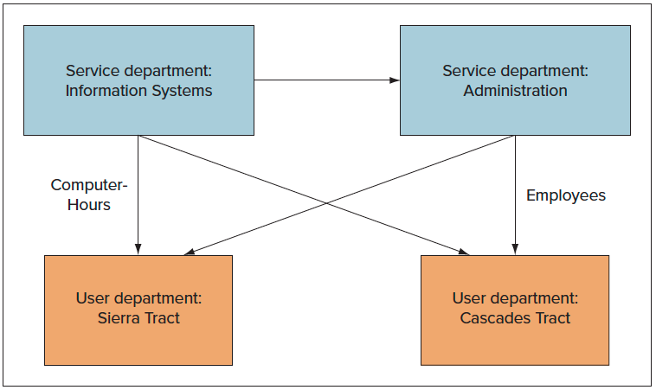
Cost Allocation: Step Method 2
LO 11-3
Cost Flow Diagram: Step Method – Green Valley Mills
Access the text alternative for these images

Slide 12
Cost Allocation: Step Method 3
LO 11-3
Service Department Cost Allocation
Percent Applicable to
 | Direct Cost | (S1) | (S2) | (P1) | (P2) | Total
Service Dept.:
(S1) | $ 800,000 | 0.0% | 50.0%ª | 10.0%^{b} | 40.0%^{c} | 100.0%
(S2) | 5,000,000 | 0.0% | 0.0% | 62.5%^{d} | 37.5%^{e} | 100.0%
ª 50.0% = 100,000 hours ÷ (100,000 hours + 20,000 hours + 80,000 hours)
^{b} 10.0% = 20,000 hours ÷ (100,000 hours + 20,000 hours + 80,000 hours)
^{c} 40.0% = 80,000 hours ÷ (100,000 hours + 20,000 hours + 80,000 hours)
^{d} 62.5% = 5,000 employees ÷ (5,000 employees + 3,000 employees)
^{e} 37.5% = 3,000 employees ÷ (5,000 employees + 3,000 employees)

Slide 13
Cost Allocation: Step Method 4
LO 11-3
Service Department Cost Allocation
To
From | (S1) | (S2) | (P1) | (P2) | Total
Dept. costs | $800,000 | $5,000,000 | $ −0− | $ −0− | $5,800,000^{k}
(S1) | (800,000) | 400,000^{f} | 80,000^{g} | 320,000^{h}
(S2) | −0− | (5,400,000) | 3,375,000^{i} | 2,025,000^{j}
 | $ −0− | $ −0− | $3,455,000 | $2,345,000 | $5,800,000^{k}
^{f} 50.0% × $800,000
^{g} 10.0% × $800,000
^{h} 40.0% × $800,000
^{I} 62.5% × $5,400,000
^{j} 37.5% × $5,400,000
^{k} $5,800,000 of service department costs were
ultimately allocated to production departments.

Slide 14
Cost Allocation: Reciprocal Method 1
LO 11-4
LO 11-4 Allocate service department costs using the reciprocal method.
The reciprocal method recognizes all services
provided by any service department, including services provided to other service departments.
It accounts for cost flows among service
departments providing services to each other.
It requires a simultaneous equation solution.

Slide 15
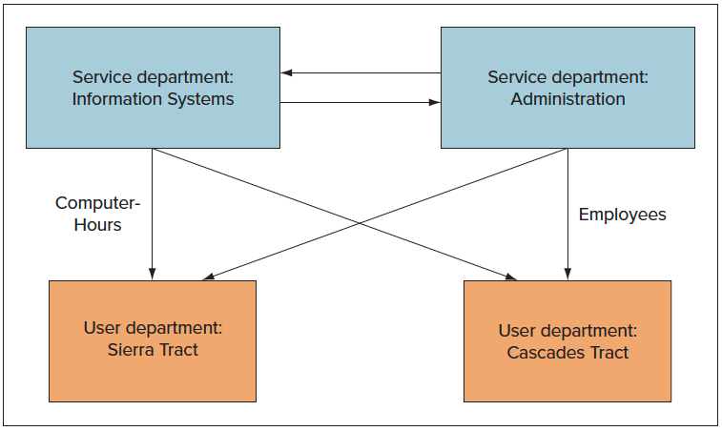
Cost Allocation: Reciprocal Method 2
LO 11-4
Cost Flow Diagram: Reciprocal Method – Green Valley Mills
Access the text alternative for these images

Slide 16
Cost Allocation: Reciprocal Method 3
LO 11-4
Write the costs of each service department
in equation form.
Total Service Department costs | = | Direct costs of the Service Department | + | Costs allocated to the Service Department
Solve equations simultaneously using matrix algebra.

Slide 17
Cost Allocation: Reciprocal Method 4
LO 11-4
Total Service Department costs | = | Direct costs of the Service Department | + | Costs allocated to the Service Department
S1 | = | $ 800,000 | + | 0.20 S2
S2 | = | $5,000,000 | + | 0.50 S1
Substituting the first equation into the second yields:
S2 = $5,000,000 + 0.50($800,000 + 0.20 S2)
S2 = $5,000,000 + $400,000 + 0.10 S2
0.9 S2 = $5,400,000 S2 = $6,000,000
Substituting the value of S2 back into the first equation gives:
S1 = $800,000 + 0.20($6,000,000)
S1 = $2,000,000

Slide 18
Cost Allocation: Reciprocal Method 5
LO 11-4
Service Department Cost Allocation
Percent Applicable to
 | Total Cost | (S1) | (S2) | (P1) | (P2) | Total
Service Dept.:
(S1) | $2,000,000 | 0.0% | 50.0%ª | 10.0%^{b} | 40.0%^{c} | 100.0%
(S2) | 6,000,000 | 20.0%^{d} | 0.0% | 50.0%^{e} | 30.0%^{f} | 100.0%
ª 50.0% = 100,000 hours ÷ (100,000 hours + 20,000 hours + 80,000 hours)
^{b} 10.0% = 20,000 hours ÷ (100,000 hours + 20,000 hours + 80,000 hours)
^{c} 40.0% = 80,000 hours ÷ (100,000 hours + 20,000 hours + 80,000 hours)
^{d} 20.0% = 2,000 employees ÷ (2,000 employees + 5,000 employees + 3,000 employees)
^{e} 50.0% = 5,000 employees ÷ (2,000 employees + 5,000 employees + 3,000 employees)
^{f} 30.0% = 3,000 employees ÷ (2,000 employees + 5,000 employees + 3,000 employees)

Slide 19
Cost Allocation: Reciprocal Method 6
LO 11-4
Service Department Cost Allocation
To
From | (S1) | (S2) | (P1) | (P2) | Total
Direct costs | $ 800,000 | $5,000,000 | $ −0− | $ −0− | $5,800,000^{i}
(S1) | (2,000,000)ª | 1,000,000^{b} | 200,000^{c} | 800,000^{d}
(S2) | 1,200,000e | (6,000,000)^{f} | 3,000,000^{g} | 1,800,000^{h}
 | $ −0− | $ −0− | $3,200,000 | $2,600,000 | $5,800,000^{i}
ª Total costs of S1
^{b} Costs allocated from S1 (50% × $2,000,000)
^{c} 10.0% × $2,000,000
^{d} 40.0% × $2,000,000
^{e} Costs allocated from S2 (20% × $6,000,000)
^{f} Total costs of S2
^{g} 50% × $6,000,000
^{h} 30% × $6,000,000
^{I} $5,800,000 of service department costs were ultimately
allocated to production departments.

Slide 20
Cost Allocation: Reciprocal Method 7
LO 11-4
Comparison of Direct, Step, and Reciprocal Methods
Method | Sierra | Cascades | Total
Direct | $3,285,000 | $2,515,000 | $5,800,000
Step | 3,455,000 | 2,345,000 | 5,800,000
Reciprocal | 3,200,000 | 2,600,000 | 5,800,000

Slide 21
The Reciprocal Method and Decision Making 1
LO 11-5
LO 11-5 Use the reciprocal approach for outsourcing decisions.
Suppose that the variable cost in Information Services (S1) is $200,000 (out of the total of $800,000) and the variable cost in Administration (S2) is $3,500,000 (out of $5,000,000).
Let's repeat the reciprocal cost analysis substituting the variable costs from the total costs.

Slide 22
The Reciprocal Method and Decision Making 2
LO 11-5
Total Service Department costs | = | Direct costs of the Service Department | + | Costs allocated to the Service Department
S1 | = | $ 200,000 | + | 0.20 S2
S2 | = | $3,500,000 | + | 0.50 S1
Substituting the first equation into the second yields:
S2 = $3,500,000 + 0.50($200,000 + 0.20 S2)
S2 = $3,500,000 + $100,000 + 0.10 S2
0.9 S2 = $3,600,000 S2 = $4,000,000
Substituting the value of S2 back into the first equation gives:
S1 = $200,000 + 0.20($4,000,000)
S1 = $1,000,000

Slide 23
The Reciprocal Method and Decision Making 3
LO 11-5
The total variable cost of Information Services, when you consider the use of Administration by Information Services is $1,000,000.
The total cost savings that would come from eliminating Information Services are the $1,000,000 variable costs plus any avoidable fixed costs.

Slide 24
Allocation of Joint Costs 1
LO 11-6
LO 11-6 Explain why joint costs are allocated.
Joint cost is the cost of a manufacturing process with two or more outputs.
Joint Products:
Outputs from a common input and common production process
Split-Off point:
Stage of processing that separates two or more products

Slide 25
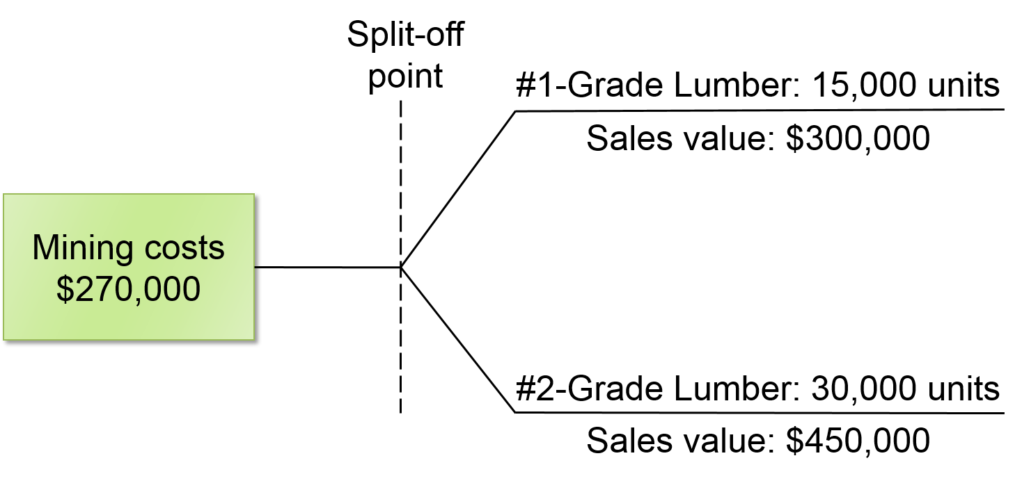
Allocation of Joint Costs 2
LO 11-6
Access the text alternative for these images

Slide 26
Allocation of Joint Costs 3
LO 11-6
Why allocate joint costs?
Evaluating executive performance
Determining the inventory value
How should joints costs be allocated?
Net realizable value method
Physical quantities method

Slide 27
Joint Cost Allocation Methods
LO 11-7
LO 11-7 Allocate joint costs using the net realizable value method.
Net realizable value method:
Joint cost allocation based on the proportional values of the products at the split-off point.
Net realizable value (NRV):
Sales value of each product at the split-off point.
Estimated net realizable value:
Sales price of a final product minus additional processing costs necessary to prepare a product for sale.

Slide 28
Net Realizable Value Method 1
LO 11-7
Green Valley Mills
Joint Allocation – NRV Method
(no additional processing costs)
 | A | B | C | D
1 |  | #1-Grade | #2-Grade | Total
2 | Final sales value | $ 300,000 | $ 450,000 | $ 750,000
3 | Less additional processing costs | 0– | –0– | –0–
4 | Net realizable value at split-off point | $ 300,000 | $ 450,000 | $ 750,000
5 | Proportionate share
6 | = $ 300,000/$ 750,000 (B4/D4) | 40%
7 | = $ 450,000/$ 750,000 (C4/D4) |  | 60%
8 | Allocated joint costs
9 | = $ 270,000 × 40% | $ 108,000
10 | = $ 270,000 × 60% |  | $ 162,000
11

Slide 29
Net Realizable Value Method 2
LO 11-7
Green Valley Mills
For the Month of March
 | A | B | C | D
1 | GREEN VALLEY MILLS
2 | For the Month of March
3 |  | #1-Grade | #2-Grade | Total
4 | Sales value | $300,000 | $450,000 | $750,000
5 | Less allocated joint costs | 108,000 | 162,000 | 270,000
6 | Gross margin | $ 192,000 | $288,000 | $480,000
7 | Gross margin as a percent of sales | 64% | 64% | 64%
8

Slide 30
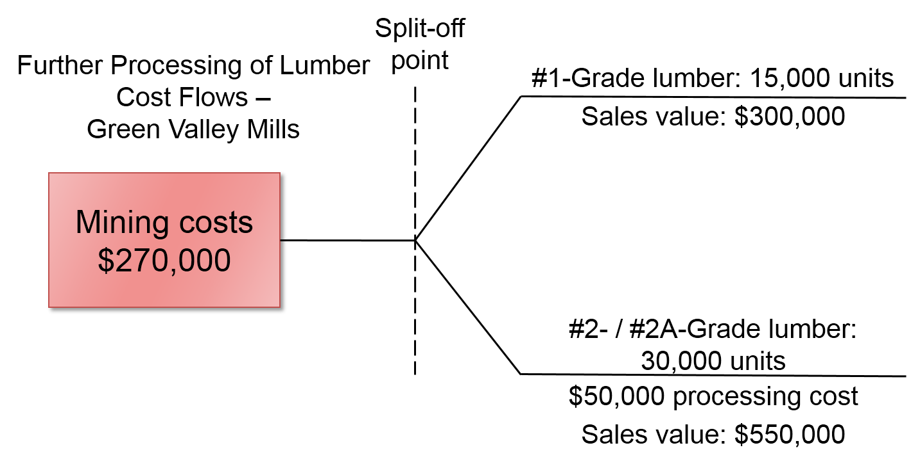
Estimating NRV 1
LO 11-7
When no sales value exists for outputs at the split-off point, the estimated NRV should be determined.
Access the text alternative for these images

Slide 31
Estimating NRV 2
LO 11-7
Green Valley Mills For the Month of March
 | A | B | C | D
1 | GREEN VALLEY MILLS
2 | For the Month of March
3 |  | #1-Grade | #2A-Grade | Total
4 | Sales value | $300,000 | $550,000 | $850,000
5 | Less additional cost to process to #2A-Grade Lumber | — | 50,000 | 50,000
6 | Estimated net realizable value at split-off | $300,000 | $500,000 | $800,000
7 | Allocation of joint costs
8 | ($ 300,000/$ 800,000) × $ 270,000 = 37.5% × $ 270,000 | 101,250 | — | 101,250
9 | ($ 500,000/$ 800,000) × $ 270,000 = 62.5% × $ 270,000 | — | 168,750 | 168,750
10 | Gross margin | $ 198,750 | $ 331,250 | $530,000
11 | Gross margin as a percent of sales | 66% | 60% | 62%
12

Slide 32
Physical Quantities Method 1
LO 11-8
LO 11-8 Allocate joint costs using the physical quantities method.
Joint cost allocation is based on measurement of the volume, weight, or other physical measure of the joint products at the split-off point.

Slide 33
Physical Quantities Method 2
LO 11-8
When to use:
Output product prices are volatile.
Significant processing occurs between the
split-off point and the first point of marketability.
Product prices are not set by the market.

Slide 34
Physical Quantities Method 3
LO 11-8
Green Valley Mills For the Month of March
 | A | B | C | D
1 | GREEN VALLEY MILLS
2 | For the Month of March
3 |  | #1-Grade | #2A-Grade | Total
4 | Quantity (Board-Feet) | 600,000 | 1,200,000 | 1,800,000
5
6 | Sales value | $ 300,000 | $ 450,000 | $ 750,000
7 | Allocation of joint costs
8 | (600,000/1,800,000) × $270,000 = 33.3% × $270,000 | 90,000 | — | 90,000
9 | (1,200,000/1,800,000) × $270,000 = 66.7% × $270,000 | — | 180,000 | 180,000
10 | Gross margin | $ 210,000 | $ 270,000 | $ 480,000
11 | Gross margin as a percent of sales | 70% | 60% | 64%
12

Slide 35
Sell or Process Further 1
LO 11-9
LO 11-9 Explain how cost data are used in the sell-or-process-further decision.
Suppose GVM can sell #2-grade lumber for $450,000 at the split-off point or process it further to make #2A-grade lumber.
#2A-grade lumber would sell for $550,000 and additional processing costs would be $50,000.
Additional revenue: | $100,000
Additional cost: | $ 50,000

Slide 36
Sell or Process Further 2
LO 11-9
Differential Analysis
Green Valley Mills
 | Sell #2-Grade Lumber | Process Further (#2A-Grade) | Additional Revenue and Costs from Processing Further
Revenues | $450,000 | $550,000 | $100,000
Less: Separate processing costs | -0- | 50,000 | 50,000
Margin | $450,000 | $500,000 | $ 50,000
Net gain from processing further

Slide 37
Deciding What to Do with By-Products
LO 11-10
LO 11-10 Account for by-products.
By-products are outputs of joint production processes that are relatively minor in quantity or value.
Accounting for by-products:
Method 1:
The net realizable value from sale of the by-products is deducted from the joint costs before allocation to the main products.
Method 2:
The proceeds from sale of the by-product are treated as other revenue.

Slide 38
By-Products – Method One
LO 11-10
Green Valley Mills
For the Month of March
 | #1-Grade | #2-Grade | Sawdust | Total
Sales value | $300,000 | $450,000 | $15,000 | $765,000
Less: Additional processing costs | -0- | -0- | -0- | -0-
Net realizable value at split-off point | $300,000 | $450,000 | $15,000 | $765,000
Deduct: Sales value of by-productª | -0- | -0- | 15,000 | 15,000
Allocated remaining joint costsª | 102,000^{b} | 153,000^{c} | -0- | 255,000
Gross margin | $198,000 | $297,000 | -0- | $495,000
Gross margin as a percent of sales | 66% | 66% | 0% | 65%
ª Joint costs adjusted for sales value of by-product (sawdust)
^{b} ($300,000 ÷ $750,000) or 40% × ($270,000 – $15,000)
^{c} ($450,000 ÷ $750,000) or 60% × ($270,000 – $15,000)

Slide 39
By-Products – Method Two
LO 11-10
Green Valley Mills
For the Month of March
 | #1-Grade | #2-Grade | Sawdust | Total
Sales value | $300,000 | $450,000 | $15,000 | $765,000
Less: Additional processing costs | -0- | -0- | -0- | -0-
Net realizable value at split-off point | $300,000 | $450,000 | $15,000 | $765,000
Allocated joint costsª | 108,000^{b} | 162,000^{c} | -0- | 270,000
Gross margin | $192,000 | $288,000 | $15,000 | $495,000
Gross margin as a percent of sales | 64% | 64% | 100% | 65%
ª Joint costs adjusted for sales value of by-product (sawdust)
^{b} ($300,000 ÷ $750,000) or 40% × $270,000
^{c} ($450,000 ÷ $750,000) or 60% × $270,000

Slide 40
Appendix: Calculation of the Reciprocal Method Using Spreadsheets 1
LO 11-11
LO 11-11 (Appendix) Use spreadsheets to solve reciprocal cost allocation problems.
For any department, we can state the equation:
Total costs = Direct costs + Allocated costs
Equations can be expressed in matrix form and solved using the matrix functions of a spreadsheet program such as Microsoft Excel®.

Slide 41
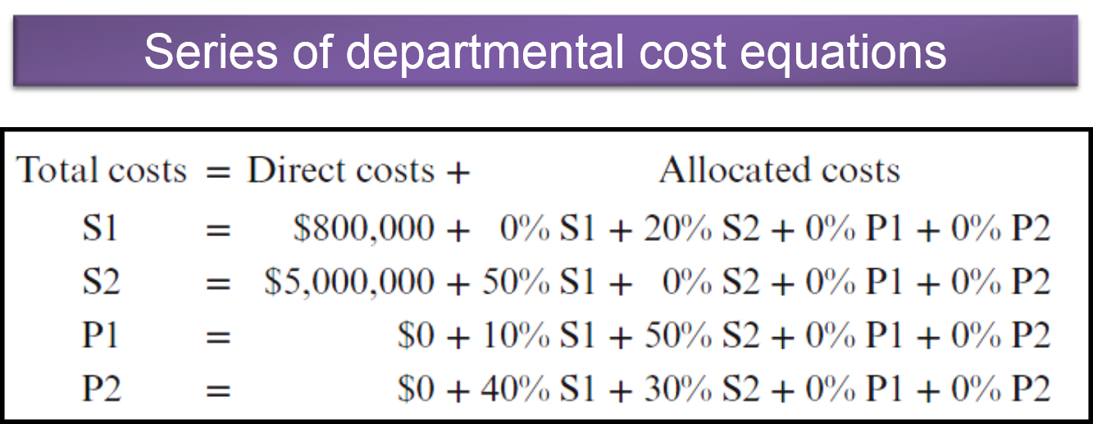
Appendix: Calculation of the Reciprocal Method Using Spreadsheets 2
LO 10-4
Access the text alternative for these images

Slide 42
Appendix: Calculation of the Reciprocal Method Using Spreadsheets 3
LO 11-11
Service Department Cost Allocation Using the Reciprocal Method: Spreadsheet Solution
 | A | B | C | D | E
1 | Panel A: Basic Data
2
3
4
5
6 |  |  |  | From Department:
7 |  | Info. Systems | Admin. | Sierra | Cascades
8 | To Department
9 | Information Systems | 100.0% | −20.0% | 0.0% | 0.0%
10 | Administration | −50.0% | 100.0% | 0.0% | 0.0%
11 | Sierra Tract | −10.0% | −50.0% | 100.0% | 0.0%
12 | Cascades Tract | −40.0% | −30.0% | 0.0% | 100.0%
13 | Total | 0.0% | 0.0% | 100.0% | 100.0%
Service Department Usage Matrix (S)
(Percentage Use)
(Positive Numbers: Provide Service – Negative Numbers: Use Service)

Slide 43
Appendix: Calculation of the Reciprocal Method Using Spreadsheets 4
LO 11-11
Service Department Cost Allocation Using the Reciprocal Method: Spreadsheet Solution
15
16 |  |  |  |  |  | Direct
17 |  |  | Inverse of Service Matrix (S-Inv) |  |  | Department |  | Allocated
18 |  |  |  |  |  | Cost |  | Cost
19 | Information Systems | 111.11% | 22.22% | 0.00% | 0.00% | $ 800,000 |  | $ 2,000,000
20 | Administration | 55.56% | 111.11% | 0.00% | 0.00% | $ 5,000,000 | = | $ 6,000,000
21 | Sierra Tract | 38.89% | 57.78% | 100.00% | 0.00% | $ 0 |  | $ 3,200,000 | ← | Reciprocal
22 | Cascades Tract | 61.11% | 42.22% | 0.00% | 100.00% | $ 0 |  | $ 2,600,000 | ← | Allocations
Panel B: Department Costs After Reciprocal Service Costs

Slide 44
Appendix: Calculation of the Reciprocal Method Using Spreadsheets 5
LO 11-11
Service Department Cost Allocation Using the Reciprocal Method: Spreadsheet Solution
25
26
27 |  | Allocation:
28
29 | Department |  | Info. Systems | Administration | Sierra | Cascades
30 | Information Systems | $ 2,000,000 | 0.00% | 50.00% | 10.00% | 40.00% | 100.00%
31 | Administration | $ 6,000,000 | 20.00% | 0.00% | 50.00% | 30.00% | 100.00%
32
33
34 | Direct Costs |  | $ 800,000 | $ 5,000,000 | $ 0 | $ 0 | $ 5,800,000
35 | Information Systems |  | ($ 2,000,000) | $ 1,000,000 | $ 200,000 | $ 800,000 | $ 0
36 | Administration |  | $ 1,200,000 | ($ 6,000,000) | $ 3,000,000 | $ 1,800,000 | $ 0
37 | Final Allocations |  | $ 0 | $ 0 | $ 3,200,000 | $ 2,600,000 | $ 5,800,000
Panel C: Alternative Presentation

Slide 45
End of Chapter 11

Slide 46
Accessibility Content: Text Alternatives for Images

Slide 47
Service Department Cost Allocation 2 Text Alternative
The flowchart contains four boxes. The top two are: Service department: Information Systems and Service department: Administration. The bottom two are: User department: Sierra Tract, and User department: Cascades Tract. A dashed line between the two service departments indicates a bidirectional relationship. Two lines with arrows descend from each of the two service department boxes into the two user department boxes.
Return to slide containing original image

Slide 48
Cost Allocation: Direct Method 1 Text Alternative
The flowchart contains four boxes. The top two are: Service department: Information Systems and Service department: Administration. The bottom two are: User department: Sierra Tract and User department: Cascades Tract. A line with an arrow descends from the Service department: Information Systems box into each of the user department boxes below. This cost relationship is indicated by computer-hours. A line with an arrow descends from the Service department: Administration box into each of the user department boxes below. This cost relationship is indicated by employees.
Return to slide containing original image

Slide 49
Cost Allocation: Step Method 2 Text Alternative
The flowchart contains four boxes. The top two are: Service department: Information Systems and Service department: Administration. A line with an arrow points to the Administration box from the Information Services box. The bottom two are: User department: Sierra Tract and User department: Cascades Tract. A line with an arrow descends from the Service department: Information Systems box into each of the user department boxes below. This cost relationship is indicated by computer-hours. A line with an arrow descends from the Service department: Administration box into each of the user department boxes below. This cost relationship is indicated by employees.
Return to slide containing original image

Slide 50
Cost Allocation: Reciprocal Method 2 Text Alternative
The flowchart contains four boxes. The top two are: Service department: Information Systems and Service department: Administration. A line with an arrow points to the Administration box from the Information Services box, and another line with an arrow points to the Information Services box from the Administration box. The bottom two are: User department: Sierra Tract and User department: Cascades Tract. A line with an arrow descends from the Service department: Information Systems box into each of the user department boxes below. This cost relationship is indicated by computer-hours. A line with an arrow descends from the Service department: Administration box into each of the user department boxes below. This cost relationship is indicated by employees.
Return to slide containing original image

Slide 51
Allocation of Joint Costs 2 Text Alternative
A box on the left is labeled Mining costs, $270,000. A line extends from it to the right and then divides into two branches. A dashed vertical line indicates that this point is the split-off point. Upper branch: #1-High grade lumber, 15,000 units; Sales value $300,000. Lower branch: #2-grade lumber, 30,000 units; Sales value $450,000.
Return to slide containing original image

Slide 52
Estimating NRV 1 Text Alternative
In the diagram, a box on the left is labeled Mining costs, $270,000. A line extends from it to the right and then divides into two branches. A dashed vertical line indicates that this point is the split-off point. Upper branch: #1-Grade lumber 15,000 units and Sales value $300,000. Lower branch: #2-Grade lumber 30,000 units, $50,000 processing cost, #2A-Grade lumber 30,000 units, and Sales value $550,000.
Return to slide containing original image

Slide 53
Appendix: Calculation of the Reciprocal Method Using Spreadsheets 2 Text Alternative
Total costs = Direct costs + Allocated costs
S1 = $800,000 + 0% S1 + 20% S2 + 0% P1 + 0% P2
S2 = $5,000,000 + 50% S1 + 0% S2 + 0% P1 + 0% P2
P1 = $0 + 10% S1 + 50% S2 + 0% P1 + 0% P2
P2 = $0 + 40% S1 + 30% S2 + 0% P1 + 0% P2
Return to slide containing original image

