Slide 1
Fundamentals of Cost Accounting
Sixth Edition
William Lanen
Shannon Anderson
Michael Maher
©2020 McGraw-Hill Education. All rights reserved. Authorized only for instructor use in the classroom. No reproduction or further distribution permitted without the prior written consent of McGraw-Hill Education.

Slide 2
Chapter 13
Planning and Budgeting

Slide 3
Learning Objectives
LO 13-1 Understand the role of budgets in overall organization plans.
LO 13-2 Understand the importance of people in the budgeting process.
LO 13-3 Estimate sales.
LO 13-4 Develop production and cost budgets.
LO 13-5 Estimate cash flows.
LO 13-6 Develop budgeted financial statements.
LO 13-7 Explain budgeting in merchandising and service organizations.
LO 13-8 Explain why ethical issues arise in budgeting.
LO 13-9 Explain how to use sensitivity analysis to budget under uncertainty.

Slide 4
Budgets
LO 13-1
LO 13-1 Understand the role of budgets in overall organization plans.
We focus on the planning purpose of the budgeting process. For our purposes here, a budget is simply the plan, stated in financial terms, of how the organization expects to carry out its activities and meet the financial goals established in the planning process.
We show how a master budget is developed and how it fits into the overall plan for achieving organization goals. Before we investigate the details of developing a master budget, we discuss the way that strategic planning can increase competitiveness and affect global operations.

Slide 5
Overall Plan
LO 13-1
A master budget is part of an overall organization plan for the next year made up of three components:
the organization goals,
the strategic long-range profit plan, and.
the tactical short-range profit plan.
Top managers establish broad objectives, which serve as organization goals that company employees work to achieve.
It is important to detail the specific steps required to achieve the goals. These steps are expressed in a strategic long-range plan.
The plan for the coming year, which is more specific than long-range plans, is called the master budget, also known as the static budget, the budget plan, or the planning budget.

Slide 6
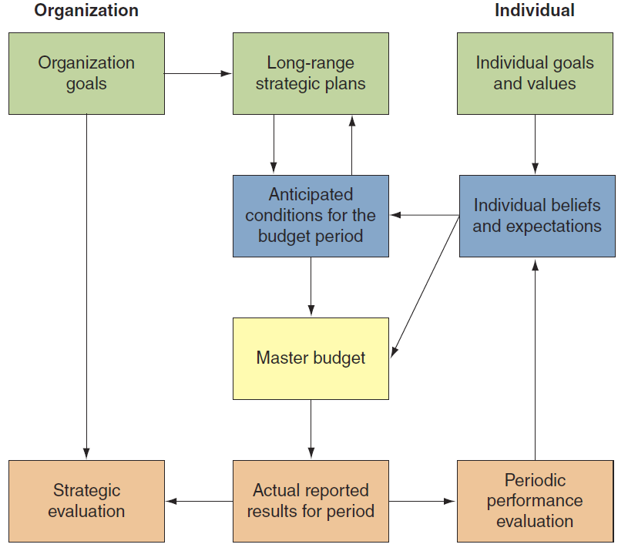
Organizational and Individual Interaction: Developing the Master Budget
LO 13-1
Access the text alternative for these images

Slide 7
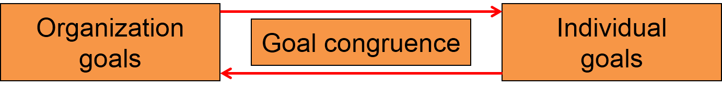
Human Element in Budgeting
LO 13-2
LO 13-2 Understand the importance of people in the budgeting process.
Participative Budgeting
Use of input from lower- and middle-management employees; also called grass roots budgeting.

Slide 8
Sales Forecasting
LO 13-3
LO 13-3 Estimate sales.
Forecasting sales is the most difficult aspect of budgeting.
How do we forecast sales?
Sales staff
Market researchers
Delphi technique
Trend analysis
Econometric models

Slide 9
Forecasting by Sales Staff
LO 13-3
After evaluating the sales forecasts derived from various sources, the budgeting task force at Rainy Day Umbrellas arrived at the following sales budget for the next budget year:
 | Units | Price per Unit | Total Sales Revenue
Estimated sales | 240,000 | $30 | $7,200,000

Slide 10
Forecasting Production
LO 13-4
LO 13-4 Develop production and cost budgets.
A production budget is a plan of resources needed to meet current sales demand and ensure that inventory levels are sufficient for future sales.
Basic inventory formula:
Beginning balance BB | + | Transfers in TI | − | Transfers out TO | = | Ending balance
For inventories, production, and sales:
Units in beginning inventory | + | Required production | − | Budgeted sales | = | Units in ending inventory

Slide 11
Production Budget 1
LO 13-4
Rearranging for required production:
Budgeted sales | + | Units in ending inventory | − | Units in beginning inventory | = | Required production
Rainy Day Umbrella’s sales budget is 240,000 units.
Management estimates that there will be 20,000 units in beginning inventory and 30,000 in ending inventory.
240,000 units | + | 30,000 units | − | 20,000 units | = | 250,000 units

Slide 12
Production Budget 2
LO 13-4
 | A | B
1 | RAINY DAY UMBRELLAS
2 | Production Budget
3 | For the Budget Year Ended December 31
4 | (in units)
5
6 | Expected sales | 240,000
7 | Add desired ending inventory of finished goods | 30,000
8 | Total needs | 270,000
9 | Less beginning inventory of finished goods | 20,000
10 | Units to be produced | 250,000
11

Slide 13
Production Costs
LO 13-4
Direct materials
Direct labor
Manufacturing overhead

Slide 14
Direct Materials Example 1
LO 13-4
 | A | B | C | D | E
1 |  |  | Estimated Production
2 |  |  | Material Data
3 |  | Fabric | Fabric | Metal | Metal
4 | Material per unit of output | 3.0 | yards | 2.0 | pounds
5 | Beginning materials inventory | 10,000 | yards | 1,000 | pounds
6 | Ending materials inventory | 15,000 | yards | 1,000 | pounds
7 | Cost per yard/pound | $2 |  | $1
8

Slide 15
Direct Materials Example 2
LO 13-4
Rainy Day Umbrellas
Estimated Production
Materials Data
Fabric = (250,000 × 3.0) + 15,000 − 10,000
= 755,000 yards
Metal = (250,000 × 2.0) + 1,000 − 1,000
= 500,000 pounds

Slide 16
Direct Materials Example 3
LO 13-4
 | A | B | C | D | E
1 |  |  | RAINY DAY UMBRELLAS
2 |  |  | Direct Materials Budget
3 |  |  | For the Budget Year Ended December 31
4
5 | Units to be produced (from the production budget in Exhibit 13.2) | 250,000
6 |  | Fabric |  | Metal
7 | Direct materials needed per unit | 3.0 | yards | 2.0 | pounds
8 | Total production needs (amount per unit times 250,000 units) | 750,000 |  | 500,000
9 | Add desired ending inventory | 15,000 |  | 1,000
10 | Total direct materials needs | 765,000 |  | 501,000
11 | Less beginning inventory of materials | 10,000 |  | 1,000
12 | Direct materials to be purchased | 755,000 | yards | 500,000 | pounds
13 | Cost of materials, per yard/pound | $ 2 |  | $ 1
14 | Total cost of direct materials to be purchased | $ 1,510,000 |  | $ 500,000
15
16 | Sum of materials (fabric and metal) to be purchased ($1,510,000 + $500,000) |  |  | $2,010,000
17

Slide 17
Direct Labor Example
LO 13-4
 | A | B
1 | RAINY DAY UMBRELLAS
2 | Direct Labor Budget
3 | For the Budget Year Ended December 31
4
5 | Units to be produced (from the production budget Exhibit 13.2) | 250,000
6 | Direct labor time per unit (in hours) | 0.25
7 | Total direct labor-hours needed | 62,500
8 | Direct labor cost per hour | $ 24
9 | Total direct labor cost | $1,500,000
10

Slide 18
Overhead Example
LO 13-4
Rainy Day Umbrellas
Schedule of Budgeted Manufacturing Overhead
For the Budget Year Ended December 31
Variable overhead needed to produce 250,000 units:
Indirect materials and supplies @ $0.15 per unit | $ 37,500
Materials handling @ $0.20 per unit | 50,000
Other indirect labor @ $0.05 per unit | 12,500
Total variable overhead | $100,000
Fixed manufacturing overhead (supervisory labor $83K, maintenance and repairs $50K, plant administration $85K, utilities $55K, depreciation $140K, insurance $30K, property taxes $60K, and other $22K) | $525,000
Total manufacturing overhead | $625,000

Slide 19
Cost of Goods Sold Example
LO 13-4
Rainy Day Umbrellas
Budgeted Statement of Cost of Goods Sold
For the Budget Year Ended December 31
Beginning work-in-process inventory |  |  | $ -0-
Manufacturing costs:
Direct materials:
Beginning inventory | $ 21,000
Purchases | 2,010,000
Materials available for manufacturing | $2,031,000
Less: Ending inventory | (31,000)
Total direct materials costs |  | $2,000,000
Direct labor |  | 1,500,000
Manufacturing overhead |  | 625,000
Total manufacturing costs |  |  | $4,125,000
Less: Ending work-in-process |  |  | -0-
Cost of goods manufactured |  |  | $4,125,000
Add: Beginning finished goods inventory |  |  | 320,000ª
Less: Ending finished goods inventory |  |  | (495,000)^{b}
Cost of goods sold |  |  | $3,950,000
ª Management estimate ^{b} Estimate: (30,000 units × $16.50 = value of finished goods).

Slide 20
Marketing and Administrative
Budget Example
LO 13-4
 | A | B | C | D
1
2
3
4
5 |  | Variable | For Total
6 |  | Marketing | Sales
7 |  | Per Unit | 240,000 | units
8 | Variable marketing costs | Sold | (Exhibit 13.2)
9 | Sales commissions | $ 1.50 | $ 360,000
10 | Other marketing | 0.75 | 180,000
11 | Total variable marketing costs |  |  | $ 540,000
12 | Fixed marketing costs
13 | Sales salaries |  | $ 130,000
14 | Advertising |  | 153,000
15 | Other |  | 67,000
16 | Total fixed marketing costs |  |  | 350,000
17 | Total marketing costs |  |  | $ 890,000
18 | Administrative costs (all fixed)
19 | Administrative salaries |  | $ 241,000
20 | Legal and accounting staff |  | 136,000
21 | Data processing services |  | 127,000
22 | Outside professional services |  | 32,000
23 | Depreciation—building, furniture, and equipment |  | 84,000
24 | Other, including interest |  | 36,000
25 | Taxes—other than income taxes |  | 140,000
26 | Total administrative costs |  |  | 796,000
27 | Total budgeted marketing and administrative costs |  |  | $1,686,000
28
RAINY DAY UMBRELLAS
Schedule of Budgeted Marketing and Administrative Costs
For the Budget Year Ended December 31

Slide 21
Income Statement Example
LO 13-4
 | A | B | C | D
1
2
3
4
5 | Budgeted revenues
6 | Budgeted price per unit | $30
7 | Budgeted sales volume (Exhibit 13.2) | 240,000 |  | $7,200,000
8 | Costs
9 | Cost of goods sold (Exhibit 13.6) |  | $ 3,950,000
10 | Marketing and administrative costs (Exhibit 13.7) |  | 1,686,000
11 | Total budgeted costs |  |  | 5,636,000
12 | Budgeted operating profit |  |  | $1,564,000
13 | Federal and other income taxes (@25%) |  |  | 391,000
14 | Budgeted profit after taxes |  |  | $1,173,000
15
16
RAINY DAY UMBRELLAS
Budgeted Income Statement
For the Budget Year Ended December 31

Slide 22
Cash Budget 1
LO 13-5
LO 13-5 Estimate cash flows.
The cash budget is a statement of cash on hand at the start of the budget period, expected cash receipts, expected cash disbursements, and the resulting cash balance at the end of the budget period.
Cash receipts:
  Collection of accounts receivable.
  Cash sales.
  Sales of assets.
  Borrowing.
  Issuing stock.
  Other.

Slide 23
Cash Budget 2
LO 13-5
Some cash disbursements:
  Materials purchases.
  Manufacturing costs.
  Operating activities.
  Debt repayment.
  Acquisition of new assets.
  Income taxes.
  Dividends.
  Other activities.

Slide 24
Cash Budget 3
LO 13-5
Rainy Day Umbrellas
Cash Budget
For the Budget Year Ended December 31
Cash balance beginning of period |  | $ 830,000
Receipts:
Collections on accounts | $6,840,000
Collections employee loans | 100,000
Total receipts |  | 6,940,000
Less: Disbursements:
Payments for accounts payable | 1,880,000
Direct labor | 1,500,000
Manufacturing overhead less noncash depreciation charges | 485,000
Marketing and administrative costs less noncash charges | 1,602,000
Payments for federal income taxes | 350,000
Dividends | 30,000
Reduction in long-term debt | 23,000
Acquisition of new assets | 1,529,000
Total disbursements |  | 7,399,000
Budgeted ending cash balance |  | $ 371,000

Slide 25
Cash Collections Example 1
LO 13-5
Rainy Day Umbrellas
Monthly Collection Experience
Sales on Credit
Cash collected from current month’s sales | 20%
Cash collected from last month’s sales | 75
Cash discounts taken (percentage of gross sales) | 2
Written off as bad debt | 3
Total disposition of credit sales in current month | 100%
Expected Sales for Three Months
January sales | $500,000
February sales | 450,000
March sales | 600,000

Slide 26
Cash Collections Example 2
LO 13-5
Rainy Day Umbrellas
Multiperiod Schedule of Cash Collections
For the Quarter Ended March 31
 |  | Month
 | January | February | March | Total for Quarter
Beginning accounts receivable,
January 1, $540,000 | $540,000 |  |  | $ 540,000
January sales, $500,000ª | 100,000 | $375,000 |  | 475,000
February sales, $450,000^{b} |  | 90,000 | $337,500 | 427,500
March sales, $600,000^{c} |  |  | 120,000 | 120,000
Total cash collections | $640,000 | $465,000 | $457,500 | $1,562,500
ª 20% collected in January, 75% collected in February, and 5% not collected.
^{b} 20% collected in February, 75% collected in March, and 5% not collected.
^{c} 20% collected in March, 75% collected in April, and 5% not collected.

Slide 27
Cash Disbursements Example 1
LO 13-5
Rainy Day Umbrellas
Monthly Disbursements for Purchases Experience
Cash disbursement for current month's purchases | 50%
Cash disbursement for prior month's purchases | 48
Cash discounts taken | 2
Total cash disbursement for purchases | 100%
Expected Purchases for Three Months
January purchases | $120,000
February purchases | $200,000
March purchases | $250,000

Slide 28
Cash Disbursements Example 2
LO 13-5
Rainy Day Umbrellas
Multiperiod Schedule of Cash Disbursements
For the Quarter Ended March 31
 |  | Month
 | January | February | March | Total for Quarter
Beginning accounts payable,
January 1, $256,000 | $256,000 |  |  | $ 256,000
January purchases, $120,000ª | 60,000 | $ 57,600 |  | 117,600
February purchases, $200,000^{b} |  | 100,000 | $ 96,000 | 196,000
March purchases, $250,000^{c} |  |  | 125,000 | 125,000
Additional cash payments | 250,000 | 250,000 | 250,000 | 750,000
Total cash disbursements | $566,000 | $ 407,600 | $471,000 | $1,444,600
ª 50% paid in January, 48% paid in February, and 2% discounts taken.
^{b} 50% paid in February, 48% paid in March, and 2% discounts taken.
^{c} 50% paid in March, 48% paid in April, and 2% discounts taken.

Slide 29
Budgeted Balance Sheet Example 1
LO 13-6
LO 13-6 Develop budgeted financial statements.
Rainy Day Umbrellas
Budget Balance Sheet (Assets)
For the Budget Year Ended December 31 ($000)
 |  | Budget Year
 | Balance Jan 1 | Additions | Subtractions | Balance Dec 31
Assets
Current assets:
Cash | $ 830 | $ 6,940 | $ 7,399 | $ 371
Accounts receivable | 540 | 7,200 | 6,840 | 900
Inventories | 341 | 4,135 | 3,950 | 526
Other current assets | 161 | -0- | 100 | 61
Total current assets | $1,872 | $18,275 | $18,289 | $1,858
Long-term assets:
Property, plant, equipment | 1,866 | 1,529 | -0- | 3,395
Less: Accumulated depreciation | (1,246) | (224) | -0- | (1,470)
Total assets | $2,492 | $19,580 | $18,289 | $3,783

Slide 30
Budgeted Balance Sheet Example 2
LO 13-6
Rainy Day Umbrellas
Budget Balance Sheet (Liabilities and Equity)
For the Budget Year Ended December 31 ($000)
 |  | Budget Year
 | Balance Jan 1 | Additions | Subtractions | Balance Dec 31
Liabilities and Shareholders’ Equity
Current liabilities:
Accounts payable | $ 442 | $2,010 | $1,880 | $ 572
Taxes payable | 187 | 391 | 350 | 228
Current portion of long-term debt | 23 | 23 | 23 | 23
Total current liabilities | $ 652 | $2,424 | $2,276 | $1,058
Long-term liabilities | 258 | -0- | 23 | 235
Total liabilities | $ 910 | $2,424 | $2,276 | $1,058
Shareholders' equity
Common stock | $ 437 | $ -0- | $ -0- | $ 437
Retained earnings | 1,145 | 1,173 | 30 | 2,288
Total shareholders’ equity | $1,582 | $1,173 | 30 | $2,725
Total liabilities and shareholders’ equity | $2,492 | $3,597 | $2,306 | $3,783

Slide 31
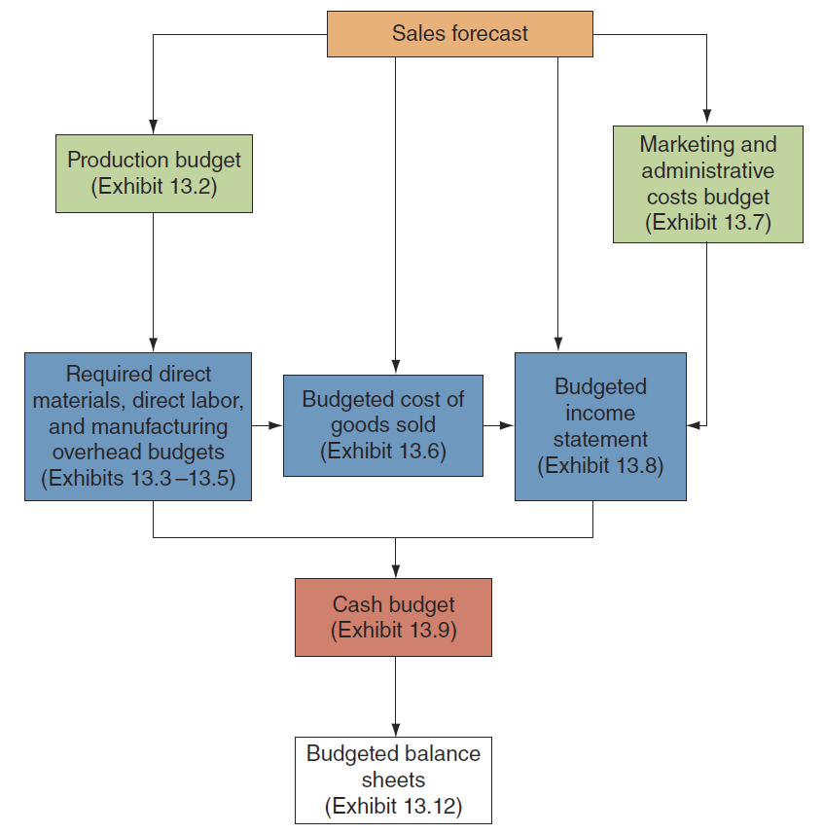
Assembling the Master Budget for a Manufacturing Firm
LO 13-6
Access the text alternative for these images

Slide 32
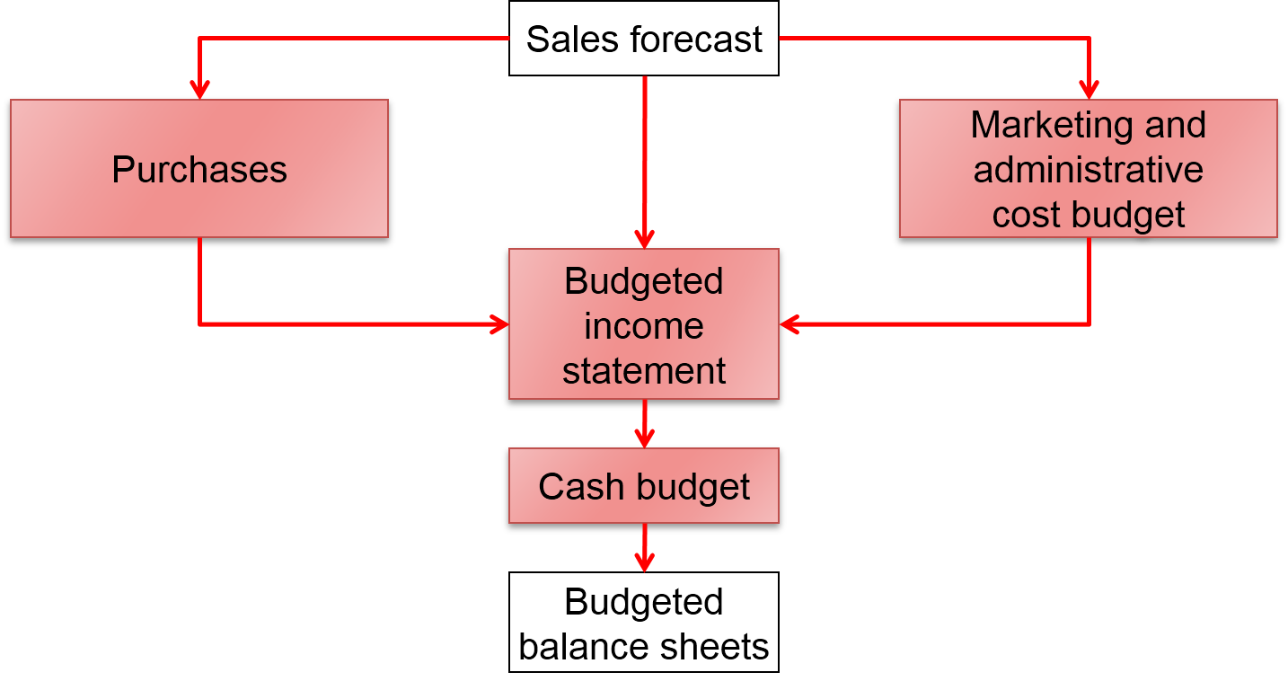
Budgeting Retail and Wholesale Organizations 1
LO 13-7
LO 13-7 Explain budgeting in merchandising and service organizations.
Access the text alternative for these images

Slide 33
Budgeting Retail and Wholesale Organizations 2
LO 13-7
Castro Audio & Video, Inc.
Estimated Information for Retail Operations
Estimated sales | 300 units
Estimated ending inventory | 5
Estimated beginning inventory | 2
Estimated cost per unit | $1,725

Slide 34
Budgeting Retail and Wholesale Organizations 3
LO 13-7
 | A | B | C
1
2
3
4
5 | Estimated sales (units) | 300 | units
6 | Add estimated ending inventory | 5
7 | Total merchandise needs | 305
8 | Less beginning inventory | 2
9 | Merchandise to be purchased | 303 | units
10 | Estimated cost per unit | × $1,725
11 | Total estimated cost of merchandise | $522,675
12
CASTRO AUDIO & VIDEO, INC.
Merchandise Purchases Budget
For the Year Ended December 31

Slide 35
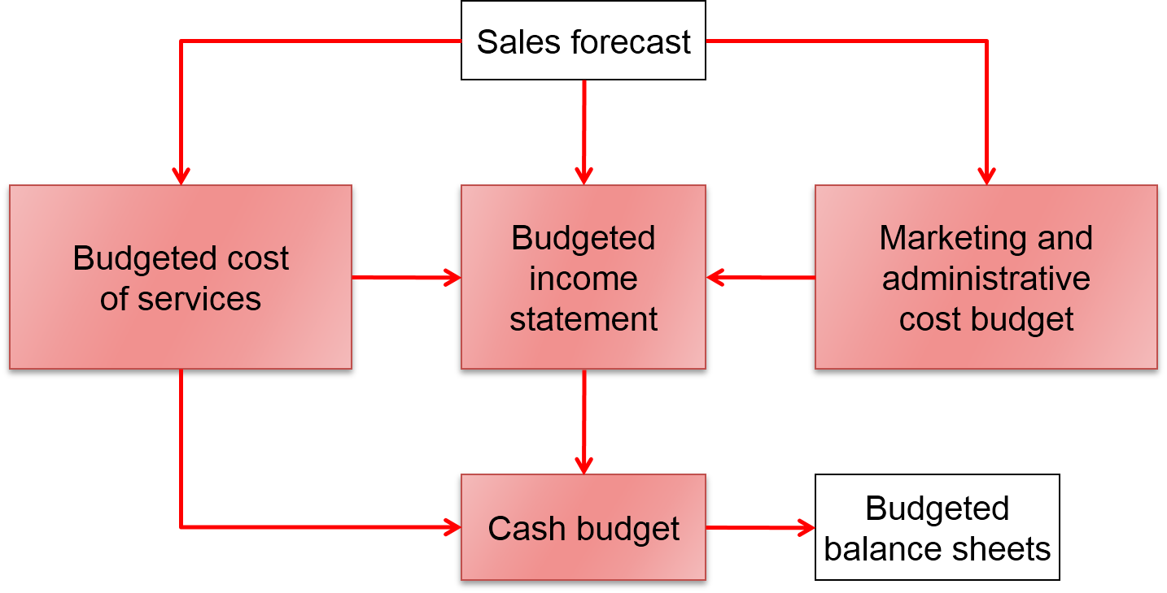
Budgeting in Service Organizations
LO 13-7
Access the text alternative for these images

Slide 36
Ethical Problems in Budgeting
LO 13-8
LO 13-8 Explain why ethical issues arise in budgeting.
Budgets can create serious ethical issues for many people.
The company must recognize the trade-off between encouraging unbiased reporting by managers and the use of budget information in performance evaluation and rewards.

Slide 37
Budgeting Under Uncertainty
LO 13-9
LO 13-9 Explain how to use sensitivity analysis to budget under uncertainty.
Budgets allow management to explore many alternatives.
Spreadsheets are helpful in preparing budgets and quantifying “what-if” conditions. Questions like what if labor costs are 10 percent higher (or lower) than projected?

Slide 38
Alternative Budgeting Scenarios
LO 13-9
Rainy Day Umbrellas Alternative Budget Scenarios
 | B | C | D | E | F | G
1 | Sales |  | Cost of | Gross | Marketing | Operating
2 | Quantity | Revenue | Goods Sold | Margin | & Admin | Profit
3
4 | 225,000 | $ 5,625,000 | $ 3,712,500 | $ 1,912,500 | $ 1,652,250 | $ 260,250
5 | 225,000 | $ 6,750,000 | $ 3,712,500 | $ 3,037,500 | $ 1,652,250 | $ 1,385,250
6 | 225,000 | $ 7,875,000 | $ 3,712,500 | $ 4,162,500 | $ 1,652,250 | $ 2,510,250
7
8 | 240,000 | $ 6,000,000 | $ 3,960,000 | $ 2,040,000 | $ 1,686,000 | $ 354,000
9 | 240,000 | $ 7,200,000 | $ 3,960,000 | $ 3,240,000 | $ 1,686,000 | $ 1,554,000
10 | 240,000 | $ 8,400,000 | $ 3,960,000 | $ 4,440,000 | $ 1,686,000 | $ 2,754,000
11
12 | 260,000 | $ 6,500,000 | $ 4,290,000 | $ 2,210,000 | $ 1,731,000 | $ 479,000
13 | 260,000 | $ 7,800,000 | $ 4,290,000 | $ 3,510,000 | $ 1,731,000 | $ 1,779,000
14 | 260,000 | $ 9,100,000 | $ 4,290,000 | $ 4,810,000 | $ 1,731,000 | $ 3,079,000
15

Slide 39
End of Chapter 13

Slide 40
Accessibility Content: Text Alternatives for Images

Slide 41
Organizational and Individual Interaction: Developing the Master Budget Text Alternative
Three boxes are situated in the top row of the flowchart: Organization goals, Long-range strategic plans, and Individual goals and values. Lines from the Organizational goals boxes lead into Long-range strategic plans as well as to the Strategic evaluation box in the fourth row of the flowchart. Lines extend in both directions between the Long-range strategic plans box and the box labeled Anticipated conditions for the budget period, situated directly below it in the second row. A line from Anticipated conditions for the budget period extends into the box labeled Master budget in the third row of the flowchart. A line from the Master budget extends into Actual reported results for period in the fourth and last row of the flowchart. Lines extend to boxes on the right (Periodic performance evaluation) and the left (Strategic evaluation) in the fourth row from Actual reported results for period. From Individual goals and values in the top row, a line extends to Individual beliefs and expectations in the second row. Lines extend from Individual beliefs and expectations into Anticipated conditions for the budget period to the left and to Master budget in the third row. Finally, another arrowing extending into Individual beliefs and expectations comes from Periodic performance evaluation.
Return to slide containing original image

Slide 42
Assembling the Master Budget for a Manufacturing Firm Text Alternative
In the diagram, the master budget process begins with the sales forecast. From there, the sales forecast informs the production budget (Exhibit 13.2), which consists of required direct materials, direct labor, and manufacturing overhead budgets (Exhibits 13.3–13.5). These budgets along with the sales forecast determine the budgeted cost of goods sold (Exhibit 13.6), which is input into the budgeted income statement. The sales forecast also provides the basis for the marketing and administrative budget (Exhibit 13.7), which is input to the budgeted income statement (Exhibit 13.8). The various budgets form the basis for the cash budget (Exhibit 13.9), which goes into the budgeted balance sheet (Exhibit 13.12).
Return to slide containing original image

Slide 43
Budgeting Retail and Wholesale Organizations 1 Text Alternative
The Sales forecast informs the Purchases, the Budgeted income statement, and the Marketing and administrative cost budget. The Purchases and Marketing and administrative cost budget inform the Budgeted income statement, which along with the Budgeted cost of services informs the Cash budget. This Cash budget, finally, informs the Budgeted balance sheets.
Return to slide containing original image

Slide 44
Budgeting in Service Organizations Text Alternative
The Sales forecast informs the Budgeted cost of services, the Budgeted income statement, and the Marketing and administrative cost budget.
The Budgeted cost of services and Marketing and administrative cost budget inform the Budgeted income statement, which along with the Budgeted cost of services informs the Cash budget. This Cash budget, finally, informs the Budgeted balance sheets.
Return to slide containing original image

