Slide 1
Fundamentals of Cost Accounting
Sixth Edition
William Lanen
Shannon Anderson
Michael Maher
©2020 McGraw-Hill Education. All rights reserved. Authorized only for instructor use in the classroom. No reproduction or further distribution permitted without the prior written consent of McGraw-Hill Education.

Slide 2
Chapter 16
Fundamentals of Variance Analysis

Slide 3
Learning Objectives
LO 16-1 Use budgets for performance evaluation.
LO 16-2 Develop and use flexible budgets.
LO 16-3 Compute and interpret the sales activity variance.
LO 16-4 Prepare and use a profit variance analysis.
LO 16-5 Compute and use variable cost variances.
LO 16-6 Compute and use fixed cost variances.
LO 16-7 (Appendix) Understand how to record costs in a standard costing system.

Slide 4
Using Budgets for
Performance Evaluation
LO 16-1
LO 16-1 Use budgets for performance evaluation.
Operating Budgets
Budgeted income statement, production budget, budgeted cost of goods sold, and supporting budgets.
Financial Budgets
Budgets of financial resources; for example, the cash budget and the budgeted balance sheet.
Variance
Difference between planned result and actual outcome.

Slide 5
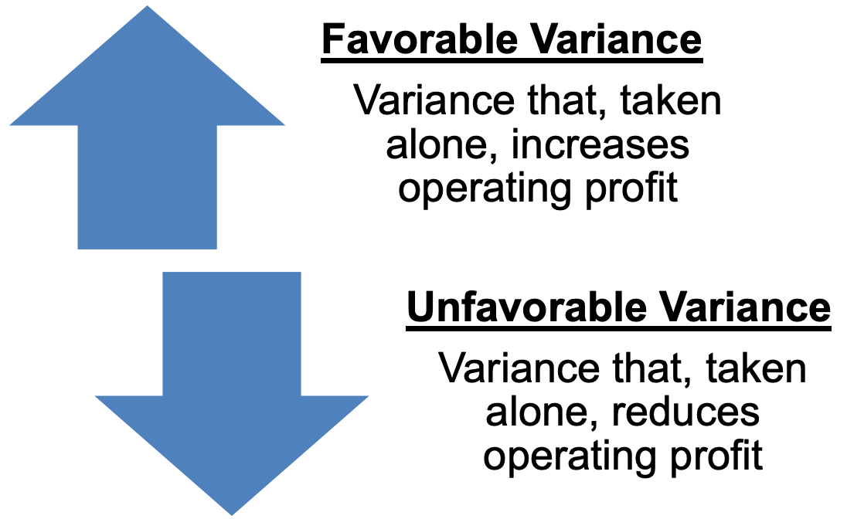
Profit Variance 1
LO 16-1

Slide 6
Profit Variance 2
LO 16-1
Peak Division
Budget and Actual Results
August
 | Actual | Variance | Master Budget
Sales (units) | 80,000 |  | 100,000
Sales revenue | $840,000 |  | $1,000,000ª
Less: Variable costs
Variable mfg. costs | 329,680 |  | 380,000^{b}
Variable selling and administrative | 68,000 |  | 90,000^{c}
Total variable costs | $397,680 |  | $ 470,000
Contribution margin | $442,320 |  | $ 530,000
Fixed costs:
Fixed manufacturing overhead | 195,500 |  | 200,000
Fixed selling and administrative costs | 132,320 |  | 140,000
Total fixed costs | $327,820 |  | $ 340,000
Profit | $114,500 |  | $ 190,000
ª $10.00 per unit ^{b} $3.80 per unit ^{c} $0.90 per unit

Slide 7
Profit Variance 3
LO 16-1
Peak Division
Budget and Actual Results
August
 | Actual | Variance | Master Budget
Sales (units) | 80,000 | 20,000 U | 100,000
Sales revenue | $840,000 | $160,000 U | $1,000,000ª
Less: Variable costs
Variable mfg. costs | 329,680 | 50,320 F | 380,000^{b}
Variable selling and administrative | 68,000 | 22,000 F | 90,000^{c}
Total variable costs | $397,680 | $ 72,320 F | $ 470,000
Contribution margin | $442,320 | $ 87,680 U | $ 530,000
Fixed costs:
Fixed manufacturing overhead | 195,500 | 4,500 F | 200,000
Fixed selling and administrative costs | 132,320 | 7,680 F | 140,000
Total fixed costs | $327,820 | $ 12,180 F | $ 340,000
Profit | $114,500 | $ 75,500 U | $ 190,000
ª $10.00 per unit ^{b} $3.80 per unit ^{c} $0.90 per unit

Slide 8
Flexible Budgeting
LO 16-2
LO 16-2 Develop and use flexible budgets.
Static Budget
Budget for a single activity level;
usually the master budget.
Flexible Budget
Budget that indicates revenues, costs,
and profits for different levels of activity.

Slide 9
Sales Activity Variance 1
LO 16-3
LO 16-3 Compute and interpret the sales activity variance.
The difference between operating profit in the master budget and operating profit in the flexible budget is called a sales activity variance, also known as the sales volume variance.
The variance arises because the actual number of units sold is different from the budgeted number.

Slide 10
Sales Activity Variance 2
LO 16-3
Peak Division
Flexible and Master Budget
August
 | A | B | C | D | E
1 |  | Flexible Budget (based on actual activity of 80,000 units) | Sales Activity Variance (based on variance in sales volume) |  | Master Budget (based on planned activity of 100,000 units)
2 | Sales (units) | 80,000 | 20,000 |  | 100,000
3
4 | Sales revenue | $ 800,000 | $200,000 | U | $1,000,000
5 | Less
6 | Variable costs
7 | Variable manufacturing costs | 304,000 | 76,000 | F | 380,000
8 | Variable selling and administrative | 72,000 | 18,000 | F | 90,000
9 | Total variable costs | $ 376,000 | $ 94,000 | F | $ 470,000
10 | Contribution margin | $ 424,000 | $106,000 | U | $ 530,000
11 | Fixed costs
12 | Fixed manufacturing overhead | 200,000 | –0– |  | 200,000
13 | Fixed selling and administrative costs | 140,000 | –0– |  | 140,000
14 | Total fixed costs | $ 340,000 | –0– |  | $ 340,000
15 | Profit | $ 84,000 | $106,000 | U | $ 190,000
16

Slide 11
Profit Variance Analysis 1
LO 16-4
LO 16-4 Prepare and use a profit variance analysis.
Profit Variance Analysis
Analysis of the causes of differences between
budgeted profits and the actual profits earned.
Sales price variance.
Variable production cost variances.
Fixed production cost variances.
Marketing and administrative cost variances.

Slide 12
Profit Variance Analysis 2
LO 16-4
Peak Division
Profit Variance Analysis August
 | Actual | Mfg. Variances | Marketing and Admin. Variances | Sales Price Variance | Flexible Budget | Sales Activity Variance | Master Budget
Sales (units) | 80,000 |  |  |  | 80,000 |  | 100,000
Sales revenue | $840,000 |  |  | $40,000 F | $800,000 | $200,000 U | $1,000,000
Less: Variable costs
Variable manufacturing costsª | 329,680 | $25,680 U |  |  | 304,000 | 76,000 F | 380,000
Variable selling and administrative | 68,000 |  | $ 4,000 F |  | 72,000 | 18,000 F | 90,000
Contribution margin | $442,320 | $25,680 U | $ 4,000 F | $40,000 F | $424,000 | $106,000 U | $ 530,000
Fixed costs:
Fixed manufacturing overhead | 195,500 | 4,500 F |  |  | 200,000 | -0- | 200,000
Fixed selling and administrative costs | 132,320 |  | 7,680 F |  | 140,000 | -0- | 140,000
Profit | $114,500 | $21,180 U | $11,680 F | $40,000 F | $ 84,000 | $106,000 U | $ 190,000
Total variance from flexible
budget = $30,500 F
Total variance from master budget = $75,500 U
ª The $25,680 manufacturing variance is explained in detail in LO 16-5.

Slide 13
Sales Price Variance
LO 16-4
Sales Price Variance
Difference between the actual selling price
and budgeted selling price multiplied by
the actual number of units sold.
($10.50 − $10.00) x 80,000 units = $40,000 F

Slide 14
Variable Production Costs
LO 16-4
Standard Cost Sheet
A form providing the standard quantities of
each input required to produce a unit of
output and the standard price for each input.
Peak Division
Standard Cost Sheet – Variable Manufacturing Costs
August
 | Standard Quantity of Input per Unit of Output | Standard Input Price or Rate per Unit of Input | Standard Cost per Unit of Output (drink)
Direct material (powder) | 4 pounds | $ 0.55 per pound | $ 2.20
Direct labor | 0.05 hours | $ 20 per hour | 1.00
Variable overhead | 0.05 hours | $ 12 per hour | 0.60
Total variable manufacturing costs |  |  | $3.80

Slide 15
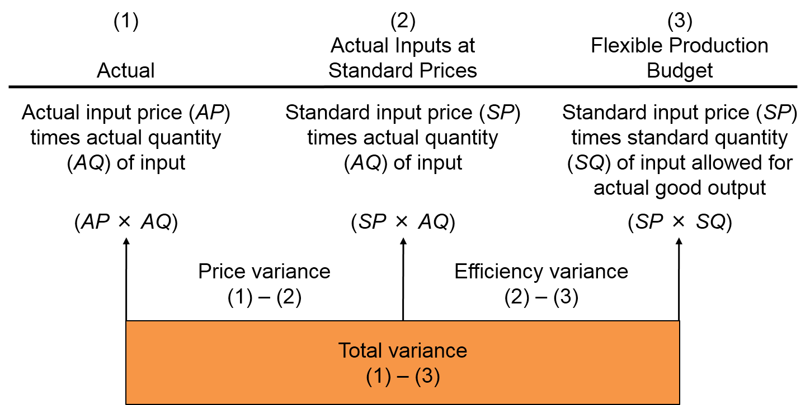
Variable Cost Variance Analysis
LO 16-5
LO 16-5 Compute and use variable cost variances.
Access the text alternative for these images

Slide 16
Production Cost Variance
LO 16-5
Price Variance
Difference between actual price and budgeted price.
Multiply this difference by the actual quantity purchased.
Price variance = (AP × AQ) – (SP × AQ)
= AQ(AP – SP)

Slide 17
Production Efficiency Variance
LO 16-5
Efficiency Variance
Difference between the actual quantity used and the
budgeted quantity for the actual level of activity.
Multiply this difference by the budgeted price per unit.
Efficiency variance = (SP × AQ) – (SP × SQ)
=SP(AQ – SQ)

Slide 18
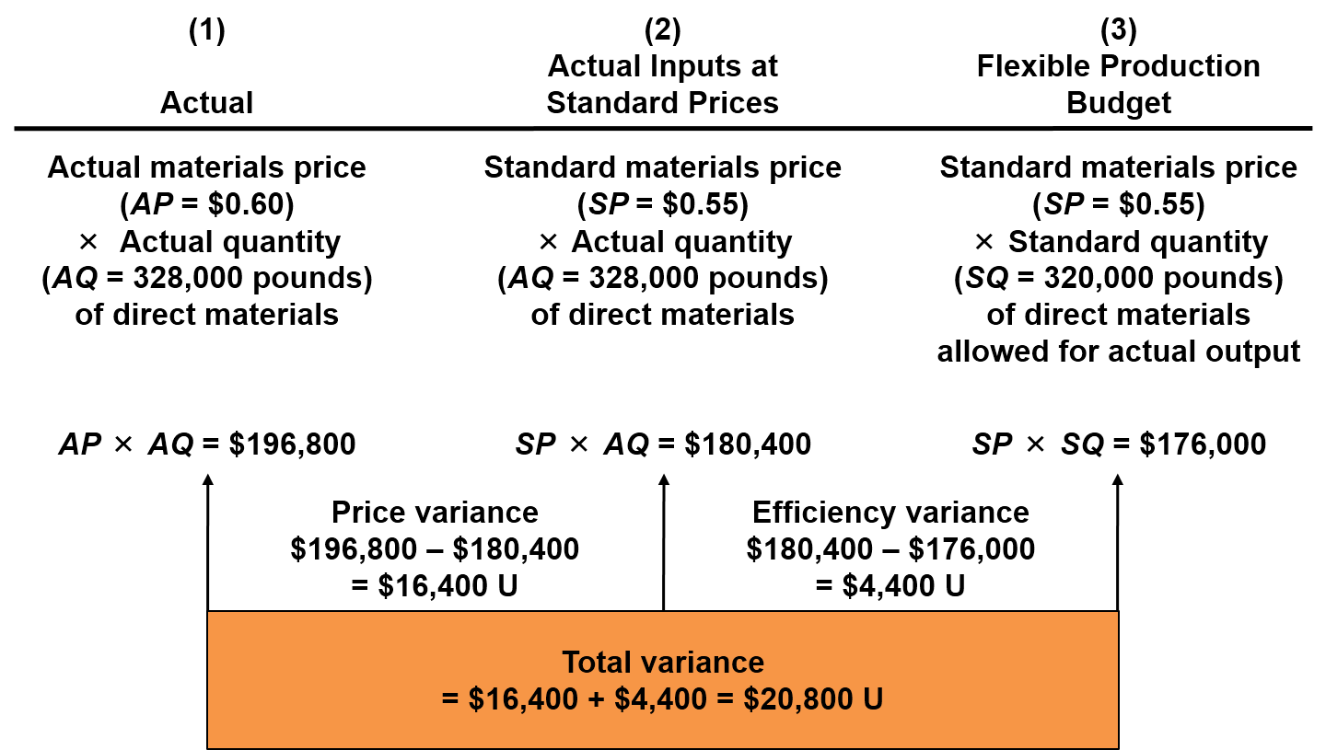
Direct Materials Variance
LO 16-5
Access the text alternative for these images

Slide 19
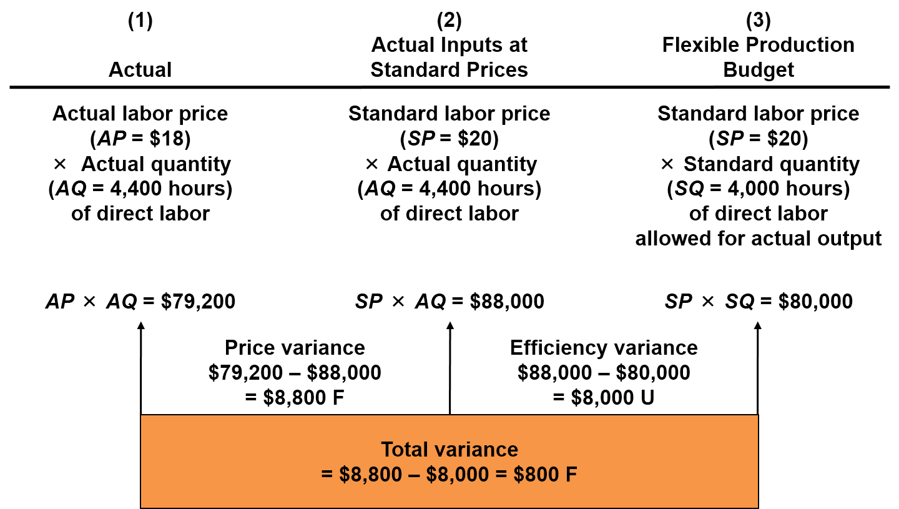
Direct Labor Variance
LO 16-5
Access the text alternative for these images

Slide 20
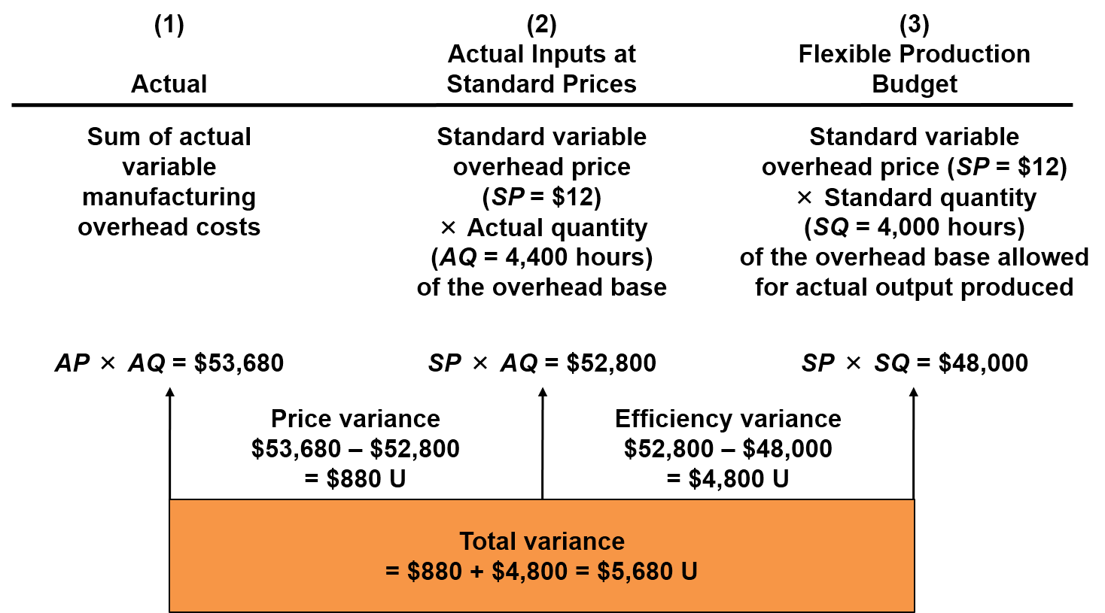
Variable Overhead Variance
LO 16-5
Access the text alternative for these images

Slide 21
Variable Manufacturing
Cost Variance Summary
LO 16-5
 | Price | Efficiency | Total
Direct materials | $16,400 U | $4,400 U | $20,800 U
Direct labor | $ 8,800 F | $8,000 U | $ 800 F
Variable overhead | $ 880 U | $4,800 U | $ 5,680 U
Total variable manufacturing
cost variance |  |  | $25,680 U

Slide 22
Fixed Cost Variances 1
LO 16-6
LO 16-6 Compute and use fixed cost variances.
Spending (or budget) variance.
Price variance for fixed overhead.
The difference between budgeted and actual fixed overhead.
$195,500 actual – $200,000 budget = $4,500 F.

Slide 23
Fixed Cost Variances 2
LO 16-6
The difference between budgeted and applied fixed overhead is called a production volume variance.
Production volume variance arises because the volume used to apply fixed overhead differs from the estimated volume used to estimate fixed cost per unit.
$200,000 budget – $160,000 applied = $40,000 U.
$200,000 budget ÷ 100,000 budgeted units = $2 per unit.
80,000 units × $2 per unit = $160,000 applied.

Slide 24
Appendix: Recording Costs in a Standard Cost System
LO 16-7
LO 16-7 (Appendix) Understand how to record costs in a standard costing system.
Work-in-process inventory is debited when direct materials and direct labor are used at standard.
Work-in-process inventory is debited when manufacturing overhead is applied at standard.
When the units are finished, work-in-process inventory is credited and finished goods inventory is debited.
Variances are usually closed to cost of goods sold.

Slide 25
End of Chapter 16

Slide 26
Accessibility Content: Text Alternatives for Images

Slide 27
Variable Cost Variance Analysis Text Alternative
(1) Actual | (2) Actual Inputs at Standard Prices | (3) Flexible Production Budget
Actual input price (AP) times actual quantity (AQ) of input | Standard input price (SP ) times actual quantity (AQ) of input | Standard input price (SP) times standard quantity (SQ) of input allowed for actual good output
(AP × AQ) | (SP × AQ) | (SP × SQ)
Price variance is calculated with (1) – (2)
Efficiency variance is calculated with (2) – (3)
Total variance is calculated with (1) – (3)
Return to slide containing original image

Slide 28
Direct Materials Variance Text Alternative
(1) Actual | (2) Actual Inputs at Standard Prices | (3) Flexible Production Budget
Actual materials price (AP = $0.60) × Actual quantity (AQ = 328,000 pounds) of direct materials | Standard materials price (SP = $0.55) × Actual quantity (AQ = 328,000 pounds) of direct materials | Standard materials price (SP = $0.55) × Standard quantity (SQ = 320,000 pounds) of direct materials allowed for actual output
(AP × AQ) | (SP × AQ) | (SP × SQ)
$196,800 | $180,400 | $176,000
Price variance is calculated with (1) – (2)
$196,800 − $180,400
$16,400 Unfavorable
Efficiency variance is calculated with (2) – (3)
$180,400 − $176,000
$4,400 Unfavorable
Total variance is calculated with (1) – (3)
$196,800 − $176,000
$20,800 Unfavorable
Return to slide containing original image

Slide 29
Direct Labor Variance Text Alternative
(1) Actual | (2) Actual Inputs at Standard Prices | (3) Flexible Production Budget
Actual labor price (AP = $18) × Actual quantity (AQ = 4,400 hours) of direct labor | Standard labor price (SP = $20) × Actual quantity (AQ = 4,400 hours) of direct labor | Standard labor price (SP = $20) × Standard quantity (SQ = 4,000 hours) of direct labor allowed for actual output
(AP × AQ) | (SP × AQ) | (SP × SQ)
$79,200 | $88,000 | $80,000
Price variance is calculated with (1) – (2)
• $79,200 − $88,000
• $8,800 Favorable
Efficiency variance is calculated with (2) – (3)
• $88,000 − $80,000
• $8,000 Unfavorable
Total variance is calculated with (1) – (3)
• $79,200 − $80,000
• $800 Favorable
Return to slide containing original image

Slide 30
Variable Overhead Variance Text Alternative
(1) Actual | (2) Actual Inputs at Standard Prices | (3) Flexible Production Budget
Sum of actual variable manufacturing overhead costs | Standard variable overhead price (SP = $12) × Actual quantity (AQ = 4,400 hours) of the overhead base | Standard variable overhead price (SP = $12) × Standard quantity (SQ = 4,000 hours) of the overhead base (direct labor in this example) allowed for actual output produced
(AP × AQ) | (SP × AQ) | (SP × SQ)
$53,680 | $52,800 | $48,000
Price variance is calculated with (1) – (2)
• $53,680 − $52,800
• $880 Unfavorable
Efficiency variance is calculated with (2) – (3)
• $52,800 − $48,000
• $4,800 Unfavorable
Total variance is calculated with (1) – (3)
• $53,680 − $48,000
• $5,680 Unfavorable
Return to slide containing original image

