Slide 1
Television Commercial
Assault on capitalism
Capitalism was originally an outgrowth of the Enlightenment
Its principal theorists believed capitalism should be based on the idea that both buyer and seller are sufficiently mature, well informed, and reasonable to engage in transactions of mutual self interest

Slide 2
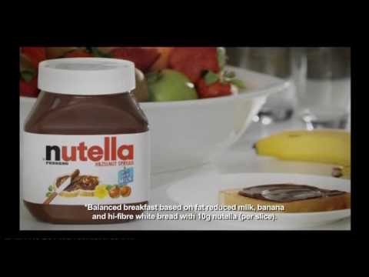
COMMERCIALS
Legally, companies are supposed to tell the truth about their products
That law is destroyed when commercials come into play
The discourse of “true” and “false” is discarded in commercials
Empirical tests, logical analysis, and any elements of reason are impotent

Slide 3
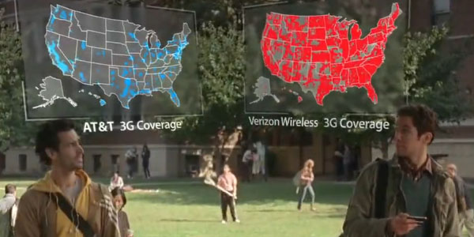
If a seller produces nothing of value, as determined by a rational market place, then the seller loses out
The assumption of rationality among buyers spurs competitors to become winners, and winners to keep winning

Slide 4
COMMERCIALS and DISCOURSE
Television commercials made linguistic discourse obsolete as the basis for product decisions
Images are substituted for claims
Pictorial commercials made emotional appeal not tests of truth, the basis of consumer decisions
The distance between rationality and advertising is wide
Notes:
2013 The Federal Trade Commission announced that Skechers USA, Inc. has agreed to pay $40 million to settle charges that the company deceived consumers by making unfounded claims that Shape-ups would help people lose weight, and strengthen and tone their buttocks, legs and abdominal muscles. The Federal Trade Commission is mailing 509,175 refund checks to purchasers of Shape-ups and other so-called toning shoes from Skechers after the company agreed to pay a $40 million settlement.

Slide 5
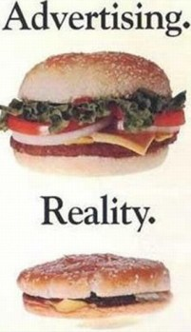
The truth of an advertisement’s claim is not an issue

Slide 6
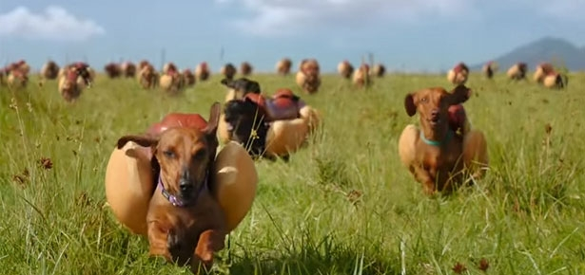
The commercial insists on unprecedented brevity
Disdains exposition
Complex language is not to be trusted
Making an argument is in bad taste and leads only to intolerable uncertainty

Slide 7
Today
Techno-optimists vs. techno-skeptics
Will the digital transformation liberate us or “tether us”?
Does tech “fire our imaginations or dull our senses”?
“nurture community or intensify our isolation?”
Expand intellectual faculties or wither our capacity for reflection?
Make us better citizens or more efficient consumers?”

Slide 8
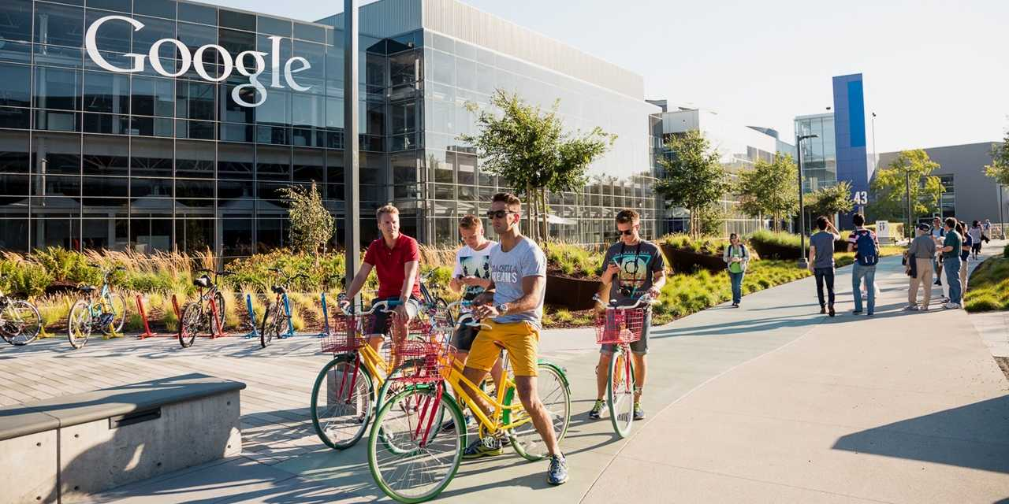
Astra Taylor says these questions are important but they make tech too central
They sidestep the issue of the larger social structures in which we and our technologies are embedded
This focus ignores the business imperatives that accelerate media consumption
The market forces that encourage compulsive online engagement

Slide 9
Problems of Past Media System
Consolidation
Centralization
Commercialism

Slide 10
Networked Technologies
Do not resolve contradictions between art and commerce, but make commercialism less visible and more pervasive
Creative fields and Journalism are in crisis, but advertising is flourishing
International surveillance infrastructure diminishes civil liberties and supports consumerism
Uncompetitive business--consolidation
Exploitative labor practices—globalization
Shady political lobbying to increase power and consolidation

Slide 11
Networked age and Power
In a networked age it is more difficult to point to how power operates
Private enterprise is given a “free pass”
Democracy is defined as sharing, collaboration, innovation and disruption (9)
Wealth and power are shifting to those who control the platforms on which we create, consume and connect (9)
We need to understand and then address the underlying social and economic forces that shape it

Slide 12
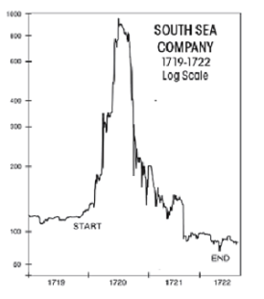
Dot-Com bust
450,000 jobs were lost in the Bay Area alone
A kind of amnesia makes us forget this
At the time of the boom, Income polarization was actually increasing, the already affluent becoming even more so while wages for most U.S. workers stagnated
Alan Greenspan thought that everyone would be getting richer forever

Slide 13
Web 2.0
E- Commerce (that went bust) is now more about human connection –less about buying and more about e-mail –humans’ need to connect
Sarah Lacy (Once You’re Lucky, Twice You’re Good) claims that that is why sites like Facebook are addictive
Not about users buying products but the users are the products
Commercialization of the once unprofitable art of conversation

Slide 14
Traditional institutions go under
Independent book, record, and video stores
Replaced by a small number of online giants: Amazon, iTunes, Netflix
These large corporations “harness collective intelligence”

Slide 15
“Content”
Money circulating online is going to tech companies
Only a small amount remaining for creators or institutions that support them
In 2010 publishers of articles and videos received 20 cents of each dollar advertisers spent on their sites
Down 1.00 from 2003
No one is claiming the market will be democratized—but the promise is that culture will be
We will “Create” and “Connect” and the entrepreneurs will keep the cash
Should creators on Flickr, Youtube, and Huffington Post get a return on the enormous valuation they create?

Slide 16
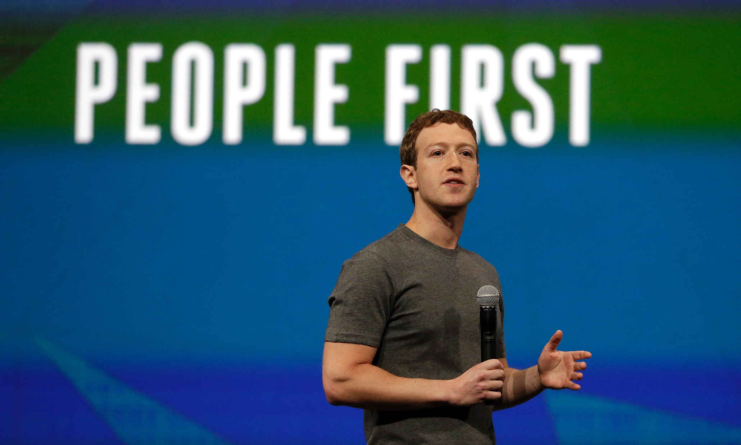
Open
Democracy of content, but commercialism and inequality are beneath the surface
New-media thinkers have claimed openness as the appropriate utopian ideal for our time
Open is Google and Wi-Fi decentralization and entrepreneurialism
The term evades ownership and equity
Highlights individual agency over commercial might and ignores power imbalances

Slide 17
Openness serve consumers’ buying interests, but the more open people’s lives are, the more easily they can be tracked and exploited by private interests
The problem is not commercialism of culture but control
There is no intermediary regulating who makes money and who doesn’t
iTunes, Spotify, and Pandora many times exclude the artists from this conversation about openness dominated by executives, academics, and entrepreneurs
Capital has not been distributed (democratized), but is largely held by the big companies (Google, Apple, Amazon)
Openness as (net neutrality) can insure the equal treatment of all data—it does not address the commercialization and consolidation of the digital sphere

Slide 18
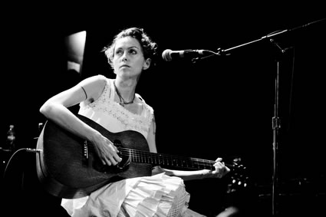
Creativity
No simple formula explains the relationship between creative effort and output
Creative labor: the dedicated application of human effort to some expressive end
Continues in spite of technological innovation
Withstanding the demand for immediate production in an economy preoccupied with speed and cost cutting
A film (for ex) is not necessarily any more informative for its demanding production qualities
We can’t reduce a novel to a summary (to cut costs of production)

Slide 19
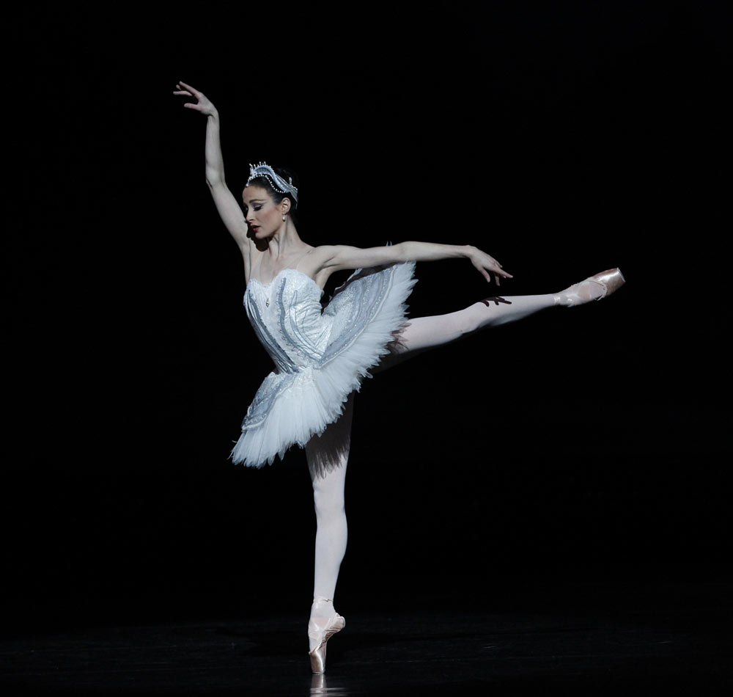
Demand for Efficiency
It still takes a classical musician or ballerina the same amount of work it took in the 19th century
In this day in age, of the democratization of media, there is a call for efficiency that does not always leave time for that kind of cultural work
Thus creative fields do not benefit from technological advancement as other industries do
The arts depend on a type of labor input that cannot be replaced by new technologies and capital

Slide 20
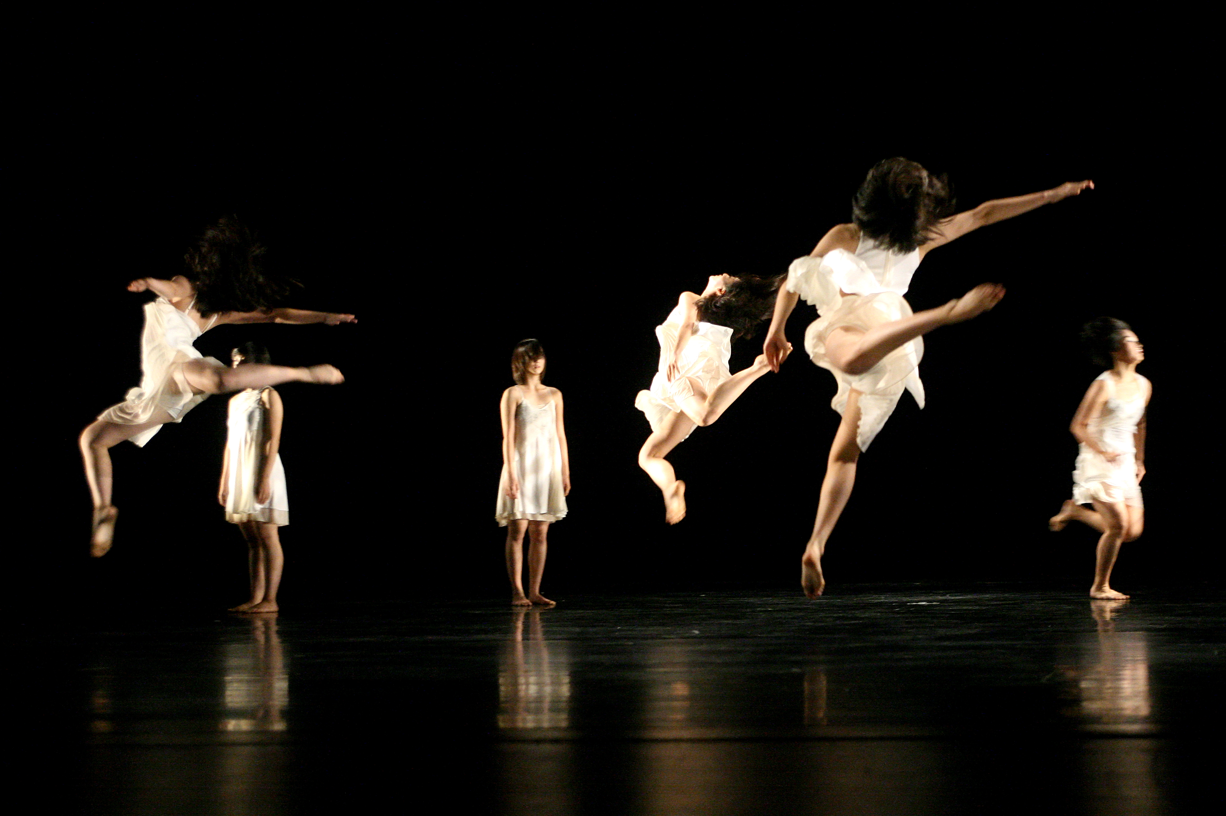
The arts
Suffer from a productivity lag
Where productivity is defined as output per work hour

Slide 21
Algorithms to make pop hits
Decrease in support for the arts
Pressure to make art-making more efficient

Slide 22
An Algorithm Successfully Predicted the Hit Dance Songs of 2015
Official Charts Company 2015 Singles
“Happy” by Pharrell Williams — 83%
“Rather Be” by Clean Bandit — 74%
“All Of Me” by John Legend (not dance)
“Waves” by Mr Probz — 68%
“Thinking Out Loud” by Ed Sheeran (not dance)
“Ghost” by Ella Henderson — 79%
“Timber” by Pitbull ft. Kesha — 90%
“Stay With Me” by Sam Smith (not dance)
“Let It Go” by Idina Menzel (not dance)
“All About That Bass” - Meghan Trainor — 87%
Notes:
The algorithm predicted a 65 percent or higher probability of a hit for all of the top 10, and over 70 percent probability for 6 out of 10 songs. Not too shabby.

Slide 23
Pop music automation
is a field of study among musicians and computer scientists with a goal of producing successful pop music algorithmically. It is often based on the premise that pop music is especially formulaic, unchanging, and easy to compose. The idea of automating pop music composition is related to many ideas in algorithmic music, Artificial Intelligence (AI) and computational creativity.
Notes:
--Wikipedia

Slide 24
My Country My Country, Laura PoItras
Cost 400,000 to make
Costs almost nothing to watch
Huge gap between operating costs of labor intensive creative products and their earned income
Notes:
My Country, My Country is a 2006 documentary film about Iraq under U.S. occupation by the filmmaker Laura Poitras.

Slide 25
New Media Utopia
Monetary concerns are irrelevant
Anyone with a mobile phone can shoot a video
Anyone can contribute to an encyclopedia
People are able to participate in cultural production for the pleasure of it
“social production”
“peer production”
“crowdsourcing”

Slide 26
Amateurs
Latin amare= “to love”
Amateurs are less motivated by skill and are making stuff without financial reward
To be an amateur means you are doing something for the love of it

Slide 27
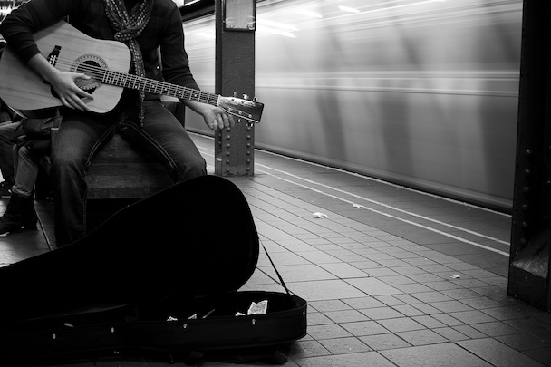
Proponents of Amateurization
Clay Shirky, NYU Professor
Yochai Benkler, Harvard Professor
Artists “unique motivations” will keep them “churning out music even if they are operating at a loss
Since artists enjoy what they do they shouldn’t care about being compensated
“Many of them enjoy fame, admiration, social status, and free beer in bars”
Notes:
Clay Shirky, Lawrence Lessig

Slide 28
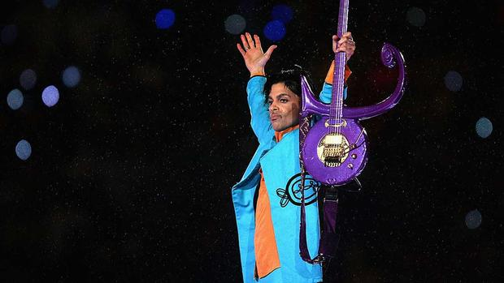
For Love
Produce content for the love of it and be prepared to produce it for free

Slide 29
Laura Poitras
Labor intensive process
You can’t crowdsource a relationship with a terrorist or a known whistleblower
Not all creative work should be romanticized—there are parts that are extremely arduous, painful, and time consuming

Slide 30
Keynes
Predicted a four hour workday
Technical improvements would allow people time to focus on the “art of life”
The exact opposite has happened
We are working too long (if we are able to work at all)

