Slide 1
Comparisons
Criticism of a TV mind vs. a typographic mind (Postman)
TV as a way to communicate context and complexity when print journalism no longer can
Does Mr. Robot communicate (context)
Is communicating with context and exposition the only way to be persuasive?
Is Mr. Robot persuasive?
What is it persuading you of?

Slide 2
Postman’s view on TV
Serious Television is a contradiction of terms
Transforms culture into show business
Attacks literate culture
Makes entertainment itself the natural format for the representation of all experience

Slide 3
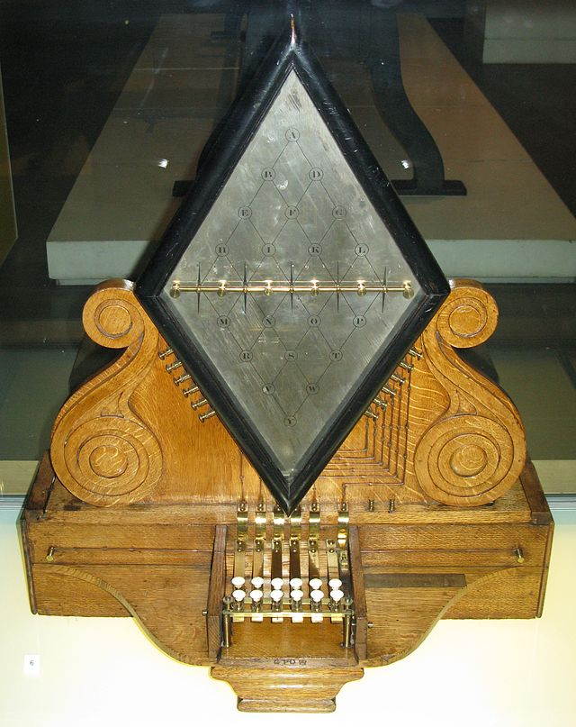
Peek-A-Boo World
“one neighborhood of the whole country”
Samuel Finley Breese Morse
co-developer of the Morse code, and helped to
develop the commercial use of telegraphy
Notes:
“America’s first true “spaceman”
contributed to the invention of a single-wire
telegraph system based on European telegraphs.
(1836)
Morse code, which he developed, would become
the primary language of telegraphy in the world

Slide 4
“We are in great haste to construct a magnetic telegraph from Maine to Texas; but Maine and Texas, it may be, have nothing important to communicate…”
--Henry David Thoreau

Slide 5
Information from a Telegraph
Irrelevance
Impotence
incoherence
Notes:
Creates media that is…

Slide 6
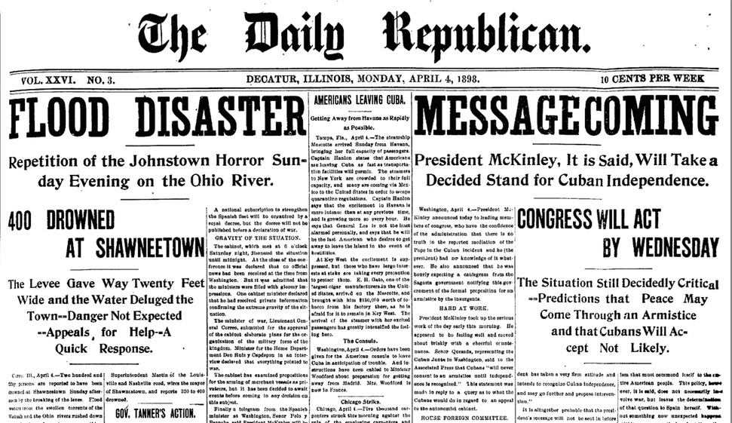
non-functional Information
All about novelty, interest and curiosity

Slide 7
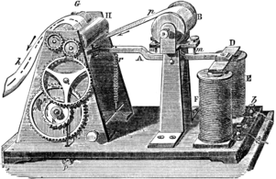
Partnership of Press and the Telegraph
Papers invested in the Magnetic Telegraph Company
Fortunes of newspapers depended on distance rather than the quality or utility of the news
James Bennett, New York Herald, boasted his paper contained 79,000 words of telegraphic content (1848)

Slide 8
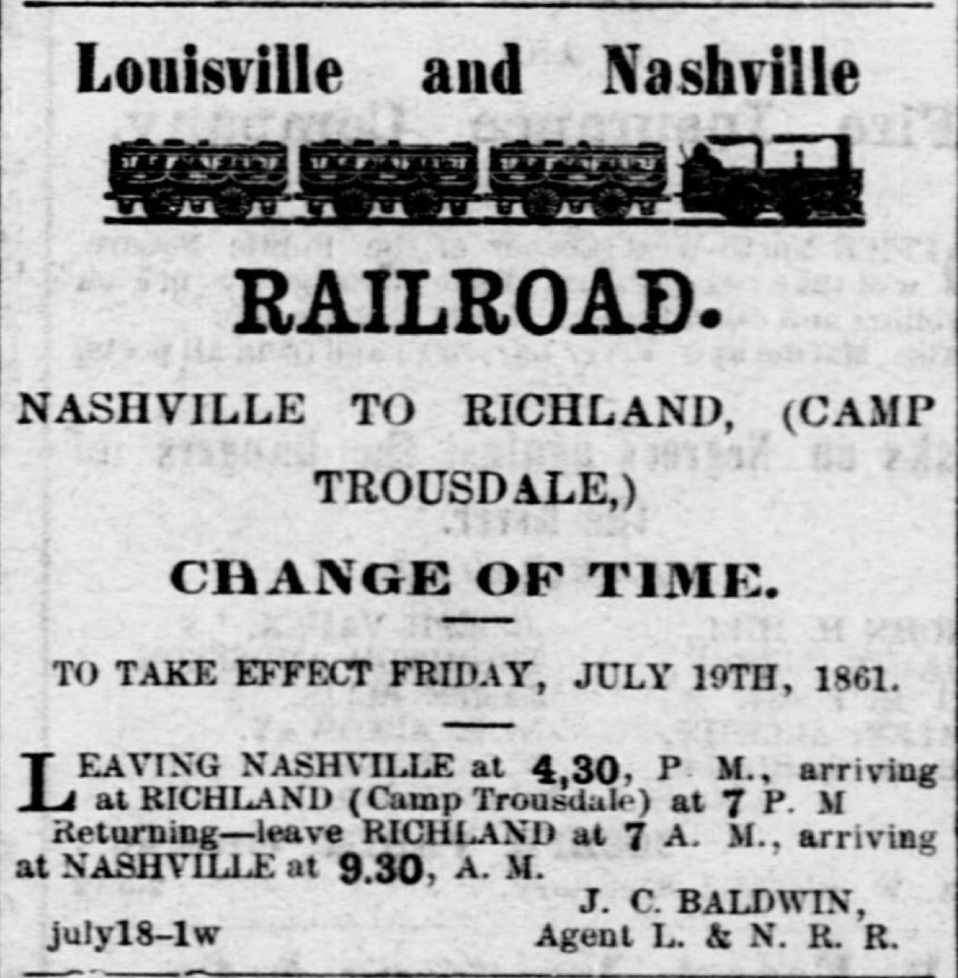
Does info from the media cause you to…
Alter your plans for the day?
Take some action you would not otherwise have taken?
Provide insight into some problem you are required to solve?

Slide 9
News (of the day) gives us something to talk about, but doesn’t lead to any meaningful action (according to Postman)
The telegraph lowered the information-action ratio

Slide 10
Limited historical perspective
Context
Implications
Background
Connections

Slide 11
Photography
A world of fact, not of dispute
“A world of photography implies that we know about the world if we accept it as the camera records it”
“all borders seem arbitrary. Anything can be separated. Can be made discontinuous from anything else: All that is necessary is to frame the subject differently”
--Susan Sontag

Slide 12
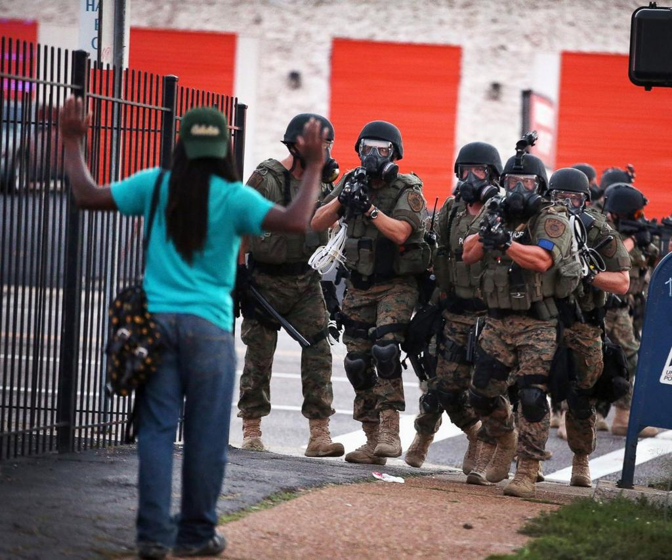
Ferguson
Notes:
Michael Brown August 2014

Slide 13
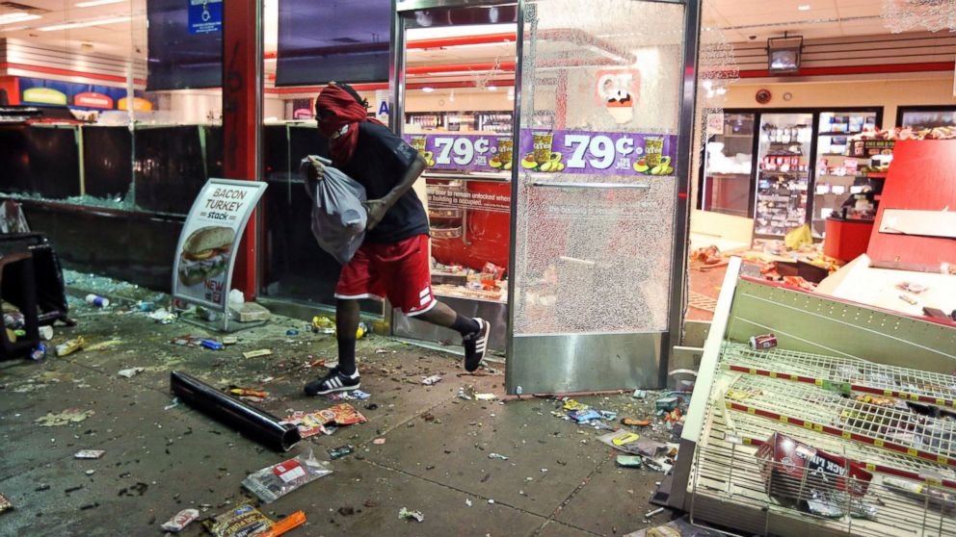
Ferguson

Slide 14
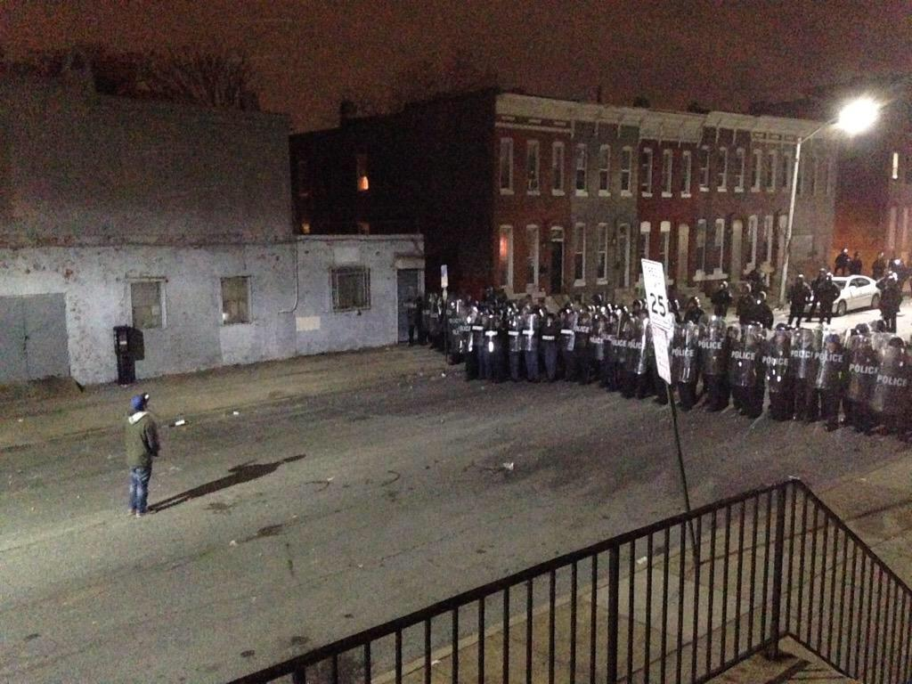
Baltimore
Notes:
2015 Baltimore April Freddy Gray

Slide 15

Baltimore

Slide 16
Photograph and telegraphy
Language that denies interconnectedness
Proceeds without context
Argues the irrelevance of history
Explained nothing
Offers fascination in place of complexity and coherence
The world created by these media is self contained and like peek-a-boo, endlessly entertaining

Slide 17
TV
Has achieved the status of myth (Roland Barthes)
We view it and it helps us understand the world in ways that are not considered “problematic”
The way TV communicates seems natural
A myth is a way of thinking so deeply embedded on our consciousness that it is invisible
The peek-a-boo world that TV has constructed does not seem strange to us
Notes:
Explain not problematic
We are not fully conscious of its status and its influence on our ways of knowing
Unless we look at it with a critical eye

Slide 18
Results
(according to Postman)
Adjustment to the epistemology of TV
Irrelevance seems important and incoherence sane
TV speaks in one consistent voice (entertainment)
Transforming our culture into one vast arena for show business
Attacks literate culture
Notes:
We have so thoroughly accepted its definitions of truth, knowledge, and, reality that irrelevance seems to us to be filled with import and incoherence seems eminently sane

Slide 19
Postman claims: Television has made entertainment itself the natural format for the representation of all experience

Slide 20
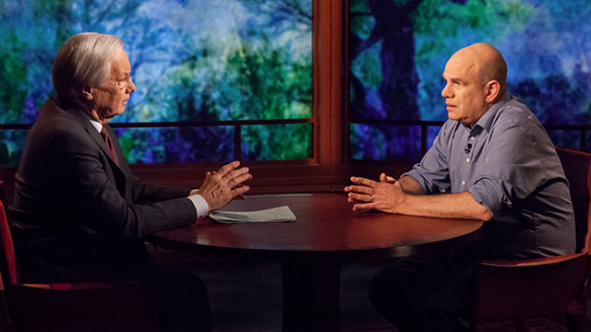
Are Meet the Press, Charlie Rose or Bill Moyers callbacks to literate culture?
These shows do not compete well with entertaining and visual forms

Slide 21
The World is staged like TV
Religion (Rock-and-Roll Priests)
Politics (Debates have to utilize one-liners—page 97)
Education (Professors who have teaching gimmicks or maybe who show TV in class?)

Slide 22
Age of Exposition" that defined Typographic America has been replaced by a spectacle that prizes flash and entertainment over substance. Entertainment has become the content of all of our discourse, so that the message itself is less important than the entertainment value of its delivery.

Slide 23

Does the news leave Viewers more confused?
Fragments of tragedy and barbarism
Good looks and amiability of the cast
Exciting music
Attractive commercials

Slide 24
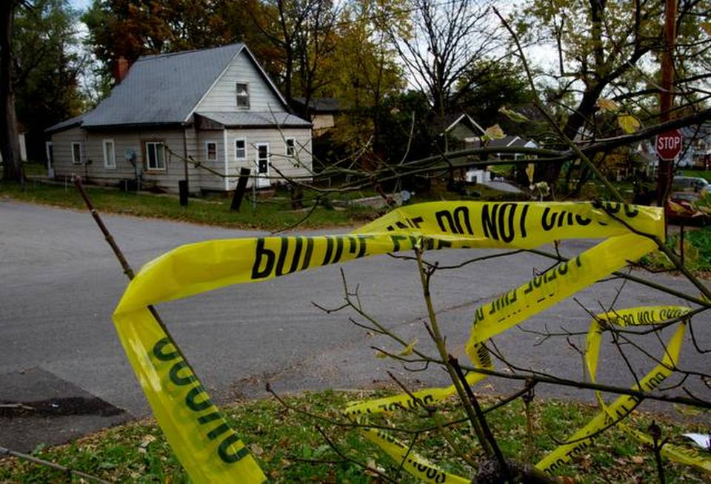
Shouldn’t we be weeping?
Not necessarily when TV news is a format of entertainment and not one of education, reflection, or catharsis

Slide 25
TV News
Has no suggestion that a story has any implication
“Now this” the most horrible news will be followed by commercials

Slide 26
If you do not receive news on TV--
What is your current experience of “Now This”?

Slide 27
Consistency of Tone
Books and films maintain consistency of tone
Consistency of Content
TV presents Discontinuity
Ex. A newscaster reports that we are on the brink of nuclear disaster and then they cut to a commercial from Burger King
Does the internet do the same?

Slide 28
Dis-information
If the lies of a president could be dramatized like a film, then there would be outrage
Lie = Contradiction
Understanding a contradiction requires context
Notes:
Statements and events must be perceived as interrelated aspects of a continuous and coherent context in order for those contradictions to be perceived

Slide 29
Debates
Debates between Stephen A. Douglas and Abraham Lincoln took place on August 21 1858. Douglas spoke first (for three hours) and Lincoln needed at least that long for a rebuttal.
Current Debates:
Quick one-liners
Talking Points
Nothing too dry, intellectual, or contextual
Notes:
Everyone went home, had dinner, and came back for Lincolns 4 hour rebuttal! That was the first of seven debates ALL THAT LONG! Who are these people who watched these DEBATES?! THEY WEREN”T EVEN PRESIDENTIAL DEBATES!!!! People watching this were people who regarded them as essential to their own political education!
Most of the Lincoln/Douglas debates were about slavery, but the first debate quite a bit more complicated—the debates become more focused as time progressed…
First debate: Douglas charged Lincoln with trying to “abolitionize” the Whig and Democratic Parties. He also charged Lincoln had been present when a very radical “abolitionist” type platform had been written by the Republican Party in 1854. Douglas accused Lincoln of taking the side of the common enemy in the Mexican War. Douglas also said Lincoln wanted to make Illinois “a free Negro colony.” Douglas asked Lincoln seven questions.
Lincoln during his turn did not respond to the questions and was on the defensive denying the allegations Douglas had made. Lincoln charged Douglas with trying to nationalize slavery.
In his rebuttal Douglas concentrated on the charge that Lincoln had been present when a very radical “abolitionist” type platform had been written by the Republican Party in 1854.
Source: Neely, Mark E. Jr. 1982. The Abraham Lincoln Encyclopedia. New York: Da Capo Press, Inc.
Full text of the Ottawa Debate follows.
Mr. Douglas' Speech
Ladies and gentlemen: I appear before you to-day for the purpose of discussing the leading political topics which now agitate the public mind. By an arrangement between Mr. Lincoln and myself, we are present here to-day for the purpose of having a joint discussion, as the representatives of the two great political parties of the State and Union, upon the principles in issue between those parties and this vast concourse of people, shows the deep feeling which pervades the public mind in regard to the questions dividing us.
Prior to 1854 this country was divided into two great political parties, known as the Whig and Democratic parties. Both were national and patriotic, advocating principles that were universal in their application. An old line Whig could proclaim his principles in Louisiana and Massachusetts alike. Whig principles had no boundary sectional line, they were not limited by the Ohio river, nor by the Potomac, nor by the line of the free and slave States, but applied and were proclaimed wherever the Constitution ruled or the American flag waved over the American soil. (Hear him, and three cheers.) So it was, and so it is with the great Democratic party, which, from the days of Jefferson until this period, has proven itself to be the historic party of this nation. While the Whig and Democratic parties differed in regard to a bank, the tariff, distribution, the specie circular and the sub-treasury, they agreed on the great slavery question which now agitates the Union. I say that the Whig party and the Democratic party agreed on this slavery question, while they differed on those matters of expediency to which I have referred. The Whig party and the Democratic party jointly adopted the Compromise measures of 1850 as the basis of a proper and just solution of this slavery question in all its forms. Clay was the great leader, with Webster on his right and Cass on his left, and sustained by the patriots in the Whig and Democratic ranks, who had devised and enacted the Compromise measures of 1850.
In 1851, the Whig party and the Democratic party united in Illinois in adopting resolutions indorsing and approving the principles of the Compromise measures of 1850, as the proper adjustment of that question. In 1852, when the Whig party assembled in Convention at Baltimore for the purpose of nominating a candidate for the Presidency, the first thing it did was to declare the Compromise measures of 1850, in substance and in principle, a suitable adjustment of that question. (Here the speaker was interrupted by loud and long continued applause.) My friends, silence will be more acceptable to me in the discussion of these questions than applause. I desire to address myself to your judgment, your understanding, and your consciences, and not to your passions or your enthusiasm. When the Democratic Convention assembled in Baltimore in the same year, for the purpose of nominating a Democratic candidate for the Presidency, it also adopted the compromise measures of 1850 as the basis of Democratic action. Thus you see that up to 1853-'54, the Whig party and the Democratic party both stood on the same platform with regard to the slavery question. That platform was the right of the people of each State and each Territory to decide their local and domestic institutions for themselves, subject only to the federal constitution.
During the session of Congress of 1853-'54, I introduced into the Senate of the United States a bill to organize the Territories of Kansas and Nebraska on that principle which had been adopted in the compromise measures of 1850, approved by the Whig party and the Democratic party in Illinois in 1851, and endorsed by the Whig party and the Democratic party in national convention in 1852. In order that there might be no misunderstanding in relation to the principle involved in the Kansas and Nebraska bill, I put forth the true intent and meaning of the act in these words: "It is the true intent and meaning of this act not to legislate slavery into any State or Territory, or to exclude it therefrom, but to leave the people thereof perfectly free to form and regulate their domestic institutions in their own way, subject only to the federal constitution." Thus, you see, that up to 1854, when the Kansas and Nebraska bill was brought into Congress for the purpose of carrying out the principles which both parties had up to that time endorsed and approved, there had been no division in this country in regard to that principle except the opposition of the abolitionists. In the House of Representatives of the Illinois Legislature, upon a resolution asserting that principle, every Whig and every Democrat in the House voted in the affirmative, and only four men voted against it, and those four were old line Abolitionists. (Cheers.)
In 1854, Mr. Abraham Lincoln and Mr. Trumbull entered into an arrangement, one with the other, and each with his respective friends, to dissolve the old Whig party on the one hand, and to dissolve the old Democratic party on the other, and to connect the members of both into an Abolition party under the name and disguise of a Republican party. (Laughter and cheers, hurrah for Douglas.) The terms of that arrangement between Mr. Lincoln and Mr. Trumbull have been published to the world by Mr. Lincoln's special friend, James H. Matheny, Esq., and they were, that Lincoln should have Shields's place in the U. S. Senate, which was then about to become vacant, and that Trumbull should have my seat when my term expired. (Great Laughter.) Lincoln went to work to abolitionize the Old Whig party all over the State, pretending that he was then as good a Whig as ever; (laughter) and Trumbull went to work in his part of the State preaching Abolitionism in its milder and lighter form, and trying to abolitionize the Democratic party, and bring old Democrats handcuffed and bound hand and foot into the Abolition camp. ("Good," "hurrah for Douglas," and cheers.) In pursuance of the arrangement, the parties met at Springfield in October, 1854, and proclaimed their new platform. Lincoln was to bring into the Abolition camp the old line Whigs, and transfer them over to Giddings, Chase, Fred Douglass, and Parson Lovejoy, who were ready to receive them and christen them in their new faith. (Laughter and cheers.) They laid down on that occasion a platform for their new Republican party, which was to be thus constructed. I have the resolutions of their State Convention then held, which was the first mass State Convention ever held in Illinois by the Black Republican party, and I now hold them in my hands and will read a part of them, and cause the others to be printed. Here are the most important and material resolutions of this Abolition platform:
1. Resolved, That we believe this truth to be self-evident, that when parties become subversive of the ends for which they are established, or incapable of restoring the government to the true principles of the constitution, it is the right and duty of the people to dissolve the political bands by which they may have been connected therewith, and to organize new parties upon such principles and with such views as the circumstances and exigencies of the nation may demand.
2. Resolved, That the times imperatively demand the reorganization of parties, and repudiating all previous party attachments, names and predilections, we unite ourselves together in defense of the liberty and constitution of the country, and will hereafter co-operate as the Republican party, pledged to the accomplishment of the following purposes: to bring the administration of the government back to the control of first principles; to restore Nebraska and Kansas to the position of free Territories; that, as the constitution of the United States, vests in the States, and not in Congress, the power to legislate for the extradition of fugitives from labor, to repeal and entirely abrogate the fugitive slave law; to restrict slavery to those States in which it exists; to prohibit the admission of any more slave States into the Union; to abolish slavery in the District of Columbia; to exclude slavery from all the territories over which the general government has exclusive jurisdiction; and to resist the acquirements of any more Territories unless the practice of slavery therein forever shall have been prohibited.
3. Resolved, That in furtherance of these principles we will use such constitutional and lawful means as shall seem best adapted to their accomplishment, and that we will support no man for office, under the general or State Government, who is not positively and fully committed to the support of these principles, and whose personal character and conduct is not a guaranty that he is reliable, and who shall not have abjured old party allegiance and ties.
(The resolutions, as they were read, were cheered throughout.)
Now, gentlemen, your Black Republicans have cheered every one of those propositions, ("good and cheers, ") and yet I venture to say that you cannot get Mr. Lincoln to come out and say that he is now in favor of each one of them. (Laughter and applause. "Hit him again.) That these propositions, one and all, constitute the platform of the Black Republican party of this day, I have no doubt; ("good") and when you were not aware for what purpose I was reading them, your Black Republicans cheered them as good Black Republican doctrines. ("That's it," etc.) My object in reading these resolutions, was to put the question to Abraham Lincoln this day, whether he now stands and will stand by each article in that creed and carry it out. ("Good." "Hit him again.") I desire to know whether Mr. Lincoln today stands as he did in 1854, in favor of the unconditional repeal of the fugitive slave law. I desire him to answer whether he stands pledged to-day, as he did in 1854, against the admission of any more slave States into the Union, even if the people want them. I want to know whether he stands pledged against the admission of a new State into the Union with such a Constitution as the people of that State may see fit to make. ("That's ot;" "put it at him.") I want to know whether he stands today pledged to the abolition of slavery in the District of Columbia. I desire him to answer whether he stands pledged to the prohibition of the slave trade between the different States. ("He does.") I desire to know whether he stands pledged to prohibit slavery in all the territories of the United States, North as well as South of the Missouri Compromise line, ("Kansas too.") I desire him to answer whether he is opposed to the acquisition of any more territory unless slavery is prohibited therein. I want his answer to these questions. Your affirmative cheers in favor of this Abolition platform is not satisfactory. I ask Abraham Lincoln to answer these questions, in order that when I trot him down to lower Egypt, I may put the same questions to him. (Enthusiastic applause.) My principles are the same everywhere. (Cheers and "hark.") I can proclaim them alike in the North, the South, the East, and the West. My principles will apply wherever the Constitution prevails and the American flag waves. ("Good" and applause.) I desire to know whether Mr. Lincoln's principles will bear transplanting from Ottawa to Jonesboro? I put these questions to him to-day distinctly, and ask an answer. I have a right to an answer, for I quote from the platform of the Republican party, made by himself and others at the time that party was formed, and the bargain made by Lincoln to dissolve and kill the old Whig party, and transfer its members, bound hand and foot, to the Abolition party, under the direction of Giddings and Fred Douglass. (Cheers.) In the remarks I have made on this platform, and the position of Mr. Lincoln upon it, I mean nothing personally disrespectful or unkind to that gentleman. I have known him for nearly twenty-five years. There were many points of sympathy between us when we first got acquainted. We were both comparatively boys, and both struggling with poverty in a strange land. I was a school-teacher in the town of Winchester, and he a flourishing grocery-keeper in the town of Salem. (Applause and laughter.) He was more successful in his occupation than I was in mine, and hence more fortunate in this world's goods. Lincoln is one of those peculiar men who perform with admirable skill everything which they undertake. I made as good a schoolteacher as I could, and when a cabinet maker I made a good bedstead and tables, although my old boss said I succeeded better with bureaus and secretaries than with anything else; (cheers,) but I believe that Lincoln was always more successful in business than I, for his business enabled him to get into the Legislature. I met him there, however, and had sympathy with him, because of the up-hill struggle we both had in life. He was then just as good at telling an anecdote as now. ("No doubt.") He could beat any of the boys wrestling, or running a foot-race, in pitching quoits or tossing a copper; could ruin more liquor than all the boys of the town together, (uproarious laughter,) and the dignity and impartiality with which he presided at a horse-race or fist-fight, excited the admiration and won the praise of everybody that was present and participated. (Renewed laughter.) I symphathised with him, because he was struggling with difficulties, and so was I. Mr. Lincoln served with me in the Legislature in 1836, when we both retired, and he subsided, or became submerged, and he was lost sight of as a public man for some years. In 1846, when Wilmot introduced his celebrated proviso, and the Abolition tornado swept over the country; Lincoln again turned up as a member of Congress from the Sangamon district. I was then in the Senate of the United States, and was glad to welcome my old friend and companion. Whilst in Congress, he distinguished himself by his opposition to the Mexican war, taking the side of the common enemy against his own country; ("that's true,") and when he returned home he found that the indignation of the people followed him everywhere, and he was again submerged or obliged to retire into private life, forgotten by his former friends. ("And will be again.") He came up again in 1854, just in time to make this Abolition or Black Republican platform, in company with Giddings, Lovejoy, Chase and Fred Douglass, for the Republican party to sand upon. (Laughter, "Hit him again," &c.)Trumbull, too, was one of our own contemporaries. He was born and raised in old Connecticut, was bred a Federalist, but removing to Georgia, turned Nullifier, when nullification was popular, and as soon as he disposed of his clocks and wound up his business, migrated to Illinois, (laughter,) turned politician and lawyer here, and made his appearance in 1841, as a member of the Legislature. He became noted as the author of the scheme to repudiate a large portion of the State debt of Illinois, which, if successful, would have brought infamy and disgrace upon the fair escutcheon of our glorious State. The odium attached to that measure consigned him to oblivion for a time. I helped to do it. I walked into a public meeting in the hall of the House of Representatives, and replied to his repudiating speeches, and resolutions were carried over his head denouncing repudiation, and asserting the moral and legal obligation of Illinois to pay every dollar of the debt she owed and every bond that bore her seal. ("Good," and cheers.) Trumbull's malignity has followed me since I thus defeated his infamous scheme.
These two men having formed this combination to abolitionize the old Whig party and the old Democratic party, and put themselves into the Senate of the Untied States, in pursuance of their bargain, are now carrying out that arrangement. Matheny states that Trumbull broke faith; that the bargain was that Lincoln should be the Senator in Shields's place, and Trumbull was to wait for mine; (laughter and cheers,) and the story goes, that Trumbull cheated Lincoln, having control of four or five abolitionized Democrats who were holding over in the Senate; he would not let them vote for Lincoln, and which obliged the rest of the Abolitionists to support him in order to secure an Abolition Senator. There are a number of authorities for the truth of this besides Matheny, and I suppose that even Mr. Lincoln will not deny it. (Applause and laughter.)
Mr. Lincoln demands that he shall have the place intended for Trumbull, as Trumbull cheated him and got his, and Trumbull is stumping the State traducing me for the purpose of securing the position for Lincoln, in order to quiet him. ("Lincoln can never get it, &c.") It was in consequence of this arrangement that the Republican Convention was impanneled to instruct for Lincoln and nobody else, and it was on this account that they passed resolutions that he was their first, their last, and their only choice. Archy Williams was nowhere, Browning was nobody, Wentworth was not to be considered; they had no man in the Republican party for the place except Lincoln, for the reason that he demanded that they should carry out the arrangement. ("Hit him again.")
Having formed this new party for the benefit of deserters from Whiggery, and deserters from Democracy, and having laid down the Abolition platform which I have read, Lincoln now takes his stand and proclaims his Abolition doctrines. Let me read a part of them. In his speech at Springfield to the Convention, which nominated him for the Senate, he said:
"In my opinion it will not cease until a crisis shall have been reached and passed. 'A house divided against itself cannot stand.' I believe this government cannot endure permanently half Slave and half Free. I do not expect the Union to be dissolved-I do not expect the house to fall - but I do expect it will cease to be divided. It will become all one thing, or all the other. Either the opponents of slavery will arrest the further spread of it, and place it where the public mind shall rest in the belief that it is in the course of ultimate extinction: or its advocates will push it forward till it shall became alike lawful in all the States-old as well as new, North as well as South."
("Good," "good," and cheers.)
I am delighted to hear you Black Republicans say "good." (Laughter and cheers.) I have no doubt that doctrine expresses your sentiments ("hit them again," "that's it,") and I will prove to you now, if you will listen to me, that it is revolutionary and destructive of the existence of this Government. ("Hurrah for Douglas," "good," and cheers.) Mr. Lincoln, in the extract from which I have read, says that this Government cannot endure permanently in the same condition in which it was made by its framers-divided into free and slave States. He says that it has existed for about seventy years thus divided, and yet he tells you that it cannot endure permanently on the same principles and in the same relative condition in which our fathers made it. Why can it not exist divided into free and slave States? Washington, Jefferson, Franklin, Madison, Hamilton, Jay, and the great men of that day, made this Government divided into free States and slave States, and left each State perfectly free to do as it pleased on the subject of slavery. ("Right, right.") Why can it not exist on the same principles on which our fathers made it? ("It can.")The knew when they framed the Constitution that in a country as wide and broad as this, with such a variety of climate, production and interest, the people necessarily required different laws and institutions in different localities. They knew that the laws and regulations which would suit the granite hills of New Hampshire would be unsuited to the rice plantations of South Carolina, ("right, right,") and they, therefore, provided that each State should retain its own Legislature and its own sovereignty, with the full and complete power to do as it pleased within its own limits, in all that was local and not national. (Applause.) One of the reserved rights of the States, was the right to regulate the relations between Master and Servant, on the slavery question. At the time the Constitution was framed, there were thirteen States in the Union, twelve of which were slaveholding States and one free State. Suppose this doctrine of uniformity preached by Mr. Lincoln, that the States should all be free or all be slave had prevailed, and what would have been the result? Of course, the twelve slaveholding States would have overruled the one free State, and slavery would have been fastened by a Constitutional provision on every inch of the American Republic, instead of being left as our fathers wisely left it, to each State to decide for itself. ("Good, good," and three cheers for Douglas.) Here I assert that uniformity in the local laws and institutions of the different States in neither possible or desirable. If uniformity had been adopted when the Government was established, it must inevitably have been the uniformity of slavery everywhere, or else the uniformity of negro citizenship and negro equality everywhere.
We are told by Lincoln that he is utterly opposed to the Dred Scott decision, and will not submit to it, for the reason that he says it deprives the negro of the rights and privileges of citizenship. (Laughter and applause.) That is the first and main reason which he assigns for his warfare on the Supreme Court of the United Sates and its decision. I ask you, are you in favor of conferring upon the negro the rights and privileges of citizenship? ("No, no.") Do you desire to strike out of our State Constitution that clause which keeps slaves and free negroes out of the State, and allow the free negroes to flow in, ("never,") and cover your prairies with black settlements? Do you desire to turn this beautiful State into a free negro colony, ("no, no,") in order that when Missouri abolishes slavery she can send one hundred thousand emancipated slaves into Illinois, to become citizens and voters, on an equality with yourselves? ("Never," "no.") If you desire negro citizenship, if you desire to allow them to come into the State and settle with the white man, if you desire them to vote on an equality with yourselves, and to make them eligible to office, to serve on juries, and to adjudge your rights, then support Mr. Lincoln and the Black Republican party, who are in favor of the citizenship of the negro. ("Never, never.") For one, I am opposed to negro citizenship in any and every form. (Cheers.) I believe this Government was made on the white basis. ("Good.") I believe it was made by white men for the benefit of white men and their posterity for ever, and I am in favor of confining citizenship to white men, men of European birth and descent, instead of conferring it upon negroes, Indians, and other inferior races. ("Good for you." "Douglas forever.")
Mr. Lincoln, following the example and lead of all the little Abolition orators, who go around and lecture in the basements of schools and churches, reads from the Declaration of Independence, that all men were created equal, and then asks, how can you deprive a negro of that equality which God and the Declaration of Independence awards to him? He and they maintain that negro equality is guarantied by the laws of God, and that it is asserted in the Declaration of Independence. If they think so, of course they have a right to say so, and so vote. I do not question Mr. Lincoln's conscientious belief that the negro was made his equal, and hence is his brother, (laughter,) but for my own part, I do not regard the negro as my equal, and positively deny that he is my brother or any kin to me whatever. ("Never." "Hit him again," and cheers.) Lincoln has evidently learned by heart Parson Lovejoy's catechism. (Laughter and applause.) He can repeat it as well as Farnsworth, and he is worthy of a medal from Father Giddings and Fred Douglass for his Abolitionism. (Laughter.) He holds that the negro was born his equal and yours, and that he was endowed with equality by the Almighty, and that no human law can deprive him of these rights which were guarantied to him by the Supreme ruler of the Universe. Now, I do not believe that the Almighty ever intended the negro to be the equal of the white man. ("Never, never.") If he did, he has been a long time demonstrating the fact. (Cheers.) For thousands of years the negro has been a race upon the earth, and during all that time, in all latitudes and climates, wherever he has wandered or been taken, he has been inferior to the race which he has there met. He belongs to an inferior race, and must always occupy an inferior position. ("Good," "that's so," &c.) I do not hold that because the negro is our inferior that therefore he ought to be a slave. By no means can such a conclusion be drawn from what I have said. On the contrary, I hold that humanity and Christianity both require that the negro shall have and enjoy every right, every privilege, and every immunity consistent with the safety of the society in which he lives. (That's so.) On that point, I presume, there can be no diversity of opinion. You and I are bound to extend to our inferior and dependent beings every right, every privilege, every facility and immunity consistent with the public good. The question then arises, what rights and privileges are consistent with the public good? This is a question which each State and each Territory must decide for itself-Illinois has decided it for herself. We have provided that the negro shall not be a slave, and we have also provided that he shall not be a citizen, but protect him in his civil rights, in his life, his person and his property, only depriving him of all political rights whatsoever, and refusing to put him on an equality with the white man. ("Good.") That policy of Illinois is satisfactory to the Democratic party and to me, and if it were to the Republicans, there would then be no question upon the subject; but the Republicans say that he ought to be made a citizen, and when he becomes a citizen he becomes your equal, with all your rights and privileges. ("He never shall.") They assert the Dred Scott decision to be monstrous because it denies that the negro is or can be a citizen under the Constitution. Now, I hold that Illinois had a right to abolish and prohibit slavery as she did, and I hold that Kentucky has the same right to continue and protect slavery that Illinois had to abolish it. I hold that New York had as much right to abolish slavery as Virginia has to continue it, and that each and every State of this Union is a sovereign power, with the right to do as it pleases upon this question of slavery, and upon all its domestic institutions. Slavery is not the only question which comes up in this controversy. There is a far more important one to you, and that is, what shall be done with the free negro? We have settled the slavery question as far as we are concerned; we have prohibited it in Illinois forever, and in doing so, I think we have done wisely, and there is no man in the State who would be more strenuous in his opposition to the introduction of slavery than I would; (cheers) but when we settled it for ourselves, we exhausted all our power over that subject. We have done our whole duty, and can do no more. We must leave each and every other State to decide for itself the same question. In relation to the policy to be pursued toward the free negroes, we have said that they shall not vote; whilst Maine, on the other hand, has said that they shall vote. Maine is a sovereign State, and has the power to regulate the qualifications of voters within her limits. I would never consent to confer the right of voting and of citizenship upon a negro, but still I am not going to quarrel with Maine for differing from me in opinion. Let Maine take care of her own negroes and fix the qualifications of her own voters to suit herself, without interfering with Illinois, and Illinois will not interfere with Maine. So with the State of New York. She allows the negro to vote provided he owns two hundred and fifty dollars' worth of property, but not otherwise. While I would not make any distinction whatever between a negro who held property and one who did not; yet if the sovereign State of New York chooses to make that distinction it is her business and not mine, and I will not quarrel with her for it. She can do as she pleases on this question if she minds her own business, and we will do the same thing. Now, my friends, if we will only act conscientiously and rigidly upon this great principle of popular sovereignty, which guaranties to each State and Territory the right to do as it pleases on all things, local and domestic, instead of Congress interfering, we will continue at peace one with another. Why should Illinois be at war with Missouri, or Kentucky with Ohio, or Virginia with New York, merely because their institutions differ? Our fathers intended that our institutions should differ. They knew that the North and the South, having different climates, productions and interests, required different institutions. This doctrine of Mr. Lincoln, of uniformity among the institutions of the different States, is a new doctrine, never dreamed of by Washington, Madison, or the framers of this Government. Mr. Lincoln and the Republican party set themselves up as wiser than these men who made this Government, which has flourished for seventy years under the principle of popular sovereignty, recognizing the right of each State to do as it pleased. Under that principle, we have grown from a nation of three or four millions to a nation of about thirty millions of people; we have crossed the Allegheny mountains and filled up the whole North-west, turning the prairie into a garden, and building up churches and schools, thus spreading civilization and Christianity where before there was nothing but savage barbarism. Under that principle we have become, from a feeble nation, the most powerful on the face of the earth, and if we only adhere to that principle, we can go forward increasing in territory, in power, in strength and in glory until the Republic of America shall be the North Star that shall guide the friends of freedom throughout the civilized world. ("Long may you live," and great applause.) And why can we not adhere to the great principle of self-government, upon which our institutions were originally based. ("We can.") I believe that this new doctrine preached by Mr. Lincoln and his party will dissolve the Union if it succeeds. They are trying to array all the Northern States in one body against the South, to excite a sectional war between the free States and the slave States, in order that the one or the other may be driven to the wall.
I am told that my time is out. Mr. Lincoln will now address you for an hour and a half, and I will then occupy an half hour in replying to him.
Mr. Lincoln's Speech
Mr. Lincoln then came forward and was greeted with loud and protracted cheers from fully two-thirds of the audience. This was admitted by the Douglas men on the platform. It was some minutes before he could make himself heard, even by those on the stand. At last he said:
MY FELLOW-CITIZENS: When a man hears himself somewhat misrepresented, it provokes him-at least, I find it so with myself; but when misrepresentation becomes very gross and palpable, it is more apt to amuse him. The first thing I see fit to notice, is the fact that Judge Douglas alleges, after running through the history of the old Democratic and the old Whig parties, that Judge Trumbull and myself made an arrangement in 1854, by which I was to have the place of Gen. Shields in the United States Senate, and Judge Trumbull was to have the place of Judge Douglas. Now, all I have to say upon that subject is, that I think no man-not even Judge Douglas-can prove it, because it is not true. [Cheers.] I have no doubt he is "conscientious" in saying it. [Laughter.] As to those resolutions that he took such a length of time to read, as being the platform of the Republican party in 1854, I say I never had anything to do with them, and I think Trumbull never had. [Renewed laughter.] Judge Douglas cannot show that either of us ever did have anything to do with them. I believe this is true about those resolutions: There was a call for a Convention to form a Republican party at Springfield, and I think that my friend, Mr. Lovejoy, who is here upon this stand, had a hand in it. I think this is true, and I think if he will remember accurately, he will be able to recollect that he tried to get me into it, and I would not go in. [Cheers and laughter.] I believe it is also true that I went away from Springfield when the Convention was in session, to attend court in Tazewell county. It is true they did place my name, though without authority, upon the committee, and afterward wrote me to attend the meeting of the committee, but I refused to do so, and I never had anything to do with that organization. This is the plain truth about all that matter of the resolutions.
Now, about this story that Judge Douglas tells of Trumbull bargaining to sell out the old Democratic party, and Lincoln agreeing to sell out the old Whig party, I have the means of knowing about that; Judge Douglas cannot have; and I know there is no substance to it whatever. Yet I have no doubt he is "conscientious" about it. I know that after Mr. Lovejoy got into the Legislature that winter, he complained of me that I had told all the old Whigs of his district that the old Whig party was good enough for them, and some of them voted against him because I told them so. Now, I have no means of totally disproving such charges as this which the Judge makes. A man cannot prove a negative, but he has a right to claim that when a man makes an affirmative charge, he must offer some proof to show the truth of what he says. I certainly cannot introduce testimony to show the negative about things, but I have a right to claim that if a man says he knows a thing, then he must show how he knows it. I always have a right to claim this, and it is not satisfactory to me that he may be "conscientious" on the subject. [Cheers and Laughter.]
Now, gentlemen, I hate to waste my time on such things, but in regard to that general Abolition tilt that Judge Douglas makes, when he says that I was engaged at that time in selling out and abolitionizing the old Whig party-I hope you will permit me to read a part of a printed speech that I made then at Peoria, which will show altogether a different view of the position I took in that contest of 1854.
VOICE-"Put on your specs."
MR. LINCOLN-Yes, sir, I am obliged to do so. I am no longer a young man. [Laughter.]
"This is the repeal of the Missouri Compromise. The foregoing history may not be precisely accurate in every particular; but I am sure it is sufficiently so for all the uses I shall attempt to make of it, and in it we have before us, the chief materials enabling us to correctly judge whether the repeal of the Missouri Compromise is right or wrong.
"I think, and shall try to show, that it is wrong; wrong in its direct effect, letting slavery into Kansas and Nebraska-and wrong in its prospective principle, allowing it to spread to every other part of the wide world, where men can be found inclined to take it.
"This declared indifference, but, as I must think, covert real zeal for the spread of slavery, I cannot but hate. I hate it because of the monstrous injustice of slavery itself. I hate it because it deprives our republican example of its just influence in the world-enables the enemies of free institutions, with plausibility, to taunt us as hypocrites-causes the real friends of freedom to doubt our sincerity, and especially because it forces so many really good men amongst ourselves into an open war with the very fundamental principles of civil liberty-criticizing the Declaration of Independence, and insisting that there is no right principle of action but self-interest.
"Before proceeding, let me say I think I have no prejudice against the Southern people. They are just what we would be in their situation. If slavery did not now exist among them, they would not introduce it. If it did now exist amongst us, we should not instantly give it up. This I believe of the masses North and South. Doubtless there are individuals on both sides, who would not hold slaves under any circumstances; and others who would gladly introduce slavery anew, if it were out of existence. We know that some Southern men do free their slaves, go North, and become tiptop Abolitionists; while some Northern ones go South, and become most cruel slave-masters.
"When Southern people tell us they are no more responsible for the origin of slavery than we, I acknowledge the fact. When it is said that the institution exists, and that it is very difficult to get rid of it, in any satisfactory way, I can understand and appreciate the saying. I surely will not blame them for not doing what I should not know how to do myself. If all earthly power were given me, I should not know what to do, as to the existing institution. My first impulse would be to free all the slaves, and send them to Liberia,-to their own native land. But a moment's reflection would convince me, that whatever of high hope, (as I think there is) there may be in this, in the long run, its sudden execution is impossible. If they were all landed there in a day, they would all perish in the next ten days; and there are not surplus shipping and surplus money enough in the world to carry them there in many times ten days. What then? Free them all, and keep them among us as underlings? Is it quite certain that this betters their condition? I think I would not hold one in slavery at any rate; yet the point is not clear enough to me to denounce people upon. What next? Free them, and make them politically and socially our equals? My own feelings will not admit of this; and if mine would, we well know that those of the great mass of white people will not. Whether this feeling accords with justice and sound judgment, is not the sole question, if, indeed, it is any part of it. A universal feeling, whether well or ill-founded, cannot be safely disregarded. We cannot, then, make them equals. It does seem to me that systems of gradual emancipation might be adopted; but for their tardiness in this, I will not undertake to judge our brethren of the South.
"When they remind us of their constitutional rights, I acknowledge them, not grudgingly, but fully and fairly; and I would give them any legislation for the reclaiming of their fugitives, which should not, in its stringency, be more likely to carry a free man into slavery, than our ordinary criminal laws are to hang an innocent one.
"But all this, to my judgment, furnishes no more excuse for permitting slavery to go into our own free territory, than it would for reviving the African slave-trade by law. The law which forbids the bringing of slaves from Africa, and that which has so long forbid the taking of them to Nebraska, can hardly be distinguished on any moral principle; and the repeal of the former could find quite as plausible excuses as that of the latter."
I have reason to know that Judge Douglas knows that I said this. I think he has the answer here to one of the questions he put to me. I do not mean to allow him to catechise me unless he pays back for it in kind. I will not answer questions one after another, unless he reciprocates; but as he has made this inquiry, and I have answered it before, he has got it without my getting anything in return. He has got my answer on the Fugitive Slave law.
Now, gentlemen, I don't want to read at any greater length, but this is the true complexion of all I have ever said in regard to the institution of slavery and the black race. This is the whole of it, and anything that argues me into his idea of perfect social and political equality with the negro, is but a specious and fantastic arrangement of words, by which a man can prove a horse-chestnut to be a chestnut horse. [Laughter.] I will say here, while upon this subject, that I have no purpose, directly or indirectly, to interfere with the institution of slavery in the States where it exists. I believe I have no lawful right to do so, and I have no inclination to do so. I have no purpose to introduce political and social equality between the white and the black races. There is a physical difference between the two, which, in my judgment, will probably forever forbid their living together upon the footing of perfect equality, and inasmuch as it becomes a necessity that there must be a difference, I, as well as Judge Douglas, am in favor of the race to which I belong having the superior position. I have never said anything to the contrary, but I hold that, notwithstanding all this, there is no reason in the world why the negro is not entitled to all the natural rights enumerated in the Declaration of Independence, the right to life, liberty, and the pursuit of happiness. [Loud cheers.] I hold that he is as much entitled to these as the white man. I agree with Judge Douglas he is not my equal in many respects-certainly not in color, perhaps not in moral or intellectual endowment. But in the right to eat the bread, without the leave of anybody else, which his own hand earns, he is my equal and the equal of Judge Douglas, and the equal of every living man. [Great applause.]
Now I pass on to consider one or two more of these little follies. The Judge is wofully at fault about his early friend Lincoln being a "grocery keeper." [Laughter.] I don't know as it would be a great sin, if I had been; but he is mistaken. Lincoln never kept a grocery anywhere in the world. [Laughter.] It is true that Lincoln did work the latter part of one winter in a little still house, up at the head of a hollow. [Roars of laughter.] And so I think my friend, the Judge, is equally at fault when he charges me at the time when I was in Congress of having opposed our soldiers who were fighting in the Mexican war. The Judge did not make his charge very distinctly, but I can tell you what he can prove, by referring to the record. You remember I was an old Whig, and whenever the Democratic party tried to get me to vote that the war had been righteously begun by the President, I would not do it. But whenever they asked for any money, or land-warrants, or anything to pay the soldiers there, during all that time, I gave the same vote that Judge Douglas did. [Loud applause.] You can think as you please as to whether that was consistent. Such is the truth; and the Judge has the right to make all he can out of it. But when he, by a general charge, conveys the idea that I withheld supplies from the soldiers who were fighting in the Mexican war, or did anything else to hinder the soldiers, he is, to say the least, grossly and altogether mistaken, as a consultation of the records will prove to him.
As I have not used up so much of my time as I had supposed, I will dwell a little longer upon one or two of these minor topics upon which the Judge has spoken. He has read from my speech in Springfield, in which I say that "a house divided against itself cannot stand." Does the Judge say it can stand? [Laughter.] I don't know whether he does or not. The Judge does not seem to be attending to me just now, but I would like to know if it is his opinion that a house divided against itself can stand. If he does, then there is a question of veracity, not between him and me, but between the Judge and an authority of a somewhat higher character. [Laughter and applause.]
Now, my friends, I ask your attention to this matter for the purpose of saying something seriously. I know that the Judge may readily enough agree with me that the maxim which was put forth by the Saviour is true, but he may allege that I misapply it; and the Judge has a right to urge that, in my application, I do misapply it, and then I have a right to show that I do not misapply it. When he undertakes to say that because I think this nation, so far as the question of slavery is concerned, will all become one thing or all the other, I am in favor of bringing about a dead uniformity in the various States, in all their institutions, he argues erroneously. The great variety of the local institutions in the States, springing from differences in the soil, differences in the face of the country, and in the climate, are bonds of Union. They do not make "a house divided against itself," but they make a house united. If they produce in one section of the country what is called for by the wants of another section, and this other section can supply the wants of the first, they are not matters of discord but bonds of union, true bonds of union. But can this question of slavery be considered as among these varieties in the institutions of the country? I leave it to you to say whether, in the history of our Government, this institution of slavery has not always failed to be a bond of union, and, on the contrary, been an apple of discord, and an element of division in the house. [Cries of "Yes, yes," and applause.] I ask you to consider whether, so long as the moral constitution of men's minds shall continue to be the same, after this generation and assemblage shall sink into the grave, and another race shall arise, with the same moral and intellectual development we have-whether, if that institution is standing in the same irritating position in which it now is, it will not continue an element of division? [Cries of "Yes, yes."] If so, then I have a right to say that, in regard to this question, the Union is a house divided against itself; and when the Judge reminds me that I have often said to him that the institution of slavery has existed for eighty years in some States, and yet it does not exist in some others, I agree to the fact, and I account for it by looking at the position in which our fathers originally placed it-restricting it from the new Territories where it had not gone, and legislating to cut off its source by the abrogation of the slave-trade thus putting the seal of legislation against its spread. The public mind did rest in the belief that it was in the course of ultimate extinction. [Cries of "Yes, yes,"] But lately, I think-and in this I charge nothing on the Judge's motives-lately, I think, that he, and those acting with him, have placed that institution on a new basis, which looks to the perpetuity and nationalization of slavery. [Loud cheers.] And while it is placed upon this new basis, I say, and I have said, that I believe we shall not have peace upon the question until the opponents of slavery arrest the further spread of it, and place it where the public mind shall rest in the belief that it is in the course of ultimate extinction; or, on the other hand, that its advocates will push it forward until it shall become alike lawful in all the States, old as well as new, North as well as South. Now, I believe if we could arrest the spread, and place it where Washington, and Jefferson, and Madison placed it, it would be in the course of ultimate extinction, and the public mind would, as for eighty years past, believe that it was in the course of ultimate extinction. The crisis would be past and the institution might be let alone for a hundred years, if it should live so long, in the States where it exists, yet it would be going out of existence in the way best for both the black and the white races. [Great cheering.]
A VOICE- "Then do you repudiate Popular Sovereignty?"
MR. LINCOLN-Well, then, let us talk about Popular Sovereignty! [Laughter.] What is Popular Sovereignty? [Cries of "A humbug," "a humbug."] Is it the right of the people to have Slavery or not have it, as they see fit, in the territories? I will state-and I have an able man to watch me-my understanding is that Popular Sovereignty, as now applied to the question of slavery, does allow the people of a Territory to have slavery if they want to, but does not allow them not to have it if they do not want it. [Applause and laughter.] I do not mean that if this vast concourse of people were in a Territory of the United States, any one of them would be obliged to have a slave if he did not want one; but I do say that, as I understand the Dred Scott decision, if any one man wants slaves, all the rest have no way of keeping that one man from holding them.
When I made my speech at Springfield, of which the Judge complains, and from which he quotes, I really was not thinking of the things which he ascribes to me at all. I had no thought in the world that I was doing anything to bring about a war between the free and slave States. I had no thought in the world that I was doing anything to bring about a political and social equality of the black and white races. It never occurred to me that I was doing anything or favoring anything to reduce to a dead uniformity all the local institutions of the various States. But I must say, in all fairness to him, if he thinks I am doing something which leads to these bad results, it is none the better that I did not mean it. It is just as fatal to the country, if I have any influence in producing it, whether I intend it or not. But can it be true, that placing this institution upon the original basis-the basis upon which our fathers placed it-can have any tendency to set the Northern and the Southern States at war with one another, or that it can have any tendency to make the people of Vermont raise sugarcane, because they raise it in Louisiana, or that it can compel the people of Illinois to cut pine logs on the Grand Prairie, where they will not grow, because they cut pine logs in Maine, where they do grow? [Laughter.] The Judge says this is a new principle started in regard to this question. Does the Judge claim that he is working on the plan of the founders of Government? I think he says in some of his speeches-indeed, I have one here now-that he saw evidence of a policy to allow slavery to be south of a certain line, while north of it it should be excluded, and he saw an indisposition on the part of the country to stand upon that policy, and therefore he set about studying the subject upon original principles, and upon original principles he got up the Nebraska bill! I am fighting it upon these "original principles''-fighting it in the Jeffersonian, Washingtonian, and Madisonian fashion. [Laughter and applause.]
Now, my friends, I wish you to attend for a little while to one or two other things in that Springfield speech. My main object was to show, so far as my humble ability was capable of showing to the people of this country, what I believed was the truth-that there was a tendency, if not a conspiracy among those who have engineered this slavery question for the last four or five years, to make slavery perpetual and universal in this nation. Having made that speech principally for that object, after arranging the evidences that I thought tended to prove my proposition, I concluded with this bit of comment:
"We cannot absolutely know that these exact adaptations are the result of preconcert, but when we see a lot of framed timbers, different portions of which we know have been gotten out at different times and places, and by different workmen-Stephen, Franklin, Roger and James, for instance-and when we see these timbers joined together, and see they exactly make the frame of a house or a mill, all the tenons and mortices exactly fitting, and all the lengths and proportions of the different pieces exactly adapted to their respective places, and not a piece too many or too few -not omitting even the scaffolding-or if a single piece be lacking, we see the place in the frame exactly fitted and prepared yet to bring such piece in-in such a case we feel it impossible not to believe that Stephen and Franklin, and Roger and James, all understood one another from the beginning, and all worked upon a common plan or draft drawn before the first blow was struck." [Great cheers.]
When my friend, Judge Douglas, came to Chicago, on the 9th of July, this speech having been delivered on the 16th of June, he made an harangue there, in which he took hold of this speech of mine, showing that he had carefully read it; and while he paid no attention to this matter at all, but complimented me as being a "kind, amiable and intelligent gentleman," notwithstanding I had said this, he goes on and eliminates, or draws out, from my speech this tendency of mine to set the States at war with one another, to make all the institutions uniform, and set the niggers and white people to marrying together. [Laughter.] Then, as the Judge had complimented me with these pleasant titles (I must confess to my weakness), I was a little "taken," [laughter] for it came from a great man. I was not very much accustomed to flattery, and it came the sweeter to me. I was rather like the Hoosier, with the gingerbread, when he said he reckoned he loved it better than any other man, and got less of it. [Roars of laughter.] As the Judge had so flattered me, I could not make up my mind that he meant to deal unfairly with me; so I went to work to show him that he misunderstood the whole scope of my speech, and that I really never intended to set the people at war with one another. As an illustration, the next time I met him, which was at Springfield, I used this expression, that I claimed no right under the Constitution, nor had I any inclination, to enter into the Slave States and interfere with the institutions of slavery. He says upon that: Lincoln will not enter into the Slave States, but will go to the banks of the Ohio, on this side, and shoot over! [Laughter.] He runs on, step by step, in the horse-chestnut style of argument, until in the Springfield speech he says, "Unless he shall be successful in firing his batteries, until he shall have extinguished slavery in all the States, the Union shall be dissolved." Now I don't think that was exactly the way to treat "a kind, amiable, intelligent gentleman." I know if I had asked the Judge to show when or where it was I had said that, if I didn't succeed in firing into the slave States until slavery should be extinguished, the Union should be dissolved, he could not have shown it. I understand what he would do. He would say, "I don't mean to quote from you, but this was the result of what you say." But I have the right to ask, and I do ask now, Did you not put it in such a form that an ordinary reader or listener would take it as an expression from me?[Laughter.]
In a speech at Springfield, on the night of the 17th, I thought I might as well attend to my own business a little, and I recalled his attention as well as I could to this charge of conspiracy to nationalize slavery. I called his attention to the fact that he had acknowledged, in my hearing twice, that he had carefully read the speech, and, in the language of the lawyers, as he had twice read the speech, and still had put in no plea or answer, I took a default on him. I insisted that I had a right then to renew that charge of conspiracy. Ten days afterward I met the Judge at Clinton-that is to say, I was on the ground, but not in the discussion-and heard him make a speech. Then he comes in with his plea to this charge, for the first time, and his plea when put in, as well as I can recollect it, amounted to this: that he never had any talk with Judge Taney or the President of the United States with regard to the Dred Scott decision before it was made. I (Lincoln) ought to know that the man who makes a charge without knowing it to be true, falsifies as much as he who knowingly tells a falsehood; and lastly, that he would pronounce the whole thing a falsehood; but he would make no personal application of the charge of falsehood, not because of any regard for the "kind, amiable, intelligent gentleman," but because of his own personal self-respect! [Roars of Laughter.] I have understood since then (but [turning to Judge Douglas] will not hold the Judge to it if he is not willing) that he has broken through the "self-respect," and has got to saying the thing out. The Judge nods to me that it is so. [Laughter.] It is fortunate for me that I can keep as good-humored as I do, when the Judge acknowledges that he has been trying to make a question of veracity with me. I know the Judge is a great man, while I am only a small man, but I feel that I have got him. [Tremendous cheering.] I demur to that plea. I waive all objections that it was not filed till after default was taken, and demur to it upon the merits. What if Judge Douglas never did talk with Chief Justice Taney and the President, before the Dred Scott decision was made, does it follow that he could not have had as perfect an understanding without talking as with it? I am not disposed to stand upon my legal advantage. I am disposed to take his denial as being like an answer in chancery, that he neither had any knowledge, information or belief in the existence of such a conspiracy. I am disposed to take his answer as being as broad as though he had put it in these words. And now, I ask, even if he had done so, have not I a right to prove it on him, and to offer the evidence of more than two witnesses, by whom to prove it; and if the evidence proves the existence of the conspiracy, does his broad answer denying all knowledge, information, or belief, disturb the fact? It can only show that he was used by conspirators, and was not a leader of them. [Vociferous cheering.]
Now, in regard to his reminding me of the moral rule that persons who tell what they do not know to be true, falsify as much as those who knowingly tell falsehoods. I remember the rule, and it must be borne in mind that in what I have read to you, I do not say that I know such a conspiracy to exist. To that I reply, I believe it. If the Judge says that I do not believe it, then he says what he does not know, and falls within his own rule, that he who asserts a thing which he does not know to be true, falsifies as much as he who knowingly tells a falsehood. I want to call your attention to a little discussion on that branch of the case, and the evidence which brought my mind to the conclusion which I expressed as my belief. If, in arraying that evidence, I had stated anything which was false or erroneous, it needed but that Judge Douglas should point it out, and I would have taken it back with all the kindness in the world. I do not deal in that way. If I have brought forward anything not a fact, if he will point it out, it will not even ruffle me to take it back. But if he will not point out anything erroneous in the evidence, is it not rather for him to show, by a comparison of the evidence, that I have reasoned falsely, than to call the "kind, amiable, intelligent gentleman" a liar? [Cheers and laughter.] If I have reasoned to a false conclusion, it is the vocation of an able debater to show by argument that I have wandered to an erroneous conclusion. I want to ask your attention to a portion of the Nebraska bill, which Judge Douglas has quoted: "It being the true intent and meaning of this act, not to legislate slavery into any Territory or State, nor to exclude it therefrom, but to leave the people thereof perfectly free to form and regulate their domestic institutions in their own way, subject only to the Constitution of the United States." Thereupon Judge Douglas and others began to argue in favor of "Popular Sovereignty" -the right of the people to have slaves if they wanted them, and to exclude slavery if they did not want them. "But," said, in substance, a Senator from Ohio (Mr. Chase, I believe), "we more than suspect that you do not mean to allow the people to exclude slavery if they wish to, and if you do mean it, accept an amendment which I propose expressly authorizing the people to exclude slavery." I believe I have the amendment here before me, which was offered, and under which the people of the Territory, through their proper representatives, might, if they saw fit, prohibit the existence of slavery therein. And now I state it as a fact, to be taken back if there is any mistake about it, that Judge Douglas and those acting with him voted that amendment down. [Tremendous applause.] I now think that those men who voted it down, had a real reason for doing so. They know what that reason was. It looks to us, since we have seen the Dred Scott decision pronounced, holding that, "under the Constitution," the people cannot exclude slavery-I say it looks to outsiders, poor, simple, "amiable, intelligent gentlemen," as though the niche was left as a place to put that Dred Scott decision in - [laughter and cheers] - a niche which would have been spoiled by adopting the amendment. And now, I say again, if this was not the reason, it will avail the Judge much more to calmly and good-humoredly point out to these people what that other reason was for voting the amendment down, than, swelling himself up, to vociferate that he may be provoked to call somebody a liar. [Tremendous applause.]
Again: there is in that same quotation from the Nebraska bill this clause- "It being the true intent and meaning of this bill not to legislate slavery into any Territory or State." I have always been puzzled to know what business the word "State" had in that connection, Judge Douglas knows. He put it there. He knows what he put it there for. We outsiders cannot say what he put it there for. The law they were passing was not about States, and was not making provisions for States. What was it placed there for? After seeing the Dred Scott decision, which holds that the people cannot exclude slavery from a Territory, if another Dred Scott decision shall come, holding that they cannot exclude it from a State, we shall discover that when the word was originally put there, it was in view of something which was to come in due time, we shall see that it was the other half of something. [Applause.] I now say again, if there is any different reason for putting it there, Judge Douglas, in a good humored way, without calling anybody a liar, can tell what the reason was. [Renewed cheers.]
When the Judge spoke at Clinton, he came very near making a charge of falsehood against me. He used, as I found it printed in a newspaper, which, I remember, was very nearly like the real speech, the following language:
"I did not answer the charge [of conspiracy] before, for the reason that I did not suppose there was a man in America with a heart so corrupt as to believe such a charge could be true. I have too much respect for Mr. Lincoln to suppose he is serious in making the charge."
I confess this is rather a curious view, that out of respect for me he should consider I was making what I deemed rather a grave charge in fun. [Laughter.] I confess it strikes me rather strangely. But I let it pass. As the Judge did not for a moment believe that there was a man in America whose heart was so "corrupt" as to make such a charge, and as he places me among the "men in America" who have hearts base enough to make such a charge, I hope he will excuse me if I hunt out another charge very like this; and if it should turn out that in hunting I should find that other, and it should turn out to be Judge Douglas himself who made it, I hope he will reconsider this question of the deep corruption of heart he has thought fit to ascribe to me. [Great applause and laughter.] In Judge Douglas's speech of March 22d, 1858, which I hold in my hand, he says:
"In this connection there is another topic to which I desire to allude. I seldom refer to the course of newspapers, or notice the articles which they publish in regard to myself; but the course of the Washington Union has been so extraordinary, for the last two or three months, that I think it well enough to make some allusion to it. It has read me out of the Democratic party every other day, at least for two or three months, and keeps reading me out, (laughter;) and, as if it had not succeeded, still continues to read me out, using such terms as "traitor," "renegade," "deserter," and other kind and polite epithets of that nature. Sir, I have no vindication to make of my Democracy against the Washington Union, or any other newspapers. I am willing to allow my history and action for the last twenty years to speak for themselves as to my political principles, and my fidelity to political obligations. The Washington Union has a personal grievance. When its editor was nominated for public printer I declined to vote for him, and stated that at some time I might give my reasons for doing so. Since I declined to give that vote, this scurrilous abuse, these vindictive and constant attacks have been repeated almost daily on me. Will my friend from Michigan read the article to which I allude?"
This is a part of the speech. You must excuse me from reading the entire article of the Washington Union, as Mr. Stuart read it for Mr. Douglas. The Judge goes on and sums up, as I think, correctly:
"Mr. President, you here find several distinct propositions advanced boldly by the Washington Union editorially, and apparently authoritatively, and any man who questions any of them is denounced as an Abolitionist, a Freesoiler, a fanatic. The propositions are, first, that the primary object of all government at its original institution is the protection of person and property; second, that the Constitution of the United States declares that the citizens of each State shall be entitled to all the privileges and immunities of citizens in the several States; and that, therefore, thirdly, all State laws, whether organic or otherwise, which prohibit the citizens of one State from settling in another with their slave property, and especially declaring it forfeited, are direct violations of the original intention of the Government and Constitution of the United States; and, fourth, that the emancipation of the slaves of the Northern States was a gross outrage on the rights of property, inasmuch as it was involuntarily done on the part of the owner.
"Remember that this article was published in the Union on the 17th of November, and on the 18th appeared the first article giving the adhesion of the Union to the Lecompton Constitution. It was in these words:
"KANSAS AND HER CONSTITUTION-The vexed question is settled. The problem is solved. The dead point of danger is passed. All serious trouble to Kansas affairs is over and gone'-
"And a column, nearly, of the same sort. Then, when you come to look into the Lecompton Constitution, you find the same doctrine incorporated in it which was put forth editorially in the Union. What is it?
" `ARTICLE 7, Section 1. The right of property is before and higher than any Constitutional sanction; and the right of the owner of a slave to such slave and its increase is the same and as inviolable as the right of the owner of any property whatever.'
"Then in the schedule is a provision that the Constitution may be amended after 1864 by a two-thirds vote.
"`But no alteration shall be made to affect the right of property in the ownership of slaves.'
"It will be seen by these clauses in the Lecompton Constitution, that they are identical in spirit with the authoritative article in the Washington Union of the day previous to its indorsement of this Constitution."
I pass over some portions of the speech, and I hope that any one who feels interested in this matter will read the entire section of the speech, and see whether I do the Judge injustice. He proceeds: "When I saw that article in the Union of the 17th of November, followed by the glorification of the Lecompton Constitution on the 18th of November, and this clause in the Constitution asserting the doctrine that a State has no right to prohibit slavery within its limits, I saw that there was a fatal blow being struck at the sovereignty of the States of this Union."
I stop the quotation there, again requesting that it may all be read. I have read all of the portion I desire to comment upon. What is this charge that the Judge thinks I must have a very corrupt heart to make? It was a purpose on the part of certain high functionaries to make it impossible for the people of one State to prohibit the people of any other State from entering it with their "property," so called, and making it a slave State. In other words, it was a charge implying a design to make the institution of slavery national. And now I ask your attention to what Judge Douglas has himself done here. I know he made that part of the speech as a reason why he had refused to vote for a certain man for public printer, but when we get at it, the charge itself is the very one I made against him, that he thinks I am so corrupt for uttering. Now, whom does he make that charge against? Does he make it against that newspaper editor merely? No; he says it is identical in spirit with the Lecompton Constitution, and so the framers of that Constitution are brought in with the editor of the newspaper in that "fatal blow being struck." He did not call it a "conspiracy." In his language it is a "fatal blow being struck." And if the words carry the meaning better when changed from a "conspiracy" into a "fatal blow being struck," I will change my expression and call it "fatal blow being struck." We see the charge made not merely against the editor of the Union, but all the framers of the Lecompton Constitution; and not only so, but the article was an authoritative article. By whose authority? Is there any question but he means it was by the authority of the President and his Cabinet-the Administration?
Is there any sort of question but he means to make that charge? Then there are the editors of the Union, the framers of the Lecompton Constitution, the President of the United States and his Cabinet, and all the supporters of the Lecompton Constitution, in Congress and out of Congress, who are all involved in this "fatal blow being struck." I commend to Judge Douglas's consideration the question of how corrupt a man's heart must be to make such a charge! [Vociferous cheering.]
Now, my friends, I have but one branch of the subject, in the little time I have left, to which to call your attention, and as I shall come to a close at the end of that branch, it is probable that I shall not occupy quite all the time allotted to me. Although on these questions I would like to talk twice as long as I have, I could not enter upon another head and discuss it properly without running over my time. I ask the attention of the people here assembled and elsewhere, to the course that Judge Douglas is pursuing every day as bearing upon this question of making slavery national. Not going back to the records, but taking the speeches he makes, the speeches he made yesterday and day before, and makes constantly all over the country-I ask your attention to them. In the first place, what is necessary to make the institution national? Not war. There is no danger that the people of Kentucky will shoulder their muskets, and, with a young nigger stuck on every bayonet, march into Illinois and force them upon us. There is no danger of our going over there and making war upon them. Then what is necessary for the nationalization of slavery? It is simply the next Dred Scott decision. It is merely for the Supreme Court to decide that no State under the Constitution can exclude it, just as they have already decided that under the Constitution neither Congress nor the Territorial Legislature can do it. When that is decided and acquiesced in, the whole thing is done. This being true, and this being the way, as I think, that slavery is to be made national, let us consider what Judge Douglas is doing every day to that end. In the first place, let us see what influence he is exerting on public sentiment. In this and like communities, public sentiment is everything. With public sentiment, nothing can fail; without it nothing can succeed. Consequently he who moulds public sentiment, goes deeper than he who enacts statutes or pronounces decisions. He makes statutes and decisions possible or impossible to be executed. This must be borne in mind, as also the additional fact that Judge Douglas is a man of vast influence, so great that it is enough for many men to profess to believe anything, when they once find out that Judge Douglas professes to believe it. Consider also the attitude he occupies at the head of a large party-a party which he claims has a majority of all the voters in the country. This man sticks to a decision which forbids the people of a Territory from excluding slavery, and he does so not because he says it is right in itself-he does not give any opinion on that-but because it has been decided by the court, and being decided by court, he is, and you are bound to take it in your political action as law-not that he judges at all of its merits, but because a decision of the court is to him a "Thus saith the Lord." [Applause.] He places it on that ground alone, and you will bear in mind that, thus committing himself unreservedly to this decision, commits him to the next one just as firmly as to this. He did not commit himself on account of the merit or demerit of the decision, but it is a Thus saith the Lord. The next decision, as much as this, will be a Thus saith the Lord. There is nothing that can divert or turn him away from this decision. It is nothing that I point out to him that his great prototype, Gen. Jackson, did not believe in the binding force of decisions. It is nothing to him that Jefferson did not so believe. I have said that I have often heard him approve of Jackson's course in disregarding the decision of the Supreme Court pronouncing a National Bank constitutional. He says, I did not hear him say so. He denies the accuracy of my recollection. I say he ought to know better than I, but I will make no question about this thing, though it still seems to me that I heard him say it twenty times. [Applause and laughter.] I will tell him though, that he now claims to stand on the Cincinnati platform, which affirms that Congress cannot charter a National Bank, in the teeth of that old standing decision that Congress can charter a bank. [Loud applause.] And I remind him of another piece of history on the question of respect for judicial decisions, and it is a piece of Illinois history, belonging to a time when the large party to which Judge Douglas belonged, were displeased with a decision of the Supreme Court of Illinois, because they had decided that a Governor could not remove a Secretary of State. You will find the whole story in Ford's History of Illinois, and I know that Judge Douglas will not deny that he was then in favor of overslaughing that decision by the mode of adding five new Judges, so as to vote down the four old ones. Not only so, but it ended in the Judge's sitting down on that very bench as one of the five new Judges to break down the four old ones. [Cheers and laughter.] It was in this way precisely that he got his title of Judge. Now, when the Judge tells me that men appointed conditionally to sit as members of a court, will have to be catechised beforehand upon some subject, I say, "You know, Judge; you have tried it." [Laughter.] When he says a court of this kind will lose the confidence of all men, will be prostituted and disgraced by such a proceeding, I say, "You know best, Judge; you have been through the mill." But I cannot shake Judge Douglas's teeth loose from the Dred Scott decision. Like some obstinate animal (I mean no disrespect), that will hang on when he has once got his teeth fixed; you may cut off a leg, or you may tear away an arm, still he will not relax his hold. And so I may point out to the Judge, and say that he is bespattered all over, from the beginning of his political life to the present time, with attacks upon judicial decisions-I may cut off limb after limb of his public record, and strive to wrench him from a single dictum of the court-yet I cannot divert him from it. He hangs, to the last, to the Dred Scott decision. [Loud cheers.] These things show there is a purpose strong as death and eternity for which he adheres to this decision, and for which he will adhere to all other decisions of the same court. [Vociferous applause.]
A HIBERNIAN- "Give us something besides Dred Scott."
MR. LINCOLN-Yes; no doubt you want to hear something that don't hurt. [Laughter and applause.] Now, having spoken of the Dred Scott decision, one more word and I am done. Henry Clay, my beau ideal of a statesman, the man for whom I fought all my humble life-Henry Clay once said of a class of men who would repress all tendencies to liberty and ultimate emancipation, that they must, if they would do this, go back to the era of our Independence, and muzzle the cannon which thunders its annual joyous return; they must blow out the moral lights around us; they must penetrate the human soul, and eradicate there the love of liberty; and then, and not till then, could they perpetuate slavery in this country! [Loud cheers.] To my thinking, Judge Douglas is, by his example and vast influence, doing that very thing in this community, [cheers,] when he says that the negro has nothing in the Declaration of Independence. Henry Clay plainly understood the contrary. Judge Douglas is going back to the era of our Revolution, and to the extent of his ability, muzzling the cannon which thunders its annual joyous return. When he invites any people, willing to have slavery, to establish it, he is blowing out the moral lights around us. [Cheers.] When he says he "cares not whether slavery is voted down or voted up''-that it is a sacred right of self-government-he is, in my judgment, penetrating the human soul and eradicating the light of reason and the love of liberty in this American people. [Enthusiastic and continued applause.] And now I will only say that when, by all these means and appliances, Judge Douglas shall succeed in bringing public sentiment to an exact accordance with his own views-when these vast assemblages shall echo back all these sentiments-when they shall come to repeat his views and to avow his principles, and to say all that he says on these mighty questions-then it needs only the formality of the second Dred Scott decision, which he indorses in advance, to make slavery alike lawful in all the States-old as well as new, North as well as South.
My friends, that ends the chapter. The Judge can take his half hour.
Mr. Douglas' Reply
Fellow citizens: I will now occupy the half hour allotted to me in replying to Mr. Lincoln. The first point to which I will call your attention is, as to what I said about the organization of the Republican party in 1854, and the platform that was formed on the 5th of October, of that year, and I will then put the question to Mr. Lincoln, whether or not, he approves of each article in that platform ("he answered that already"), and ask for a specific answer. ("He has answered." "You cannot make him answer," &c.) I did not charge him with being a member of the committee which reported that platform. ("Yes, you did.") I charged that that platform was the platform of the Republican party adopted by them. The fact that it was the platform of the Republican party is not denied, but Mr. Lincoln now says, that although his name was on the committee which reported it, that he does not think he was there, but thinks he was in Tazewell, holding court. ("He said he was there.") Gentlemen, I ask your silence, and no interruption. Now, I want to remind Mr. Lincoln that he was at Springfield when that Convention was held and those resolutions adopted. ("You can't do it." "He wasn't there," &c.)
[MR. GLOVER, chairman of the Republican committee - I hope no Republican will interrupt Mr. Douglas. The masses listened to Mr. Lincoln attentively, and as respectable men we ought now to hear Mr. Douglas, and without interruption.] ("Good.")
MR. DOUGLAS, resuming - The point I am going to remind Mr. Lincoln of is this: that after I had made my speech in 1854, during the fair, he gave me notice that he was going to reply to me the next day. I was sick at the time, but I staid over in Springfield to hear his reply and to reply to him. On that day this very Convention, the resolutions adopted by which I have read, was to meet in the Senate chamber. He spoke in the hall of the House; and when he got through his speech-my recollection is distinct, and I shall never forget it-Mr. Codding walked in as I took the stand to reply, and gave notice that the Republican State Convention would meet instantly in the Senate chamber, and called upon the Republicans to retire there and go into this very Convention, instead of remaining and listening to me. (Three cheers for Douglas.)
MR. LINCOLN, interrupting, excitedly and angrily - Judge, add that I went along with them. (This interruption was made in a pitifulm, mean, sneaking way, as Lincoln floundered around the stand.)
MR. DOUGLAS-Gentlemen, Mr. Lincoln tells me to add that he went along with them to the Senate chamber. I will not add that, because I do not know whether he did or not.
MR. LINCOLN, again interrupting - I know he did not.
[Two of the Republican committee here seized Mr. Lincoln and by a sudden jerk caused him to disappear from the front of the stand, one of them saying quite audibly, "What are you making such a fuss for. Douglas didn't interrupt you, and can't you see that the people don't like it."]
MR. DOUGLAS-I do not know whether he knows it or not, that is not the point, and I will yet bring him on to the question.
In the first place - Mr. Lincoln was selected by the very men who made the Republican organization, on that day, to reply to me. He spoke for them and for that party, and he was the leader of the party; and on the very day he made his speech in reply to me, preaching up this same doctrine of negro equality, under the Declaration of Independence, this Republican party met in Convention. (Three cheers for Douglas.) Another evidence that he was acting in concert with them is to be found in the fact that that Convention waited an hour after its time of meeting to hear Lincoln's speech, and Codding one of their leading men, marched in the moment Lincoln got through, and gave notice that they did not want to hear me, and would proceed with the business of the Convention. Still another fact. I have here a newspaper printed at Springfield, Mr. Lincoln's own town, in October, 1854, a few days afterward, publishing these resolutions, charging Mr. Lincoln with entertaining these sentiments, and trying to prove that they were also the sentiments of Mr. Yates, then candidate for Congress. This has been published on Mr. Lincoln over and over again, and never before has he denied it. (Three cheers.)
But, my friends, this denial of his that he did not act on the committee, is a miserable quibble to avoid the main issue, (applause.) ("That's so,") which is, that this Republican platform declares in favor of the unconditional repeal of the Fugitive Slave law. Has Lincoln answered whether he indorsed that or not? (No, no.) I called his attention to it when I first addressed you, and asked him for an answer, and I then predicted that he would not answer. (Bravo, glourious, and cheers.) How does he answer. Why, that he was not on the committee that wrote the resolutions. (Laughter.) I then repeated the next proposition contained in the resolutions, which was to restrict slavery in those States in which it exists, and asked him whether he indorsed it. Does he answer yes, or no? He says in reply, "I was not on the committee at the time; I was up in Tazewell." The next question I put to him was, whether he was in favor of prohibiting the admission of any more slave States into the Union. I put the question to him distinctly, whether, if the people of the Territory, when they had sufficient population to make a State, should form their Constitution recognizing slavery, he would vote for or against its admission. ("That's it.") He is a candidate for the United States Senate, and it is possible, if he should be elected, that he would have to vote directly on that question. ("He never will.") I asked him to answer me and you, whether he would vote to admit a State into the Union, with slavery or without it, as its own people might choose. ("Hear him," "That's the docntrine," and applause.) He did not answer that question. ("He never will.") He dodges that question also, under the cover that he was not on the Committee at the time, that he was not present when the platform was made. I want to know if he should happen to be in the Senate when a State applied for admission, with a Constitution acceptable to her own people, he would vote to admit that State, if slavery was one of its institutions. (That's the question.) He avoids the answer.
MR. LINCOLN-interrupting a third time excitedly, No, Judge - (Mr. Lincoln again disappeared suddenly aided by a pull from behind.)
MR. DOUGLAS. It is true he gives the Abolitionists to understand by a hint that he would not vote to admit such a State. And why? He goes on to say that the man who would talk about giving each State the right to have slavery, or not, as it pleased, was akin to the man who would muzzle the guns which thundered forth the annual joyous return of the day of our independence. (Great laughter.) He says that that kind of talk is casting a blight on the glory of this country. What is the meaning of that? That he is not in favor of each State to have the right of doing as it pleases on the slavery question? ("Stick it to him," "don't spare him," and applause.) I will put the question to him again and again, and I intend to force it out of him. (Immense applause.)
Then again, this platform which was made at Springfield by his own party, when he was its acknowledged head, provides that Republicans will insist on the abolition of slavery in the District of Columbia, and I asked Lincoln specifically whether he agreed with them in that? Did you get an answer? ("No, no.") He is afraid to answer it. ("We will not vote for him.") He knows I will trot him down to Egypt. (Laughter and cheers.) I intend to make him answer there, ("that's right,") or I will show the people of Illinois that he does not intend to answer these questions. ("Keep him to the point," "give us more," etc.) The convention to which I have been alluding goes a little further, and pledges itself to exclude slavery from all the Territories over which the General Government has exclusive jurisdiction north of 36 deg. 30 min., as well as South. Now I want to know whether he approves that provision. (He'll never answer and cheers.) I want him to answer, and when he does, I want to know his opinion on another point, which is, whether he will redeem the pledge of this platform and resist the acquirement of any more territory unless slavery therein shall be forever prohibited. I want him to answer this last question. Each of the questions I have put to him are practical questions-questions based upon the fundamental principles of the Black Republican party, and I want to know whether he is the first, last, and only choice of a party with whom he does not agree in principle. ("Great applause,") ("Rake him down.") He does not deny but that that principle was unanimously adopted by the Republican party; he does not deny that the whole Republican party is pledged to it; he does not deny that a man who is not faithful to it is faithless to the Republican party; and now I want to know whether that party is unanimously in favor of a man who does not adopt that creed and agree with them in their principles: I want to know whether the man who does not agree with them, and who is afraid to avow his differences, and who dodges the issue, is the first, last, and only choice of the Republican party. (Cheers.) A VOICE, how about this conspiracy?
MR. DOUGLAS, never mind, I will come to that soon enough. (Bravo, Judge, hurra, three cheers for Douglas.) But the platform which I have read to you not only lays down these principles, but it adds:
Resolved, That in furtherance of these principles we will use such constitutional and lawful means as shall seem best adapted to their accomplishment, and that we will support no man for office, under the general or state government, who is not positively and fully committed to the support of these principles, and whose personal character and conduct is not a guaranty that he is reliable, and who shall not have abjured old party allegiance and ties.
("Good," "you have him," &c.)
The Black Republican party stands pledged that they will never support Lincoln until he has pledged himself to that platform, (tremendous applause, men throwing up their hats, and shouting, "you've got him,") but he cannot devise his answer; he has not made up his mind whether he will or not. (Great laughter.) He talked about everything else he could think of to occupy his hour and a half, and when he could not think of anything more to say, without an excuse for refusing to answer these questions, he sat down long before his time was out. (Cheers.)
In relation to Mr. Lincoln's charge of conspiracy against me, I have a word to say. In his speech today he quotes a playful part of his speech at Springfield, about Stephen, and James, and Franklin, and Roger, and says that I did not take exception to it. I did not answer it, and he repeats it again. I did not take exception to this figure of his. He has a right to be as playful as he pleases in throwing his arguments together, and I will not object; but I did take objection to his second Springfield speech, in which he stated that he intended his first speech as a charge of corruption or conspiracy against the Supreme Court of the United States, President Pierce, President Buchanan, and myself. That gave the offensive character to the charge. He then said that when he made it he did not know whether it was true or not (laughter), but inasmuch as Judge Douglas had not denied it, although he had replied to the other parts of his speech three times, he repeated it as a charge of conspiracy against me, thus charging me with moral turpitude. When he put it in that form I did say that inasmuch as he repeated the charge simply because I had not denied it, I would deprive him of the opportunity of ever repeating it again, by declaring that it was in all its bearings an infamous lie. (Three cheers for Douglas.) He says he will repeat it until I answer his folly and nonsense, about Stephen, and Franklin, and Roger, and Bob, and James.
He studied that out, prepared that one sentence with the greatest care, committed it to memory, and put it in his first Springfield speech, and now he carries that speech around and reads that sentence to show how pretty it is. (Laughter.) His vanity is wounded because I will not go into that beautiful figure of his about the building of a house. (Renewed laughter.) All I have to say is, that I am not green enough to let him make a charge which he acknowledges he does not know to be true, and then take up my time in answering it, when I know it to be false and nobody else knows it to be true. (Cheers.)
I have not brought a charge of moral turpitude against him. When he, or any other man, brings one against me, instead of disproving it I will say that it is a lie, and let him prove it if he can. (Enthusiastic applause.)
I have lived twenty-five years in Illinois. I have served you with all the fidelity and ability which I possess, ("That's so," "good." and cheers,) and Mr. Lincoln is at liberty to attack my public action, my votes, and my conduct; but when he dares to attack my moral integrity, by a charge of conspiracy between myself, Chief Justice Taney and the Supreme Court, and two Presidents of the United States, I will repel it. ("Three cheers for Douglas.")
Mr. Lincoln has not character enough for integrity and truth, merely on his own ipse dixit to arraign President Buchanan, President Pierce, and nine judges of the Supreme Court, not one of whom would be complimented by being put on an equality with him. ("Hit him again, three cheers" &c.) There is an unpardonable presumption in a man putting himself up before thousands of people, and pretending that his ipse dixit, without proof, without fact and without truth, is enough to bring down and destroy the purest and best of living men. ("Hear him," "Three cheers.")
Fellow-citizens, my time is fast expiring; I must pass on. Mr. Lincoln wants to know why I voted against Mr. Chase's amendment to the Nebraska bill. I will tell him. In the first place, the bill already conferred all the power which Congress had, by giving the people the whole power over the subject. Chase offered a proviso that they might abolish slavery, which by implication would convey the idea that they could prohibit by not introducing that institution. Gen. Cass asked him to modify his amendment, so as to provide that the people might either prohibit or introduce slavery, and thus make it fair and equal. Chase refused to so modify his proviso, and then Gen. Cass and all the rest of us, voted it down. (Immense cheering.) These facts appear on the journals and debates of Congress, where Mr. Lincoln found the charge, and if he had told the whole truth, there would have been no necessity for me to occupy your time in explaining the matter.
Mr. Lincoln wants to know why the word "state," as well as "territory," was put into the Nebraska Bill! I will tell him. It was put there to meet just such false arguments as he has been adducing. (Laughter.) That first, not only the people of the Territories should do as they pleased, but that when they come to be admitted as States, they should come into the Union with or without slavery, as the people determined. I meant to knock in the head this Abolition doctrine of Mr. Lincoln's, that there shall be no more slave States, even if the people want them. (Tremendous applause.) And it does not do for him to say, or for any other Black Republican to say, that there is nobody in favor of the doctrine of no more slave States, and that nobody wants to interfere with the right of the people to do as they please. What was the origin of the Missouri difficulty and the Missouri compromise? The people of Missouri formed a constitution as a slave State, and asked admission into the Union, but the Free Soil party of the North being in a majority, refused to admit her because she had slavery as one of her institutions. Hence this first slavery agitation arose upon a State and not upon a Territory, and yet Mr. Lincoln does not know why the word State was placed in the Kansas-Nebraska bill. (Great laughter and applause.) The whole Abolition agitation arose on that doctrine of prohibiting a State from coming in with Slavery or not, as it pleased, and that same doctrine is here in this Republican platform of 1854; it has never been repealed; and every Black Republican stands pledged by that platform, never to vote for any man who is not in favor of it. Yet Mr. Lincoln does not know that there is a man in the world who is in favor of preventing a State from coming in as it pleases, notwithstanding. The Springfield platform says that they, the Republican party, will not allow a State to come in under such circumstances. He is an ignorant man. (Cheers.)
Now you see that upon these very points I am as far from bringing Mr. Lincoln up to the line as I ever was before. He does not want to avow his principles. I do want to avow mine, as clear as sunlight in mid-day. (Cheers and applause.) Democracy is founded upon the eternal principle of right. (That is the talk.) The plainer these principles are avowed before the people, the stronger will be the support which they will receive. I only wish I had the power to make them so clear that they would shine in the heavens for every man, woman, and child to read. (Loud cheering.) The first of those principles that I would proclaim would be in opposition to Mr. Lincoln's doctrine of uniformity between the different States, and I would declare instead the sovereign right of each State to decide the slavery question as well as all other domestic questions for themselves, without interference from any other State or power whatsoever. (Hurrah for Douglas.)
When that principle is recognized, you will have peace and harmony and fraternal feeling between all the States of this Union; until you do recognize that doctrine, there will be sectional warfare agitating and distracting the country. What does Mr. Lincoln propose? He says that the Union cannot exist divided into free and slave States. If it cannot endure thus divided, then he must strive to make them all free or all slave, which will inevitably bring about a dissolution of the Union. (Cries of "he can't do it.")
Gentlemen, I am told that my time is out, and I am obliged to stop. (Three times three cheers were here given for Senator Douglas.)
Second Debate
Back to Debates
Back to History and Culture
Did You Know?
Mary Todd Lincoln
Mary Lincoln never returned to the family home in Springfield after the death of Abraham Lincoln. She instead lived in Chicago and in Europe until returning to her sister's house in Springfield later in life. Lincoln Home National Historic Site, Illinois
Site Map

Slide 30
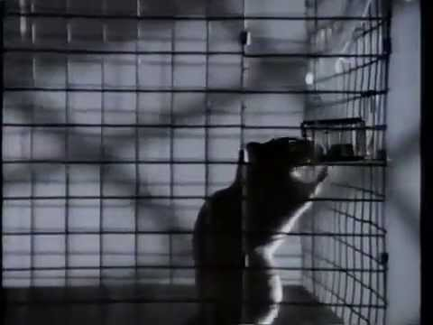
Addictions
80’s Experiment: A rat alone in a cage. One water bottle has drugs, the other is plain water.
The rat becomes obsessed with the drugged water and eventually dies

Slide 31
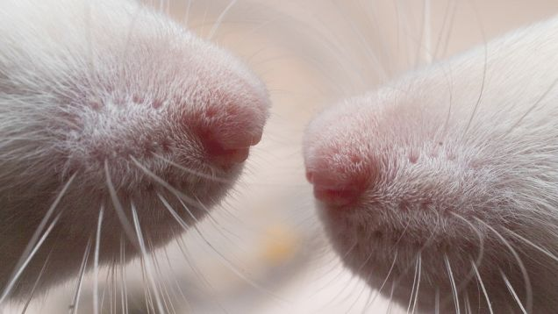
Bruce Alexander
Professor of Psychology in Vancouver Built a rat community
In an experiment created a rat cage with plenty of toys, food, tunnels, and friends
As well as a cage with none of those things

Slide 32
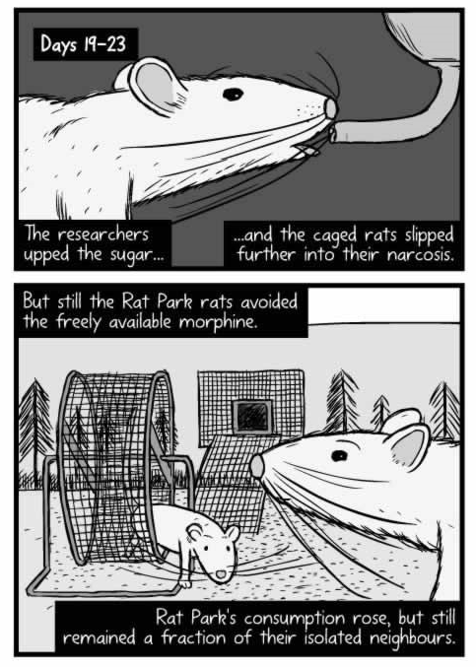
Comparative: rats who were alone drank the drugged water
Rats with friends tried the drugged water, but didn’t continue to drink it

Slide 33
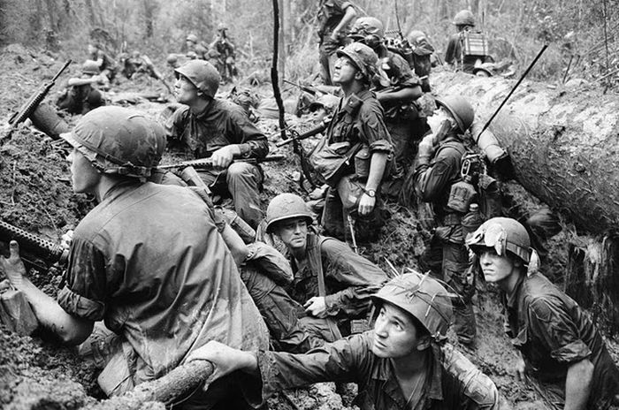
Vietnam
20% of soldiers used heroin while on duty
Raised concern about these soldiers coming home and still being addicted
95% of the addicts discontinued use after returning home

Slide 34
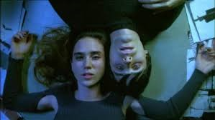
Concepts of Addiction
Hedonistic
A disease
Alexander: It’s not you, but your cage

Slide 35
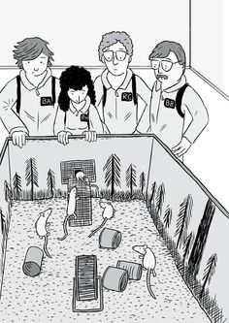
3rd Experiment
Rats alone in a cage with the drug for 57 days
Were then placed in the rat park
They went through withdrawal, but…

Slide 36
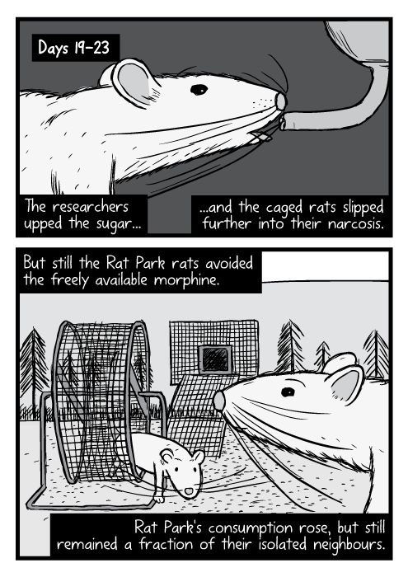
Ended up kicking the habit and adapting back to their surroundings

Slide 37
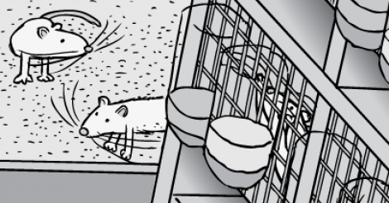
Another more common experiment…

Slide 38

Prescription Medicine
People who are prescribed opiates for injuries do not, in large percentages, become addicted to street heroin.

Slide 39
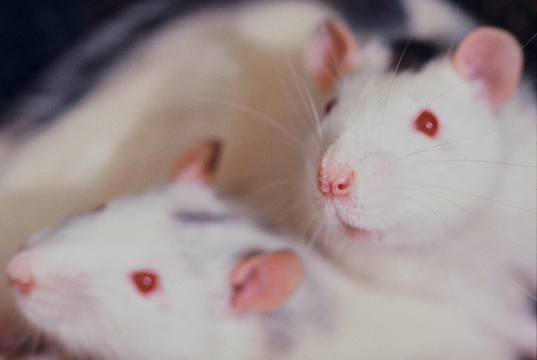
Street addicts are isolated & someone who is getting over an injury is quite possibly going home to families, work, friends etc.

Slide 40
Professor Peter Cohen (Centre for Drug Research.) argues that human beings have a deep need to bond and form connections. It's how we get our satisfaction. If we can't connect with each other, we will connect with anything we can find -- the whir of a roulette wheel or the prick of a syringe. He says we should stop talking about 'addiction' altogether, and instead call it 'bonding.' A heroin addict has bonded with heroin because she couldn't bond as fully with anything else.
So the opposite of addiction is not sobriety. It is human connection.
Notes:
Peter Cohen has been researching drug use, drug policy and drug use epidemiology at the Universiteit van Amsterdam, as director of the first Amsterdam Drug Research Program, and since 1996 as director of CEDRO, the Centre for Drug Research.

Slide 41
War on Drugs
Prisons isolate drug users more
Isolation (for drug offenses in prison)
Difficult to find work once they are out of jail
Leading to more isolation
The War on Drugs also costs money (keeping money from social programs, schools etc.)

Slide 42
Portugal had one of the worst drug problems in Europe, with 1 percent of the population addicted to heroin.

Slide 43
They had tried a drug war, and the problem just kept getting worse. So they decided to do something radically different.

Slide 44
They resolved to decriminalize all drugs, and transfer all the money they used to spend on arresting and jailing drug addicts, and spend it instead on reconnecting them -- to their own feelings, and to the wider society.

Slide 45
The most crucial step is to get them secure housing, and subsidized jobs so they have a purpose in life, and something to get out of bed for.

Slide 46
They were helped, in warm and welcoming clinics, to learn how to reconnect with their feelings, after years of trauma and stunning them into silence with drugs.

Slide 47
A group of addicts were given a loan to set up a removals firm. Suddenly, they were a group, all bonded to each other, and to the society, and responsible for each other's care.

Slide 48
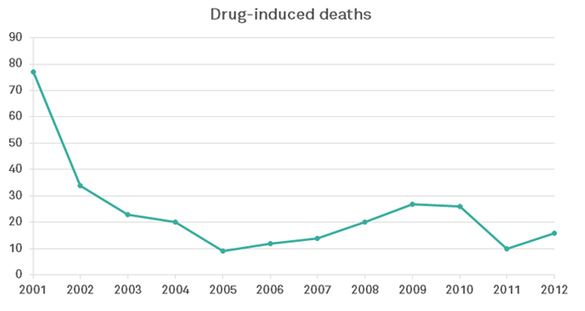
The results of all this are now in. An independent study by the British Journal of Criminology found that since total decriminalization, addiction has fallen, and injecting drug use is down by 50 percent and drug-induced deaths are down by 75%
Notes:
Portugal decriminalized the use of all drugs in 2001. Weed, cocaine, heroin, you name it -- Portugal decided to treat possession and use of small quantities of these drugs as a public health issue, not a criminal one. The drugs were still illegal, of course.

Slide 49
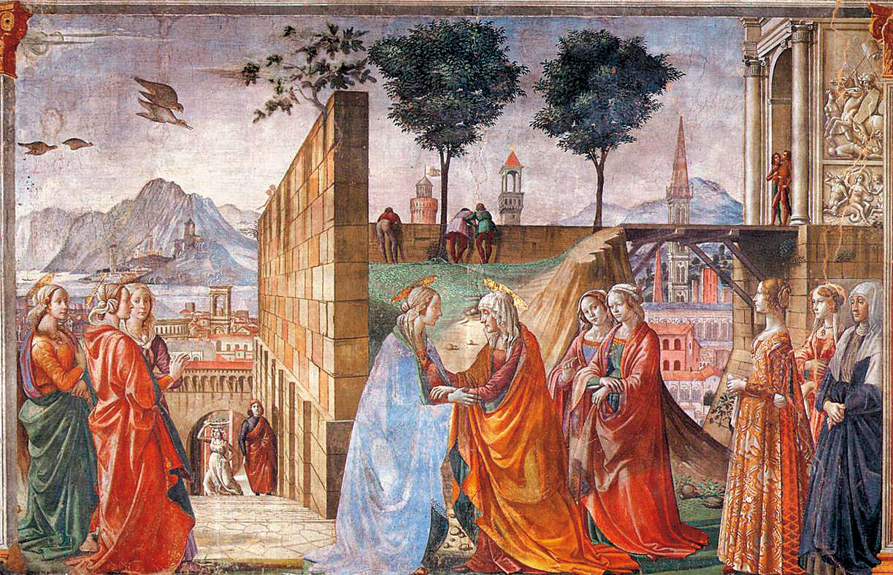
These studies help us think differently about ourselves
Human beings are bonding animals

Slide 50

Isolation
We have created an environment and a culture that cut us off from connection, or offer only the parody of it offered by the Internet. The rise of addiction is a symptom of a deeper sickness in the way we live -- constantly directing our gaze towards the next shiny object we should buy, rather than the human beings all around us.

Slide 51
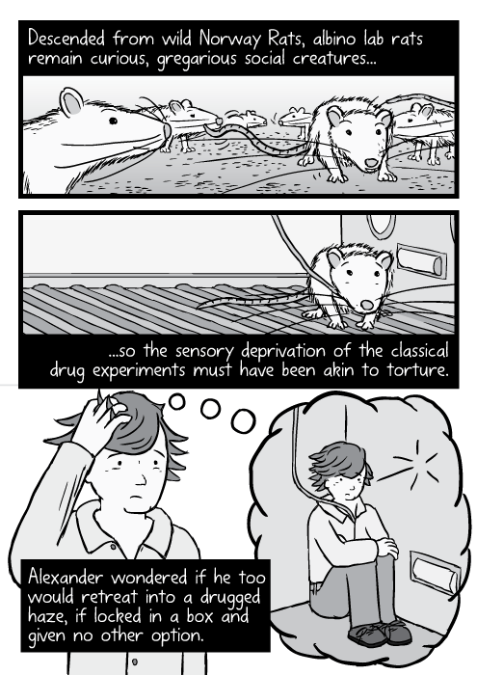
--For too long, we have talked exclusively about individual recovery from addiction. We need now to talk about social recovery -- how we all recover, together, from the sickness of isolation that is sinking on us like a thick fog.
--Bruce Alexander

