Slide 1
Epistemology
the study of the nature, origin, and limits of human knowledge.
How do we know things?
How do we understand something to be the truth?
Postman wants to show that definitions of the truth are derived, at least in part, from the character of the media of communication through which information is conveyed

Slide 2
Postman believes that some forms of truth telling are better than others
Some have a healthier influence than others
TV “we are getting sillier by the minute”

Slide 3
“the content of much of our public discourse has become dangerous nonsense”
Epistemology is concerned with the origins and nature of knowledge
Definitions of truth and the sources where such definitions come
Resonance: metaphor is a generative force—that is, the power of a phrase, a book, a character

Slide 4
There is no universal way to know truth, but rather that a civilization will identify truth largely based on its forms of communication.

Slide 5
Truth is linked to the biases of forms of expression
The truth is a cultural prejudice
Each culture conceives of it as being most authentically expressed in certain symbolic forms that other cultures may regard as trivial or irrelevant

Slide 6
Can a modern economist tell truths about our standard of living in a poem? a proverb? An anecdote?
In our current culture we feel the truth in economics is best to be discovered and expressed in numbers.

Slide 7
primitive oral culture
great stock in a man who remembers proverbs, since truth is passed on through such stories
Proverbs resonate in an oral culture
Resonance: something that is meaningful or important to someone—or to a culture

Slide 8
culture of the written word
Will find oral proverbs quaint
A rational argument will resonate
Logic
Exposition
Evidentiary support
Clarity

Slide 9
Typographic Culture
“The written word endures, the spoken word disappears, so writing is closer to the truth.
The rationality of written arguments would be considered superior to a proverb
In the typographic era America was different from what it is now: generally coherent, serious and rational

Slide 10
Television
limited our discourse to where all of our serious forms of discussion have turned into entertainment.
Television has influenced the way we live off the screen.
Junk TV is Ok, but it is dangerous when its aspirations are high

Slide 11
--A medium has the power to fly beyond that context into new and unexpected ones, because of the way it directs us to organize our minds and integrate our experience of the world

Slide 12
Medium of TV
Creates new forms of truth-telling
The epistemology of TV is inferior to a print based one
Amusement and pleasure are how TV communicates

Slide 13
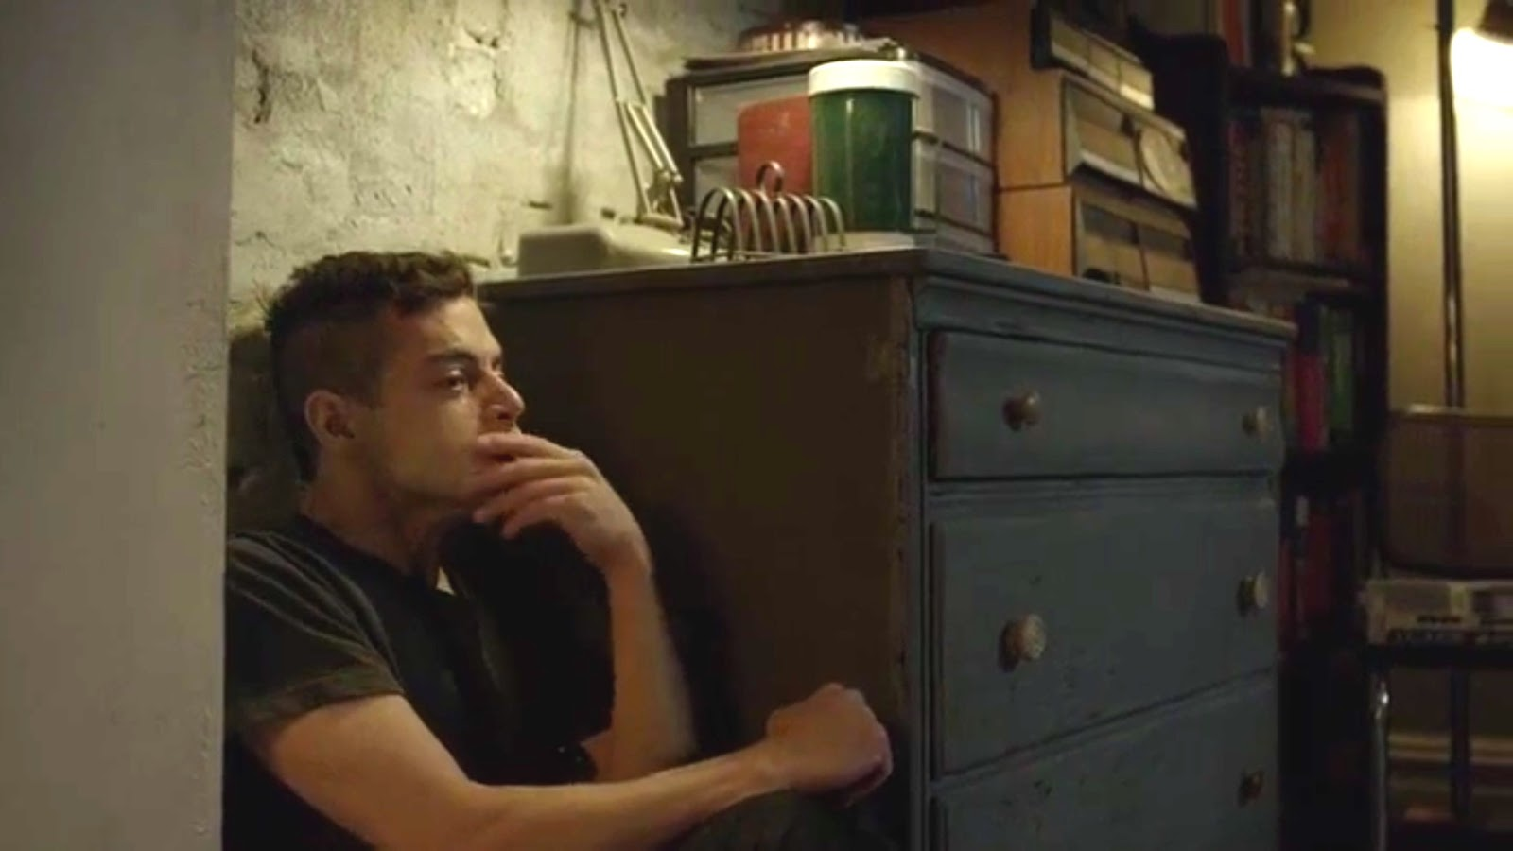
Emotional Power
Emotional power so great that it could arouse sentiment against the Vietnam War or against Racism
We must be careful in (fully) praising or condemning a medium because the future may hold surprises for us

Slide 14
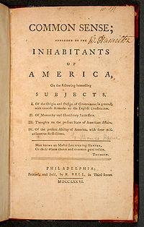
Literate Culture
Common Sense by Thomas Paine published 1776
The popularity of that book at the time is close to an event like the Superbowl
Different classes were all interested in reading about a variety of subjects
Printed matter was all that was available
America was founded by intellectuals
Notes:
by Thomas Paine in 1775–76 advocating independence from Great Britain to people in the Thirteen Colonies. Written in clear and persuasive prose, Paine marshaled moral and political arguments to encourage common people in the Colonies to fight for egalitarian government.

Slide 15
Literate Culture
Approaches the world from a rational perspective
based around a series of rational propositions that challenge a reader or audience to judge them as true or false, the entire society was founded around the idea of rational discourse.

Slide 16
“The Age of Exposition"
defined Typographic America
Exposition: a comprehensive description and explanation of an idea or theory.
replaced by a spectacle that prizes flash and entertainment over substance.
The message itself is less important than the entertainment value of its delivery.

Slide 17
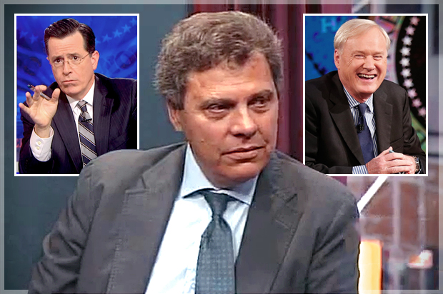
TV
Postman speaks highly of TV as a form of entertainment
His concern is that entertainment has become a dominant form of communication
Television influences: politics, education, religion, and journalism

Slide 18
Typographic Mind
Colonial mid nineteenth century
Early Americans were a literate culture
Written word is rational discourse
A written argument provides, exposition and makes points that are explained
The reader makes a judgment about whether the statements are true or false (based on supporting evidence)

Slide 19
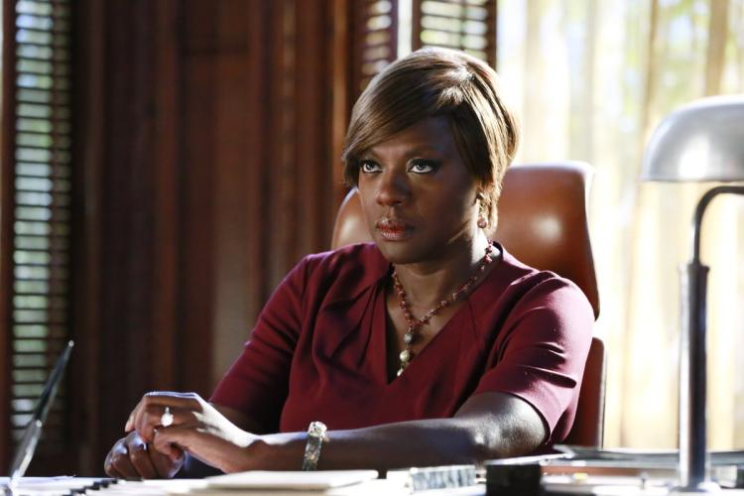
TV
Demands rapid-fire editing, non-stop stimulation, and quick decisions rather than rational deliberation (not in the case of The Wire)
Also, the pleasure of an ending that ties everything up into a bow
No spoilers either! The pleasure of a surprise ending that ties everything up.

Slide 20
A democracy of images
“Art’s past is digitally disseminated by futuristic technologies across the global village” (178).
Viewers around the world can easily see reproductions of famous works of art; televised performances of opera, for example, make it widely accessible.
“But for good or ill? And how have artists responded?”

Slide 21
Benjamin and the tarnished aura
chronicled the loss of that special halo or aura around great works, a loss that resulted from “the age of mechanical reproduction,” when new technologies could easily make copies of the Mona Lisa, turning a masterpiece into a cheap commodity.
WB regarded technical reproducibility as very promising: the age of photography and film would enable the masses to achieve a [pro-democratic] critical distance from any [potentially fascist] aura.
Notes:
Work of art in the Age of Mechanical Reproduction: 1936 The removal of authority within the original work of art infers a loss of authority, however, in regards to mass consumption, this liberation is not necessarily contingent.
he cameraman, for example, intervenes with what we see in a way which a painting can never do. It directs the eye towards a specific place and a specific story; at the same time it is radical and revolutionary it is also totalitarian. It guides us to a particular side of a story and leaves other parts out.
a whole new mode of deception and distraction also enters. For Benjamin, a distance from the aura is a good thing. The loss of the aura has the potential to open up the politicization of art, whether or not that opening is detrimental or beneficial is yet to be determined. However, it allows for us to raise political questions in regards to the reproducible image which can be used in one way or another.

Slide 22
Absence of Mind
Films commonly promise absence of mind rather than critical consciousness
the aura of the Mona Lisa remains appealing.

Slide 23
Canadian theorist Marshall McLuhan (1911-1980) popularized bold theses about the impact of the kind of technology that dominates a given historical age.
“The invention of print and books prompted many social changes, fostering individualism, linear thinking, privacy, repression of thought and feeling, detachment, specialization, and even modern militarization
The new media promote connectedness and a new international community (‘the global village’) that transcends parochial political barriers
The new media offer an aid or ‘prosthesis’ that changes our senses and even our brains to promote non-linear, ‘mosaic’ thinking, as viewers must fill in the blanks in continuously updated inputs.”
Notes:
l "technological determinism." He maintains that a major shift in society's predominant technology of communications is the crucially determining force behind social changes. Initiating great transformations not only in social organization but human sensibilities. The mass production of printed materials encouraged nationalism by allowing more rapid and wider spread of information than permitted by hand-written messages. The linear forms of print influenced music to repudiate the structure of repetition, as in Gregorian changes, for that of linear development, as in a symphony. Also, print reshaped the sensibility of Western man, for whereas he once saw experience as individual segments, as a collection of separate entities, man in the Renaissance saw life as he saw print--as a continuity, often with casual relationships. Print even made Protestantism possible, because the printed book, by enabling people to think alone, encouraged individual revelation. Finally: "All forms of mechanization emerge from movable type, for type is the prototype of all machines.”
The phrase first suggests that each medium develops an audience of people whose love for that medium is greater than their concern for its content. That is, the TV medium itself becomes the prime interest in watching television; just as some people like to read for the joy of experiencing print, and more find great pleasure in talking to just about anybody on the telephone, so others like television for the mixture of kinetic screen and relevant sound. Second, the "message" of a medium is the impact of its forms upon society. The "message" of print was all the aspects of Western culture that print influenced. "The message of the movie medium is that of transition from linear connections to configurations." Third, the aphorism suggests that the medium itself--its form-- shapes its limitations and possibilities for the communication of content. One medium is better than another at evoking a certain experience. American football, for example, is better on television than on radio or in a newspaper column; a bad football game on television is more interesting than a great game on radio. Most Congressional hearings, in contrast, are less boring in the newspaper than on television. Each medium seems to possess a hidden taste mechanism that encourages some styles and rejects others
Understanding Media: The Extensions of Man, published in 1964.[1]

Slide 24
McLuhan and MTV
By and large the videos are mind-numbing, with formulaic glamour shots, stage sets, pseudo-documentary street scenes, or neon animations.
videos alternate seamlessly with pulsing ads for shampoos, Levi’s, toothpaste, or even the army, MasterCard, Cadillacs, and life insurance.
These relentless ads, coupled with the fundamental marketing aim of the videos themselves—They could hardly believe that MTV has facilitated greater democratic participation and fostered the critical awareness of viewers gathered around the world into a genuine global village.
Instead it threatens to homogenize the world into a suburban American strip mall, crowded with McDonald’s and Gap stores.” (192-93)

Slide 25
Baudrillard in Disneyland
Theorist of the computer monitor
He describes an audience that is absent—lost in its own images
Notes:
Simulacra and Simulation (French: Simulacres et Simulation) is a 1981 philosophical treatise by Jean Baudrillard, in which he seeks to examine the relationships among reality, symbols, and society.
Simulacra are copies that depict things that either had no original to begin with, or that no longer have an original.[1] Simulation is the imitation of the operation of a real-world process or system over time.[2]

Slide 26
Hyperreal
Something fake and artificial that becomes more definitive of the real than reality itself
“the news” sound bites from staged rallies that determine outcomes of political contests
And Disneyland

Slide 27
Simulation
A copy or an imitation that substitutes for reality
TV speech of a political candidate is staged entirely to be seen on TV
Weddings exist in order for videos and photos to be made
Notes:
Read page 196

Slide 28
TV
False immediacy
Reverses Platonic relation between mimesis and reality
Representation precedes the reality and even comes to define it
It becomes more real than real or hyperreal

Slide 29
Self-Seduction
Certain aspects of the audience’s enjoyment of and participation in the hyperreal are creative and even subversive
If we are self-seducing ourselves in the spectacle, then we bear some responsibility
Notes:
Read page 197

Slide 30
Creativity
Artists are marginal to other forces tending towards general social vacuity and despair, so that ideals of individual creativity and self expression are no longer viable

Slide 34
