Slide 1
William Howard Taft (27th President)
Neil Postman questions whether a 300 pound man could be president today

Slide 2
Television
Gives us a conversation in images and not words

Slide 3
The news of the day
Comes from the telegraph
And is continued through the news media
Made it possible to move decontextualized information across vast distances
Without a medium to create its form, the news of the day does not exist
Aligns with Marshall McLuhan in this instance
Postman agrees that the clearest way to see through a culture is to look at its tools of conversation
William Fothergill Cooke and Charles Wheatstone's electric telegraph ("needle telegraph") from 1837

Slide 4
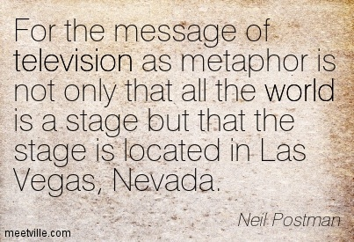
Metaphor
Suggests what a thing is like by comparing it to something else
Now metaphors are far more complex
Symbolism as communication rather than critical thinking
Postman associates linear thinking in reading with critical thinking

Slide 5
Medium vs. Metaphor
Message: denotes a specific, concrete statement about the world
Our current forms of media, including the symbols through which they permit conversation, do not make such statements.
They are more like metaphors, working by unobtrusive but powerful implication to enforce their special definitions of reality
Metaphor for American=Sizzler promotional video

Slide 6
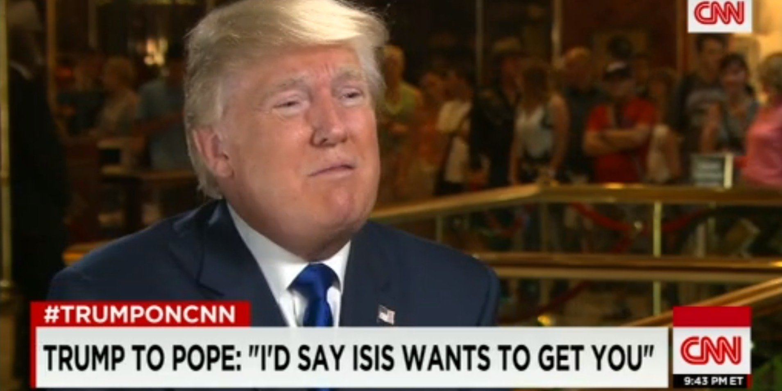
Media and Truth
There is no one way to know truth
A civilization’s media will determine that culture’s understanding of truth
Primitive oral cultures will value someone who has the ability to remember proverbs
A written culture may find proverbs quaint and value written word as the way to truth

Slide 7
“Truth, like time itself, is a product of a conversation man has with himself about and through the techniques of communication he has invented.”
“Some ways of truth-telling are better than others, and therefore have a healthier influence on the cultures that adopt them.”

Slide 8
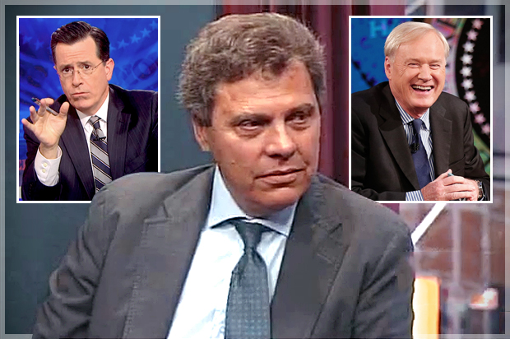
TV
Postman speaks highly of TV as a form of entertainment
His concern is that entertainment has become a dominant form of communication
Television influences: politics, education, religion, and journalism

Slide 9
Typographic Mind
Colonial-mid nineteenth century
Early Americans were a literate culture
Written word is rational discourse
A written argument provides, exposition and makes points that are explained
The reader makes a judgment about whether the statements are true or false (based on supporting evidence)

Slide 10
The Telegraph and the News of the Day
“Peek a boo world”
The telegraph (and later forms of media) bring instantaneous information that was no longer limited by geographic distance
Society became less driven by the understanding of context
The news of the day brings us irrelevant information divorced from its context.
The deliberate process of rational discourse began to break down

Slide 11
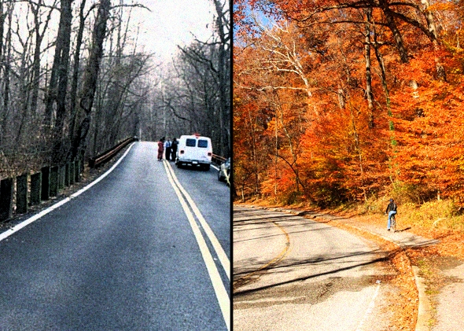
Serial: The Alibi (Exposition)
Jay recounts the entire day of the murder
the entire case hinges on just 21 minutes
the window of time in which Hae is killed
About those 21 minutes, precious little is known.
"The Alibi," lays out the day of the murder and Adnan's alibi that would clear him of killing Hae.

Slide 12
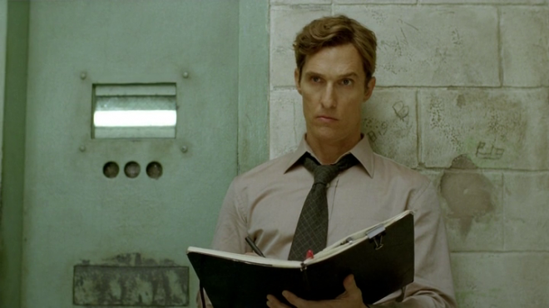
As a crime reporter or a lawyer
Question the truth of Jay’s statement
Find out reasons why Jay would lie
Point to moments in his testimony when he has implicated himself in a large crime
Have the detectives been involved in other cases where false testimonies have been made?
Interview many people about the timeline Jay gives
Point to the many times Jay changes his story

Slide 13
To write a crime story
You introduce intriguing characters
You delay the listeners access to information
You introduce information that makes a central character look either guilty or innocent (in Serial—week to week wavering from one to the other) forcing the audience to make hypotheses

Slide 14
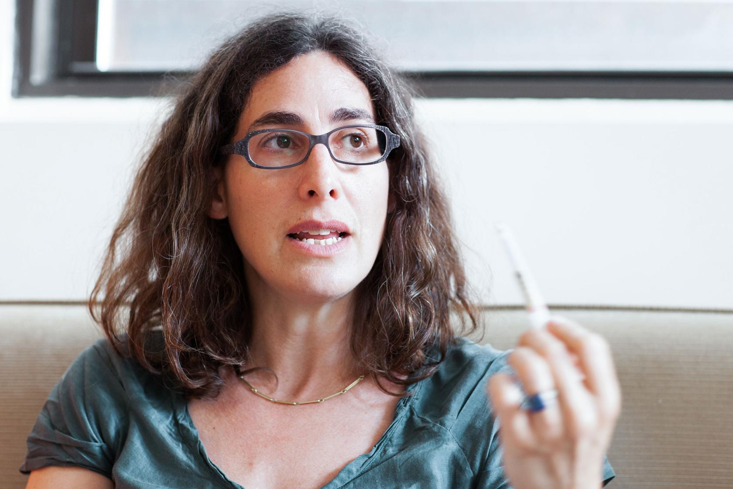
What is the exposition setting the listener up for?
The groundwork for finding the truth?
The groundwork for a good story?

Slide 15
The groundwork for a good story
Did Serial start the story by investigating Jay and why he would give that testimony?
Past trouble with the law?
Reward money?
How the investigators get him to cop to accessory (punishable by the death penalty)
Did Serial look at how the investigators focused primarily on Adnan?

Slide 16
They were not building the foundation for finding the truth
Serial sets up an amazing structure where each week we have certain aspects of the case revealed that lead us to question either Adnan or Jay
The story she is following, is the story of the investigators and the prosecution
That story is slanted and flawed
It is incomplete

Slide 17
Arousing Suspicion
Sarah gives the listener her story of being conflicted between the state’s (incomplete and flawed) investigation and her perception of Adnan

Slide 18
Humanization of the Invisible
In traditional crime stories characters like Adnan are not so richly humanized
This is the most truthful aspect to the Serial Podcast

Slide 19
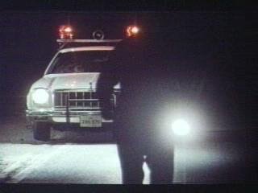
The Thin Blue Line (1988)
Documentary about the arrest and conviction of Randall Adams for the murder of a Dallas Policeman in 1976

Slide 20
Documentary
A documentary film is, at its heart, a document. The word comes from the Latin docere, to teach.

Slide 21
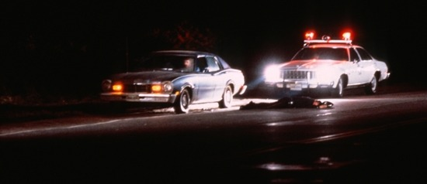
In aiming to inform, teach or persuade, the documentarian can be a recorder of history, a political activist, an observer of humanity, or a visual poet.

Slide 22
In his search to uncover the facts in the case of a convicted murderer, Morris seeks not only to reveal the truth but also to right a wrong, becoming, in essence, a self-proclaimed investigator and a purveyor of justice.
Notes:
--Credit Cathy Dunn

Slide 23
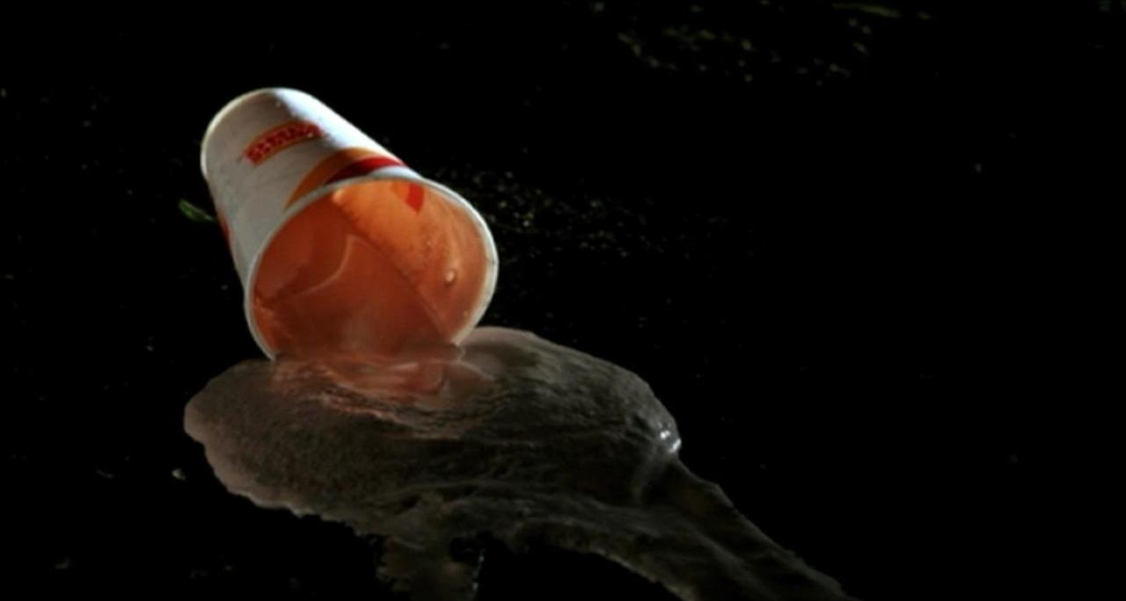
Reflexive
Draws attention to formal cinematic processes

Slide 24
Expressionistic
Milkshake sailing through air in slow motion
Stopwatch swinging back and forth
News clippings shown in microscopic close-ups
Stylized
Calls for the viewer to question what they are seeing and reflect on what it means

Slide 25
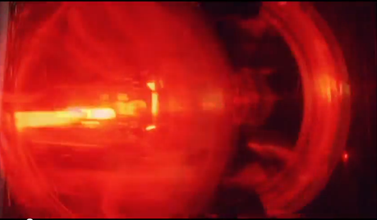
Allows Morris to expose the institutionalized “self-deception” that led to Adams’ conviction and life sentence

Slide 26
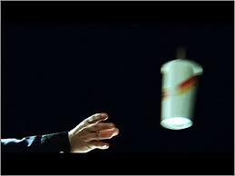
Re-enactments
Errol Morris’ crime re-enactments were meant to be hypnotic and expressive
Draw attention to varying viewpoints
The style has been used in countless “true-crime” shows since

Slide 27
Errol Morris
Morris’ films have won many awards, including an Academy Award for Best Documentary Feature, an Emmy, the Grand Jury Prize at Sundance Film Festival, the Silver Bear at Berlin International Film Festival, the Golden Horse at the Taiwan International Film Festival and the Edgar from the Mystery Writers of America.
The Tin Blue Line is one of the most acclaimed documentaries ever made

Slide 28
Errol Morris
He is a graduate of the University of Wisconsin-Madison and was a graduate student at Princeton University and the University of California-Berkeley.
Went to a variety of graduate school programs, and after attending Berkeley for some time became a regular at the Pacific Film Archives

Slide 29
Made two features (narratives) before making The Thin Blue Line
Morris was interested in Dr. James Grigson, a psychiatrist in Dallas.
Met Randall Dale Adams (was unconvinced of his innocence)
Not sure after reading transcripts and meeting David Harris
Notes:
The Death Penalty could only be issues if the jury is convinced that the defendant is not only guilty but will commit further violent crimes
Always gave the same testimony
Dr. Death Met Randall Dale Adams

Slide 30
At the time Morris was a private detective
Put together his skills with his interest in film
His un-edited interviews were used in Adams’ appeal hearing
Prosecution witnesses’ contradictions

Slide 31
“Two Films Grafted Together”
Simplest terms: “Did he do it or not?”
The film is also an essay on false history
A group of people, literally everyone, believed a version of the world that was entirely wrong.
His accidental investigation of the story provided a different version of what happened

Slide 32
Give an example of the film being reflexive
Give an example of the film being expressionist
How did your understanding of truth shift throughout the film?

