Slide 1
Confirmation Bias
tendency to search for, interpret, favor, and recall information in a way that confirms one's beliefs or hypotheses, while giving disproportionately less consideration to alternative possibilities
People display this bias when they gather or remember information selectively, or when they interpret it in a biased way.
The effect is stronger for emotionally charged issues and for deeply entrenched beliefs.
people show confirmation bias because they are weighing up the costs of being wrong, rather than investigating in a neutral, scientific way.
Notes:
Credit: wikipedia

Slide 2
What happens when you see someone behind bars?
How does that change your perspective?
Can anyone get the presumption of innocence?
Once the story is told that Adnan has been arrested and charged with a murder--you can’t help but have confirmation bias.
That makes you suspect him.
Also, since Jay is the primary witness, you may being thinking either it’s Adnan or Jay.
The cops perhaps had tunnel vision or were not in a position to find the truth

Slide 3
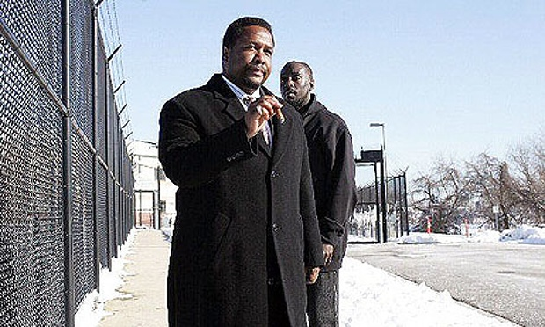
“The job isn’t about picking the stories you like best”
--Bunk Moreland

Slide 4
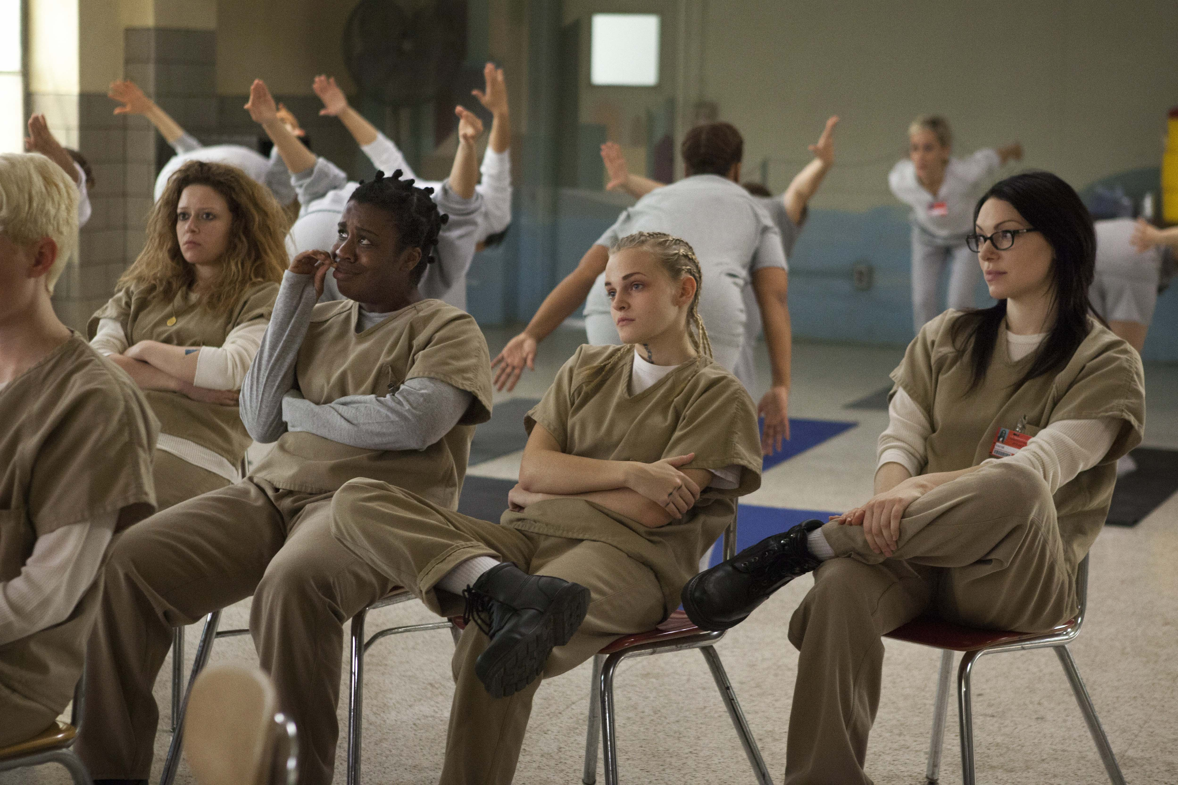
In Serial Melodrama Viewers get “hooked” on not so much a single story but the intertwining and of unfolding many stories.

Slide 5
From Season 5:
Great quotes don’t necessarily make a great story: “You got a guy telling us how rough it is on the street…that doesn’t have much pull; but if you can describe how it really is, tell his story in moments..
Writing with authenticity

Slide 6
Serial Drama
Segmented quality
Moves from place to place and also creates: Parallels, Contrasts, and Interruptions
Must parcel out (often melodramatic) units of information that grab attention
Also grabs attention through stories about compelling characters facing difficult obstacles

Slide 7
TV Melodrama
Series
Season
Episode
Beat

Slide 8
Beats
Smallest unit of TV time
Rapid succession of short segments—each organized into an “act” that leads to a commercial
Each act (many times 4 or 5) contain six beats
Each act is meant to leave the audience in anticipation of what will happen after the commercial break
Even though there aren’t commercial breaks on cable, stories are still arranged by beats
The final act leading up to some sort of closure
Short beats can allow for more complex weavings in a longer serial as long as the storytelling is clear
No “natural” reason for the segmentation except for the necessity of commercial breaks

Slide 9
Beats and Acts in The Wire
Each representation of a storyline consists of beats and acts
For the most part a cut from one storyline to another cuts from one act to another—sometimes acts are interrupted

Slide 10
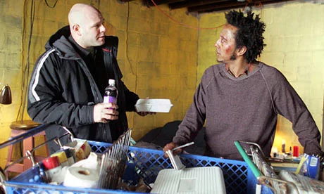
Ex: Herc and Bubbles
Storyline: Bubbles informs Herc that Marlo is a preacher
Acts: ends with a beat—Bubbles tries to sell his phone
Storyline ends when Herc pulls over the preacher.

Slide 11
Bop Gun, Homicide Episode
Central figures are a middle class white cop and a middle class white victim
Gritty and realistic
Rifle-shot style of storytelling (or journalism)
Editorializing is present (strong gun control statement—not explicitly stated)
Mystery is solved at the end

Slide 12
“Time after Time” The Wire
Fall of The Towers
Drug Surveillance
Cops chase drug dealers (ineffectively)
“Bubbles” gets his pants stolen by Marlo
Thomas Carcetti is introduced at a city council meeting
Prison scene, “Cutty” is introduced
Upper level police politics
Jimmy McNulty and Bunk are at an Orioles game
Meeting between Burrell, Rawls and Colvin about crime stats
McNulty argues with Daniels about continuing wire taps
Someone tries to deal drugs to Bunny Colvin and he sees the futility of it all

Slide 13
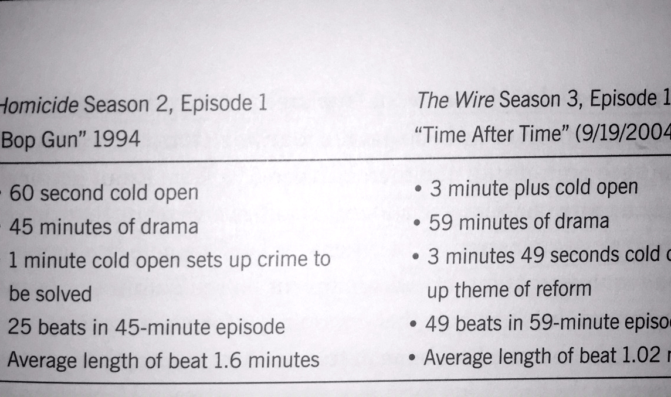

Slide 14
Style
Homicide must arouse and re-arouse our interest because of commercial breaks and weak seriality
The Wire doesn’t even try
Nothing is resolved
No redundancy
It assumes audiences are paying attention—and demands that they do
Opens up many narrative threads and story arcs without offering any payoff or closure

Slide 15
It is more complex than typical TV
Doesn’t always satisfy the audience
Nothing happens in the episode in a traditional sense, but is thematically rich
Narrative and character arcs are rich and complex
They still obey the basic rhythmic structure of serial television
There just aren’t mini-climaxes before the commercial break

Slide 16
The Wire has a lack of enigma
The audience doesn’t wonder who killed whom
Similar liberal outrage as “Homicide”
Deploys fuller “world and time” of serial melodrama in The Wire
The worlds of the “underclass” in The Wire are observed closely as those of the police
Typical rhythm of TV extended to many different equally important worlds

Slide 17
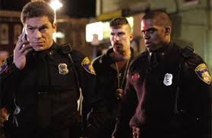
The editorial voice of Simon is heard in parallel cutting or cross-cutting
Ex: Season 4 Cross-Cutting from a power-point given to teachers and police.
The rapid cross-cuts across institutions are Simon’s way of creating editorial critique
This cross-cutting builds a very large and comprehensive world
All institutions represented in that episode of The Wire are all attempting to institute change in its own way

Slide 18
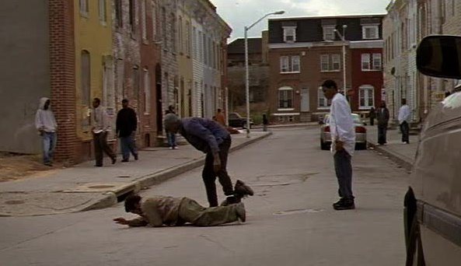
Melodramatic Conventions and their Effect on Culture
To repeat—we are not taking about the less respected, and antiquated conventions of melodrama
Recognition of good and evil and in that the recognition of the utopian hope that justice will be done
Notes:
like over-the-top music and performance you end up with something present in a lot of forms

Slide 19
Melodrama
Endures not only as an archaic holdover of the nineteenth-century stage play (virtuous victims and leering villains)
Or as women’s films or chick flicks, Oprah confessions, not only as soap operas and disease-of-the-week TV movies
Williams recognizes it as an evolving mode of storytelling crucial to the establishment of moral good in a secular, liberal age
It is not old-fashioned, creaky, stage-bound drama
It seeks a justice that is part of the liberal sensibility
It endures in The Wire
Nietzschean Ressentiment
Friedrich Wilhelm Nietzsche
Notes:
On the Genealogy of Morality 1887
Book by Friedrich Nietzsche
World enough and time it moves beyond Nietzschean ressentiment and beyond the generation of mere pity
is a sense of hostility directed at that which one identifies as the cause of one's frustration, that is, an assignment of blame for one's frustration.
If I suffer, self-righteousness contends, that I am good and deserve to triumph
Is melodrama condemned only to repeat these patterns of personal injury, suffering and vindication?

Slide 20

Tragedy and The Wire
Many critics call it a tragedy, because it is serious and realistic
Unafraid of facing the worst aspects of American Life
Linda Williams insists on calling it Melodrama even though the term brings with it many negative clichés
The Wire self-consciously avoids many of the well-known aesthetics of melodrama
Most of the negative qualities we attribute to melodrama come from the 19th century stage
Notes:
Pounding music, pathetic victims mustache twirlers badly motivated happy endings
19th century and early 20th century film that migrated from the stage ◊August Friederich von Kotzebue (1761-1819) – German – over 200 plays: domestic melodramas:August Friederich von Kotzebue (1761-1819) – German – over 200 plays: domestic melodramas:Uncle Tom’s Cabin – the novel by Harriet Beecher Stowe (1852) had several dramatizations:
George L. Aiken’s was the most popular--1853. Six acts, done without an afterpiece – established the single-play format. 325 performances in New York.
In the 1870’s, at least 50 companies doing it in the U.S.
In 1899: 500 companies.
In 1927: 12 still doing it.
12 movie versions since 1900.
The most popular melodrama in the world until the First World War.

Slide 21
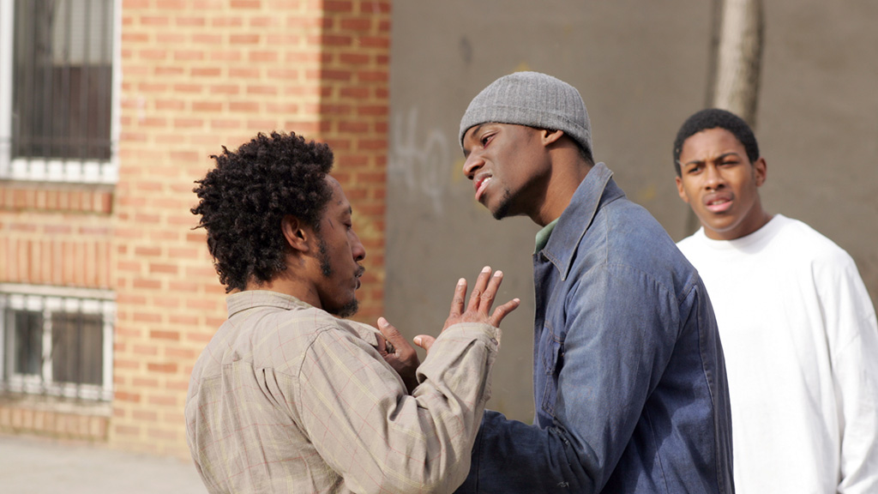
Melodrama, less enlightened than classical forms?
Modernity of melodrama—not just frozen in the high hyperbole of the 19th Century French Stage
Are all further developments of melodrama callbacks to earlier forms rather than a continued response to the changing conditions of modernity?
The term is commonly tied to excess
Notes:
hyperbole: is an extreme exaggeration used to make a point. It is like the opposite of “understatement.” It is from a Greek word meaning “excess.” Hyperboles can be found in literature and oral communication.
melodrama is a dramatic or literary work in which the plot, which is typically sensational and designed to appeal strongly to the emotions, melodramas are dramas of the 18th and 19th centuries in which orchestral music or song was used to accompany the action. 19th-century French word mélodrame Beginning in France after the theatre monopolies were abolished in 1791 during the French Revolution, melodrama became the most popular theatrical form of the century. Although monopolies and subsidies were reinstated under Napoleon, theatrical melodrama continued to be more popular and brought in larger audiences than the state-sponsored drama and operas. Although melodrama can be traced back to classical Greece, the term mélodrame did not appear until 1766 and only became popular after 1800. August von Kotzebue's Misanthropy and Repentance (1798) is often considered the first melodramatic play. The plays of Kotzebue and René Charles Guilbert de Pixérécourt established melodrama as the dominant dramatic form of the early 19th century.[3] David Grimsted, in his book Melodrama Unveiled (1968), argues that:
Its conventions were false, its language stilted and commonplace, its characters stereotypes, and its morality and theology gross simplifications. Yet its appeal was great and understandable. It took the lives of common people seriously and paid much respect to their superior purity and wisdom. [...] And its moral parable struggled to reconcile social fears and life's awesomeness with the period's confidence in absolute moral standards, man's upward progress, and a benevolent providence that insured the triumph of the pure.[4]
In Paris, the 19th century saw a flourishing of melodrama in the many theatres that were located on the popular Boulevard du Crime, especially in the Gaîté. All this was to come to an end, however, when most of these theatres were demolished during the rebuilding of Paris by Baron Haussmann in 1862.[5]
By the end of the 19th century, the term melodrama had nearly exclusively narrowed down to a specific genre of salon entertainment: more or less rhythmically spoken words (often poetry)—not sung, sometimes more or less enacted, at least with some dramatic structure or plot—synchronized to an accompaniment of music (usually piano). It was looked down on as a genre for authors and composers of lesser stature (probably also the reason why virtually no realisations of the genre are still remembered).

Slide 22
More excessive than what?
At the beginning of the 19th century Melodrama was excessive compared to the respected Neo-Classical Tragedy
Excessive compared to the decorum, unity, and efficiency of the earlier high culture form of Neo-Classical Tragedy
(in Classical Tragedy) No grand gestures, no startling tableaux, no music etc
(In melo-drama) Hyperbolic, bigger than life, inflated rhetoric, unprecedented use of music
The term comes from “le melodrame” drama with music
What mattered most in this modern change to the theatre was not the excess of music, but that it was used at all
Notes:
Greek and roman forms on which it was based Greek tragedy was a popular and influential form of drama performed in theatres across ancient Greece from the late 6th century BCE. The most famous playwrights of the genre were Aeschylus, Sophocles, and Euripides and many of their works were still performed centuries after their initial premiere. Following the expansion of the Roman Republic (509–27 BCE) into several Greek territories between 270–240 BCE, Rome encountered Greek tragedy neo-classical: 17th- and 18th-century France was the neoclassical drama. Neoclassical theorists advocated a return to the values and conventions of classical Greek drama as these were then understood. In particular, they ascribed a great importance to the Poetics of Aristotle, and to the unities of time, place, and action that they deduced from this work.

Slide 23
When you walk through the garden
You gotta watch your back
Well I beg your pardon
Walk the straight and narrow track
If you walk with Jesus
He’s gonna save your soul
You gotta keep the devil way down in the hole
Notes:
Tom Wait’s Way Down in the Hole 1987 all variations of the same thing, a cycle, the kids become the players in the next cycle, and the mayor becomes the same as the old mayor. Addiction keep the devil way down in the hole

Slide 24

Music in The Wire
There is none, except for the opening theme
And season finale montage sequences
Non-diegetic music
Diegetic music
Sounds that evoke emotions
There aren’t specific cues indicating exactly how you should feel at any given time
Notes:
Unsourced melos—extra-diegetic music an ancient Greek term meaning a tune, a melody, or a lyric poem intended for singing. In ancient Greek music theory “melos”meant the melodic basis of music. The teaching of harmonics and melopoeia was associated with melos.

Slide 25
Absence of Music=Absence of Melodrama?
Does this make the work more realistic as opposed to melodramatic?
Highly restricted use of music, repetitive serial nature of the performance of that music from the opening sequence
Infrequent music, understated music, and different versions of the same music do not undermine the power of melos to make an audience feel, but it can enhance it
The absence of music doesn’t necessarily mean realism
Maybe we have come full circle—mid-19th century (introduction of music to drama—and now less music makes for more effective melodrama)
Notes:
Term used by Richard Wagner to denote the vocal progressions in some of his operas that do not have the form or unity of regular melodies.
For more information on the music term "Melos" check out these other resources:

Slide 26
Demand for Justice
Melodrama has been increasingly approached less as a fly-by- night genre by academics like Peter Brooks and Linda Williams
Less as manipulative lower form and more of an enduring mode of expression and experience
Increasing number of scholars consider the study of modernity to be grounded in new conditions and ways of thinking about experience like family, gender and race that melodrama, not tragedy is a much more appropriate way to address current conditions
In Greek Tragedy there is a constant theme of injustice, tragic heroes may rail against injustice, but eventually must accept their fate
Melodrama demands justice, while tragedy reconciles us to its lack
Notes:
The melodramatic imagination: Balzac, Henry James, Melodrama and the Mode of Excess

Slide 27
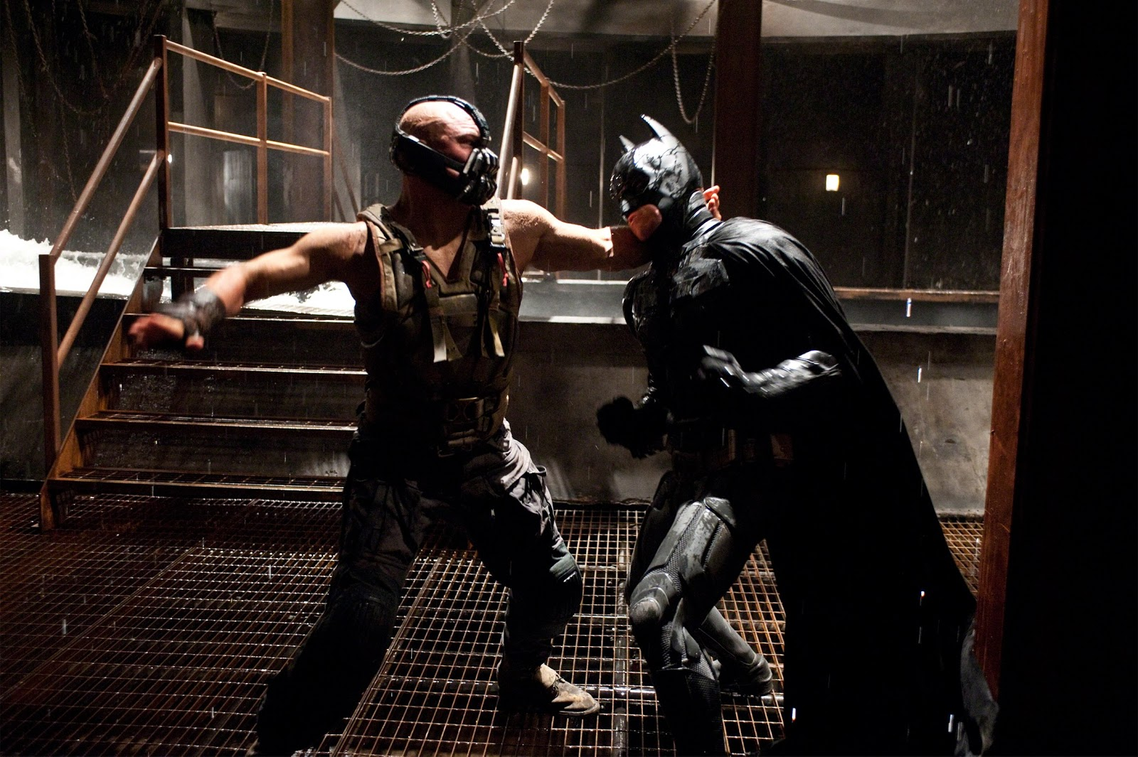
Blockbuster Films
Pathos of the suffering victim turned righteous action hero is the convention of the contemporary popular melodrama

Slide 28
Examples of Melodramatic Imagination in American Culture
Conquest of the West
Invasion of other Countries
We imagine ourselves as suffering at the hand of villainous others
Or more prevalent at the end of the Viet-Nam era we are forced to see ourselves as the villains
As long as we can portray ourselves as victims we seem to morally deserve to conquer and invade

Slide 29
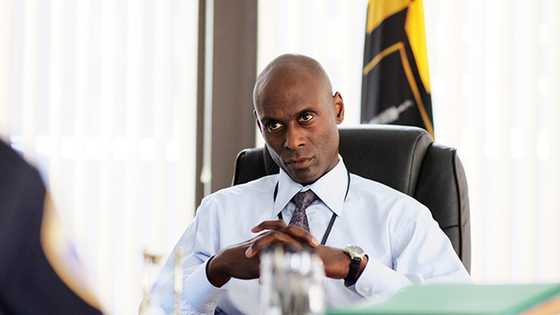
The Wire recognizes, but does not always show institutional routes to good
Enlists a form of realism to generate outrage against realities that could and should (according to its creators) be changed
The emphasis on how things should be i.e. justice, renders it as melodrama rather than tragedy.

Slide 30
Ressentiment
a sense of hostility directed at that which one identifies as the cause of one's frustration, that is, an assignment of blame for one's frustration.
If I suffer, self-righteousness contends, that I am good and deserve to triumph?
Is melodrama condemned only to repeat these patterns of personal injury, suffering and vindication?
Notes:
riedrich Wilhelm Nietzsche (/ˈniːtʃə/ German: [ˈfʁiːdʁɪç ˈvɪlhɛlm ˈniːt͡sʃə]; 15 October 1844 – 25 August 1900) On the Genealogy of Morality On the Genealogy of Morality

Slide 31
Is melodrama itself the problem as greater portions of the modern imagination have been given over to its influence?
Matthew Buckley asks whether melodrama’s affective structures and sensational effects have become by now “a normative form of feeling and thought”
Notes:
University, New Brunswick, where he teaches courses on comparative drama, media, and visual culture in modernity.

Slide 32
In a variety of contexts it reassures an individual group of its inherent virtue as well as the villainy of those who threaten us
“left melodrama” melodrama that particularly works in the American context towards social justice
“War on Terror” American freedom was attacked by a villainous other and the response to that attack ironically increased state power.
Notes:
The USA PATRIOT Act is an Act of Congress that was signed into law by President George W. Bush on October 26, 2001. Its title is a ten-letter backronym (USA PATRIOT) that stands for "Uniting and Strengthening America by Providing Appropriate Tools Required to Intercept and Obstruct Terrorism Act of 2001".
In the aftermath of 9/11, President George W. Bush guided the Patriot Act through Congress, unilaterally expanded surveillance of Americans, amplified executive detention authority and took other dramatic measures that shifted the balance between liberty and government power significantly, in the name of national security.
After the initial Patriot Act was passed, many Democrats perceived the growing threat to civil liberties and started to have misgivings. Now, five years into the Obama presidency enthusiasm for these measures seems to be bipartisan.

Slide 33
Linda Williams asks if there could be a less self righteous melodrama—less dependent on wild swings between pathos and action, less a matter of cycles of victimization and retributive violence
Can we reach beyond personal good or evil to determinations of better justice?
Notes:
Pathos a quality that evokes pity or sadness.

Slide 34
The Wire
Breaks some—not all—of the pervasive forms of melodramatic thinking
The seriality of The Wire and the blurring of the lines between good and evil
showing multiple sites
Its central dilemma is that “good” is no-longer self evident in a neo-liberal world
The drama, the realism, and the tragic situations make us yearn for that “good” or justice without being overly simplistic
Notes:
advocates of neo-liberalism support extensive economic liberalization policies such as privatization, fiscal austerity, deregulation, free trade, and reductions in government spending in order to enhance the role of the private sector in the economy.
Bubbles is an example of an Entrepreneur making it on his own, having his own business and The Wire shows that Bubbles on his own is very vulnerable he asks for nothing from the dwindling welfare state the wire makes the case for state sponsored care and thus against neo-liberal ideology the failure of bubble’s own neoliberal ethic of self sufficiency

Slide 35
The Mode of Melodrama still Holds us in its Grip!
Melodrama is a central form of communication (poetics of modern life—according to Peter Brooks)
Inextricable from popular media
It should be part of our modern vocabulary
We should be able to complain about it when its archaic qualities persist
Notes:
The Melodramatic Imagination Peter Brooks these "realist" novelists created fiction using the rhetoric and excess of melodrama - in particular its secularized conflicts of good and evil, salvation and damnation. The Melodramatic Imagination has become a classic work for understanding theater, fiction, and film.

Slide 36
We should also appreciate it when it evolves into something new (As in the case of The Wire)
It can be a tool with which mass culture makes a case for some kind of justice (not just a way of forming simplistic views of good and evil—sufferer and villain)
Validates aspirations of a liberal democracy in a neo-liberal era

