Slide 1
Dis-information
If the lies of a president could be dramatized like a film, then there would be outrage
Lie = Contradiction
Understanding a contradiction requires context
Notes:
Statements and events must be perceived as interrelated aspects of a continuous and coherent context in order for those contradictions to be perceived

Slide 2
Debates
Debates between Stephen A. Douglas and Abraham Lincoln took place on August 21 1858. Douglas spoke first (for three hours) and Lincoln needed at least that long for a rebuttal.
Current Debates:
Quick one-liners
Talking Points
Nothing too dry, intellectual, or contextual
Notes:
Everyone went home, had dinner, and came back for Lincoln’s 4 hour rebuttal! That was the first of seven debates ALL THAT LONG! Who are these people who watched these DEBATES?! THEY WEREN”T EVEN PRESIDENTIAL DEBATES!!!! People watching this were people who regarded them as essential to their own political education!
The critical issues dividing the nation--slavery versus free labor, popular sovereignty, and the legal and political status of black Americans --were brought into sharp focus in a series of dramatic debates during the 1858 election campaign for U.S. senator from Illinois. The campaign pitted a little-known lawyer from Springfield named Abraham Lincoln against Senator Stephen A. Douglas, the front runner for the Democratic presidential nomination in 1860.
The Lincoln–Douglas Debates of 1858 (also known as The Great Debates of 1858) were a series of seven debates between Abraham Lincoln, the Republican candidate for the United States Senate fromIllinois, and incumbent Senator Stephen Douglas, the Democratic Party candidate.

Slide 3
Addictions
http://www.huffingtonpost.com/johann-hari/the-real-cause-of-addicti_b_6506936.html
80’s Experiment: A rat alone in a cage. One water bottle has drugs, the other is plain water. The rat becomes obsessed with the drugged water and eventually dies

Slide 4
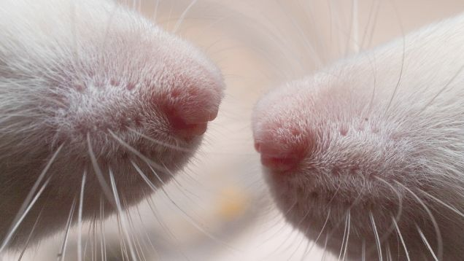
Bruce Alexander
professor of Psychology in Vancouver called Bruce Alexander
Built a rat community
Rat cage with plenty of toys, food, tunnels, and friends
Comparative: rats who were alone drank the drugged water
Rats with friends tried the drugged water, but didn’t continue to drink it

Slide 5
Vietnam
Heroin use was common amongst US soldiers
20% of soldiers
Concern about these soldiers coming home and still being addicted
95% of the addicts discontinued use after returning home

Slide 6
Concepts of Addiction
Hedonistic
A disease
Alexander: It’s not you, but your cage

Slide 7
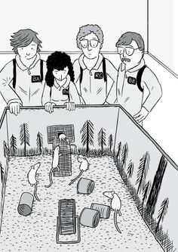
3rd Experiment
Rats were in a cage alone in a cage with the drug for 57 days
They were then placed in the rat park
They went through withdrawal, but…

Slide 8
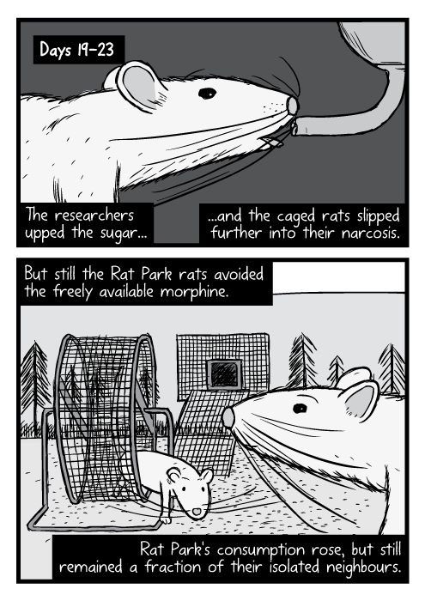
Ended up kicking the habit and adapting back to their surroundings

Slide 9
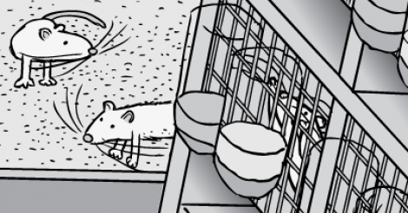
Another more common experiment…

Slide 10
Prescription Medicine
People who are prescribed opiates for injuries do not, in large percentages, become addicted to street heroin.

Slide 11
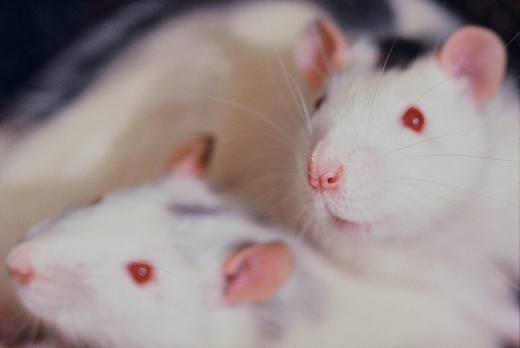
Street addicts are isolated &
Someone who is getting over an injury is quite possibly going home to families, work, friends etc.

Slide 12
Professor Peter Cohen argues that human beings have a deep need to bond and form connections. It's how we get our satisfaction. If we can't connect with each other, we will connect with anything we can find -- the whirr of a roulette wheel or the prick of a syringe. He says we should stop talking about 'addiction' altogether, and instead call it 'bonding.' A heroin addict has bonded with heroin because she couldn't bond as fully with anything else.
So the opposite of addiction is not sobriety. It is human connection.

Slide 13
War on Drugs
Prisons isolate drug users more
Isolation (for drug offenses in prison)
Difficult to find work once they are out of jail
Leading to more isolation
The War on Drugs also costs money (keeping money from social programs, schools etc.)
Notes:
Portugal had one of the worst drug problems in Europe, with 1 percent of the population addicted to heroin. They had tried a drug war, and the problem just kept getting worse. So they decided to do something radically different. They resolved to decriminalize all drugs, and transfer all the money they used to spend on arresting and jailing drug addicts, and spend it instead on reconnecting them -- to their own feelings, and to the wider society. The most crucial step is to get them secure housing, and subsidized jobs so they have a purpose in life, and something to get out of bed for. I watched as they are helped, in warm and welcoming clinics, to learn how to reconnect with their feelings, after years of trauma and stunning them into silence with drugs.

Slide 14
One example I learned about was a group of addicts who were given a loan to set up a removals firm. Suddenly, they were a group, all bonded to each other, and to the society, and responsible for each other's care.

Slide 15
The results of all this are now in. An independent study by the British Journal of Criminology found that since total decriminalization, addiction has fallen, and injecting drug use is down by 50 percent

Slide 16
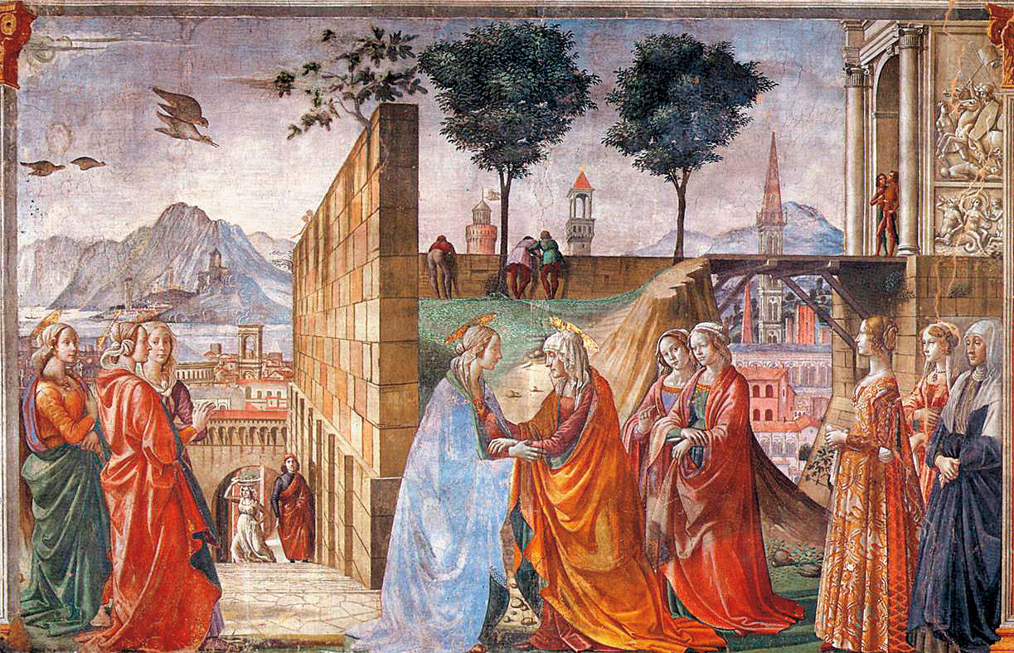
These studies help us think differently about ourselves
Human beings are bonding animals

Slide 17
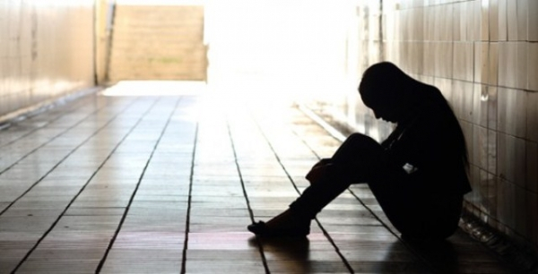
Isolation
ISOLATION
We have created an environment and a culture that cut us off from connection, or offer only the parody of it offered by the Internet. The rise of addiction is a symptom of a deeper sickness in the way we live -- constantly directing our gaze towards the next shiny object we should buy, rather than the human beings all around us.

Slide 18
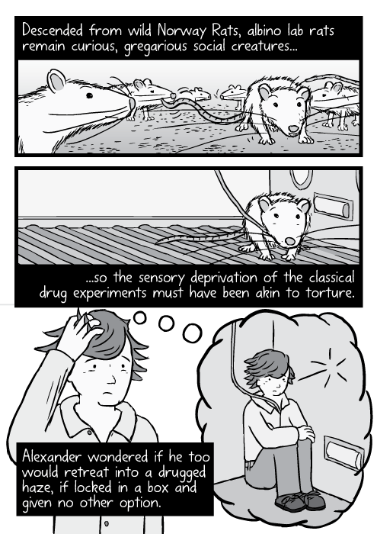
--For too long, we have talked exclusively about individual recovery from addiction. We need now to talk about social recovery -- how we all recover, together, from the sickness of isolation that is sinking on us like a thick fog.
--Bruce Alexander

Slide 19
Religion
Art
Music
Icons
Ritual

Slide 20
Entertainment
Are all of these things entertaining?
Is there another word?
“Enchantment”
By endowing these things with “magic” enchantment is the means through which we may gain access to sacredness
Entertainment is the means by which we separate ourselves from it

Slide 21
Television (or any screen)
Has a strong bias towards a psychology of secularism
The power of a close-up face makes idolatry a hazard
Brings personalities into our hearts and not abstractions into our heads
Walter Cronkite plays better than the Milky Way and Jimmy Swaggart better than Jesus
Attracts viewers by the millions (good thing?)

Slide 22
Television Commercial
Assault on capitalism
Capitalism was originally an outgrowth of the Enlightenment
Its principal theorists believed capitalism should be based on the idea that both buyer and seller are sufficiently mature, well informed, and reasonable to engage in transactions of mutual self interest

Slide 23
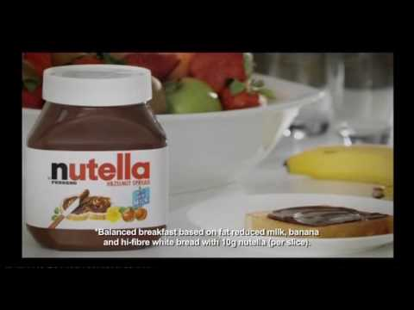
Commercials
Legally, companies are supposed to tell the truth about their products
That law is destroyed when commercials come into play
The discourse of “true” and “false” is discarded in commercials
Empirical tests, logical analysis, and any elements of reason are impotent

Slide 24
If a seller produces nothing of value, as determined by a rational market place, then the seller loses out
The assumption of rationality among buyers that spurs competitors to become winners, and winners to keep winning

Slide 25
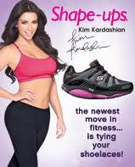
Television commercials made linguistic discourse obsolete as the basis for product decisions
Images are substituted for claims
Pictorial commercials made emotional appeal not tests of truth, the basis of consumer decisions
The distance between rationality and advertising wide

Slide 26
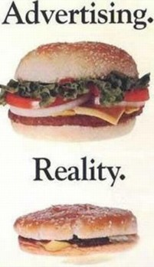
The truth of an advertisement’s claim is not an issue

Slide 27
The commercial insists on unprecedented brevity
Disdains exposition
Complex language is not to be trusted
The argument is in bad taste and leads only to intolerable uncertainty

Slide 28
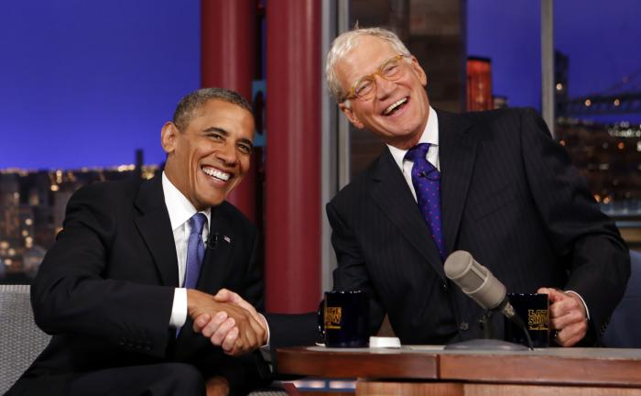
Politics as show business
What if we didn’t know anything about the politicians except their policies, voting history etc?
What do we know primarily about politicians?

Slide 29
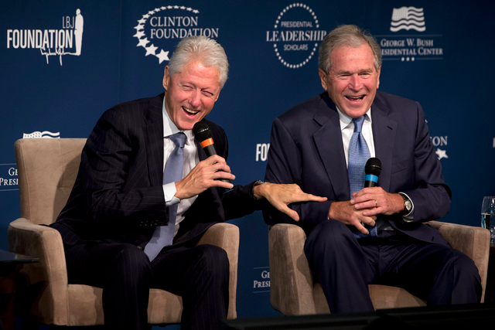
What makes a better politician?
Capable in negotiation?
More imaginative in executive skill?
More knowledgeable in international affairs?
More understanding of the interrelations of economic systems?

Slide 30
Reach out and Touch Someone
The reason we almost always believe a politician is better is because of image
A politician does not offer an image of himself
A politician offers himself as an image of the audience
Reach out and Touch Someone: Most powerful example of the TV commercial on political discourse

Slide 31
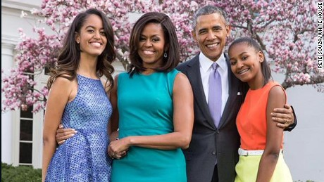
The lesson of most TV commercials like “Reach out and Touch Someone” They provide a slogan, or a symbol or a focus that creates for viewers a comprehensive and compelling vision of themselves
We are likely to vote for people whose personality, family life, and style, as imaged on screen, reflect our most positive images of ourselves

Slide 32
Voter Interests
Tangible Interests
Symbolic interests
Supreme Court Appointments
Investment in programs that have positive effect on the populace
Protection from Bureaucracy
Support for one’s own union community
Support for poor and homeless
Image
Charm
Good looks
Celebrity
Personal disclosure

Slide 33
TV and (lack of) History
“The past is a world, and not a void of grey haze” --Thomas Carlyle
The past is not just a world, but a living world
The world of the present is the most shadowy and difficult to understand
The world of television is all about immediacy
The quickness of information and TV communication removes contextual and historical content from politics

Slide 34
Huxleyan vs Orwellian
Television does not ban books it displaces them
With a limited ability to interpret, contextualize (historically and conceptually) we have way of protecting ourselves from corporate America

