Slide 1
Comparisons
Criticism of a TV mind vs. a typographic mind (Postman)
TV as a way to communicate context and complexity when print journalism no longer can (The Wire)
Radio program that seems like long-form journalism, but is actually crime storytelling. (Serial)

Slide 2
Postman’s view on TV
Serious Television is a contradiction of terms
Transforms culture into show business
Attacks literate culture
Makes entertainment itself the natural format for the representation of all experience

Slide 3
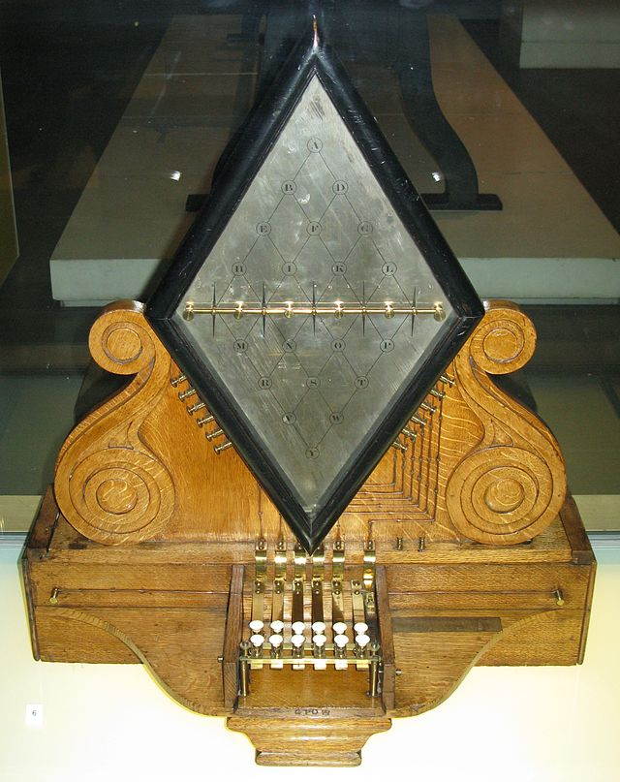
Peek-A-Boo World
“one neighborhood of the whole country”
Samuel Finley Breese Morse
co-developer of the Morse code, and helped to
develop the commercial use of telegraphy
Notes:
“America’s first true “spaceman”
contributed to the invention of a single-wire
telegraph system based on European telegraphs.
(1836)
Morse code, which he developed, would become
the primary language of telegraphy in the world

Slide 4
“We are in great haste to construct a magnetic telegraph from Maine to Texas; but Maine and Texas, it may be, have nothing important to communicate…”
--Henry David Thoreau

Slide 5
Information from a Telegraph
Irrelevance
Impotence
incoherence
Notes:
Creates media that is…

Slide 6
non-functional Information
All about novelty, interest and curiosity

Slide 7
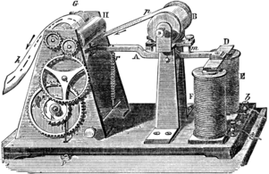
Partnership of Press and the Telegraph
Papers invested in the Magnetic Telegraph Company
Fortunes of newspapers depended on distance rather than the quality or utility of the news
James Bennett, New York Herald, boasted his paper contained 79,000 words of telegraphic content (1848)

Slide 8
Does info from the media cause you to…
Alter your plans for the day?
Take some action you would not otherwise have taken?
Provide insight into some problem you are required to solve?

Slide 9
News (of the day) gives us something to talk about, but doesn’t lead to any meaningful action (according to Postman)
The telegraph lowered the information-action ratio

Slide 10
Limited historical perspective
Context
Implications
Background
Connections

Slide 11
Photography
A world of fact, not of dispute
“A world of photography implies that we know about the world if we accept it as the camera records it”
“all borders seem arbitrary. Anything can be separated. Can be made discontinuous from anything else: All that is necessary is to frame the subject differently”
--Susan Sontag

Slide 12
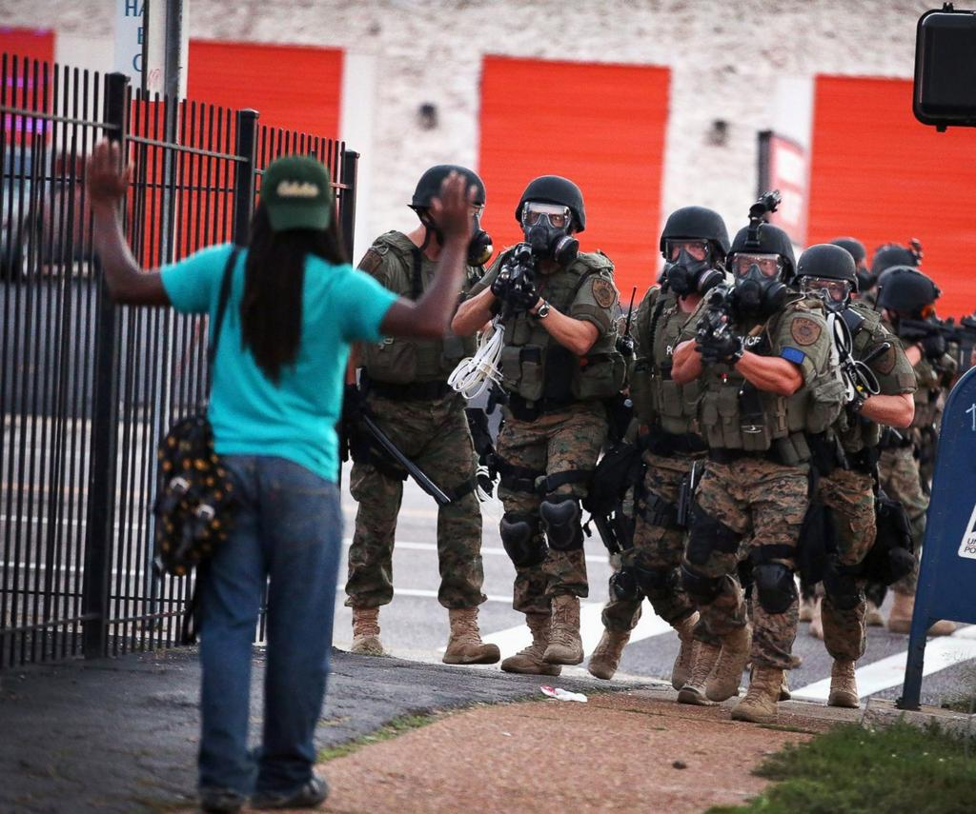
Ferguson
Notes:
Michael Brown August 2014

Slide 13
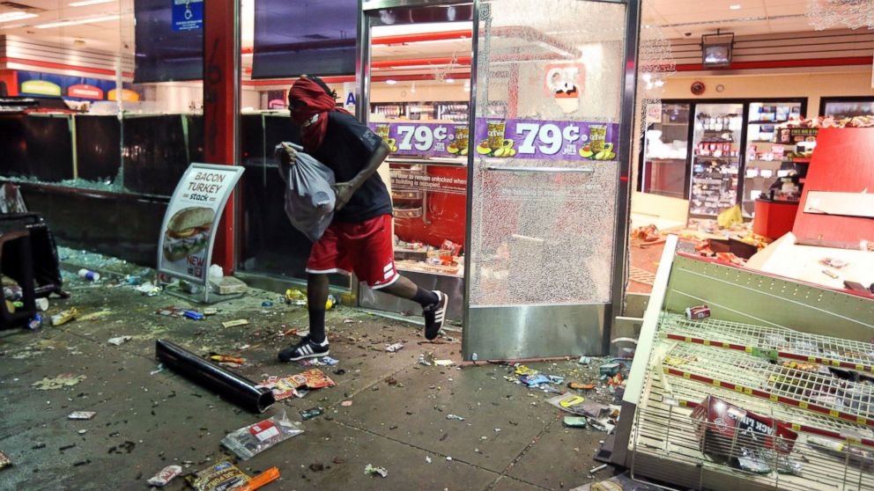
Ferguson

Slide 14
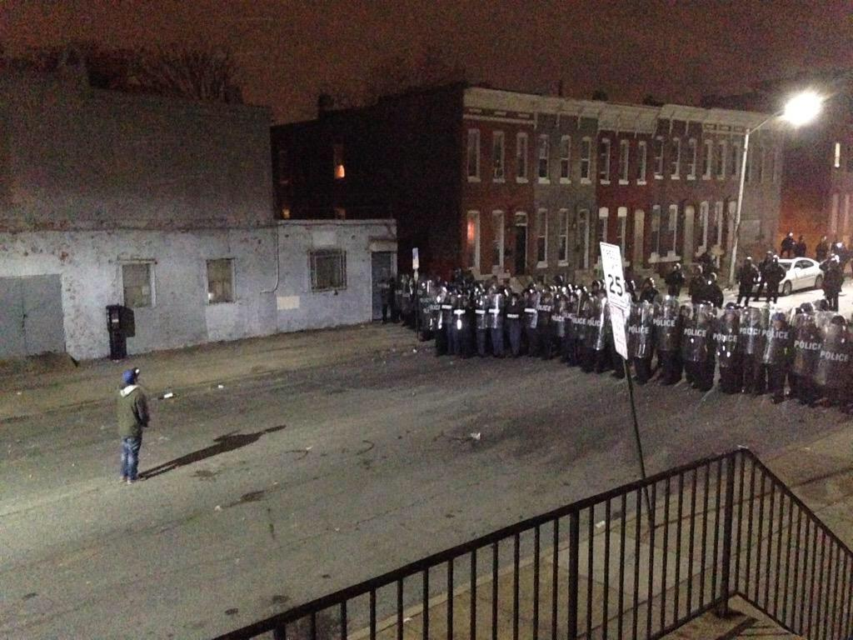
Baltimore
Notes:
2015 Baltimore April Freddy Gray

Slide 15
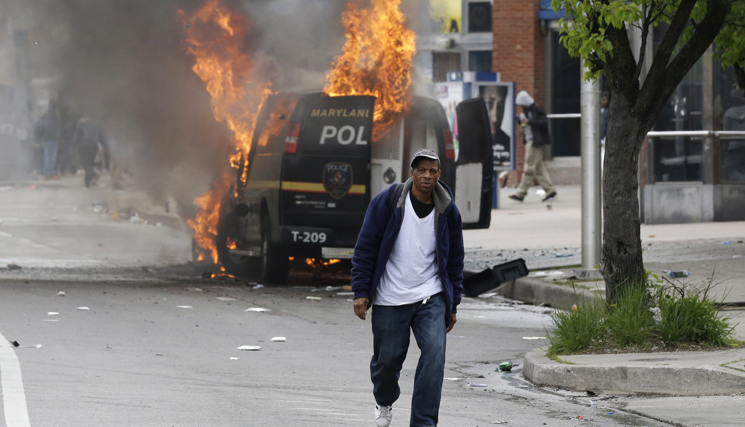
Baltimore

Slide 16
Photograph and Telegraphy
Language that denies interconnectedness
Proceeds without context
Argues the irrelevance of history
Explained nothing
Offers fascination in place of complexity and coherence
The world created by these media is self contained and like peek-a-boo, endlessly entertaining

Slide 17
TV
Has achieved the status of myth (Roland Barthes)
We view it and it helps us understand the world in ways that are not considered “problematic”
The way TV communicates seems natural
A myth is a way of thinking so deeply embedded on our consciousness that it is invisible
The peek-a-boo world that TV has constructed does not seem strange to us
Notes:
Explain not problematic
We are not fully conscious of its status and its influence on our ways of knowing
Unless we look at it with a critical eye

Slide 18
Results
(according to Postman)
Adjustment to the epistemology of TV
Irrelevance seems important and incoherence sane
TV speaks in one consistent voice (entertainment)
Transforming our culture into one vast arena for show business
Attacks literate culture
Notes:
We have so thoroughly accepted its definitions of truth, knowledge, and, reality that irrelevance seems to us to be filled with import and incoherence seems eminently sane

Slide 19
Postman claims: Television has made entertainment itself the natural format for the representation of all experience

Slide 20
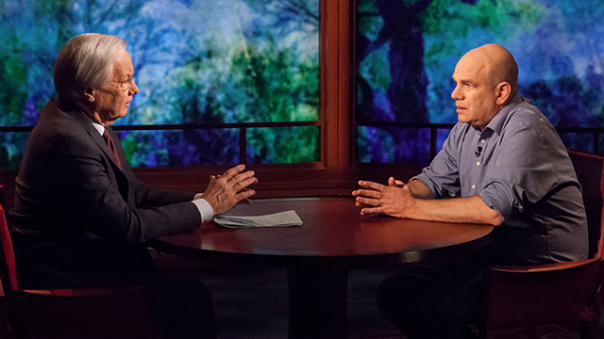
Are Meet the Press, Charlie Rose or Bill Moyers callbacks to literate culture?
These shows do not compete well with entertaining and visual forms

Slide 21
The World is staged like TV
Religion (Rock-and-Roll Priests)
Politics (Debates have to utilize one-liners—page 97)
Education (Professors who have teaching gimmicks or maybe who show TV in class?)

Slide 22
Age of Exposition" that defined Typographic America has been replaced by a spectacle that prizes flash and entertainment over substance. Entertainment has become the content of all of our discourse, so that the message itself is less important than the entertainment value of its delivery.

Slide 23

Does the news leave Viewers more confused?
Fragments of tragedy and barbarism
Good looks and amiability of the cast
Exciting music
Attractive commercials

Slide 24
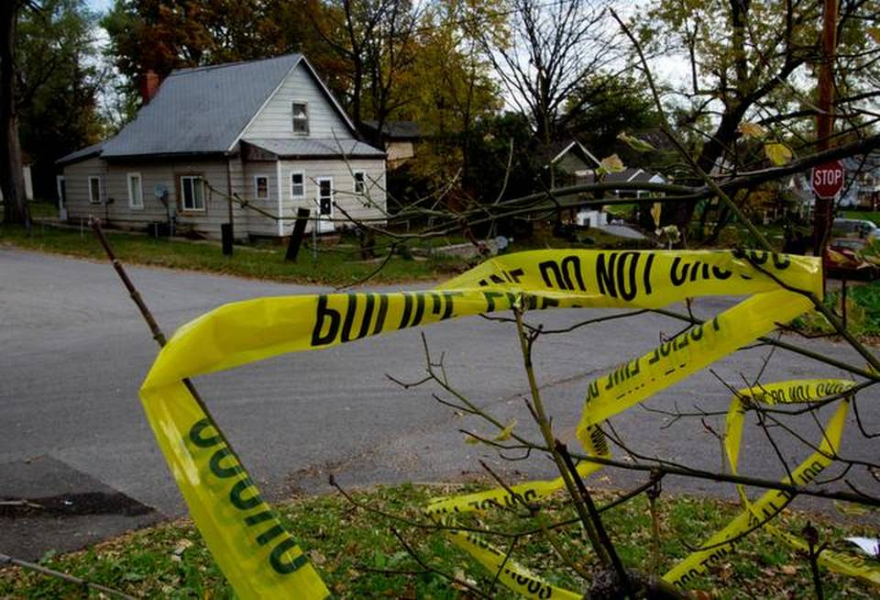
Shouldn’t we be weeping?
Not necessarily when TV news is a format of entertainment and not one of education, reflection, or catharsis

Slide 25
TV News
Has no suggestion that a story has any implication
“Now this” the most horrible news will be followed by commercials

Slide 26
If you do not receive news on TV--
What is your current experience of “Now This”?

Slide 27
Consistency of Tone
Books and films maintain consistency of tone
Consistency of Content
TV presents Discontinuity
Ex. A newscaster reports that we are on the brink of nuclear disaster and then they cut to a commercial from Burger King
Does the internet do the same?

Slide 28
Aesthetics=Dadaism
Philosophy=Nihilism
Psychology=Schizophrenia

Slide 29
Dis-information
If the lies of a president could be dramatized like a film, then there would be outrage
Lie = Contradiction
Understanding a contradiction requires context
Notes:
Statements and events must be perceived as interrelated aspects of a continuous and coherent context in order for those contradictions to be perceived

Slide 30
Debates
Debates between Stephen A. Douglas and Abraham Lincoln took place on August 21 1858. Douglas spoke first (for three hours) and Lincoln needed at least that long for a rebuttal.
Current Debates:
Quick one-liners
Talking Points
Nothing too dry, intellectual, or contextual
Notes:
Everyone went home, had dinner, and came back for Lincoln’s 4 hour rebuttal! That was the first of seven debates ALL THAT LONG! Who are these people who watched these DEBATES?! THEY WEREN”T EVEN PRESIDENTIAL DEBATES!!!! People watching this were people who regarded them as essential to their own political education!
The critical issues dividing the nation--slavery versus free labor, popular sovereignty, and the legal and political status of black Americans --were brought into sharp focus in a series of dramatic debates during the 1858 election campaign for U.S. senator from Illinois. The campaign pitted a little-known lawyer from Springfield named Abraham Lincoln against Senator Stephen A. Douglas, the front runner for the Democratic presidential nomination in 1860.
The Lincoln–Douglas Debates of 1858 (also known as The Great Debates of 1858) were a series of seven debates between Abraham Lincoln, the Republican candidate for the United States Senate fromIllinois, and incumbent Senator Stephen Douglas, the Democratic Party candidate.

Slide 31
Addictions
http://www.huffingtonpost.com/johann-hari/the-real-cause-of-addicti_b_6506936.html
80’s Experiment: A rat alone in a cage. One water bottle has drugs, the other is plain water. The rat becomes obsessed with the drugged water and eventually dies

Slide 32
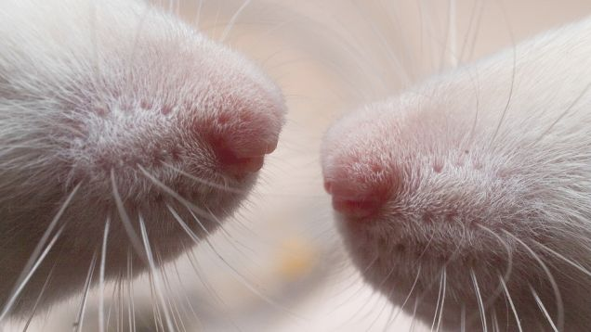
Bruce Alexander
professor of Psychology in Vancouver called Bruce Alexander
Built a rat community
Rat cage with plenty of toys, food, tunnels, and friends
Comparative: rats who were alone drank the drugged water
Rats with friends tried the drugged water, but didn’t continue to drink it

Slide 33
Vietnam
Heroin use was common amongst US soldiers
20% of soldiers
Concern about these soldiers coming home and still being addicted
95% of the addicts discontinued use after returning home

Slide 34
Concepts of Addiction
Hedonistic
A disease
Alexander: It’s not you, but your cage

Slide 35
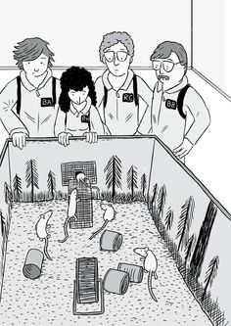
3rd Experiment
Rats were in a cage alone in a cage with the drug for 57 days
They were then placed in the rat park
They went through withdrawal, but…

Slide 36
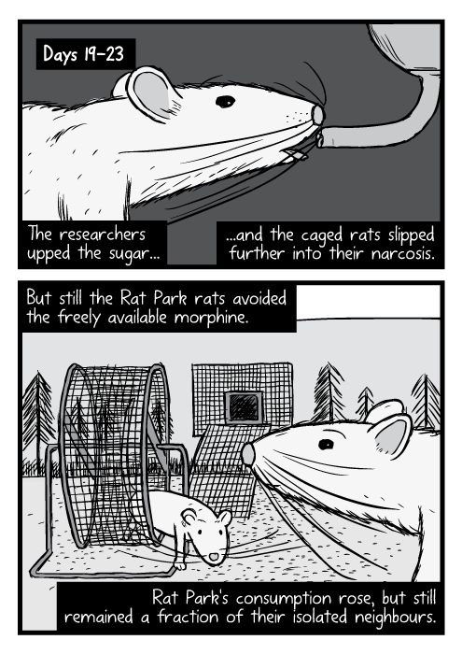
Ended up kicking the habit and adapting back to their surroundings

Slide 37
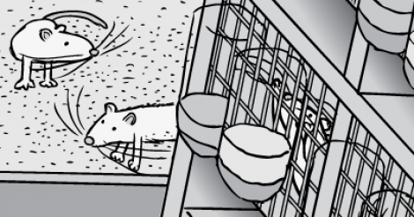
Another more common experiment…

Slide 38
Prescription Medicine
People who are prescribed opiates for injuries do not, in large percentages, become addicted to street heroin.

Slide 39
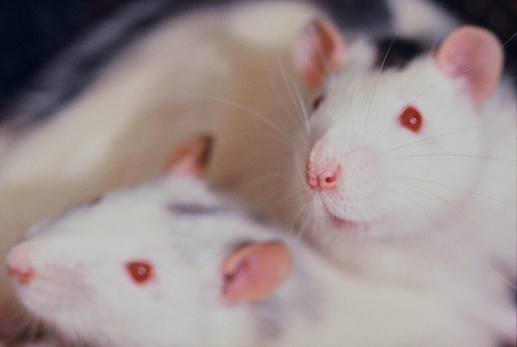
Street addicts are isolated &
Someone who is getting over an injury is quite possibly going home to families, work, friends etc.

Slide 40
Professor Peter Cohen argues that human beings have a deep need to bond and form connections. It's how we get our satisfaction. If we can't connect with each other, we will connect with anything we can find -- the whirr of a roulette wheel or the prick of a syringe. He says we should stop talking about 'addiction' altogether, and instead call it 'bonding.' A heroin addict has bonded with heroin because she couldn't bond as fully with anything else.
So the opposite of addiction is not sobriety. It is human connection.

Slide 41
War on Drugs
Prisons isolate drug users more
Isolation (for drug offenses in prison)
Difficult to find work once they are out of jail
Leading to more isolation
The War on Drugs also costs money (keeping money from social programs, schools etc.)
Notes:
Portugal had one of the worst drug problems in Europe, with 1 percent of the population addicted to heroin. They had tried a drug war, and the problem just kept getting worse. So they decided to do something radically different. They resolved to decriminalize all drugs, and transfer all the money they used to spend on arresting and jailing drug addicts, and spend it instead on reconnecting them -- to their own feelings, and to the wider society. The most crucial step is to get them secure housing, and subsidized jobs so they have a purpose in life, and something to get out of bed for. I watched as they are helped, in warm and welcoming clinics, to learn how to reconnect with their feelings, after years of trauma and stunning them into silence with drugs.

Slide 42
One example I learned about was a group of addicts who were given a loan to set up a removals firm. Suddenly, they were a group, all bonded to each other, and to the society, and responsible for each other's care.

Slide 43
The results of all this are now in. An independent study by the British Journal of Criminology found that since total decriminalization, addiction has fallen, and injecting drug use is down by 50 percent

Slide 44
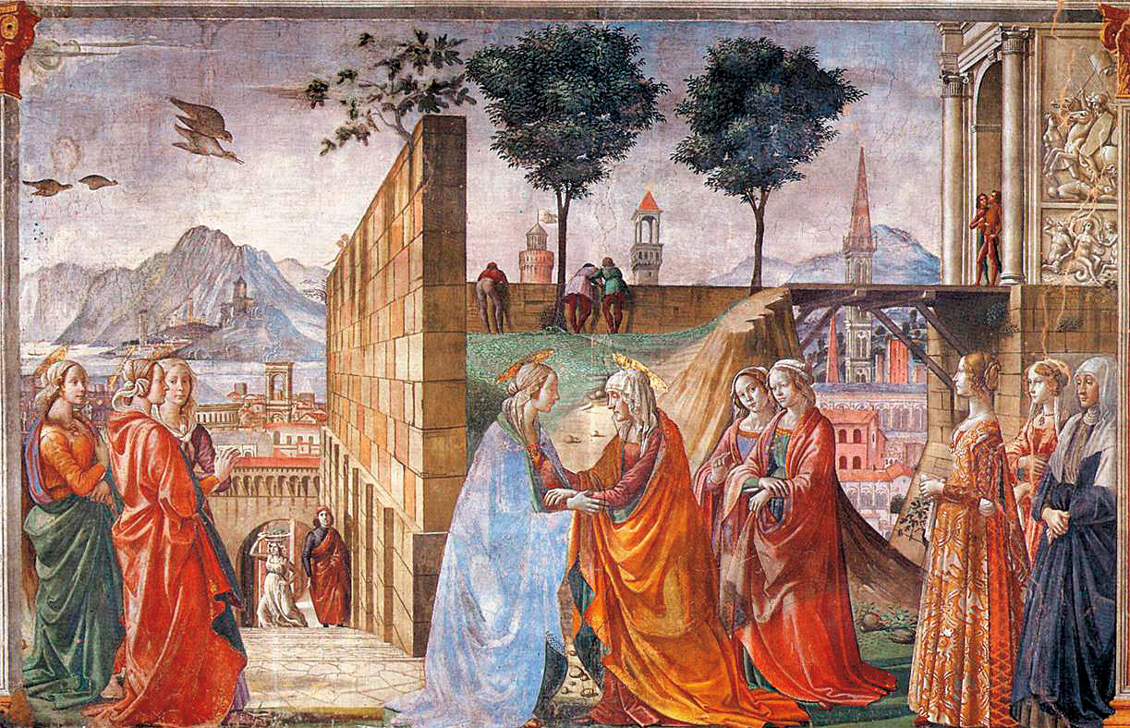
These studies help us think differently about ourselves
Human beings are bonding animals

Slide 45

Isolation
We have created an environment and a culture that cut us off from connection, or offer only the parody of it offered by the Internet. The rise of addiction is a symptom of a deeper sickness in the way we live -- constantly directing our gaze towards the next shiny object we should buy, rather than the human beings all around us.

Slide 46
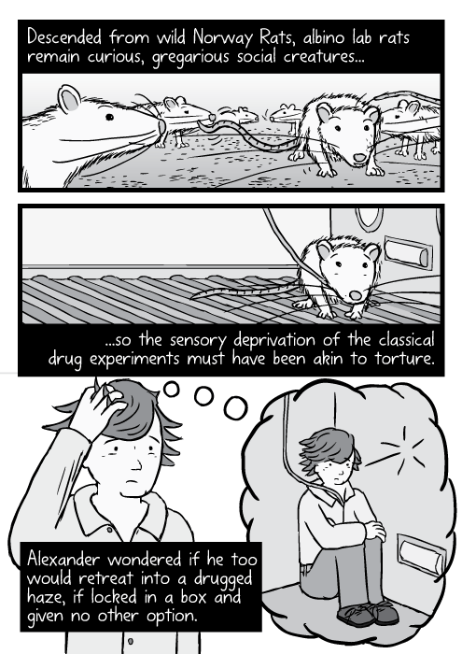
--For too long, we have talked exclusively about individual recovery from addiction. We need now to talk about social recovery -- how we all recover, together, from the sickness of isolation that is sinking on us like a thick fog.
--Bruce Alexander

