Slide 2
Depth of Field
What are the four determiners of depth of field?

Slide 3
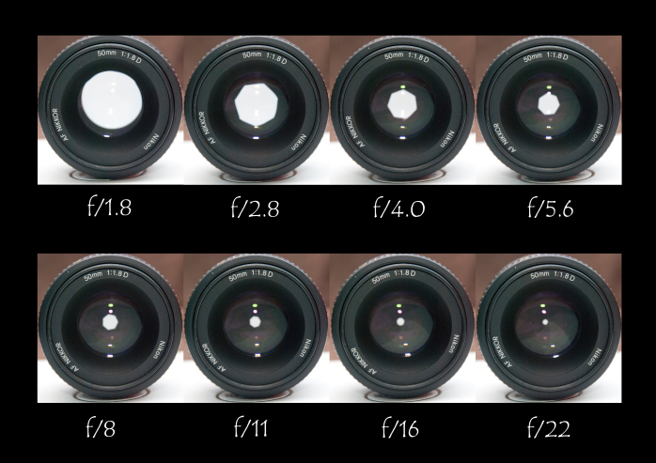
Aperture
Opening in the lens
Aperture
f-number or stop
fraction= focal length/Aperture diameter
Each stop represents either half or double the amount of light exposing the film or chip

Slide 4
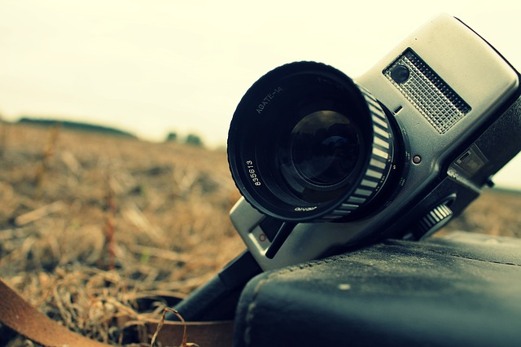
Film Camera and Video Camera
Both have lenses that capture light
Both have a light sensitive element
Both translate fluid motion into a series of still images

Slide 5

Filmmaking
Is a photo chemical process
Film is exposed to light and then soaked in chemicals

Slide 6
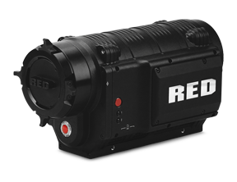
Video-making
Photo-electrical process
Light enters the lens
Is focused on a plane
Image sensor or chip (instead of film)

Slide 7
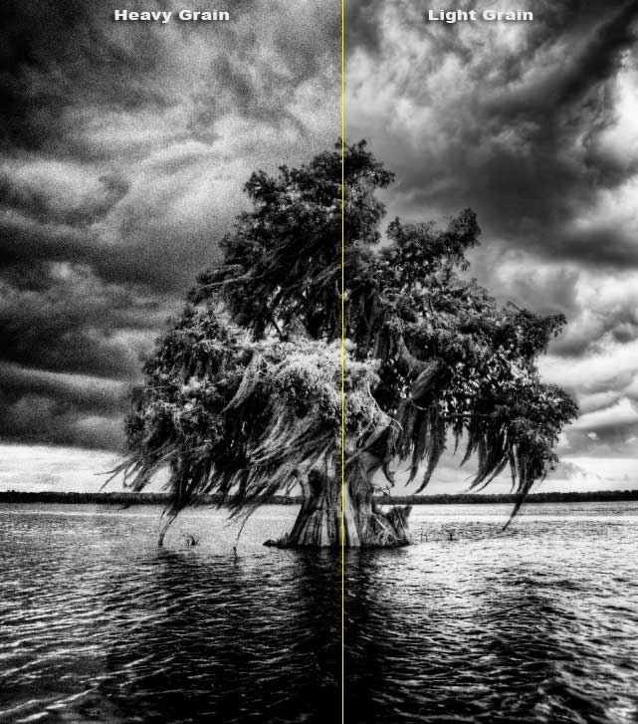
Film Grain vs. Pixels
Film grains are the building blocks of film images
Pixels are the building blocks of the video image
Pixels convert light to a higher charge and lower light into a lower charge

Slide 8
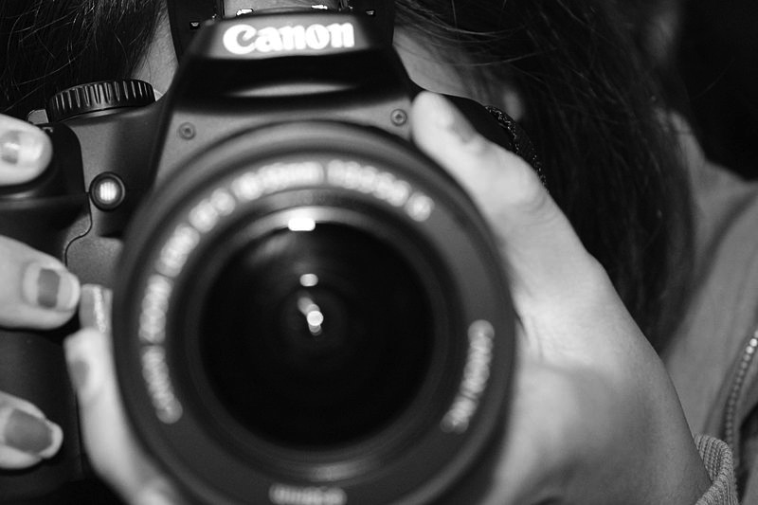
Eye and F/V Camera
Both images captured are upside down
Because the eye and lenses are convex (curve outward)
Images are inverted
In the brain (or in the camera viewfinder, the images are turned right side up)
Single Lens Reflex has a mirror and a prism allowing the shooter to see the image as it will be recorded

Slide 11
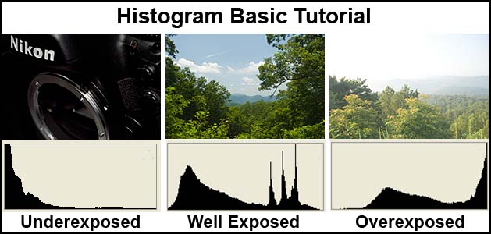
Video cameras allow you to see the exposure as you shoot

Slide 12

Automatic Functions
Many cameras have auto exposure
They select proper exposures for you
Auto focus
Auto white balance

Slide 13
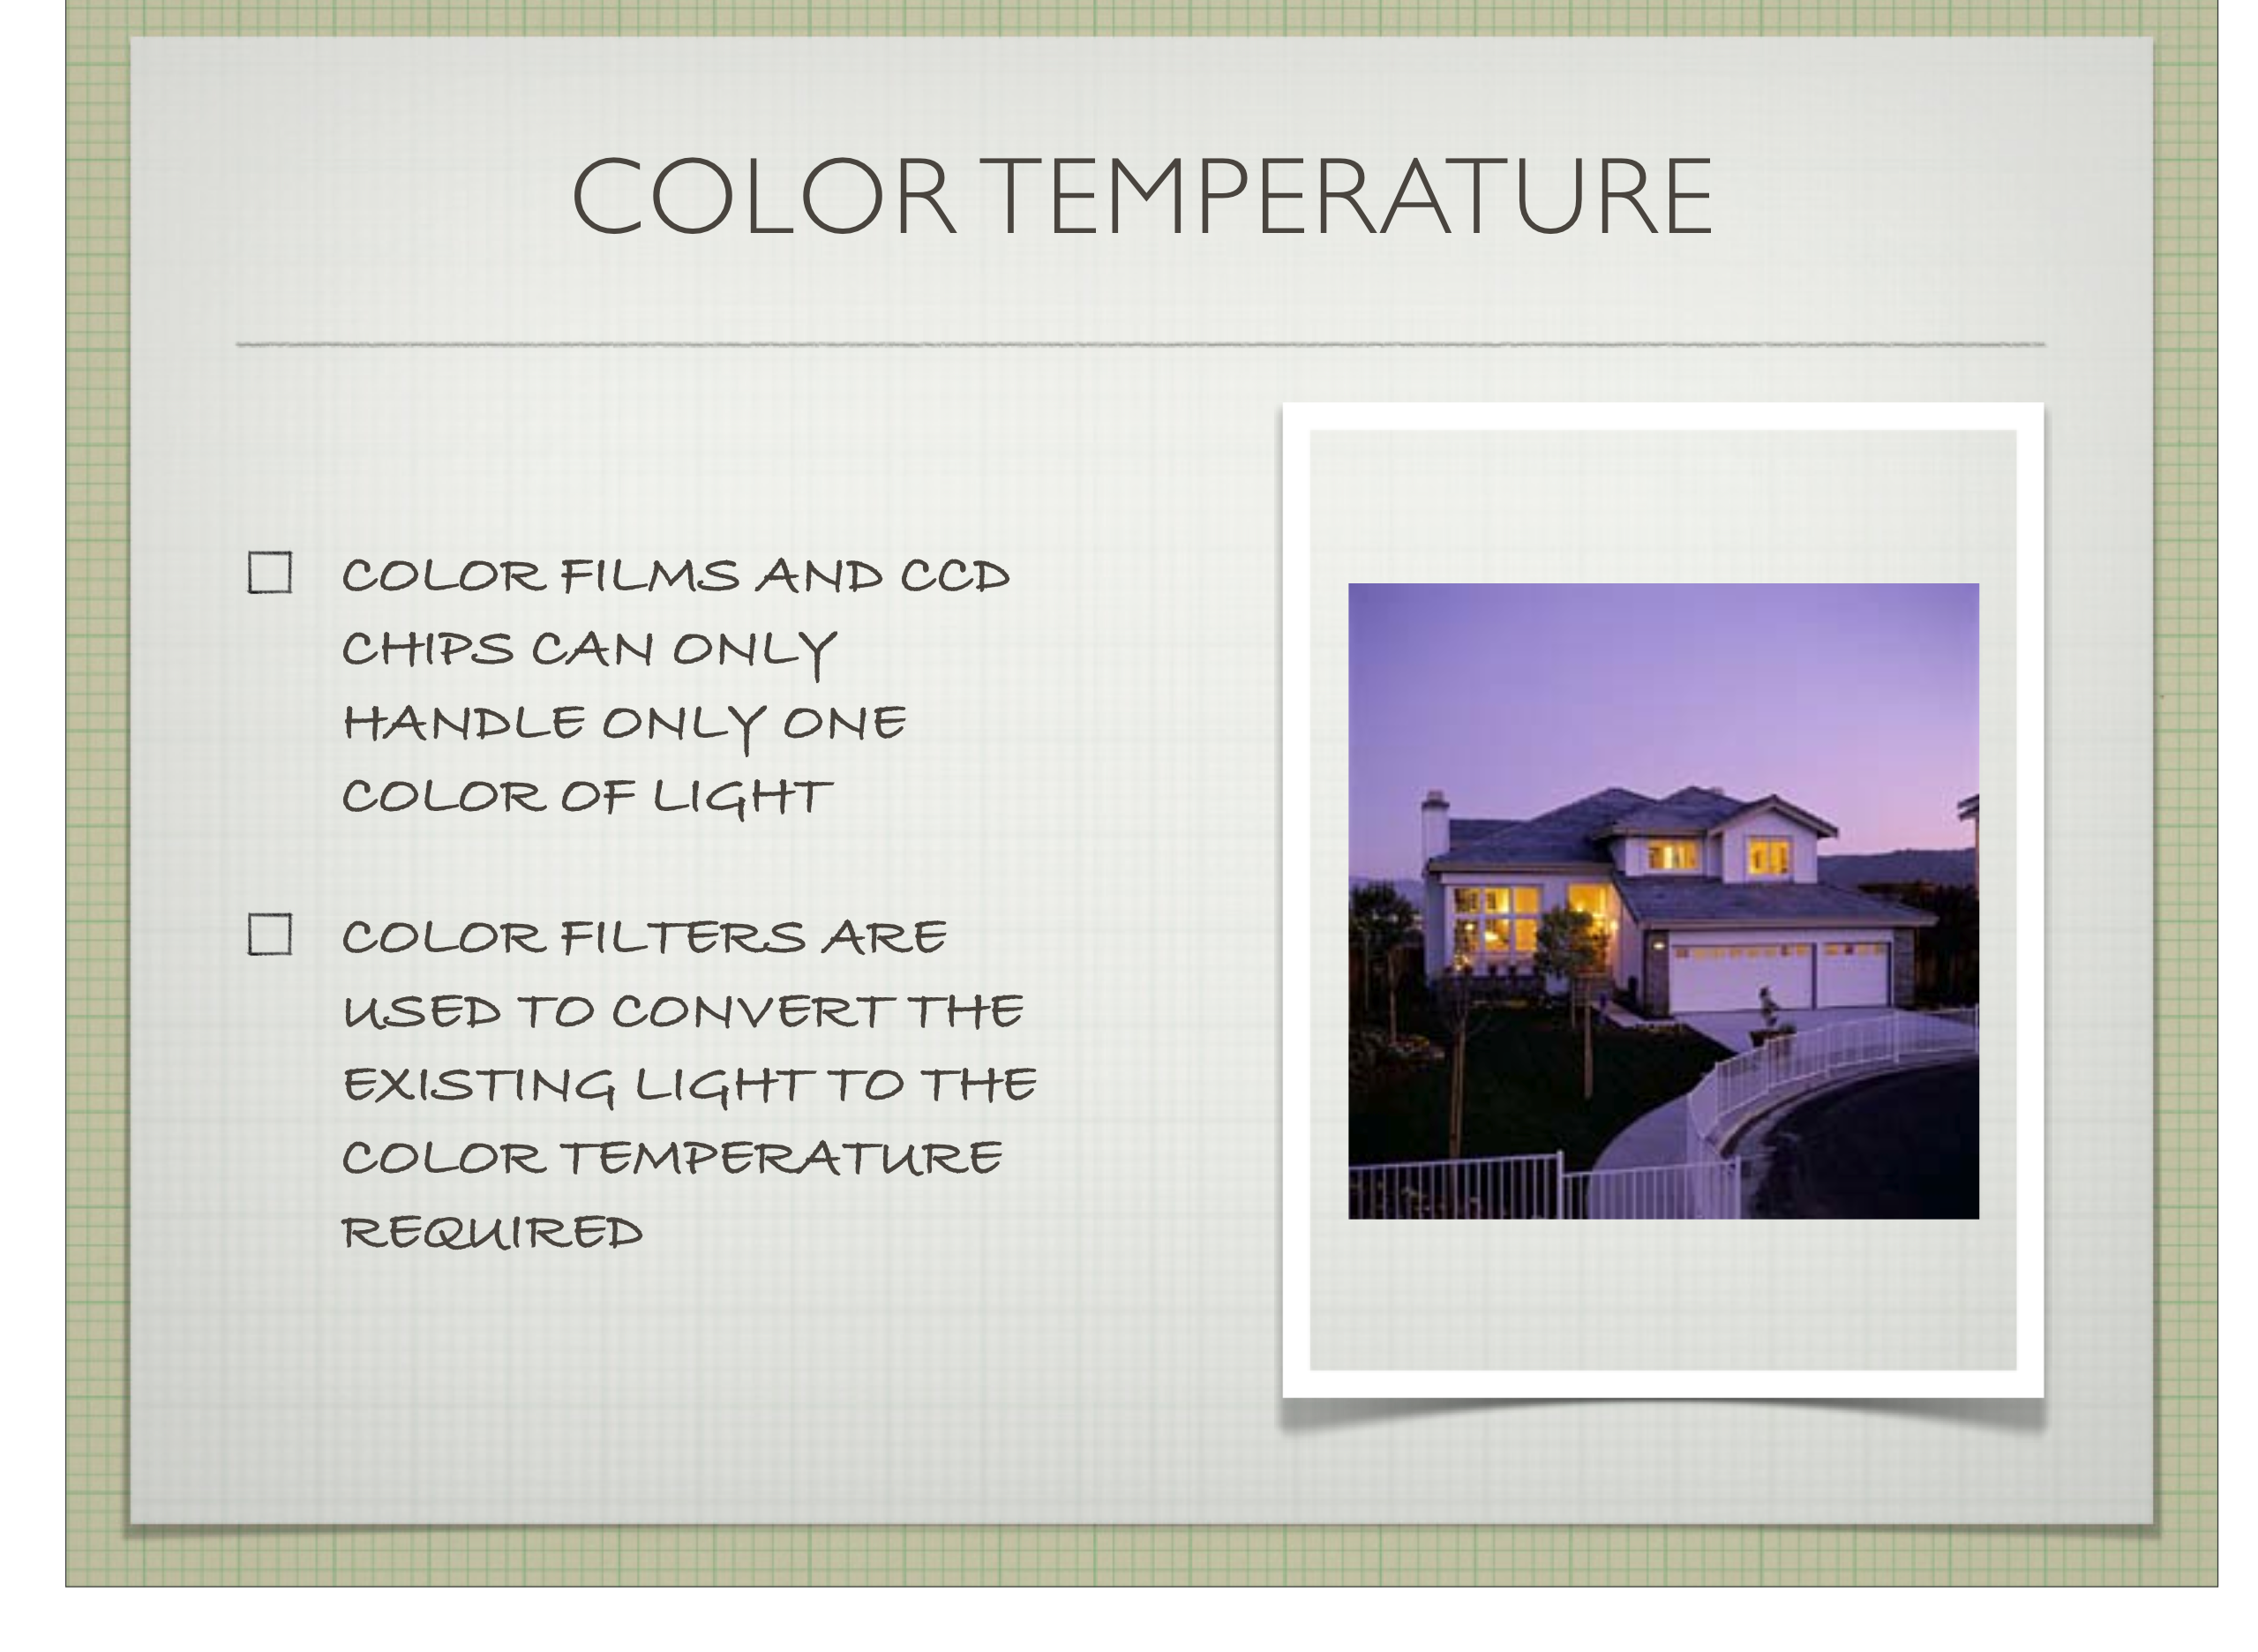

Slide 14
Where is the light coming from?
Is it a cloudy or sunny day?
Is this high or low contrast lighting?
What is framed out of this image?

