Slide 1
Panopticism and Power
By individualizing the subjects and placing them in a state of constant visibility, the efficiency of the institution is maximized.
These qualities also give an authoritative figure the "ability to penetrate men’s behavior" without difficulty.
"The Panopticon must not be understood as a dream building: it is the diagram of a mechanism of power reduced to its ideal form; its functioning, abstracted from any obstacle, resistance or friction, must be represented as a pure architectural and optical system
In light of this fact Foucault compares jails, schools, and factories in their structural similarities.
The imprisoned plays both roles: he becomes the principle of his own subjection
Notes:
Furthermore, it guarantees the function of power, even when there is no one actually asserting it. It is in this respect that the Panopticon functions automatically.
This design is also applicable for a laboratory. "It could be used as a machine to carry out experiments, to alter behavior to train or correct individuals."
: it is in fact a figure of political technology that may and must be detached from any specific use.”
… Each individual, in his place, is securely confined to a cell from which he is seen from the front by the supervisor; but the side walls prevent him from coming into contact with his companions. He is seen, but he does not see; he is the object of information, never a subject in communication. The arrangement of his room, opposite the central tower, imposes on him an axial visibility; but the divisions of the ring, those separated cells, imply a lateral invisibility. And this invisibility is a guarantee of order. If the inmates are convicts, there is no danger of a plot, an attempt at collective escape, the planning of new crimes for the future, bad reciprocal influences; if they are patients, there is no danger of contagion; if they are madmen there is no risk of their committing violence upon one another; if they are schoolchildren, there is no copying, no noise, no chatter, no waste of time; if they are workers, there are no disorders, no theft, no coalitions, none of those distractions that slow down the rate of work, make it less perfect or cause accidents. The crowd, a compact mass, a locus of multiple exchanges, individualities merging together, a collective effect, is abolished and replaced by a collection of separated individualities. From the point of view of the guardian, it is replaced by a multiplicity that can be numbered and supervised; from the point of view of the inmates, by a sequestered and observed solitude.

Slide 2
Surveillance and You
Talk about your experience with surveillance.
Notes:
Have you felt docile because of surveillance?
Has the thought of surveillance limited your movement in any way?
Any other direct effects of surveillance on your life?
Think about the idea of (always being watched and never being in contact with others)

Slide 3
Surveillance in Popular Culture
Describe the power dynamic of surveillance in 24 and Homeland
Notes:
Are there clear representations of good and evil?
Who is good and who is evil?
Is there complexity?

Slide 4
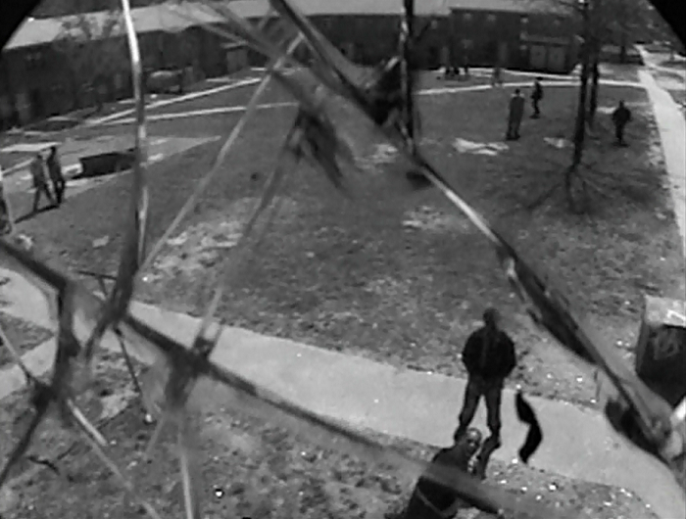
Not so Docile Bodies
Surveillance in The Wire is thwarted on many occasions
Happy Symbiosis between institutions
Both institutions: The Dealers and the police need the war on drugs to stay in business

Slide 5
Surveillance and The Wire
The War on Drugs, produces many arrests—mostly of black men, but doesn’t make a dent in the problem
Unwillingness to follow the money (Season 4)
Even state-of-the-art technology does not get the police the information that they seek
The Wire is neither a CSI style celebration of crime-solving technologies nor designed to inspire confidence in other state or government authorities in a post 9/11 world

Slide 6
Some effects of the new model of organization –panoptic schema
1) the internalization of rules and regulations. As we naturalize rules, society could be said to become less willing to contest unjust laws. Of course, Foucault has Nazi Germany in mind when he thinks about conformity; however, studies of American society (Philip Zimbardo, Stanley Milgram) have suggested that Americans are, in fact, just as willing to follow authorities even when it means doing violence to innocent subjects.
2) rehabilitation rather than cruel and unusual punishment. This reform was implemented because of nineteenth-century outcries over the inhumane treatment of prisoners and the insane. Foucault however questions the subsequent emphasis on the "normal," which entails the enforcement of the status quo on ever more private aspects of our lives (for example, sexuality). As he puts it, "The judges of normality are present everywhere. We are in the society of the teacher-judge, the doctor-judge, the educator-judge, the 'social-worker'-judge; it is on them that the universal reign of the normative is based; and each individual, wherever he may find himself, subjects to it his body, his gestures, his behaviour, his aptitudes, his achievements" (Discipline 304).

Slide 7
Hegemony
domination of a culturally diverse society by the ruling class, who manipulate the culture of that society
so that their ruling-class worldview becomes the worldview that is imposed and accepted as the cultural norm; as dominant ideology that justifies the social, political, and economic status quo as natural, inevitable, perpetual and beneficial for everyone, rather than as artificial social constructs that benefit only the ruling class.^{[1][2]}

Slide 8
Example
A female director, a Latino director or and African American director are labeled as such while white men are just called directors
This is considered natural or normative

Slide 9
Spatial Imaginary “The Dream”
A central mechanism for skewing opportunities and life chances in the U.S. along racial lines
Attempts to explain how white supremacy is transferred across generation and reproduced in the United States
Names a form of privilege that has been foundational to the transfer of intergenerational wealth and power and why these forms of privilege remain invisible to a majority of Americans
The imaginary refers to how predominantly white residential neighborhoods appear to be “natural” and how white supremacy became inscribed into residential neighborhoods where access to education, safety, opportunities to form friendships across racial/ethnic lines, upward mobility, and to wealth accumulation continue to exclude many people

Slide 10
White Spatial Imaginary --G. Lipsitz
People of different races in U.S. live specifically different lives
Zoning laws
School district boundaries
Police Practices
Transit System Design
Ideal of the pure American space– is the white spatial imaginary
Public housing—Oscar Newman (Yonkers—1987)

Slide 11
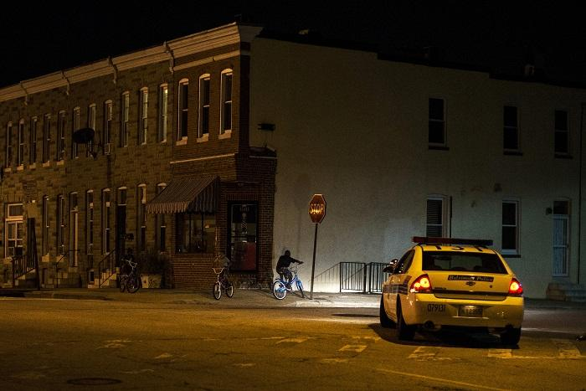
Does a patrol car protect citizenry or does it keep citizenry in place?
Does a patrol car maintain the status quo?

Slide 12
The show has “Soft Eyes” in the sense that it attempts to take in the big picture
Notes:
Like I’m supposed to cry and shit?
If you got hard eyes you staring at the same tree missing the forest
Ah zen shit
If you look really hard at one thing you miss the whole
That’s why she didn’t see that Bunk put the note: “Tater shot me”
And how she finds out later that tater did really shoot him

Slide 13
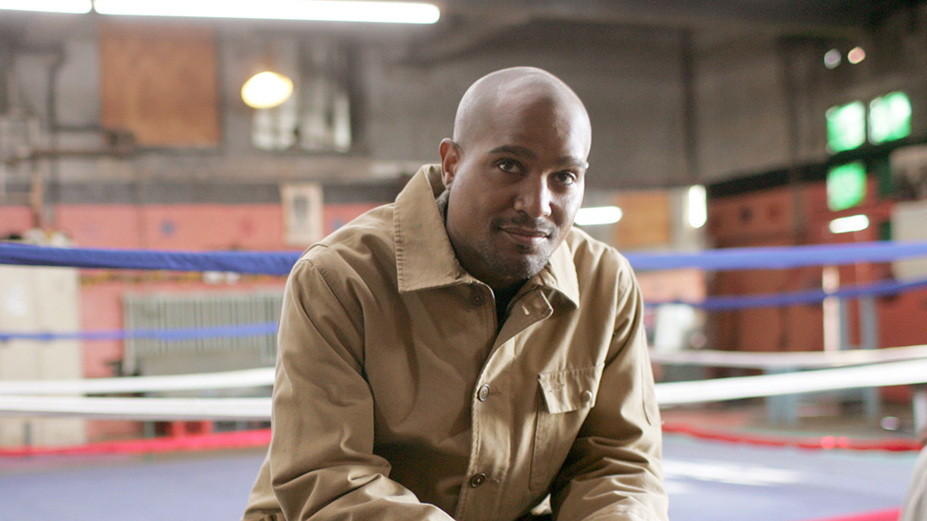
Proximate Surveillance “Soft Eyes”
In Bentham’s model, the watchtower wasn’t the only mode of control
A kindly eye, a soft eye, a proximate eye can be the best thing that can happen to a young person, a dope fiend, or a policed neighborhood
Not all surveillance is destructive
Conversely: The Wire repeatedly shows the foiling of “Hard Eyes”
Is it making a case for “Soft Eyes”?
Notes:
Separation of criminals as well—that have to be isolated and watched

Slide 14
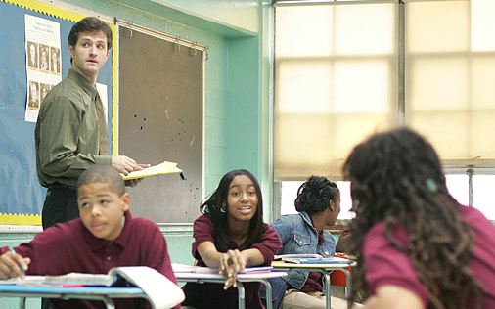
Docile Bodies in the Classroom
Season 4 shows how teaching is like policing
Windows closed to make them drowsy
Busywork to keep them off guard
An older teacher says: “You need soft eyes”

Slide 15
Opening Credits of the Show
Depict technologies of surveillance
Destruction of those technologies
Panopticism is flawed, because it aims to suppress the deviancy of crime, but produces the deviants it tries to suppress
The more surveillance exists the more potential to resist it increases
Systems of surveillance are only as good as the people who use them
Notes:
Alasdair Mcmillan
Police in The Wire are foiled by the discipline of wary criminals

Slide 16
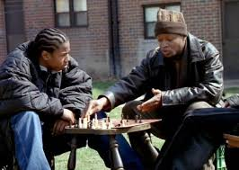
School
Significance of the Chess Game
Expendable Role in The Game
The game isn’t fair and democratic like they want it to be
https://www.youtube.com/watch?v=N8lyda_ZkLQ

Slide 17
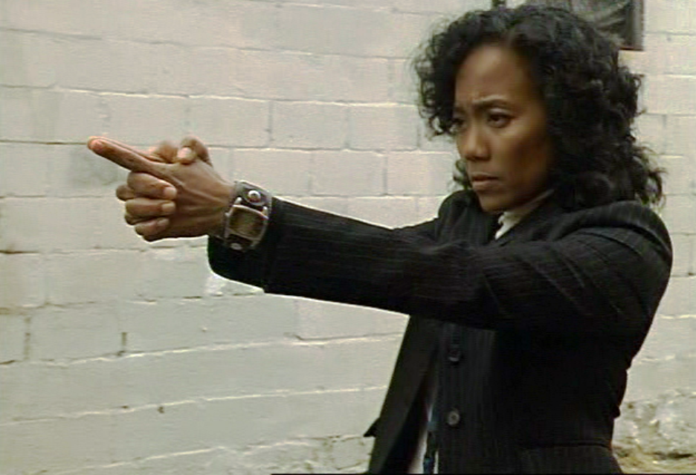
Soft Eyes
If you have soft eyes you can see the whole thing
That’s why Kima is able to solve the crime
Prez watches over instead of surveilling his class

Slide 18
Soft Eyes
Multi-Sited Ethnography
Gives greater breadth and scope to the discipline (or story)
As opposed to the unique, single sited, perspective
Takes multiple forms of information about an interconnected whole situation and its contexts of significance

Slide 19
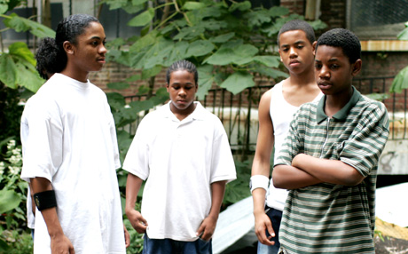
Soft Eyes are a Liability
The little bit of softness required to observe without reacting with defensive violence is a useless skill in the world of the students in Prez’s class.
Kima can risk a gamble on softness
Throughout the many seasons of The Wire, anyone from The Corner is in danger when they exhibit “softness”
These characters have to put on blinders to the suffering of others or become victims themselves
A character like Dukie is not able to harden himself like Michael

Slide 20
Soft eyes can make Kima a better cop and Prez a better teacher, but they are a liability for someone like Dukie
How does Dukie get from where he is, to somewhere else?
Soft eyes are a privilege for people who have more options

Slide 21
Soft eyes are only available to those who with a future stake in the culture in which they live, to those more fortunate beings who do not have to harden themselves to merely survive
Notes:
Michael has limited options as well.
He can’t go to a social worker to protect his brother
He can’t accept friendliness or trust others
There is nothing he feels he can do, but protect his family in a more criminal way. The “power” or “law” that he seeks help from is not from the system which will undoubtedly fail him, but from “the king” Marlo

Slide 22
Namond
Doesn’t want to deal drugs
Can’t be hard like Michael
Takes his pent up frustrations out on Dukie
His mom gives him no other opportunity

Slide 23
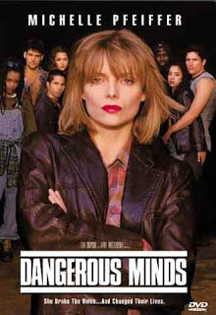
Generic School Melodrama
The Wire, Season 4 turns it on its head by allowing “The Corner” students the opportunity to teach the teachers
The cliché: An enlightened teacher who succeeds at teaching and breaks through defensive hardness to enlighten the kids
A different viewpoint: The Wire focuses on moral legibility on the institutional level
Personal goodness can’t trump institutional failure
Notes:
Moral legibility is (showing the problem, so that you have a sense of what justice should be)
The best way to save the individuals is not through the help of a singular enlightened liberal hero, but through institutions working together to help

Slide 24
Surveillance, on The Wire is quite often useless
Soft Eyes are better ways to gain knowledge, but are unavailable or unadvisable to people who have to survive on the street
Notes:
Separating students due to expected performance

Slide 25
Supervision vs. Surveillance
Soft Eyes on the part of the educators and not the hard eyes of surveillance, offer the students in the special class a safe place for the moment
Offers supervision rather than surveillance
Those who run the program are accused of “tracking”
The accusation of “tracking” is based on the false assumption of an otherwise equal society “White Spatial Imaginary” “The Dream”

Slide 26
The spy melodrama and the school melodrama are both rewritten by The Wire
One is about surveillance as a tool to protect “the good”
The other argues that the value of “softness” (liberal, democratic values) is a good that can be taught
The Wire teaches that surveillance and teaching can’t overcome larger systems of inequality
The show brings the two genres together and explores the limitations of both

Slide 27
Surveillance is not the key to better policing and magical teaching is not the solution to better schools

Slide 28

Many academics have admitted that The Wire is more than pedagogically defensible—it has the ability to teach as effectively as many educators can
It turns the school melodrama into an extraordinary one through its breadth and depth (over time)
The Wire doesn’t focus on the liberal righteousness of the teachers—like other inner-city school melodramas
It focuses instead on better opportunity for all (by presenting the lack of it in our current state)
Notes:
By using suffering, showing the problems, and not providing easy solutions

Slide 29
You exist
You matter
You have every right to wear your hoodie
To play your music as loud as you want
You have every right to be you
An no one should deter you from being you
You have to be you
And you can never be afraid to be you

Slide 30
“If my life ended today
I would tell you it was a happy life
That I drew great joy from the study, from the struggle toward which I now urge you--
The changes have awarded me a rapture that comes only when you can no longer be lied to,
When you have rejected the Dream--
To best exploit that singular gift of study, to question what I see and then question what I see after that.”
Notes:
--Coates, Between the World and Me

Slide 31
“I wasn’t so much bound to a biological race as to a group of people, and these people were not black because of any uniform color or any uniform physical feature. They were bound because they suffered under the weight of the dream and they were bound by all of the beautiful things, all the language and mannerisms, all the food and music, all the literature and philosophy, all the common language that they fashioned like diamonds under the weight of the dream.”
“The US is a tapestry of many worlds: immigrants, Native Americans, LGBT.”
“What divides us from the world was not anything intrinsic to us, but the injury done by people intent on naming us.”
Notes:
--Coates, Between the World and Me

Slide 32
Loneliness of travelling to another country: France
“I had never felt myself so far outside someone else’s dream
Notes:
--Coates, Between the World and Me

Slide 33
“We are entering our last year’s together and I wish that I had been softer with you
I am tied to old ways which I learned in a hard house”
Coates did not die in his aimless youth, He was not jailed, He had proven to himself that there was another way
Beyond the schools and streets
“When I was eleven my highest priority was the simple security of my body”
“The warehousing of black bodies into a jobs program for Dreamers.”
Notes:
--Coates, Between the World and Me

Slide 34
Dr. Jones
Became aware of “the distance” through segregation
Coates asks how his son became aware of the distance
Prince Jones “had means. A family. Dr. Jones spent years developing a career, acquiring assets, engaging responsibilities. And one racist act. It’s all it takes.”
Notes:
--Coates, Between the World and Me

Slide 35
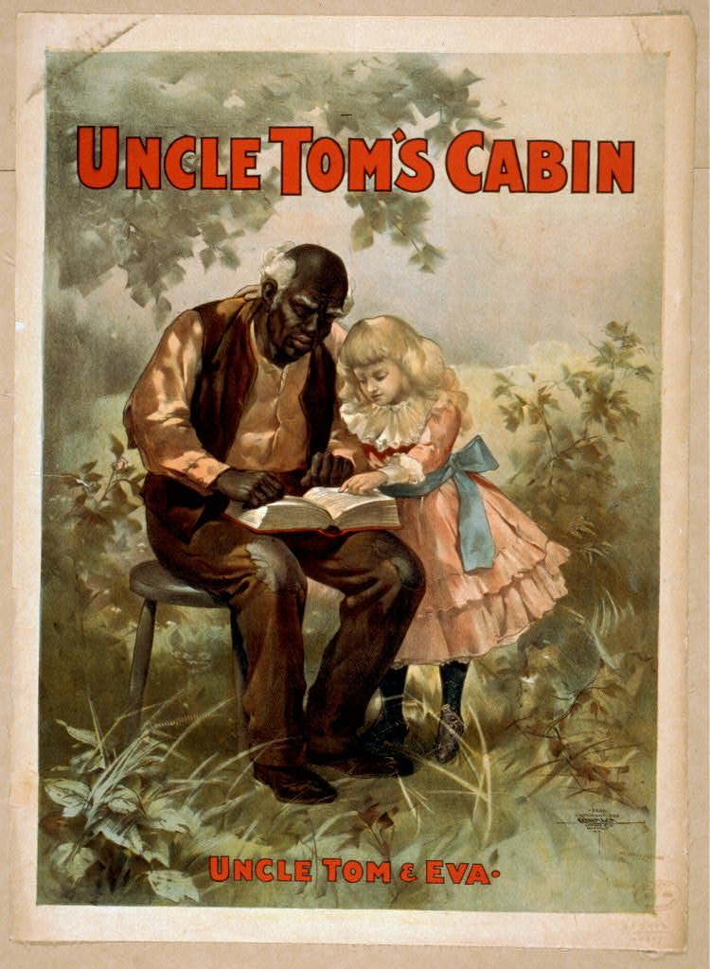
The Imaginary
A comprehensive worldview—seen as natural
is the set of values, institutions, laws, and symbols common to a particular social group and the corresponding society through which people imagine their social whole.
makes itself visible through representations and visual constructions –

Slide 36
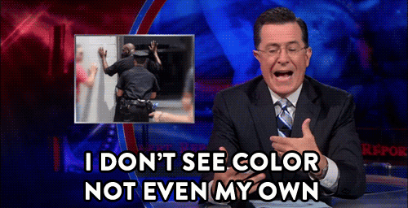
Hegemony
the idea that the ruling class can manipulate the value system and mores of a society, so that their view becomes the world view
i.e. a white male is invisible (has no identity) and is just considered a person not a gendered or racialized person

Slide 37
George Lipsitz
Wrote negatively about The Wire
Difference between white and black spatial imaginaries
The white suburban home is the privileged moral center of culture
The Wire does not include historical (institutional racism) that created racial inequality
Linda Williams argues that this would be an entirely different show—and that issues of geography and privilege are central to the show’s multi-sited storytelling

Slide 38
Wanted The Wire to explain Baltimore’s failure to provide fair market housing to blacks
The 1993 protests against public housing
HUD’s four decade violation of the 1968 Fair Housing Act

Slide 39
Linda Williams disagrees claiming that an approach like that would turn The Wire into a period piece
The Wire also “assiduously builds and constantly compares white and black spatial imaginaries”
Notes:
“the white spatial imaginary idealizes ‘pure’ and homogenous spaces, controlled environments, and predictable patterns of design and behavior” (
e defined it as “that which is visible or thinkable for each society and culture, that which grants meaning to the social, to the individuals and their experiences”[2]. In other words, Castoriadis sees the Social Imaginary as a specific society’s comprehensive worldview of which they depend and where all meanings, affections, practices and discourses are shaped. This comprehensive worldview is expressed or makes itself visible through representations and visual constructions –whether regarding urban space configurations or an image, regardless if it is filmic or digital, produced in the mass media context or in the artistic sphere. These representations are what Castoriadis named “Secondary Imaginary” and are a symptom of the “Radical Imaginary”, which corresponds to the original creation of fantasies or the capacity of formulating that which is not there[3]. Therefore, the imaginary could be defined as the “creative capacity of generating representations and set of representations, affections and desires arising from the same”[4]. - See more at: http://interartive.org/2013/07/space-flows-social-imaginary-digital-art/#sthash.XPWmTcTV.dpuf

Slide 40
Black and White Spatial Imaginaries
Season 1: Bubbles in the suburbs
The scene is presented completely from Bubbles’ point of view
Gives both, the inner-city and the suburbs meaning
https://www.youtube.com/watch?v=sEQUR7Fts-w

Slide 41
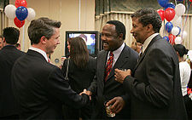
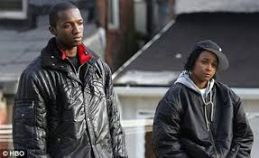
Baltimore Demographics
African Americans are in the majority in Baltimore
The show presents wide array of black characters
Generates both sympathy and respect

Slide 42
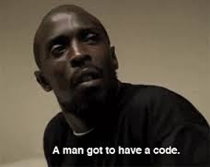
Racially aware
Class aware
And Queer aware
(Though according to Williams—
not gender aware)

Slide 43
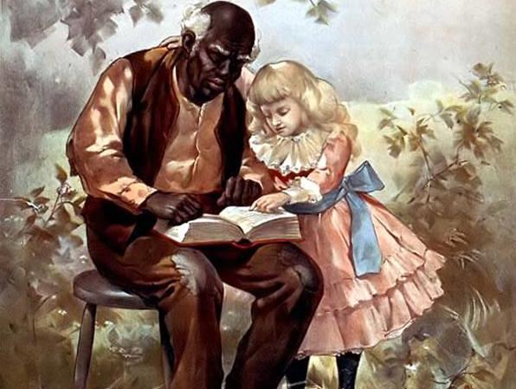
Uncle Tom’s Cabin, Harriet Beecher Stowe (1852)
First racial melodrama that was compelling to a wide American audience
Story of a black Christian slave—the story moved primarily white viewers
Christian slave as virtuous sufferer
Notes:
The phrase "Uncle Tom" has also become an epithet for a person who is slavish and excessively subservient to perceived authority figures, particularly a black person who behaves in a subservient manner to white people; or any person perceived to be complicit in the oppression of their own group.[1][2] The negative epithet is the result of later works derived from the original novel.

Slide 44
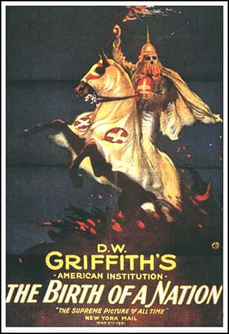
The Birth of a Nation, DW Griffith 1915
The Clansman, by Thomas S. Dixon
Racial sympathy was redirected to the sexually threatened white woman
Racial hatred was engendered towards rapacious unruly former slaves

Slide 45
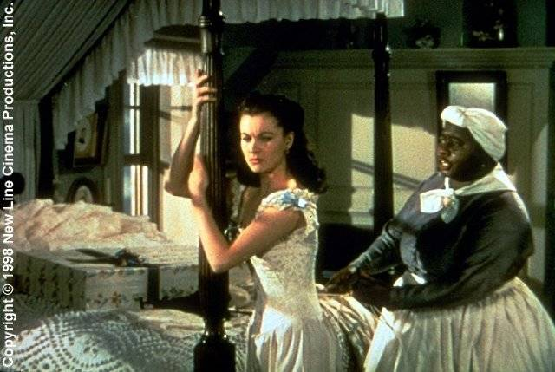
Gone with the Wind 1939
Couldn’t be overtly racist (like Birth of a Nation)
Hollywood films tended to portray blacks as either background smiling servants or vague threats

Slide 46
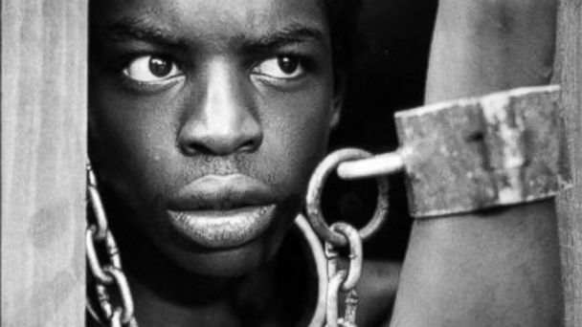
Roots 1977
“Broke the monopoly of white authorship”
An “American Family” could finally be imagined as black in mainstream American culture
Notes:
American family from before slavery to emancipation

Slide 47
Uncle Tom vs. Birth of a Nation
Williams suggests that the older melodramas of race still exist—
Rodney King as sympathetic oppressed by evil white men, but also as “the other”
OJ Simpson, white as oppressed by black villain (depending on whether one thinks he is evil)
White, then black quests to flourish from victimization have reached an impasse
Contribute to racial animosity rather than contribute to solutions for racial animosity

Slide 48
This encourages forms of racial resentment that only dig deeper trenches of now (often unspoken animosity)
In a neoliberal era no longer inclined to to correct social injustices but to blame them on the morally failed character of the disenfranchised, playing the race card can only be regressive

Slide 49
Linda Williams claims that The Wire does not perpetuate a “melodramatic racial fix”
Or keep score of racial injury, and fear and suspicion of the racial “other”

Slide 50
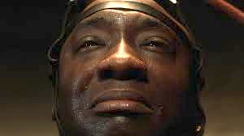
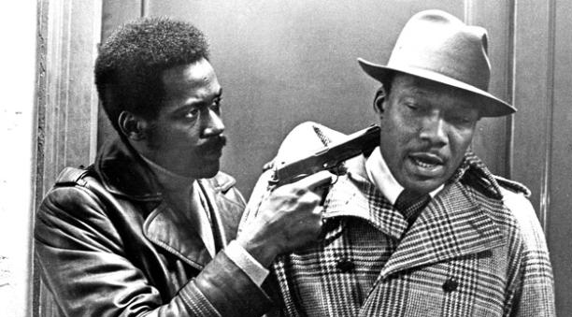
The Green Mile, 1999
Mainstream American audiences have a great deal of sympathy for black characters
Poor, uneducated, rural
Christ-like (Tom) John Coffey
Blaxploitation antiheroes like Shaft and Sweetback were “bad” to counter the saintliness of the emasculated Tom (stereotype)

Slide 51
“Magical Negro” –Spike Lee
A supporting role designed to guide the more troubled and sophisticated white often through supernatural powers
Designed to reestablish racial harmony from a white hegemonic point of view
Interracial sympathy
Feel good movies about racism

Slide 52
Magical John Coffey
John Coffey relieves the troubles of white jailors
Does not use his “magical powers” to help himself
Black punishment by white authority as kindness

Slide 53
“Random acts of kindness” will neither change the world nor alter the basic conditions that have produced greater segregation and incarceration of blacks than was experienced in the 1960’s and 70’s.
These films make whites feel good about their own good feelings towards blacks

Slide 54
Dialectic
the Hegelian process of change in which a concept or its realization passes over into and is preserved and fulfilled by its opposite
A way of framing something by constructing thesis, antithesis

Slide 55
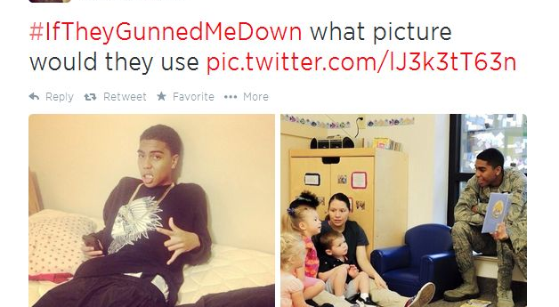
Tom and Anti-Tom, Leslie Fielder
Is the dialectic of racial feelings as well as the white hegemony within which they were originally and still continue to be generated.
Race matters in The Wire, but it is not part of this dialectic
The Wire points to the realities of neo-liberalism rather than follow a trajectory of racial victims/villains
Neither the liberal ideology of color blindness nor the old melodrama of black and white is the story found in The Wire

Slide 56
A Black racial imaginary is at the cultural center of The Wire’s many worlds.
Takes the burden off race as the key difference between social groups
Class is thus more visible than it usually is in American television or film
Gives the series the freedom to show negative black stereotypes as well
Starts with stereotypes, but doesn’t end with them

Slide 57
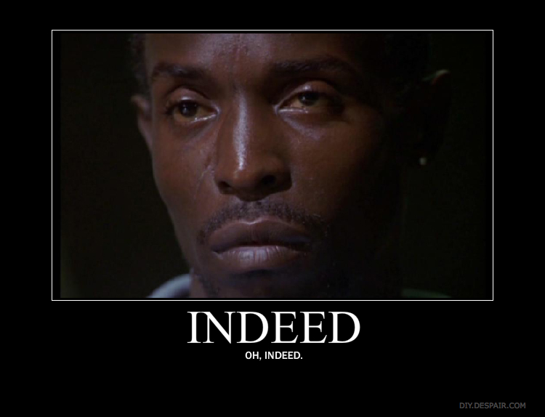
According to Williams, The Wire’s greatest innovation is to refuse to play the game of “vying to be the victim” of a racialized other

Slide 58
Forms of Tautology
“The game is the game”
A statement in which you repeat a word, idea etc., in a way that is not necessary
Makes no claims about reality and is used by authority figures to underwrite their own power
A leader will ask another to assent to its truth without actually knowing what that truth is

Slide 59
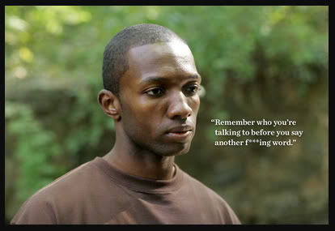
“The Game”
For Marlo “the game” is simply his own power
For Omar, “it’s all in the game” means he accepts responsibility for known rules
The game only means what any powerful player says it means
It does not need to mean anything beyond the acquisition of money and power
The game with no rules is a symbol for pure unbridled capitalism—neoliberalism
Drug dealers operate, like neoliberal capitalism, outside most conventional systems of constraint

Slide 60
The Good Old Days: Liberal Democracy of the Past
Neo-liberal capitalism does not guarantee work, economic growth, or stability, at the level it once delivered with systems of social guarantees
(The poor, blacks, women and other minorities were less likely to participate in these social guarantees
The good old days weren’t the good old days for everyone

Slide 61
If Marlo offers a vision of neoliberal subjectivity at its most ruthless, Omar offers a vision of its more creative, flexible possibilities
Universal recognition of Omar as “the best” character is not to redeem the value of neoliberalism, but to recognize how it reigns
The old economic system of “back in the day” worshipped by the dockworkers (working middle-class who earned livable wages) may never have been what it was cracked up to be and will likely never return

Slide 62
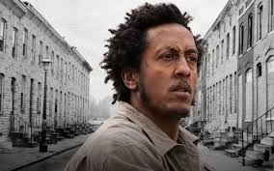
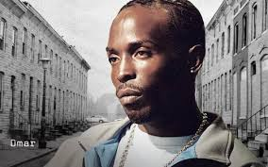
Neo-liberalism is not presented as an absolute evil that must be fought at every level, rather it is an economic reality that must be faced –Eric Beck on Omar Little in The Wire
Omar and Bubbles “play the middle” can maneuver and live by their own “codes”

Slide 63
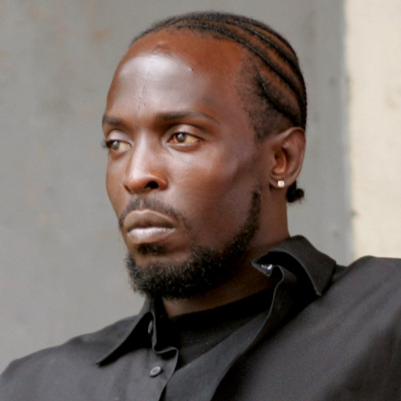
Omar
Answer to Spike Lee’s “magical negro” or subverts the Toms of the white imaginary
His magic does not serve a down-on-his-luck beleaguered white man
It allows him to continue his own pursuits
He belongs to none of the institutions profiled in the series
Queer man of color in a black community that is homophobic

Slide 64
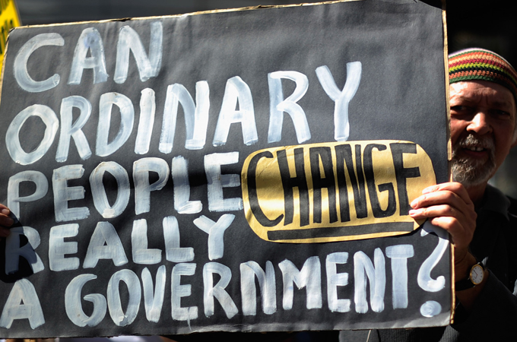
Wendy Brown on Neo-liberalism
Neoliberalism “openly weds the state to capital and re-signifies democracy as ubiquitous entrepreneurialism
For leftists to hold on to the tenets of liberal democracy in the face of their erosion by neoliberalism, is a hopeless exercise of melancholic dependency on a “lost object”
Enshrines and fixes the lost object: equal opportunity, guaranteed work, the welfare state
This American dream was never realized by many minorities and women
There needs to be an alternative vision for good (more egalitarianism? Sharing of wealth? Etc.)
Notes:
The neoliberal project is to turn the "nation-state" into a "market-state," one with the primary agenda of facilitating global capital accumulation unburdened from any legal regulations aimed at assuring welfare of citizens. In summary, neoliberalism seeks unbridled accumulation of capital through a rollback of the state, and limits its functions to minimal security and maintenance of law, fiscal and monetary discipline, flexible labor markets, and liberalization of trade and capital flows.

Slide 65
Bubbles and Omar
No liberal democratic delusions
Not driven by pure capitalism
Each have a vision of justice that runs counter to the neoliberal world they inhabit
Do not rely on racial injury to define themselves
They may exist outside acceptable strata of power, but that place outside (or in-between) gives them the ability to invent themselves

Slide 66
Black heroes within a predominantly black spatial imaginary
Gives them a fresh moral authority
Not because we perceive them or they perceive themselves as racial victims
They have the imagination to challenge or maneuver around the existing institutions of power

Slide 67
Race Matters in The Wire
Class matters and the proliferation of characters allows it to matter as much as race
It is a disadvantage for the kids to be born in all-black neighborhoods where drugs are the main source of income, and the way out is not clear
Namond is depicted as more advantaged than Dukie, so class is part of the reason why Namond is able to escape
Race matters, and doesn’t go unmentioned in the “color blind” way
The series does not play off one racial advantage or disadvantage against another in the tit-for-tat way of melodrama of black and white

