Slide 1
Ta-Nehisi Coates
Progress of white people (those who believe they are white) is built on violence
“Government of the people” what has the US considered the word people to mean?
Race is the child of racism and not the father—it is not about genealogy or physiognomy, but about hierarchy
Notes:
http://www.theatlantic.com/video/index/397715/Between-the-World-and-Me-Teaser/
Read page 71

Slide 2
Hegemony
before white people were white they were Catholic, Corsican, Welsh, Mennonite, Jewish
Notes:
domination of a culturally diverse society by the ruling class, who manipulate the culture of that society
so that their ruling-class worldview becomes the worldview that is imposed and accepted as the cultural norm; as dominant ideology that justifies the social, political, and economic status quo as natural, inevitable, perpetual and beneficial for everyone, rather than as artificial social constructs that benefit only the ruling class.^{[1][2]}

Slide 3
American Exceptionalism
America believes itself exceptional—we should accept American innocence at face value—
Coates holds America to that high standard

Slide 4
Destruction of the Black Body
Coates, speaking to his son, speaks of the vulnerability and danger
He doesn’t view police brutality as “a few bad apples,” but that the police are “Correctly enforcing the whims of our country”
Page 10—page 11 the dream
“This is your country, this is your world, this is your body”

Slide 5
Vulnerability of the black body is not an accident or a pathology, it is correct and intended policy of a society
“the other world was suburban and endless, organized by pot roasts, blueberry pies, ice cream sundaes, immaculate bathrooms and small toy trucks”
“personal responsibility”
Notes:
Page 22 top of page
Page 29 top of page

Slide 6
Certainty
Constant questioning, questioning as ritual, questioning as exploration rather than the search for certainty
Current views on implicit bias training is unnecessary
“The dream thrives on generalization, on limiting the number of possible questions, on privileging immediate answers. The Dream is the enemy of all art, courageous thinking, and honest writing”

Slide 7
Softness (Soft eyes)
No room for softness during Coates’ upbringing

Slide 8
Melodrama
Endures not only as an archaic holdover of the nineteenth-century stage play (virtuous victims and leering villains)
women’s films, chick flicks, Oprah confessions, not only as soap operas and disease-of-the-week TV movies
Williams recognizes it as an evolving mode of storytelling crucial to the establishment of moral good in a secular, liberal age
It is not old-fashioned, creaky, stage-bound drama
It seeks a justice that is part of the liberal sensibility that endures in The Wire

Slide 9

Tragedy and The Wire
Many critics call it a tragedy, because it is serious and realistic
Unafraid of facing the worst aspects of American Life
Linda Williams insists on calling it Melodrama even though the term brings with it many negative clichés
The Wire self-consciously avoids many of the well-known aesthetics of melodrama
Most of the negative qualities we attribute to melodrama come from the 19th century stage
Notes:
Pounding music, pathetic victims mustache twirlers badly motivated happy endings
19th century and early 20th century film that migrated from the stage ◊August Friederich von Kotzebue (1761-1819) – German – over 200 plays: domestic melodramas:August Friederich von Kotzebue (1761-1819) – German – over 200 plays: domestic melodramas:Uncle Tom’s Cabin – the novel by Harriet Beecher Stowe (1852) had several dramatizations:
George L. Aiken’s was the most popular--1853. Six acts, done without an afterpiece – established the single-play format. 325 performances in New York.
In the 1870’s, at least 50 companies doing it in the U.S.
In 1899: 500 companies.
In 1927: 12 still doing it.
12 movie versions since 1900.
The most popular melodrama in the world until the First World War.

Slide 10

Melodrama, less enlightened than classical forms?
Modernity of melodrama—not just frozen in the high hyperbole of the 19th Century French Stage
Is it a callback to earlier forms rather than a continued response to the changing conditions of modernity?
The term is commonly tied to excess
Notes:
hyperbole: is an extreme exaggeration used to make a point. It is like the opposite of “understatement.” It is from a Greek word meaning “excess.” Hyperboles can be found in literature and oral communication.
melodrama is a dramatic or literary work in which the plot, which is typically sensational and designed to appeal strongly to the emotions, melodramas are dramas of the 18th and 19th centuries in which orchestral music or song was used to accompany the action. 19th-century French word mélodrame Beginning in France after the theatre monopolies were abolished in 1791 during the French Revolution, melodrama became the most popular theatrical form of the century. Although monopolies and subsidies were reinstated under Napoleon, theatrical melodrama continued to be more popular and brought in larger audiences than the state-sponsored drama and operas. Although melodrama can be traced back to classical Greece, the term mélodrame did not appear until 1766 and only became popular after 1800. August von Kotzebue's Misanthropy and Repentance (1798) is often considered the first melodramatic play. The plays of Kotzebue and René Charles Guilbert de Pixérécourt established melodrama as the dominant dramatic form of the early 19th century.[3] David Grimsted, in his book Melodrama Unveiled (1968), argues that:
Its conventions were false, its language stilted and commonplace, its characters stereotypes, and its morality and theology gross simplifications. Yet its appeal was great and understandable. It took the lives of common people seriously and paid much respect to their superior purity and wisdom. [...] And its moral parable struggled to reconcile social fears and life's awesomeness with the period's confidence in absolute moral standards, man's upward progress, and a benevolent providence that insured the triumph of the pure.[4]
In Paris, the 19th century saw a flourishing of melodrama in the many theatres that were located on the popular Boulevard du Crime, especially in the Gaîté. All this was to come to an end, however, when most of these theatres were demolished during the rebuilding of Paris by Baron Haussmann in 1862.[5]
By the end of the 19th century, the term melodrama had nearly exclusively narrowed down to a specific genre of salon entertainment: more or less rhythmically spoken words (often poetry)—not sung, sometimes more or less enacted, at least with some dramatic structure or plot—synchronized to an accompaniment of music (usually piano). It was looked down on as a genre for authors and composers of lesser stature (probably also the reason why virtually no realisations of the genre are still remembered).

Slide 11
More excessive than what?
At the beginning of the 19th century Melodrama was excessive compared to the respected Neo-Classical Tragedy
Excessive compared to the decorum, unity, and efficiency of the earlier high culture form of Neo-Classical Tragedy
No grand gestures, no startling tableaux, no music etc
Hyperbolic, bigger than life, inflated rhetoric, unprecedented use of music
The term comes from “le melodrame” drama with music
What mattered most in this modern change to the theatre was not the excess of music, but that it was used at all
Notes:
Greek and roman forms on which it was based Greek tragedy was a popular and influential form of drama performed in theatres across ancient Greece from the late 6th century BCE. The most famous playwrights of the genre were Aeschylus, Sophocles, and Euripides and many of their works were still performed centuries after their initial premiere. Following the expansion of the Roman Republic (509–27 BCE) into several Greek territories between 270–240 BCE, Rome encountered Greek traged

Slide 12
Opening Music of The Wire: Lyrics
When you walk through the garden
You gotta watch your back
Well I beg your pardon
Walk the straight and narrow track
If you walk with Jesus
He’s gonna save your soul
You gotta keep the devil way down in the hole
Notes:
Tom Wait’s Way Down in the Hole 1987 all variations of the same thing, a cycle, the kids become the players in the next cycle, and the mayor becomes the same as the old mayor. Addiction keep the devil way down in the hole

Slide 13

Music in The Wire
There is none, except for the opening theme
And season finale montage sequences
Non-diegetic music
Diegetic music
Sounds that evoke emotions
There aren’t specific cues indicating exactly how you should feel at any given time
Notes:
Unsourced melos—extra-diegetic music an ancient Greek term meaning a tune, a melody, or a lyric poem intended for singing. In ancient Greek music theory “melos”meant the melodic basis of music. The teaching of harmonics and melopoeia was associated with melos.

Slide 14
Absence of Music=Absence of Melodrama?
Does this make the work more realistic as opposed to melodramatic?
Highly restricted use of music, repetitive serial nature of the performance of that music from the opening sequence
Infrequent music, understated music, and different versions of the same music do not undermine the power of melos to make an audience feel, but it can enhance it
The absence of music doesn’t necessarily mean realism
Maybe we have come full circle—mid-19th century (introduction of music to drama—and now less music makes for more effective melodrama)
Notes:
Term used by Richard Wagner to denote the vocal progressions in some of his operas that do not have the form or unity of regular melodies.
For more information on the music term "Melos" check out these other resources:

Slide 15
Demand for Justice
Melodrama has been increasingly approached less as a fly-by- night genre by academics like Peter Brooks and Linda Williams
Less as manipulative lower form and more of an enduring mode of expression and experience
In Greek Tragedy there is a constant theme of injustice, tragic heroes may rail against injustice, but eventually must accept their fate
Melodrama demands justice, while tragedy reconciles us to its lack
Notes:
The melodramatic imagination: Balzac, Henry James, Melodrama and the Mode of Excess

Slide 16
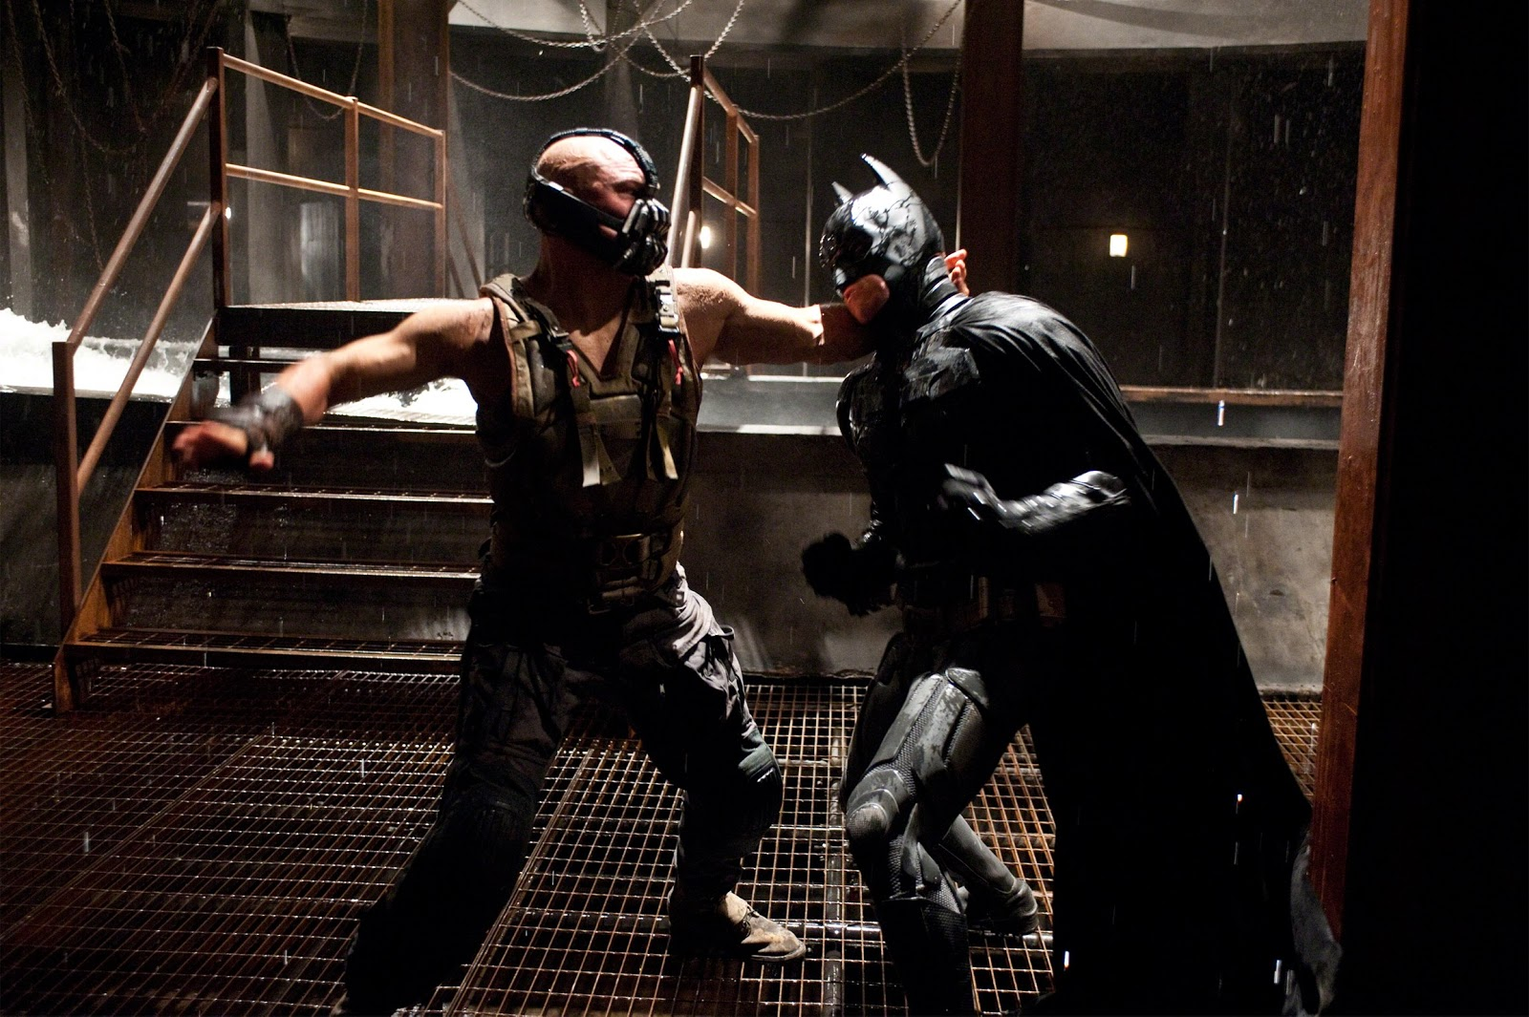
Blockbuster Films
Pathos of the suffering victim turned righteous action hero is the convention of the contemporary popular melodrama

Slide 17
Nietzschean Ressentiment
Friedrich Wilhelm Nietzsche
On the Genealogy of Morality 1887
Notes:
Book by Friedrich Nietzsche
World enough and time it moves beyond Nietzschean ressentiment and beyond the generation of mere pity
is a sense of hostility directed at that which one identifies as the cause of one's frustration, that is, an assignment of blame for one's frustration.
If I suffer, self-righteousness contends, that I am good and deserve to triumph
Is melodrama condemned only to repeat these patterns of personal injury, suffering and vindication?

Slide 18
Examples of Melodramatic Imagination in American Culture
Conquest of the West
Invasion of other Countries
We imagine ourselves as suffering at the hand of villainous others
Or more prevalent at the end of the Viet-Nam era we are forced to see ourselves as the villains
As long as we can portray ourselves as victims we seem to morally deserve to conquer and invade

Slide 19
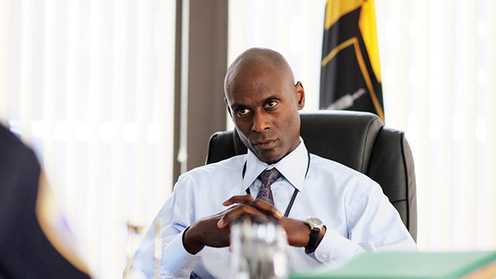
The Wire recognizes, but does not always show institutional routes to good
Enlists a form of realism to generate outrage against realities that could and should (according to its creators) be changed
The emphasis on how things should be i.e. justice, renders it as melodrama rather than tragedy.

Slide 20

Ressentiment
a sense of hostility directed at that which one identifies as the cause of one's frustration, that is, an assignment of blame for one's frustration.
If I suffer, self-righteousness contends, that I am good and deserve to triumph?
Is melodrama condemned only to repeat these patterns of personal injury, suffering and vindication?
Notes:
riedrich Wilhelm Nietzsche (/ˈniːtʃə/ German: [ˈfʁiːdʁɪç ˈvɪlhɛlm ˈniːt͡sʃə]; 15 October 1844 – 25 August 1900) On the Genealogy of Morality On the Genealogy of Morality

Slide 21
Is melodrama itself the problem as greater portions of the modern imagination have been given over to its influence?
Matthew Buckley asks whether melodrama’s affective structures and sensational effects have become by now “a normative form of feeling and thought”
Notes:
University, New Brunswick, where he teaches courses on comparative drama, media, and visual culture in modernity.

Slide 22

In a variety of contexts it reassures an individual group of its inherent virtue as well as the villainy of those who threaten us
“left melodrama” melodrama that particularly works in the American context towards social justice
“War on Terror” American freedom was attacked by a villainous other and the response to that attack ironically increased state power.
Notes:
The USA PATRIOT Act is an Act of Congress that was signed into law by President George W. Bush on October 26, 2001. Its title is a ten-letter backronym (USA PATRIOT) that stands for "Uniting and Strengthening America by Providing Appropriate Tools Required to Intercept and Obstruct Terrorism Act of 2001".
In the aftermath of 9/11, President George W. Bush guided the Patriot Act through Congress, unilaterally expanded surveillance of Americans, amplified executive detention authority and took other dramatic measures that shifted the balance between liberty and government power significantly, in the name of national security.
After the initial Patriot Act was passed, many Democrats perceived the growing threat to civil liberties and started to have misgivings. Now, five years into the Obama presidency enthusiasm for these measures seems to be bipartisan.

Slide 23
Linda Williams asks if there could be a less self righteous melodrama—less dependent on wild swings between pathos and action, less a matter of cycles of victimization and retributive violence
Can we reach beyond personal good or evil to determinations of better justice?
Notes:
Pathos a quality that evokes pity or sadness.

Slide 24
The Wire
Breaks some—not all—of the pervasive forms of melodramatic thinking
The seriality of The Wire and the blurring of the lines between good and evil
showing multiple sites
Its central dilemma is that “good” is no-longer self evident in a neo-liberal world
The drama, the realism, and the tragic situations make us yearn for that “good” or justice without being overly simplistic
Notes:
advocates of neo-liberalism support extensive economic liberalization policies such as privatization, fiscal austerity, deregulation, free trade, and reductions in government spending in order to enhance the role of the private sector in the economy.
Bubbles is an example of an Entrepreneur making it on his own, having his own business and The Wire shows that Bubbles on his own is very vulnerable he asks for nothing from the dwindling welfare state the wire makes the case for state sponsored care and thus against neo-liberal ideology the failure of bubble’s own neoliberal ethic of self sufficiency

Slide 25
The Mode of Melodrama still Holds us in its Grip!
Melodrama is a central form of communication (poetics of modern life—according to Peter Brooks)
Inextricable from popular media
It should be part of our modern vocabulary
We should be able to complain about it when its archaic qualities persist
Notes:
The Melodramatic Imagination Peter Brooks these "realist" novelists created fiction using the rhetoric and excess of melodrama - in particular its secularized conflicts of good and evil, salvation and damnation. The Melodramatic Imagination has become a classic work for understanding theater, fiction, and film.

Slide 26
We should also appreciate it when it evolves into something new (As in the case of The Wire)
It can be a tool with which mass culture makes a case for some kind of justice (not just a way of forming simplistic views of good and evil—sufferer and villain)
Validates aspirations of a liberal democracy in a neo-liberal era

