Slide 1
The Wire
Breaks some—not all—of the pervasive forms of melodramatic thinking
The seriality of The Wire and the blurring of the lines between good and evil
showing multiple sites
Its central dilemma is that “good” is no-longer self evident in a neo-liberal world
The drama, the realism, and the tragic situations make us yearn for that “good” or justice without being overly simplistic
Notes:
advocates of neo-liberalism support extensive economic liberalization policies such as privatization, fiscal austerity, deregulation, free trade, and reductions in government spending in order to enhance the role of the private sector in the economy.
Bubbles is an example of an Entrepreneur making it on his own, having his own business and The Wire shows that Bubbles on his own is very vulnerable he asks for nothing from the dwindling welfare state the wire makes the case for state sponsored care and thus against neo-liberal ideology the failure of Bubble’s own neoliberal ethic of self sufficiency

Slide 2
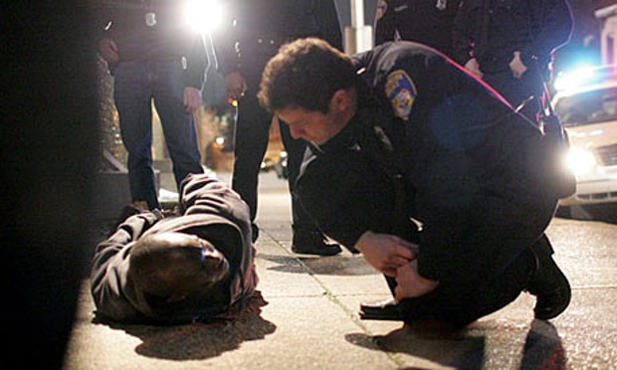
The Mode of Melodrama still Holds us in its Grip!
Melodrama is a central form of communication
Inextricable from popular media
It should be part of our modern vocabulary
We should be able to complain about it when its archaic qualities persist
Notes:
The Melodramatic Imagination Peter Brooks these "realist" novelists created fiction using the rhetoric and excess of melodrama - in particular its secularized conflicts of good and evil, salvation and damnation. The Melodramatic Imagination has become a classic work for understanding theater, fiction, and film.

Slide 3
We should also appreciate it when it evolves into something new
(As in the case of The Wire)
It can be a tool with which mass culture makes a case for some kind of justice (not just a way of forming simplistic views of good and evil—sufferer and villain)
Validates aspirations of a liberal democracy in a neo-liberal era

Slide 4
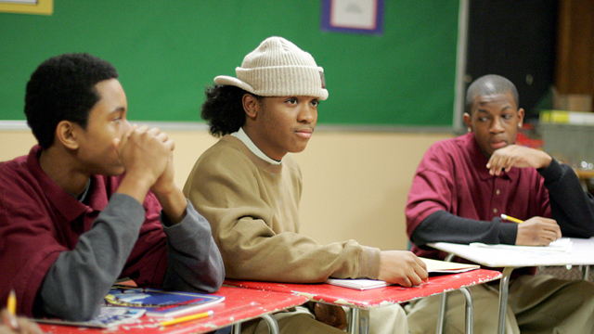
Ultimately, The Wire is about individuals grappling with inherently corrupt institutions who, at best, may claim small victories.

Slide 5
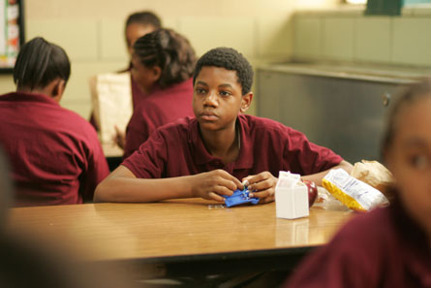
None of these institutions can deeply recognize what is just and good in its own operation, despite the many individuals who try. This is the basis of the series' famous anger and realism.
Melodrama does not demand a happy ending, though Dickens' readers did. It merely demands an awareness of what would be just.

Slide 6

Chimamanda Adichie
warns that if we hear only a single story about another person or country, we risk a critical misunderstanding.
This is even more apparent in the form of archaic melodrama which points to a hero’s pain and righteousness caused by a villainous other

Slide 7

Everyone is Watching Me

Slide 8
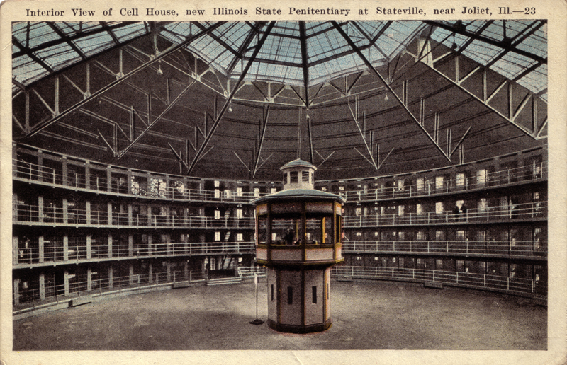
Panopticon
Jeremy Bentham Proposal for a New and Less Expensive mode of Employing and Reforming Convicts (London, 1798)
The Panopticon ("all-seeing") was a prison. It was designed to allow round-the-clock surveillance of the inmates by their superintendent.
Michele Foucault (Discipline and Punish-1975)
Notes:
Bentham was influenced by the moral philosophy of Hume, David, who was attempting to describe the structure of the human mind. Hume proposed that simple ideas can be linked together through associations.
Enlightenment a European intellectual movement of the late 17th and 18th centuries emphasizing reason and individualism rather than tradition. It dominated the world of ideas in Europe in the 18th century. The principal goals of Enlightenment thinkers were liberty, progress, reason, tolerance, and ending the abuses of the church and state.

Slide 9
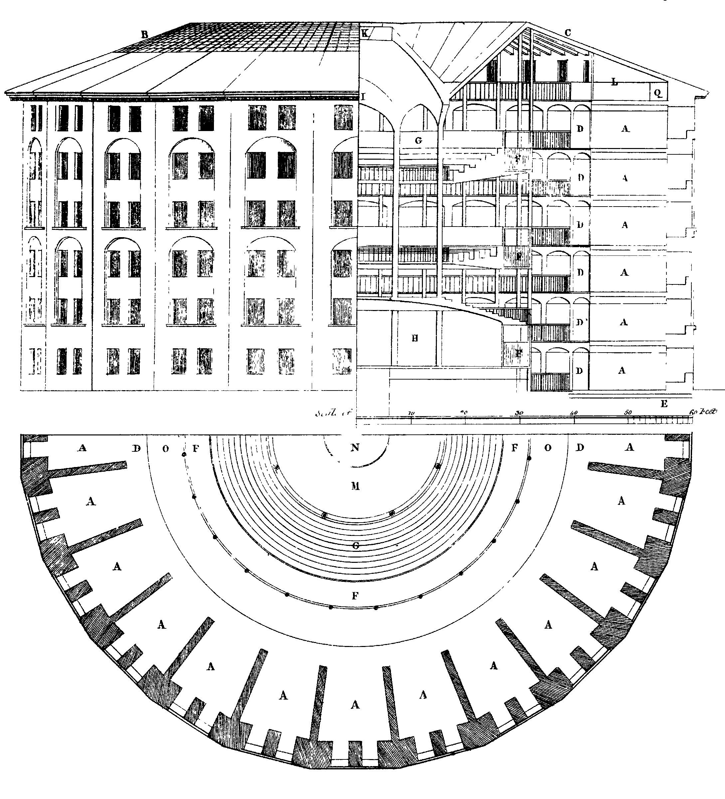
Panopticism
A model of internalized subjection that seemed to produce perfectly docile bodies
Notes:
Once punishment was administered on display: for thousands of years, men were crucified, hanged, and garroted to demonstrate social rights and wrongs. Now, though, we are “disciplined” internally, through the composition of our character.
"Each individual, in his place, is securely confined to a cell from which he is seen from the front by the supervisor; but the side walls prevent him from coming into contact with his companions. He is seen, but he does not see; he is the object of information, never a subject in communication."
"Bentham laid down the principle that power should be visible and unverifiable. Visible: the inmate will constantly have before his eyes the tall outline of the central tower from which he is spied upon. Unverifiable: the inmate must never know whether he is being looked at at any one moment; but he must be sure that he may always be so."
"Inspection functions ceaselessly. The Gaze is alert everywhere."

Slide 10
Panopticism and Power
By individualizing the subjects and placing them in a state of constant visibility, the efficiency of the institution is maximized.
These qualities also give an authoritative figure the "ability to penetrate men’s behavior" without difficulty.
"The Panopticon must not be understood as a dream building: it is the diagram of a mechanism of power reduced to its ideal form; its functioning, abstracted from any obstacle, resistance or friction, must be represented as a pure architectural and optical system
In light of this fact Foucault compares jails, schools, and factories in their structural similarities.
The imprisoned plays both roles: he becomes the principle of his own subjection
Notes:
Furthermore, it guarantees the function of power, even when there is no one actually asserting it. It is in this respect that the Panopticon functions automatically.
This design is also applicable for a laboratory. "It could be used as a machine to carry out experiments, to alter behavior to train or correct individuals."
: it is in fact a figure of political technology that may and must be detached from any specific use.”
… Each individual, in his place, is securely confined to a cell from which he is seen from the front by the supervisor; but the side walls prevent him from coming into contact with his companions. He is seen, but he does not see; he is the object of information, never a subject in communication. The arrangement of his room, opposite the central tower, imposes on him an axial visibility; but the divisions of the ring, those separated cells, imply a lateral invisibility. And this invisibility is a guarantee of order. If the inmates are convicts, there is no danger of a plot, an attempt at collective escape, the planning of new crimes for the future, bad reciprocal influences; if they are patients, there is no danger of contagion; if they are madmen there is no risk of their committing violence upon one another; if they are schoolchildren, there is no copying, no noise, no chatter, no waste of time; if they are workers, there are no disorders, no theft, no coalitions, none of those distractions that slow down the rate of work, make it less perfect or cause accidents. The crowd, a compact mass, a locus of multiple exchanges, individualities merging together, a collective effect, is abolished and replaced by a collection of separated individualities. From the point of view of the guardian, it is replaced by a multiplicity that can be numbered and supervised; from the point of view of the inmates, by a sequestered and observed solitude.

Slide 11
Surveillance and You
Talk about your experience with surveillance.
Notes:
Have you felt docile because of surveillance?
Has the thought of surveillance limited your movement in any way?
Any other direct effects of surveillance on your life?
Think about the idea of (always being watched and never being in contact with others)

Slide 12
Surveillance in Popular Culture
Describe the power dynamic of surveillance in 24 and Homeland
Notes:
Are there clear representations of good and evil?
Who is good and who is evil?
Is there complexity?

Slide 13
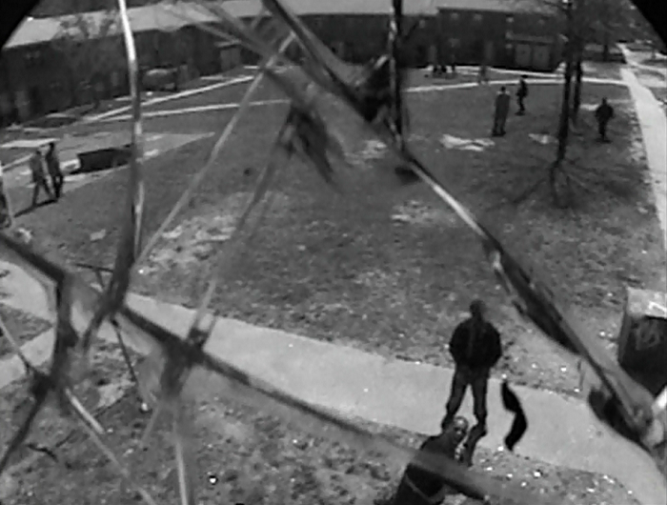
Not so Docile Bodies
Surveillance in The Wire is thwarted on many occasions
Happy Symbiosis between institutions
Both institutions: The dealers and the police need the war on drugs to stay in business

Slide 14
Surveillance and The Wire
The War on Drugs, produces many arrests—mostly of black men, but doesn’t make a dent in the problem
Unwillingness to follow the money (Season 4)
Even state-of-the-art technology does not get the police the information that they seek
The Wire is neither a CSI style celebration of crime-solving technologies nor designed to inspire confidence in other state or government authorities in a post 9/11 world

Slide 15
Surveillance is marked by social internalization of rules and regulation—and our conditioned hesitance to contest unjust law.
The judges of normality are present everywhere. We are in the society of the teacher-judge, the doctor-judge, the educator-judge, the ‘social-worker’-judge; it is on them that the universal reign of the normative is based; and each individual, wherever he may find himself, subjects to it his body, his gestures, his behavior, his aptitudes, his achievements.
the emphasis on normalcy harms those who exist outside the status quo “tracking” the issue assumes that these students should be able to perform at the same level of other students.
Adnan as “the other” was possibly harmed by his existence outside the status quo.
Notes:
Rehabilitation is favored over cruel and unusual corporal punishment, and while this change may be superficially kind, the emphasis on normalcy harms those who exist outside the status quo. In Foucault’s words:

Slide 16
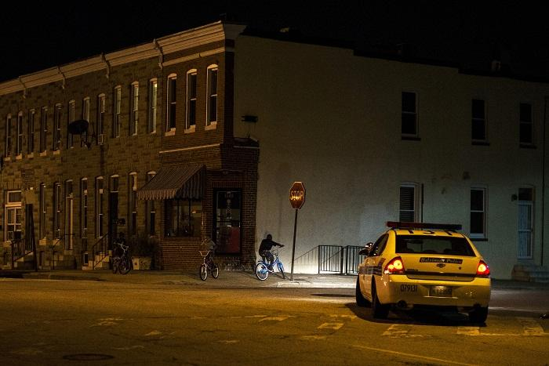
Does a patrol car protect citizenry or does it keep citizenry in place?
Does a patrol car maintain the status quo?

Slide 17
The show has “Soft Eyes” in the sense that it attempts to take in the big picture
Notes:
Like I’m supposed to cry and shit?
If you got hard eyes you staring at the same tree missing the forest
Ah zen shit
If you look really hard at one thing you miss the whole
That’s why she didn’t see that Bunk put the note: “Tater shot me”
And how she finds out later that tater did really shoot him

Slide 18
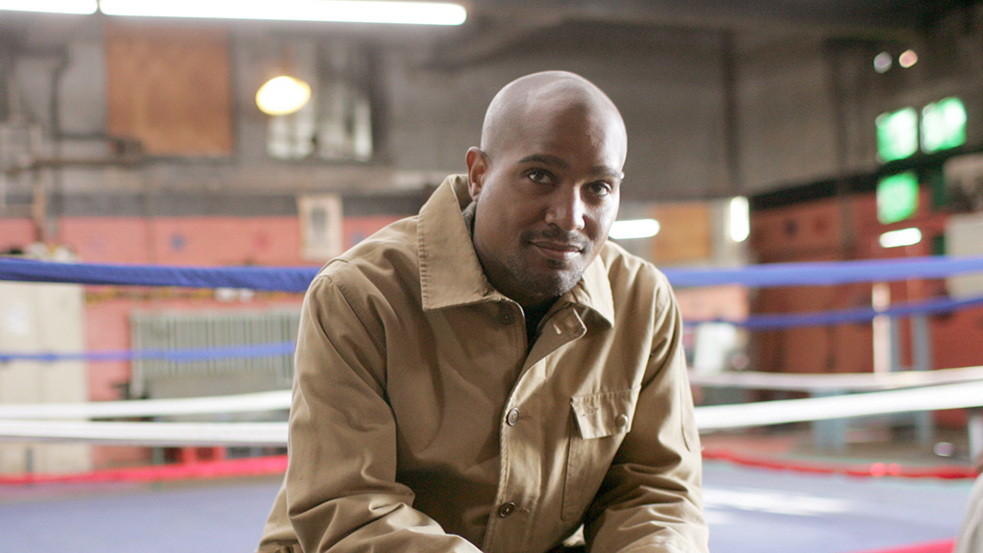
Proximate Surveillance “Soft Eyes”
In Bentham’s model, the watchtower wasn’t the only mode of control
A kindly eye, a soft eye, a proximate eye can be the best thing that can happen to a young person, a dope fiend, or a policed neighborhood
Not all surveillance is destructive
Conversely: The Wire repeatedly shows the foiling of “Hard Eyes”
Making a case for “Soft Eyes”
Notes:
Separation of criminals as well—that have to be isolated and watched

Slide 19
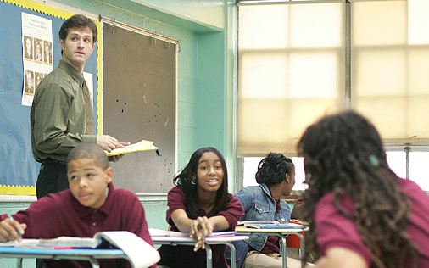
Docile Bodies in the Classroom
Season 4 shows how teaching is like policing
Windows closed to make them drowsy
Busywork to keep them off guard
An older teacher says: “You need soft eyes”

Slide 20
Opening Credits of the Show
Depict technologies of surveillance
Destruction of those technologies
Panopticism is flawed, because it aims to suppress the deviancy of crime, but produces the deviants it tries to suppress
The more surveillance exists the more potential to resist it increases
Systems of surveillance are only as good as the people who use them
Notes:
Alasdair Mcmillan
Police in The Wire are foiled by the discipline of wary criminals

Slide 21
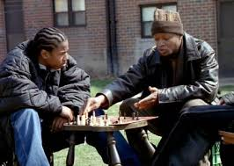
School
Significance of the Chess Game
Expendable Role in The Game
The game isn’t fair and democratic like they want it to be
https://www.youtube.com/watch?v=N8lyda_ZkLQ

Slide 22
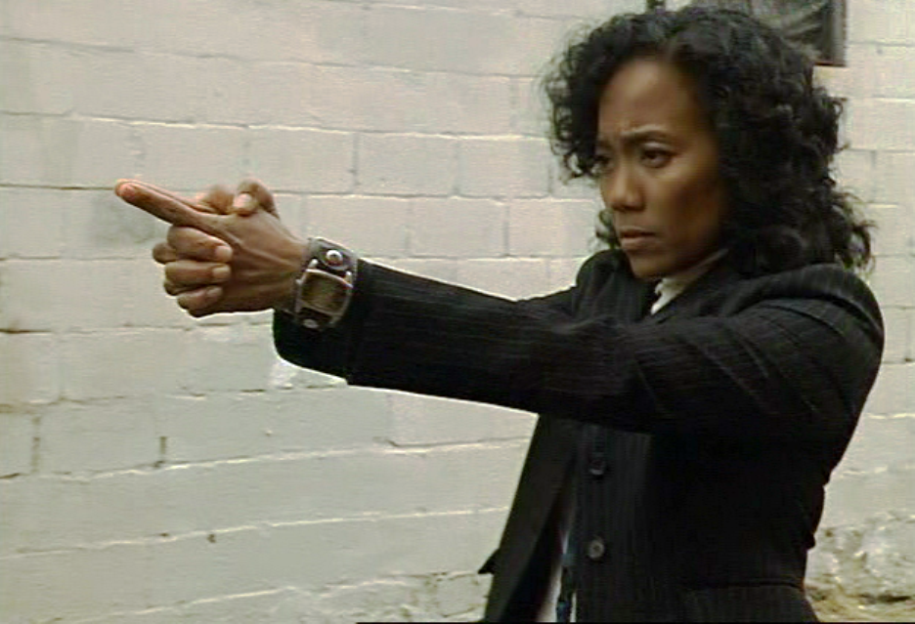
Soft Eyes
If you have soft eyes you can see the whole thing
That’s why Kima is able to solve the crime
Prez watches over instead of surveilling his class

Slide 23
Soft Eyes
Multi-Sited Ethnography
Gives greater breadth and scope to the discipline (or story)
As opposed to the unique, single sited, perspective
Takes multiple forms of information about an interconnected whole situation and its contexts of significance

Slide 24
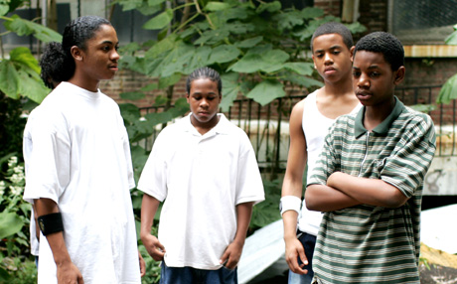
Soft Eyes are a Liability
The little bit of softness required to observe without reacting with defensive violence is a useless skill in the world of the students in Prez’s class.
Kima can risk a gamble on softness
Throughout the many seasons of The Wire, anyone from The Corner is in danger when they exhibit “softness”
These characters have to put on blinders to the suffering of others or become victims themselves
A character like Dukie is not able to harden himself like Michael

Slide 25
Soft eyes can make Kima a better cop and Prez a better teacher, but they are a liability for someone like Dukie
How does Dukie get from where he is, to somewhere else?
Soft eyes are a privilege for people who have more options

Slide 26
Soft are only available to those who with a future stake in the culture in which they live, to those more fortunate beings who do not have to harden themselves to merely survive
Notes:
Michael has limited options as well.
He can’t go to a social worker to protect his brother
He can’t accept friendliness or trust others
There is nothing he feels he can do, but protect his family in a more criminal way. The “power” or “law” that he seeks help from is not from the system which will undoubtedly fail him, but from “the king” Marlo

Slide 27
Namond
Doesn’t want to deal drugs
Can’t be hard like Michael
Takes his pent up frustrations out on Dukie
His mom gives him no other opportunity

Slide 28

Generic School Melodrama
The Wire, Season 4 turns it on its head by allowing “The Corner” students the opportunity to teach the teachers
The cliché: An enlightened teacher who succeeds at teaching and breaks through defensive hardness to enlighten the kids
A different viewpoint: The Wire focuses on moral legibility on the institutional level
Personal goodness can’t trump institutional failure
Notes:
Moral legibility is (showing the problem, so that you have a sense of what justice should be)
The best way to save the individuals is not through the help of a singular enlightened liberal hero, but through institutions working together to help

Slide 29
Surveillance, on The Wire is quite often useless
Soft Eyes are better ways to gain knowledge, but are unavailable or unadvisable to people who have to survive on the street
Notes:
Separating students due to expected performance

Slide 30
Soft Eyes on the part of the educators and not the hard eyes of surveillance, offer the students in the special class a safe place for the moment
Offers supervision rather than surveillance
Those who run the program are accused of “tracking”
The accusation of “tracking” is based on the false assumption of an otherwise equal society

Slide 31
The spy melodrama and the school melodrama are both rewritten by The Wire
One is about surveillance as a tool to protect “the good”
The other argues that the value of “softness” (liberal, democratic values) is a good that can be taught
The Wire teaches that surveillance and teaching can’t overcome larger systems of inequality
The show brings the two genres together and explores the limitations of both

Slide 32
Surveillance is not the key to better policing and magical teaching is not the solution to better schools
Supervision vs. Surveillance

Slide 33

Many academics have admitted that The Wire is more than pedagogically defensible—it has the ability to teach as effectively as many educators can
It turns the school melodrama into an extraordinary one through its breadth and depth (over time)
The Wire doesn’t focus on the liberal righteousness of the teachers—like other inner-city school melodramas
It focuses instead on better opportunity for all (by presenting the lack of it in our current state)
Notes:
By using suffering, showing the problems, and not providing easy solutions

