Slide 1
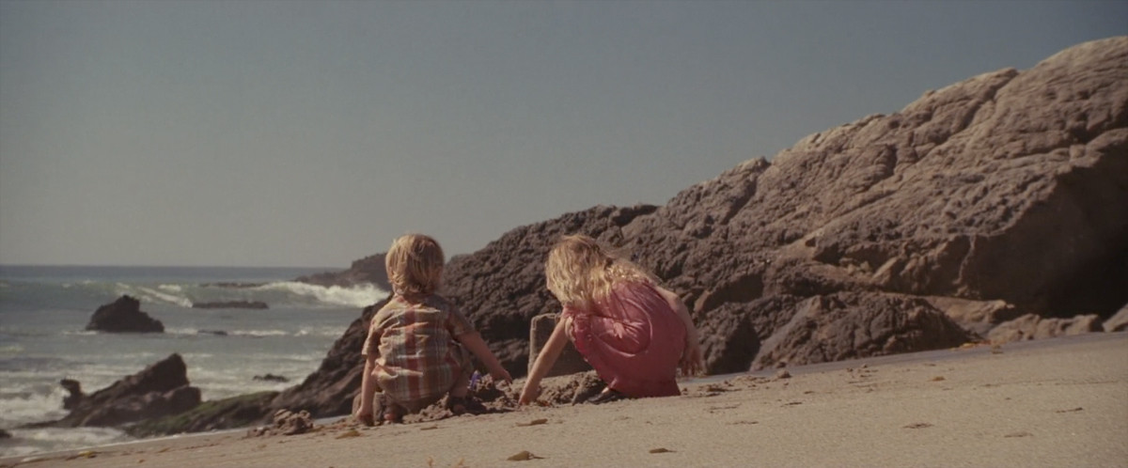
Watch the following:
Types of Film Cuts
Great right?

Slide 2
2 Main Transitions
Basic cut—a cut from one shot to another. Continuity is created through direction
Fade or dissolve—transition from one shot to the other (using transparency)
Dissolves usually signify a dreamy atmosphere or the passage of time
They are not used to mask bad edits
Fade to black—fade up from black also signifies passage of time

Slide 3
Shooting to Edit The following techniques are for achieving continuity editing

Slide 4
Continuity Editing
gives the viewer the impression that the action unfolds with spatiotemporal consistency. In most films, logical coherence is achieved by cutting to continuity, which emphasizes smooth transition of time and space.

Slide 5
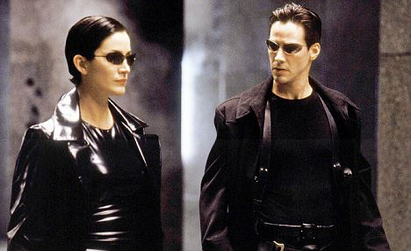
Continuity Editing
Or Classical Hollywood Editing
Is meant to be invisible
Watch the following sequence all the way through
Action sequence
Watch again—counting all of the cuts you see

Slide 6
Continuity Editing can be Achieved by:
Getting Coverage (multiple shots—b-roll)
Cutting on Action
45 Degree Rule
180 Degree Rule
Spatial Unity

Slide 7
Basic Sequence
Master shot
Most of the time a conversation like this (about a minute) will consist of multiple shots to create interest
Notes:
The reason why we don’t use this method is because it can be boring. Makers of neo-realism would disagree see: Bicycle Thief
Shooting other angles can help editors have other options

Slide 8
Master SRS
Notes:
The process of shooting a sequence like this involves shooting all of the angles all the entire scene---all the way through! Ever set up!

Slide 9
Wide or Establishing
Shows your subject within context
Notes:
Shows your subjects in relationship to one another and to the entire scene. Spatial Unity

Slide 10
Cutaway
How can you use a cutaway to cut the boring parts out?
Example
Notes:
Having another shot-or angle can allow you to cut into a sequence without creating a jump cut.

Slide 11
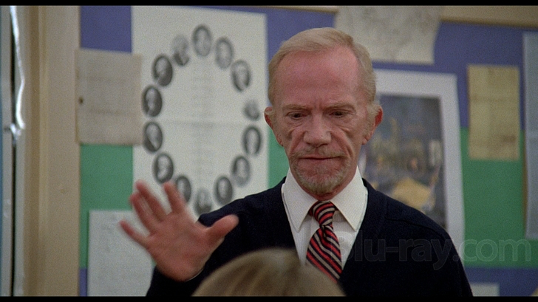
Basic Sequence
Movie Clip
Online Lecture about Clip password: paloma

Slide 12
Documentary Cutaway
The Thin Blue Line (start at 2:54)
2:54 Interview main shot
3:04 Still from newspaper cutaway
3:15 re-enactment cutaway (multiple shots)

Slide 13
Other Cutaways?
What cutaways can you imagine for an interview with a student athlete?

Slide 14
B-roll examples Student Athlete
Footage from a game
Shots from practice
Photos
Trophies
Any more?

Slide 15
Promotional video for Soul Cycle
What are all of the different examples of cutaways?

Slide 16
B- Roll
The modern day use of broll (or b-roll) is with broadcast TV as supplemental footage inserted as a cutaway to help tell the story. B-roll includes the shots that are shown to introduce a segment and/or in between the live or taped interviews.
--quora

Slide 17
A basic sequence
Each new shot should if at all possible involve a change in image size and camera angle
Makes movie interesting and makes it easier to cut back and forth between shots

Slide 18
45 Degree Rule or the 30 degree rule
Makes transition from shot to shot smoother and easier to accomplish
If there is a subtle change in an image it will be noticed if both shots are similar
Note: the barebones book calls it 45 degree rule though it is most commonly called the 30 degree rule

Slide 19
Cutting on Action
The viewers eye naturally follows movement on screen
Start movement on one shot and complete it on the next

Slide 20
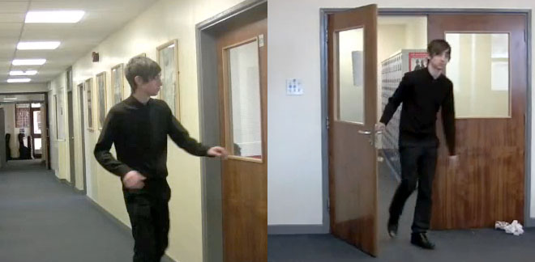
Obvious situations where editing on the action is convenient
Opening doors
Getting out of cars
Sitting down
Standing up
Reaching for objects
Walking
Running

Slide 21
Overlapping Action
The important thing to remember is that the last action of the first shot has to be repeated at the beginning of the second shot
You have to shoot the same movement twice

Slide 22
Clean entrance and Clean Exit
If you show an action from beginning to end you don’t have to match anything

Slide 23
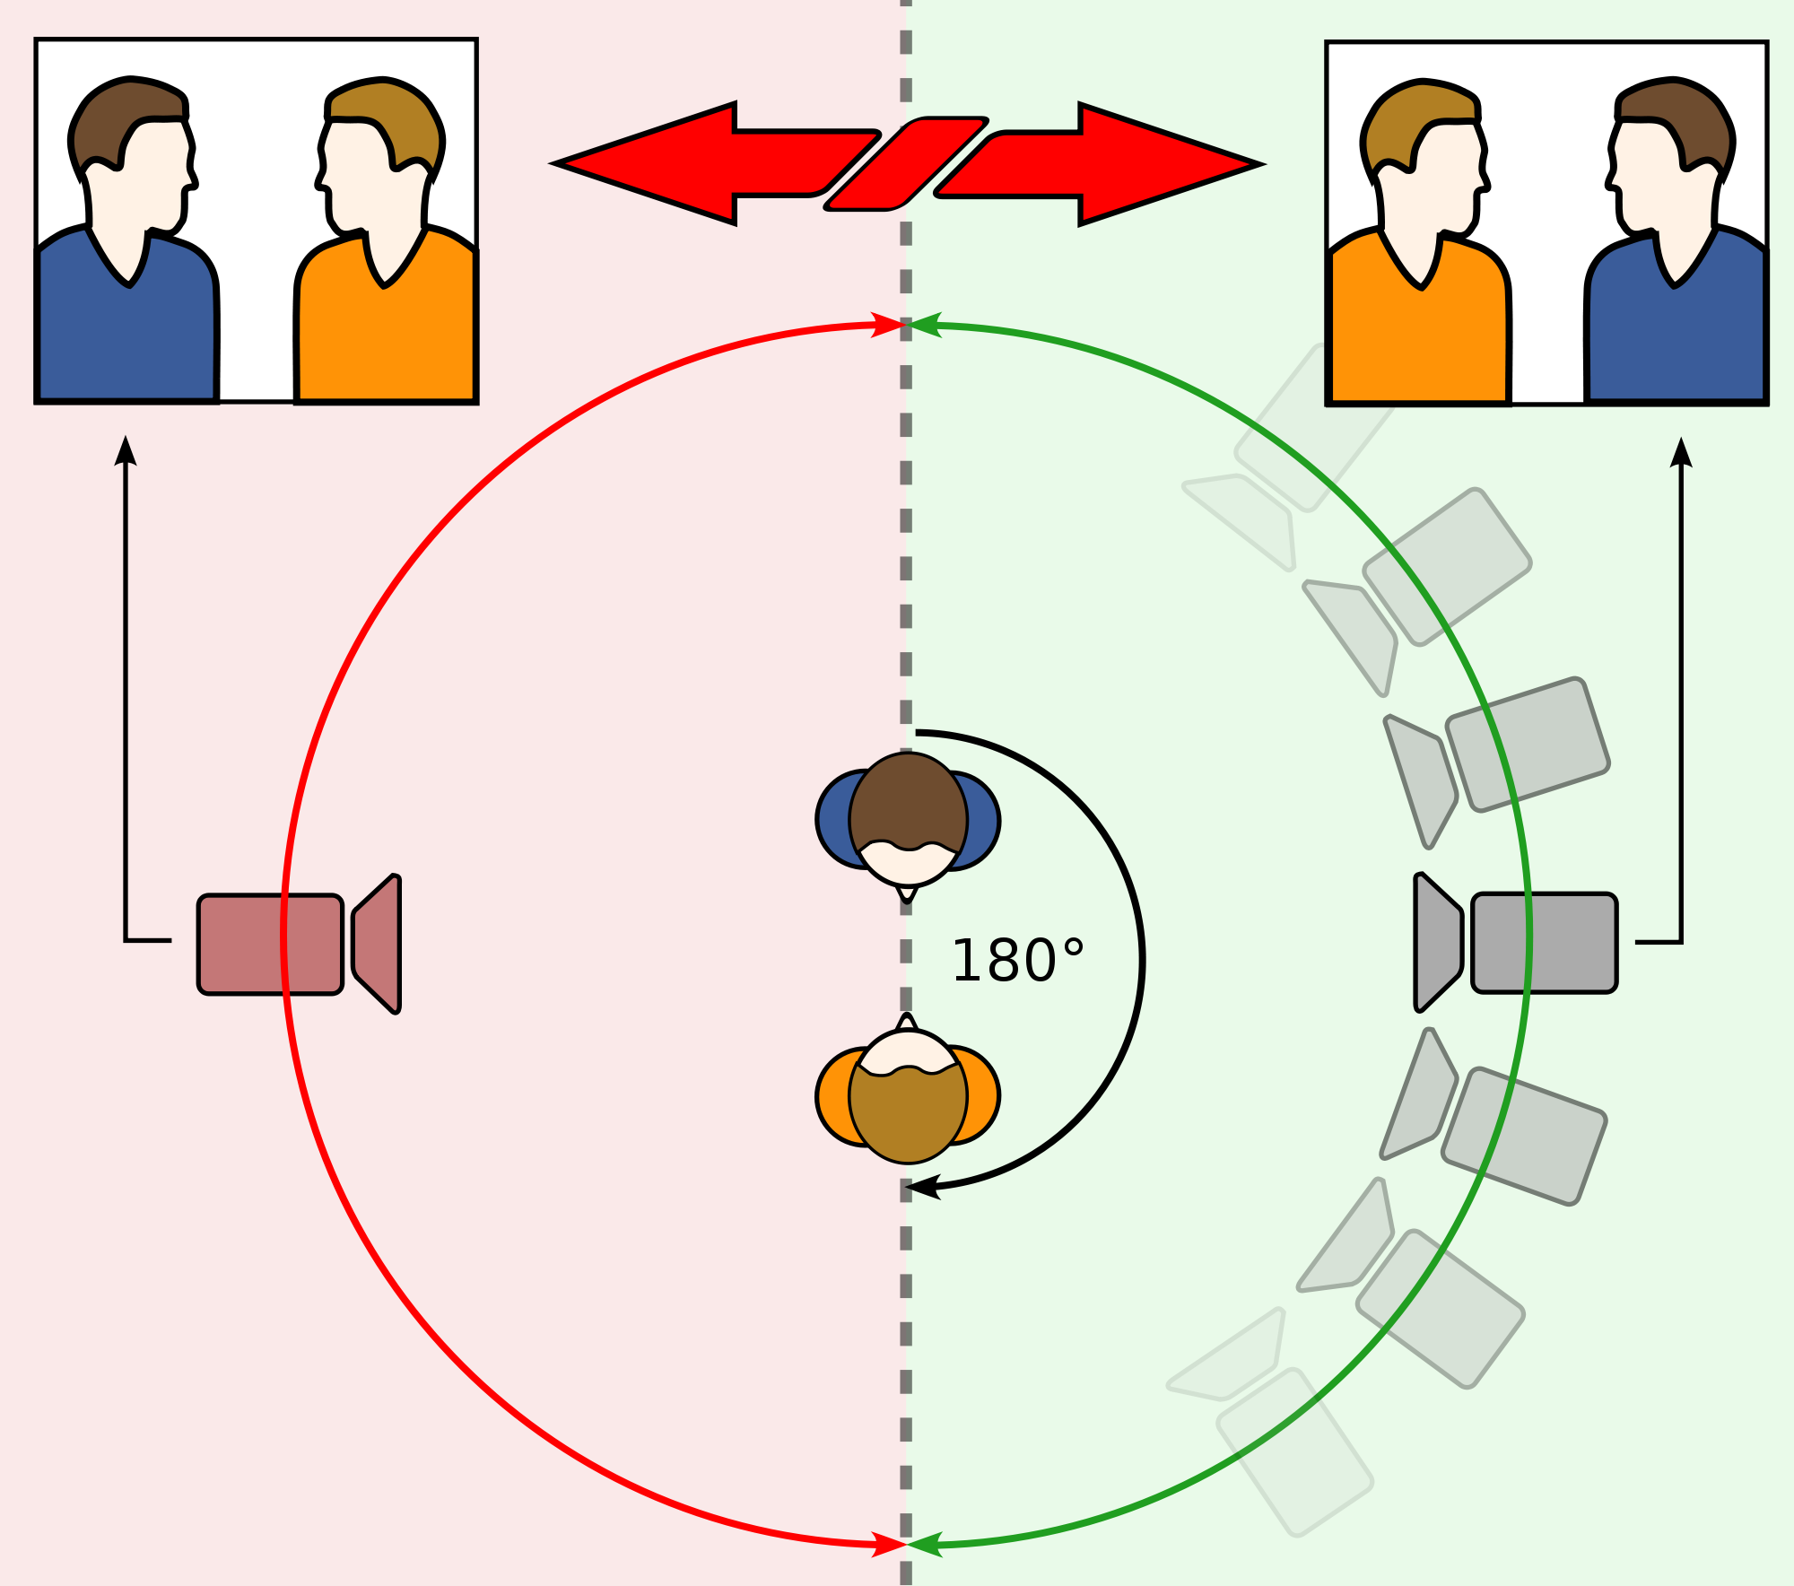
180 Degree Rule

Slide 24
Fast Cutting and Slow Cutting
Fast and Slow Cutting
Slow cutting to create suspense
A lot of people think that the tension created in scary movies is created by fast cutting. Not true, it’s all about the slow cuts

