Slide 1
Non-Linear Editing
Allows access to any clip without scrubbing through entire clips
Film was the first nonlinear editing system

Slide 2
Workflow
Non Linear Editing Video Here

Slide 3
Premiere Pro and Cache Files
Cache: A cache (pronounced CASH) is a place to store something temporarily in a computing environment.
In computing, active data is often cached to shorten data access times
Allows Premiere to play different codecs (video compression types)
More info at this link

Slide 4
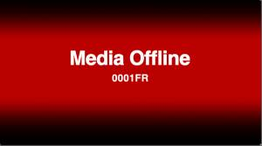
Editing Software
Is only making references to clips on your hard drive. The clips are not actually there in the software program. That means that if you move your clips around or delete them off of your hard drive—you will offline your media.
Timecode

Slide 5
Components of Continuity Editing
Avoid jump cuts: A shot of a person sitting—cut to the same shot of the person standing creates a noticeable jump in time
Preserving screen direction at cuts (180 degree rule)
Intercutting (Parallel cutting)
Link to movie: Cutting Edge
Watch the first 15 minutes (or more)
Study point: Verna Fields edited Jaws

Slide 6
Cut tight – The best editing approach is to cut tight scenes without becoming too “cutty.”
Editing Link 1
Editing Link 2

Slide 7
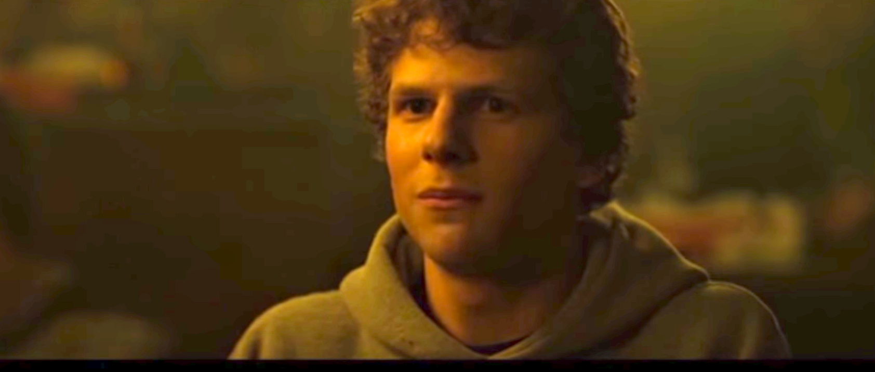
This means taking out unnecessary pauses between actors’ delivery of dialogue lines.
Sometimes it means tightening the gaps within dialogue sentences through the use of carefully placed cutaways.
It may also mean losing redundant lines of dialogue, after the director has reviewed your cut.
Link: Opening Scene from Social Network

Slide 8
Coverage
Think about how all of the different angles (coverage) in the last scene allow for tighter cuts and editing options
Almost Famous: “What Kind of Beer?” Link here
Editing shows Kate Hudson’s talent for emotional transition within a single take

Slide 9
Looking back over different cut types:
The Cut
Jump Cut
J and L Cuts
Cutting on Action
Cutaways
Cross cut—parallel editing
Montage
Match Cuts
Example Link

Slide 10
B-roll shots in threes
When the scene calls for cutaway inserts, it feels right to use three on a row. Not a single shot, not two, but three.
These should be at least 1.5-2 seconds long (or longer). An example might be when a character enters the room and looks around.
It mimics our real-world experience of moving our head around and seeing different aspects of the same surroundings.
B-Roll tutorial here

Slide 11
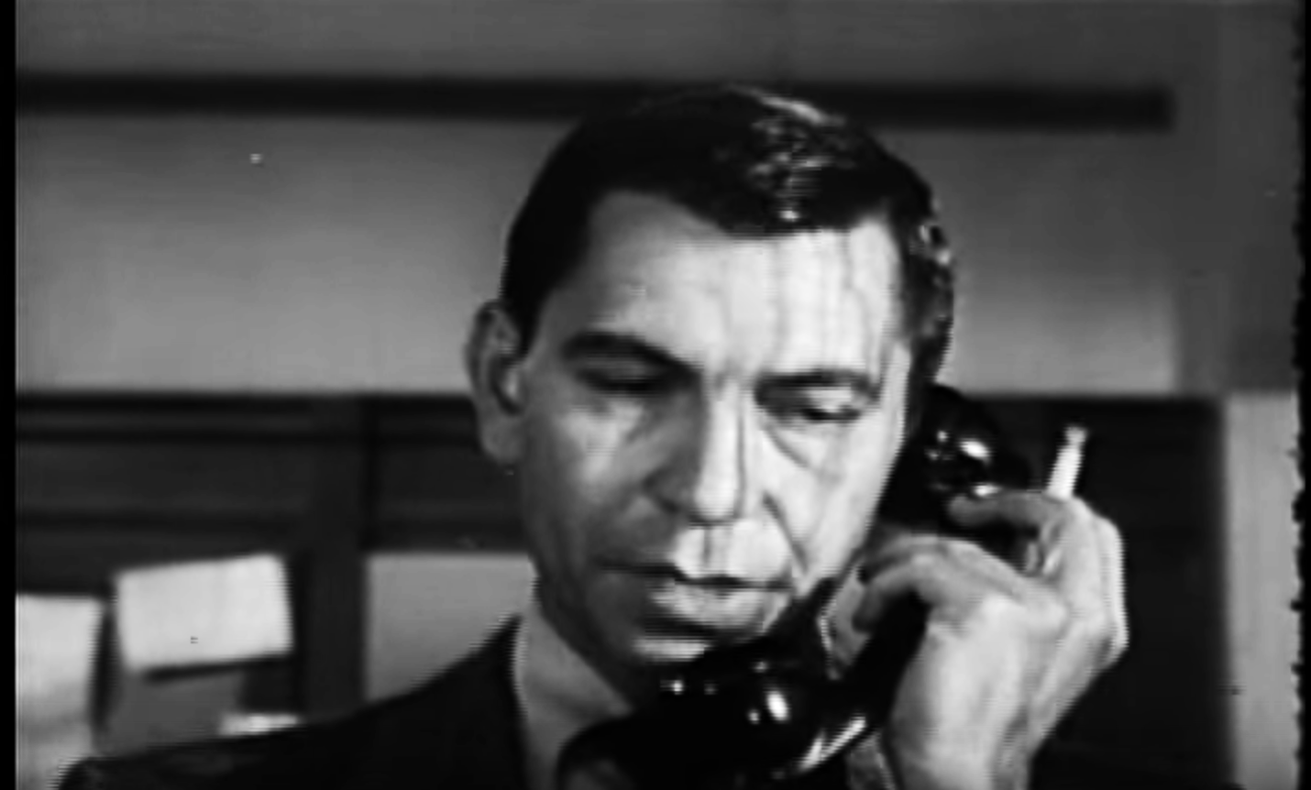
No Dragnet edits – The original Dragnet television series used a certain approach to cutting dialogue scenes. Link Here

Slide 12
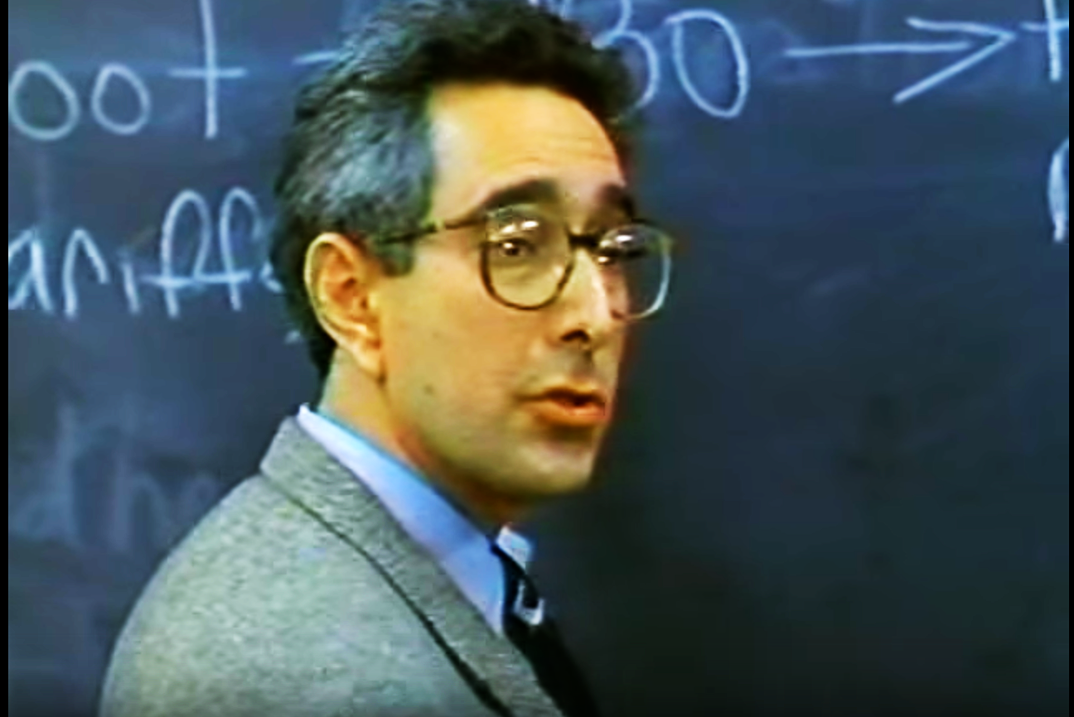
Audio and video edits tended to be made as straight cuts between the actors without any overlaps as they delivered their lines. It followed this formula: cut to actor A – deliver the line; cut to actor B – deliver the line; cut back to actor A and so on. Our brains seem to react better to edits where the change in picture and sound is not always together. Link: These are called split edits, L-cuts or J-cuts.

Slide 13
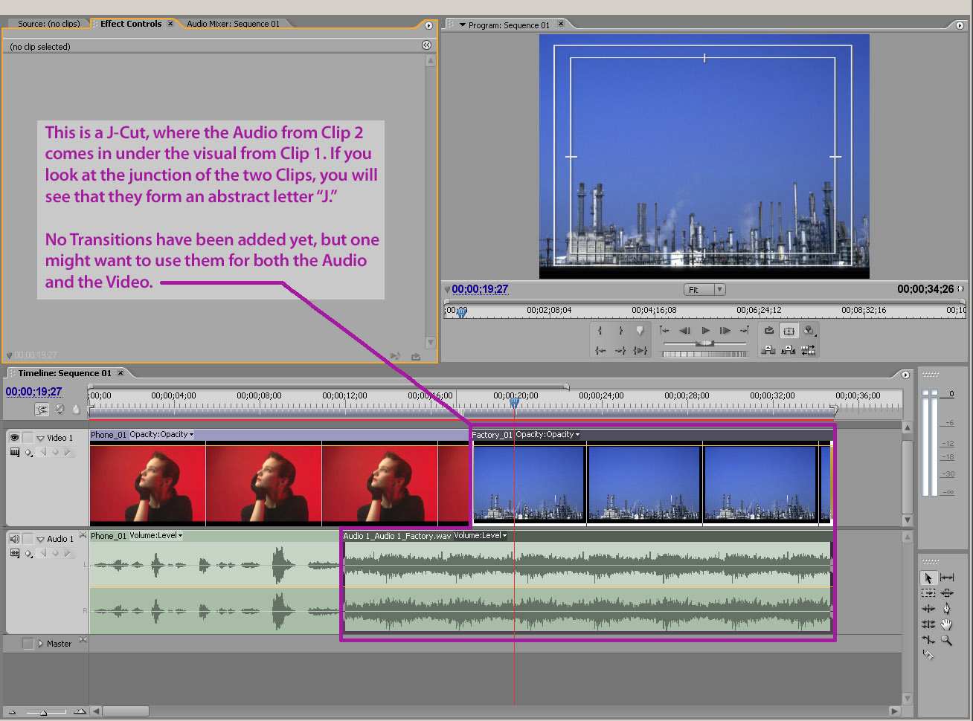
J CUT

Slide 14
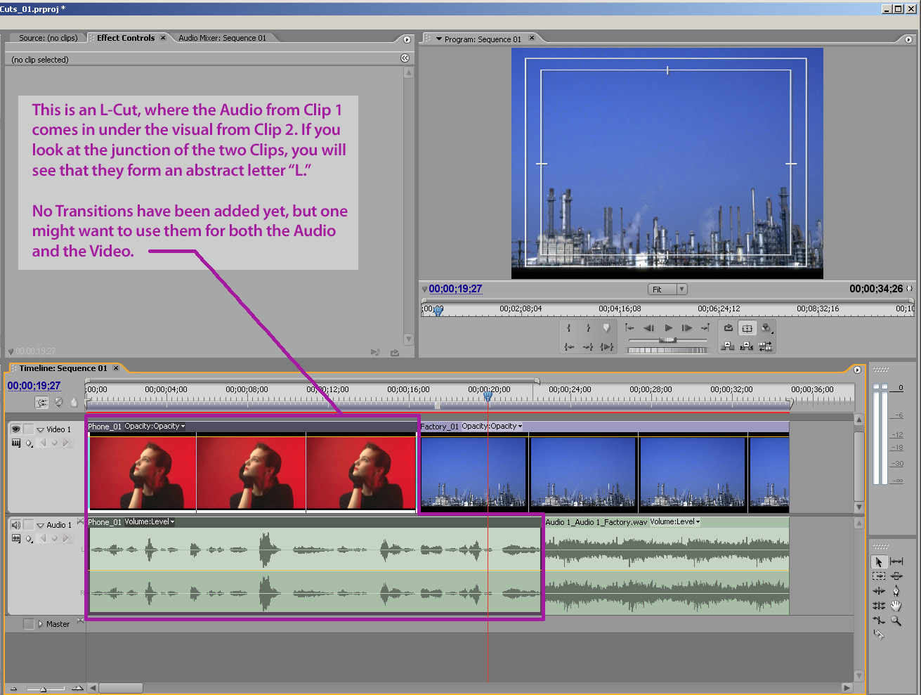
L CUT

Slide 15
Go back and re-watch the Ferris Bueller scene to determine which are J cuts and which are L shots
More on J and L cuts here
The Breakfast Club Try to find the J and L cuts.

Slide 16
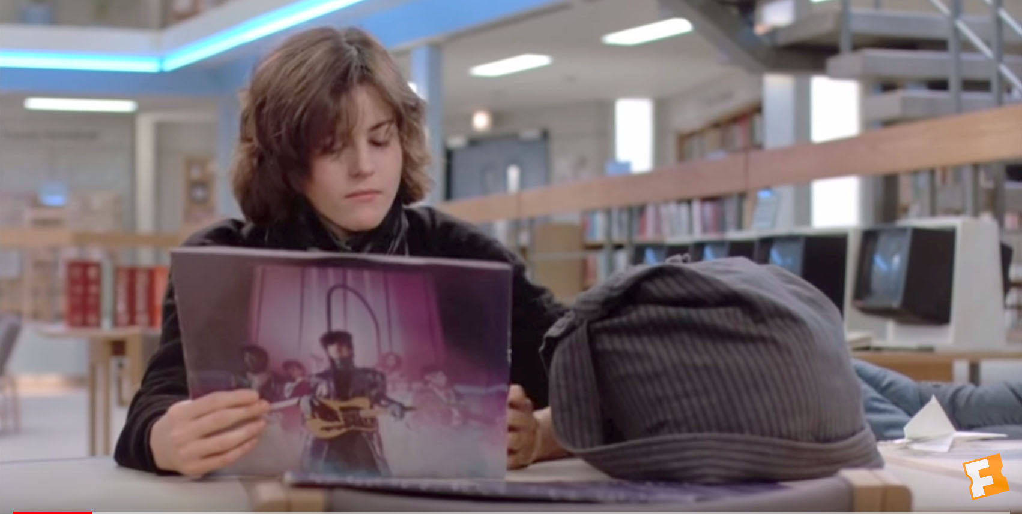
J and L cuts—sounds and not just dialogue Link: more info

Slide 17
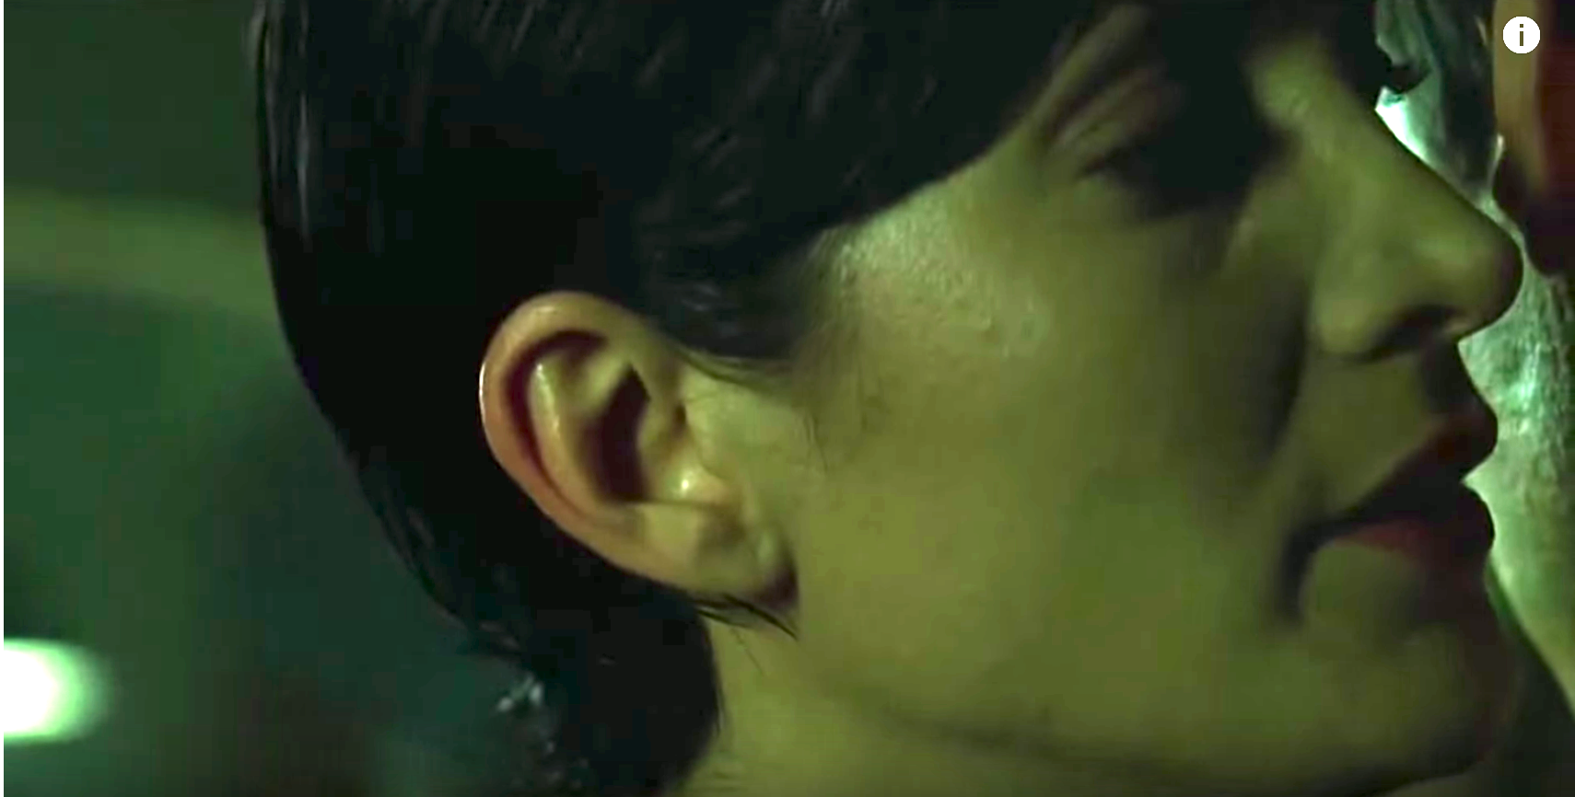
Sound Bridge Link Here
are one of the most common transitions in the continuity editing style, one that stresses the connection between both scenes since their mood (suggested by the music) is still the same.

Slide 18
Audio Waveform in Premiere

Slide 19
Wavelength
The distance between any point on a wave and the equivalent point on the next phase. Literally, the length of the wave.

Slide 20
Amplitude:
The strength or power of a wave signal. The "height" of a wave when viewed as a graph. Higher amplitudes are interpreted as a higher volume, hence the name "amplifier" for a device that increases amplitude.

Slide 21
Frequency:
The number of times the wavelength occurs in one second. Measured in kilohertz (Khz), or cycles per second. The faster the sound source vibrates, the higher the frequency. Higher frequencies are interpreted as a higher pitch. For example, when you sing in a high-pitched voice you are forcing your vocal chords to vibrate quickly.

Slide 22
Analog recorders can record to 0db without clipping
Record as strong a signal as possible without clipping
usually between -12 dB and -6 dB)
Clipped digital audio is unusable

Slide 23
Noise (recording)
You want the recording levels to get the least amount of noise by
Raising recording levels
Getting the mic closer to your subject
And turning off eliminating sound in the location

Slide 24
Audio Levels on Premiere
“The key is, you never want to exceed zero, because your audio will get distorted.”
Link Here

Slide 25
Levels
Total audio mix level: -3 dB to -6 dB
Principle speaker (SOT) audio: -6 dB to -12 dB
Sound effects audio: -12 dB to -18 dB
Music when its an underscore: -18 dB
PDF of this on syllabus

Slide 26
Diegetic and Non-Diegetic Sound
Diegetic
Non-diegetic
Sound whose source is visible on the screen or whose source is implied to be present by the action of the film:
voices of characters
sounds made by objects in the story
music represented as coming from instruments in the story space ( = source music)
Diegetic sound is any sound presented as originated from source within the film's world
Digetic sound can be either on screen or off screen depending on whatever its source is within the frame or outside the frame.
Sound whose source is neither visible on the screen nor has been implied to be present in the action:
narrator's commentary
sound effects which is added for the dramatic effect
mood music
Non-diegetic sound is represented as coming from the a source outside story space.
Link to story about The Shining

Slide 27
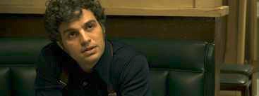
Diegetic vs. Non-Diegetic
The Most Dangerous Game Is the sound mainly diegetic of non-diegetic? How does the sound influence your experience of the scene?
Diner Scene Is the music diegetic or non-diegtic? How does the music influence your experience of the scene?
Diner Scene 2 (adult subject matter) Is the music diegetic or non-diegetic? How does the music influence your experience of the scene?

Slide 28
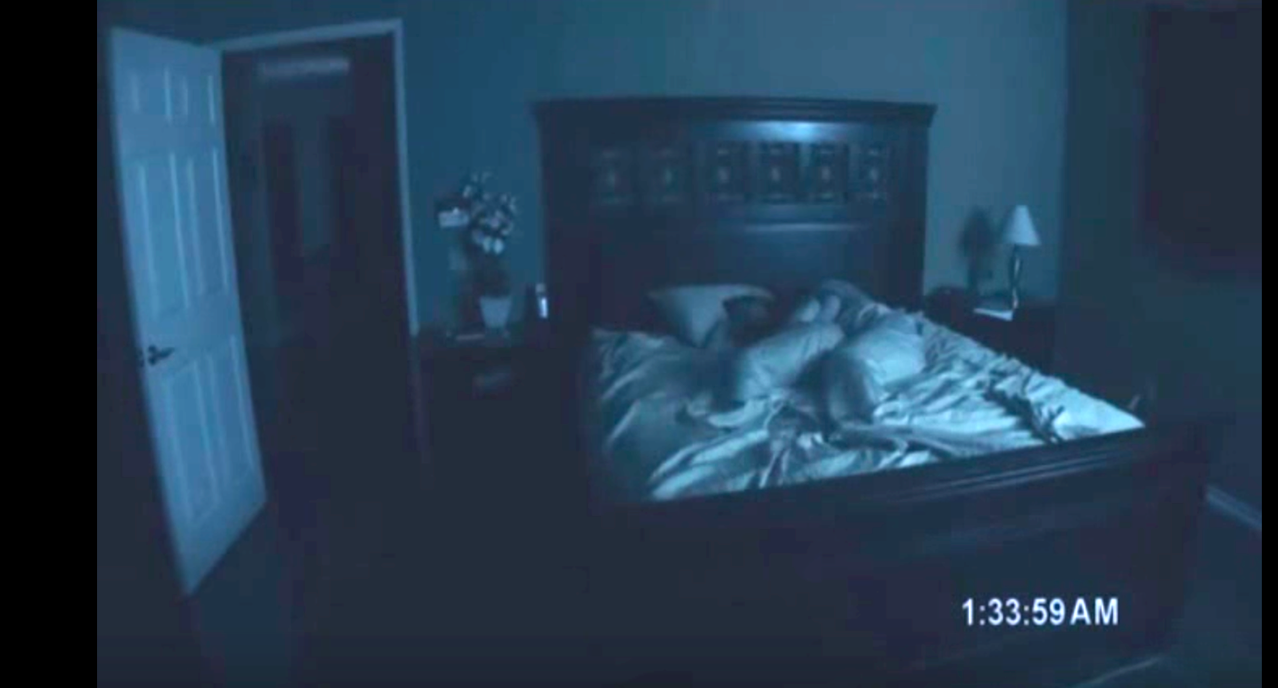
Offscreen Sound: Paranormal Activity 1 and Paranormal Activity 2
Link Here
Is the sound primarily diegetic or non-diegetic?

Slide 29
Cutting Dialogue Tracks
Sometimes words have to be separated
Avoid clipping (up-cutting a word)
A two-frame crossfade can help make an awkward cut sound natural
Link Here
“You can’t handle the truth!!”

Slide 30
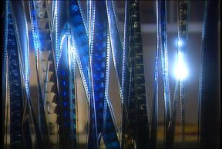
Non-diegetic Narration or Voiceover
Narration works best when woven in with sync sound from a scene
Be careful that background sounds do not become distracting
Ideally, final narration should be recorded in a sound booth to get high-quality clean sound
Tips and Tricks from -- Digital Films a blog by Oliver Peters

