Slide 1
Cinematography
Film/Coms 121: Media Aesthetics

Slide 2
Hard Light (link) No Country for Old Men (2007)
Emphasizes facial flaws and textures.
Has fast fall-off meaning that light transitions into dark (faster—or in less space)
The hard lighting in the above scene accentuates Tommy Lee Jones’ age and draws a connection between the harsh landscape and his weary appearance
Hard lighting is commonly used in Film Noir films, Horror and Thrillers

Slide 3
(Link here) Soft Light The Notebook (2004)
More flattering
Hides imperfections and textures
Slow fall-off (meaning it takes more area for light to transition to shadow)
Creates high-key lighting which is mainly used for romantic comedies and lighter romantic films

Slide 4
Hard Light=Low Key Lighting
Allows for the cinematographer to paint with light and shadow, but makes it difficult for actors to move around freely on a set

Slide 5
Film Noir=Low Key lighting

Slide 6
Low Key in Color

Slide 7
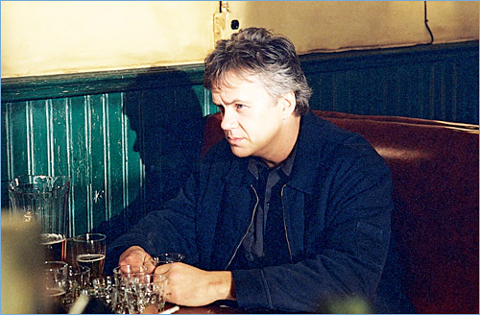

Slide 8
(Link)Double Indemnity 1944
Pools of light are used as the subject walks from shadow to shadow
The actors have to meet their marks (stand or sit in the proper place for lighting)
Movement of the actors has to be precise in this type of scenario in order for them to be lit properly

Slide 9
(Link)Touch of Evil
Notice how the subjects walk in and out of pools of light
The movement had to be choreographed with camera moves
The actors also had to be aware of where to walk, so that they would be lit during their conversations

Slide 10
(Link) Blood Simple
Look for the use of hard light in the exterior shots and in the car scene
The lighting in this film is making a reference to past noir films like Double Indemnity
Hard light not only creates stronger shadows (the look of darkness) but can also make color film appear more saturated

Slide 11
(link) Drive
Film is shot digitally with a mechanism that can handle low light
Even though spot lights aren’t used, there is still hard light and fast falloff
This could be considered a Neo Noir style of cinematography

Slide 12
Soft Light=High Key
Soft Light
High-Key lighting is common in comedies, romantic comedies, variety shows and sit coms
Used in a lot for situation comedies because it allows for physical comedy
Actors can move freely around a set without stepping out of the light
It also conveys a happier and lighter mood

Slide 13
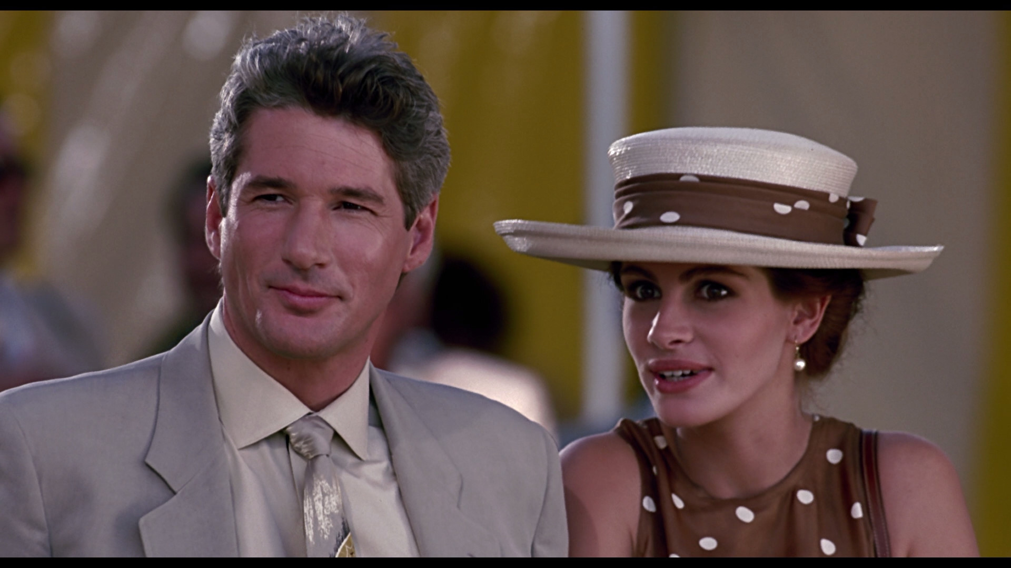
(link) High key lighting for a romantic comedy to communicate a happy, light-hearted mood
Other Uses of High Key Lighting:
(link) High key lighting for physical comedy
(link) High key lighting for a talk show (so the host can move around freely—first 20 seconds)

Slide 14
Will you likely find high key lighting on a cloudy day or a sunny day?

Slide 15
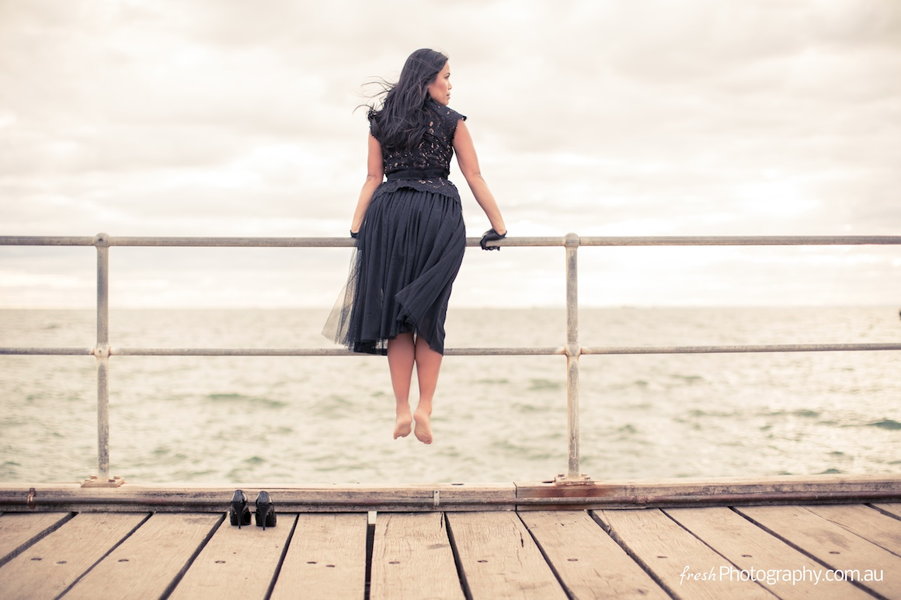
A cloudy day!

Slide 16
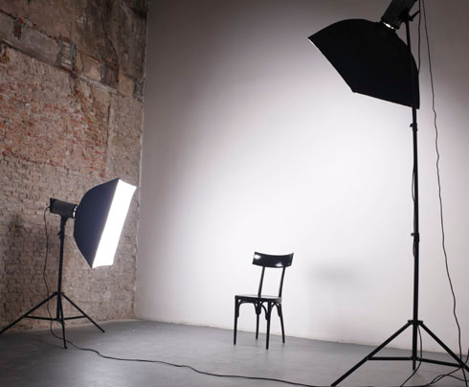
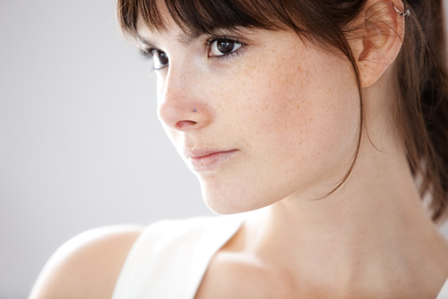
Lights with diffusion i.e. umbrellas, soft boxes, diffusion etc. are used to create high key lighting
This is very similar to light shining through clouds on a cloudy day
The clouds are almost like gigantic soft boxes!!

Slide 17
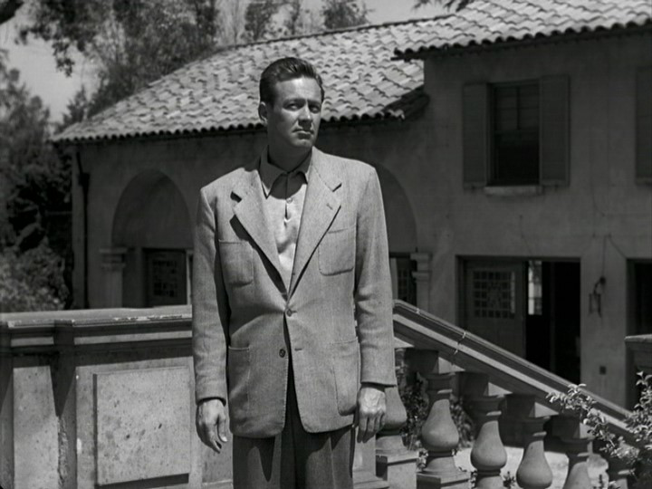
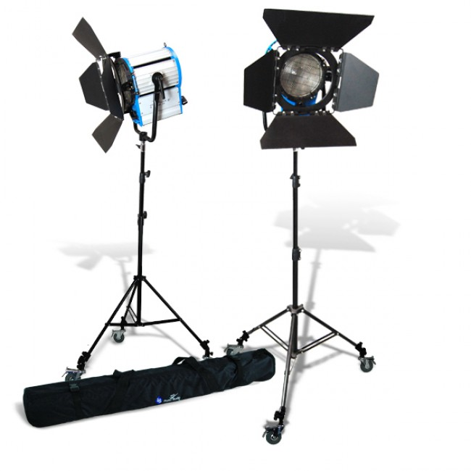
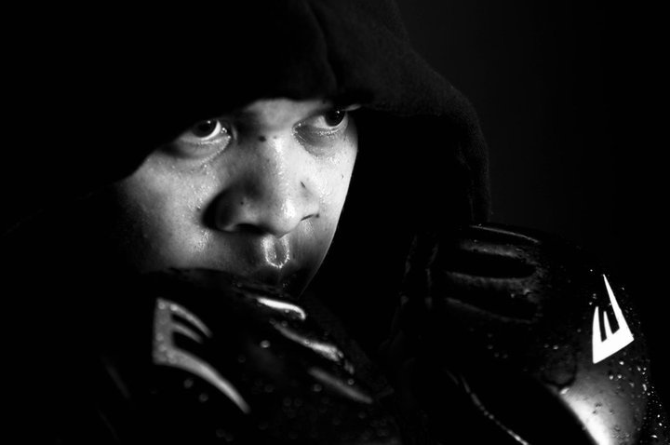
Conversely, low key lighting comes from a specular or shiny surface which is more like direct sunlight. Spot lights like the ones below, reflect light off of shiny surfaces
Above: Exterior shot in the Noir
film Sunset Blvd (1950)
The direct sunlight is creating harsh shadows
Right: Studio shot taken with spot lights like
the ones shown above right

Slide 18
Low-Key is high contrast lighting and High-Key lighting is low contrast lighting

Slide 19
Are all the shades of gray represented in both images?

Slide 20
The answer was yes!
The full tonal range (or dynamic range) in the first scene is achieved mainly through lighting
The full tonal range in the second scene is achieved mainly through art direction
That means that even though the lighting is “flat” or low contrast in the second scene, the range of grays and blacks and whites are still there, because of the objects that are placed on the set
In the right image look at all the objects in the frame: the decorations, books, bookshelves etc.
All of the shades of the grayscale represented

Slide 21
(link) 3 Point Lighting

Slide 22
Shadow used to obscure subject
This works on two levels:
It makes the attacker more frightening
It also hides the identity of the attacker

Slide 23
Three types of lenses
Wide angle lens (28mm on a 35)
Normal lens (50mm on a 35)
Telephoto lens (200mm on a 35)

Slide 24
Wide angle lens
Characteristics
Short focal length
Emphasize distance between subjects
Deep focus
More image visibility
Distortion and curvature of objects

Slide 25
Normal Lens
Characteristics
Normal focal length
Causes minimal distortion of images
Creates an image close to what the normal human eye would see in the same circumstances

Slide 26
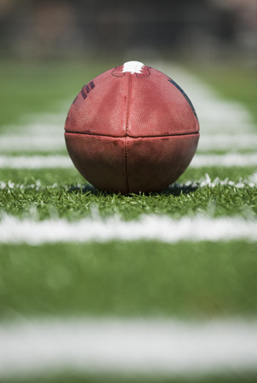
Telephoto Lens
All Planes appear closer to the camera and to each other
Shallow focus: only some of the planes very close to each other are in focus
Less image area
Movements toward or away from the camera seem slowed down

Slide 27
3 factors that determine Depth of Field
Aperture or lens opening. A larger lens opening = shallower depth of field
Choice of Lens or focal length. Longer focal length/lens=shallow depth of field
Distance from Subject. The closer the camera is to the subject the shallower the depth of field
Shallow depth of field

Slide 28
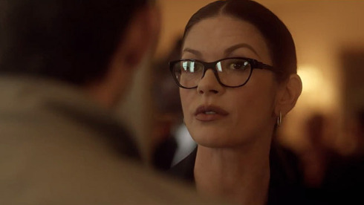
Shallow Focus
Telephoto or a large aperture
Either the foreground or the background will be in sharp focus
Viewers’ attention will be directed to what is in sharp focus

Slide 29
Deep Focus
Wide angle lens, small aperture and and greater distance from subjects

Slide 30
Andre Bazin
Deep focus scenes with long takes are more open to interpretation than heavily edited scenes
Deep focus shots of long duration can let viewers experience clear images for lengthy segments of uninterrupted time
Viewers are freer to look at details in the frame and select those that seem significant
http://www.youtube.com/watch?v=VYA1wVgiuAA
In deep focus filmmakers can guide viewers’ attention through lighting, camera placement and composition
Deep focus allows more opportunities to use foreground and background interplay expressively

Slide 31
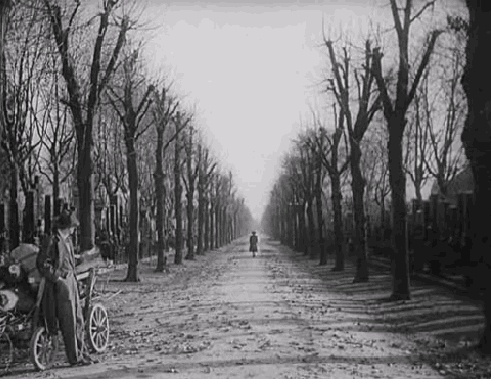
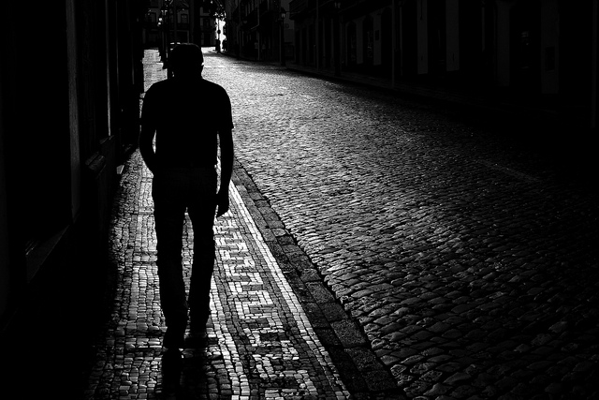
Camera Distances
Extreme Long Shot
Long Shot

Slide 32
Medium Shot
Medium Close-up

Slide 33
Close up
Extreme Close-up

Slide 34
Changing Perspective
Vertigo http://www.youtube.com/watch?v=GnpZN2HQ3OQ

Slide 35
(link) Zoom in/dolly out in Goodfellas
The camera’s variable focal length is increased (magnifying the image) while, at the same time, the camera is moved back (dolly out) at the same rate.

Slide 36
High Angle Shots
“Bird’s Eye View” can add context to a setting
A high angle shot of a person can make them look weak or small
(link) Opening Scene of American Beauty
Hey! That’s Sacramento!
In this scene from Psycho the high angle
Shot adds to the suspense

Slide 37
(link) Low Angle Shot: Citizen Kane
A low angle shot of someone gives a subject power and authority. This extreme low angle emphasizes the topic of power in the film and how it can distort a person’s world view.

Slide 38
(link) Camera Moves
Flat space moves
Deep space moves
Pan
Tilt
Zoom
Dolly
Track
Crane

Slide 39
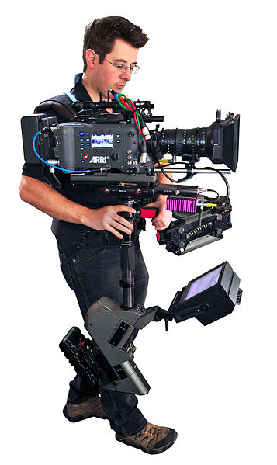
Steadicam
Consists of a lightweight frame, torsion arm, movie or video camera, and a small TV monitor
Allows the cameraperson to move around smoothly while filming
Duplicates positive aspects of handheld camerawork without the lack of stability
Provides speed, flexibility, mobility, and responsiveness

Slide 40
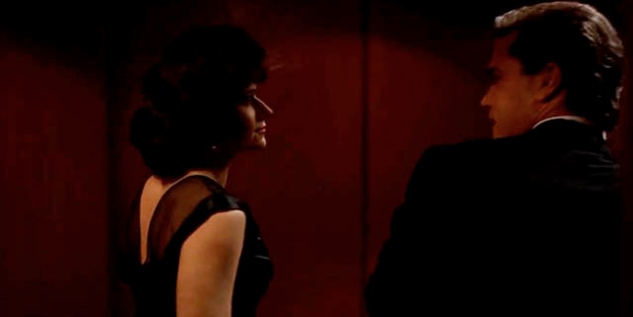
(link) Steadicam Goodfellas (1990) - The Copacabana Shot

