Slide 1
Editing and Sound
Chapters 3 and 4

Slide 2
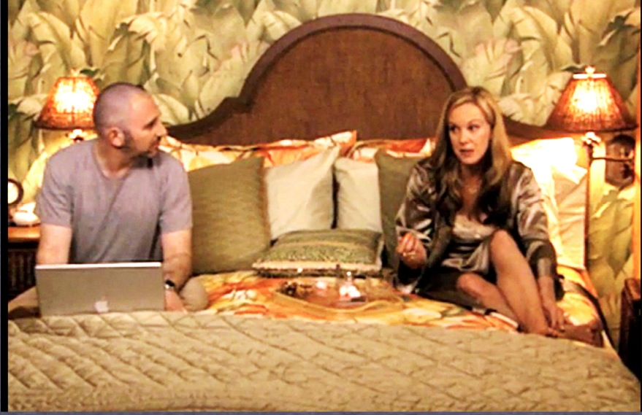
A scene is a section of narrative that gives the impression of continuous action taking place in a continuous time and place
A shot is an uninterrupted strip of exposed motion-picture film or video that represents a subject during an uninterrupted segment of time

Slide 3
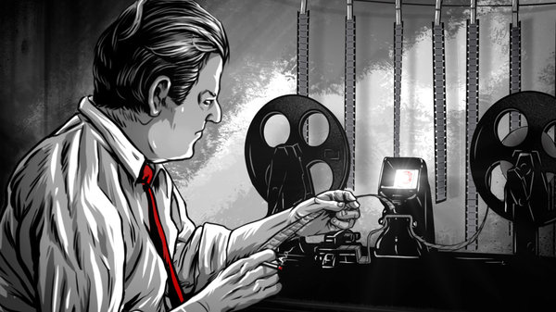
Link to Introduction to Editing
Film: The Cutting Edge: The Magic of Movie Editing
Whole movie here with Spanish subtitles

Slide 4
Basic Sequence
The process begins with the recording of a Master Shot which records the entire scene usually in a long shot

Slide 5
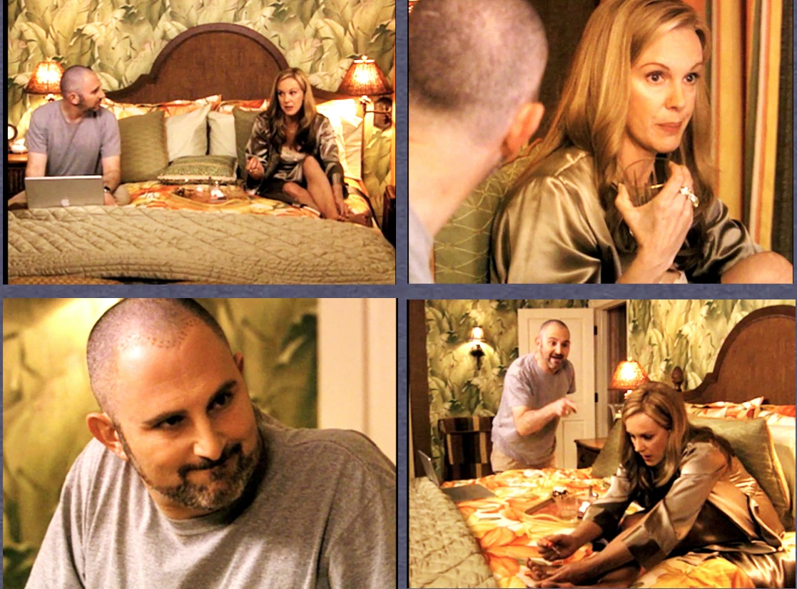
The top left is the master shot again, the top right shot is a medium close-up of the actress continuing the dialogue, the bottom left is a reverse shot or cutaway and the bottom right is another cutaway

Slide 6
What is the process of shooting a scene with multiple shots
For a “single camera” process each shot or set-up will be filmed all the way through
The master shot is set up, lit and framed. The scene in its entirety is then shot from that angle. Multiple takes will be recorded of that particular angle
The same for the second angle
The same for the reverse angle—cutaway
Most likely the same for the second cutaway(bottom right)—unless it is primarily recorded to show the exit of that character
When editors have multiple takes of multiple angles that is called coverage
Coverage allows editors to determine which angles and which takes are strongest for the scene. With coverage they can also change the length and rhythm of each scene and highlight stronger performances.

Slide 7
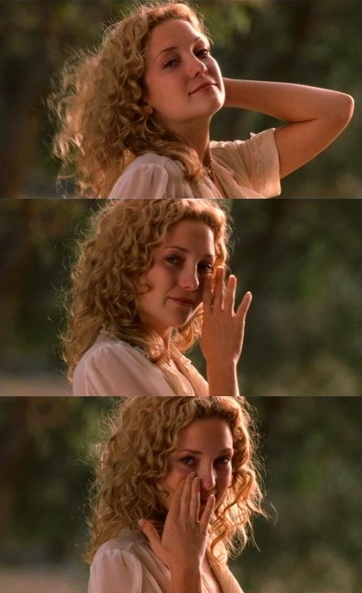
Strong performance emphasized by editing
Cameron Crowe and editors Joe Hutshing and Saar Klein found that newcomer (at the time) Kate Hudson could transition from one emotion to another with impressive ease.
In many scenes including the one linked below, they chose to keep the camera on her for longer than expected to show those emotional transitions in their entirety.
Watch the following clip:
Almost Famous (2000)
As you can see, coverage can create some movie magic!

Slide 8
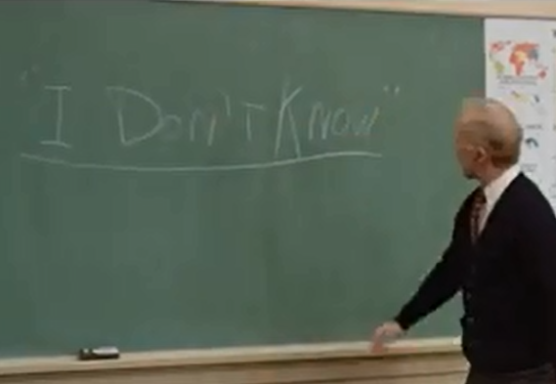
Classical Hollywood Editing
Watch clip: Fast Times at Ridgemont High
The distinctive quality of classical Hollywood Editing is that it is meant to go unnoticed. (invisible edits)

Slide 9
Examples of ways continuity editing can be achieved
Eyeline match: a subject looks at something offscreen, and the next shot shows what is being looked at from what appears to be the point of view of the looking subject
The 180 degree system: shooting subjects from one side of an imaginary line
Shot reverse shot: a shot from over the first person’s shoulder or to the side of it shows the face of the second person—the next shot is behind the other shoulder of the next person or the side of it. This indicates that two people are speaking to one another

Slide 10
Action and Reaction
In nearly all narrative films many scenes show actions and other people’s reactions
Pulp Fiction (1994)
Shot 1, action, then reaction
Shot 2 more reactions, then action

Slide 11
Parallel Editing
Also known as cross-cutting
The film shifts back and forth between two or more actions
Parallel editing suggests simultaneous events taking place
Ferris Bueller’s Day Off (1986)
In the above scene the parallel cutting increases the tension of the scene
It adds to the urgency of Bueller making it home without getting found out.

Slide 12
Soviet Montage
Does not promote invisible continuity like Classical Hollywood Editing
Uses editing to convey a meaning
Edits are noticeable
Like this scene

Slide 13
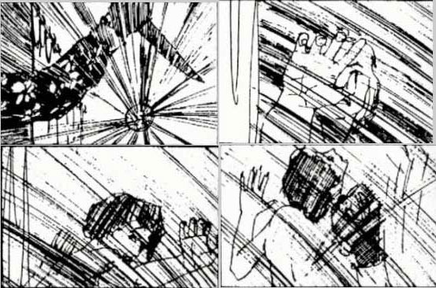
Link to: Psycho, Shower Scene
The scene was, in part directed by graphic designer Saul Bass (who did titles for Hitchcock)
Bass drew a storyboard for the scene comprised of 77 tight shots
The scene took seven days to film
All of the cuts create a violence in the scene that predates gory special effects
It is also a conscious homage to Soviet Montage
Saul Bass story here and full storyboards here

Slide 14
Fast and Slow Cutting
Cuts can be as short as a frame though viewers most likely won’t see content at that rate
In cases like the film “Rope” by Alfred Hitchcock a shot may run for as long as the reel of film in the camera
Fast cutting: Consecutive shots of brief duration
Slow cutting: Consecutive shots of long duration
Link to film about fast and slow cutting

Slide 15
Different types of Editing Transitions
A cut (just a splice from one shot to the next) In Hollywood editing these are usually meant to be invisible
A lap (or cross dissolve when one shot fades into another) Usually meant to show passage of time
Fade to black or fade up from black: also shows the passage of time. It can also signify the beginning or end of a film or scene
Wipe: another indicator of time passage much like a swish pan which is a wipe created with a camera.

Slide 16
Hollywood Montage
Like Soviet Montage, Hollywood Montage communicates through editing
Unlike Soviet Montage, Hollywood Montage communicates one concept: The compression of time
Hollywood Montage usually consists of “Quick, impressionistic sequences of images, usually linked by dissolves, superimpositions or wipes” and are meant to eliminate dead time in a film
Link to typical Hollywood Montage it shows a couple falling in love—(conventionally just before something happens to disrupt the relationship)
Link to Citizen Kane montage which shows the dissolution of a marriage over time. Time passing is indicated by “swish pans” and progressive changes in the mise en scene
Link to Raging Bull montage which uses super 8 footage intercut with titles (historical fight dates) and images from those fights

Slide 17
Sound
Sound has always been part of film viewing—music was usually played live along with silent films
Later in film history the theaters would supply sound effects sound effects (link)
In the late 20’s the Vitaphone system came along where sound was played on a phonograph which was synchronized with a projector
The first film that used the Vitaphone was The Jazz Singer (1927)
Here is a brief History of Sound and the Studio System

Slide 18
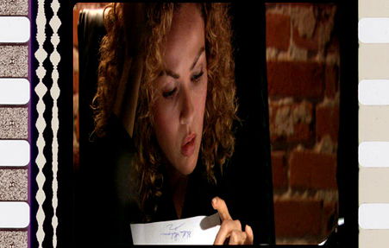
Sound on Film
Shortly after a Sound on Film system was created—where optical tracks on the film itself create sound—the wavy lines are sound tracks

Slide 19
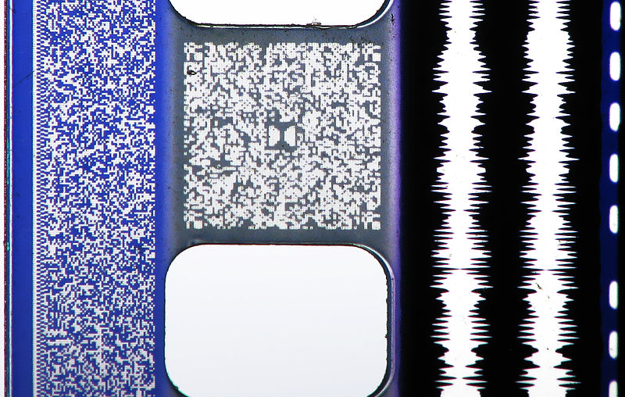
A photo of a 35 mm film print featuring all four audio formats (or quad track)- from left to right:Sony Dynamic Digital Sound (SDDS) (blue area to the left of the sprocket holes), Dolby Digital (grey area between the sprocket holes labelled with the Dolby Double-D logo in the middle), analog optical sound (the two white lines to the right of the sprocket holes), and the DTS time code (the dashed line to the far right.)—from Wikipedia

Slide 20
Sound editing in Hollywood film is meant to invisible much like film picture edits
This is achieved by creating smooth transitions between each cut
Most significantly this is done by making sure a set or a location is as quiet as possible before filming
That’s why you have heard a director yell: “Quiet on the set!”
Most of the ambient sound that you hear in the final cut is created in post
For instance: if a film is shot in a classroom—the dialogue will be recorded in total silence. Later sounds of students laughing, speaking to each other, or moving around books and paper will be edited in later
Production sound recorders will also make sure to get a microphone as close as possible to a sound source to eliminate background noise and achieve smooth transitions from cut to cut

Slide 21
Transitions in editing may include cross fades—where one sound dissolves into another
A music or sound bridge (where a sound will continue through multiple image cuts)
Another example of a sound bridge
And through the avoidance of the dreaded Dragnet Edits!

Slide 22
Dragnet edits – The original Dragnet television series used a certain approach to cutting dialogue scenes. Audio and video edits tended to be made as straight cuts between the actors without any overlaps as they delivered their lines. It followed this formula: cut to actor A – deliver the line; cut to actor B – deliver the line; cut back to actor A and so on. Our brains seem to react better to edits where the change in picture and sound is not always together.
(link) These are called split edits, L-cuts or J-cuts.

Slide 23
Diegetic and Non Diegetic Sound

Slide 24
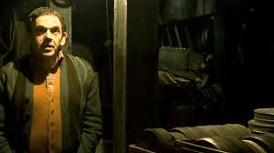
Link to The Most Dangerous Game
The most Dangerous
Diegetic sound is sound that comes from the story of the film. Things like dialogue, sounds from the scene, or sound effects that are meant to be naturalistic.
Do you only hear diegetic sounds in this scene?

Slide 25
No, is the answer to that question
Most of the sound (the creepy offscreen ones even) are diegetic sounds
Even the sound of the tea kettle is diegetic even though it feels like a creepy musical score
The reason why the answer is no, is because there is a subtle score in this scene to increase tension (yikes)

Slide 26
Link to Non-Diegetic Sound
So what constitutes non-diegetic sound?
A music score: So, when you are in love, you may feel like you hear romantic tunes, but love can’t produce music out of thin air in real life. A romantic music score is non-diegetic sound
Sound effects that are not naturalistic (for instance: when someone is running and you hear a heart beat. That could never happen)
When you are confused, an omniscient voice doesn’t explain everything like in voiceover
Unlike Sookie from True Blood, we can’t really hear people’s thoughts. So hearing people’s thoughts in a film is non-diegetic sound
We can hear our own thoughts in our head, but they aren’t actually audible in the real world. Again, non-diegetic sound

Slide 27
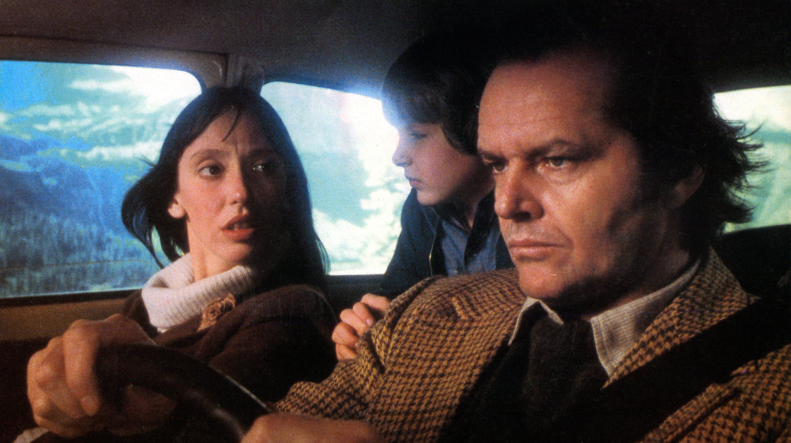
(link) Non-Diegetic Sound (the movie score)
Listen to the story and watch the scene

Slide 28
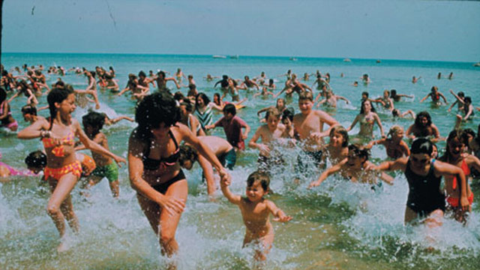
Link to: Leitmotif from Jaws
An audio leitmotif is usually used as an intratextual device, meaning it refers to other parts of the film. Take for example the score from Jaws. Once you learn to associate the audio with a shark attack, then you only need to hear the music to know the shark is looming nearby. A leitmotif can also be used intertextually when another film uses the Jaws theme to signify danger. In many cases this type of intertextual use of a leitmotif will be humorous. (Like in Spaceballs. (Can’t find a clip, sorry)

Slide 29
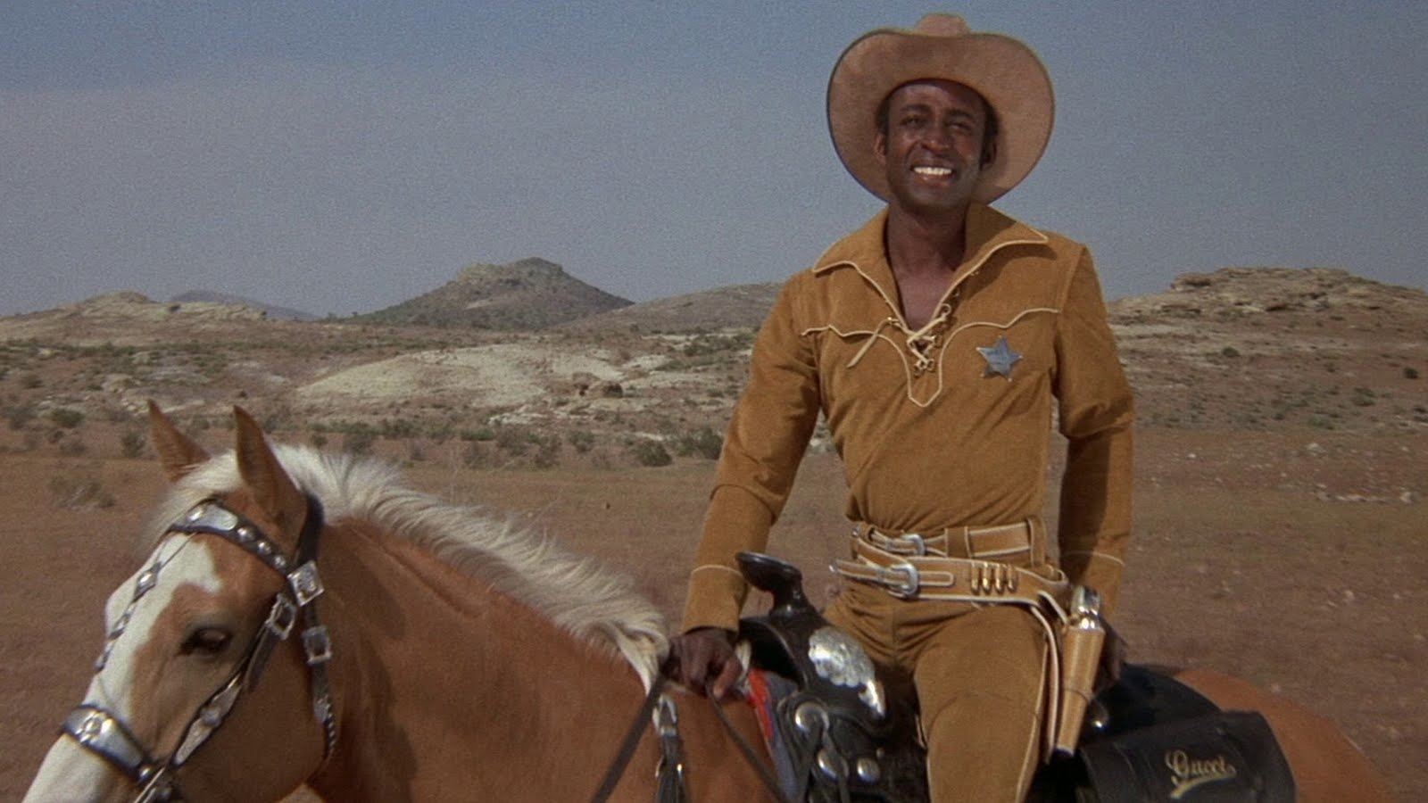
Wait, What?
Link: Blazing Saddles Scene

Slide 30
Yep, that was diegetic sound y’all!! Improbable, but still diegetic.

Slide 31
Think about how many ways diegetic music can be used in a scene
Link to another diner scene: (some mature content)

Slide 32
Offscreen Sound
Offscreen Sound: Paranormal Activity 1 and Paranormal Activity 2
How is offscreen sound used in these two scenes?
Do you think one scene uses offscreen sound better than the other?

