Slide 1
CONTEXTS
ORANGE IS THE NEW BLACK
LA JETEE

Slide 2
Artistic Conventions
A man will show no pain while taking the most ferocious beating, but will wince when a woman tries to clean his wounds
If staying in a haunted house, women should investigate any strange noises alone while wearing their most revealing underwear

Slide 3
Artistic Conventions
Filmic conventions are representations or techniques that both audiences and filmmakers have grown to accept as natural or typical in certain contexts
Filmmakers may follow conventional practices or reject them, as in many Westerns made since the 1950’s
Film conventions may fall out of favor, and unconventional representations or techniques may catch on and become more conventional
Filmmaking conventions do not have inevitable and fixed meanings; usage, which varies over time, establishes their meaning

Slide 4
Financial Constraints
More money leads to more control by market forces
Less money means limitations on production and post

Slide 5
Filmmaking Technology
3-D
Digital Filmmaking

Slide 6
Version of Film Seen
Movie Screen
Digital Projection in Theater
High Definition Monitor
Computer
Phone

Slide 7
Contexts of Orange is the New Black
Netflix
Binge watching
Differing experience

Slide 8
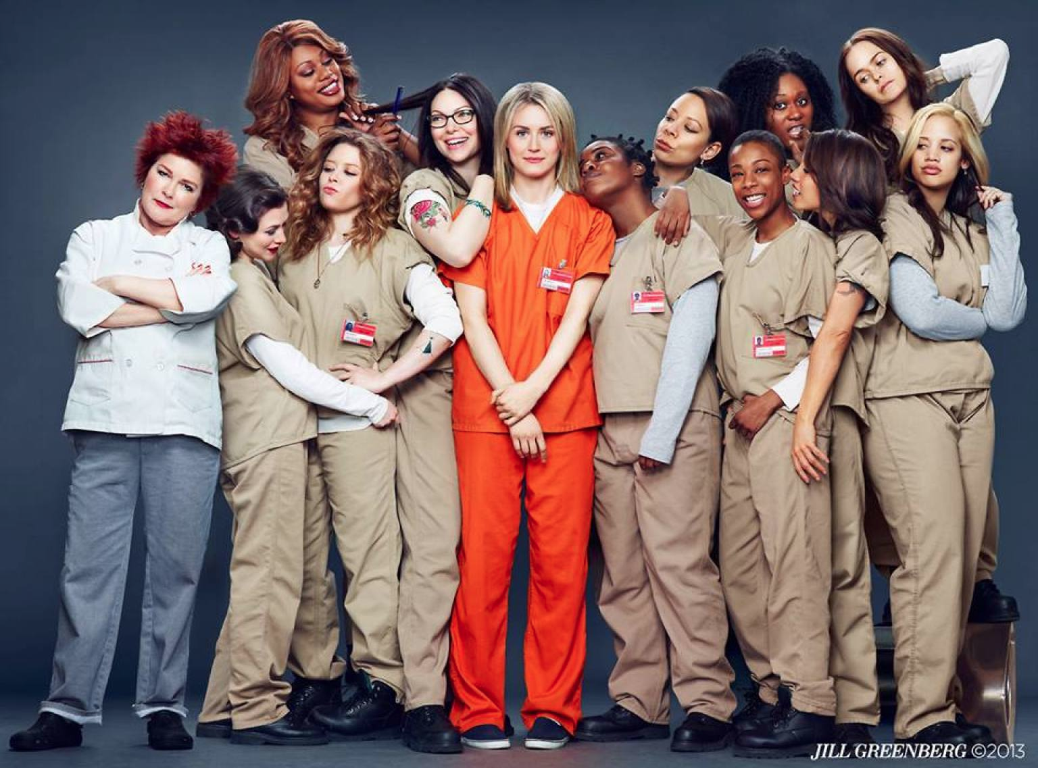
Orange is the New Black
How does it fit into historical context?
What does it say about our time?

Slide 9
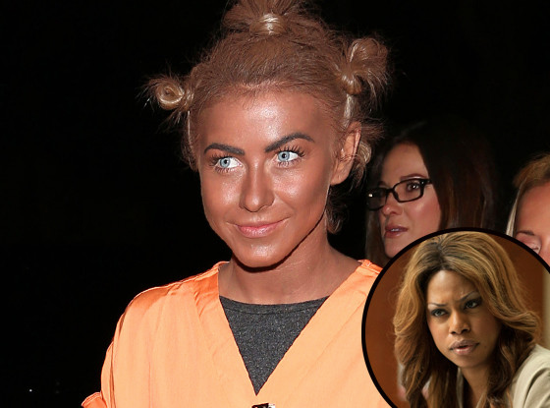
CONTEXTLESS?
Here's something I shouldn't have to be saying in 2013:
it's wrong to wear blackface. Blackface represents a time when white Americans
would put dark paint on their faces and act out incredibly racist and offensive
stereotypes about African Americans. The symbolism of blackface is incendiary, insensitive and racist. This is a fact. This is not up for debate. --David Dennis

Slide 10
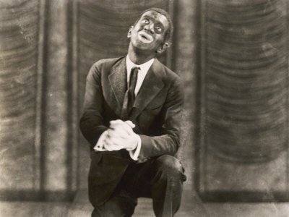
D. W. Griffith's The Birth of a Nation (1915) used whites in blackface to represent all of its major black characters,^{[43]} but reaction against the film's racism largely put an end to this practice in dramatic film roles. Thereafter, whites in blackface would appear almost exclusively in broad comedies or "ventriloquizing" blackness ^{[44]} in the context of a vaudeville or minstrel performance within a film.^{[45]} This stands in contrast to made-up whites routinely playing Native Americans, Asians, Arabs, and so forth, for several more decades.^{[46]}

Slide 11
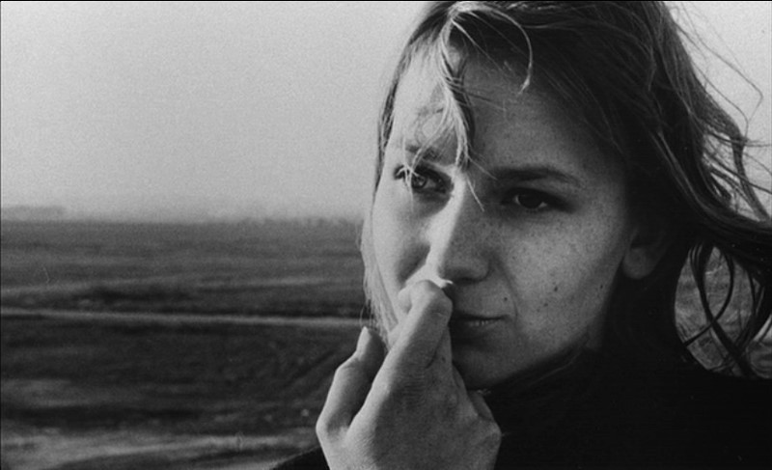
La Jetee 1962
1962 France
People had recent memories of WWI and WWII
Beginning of the Cold War
Threat of Nuclear War
The mental image of WWIII
Imagining a perfect (innocent world) where things are “real”
Draws attention to a world is not real

Slide 12
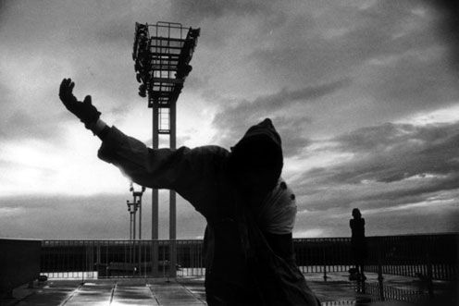
How does your generation view war?
Do you ever think about WWIII
Why or why not?
Suicide rates of veterans from the most recent wars is twice that of the normal population
Afghanistan War 13 years old
Iraq War 2003-2011
How often do you think about these wars?
Do you think these wars have influenced filmmaking? (popular films or indies)

Slide 13
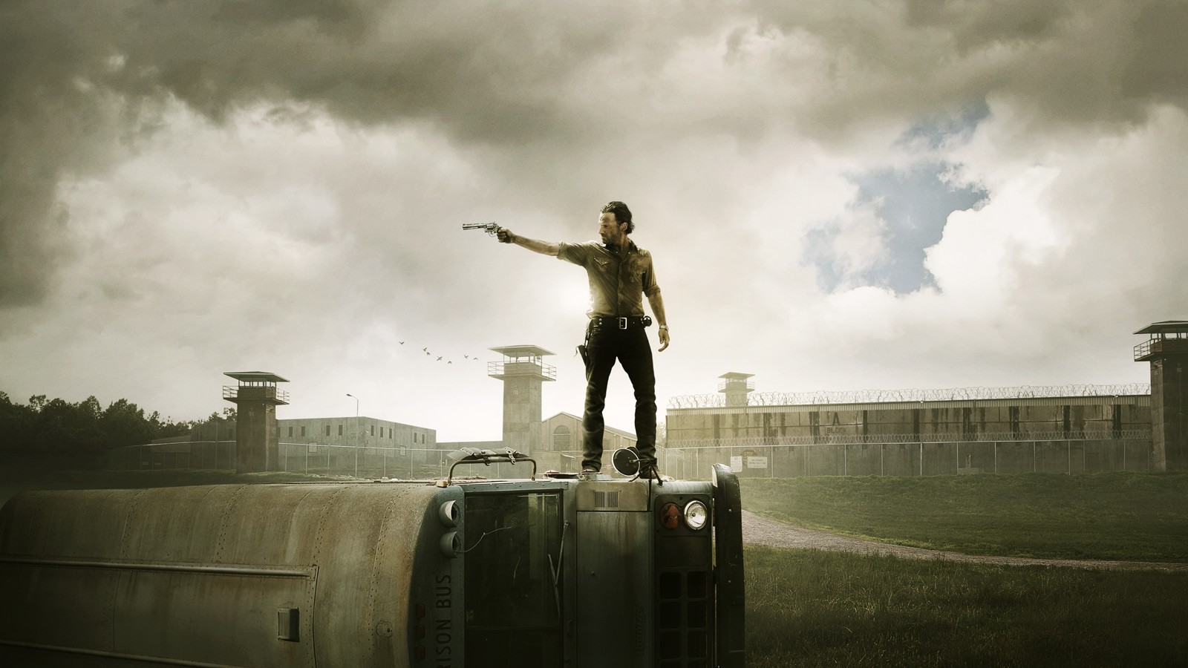
Dystopia—Post Apocalyptic
What films fit into this category?
How do you think they fit into historical context?
How do you think they are viewed?

