Slide 1
Types of Films
From Classical Hollywood Cinema to Experimental Films

Slide 2
Classical Hollywood Cinema
Mainly in a present world—though not necessarily the time the film was made
It is seen largely from outside the action, through point of view shots, memories, fantasies, dreams, or other mental states are sometimes included
The film focuses on one character or a few distinct individuals
The main characters have a goal or a few goals

Slide 3
Characters confront antagonists or a series of problems
The emphasis is on clear causes and effects of actions. What events happen and why they happen are clear and unambiguous
The film has closure, a sense of resolution or completion at the end.
The film uses unobtrusive filmmaking techniques

Slide 4
Film Genres
A genre recognizes that the audience watches a film within the context of other films
Both those they have seen and those they have heard about
The function of genre is to make films comprehensible and more or less familiar

Slide 5
Why do you think filmmakers use genre to make films seem more familiar?

Slide 6
Most hollywood films are genre films
Action
War
Western
Comedy
Science Fiction
Horror
Mystery/Suspense
Drama
Family
Children’s

Slide 7
Westerns
Revisionist Westerns of the 50’s and 60’s subverted some of the conventions of the form.
Revisionist Westerns with outlaw protagonists. (In this case likable ones.)
Central characters are scornful of business and government
Growing disillusionment of the late 60’s
Revisionist Films: ignore or challenge the fundamental traditions of the western film.

Slide 8
Film Noir
“black or dark cinema”
Made during and after WWII
Scenes with dark, shadowy low-key lighting
Many night scenes
Urban settings
Characters motivated by selfishness, greed, cruelty and ambition.
Femme Fatale

Slide 9
Romantic Comedies
Usually characters are unlikely couples
They get acquainted and fall in love
Something happens that challenges their relationship
They get back together before the end

Slide 10
Coming of age Film
dramatize situations and events that bear upon the child's initiation into new domains of psychosocial experience
Show the adolescent's and post-adolescent's encounters with the pleasures and perils of modern life
They depict the formation of identity
In many cases coming of age films promote the cultural fantasies of a commercialistic society
Conversely they also have the capacity for social criticism, irony, and self-reflexivity. Many coming of age films address issues of class and race when “grown-up” Hollywood cinema avoids those issues.
http://www.youtube.com/watch?v=BEG66-Lro7U
http://www.youtube.com/watch?v=ZyFq-8noV_o
http://www.youtube.com/watch?v=NyxW1SxFqzk (baby Kerry Washington!)

Slide 11
Othercinemas
Italian Neo-realist: (film art of authenticity)
American neorealist film
French New Wave Cinema: reaction to past French cinema “Grandfather’s Cinema.”
Conventions of all three:
Deal with current subjects (at the time of the film’s creation)
Untraditional techniques.
Show an awareness of earlier films

Slide 12
Italian neorealism
Real people
Actual Locations
Little or no supplemental lighting
Natural Lighting
Vittorio De Sica strove to create a film art of authenticity feeling that reality could be better conveyed through created situations rather than the direct recording of actual events

Slide 13
Characters
Ordinary and believable
Neorealist films do not attempt to display their psychological complexities
The focus is on the difficult conditions of Italy during and after World War II
Italian Neorealist films were more popular in America than in Italy
In the US these films were seen as an alternative to studio-made classical Hollywood cinema
Salt of the Earth (1954) American neorealist film in the tradition of Italian neorealism.

Slide 14
French New Wave Cinema
Late 50’s and Early 60’s
Reaction to the carefully scripted products of the French Film industry
Exploration of more current subjects
Untraditional techniques
http://www.youtube.com/watch?v=DJUztKf6Zuo
http://www.youtube.com/watch?v=1KUVwKp6MDI
Francious Truffalt, Jean-Luc Godard, Jaques Rivette

Slide 15
The Homage in French New wave
Michel in Breathless pays homage to Humphrey Bogart
The film pays homage to the detective and crime films (noir) of the US.

Slide 16
European Independent films
Memories, fantasies and mental states are rendered more than in Hollywood films
Scene from “8 ½”
Focus on one character
Many times these characters have unclear and shifting goals
Antagonists and problems are not always clear
Many times these films lack closure or have unresolved plotlines
Emphasis isn’t always on clear causes and effects
Unobtrusive techniques
Self reflexive: in part about the film medium or filmmaking

Slide 17
American Independent Cinema
Historically these films have been made outside the Hollywood studio system
In the late 80’s and early 90’s, after these films were proven to be profitable, studios began producing more Indies
They tend to have lower production budgets than big studio films, but that can increase their profit margin
They tend to be less formulaic
American Indies also tend to express a more individual point of view
American Independents are more likely to deal with controversial topics
Anatomy of a Scene: Fruitvale Station

Slide 18
Supporters of Indies come from non-profits and from Studios
IFP: Independent Film Project
AIVF: Association of Independent Video and Filmmakers
Sundance Institute
Sony Pictures Classics 1992
Fox Searchlight Pictures 1995
Paramount Vantage 1998
Focus Features 2002
Warner Independent Pictures
The Weinstein Company (TWC) i

Slide 19
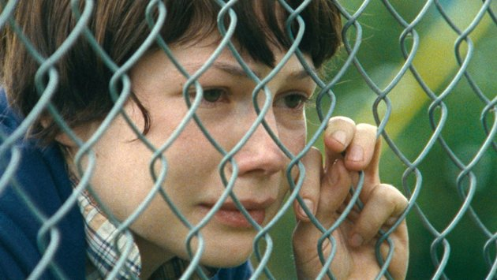
DIY TO INDUSTRY BACK TO DIY AGAIN
Initial budget for Night of the Living Dead was 6,000.
Early Indie directors like John Waters, David Lynch, Jim Jarmusch and Spike Lee also made films for extremely low budgets
In the early 90’s the studios formed Independent offshoots after the success of Pulp Fiction and others
Now studios have downsized and there are fewer specialty offshoots
Given the technology available to filmmakers, there has been the possibility of low-no budget types of productions again.

Slide 20
Alternative Sources
Blog: Truly Free Film http://trulyfreefilm.hopeforfilm.com/2013/08/ask-not-what.html
Crowd Sourcing
Less Expensive production techniques
Buzz created on youtube, twitter and Facebook
New possibilities for DIY

Slide 21
Cable Television is also a new venue for independent filmmaking voices
HBO, SUNDANCE, IFC etc.
Lena Dunham made webcasts before making independent films
Young writer/filmmaker Lena Dunham was blogging and making online video serials before getting her first film funded.
Delusional Downtown Divas
That led to her success on the TV show “Girls”

