Slide 1
Early European Film Movements
Jean Renoir: Early French Cinema

Slide 2
Jean Renoir: b. September 15, 1894, Montmartre, Paris, France d. February 12, 1979, Beverly Hills California, U.S.A.
Today his films are considered to be in the canon of the greatest films ever made
At the time they were made, they weren’t considered to be fully realized
The generation of French filmmakers in the 60’s and 70’s identified with his films
Son of the the painter Pierre-Auguste Renoir
Renoir's films show strong social and political sensitivity to the inequality of the French class structure and sympathy for the working class. The bleak pessimism and anarchic escapes from bourgeois conventions depicted in his films, are partly a response to the depression of the early 30s

Slide 3
30’s
Renoir made many popular films in the early 30’s
Joined the popular front (a group of leftists who were in apposition to Nazi sympathizers)
Made Grand Illusion 1937 and Rules of the Game 1939
The former was the only one that was well received at the time

Slide 4
Bazin: “What is Cinema”
Bazin was one of the French theorists of the 60’s and 70’s who developed an appreciation for Renoir’s work

Slide 5
Bazin asked “What is Cinema?” in his famous article
How does Cinema relate to our being?
How do certain approaches to life and the social being find cinematic expression?
How does cinema help us approach the mystery of the human: “the real” that element of our existence toward which we incline

Slide 6
Realism
Opposite end of the spectrum as montage
Soviet Montage sought to construct meaning through editing
The realist aesthetic is about composition and contemplation
The use of deep space (deep focus and long shots) are part of the aesthetic of realism
Soviet Montage directs or restricts the viewer’s attention and limits the viewer’s capacity for contemplation
“Destroys the ambiguity inherent in reality”
Presents a judgment (by the director) on reality itself

Slide 7
Side by Side Comparison
Realist Aesthetic
Montage Aesthetic

Slide 8
Cahier du Cinema
Influential French film magazine founded in 1951 by André Bazin
Not only valued the European makers of realist works, but also, Orson Welles and John Ford
Appreciated the use of mise en scene and deep space to communicate ideas

Slide 9
Elements of Mise en Scene
Set/Location
Staging
Movement
Lighting
Costume
Make-up
Performance

Slide 10
Rules of the Game 1939
Seems like a country farce
Subtext: “Europe was going to war. In France, left-wing Popular Front members like Renoir were clashing with Nazi sympathizers. Renoir's portrait of the French ruling class shows them as silly adulterous twits, with the working classes emulating them within their more limited means.”—Ebert
Renoir recalls that a man set fire to his newspaper at the movie's premiere, trying to burn the theater down. Audiences streamed out, the reviews were savage, and the film was a disaster, even before it was banned by the occupying Nazis. The French like to be funny, but they do not much like to be made fun of. "We were dancing on a volcano," Renoir said.

Slide 11
Non-traditional Plot
The camera drifts from person to person communicating an experience rather than a plot.
Ruminations on themes (violence and dishonesty)
Also a melancholy pre-war look at joy: That on the brink of war they know what gives them joy but play at denying it, while the world around them is closing down joy, play and denial.

Slide 12
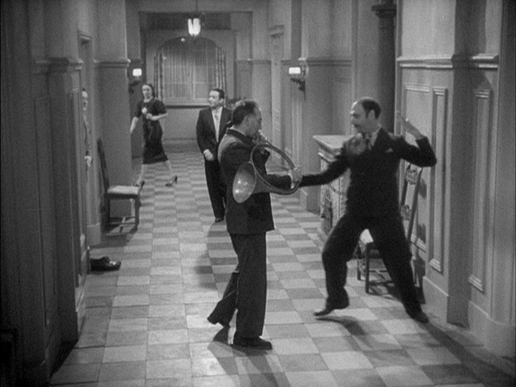
Deep Space
No less visually impressive than Citizen Kane (which was known for deep focus)
Every person within the frame is acting at all times (in the foreground and the background)
Subplots unfold in the background—using deep space to communicate multiple moments at once
There is a freedom there for the viewer, because she can observe the part of the frame that she wants.
The director relinquishes some control over where the audience’s attention will land
That sort of ambiguity, according to Bazin, can only be achieved through long takes and deep focus

