Slide 1
Stories
Meanings and structures

Slide 2
Components of Fictional Films
Meanings and Structures

Slide 3
Narrative
Always recounts one or more events
Doesn’t mirror what happens
Explores and devises what happens

Slide 4
Screenplay
The earliest version of a script
Written before the filming begins and supplies the film with settings, actions, vocals including dialogue and structure
Link to actors reading screenplay

Slide 6
Storyboard
Are a series of drawings or photographs of each shot of a planned film
They are often accompanied by brief descriptions or notes
They allow filmmakers to see how a finished film might look before the laborious and costly professes of filming and editing begin

Slide 7
Storyboard from the Dark Knight

Slide 8
Texts
Things that people produce or modify to create meaning

Slide 9
History vs. Fiction
In order for a story to be told in a compelling way, even historical elements have to be fictionalized
This creates some ethical dilemmas, because some viewers may believe a historical film as the truth
Original screenplays are narratives written primarily for film

Slide 10
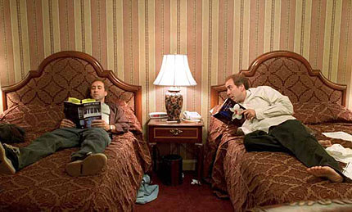
Adaptations
Adapted screenplays come from Novels or other sources of fiction
Many times viewers do not feel like adaptations live up to their expectations if they have read the book prior to seeing the film
This happens because these viewers have created the book in their mind’s eye and someone else’s vision will never match up
Also, films can’t have all of the content found in a novel, so certain elements are left out (link)

Slide 11
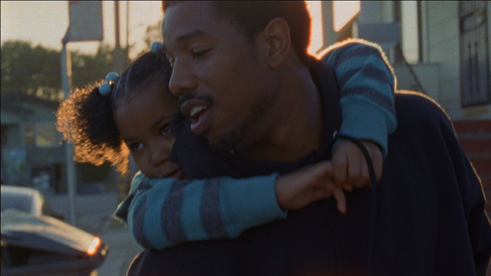
Real Life vs. Stories
Real life mixes meaning with the amorphous and random
A story’s ingredients are selected for appropriateness to the story’s meanings and structures
Can be free from redundancy, meaninglessness and inexpressiveness

Slide 12
Narrative
Recounts one or more events
It explores and devises what CAN happen, not what did happen
During the late 1910’s fictional films became so popular that feature films became commonplace and drew large audiences

Slide 13
Narratives
Representation of unified events
Happenings and actions situated in one or more settings
May be arranged chronologically or non-chronologically
May be factual fictional or a blend of the two

Slide 14
Short Films
At best, they are not shortened and compressed features
Flexible and expressive form in their own right
May be more compressed, demanding and subtle
Fewer financial pressures to conform to the usual Hollywood format
Watch “Locks” by Ryan Coogler (Link)

Slide 15
Qualities of Short Films “Locks”
Brief story time
One goal which the main character does not state explicitly but which viewers can figure out early in the film
One or more obstacles, conflicts, none of them very time-consuming, thwarting the achievement of the goal
Success or failure in reaching the goal
Can be ambiguous

Slide 16
Structure
Events of a fictional film are arranged in a meaningful order
Represented over time—chronologically or not
Events are represented in one or more styles
Some scholars call this form
Refers to the arrangement of the parts of a text

Slide 17
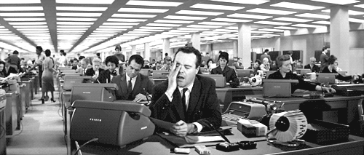
Baxter having to reschedule the use of his apartment is a plotline within the main story
(the basics of fictional structure): characters, goals, conflicts and resolution
Some functions of beginnings middles and endings
The combining of different brief stories (PLOTLINES) into a larger more complex story

Slide 18
Unlikely pairing presents a goal and an obstacle
Characters—usually based on actual people
Even non-humans have human characteristics (anthropomorphism)
Viewers are fascinated with characters who have trouble reaching their goals
Usually at least one goal of the main character becomes clear early in the film, so viewers start to experience identification with the film

Slide 19
The TV show LOST shows the three types of conflict possible in stories
3 main types of conflict
People vs People
People vs Nature
Characters conflicted in his or her thinking
SPOILER ALERT: How does LOST deal with this conflict?

Slide 20
People vs People (link)
When you have plane crash victims attempting to survive together on an island there is bound to be human on human conflict
The character Sawyer creates a lot of conflict by compulsively calling people nicknames

Slide 21
People vs. Themselves (link)
Jack’s character has been said to be one of the greatest leaders in TV history. His role as leader required him to overcome internal conflict.

Slide 22
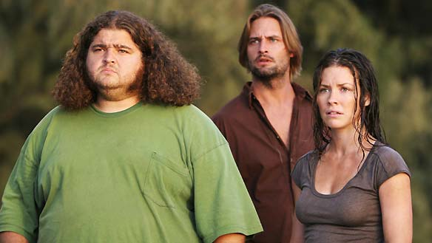
People vs. Nature
On the show “Lost” there are many mysterious conflicts
One of the main conflicts-is man against nature
This is represented by the characters’ surviving from day to day

Slide 23
Climactic scene from Dirty Dancing
In most movies, especially the popular ones, the major characters don’t just succeed, they do so against enormous odds

Slide 24
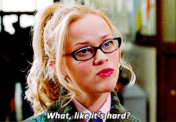
Beginnings Middles and Ends
Exposition
Conflict
Resolution

Slide 25
BEGINNING
Establishing Shot or Shots
Exposition
Introduced Minimally (little tidbits)
Introduce the major characters and encourage viewers to infer their goals
Often a character’s need or desire at the story’s beginning largely determines the story’s ending

Slide 26
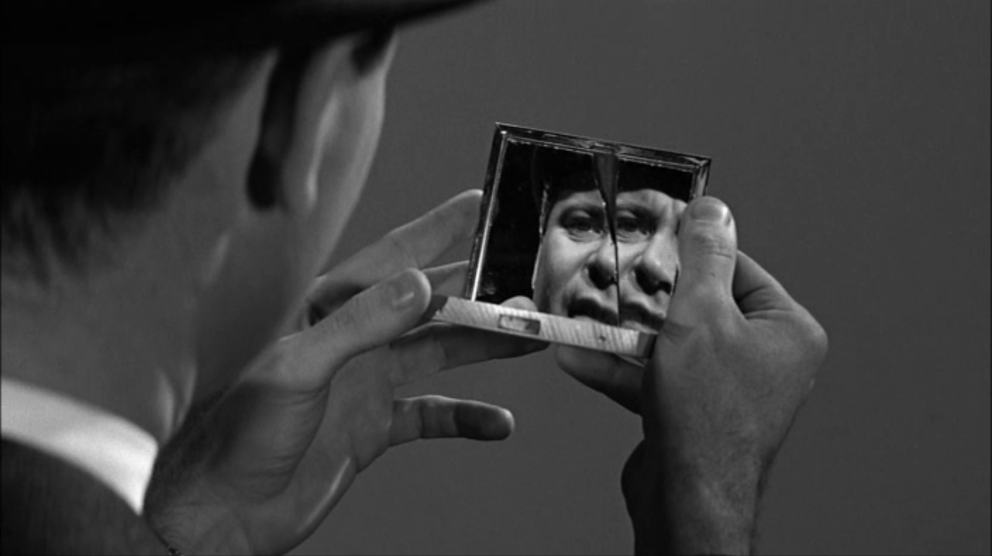
Middle: Introduction of Obstacles
Includes a series of obstacles that prevent or delay the main characters from achieving their goals

Slide 27
What do obstacles reveal about this character?
In Dealing with the impediments to reaching their goals, the central characters in films reveal their natures and the consequences of their decisions
The middle section of a film tests the filmmaker’s inventiveness and skill in creating satisfying surprise and suspense in using other ways to keep the audience involved with the story

Slide 28
Endings
Narrative Endings show the consequences of the major previous events
Sometimes Hollywood endings are improbable, because of how unpopular sad endings are with audiences
“Maybe the reason why people seem to find it harder to take unhappy endings in movies than in plays and novels is that a good movie engages you so heavily that you find unhappy endings almost unbearable.”
--Stanley Kubrick

Slide 29
Audiences do not always respond well to lack of closure.
Films (or TV shows) with closure end by showing the consequences of events that viewers have become curious about
Closure supplies viewers with answers and completion that real life so often withholds
Films and TV can lack closure—that is, be open ended leaving the fate of significant character unknowable
More conventional films and tv tend to have closure, becaue it is more popular

Slide 30
No Country for Old Men 2007 (Lack of closure used to express a nihilistic view)
This country is hard on people ... You can't stop what's comin'.' ... As such, the West is now a world where there is no rhyme or reason, and those within it are never held accountable. It has become a country without meaning and without any inherent value. The country, in short, has collapsed into nihilism."[19]

Slide 31
Last Shots can serve any number of important functions
Contributing to film’s closure
Extracting the viewer from the film’s world
Techniques used: image increasingly going out of focus, a cut to black, a fade out, freeze frame, reaction shot, slow motion, may pull back or up into the air, zoom out

Slide 32
PLOTLINES
Brief narrative –
A series of related events situated in one or more settings—
That usually involves only a few characters
A plotline can function as a complete short narrative as it typically does in a short film
A feature film usually has two or more plotlines
"As far as boyfriends go, Paulie Bleeker is totally boss. He is the cheese to my macaroni.”
The story of Paulie and Juno is secondary to the story of Juno’s pregnancy

Slide 33
Alternating or consecutive plotlines
Consecutive, but with large gaps of story time between them
Multiple alternating plotlines (relationships between different time periods)
Multiple simultaneous plotlines to increase suspense
Can show how life’s occurrences may have unexpected connections and unanticipated consequences

Slide 34
Chronological Time vs. Non-chronological time
Plot
Fabula
the reconstruction of the events of a non-chronological narrative into chronological order
The selection and arrangement of a story’s events

Slide 35
Completely non-chronological plotlines
Can be frustrating for the viewer
Human inclination to try to sort through events and make sense of time is deep-seated
Many viewers will attempt to construct fabulas out of non-chronological plots like Mulholland Drive, Lost Highway etc
May be problematic, because certain events may not even be present, past, or future, but imagined ones
A film like Pulp Fiction is constructed, so that making a complete fabula is possible

Slide 36
Time: Present-time, Flash-Forwards and Flashbacks “A film should have a beginning, middle and end, bu not necessarily in that order.” Jean-luc Goddard
All Films have three main tenses: Present future and past
In Easy Rider, a cutaway shot gives a brief glimpse of the future
Flash forwards can only be recognized retrospectively
Flashbacks are much more common
A Flashback briefly interrupts a chronological progression of events to show what influences a character

Slide 37
Running Time vs. Story time
Running time: the amount of time it takes to watch a film
Story time: the amount of time covered in a film’s narrative or story
Rarely does a movie’s running time seem to equal its story time

Slide 38
Style
Refers to the way a text, such as film represents its subjects. Possible styles include: Farce, Black comedy, fantasy realism, magic realism, socialist realism, and parody
A style can be used in any genre (type of fictional film)

Slide 39
Styles
Satire: representation that indirectly exposes and perhaps ridicules individuals for their shortcomings
Black Comedy: considers the humor in subjects that wouldn’t usually be considered funny
Magic Realism: wildly improbable or impossible events in an otherwise realistic narrative

Slide 40
Implicit Meanings
A generalization that a viewer or reader makes about a text (such as a film) or a subject in a text
Satire and other styles are conveyed implicitly
It is up to the readers or viewers to figure out (in satire) what behavior is satirized and what in general is implied about the behavior

Slide 41
Some films indirectly criticized the political climate
Imitation of Life, Douglas Sirk (1959)
High Noon (1952) both acted on their principles and refused to give in to intimidating forces
Invasion of the Body Snatchers (1956) shows a gradual, unobtrusive invasion of alien life forms that take on the appearance of people, but not their emotions and then replace them. (spreading menace to society and the passivity of the era)

Slide 42
Artistic Conventions
Filmic conventions are representations or techniques that both filmmakers and audiences have grown to accept as natural or typical in certain contexts
Filmmakers may follow conventional practices or they may reject them
Film conventions may fall out of favor and unconventional representations or techniques may become conventional
Filmmaking conventions do not have inevitable and fixed meanings; usage which varies over time, establishes their meanings

Slide 43
Financial constraints
Generally, the greater the finances needed to make and promote a movie, the greater are the pressures to make a movie with such popular characteristics as chases, fights, explosions and other spectacular sights, romance or sex, heartthrobs, and a happy ending
In general the smaller the budget the greater is the control that a filmmaker has over their work, and the more individualistic it is likely to be

