Slide 1
Using APDB Data to Create Faculty and Course Reports and Dashboards for University Reporting
Nancy Hardy, Academic Planning Database Coordinator
Office of Institutional Research, Effectiveness and Planning-
California State University, Sacramento

Slide 2
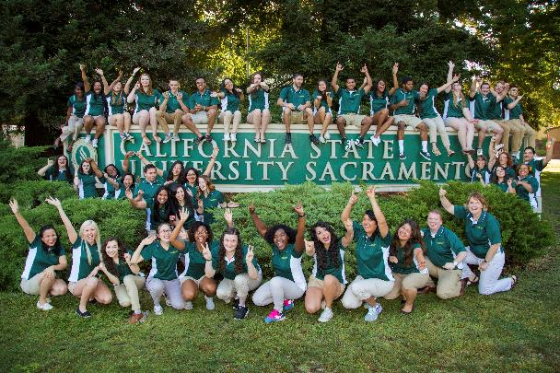
California State University, Sacramento
Founded 1947
Designated a Tree Campus USA
  300 acres with 3,500 trees
Seven academic colleges
58 undergraduate majors
More than 30,700 students enrolled
US News ranked for Diversity

Slide 3
Introduction
Sacramento State has developed specialized annual faculty reports including the Faculty Teaching Assignment Report (FTAR), a historical dashboard containing 5 years’ worth of data as well as a historical dashboard on courses taught here at Sac State.
These reports demonstrate faculty teaching load (WTU), assigned and reimbursed release time, course enrollment, Student Credit Unit (SCU), Full-time Equivalent Students (FTES) and Full-time Equivalent Instructional Faculty (FTEF) as well as course count and classification.
These reports were originated and requested by the Provost and Vice Provost in 2007. To date, they are used regularly in support of planning, budget allocation, and faculty hiring.
In the past, these reports were generated in Excel and published to the campus community. Now, we have been able to create a Faculty Teaching Assignment Report that is more dynamic and interactive with 5 years of historical data which is easier to use and navigate.

Slide 4
Why do we care?
Sacramento State utilizes these reports to help make decisions
Historically speaking, APDB holds a lot of the university's historical data on faculty and course data.
Our office wants to assist various entities on campus with data and research

Slide 5

Processes
-Extract information from the CMS System for any given semester-Perform standard APDB edits and submit final APDB report to the Chancellor’s Office
-Use flat faculty and section summary files received from the Chancellor’s Office to generate reports
-Verify and cross reference all data inputs
-Create 3 reports and use Tableau for interactive visualization

Slide 6

Steps
Participants in this session will learn how I was able to utilize the APDB reports to generate an easy to navigate tableau dashboards and how I was able to generate historical information fairly quickly with the excel files originally generated from the APDB files. The user will be able to see how to create a similar dashboard. They will also see how easy it is to maintain and upload fresh new data per semester.
After acquiring the Course Section and Faculty Summary files from the Chancellor’s Office, we take the file and merge the section summary file with data provided by the Office of Human Resources.
Once the data is merged and free of error, the following base reports are created to which the dashboards are then formalized in Tableau.

Slide 7

Old Method
The old method of creating the Faculty Course Assignment report details the instructor’s workload by individual course(s), student course credit, enrollment per section, team teaching percentage, Weighted Teaching Unit and FTES generated in Excel. Every department on campus will get a detail report of their faculty’s teaching assignment. In the old Excel version it was neat, tedious but also static and the final result was a PDF which was hard to pinpoint each data element quickly. Department totals were available but not College Totals.

Slide 8
Excel Reports

Slide 9
Example:

Slide 10
New Dashboard utilizing Tableau
The new more interactive Faculty Course Assignment report details the instructor’s workload by individual course(s), student course credit, enrollment per section, team teaching percentage, Weighted Teaching Unit and FTES generated.
But now, users can drill down by each of the Colleges, Departments, and even by Faculty. The visualization allows the user to get College, Department totals based on their preferences. And most importantly….they can do this quickly.

Slide 11
Faculty Teaching Assignment Report

Slide 13
ADDITIONAL TABLEAU DASHBOARDS
The reports are also used to create trends analyses. The 5-year academic comparison report shows the difference in FTES, FTEF, SCU and WTU, as well as related trends. Again, by adding in the same information from the previous terms, we now have historical data that is easily accessible and more dynamic. The statistics are manageable and drillable based on the users needs. The user can decide to create even more meaningful tables and graphs.

Slide 15
HISTORICAL COURSE DETAIL BY COUNT, LEVEL & CLASSIFICATION
The Historical Course Detail report is a new dashboard using the Faculty Course Assignment base data to report information on the courses taught here at Sac State.
We can now see how many course sections there are historically by College and by Department. We can do run a percentage difference graph to show the five-year trend.
Subsequently, the Provost, Deans, and College Chairs use these reports for budget allocation, planning and policy decision making.

Slide 17
Historical Course Info
The Count of courses by classification gives the campus community and decision makers an idea of the “type” of courses being taught by Department and by College. As you can see from the informational graph, we can easily detect that there are a greater number of Lecture, Discussions and Seminars taught then there are Activity and Lab courses and further, Supervision and Independent Study. Course Planning could use this report for historical use and aid in future course planning.

Slide 19

This Table shows the Course Count by Course Level. The user can find out how many courses taught at Sac State are Pre-Collegiate, Lower Div., Upper Div., and Graduate by College and Department

Slide 20
Contact
Nancy Hardy, Academic Planning Database Coordinator
California State University, Sacramento
Office of Institutional Research, Effectiveness
and Planning
6000 “J” Street
Sacramento, CA 95819-6028
916-278-7914 (p)
916-278-6828 (f)
nhardy@csus.edu
www.csus.edu/oir

Slide 21


Questions?
Matthew Basinger, Research Analyst
  matthew.basinger@csus.edu
Nancy Hardy, Academic Planning Database Coordinator
  nhardy@csus.edu

